Slide 1

Disregulation of Golgi localization of glycosyltransferases alters mucin O-glycosylation and survival or metastatic properties of cancer cells
Pi-Wan Cheng, Ph. D.
Mohamed Ali, Ph.D. and Armen Petrosyan, M.D.-Ph.D.
Department of Veterans Affairs Nebraska and Western Iowa Health Care System and Department of Biochemistry and Molecular Biology, University of Nebraska Medical Center, Omaha, NE 68198-5870 USA
VA Merit Award 1I0 1BX000985: NIH R21 HL097238: Nebraska LB506

Slide 2
Outline
☺ Structures and functions of mucin O-glycans
☺ Factors that regulate glycan biosynthesis
☺ Golgi retention of glycosyltransferases
☺ Golgi targeting of glycosyltransferases
☺ Future study

Slide 3
GlcNAcβ1,3GalNAcα1-Ser/Thr
Major Mucin Core Structures and synthesis of sLe^{x} on Core 2
Core 3
GlcNAcβ1,3GalNAcα1-Ser/Thr
Ser/Thr
C2GnT-M
C3GnT/β3GnT6
GlcNAcβ1,6
ppGalNAcTs
Core 4
GalNAcαSer/Thr
β3GalT1
NeuAcα2-3Galβ1,3GalNAcαSer/Thr
Galβ1,3GalNAcαSer/Thr
Core 1
ST3Gal1
Galβ1,3GalNAc-Ser/Thr
GlcNAcβ1,6
C2GnT-L/M/T
Core 2
Galβ1,3GalNAcαSer/Thr
β4GalTs
Galβ1,4
GlcNAcβ1,6
Galβ1,3GalNAcαSer/Thr
NeuAcα2-3
Galβ1,4
GlcNAcβ1,6
ST3GalTs
Galβ1,3GalNAcαSer/Thr
NeuAcα2-3
Galβ1,4
GlcNAcβ1,6
FucTs
sLe^{x}
Fucα1-3

Slide 4
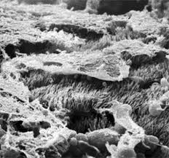
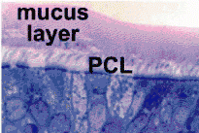
Functions of Mucins
Secreted mucins: Protection of mucus secretory epithelium
1. Retain water
High carbohydrate content
2. Bind and clear inhaled and ingested pathogens
Heterogeneous carbohydrate structure

Slide 5
Membrane-bound mucins: Signal transduction
1. Retain water: High carbohydrate content
2. Guide migration of leukocytes/cancer cells:
sLe^{a/x} and 6-sulfo-sLe^{x}

Slide 6
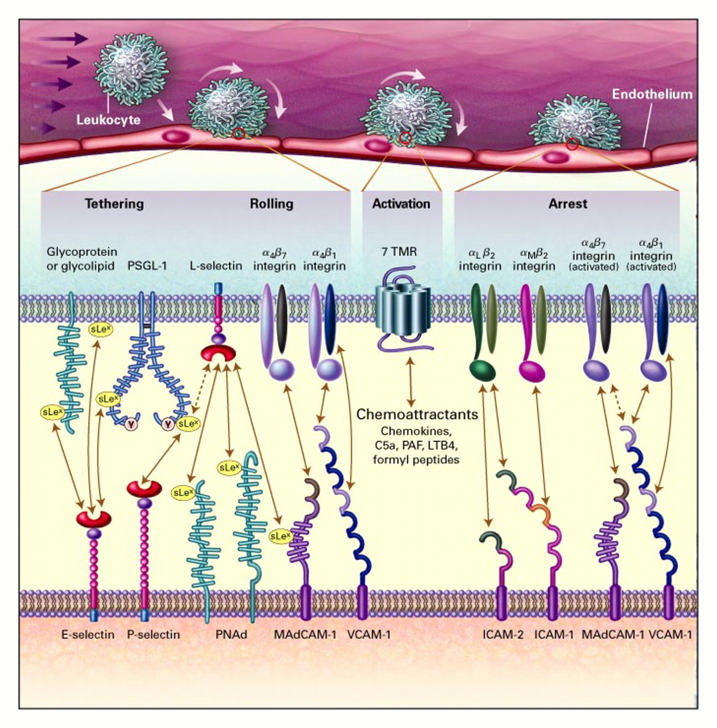
Membrane-bound mucins: Signal transduction
1. Retain water: High carbohydrate content
2. Guide migration of leukocytes/cancer cells:
sLe^{a/x} and 6-sulfo-sLe^{x}
Leukocyte Multistep Adhesion Cascade during Inflammatory Response
(Von Andrian and Mackay, NEJM 343:1020, 2000)

Slide 7
Glycosyltransferase (β4GalT1)-catalyzed reaction
UDP-Gal + GlcNAc-R → Galβ1-4GlcNAc-R + UDP
(sugar donor) (sugar acceptor)

Slide 8
Glycosyltransferase (β4GalT1)-catalyzed reaction
UDP-Gal + GlcNAc-R → Galβ1-4GlcNAc-R + UDP
(sugar donor) (sugar acceptor)
Factors that regulate glycan biosynthesis
Substrate (Acceptor) specificity
Availability of sugar donor (Nucleotide-sugar)
Availability of sugar acceptor
Divalent ions and pH
Levels of enzymes
Golgi localization: Golgi targeting and retention

Slide 9
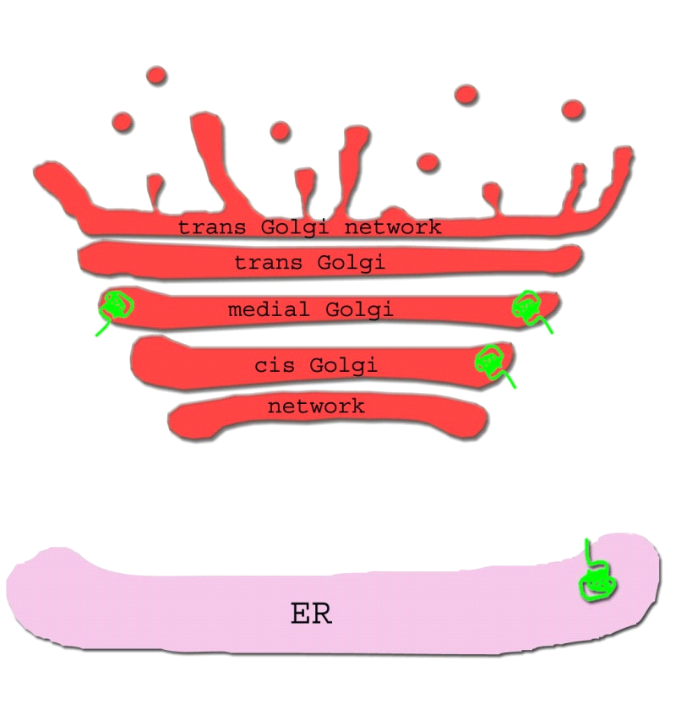
Golgi Targeting, Retention and Recycling of Glycosyltransferases
O
2
O
O
3
1

Slide 10
Golgi Targeting, Retention and Recycling of Glycosyltransferases
1a. Petrosyan et al: Glycosyltransferase-specific Golgi targeting mechanisms. J Biol Chem 287:37621-7, 2012.
1b/3d.. Petrosyan et al: Restoration of compact Golgi morphology in advanced prostate cancer enhances susceptibility to galectin-1-induced apoptosis by modifying mucin O-glycan synthesis. Mol Cancer Res 12:1704-16, 2014.
2a. Ali et al: Golgi phosphoprotein 3 determines cell binding properties under dynamic flow by controlling Golgi localization of C2GnT1. J Biol Chem 287:39564-7, 2012.
2b. Petrosyan et al: Keratin 1 plays a key role in Golgi localization of Core 2 N-acetylglucosaminyltransferase M via its cytoplasmic tail. J Biol Chem 290:6256-69, 2015.
O
2
O
O
3a. Petrosyan et al: Non-muscle myosin IIA transports a Golgi enzyme to the ER by binding to its cytoplasmic tail. Int J Biohem Cell Biol 44:1153-6, 2012.
3b. Petrosyan and Cheng: A non-enzymatic function of Golgi glycosyltransferases: mediation of Golgi fragmentation by interaction with non-muscle myosin IIA. Glycobiology 23:690-708, 2013.
3c.. Petrosyan and Cheng: Golgi fragmentation induced by heat shock or inhibition of heat shock proteins is mediated by non-muscle myosin IIA via its interaction with glycosyl-transferases. Cell Stress & Chaperones. 19:241-54, 2014.
3
1

Slide 11
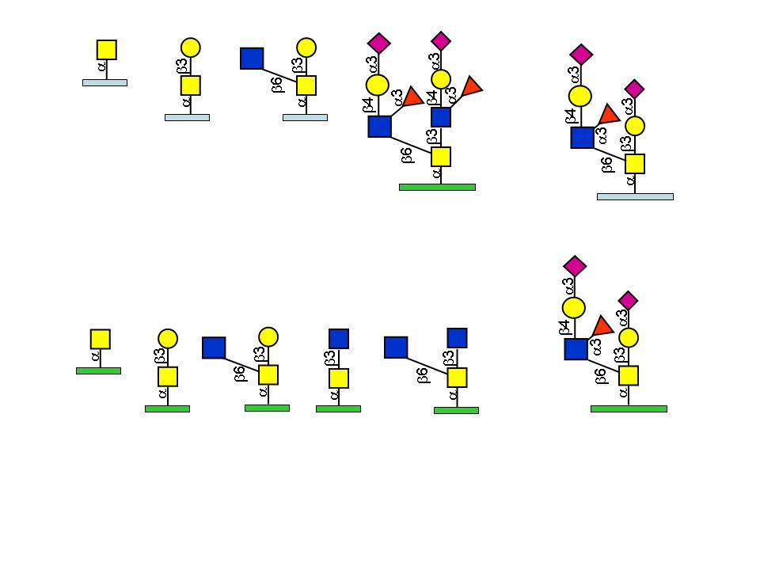
In vivo Glycosylation Scheme
trans
ST3Gal1
ST3Gal1
ST3Gal1
ST3Gal1
medial
C2GnT-L
C2GnT-M
C2GnT-L
Core 3 Synthase
C2GnT-M
cis
MUC1
MUC5AC
Core 1 synthase
GlcNAc
GalNAc
Neu5Ac
Galactose
Fucose

Slide 12
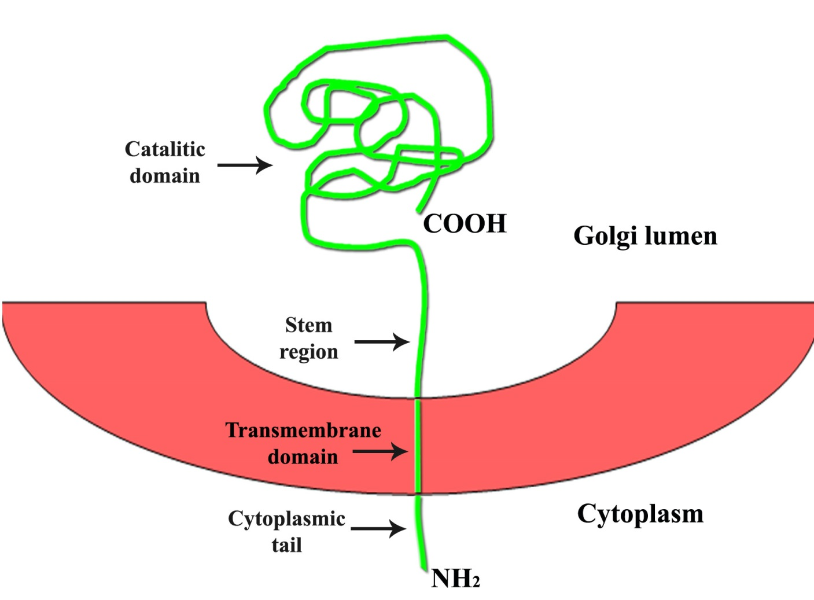
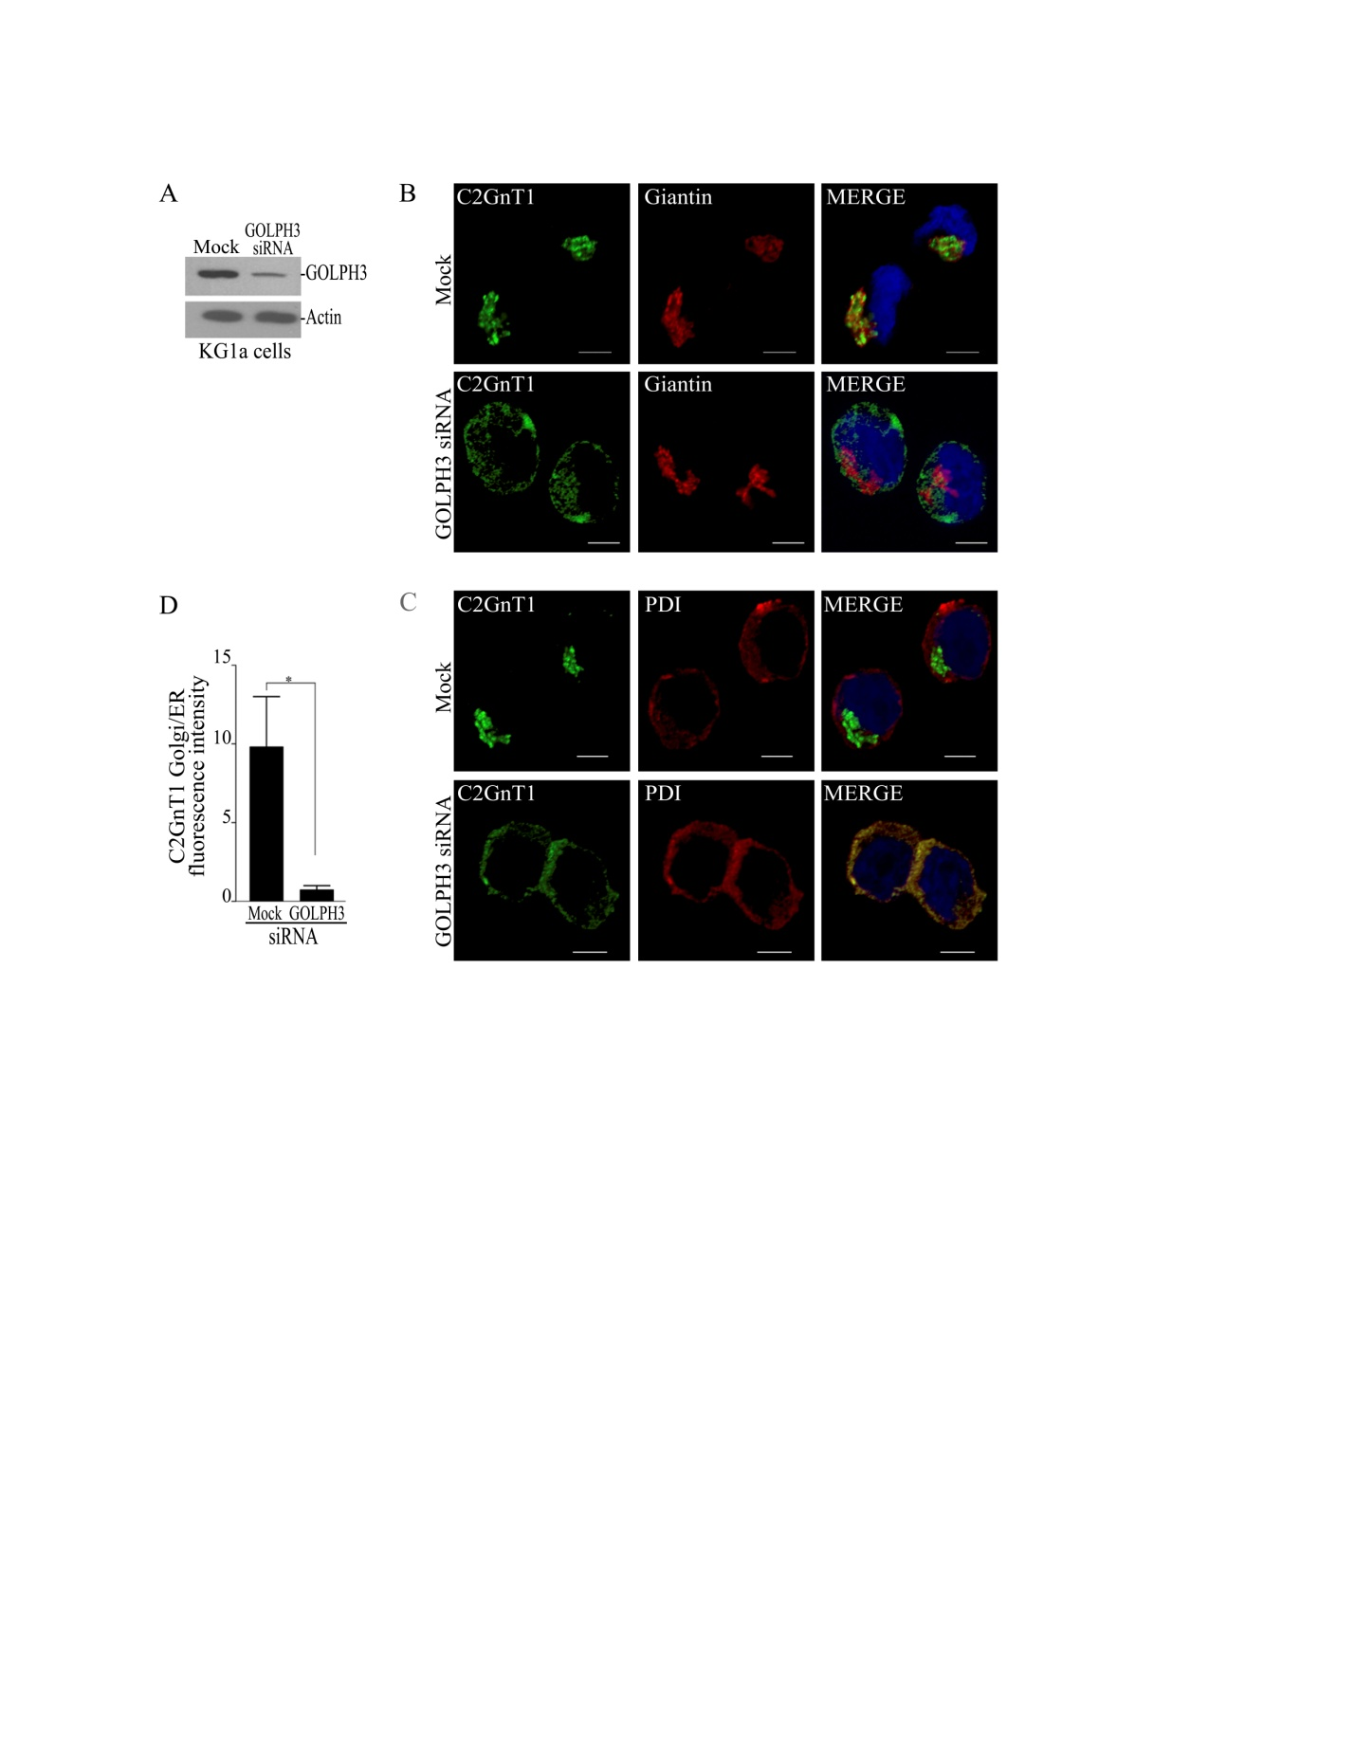
Golgi phosphoprotein 3 (GOLPH 3) is identified as the C2GnT-1/L Golgi-retention protein
Ali et al: J. Biol. Chem. 287:39564-7, 2012.

Slide 13
Knockdown of C2GnT1 or GOLPH3 in KG1a cells reduces their (I) tethering to and rolling on P or E-selectin and (II) adhesion to ICAM-1 (after activation by E-selectin) under dynamic flow
(I)
(II)
Ali et al: J. Biol. Chem. 287:39564-7, 2012.

Slide 14
GOLPH 3 regulates the metastatic potential of KG1a cells
by controlling Golgi retention of C2GnT1/L
Ali et al: J. Biol. Chem. 287:39564-7, 2012.

Slide 15
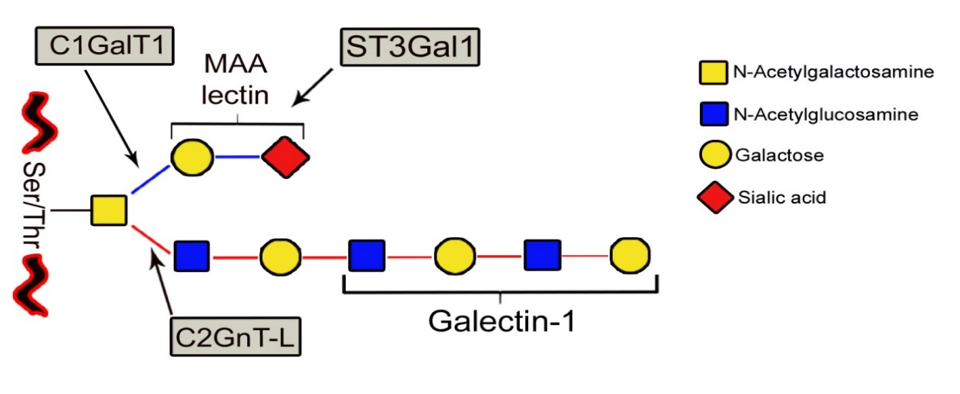
Androgen-sensitive LNCaP cells but not androgen-refractory PC3
and DU145 cells generate Core 2-associated polylactosamine, which
renders LNCaP cells susceptible to Galectin 1-induced apoptosis
(Valenzuela et al. Cancer Res. 67:6155–62, 2007.)
Prostate
Cancer Core 2-associated Galectin 1-induced
Cells ST3Gal1 C2GnT-1/L Sialyl-T polylactosamine apoptosis____
LNCaP + + - + +
PC3/DU145 + + + - -_________
LEA lectin

Slide 16
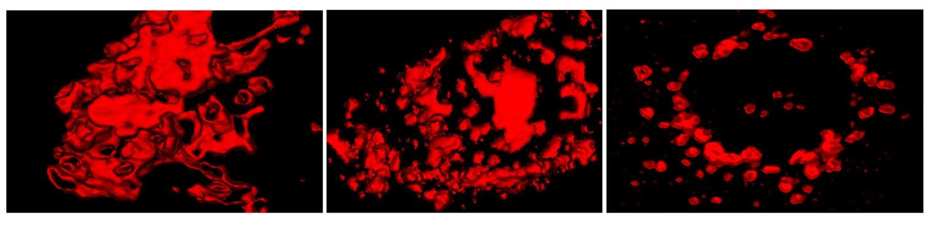
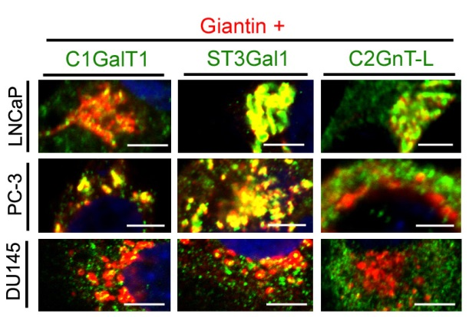
Androgen-sensitive LNCaP prostate cancer cells have compact Golgi,
androgen-refractory PC-3 and DU145 cells have fragmented Golgi, and C1GalT1 and ST3GalT1 are in the Golgi of these two cells but C2GnT-L is not
LNCaP
PC-3
DU145
B
10 µ
Petrosyan et al: Mol. Cancer Res. 12:1704-16, 2014.

Slide 17
Prostatic tumors exhibit tumor progression-dependent Golgi fragmentation and outside-of-the-Golgi distribution of C2GnT-L
Petrosyan et al: Mol. Cancer Res. 12:1704-16, 2014.

Slide 18
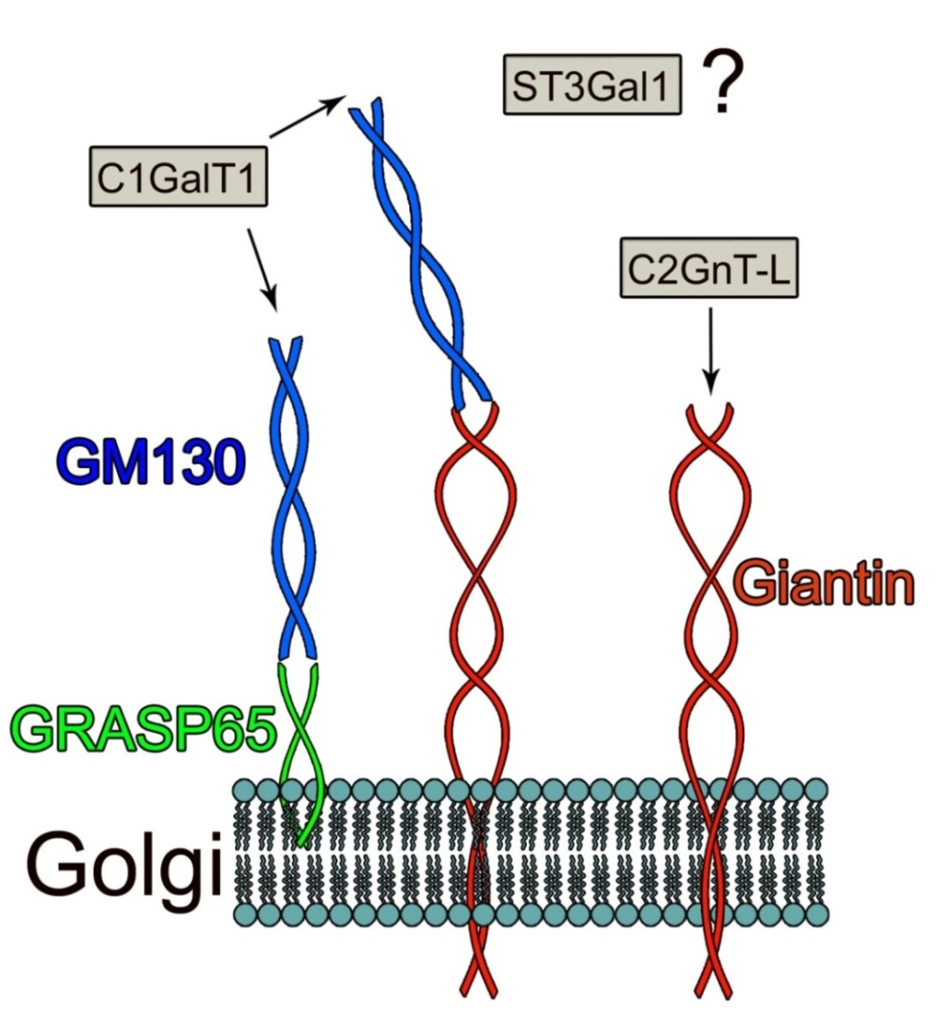
C1GalT1 uses GRASP65-GM130/Giantin for Golgi targeting
and C2GnT-M uses Giantin exclusively for Golgi targeting
C2GnT-M
Petrosyan et al: J. Biol. Chem. 287:37621-7, 2012.

Slide 19

What are the Golgi-targeting sites for ST3Gal 1 and C2GnT-1/L?
C2GnT-L
?
ST3Ga1
?
C2GnT-M
C2GnT-M
Petrosyan et al: J. Biol. Chem. 287:37621-7, 2012.
Petrosyan et al: Mol. Cancer Res. 12:1704-16, 2014.

Slide 20
In LNCaP cells, KD of Giantin+C2GnT-L but not Giantin, GM130, or GRASP65 prevents Golgi targeting of ST3Gal1, and KD of Giantin prevents Golgi targeting of C2GnT-L. In PC3 and DU145 cells, KD of GM130 prevents Golgi targeting of ST3Gal1
PC 3 DU145
ST3Gal1/Giantin
Petrosyan et al: Mol. Cancer Res. 12:1704-16,2014.

Slide 21
For Golgi targeting, C2GnT-M uses Giantin exclusively, ST3Gal1 uses Giantin and GM130-GRASP65, and C1GalT1 uses GM130-GRASP65/Giantin
ST3Ga1
C2GnT-L
C2GnT-M
Petrosyan et al: J. Biol. Chem. 287:37621-7, 2012.
Petrosyan et al: Mol. Cancer Res. 12:1704-16, 2014 .

Slide 22
Inhibition or KD of Non-muscle myosin IIA (NMIIA) in DU145 (also PC3) cells restores compact Golgi morphology (A & B) and Golgi targeting of C2GnT-L (B)
A. Transmission Electron Microscopy
B. Confocal Immunofluorescence Microscopy
Petrosyan et al: Mol. Cancer Res. 12:1704-16, 2014 .

Slide 23
Inhibition (Blebb) or KD of NMIIA in DU145 (also PC3) cells converts mucin O-glycan from sialyl-T to Core 2-associated polylactosamine
Petrosyan et al: Mol. Cancer Res. 12:1704-16, 2014 .

Slide 24
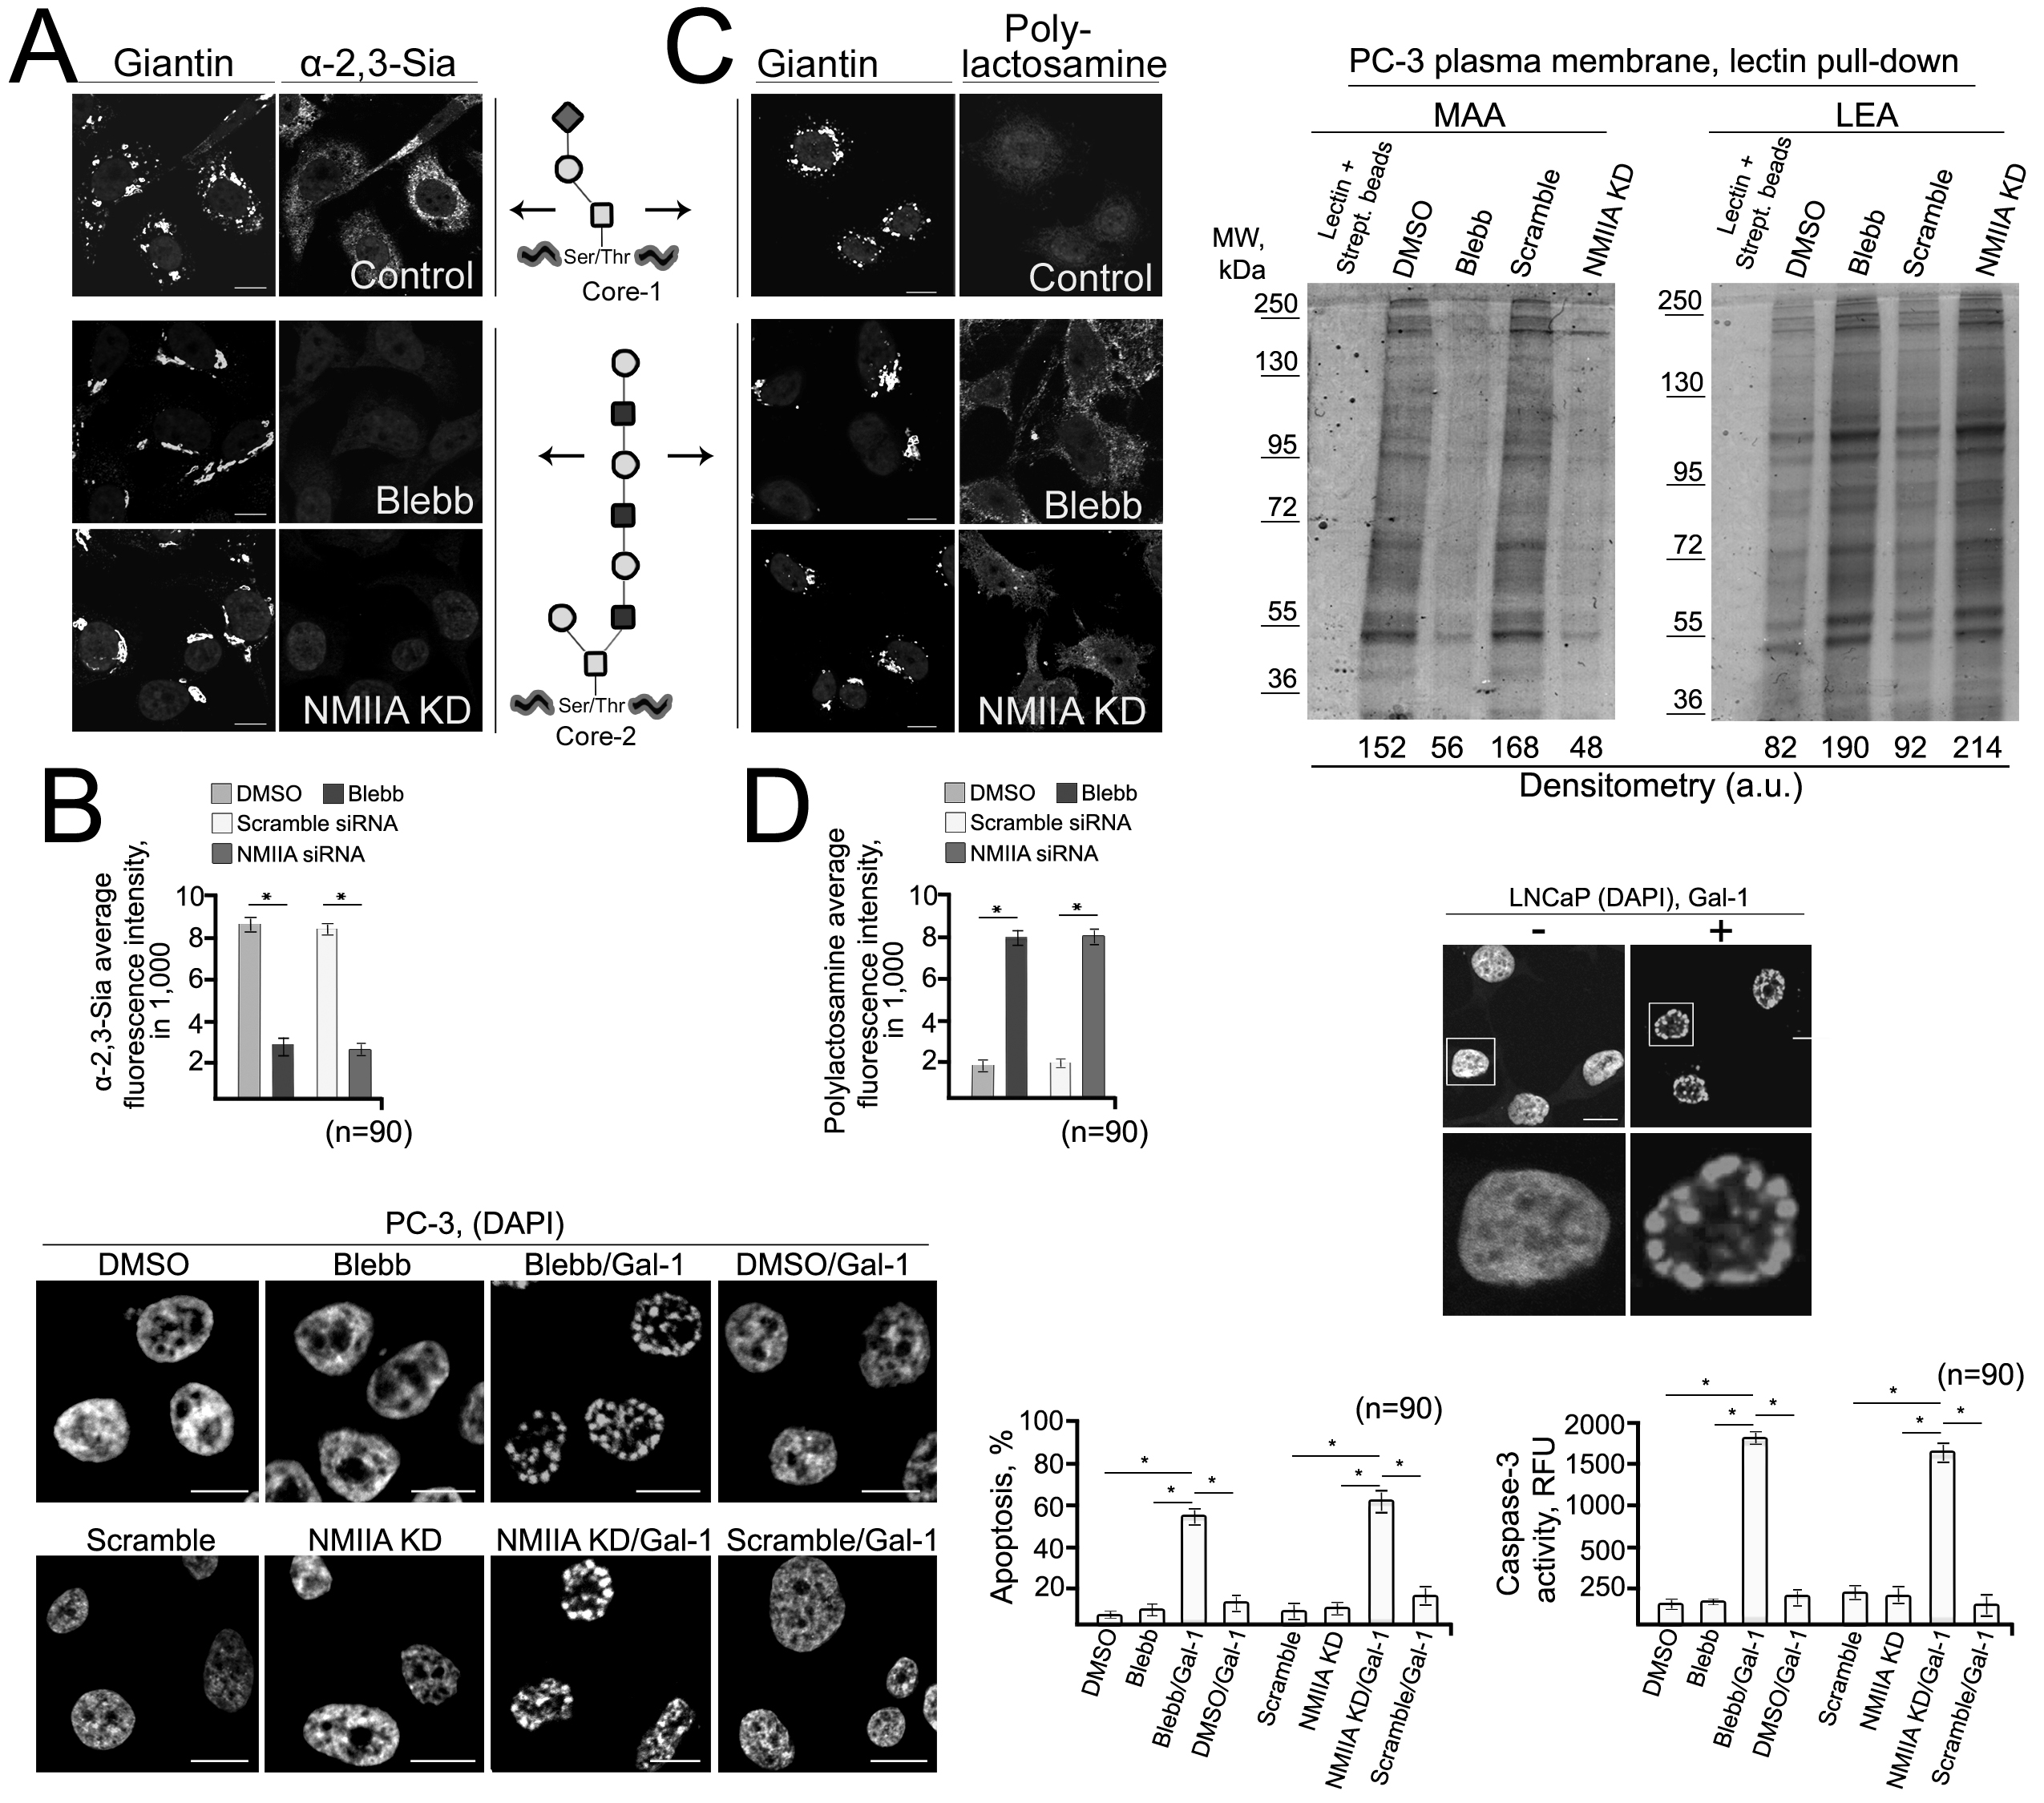
Galectin-1 induces apoptosis in LNCaP cells but not PC3 (and DU145) cells unless NMIIA is inhibited or knocked down
Petrosyan et al: Mol. Cancer Res. 12:1704-16, 2014 .

Slide 25
Conclusions
1. The enzymatic function of a Golgi glycosyltransferase is regulated by its cognate retention protein.
2. The enzymatic functions of C2GnTs are also regulated by giantin, the exclusive Golgi targeting site for these enzymes.

Slide 26
Future study
The effects of altered Golgi targeting of glycosyltransferases induced by stress, such as heat shock, alcohol abuse, caner malignant transformation etc, on N- and O-glycosylation

