Slide 1


Identification and composition of compounds and petroleum fractions of oils recovered from waste tyres
By: PC Tsipa
Supervisor: Dr PS Hlangothi
Co-supervisors: Prof B Zeelie, Dr N Mama & Dr M Phiri

Slide 2
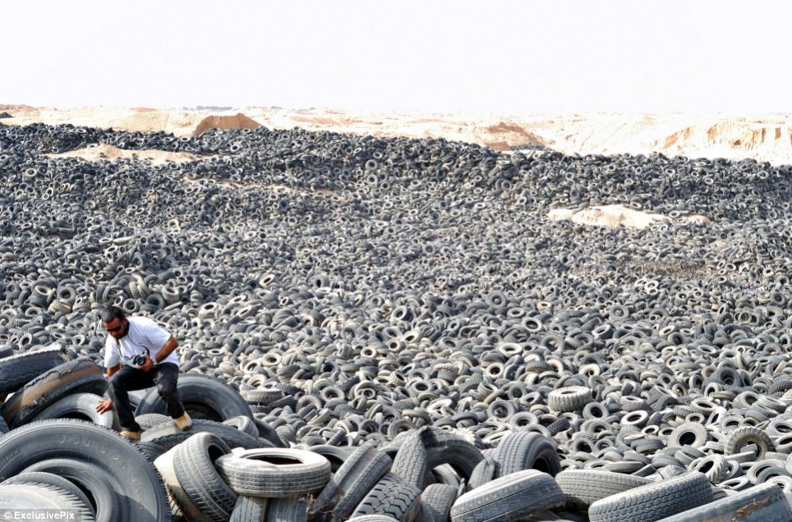

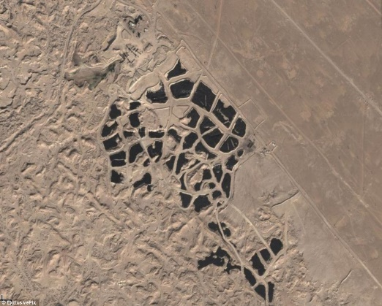
Introduction
Primary resources are exploited as there is an increase in demand to improve technology
A tyre is one of the most engineered part of a car with natural rubber and crude oil being the primary resources
The complex nature of a tyre makes it hard for tyres to be disposed which causes:
Increase in landfills, abandoned tyres
and some tyre are burnt for heat
South Africa - #Feesmustfall
Saudi Arabia – Kuwait city
2

Slide 3
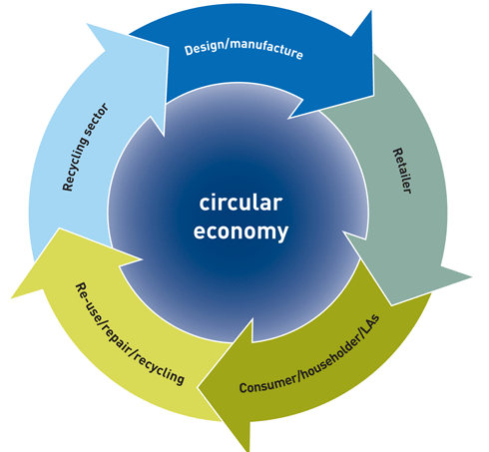
Introduction…
Linear economy
Take
Utilize
Dispose
REDISA is trying to adopt the concept of circular economy
The Circular Economy Package consists of an EU Action Plan for the Circular Economy that establishes a concrete programme of action, with measures covering the whole cycle: from production and consumption to waste management and the market for secondary raw materials.
Recycling and Economic Development Initiative of South Africa
3

Slide 4
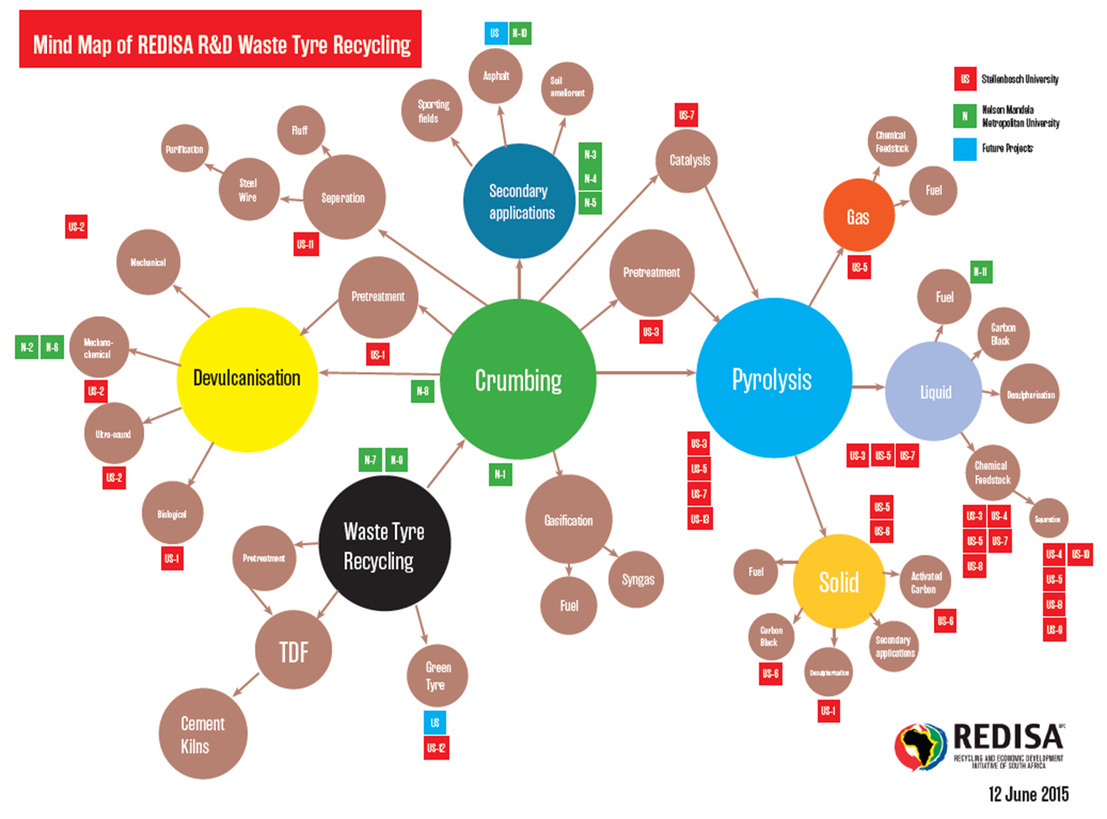
4

Slide 5
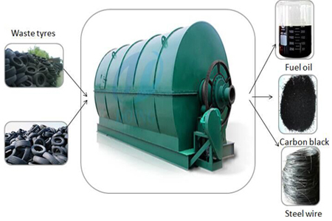
Literature review
One of the ways to recycle tyres is the use of pyrolysis
Pyrolysis is the process whereby a material is heated in the absence of oxygen
The first type of pyrolysis was performed in South America – fertility of the soil
Tyre pyrolysis produces three products:
50%
Gas – 8%
30%
12%
5

Slide 6
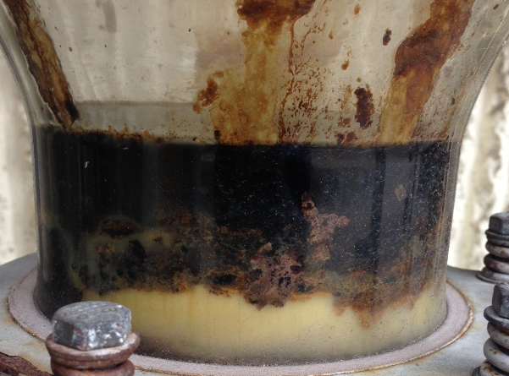
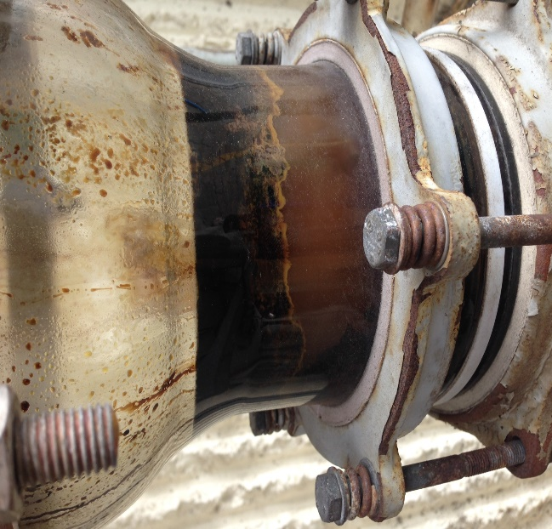
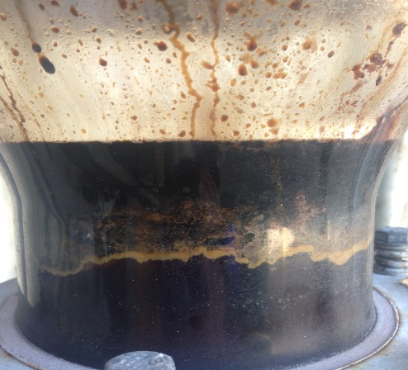
Literature review…
Studies have shown that tyre pyrolysis process is a non-conventional method
  Heterogeneity of the products therefore make it difficult to utilize further
  High sulphur content
Pyrolysis oil is very unstable:-
Is not consistent process - meaning it produces difference products every time.
Consumes energy
Fresh
After 1hr
After 24hrs
6

Slide 7
Aims and Objectives
Aim
Develop an alternative chemical degradation method for pyrolysis and attempt to produce fuel from the tyre derived oil.
Objectives
Like pyrolysis three products are produced: gas, solid and liquid
Chemical reaction at room temperature
Separate the oils based on their molecular weight by using different solvent systems – able to utilize further
Low sulphur content
Oil must be stable
Study the quality of oils
Attempt to produce fuel
7

Slide 8

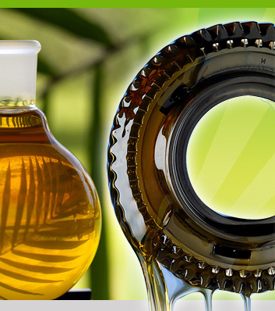
Overview
Goal of the project!!!
8

Slide 9
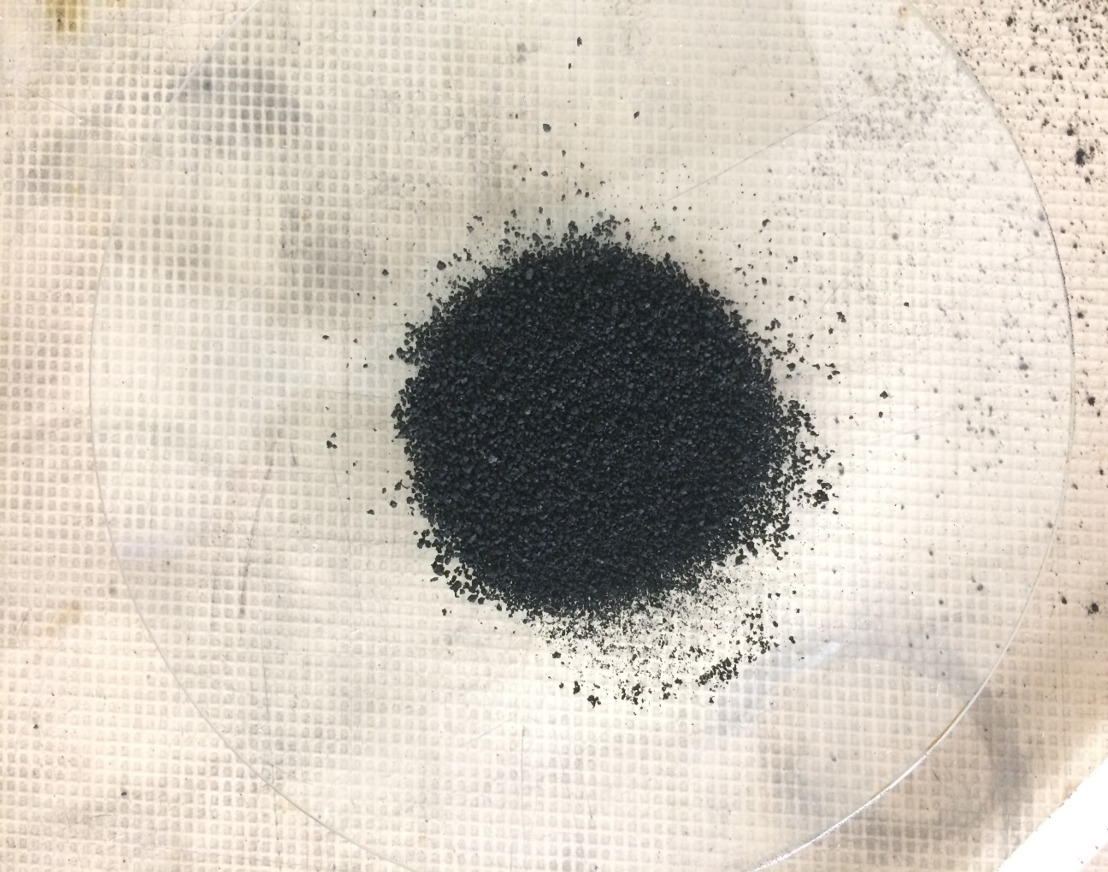
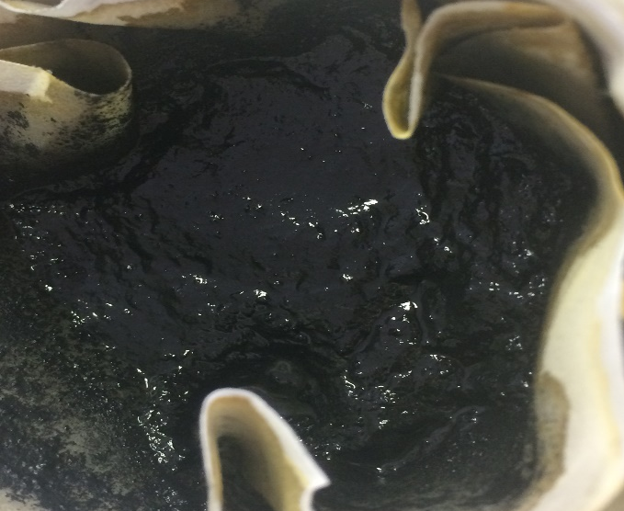
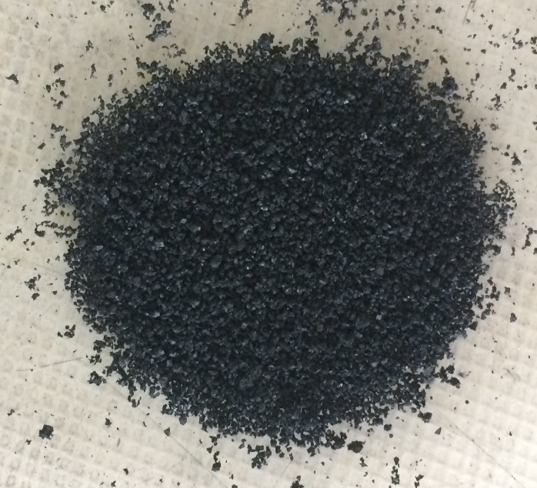
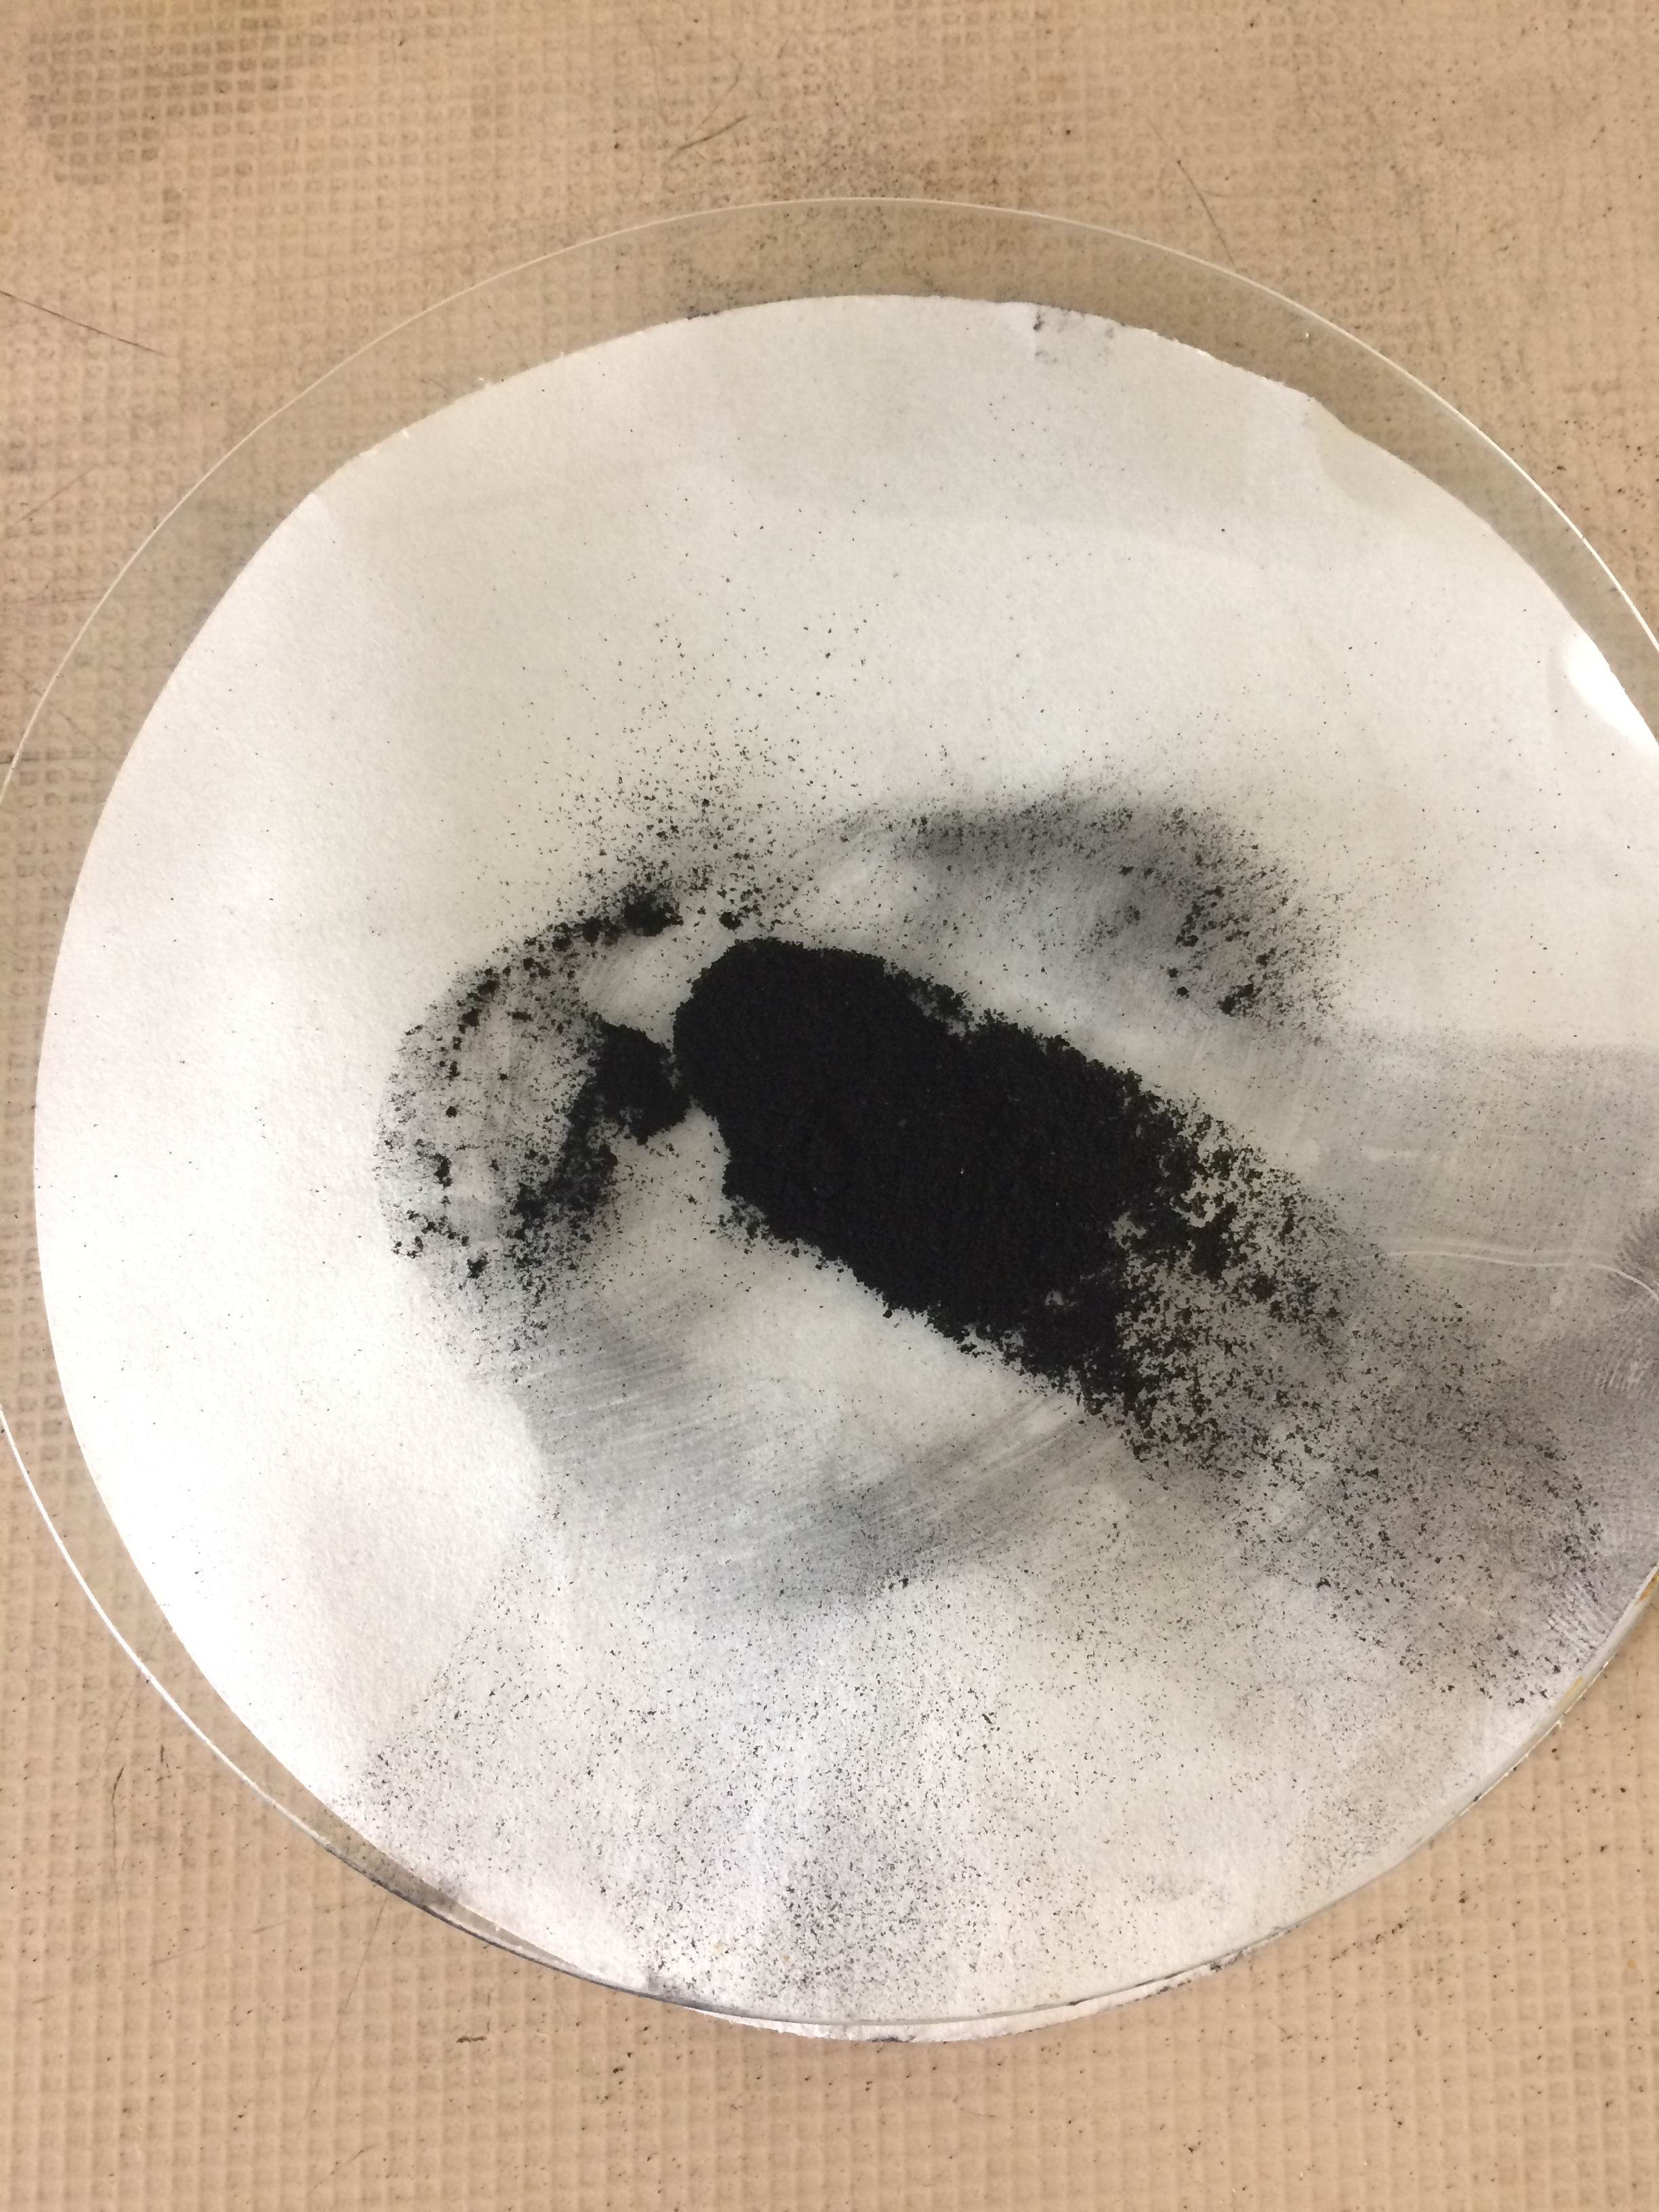
Overview
Extraction Process
2nd Extraction
IM: 2g FM:0.49g
Residual - 24.5%
Crumb
Destroying solvent system
3rd Extraction
1st Extraction
Collecting/wash solvent system
Selective solvent system
9

Slide 10
Overview: Solid product (Char)
TGA analysis comparing Carbon black, rubber crumb with extraction residual
10

Slide 11
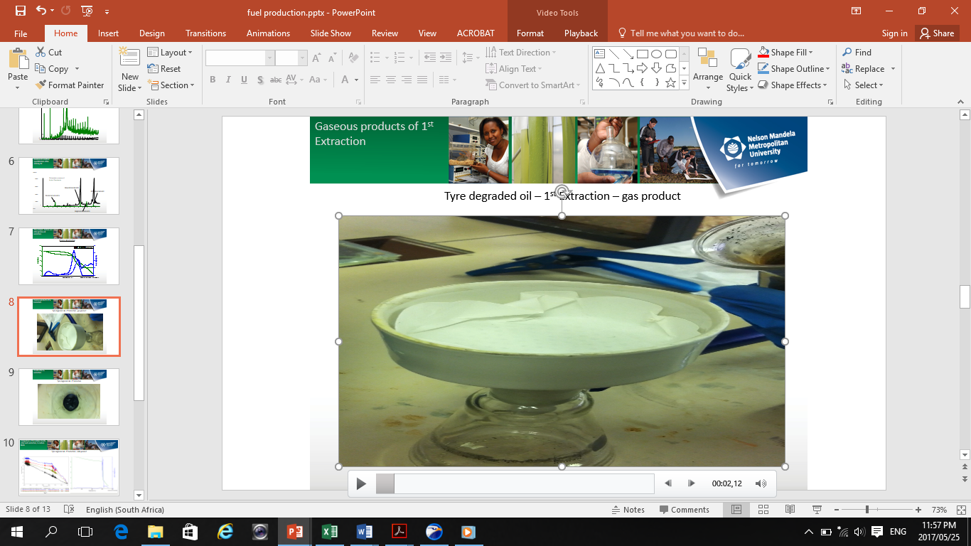
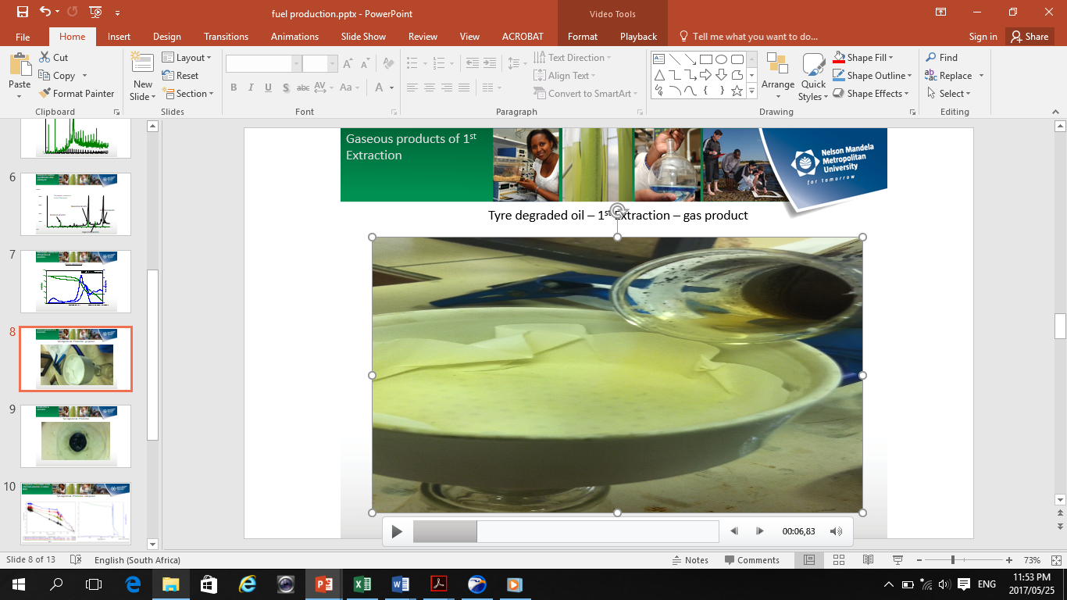
Overview: Gas product
11

Slide 12
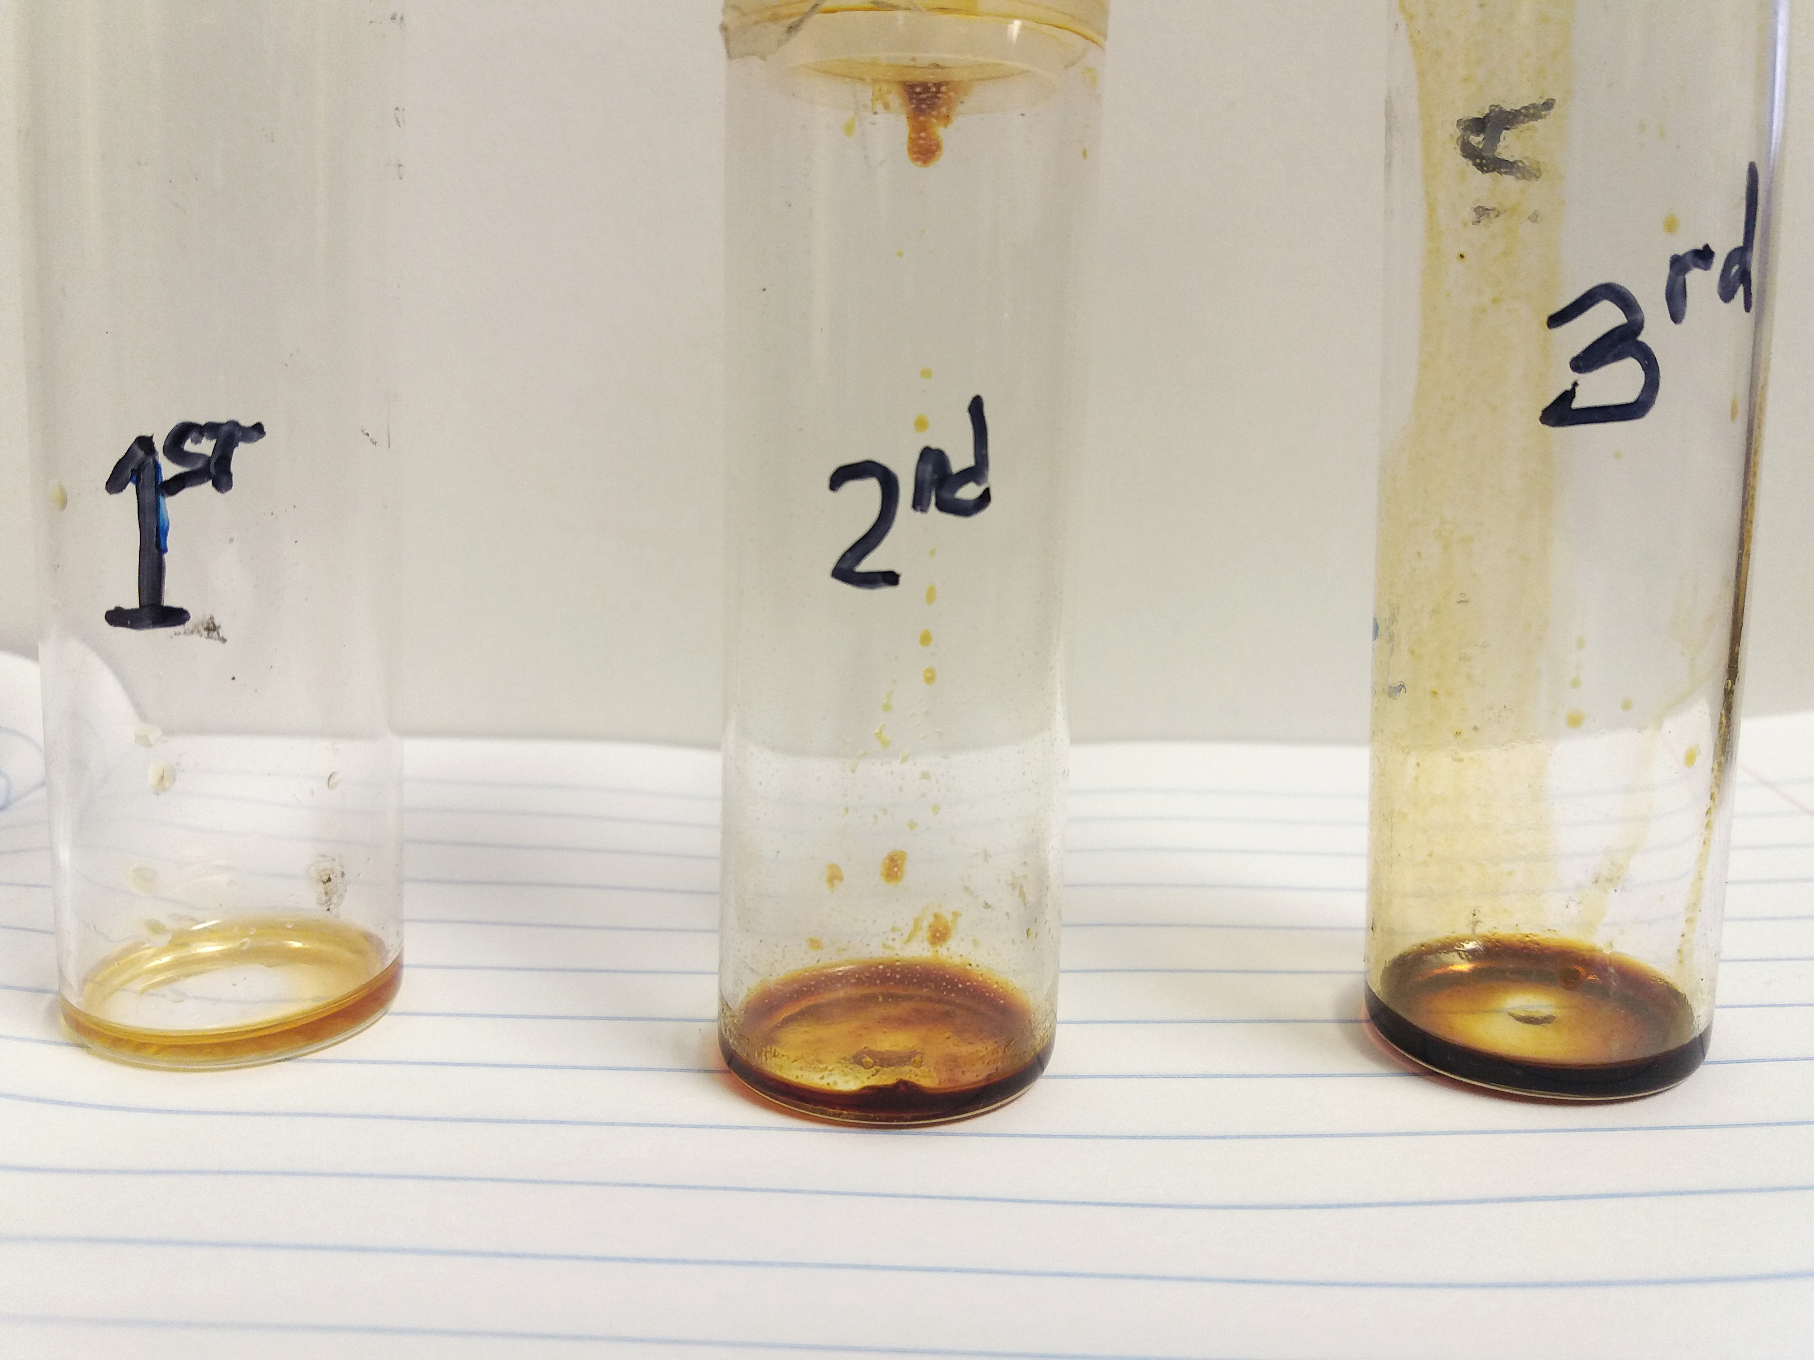
Overview: Liquid products
12

Slide 13
Overview: Liquid products
TGA & DTG analysis comparing extracted oils from rubber crumb
13

Slide 14

This technique was performed to Identify and Quantify the compounds present in the extracted oil
Part 1: GC-MS – composition of the oil
14

Slide 15

Tyre derived oil composition GC-MS
HP 5890 series II Hewlett packet GC-MS system (Agilent, Midland, Canada) coupled to Mass spectrometric detector (Agilent, Palo Alto, CA)
Oven:
The inlet head pressure of 348 kPa was used under constant flow mode (flow rate of 1.20 mL/min, linear velocity of 27.9 cm/s)
Injection program:
1ul volume of the clean extract was then injected at into the split/splitless injector operated at 300 ˚C using split 1:20
Column:
An apolar capillary column with dimensions: 60 m × 0.18 mm i.d. × 0.10 µm d_{f} Rxi-5 Sil-MS (Restek, Pann Eagle Park,CA,USA)
MS:
The transfer line to the MS was kept at 280 ˚C and the MS was operated in full scan mode from 35 to 500 m/z at a scan rate of 3.15 scans/sec with standard electron ionisation energy of 70 eV. The electron multiplier (EM) voltage was 1 188 V.
15

Slide 16
Composition of the oils: GC-MS
TIC: extracted proc. oil
TIC: Paraffinic oil
TIC: Naphthenic oil
TIC: Aromatic oil
16

Slide 17
GC-MS analysis: External std. method for identification of hydrocarbons
Extracted Process oil
Hydrocarbon Standards
C9
C35
0
6.00
8.00
10.00
12.00
14.00
16.00
18.00
20.00
22.00
24.00
26.00
28.00
30.00
17

Slide 18
GC-MS analysis: External std. method and quantification of the acid in the extracted oil
Abundance
Extracted process oil
7000000
Acids Standards
5000000
Hexadecanoic acids
Octadecanoic acid
3000000
Dodecanoic acids
1000000
0
12.00
12.50
13.00
13.50
14.00
14.50
15.00
15.50
16.00
16.50
17.00
17.50
18.00
Time-->
Heptadecanoic acids
18

Slide 19
Calibration curves for quantification
Quantification of the Market value Acids identified from the oil
Compound: Dodecanoic acid RT:13.25 min
concentration(ppm) | concentration(ppm)
250 | 5104884
125 | 2078647
62.5 | 714209
31.25 | 5547
36.86946267 | 102933
Acid name | percentage in the sample(%)
dodecanoic acid | 0.37
hexadecanoic acid | 5.1
heptadecanoic acid | 0.49
octadecanoic acid | 9.98
19

Slide 20
Compounds identified
Peak No | Compound | RT | Ions/Mz | n | N | trn | trN | RI(CALC) | RI(litr) | difference
1 | p-xylene` | 6.19 | 91 106 |  |  |  |  | <c9
2 | cyclohexylthiol | 7.19 | 82 116 | 9 | 10 | 6.533 | 7.781 | 952.6442 | MS
3 | limonene | 8.17 | 93 136 | 10 | 11 | 7.781 | 8.945 | 1033.419 | 1031 | 2.419244
4 | 2-ethylhexanoic acid | 9.14 | 78,88 | 11 | 12 | 8.945 | 10 | 1118.483 | 1122 | -3.51659
5 | 1,2,3,5-tetramethylbenzene | 9.21 | 119 134 | 11 | 12 | 8.945 | 10 | 1125.118 | 1123 | 2.118483
6 | beta-ocimene | 9.24 | 121 136 | 11 | 12 | 8.945 | 10 | 1127.962 | MS
7 | α-campholene aldehyde | 9.28 | 9 108 | 11 | 12 | 8.945 | 10 | 1131.754 | 1130 | 1.753555
8 | Bicyclo[3.1.1]hept-3-en-2-one, 4,6,6-trimethyl- | 10.17 | 107 135 | 12 | 13 | 10 | 10.97 | 1217.526 | 1209 | 8.525773
9 | 2,4-di(trimethylsiloxy)-6,7-(methylenedioxy)-2H-1,4-benzoxazin-3-one | 10.52 | 73,102,341 | 12 | 13 | 10 | 10.97 | 1253.608 | MS
10 | Hexanoic acid, 2-ethyl-, methyl ester | 10.76 | 87,102 | 13 | 14 | 10.97 | 11.871 | 1276.693 | MS
11 | Tetradecane | 11.85 | 57,71 | 13 | 14 | 10.97 | 11.871 | 1397.669 | STD
12 | 3-methyltridecane | 12.63 | 71,85 | 14 | 15 | 11.871 | 13.518 | 1446.084 | MS
MS internal library: 90% accept
RI = 100 [n+(𝑡𝑟𝑥−𝑡𝑟𝑛 /𝑡𝑟𝑁−𝑡𝑟𝑥)]
External Standards
20

Slide 21
Compounds identified
Peak No | Compound | RT | Ions/Mz | n | N | trn | trN | RI(CALC) | RI(litr)
1 | p-xylene` | 6.19 | 91 106 |  |  |  |  | <c9
2 | cyclohexylthiol | 7.19 | 82 116 | 9 | 10 | 6.533 | 7.781 | 952.6442 | MS
3 | limonene | 8.17 | 93 136 | 10 | 11 | 7.781 | 8.945 | 1033.419 | 1031
4 | 2-ethylhexanoic acid | 9.14 | 78,88 | 11 | 12 | 8.945 | 10 | 1118.483 | 1122
5 | 1,2,3,5-tetramethylbenzene | 9.21 | 119 134 | 11 | 12 | 8.945 | 10 | 1125.118 | 1123
6 | beta-ocimene | 9.24 | 121 136 | 11 | 12 | 8.945 | 10 | 1127.962 | MS
7 | α-campholene aldehyde | 9.28 | 9 108 | 11 | 12 | 8.945 | 10 | 1131.754 | 1130
8 | Bicyclo[3.1.1]hept-3-en-2-one, 4,6,6-trimethyl- | 10.17 | 107 135 | 12 | 13 | 10 | 10.97 | 1217.526 | 1209
9 | 2,4-di(trimethylsiloxy)-6,7-(methylenedioxy)-2H-1,4-benzoxazin-3-one | 10.52 | 73,102,341 | 12 | 13 | 10 | 10.97 | 1253.608 | MS
10 | Hexanoic acid, 2-ethyl-, methyl ester | 10.76 | 87,102 | 13 | 14 | 10.97 | 11.871 | 1276.693 | MS
11 | Tetradecane | 11.85 | 57,71 | 13 | 14 | 10.97 | 11.871 | 1397.669 | STD
12 | 3-methyltridecane | 12.63 | 71,85 | 14 | 15 | 11.871 | 13.518 | 1446.084 | MS
13 | pentadecane | 12.69 | 57,71 | 14 | 15 | 11.871 | 13.518 | 1449.97 | STD
14 | Dodecanoic acid | 13.2 | 57,73 | 14 | 15 | 11.871 | 13.518 | 1480.692 | STDS
15 | Hexadecane | 13.51 | 57,71 | 14 | 15 | 11.871 | 13.518 | 1499.514 | STDs
16 | Heptadecane | 14.27 | 57,71 | 17 | 18 | 13.518 | 14.275 | 1799.339 | STDs
17 | Pentadecane, 2,6,10,14-tetramethyl- | 14.29 | 57,71 | 17 | 18 | 13.518 | 14.275 | 1801.982 | MS
18 | tetradecanoic acid | 14.72 | 60,73 | 18 | 19 | 14.275 | 15.996 | 1825.857 | MS
19 | octadecane | 14.99 | 57,71 | 18 | 19 | 14.275 | 15.996 | 1841.546 | STDs
20 | Hexadecane, 2,6,10,14-tetramethyl- | 15.04 | 57,71 | 19 | 20 | 14.996 | 15.996 | 1904.4 | MS
21 | anthracene | 15.18 | 178 | 19 | 20 | 14.996 | 15.996 | 1918.4 | MS
22 | nonadecane | 15.7 | 57,71 | 19 | 20 | 14.996 | 15.996 | 1970.4 | STD
23 | Hexanoic acid | 16.2 | 60,73 | 20 | 21 | 15.713 | 16.44 | 2066.988 | MS
24 | eicosane | 16.44 | 57,71 | 20 | 21 | 15.713 | 16.44 | 2100 | STD
25 | 3,6-dimethyl phenanthrene | 16.83 | 189 206 | 21 | 22 | 16.444 | 17.207 | 2150.59 | MS
25 | heptadecanoic acid | 16.93 | 57 113 | 21 | 22 | 16.44 | 17.207 | 2163.885 | STD
26 | 10,18-Bisnorabieta-8,11,13-triene | 16.99 | 143 227 | 21 | 22 | 16.44 | 17.207 | 2171.708 | MS
27 | 3,3,5,5-TETRAMETHYL-1,7-S-HYDRINDACENEDIONE (indacene) | 17.02 | 143 227 | 21 | 22 | 16.444 | 17.207 | 2175.491 | MS
28 | 2,7-Dimethylphenanthrene | 17.04 | 191 206 | 21 | 22 | 16.444 | 17.207 | 2178.113 | MS
29 | heneicosane | 17.21 | 57,71 | 21 | 22 | 16.444 | 17.207 | 2200.393 | STD
30 | pyrene | 17.35 | 125 202 | 22 | 23 | 17.207 | 18.885 | 2208.522 | MS
31 | diphenyl sulphoxide | 17.35 | 137 202 | 22 | 23 | 17.207 | 18.885 | 2208.522 | MS
32 | oleic acid | 17.59 | 55,69 | 22 | 23 | 17.207 | 18.885 | 2222.825 | MS
33 | octadecanoic acid | 17.84 | 73 284 | 22 | 23 | 17.207 | 18.885 | 2237.723 | STD
34 | heptadecane | 18.03 | 57,71 | 22 | 23 | 17.207 | 18.885 | 2248.749 | STD
35 | docasane | 18.03 | 57,71 | 22 | 23 | 17.207 | 18.885 | 2249.046 | STD
36 | tricosene | 18.08 | 69,97 | 22 | 23 | 17.207 | 18.885 | 2252.026 | STD
37 | heptadecane | 18.9 | 57,71 | 22 | 23 | 17.207 | 18.885 | 2300.894 | STD
38 | eicosanoic acid | 19.5 | 55,73 | 24 | 25 | 18.885 | 19.813 | 2466.272 | MS
39 | Hexanedioic acid, bis(2-ethylhexyl) ester | 19.7 | 57 129 | 24 | 25 | 18.885 | 19.813 | 2487.823 | MS
40 | tetracosane | 19.82 | 57,71 | 24 | 25 | 18.885 | 19.813 | 2500.754 | STD
41 | 1-phenanthrene ,carboxylic acid | 20.5 | 239 285 | 24 | 25 | 18.885 | 19.813 | 2574.03 | MS
42 | eicosane | 20.82 | 57,71 | 25 | 25 | 19.813 | 20.807 | 2601.308 | STD
43 | isooctyl phthalate | 21.19 | 149 197 | 26 | 26 | 20.807 | 21.854 | 2636.581 | MS
44 | tetracosane | 21.87 | 57,71 | 26 | 27 | 20.807 | 21.854 | 2701.528 | STD
45 | hexacosane | 21.88 | 57,71 | 26 | 27 | 20.807 | 21.854 | 2702.483 | STD
46 | heptacosane | 22.97 | 57,71 | 27 | 28 | 21.854 | 22.949 | 2801.918 | STD
47 | C29 | 24.12 | 57,71 | 28 | 29 | 22.949 | 24.071 | 2904.367 | STD
48 | C30 | 25.26 | 57,83 | 29 | 30 | 24.071 | 25.221 | 3003.391 | STD
49 | C31 | 26.42 | 57,71 | 30 | 31 | 25.221 | 26.37 | 3104.352 | STD
50 | C32 | 27.64 | 57,71 | 31 | 32 | 26.37 | 27.537 | 3208.826 | STD
51 | C33 | 28.77 | 57,71 | 32 | 33 | 27.537 | 28.681 | 3307.78 | STD
52 | C34 | 29.78 | 57,97 | 33 | 34 | 28.681 | 29.821 | 3396.404 | STD
53 | C35 | 30.17 | 57,97 | 34 | 35 | 29.821 | 30.948 | 3430.967 | STD
53 compounds identified
21

Slide 22
GC analysis comparing tyre derived oil
1ST Extracted process oil
2ND Extraction
3RD Extraction
6.00
8.00
10.00
12.00
14.00
16.00
18.00
20.00
22.00
24.00
26.00
28.00
30.00
Time-->
22

Slide 23
GC analysis comparing tyre derived oil
Peak No | Compound | RT | Ions/Mz | RI(Cal) | RI(lit) | A | E | F
1 | p-xylene` | 6.19 | 91 106 |  |  | d | nd | nd
2 | cyclohexylthiol | 7.19 | 82 116 | 952.6442 |  | d | nd | nd
3 |  | 7.16 |  |  |  | nd | nd | d
 |  | 7.61 |  |  |  | nd | nd | d
 |  | 7.74 |  |  |  | nd | nd | d
3 | limonene | 8.17 | 93 136 | 1033.419 | 1031 | d | d | d
4 | 2-ethylhexanoic acid | 9.14 | 78,88 | 1118.483 |  | d | nd | nd
5 | 1,2,3,5-trimethylbenzene | 9.21 | 119 134 | 1125.118 |  | d | d | nd
6 | beta-ocimene | 9.24 | 121 136 | 1127.962 |  | d | d | nd
7 | alpha-campholene adehyde | 9.28 | 91 108 | 1131.754 |  | d | d | d
8 | Bicyclo[3.1.1]hept-3-en-2-one, 4,6,6-trimethyl- | 10.17 | 107 135 | 1217.526 |  | d | d | d
9 | 2,4-di(trimethylsiloxy)-6,7-(methylenedioxy)-2H-1,4-benzoxazin-3-one | 10.52 | 73 102 341 | 1253.608 |  | d | nd | nd
10 | Hexanoic acid, 2-ethyl-, methyl ester | 10.76 | 87 102 | 1276.693 |  | d | nd | nd
11 | Tetradecane | 11.85 | 57,71 | 1397.669 |  | d | d | nd
12 | 3-methyltridecane | 12.63 | 71,85 | 1446.084 |  | d | d | nd
13 | pentadecane | 12.694 | 57,71 | 1449.97 |  | d | nd | nd
14 | Dodecanoic acid | 13.2 | 57,73 | 1480.692 |  | d | d | d
15 | Hexadecane | 13.51 | 57,71 | 1499.514 |  | d | nd | nd
16 | Heptadecane | 14.27 | 57,71 | 1799.339 |  | d | d | nd
23

Slide 24
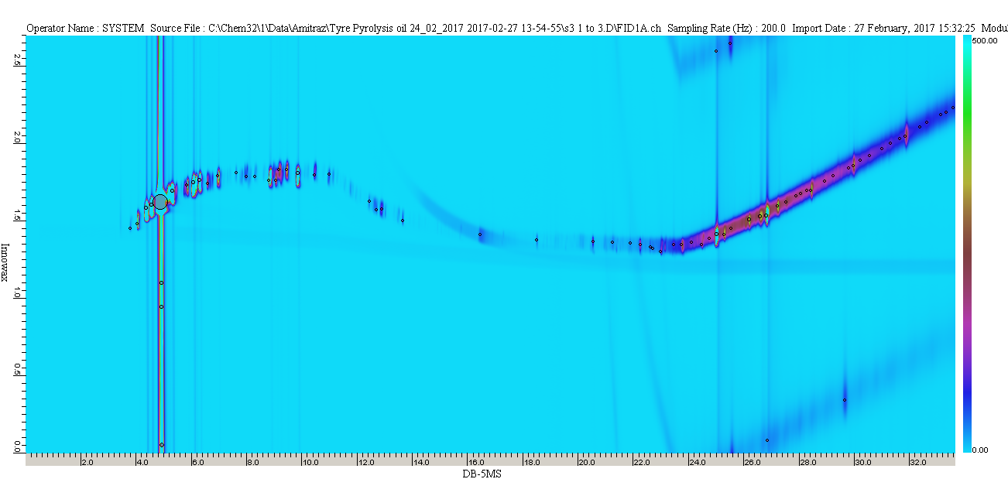
GC-GC: polar and non-polar column 2D
24

Slide 25
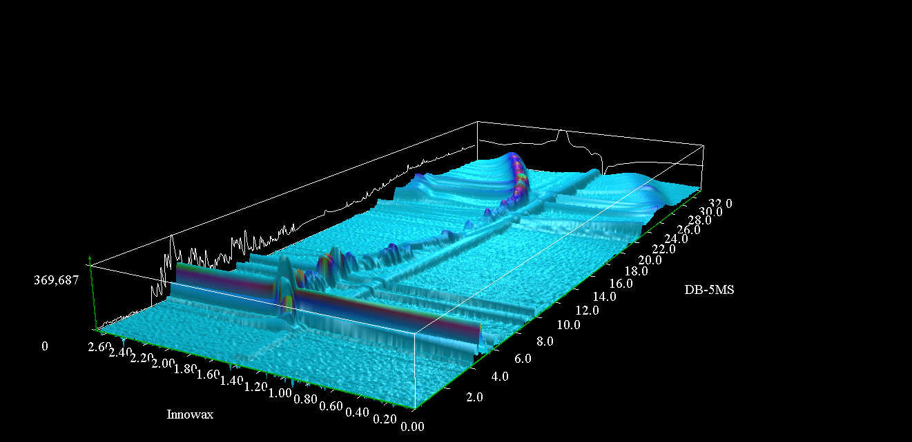
GC-GC: 3D representation…
25

Slide 26
This technique was performed to get the estimation of oil and petroleum fractions in the extracted oils
Part 2: SIMDIST D86 - Oil and Petroleum fraction
26

Slide 27
SIMDIST D86 conditions
Agilent Technologies 7890 A GC
D 2887-06 (D86 Correlation BP Distribution)
IBP (⁰C) = 322.5 WT4,270 WT5 and 179.6 WT6 10%
FBP (⁰C) = 489.3 WT4, 490 WT5 and 491.5 WT6 90%
Flame Ionization Detector
200⁰C; H₂ 40 ml/min; Air 295 ml/min
Oven:
100⁰C; Time: 0.5-1.2 min; Rate: 15⁰C/min
Injector Program:
100-350⁰C; Time: 0-2.5 min Rate: 35⁰C/min
Column:
Injector volume: 0.1 µl; flow: 19 ml/min;
Gas flow (He): 26 ml/min;
Dimension: 10 m X 0.53 mm
27

Slide 28
Oil fractions
PETROLEUM FRACTIONS | % | % | %
(Ref. Fischer, C.H: Composition of WASTE TYRE OILS) | 1st EXT. | 2nd EXT. | 3rd EXT.
(0-170⁰C) LIGHT OIL | n/a | n/a | n/a
(170-230⁰C) MIDDLE OIL |  |  | 6.90
(230-270⁰C) HEAVY OIL |  |  | 3.70
(270-350⁰C) ANTHRACENE OIL | 9.20 | 8.20 | 10.60
>350⁰C RESIDUE CARBON | 90.80 | 91.80 | 78.80
TOTAL | 100.00 | 100.00 | 100.00
28

Slide 29
Oil fractions contd…
29

Slide 30
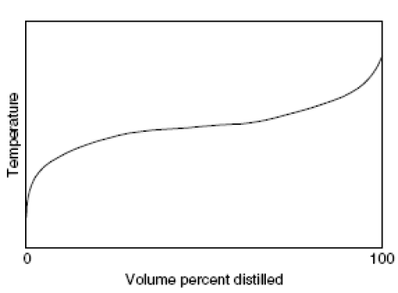
Petroleum fractions
Properties of pseudo-component curve
Molecular weight
Critical constant
Acentric factor
Heat of formation
Ideal gas enthalpy
Latent heat
Vapour pressure
Transport properties
Pseudo-component curve
30

Slide 31
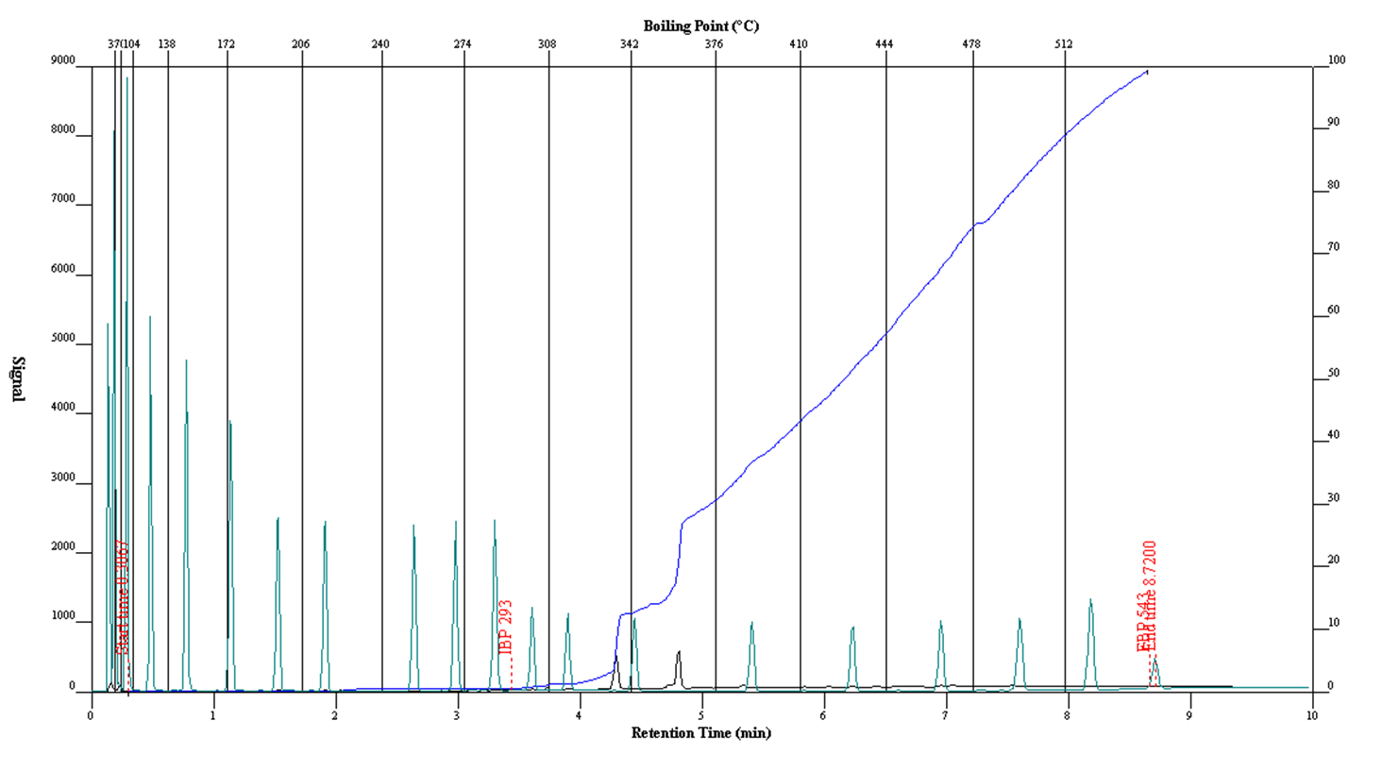
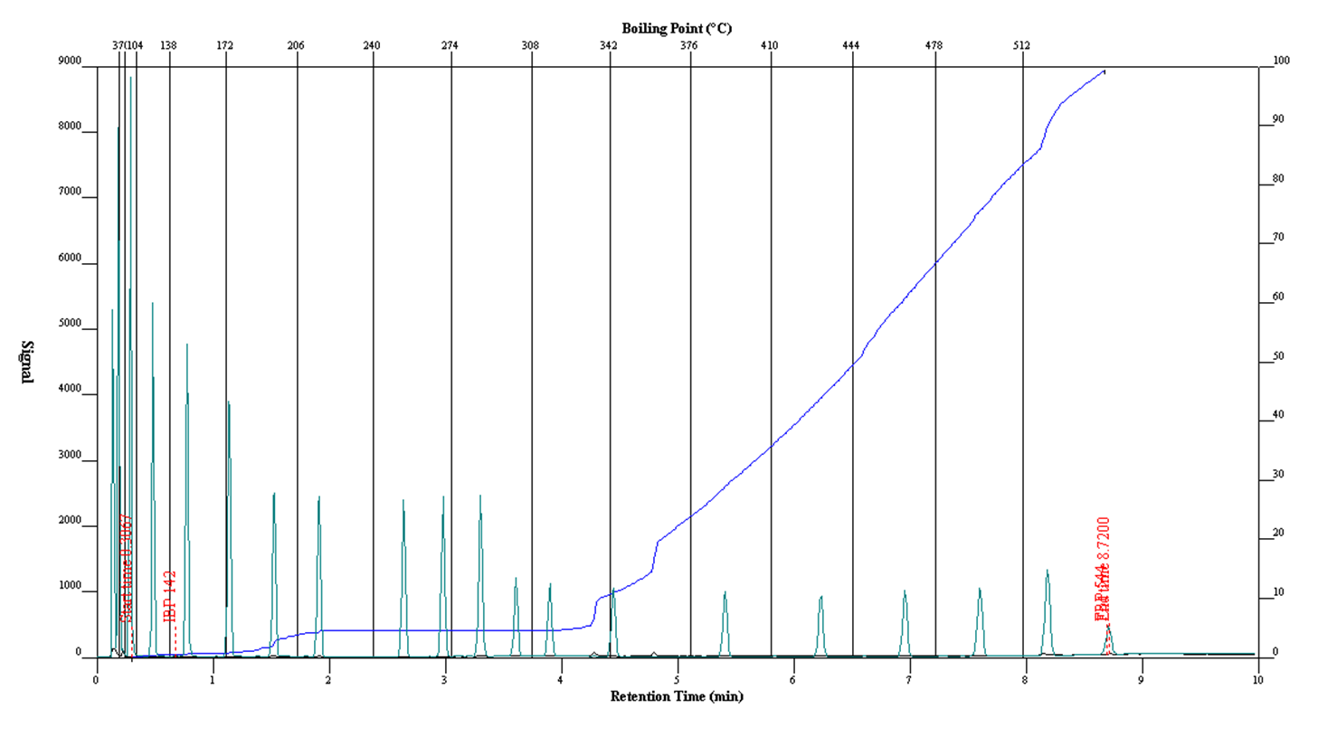
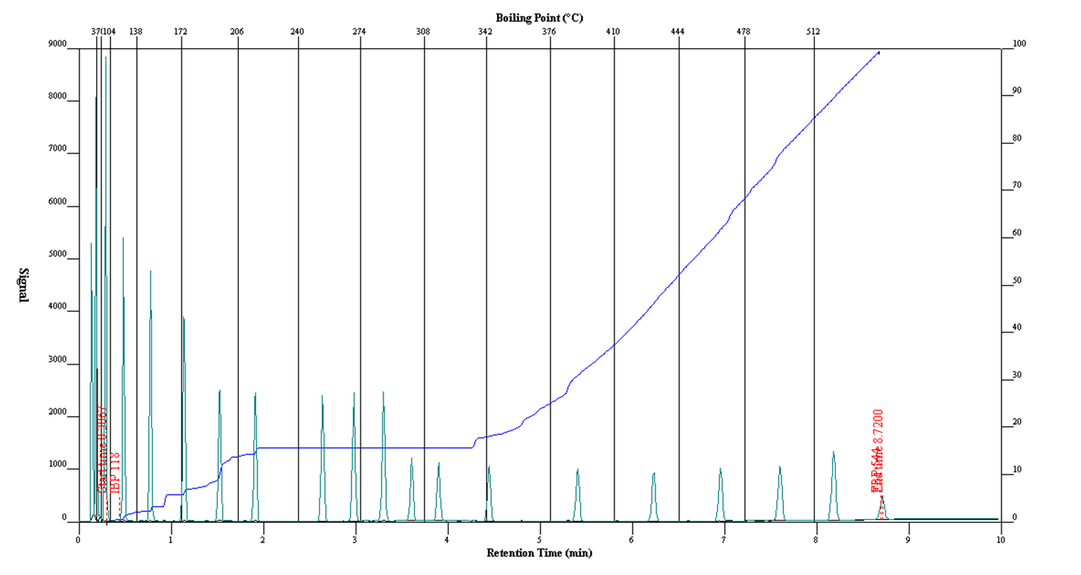
Petroleum fractions contd…
31

Slide 32
Petroleum fractions contd…
32

Slide 33
Petroleum fractions contd…
33

Slide 34
Possible uses
Petroleum fractions | Boiling point (ºC) | Average specific gravity | Number of C atoms | Test method | Uses
L.P.G | Up to 30 | 0.6 | 1 to 4 | ASTM D86 | Camping stoves
Light Naphtha | 30 to 100 | 0.69 | 5 to 8 | ASTM D86 | Fuel for cars
Heavy Naphtha | 100 to 150 | 0.758 | 8 to 10 | ASTM D86 | Reforming petrochemical feed
Kerosene | 150 to 250 | 0.808 | 10 to 14 | ASTM D86 | Fuel for aeroplane
Light vacuum gas oil | 250 to 350 | 0.84 | 15 to 20 | ASTM D216 | Fuel for lorries, trains and cars
Heavy vacuum gas oil | 350 to 450 | 0.885 | 21 to 28 | ASTM D158 | Lubricant heating
Residual | Over 450 | 0.945 | Over 28 | ASTM D1160 | Road surfacing
34

Slide 35
Conclusions…
Based on the results obtained: GC-MS and SIMDIST we can conclude that the extracted oil is a heavy oil.
From the previous work done it has been recorded that palmitic, oleic and steric acids are the stating material for biodiesel.
  Extracted oil may be suitable for Biodiesel
Light vacuum gas oil forms the largest part of the petroleum fractions in all the extracted oils.
Future work
  Use a sensitive instrument to get the quantitative sulfur content in the oil like Atomic Absorption spectroscopy (AA).
  Build a reactor to upscale – currently designing one.
  Crack the oil to produce diesel and petrol - possibility
  Analysis the quality of the petroleum fuel from extracted oil compared to that of commercial fuels.
35

Slide 36



Acknowledgements
REDISA
Supervisor and co-supervisors
Center for Rubber Science and Technology
Physical and Polymer science staff NMMU
SUN, Innoventon and NMMU
Center for
Rubber
Science and
Technology

Slide 37
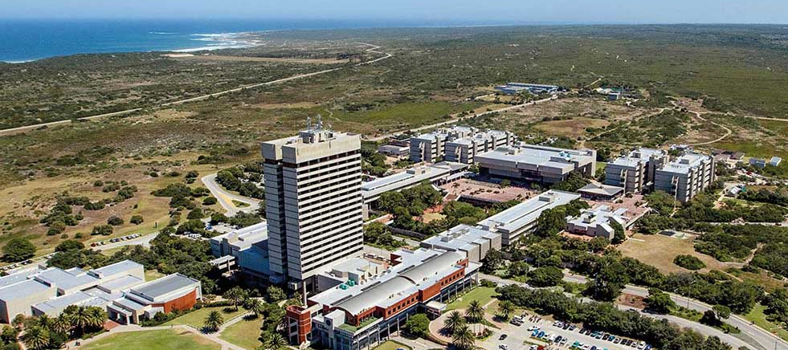
THANK YOU!

