Slide 1
Dyspepsia: an underestimated problem among end-stage renal disease patients
Paulo Santos
Federal University of Ceará, Brazil

Slide 2
Highly prevalent
Great impact on quality of life

Slide 3
Prevalence
In the literature:
between 50% and 70%
VanVlem et al Am J Kidney Dis 2000; 36:962
Cano et al Am J Gastroenterol 2007 102:1990

Slide 4
Impact on Quality of Life
PAIN
GENERAL HEALTH
VITALITY
ROLE-EMOTIONAL
MENTAL HEALTH

Slide 5
What is dyspepsia?

Slide 6
Constellation of symptoms
Upper abdominal pain; Nausea; Vomiting; Upper abdominal bloating; Early satiety
Tack et al. Gastroenterology 2006; 130:1466

Slide 7
WHY?
Gastric emptying delay
Hypervolemia

Slide 8
WHY?
Gastric emptying delay
Hypervolemia

Slide 13
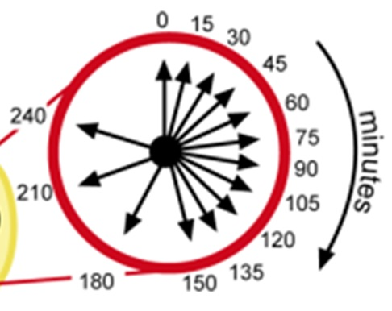

Slide 17
Clinical implications
It is very easy to search for symptoms of dyspepsia, so it should be done often
Our finding raises the question about the main role of prokinetics in dyspepsia cases

Slide 18
WHY?
Gastric emptying delay
Hypervolemia

Slide 19
WHY?
Gastric emptying delay
Hypervolemia

Slide 20
Volemic status

Slide 23
Clinical implications
Functional dyspepsia could be an alert of the need to revise the prescribed dry-weight of patients on HD
Dyspeptic symptoms could be another tool to help estimate the optimal dry weight of patients on HD

Slide 24
IMPACTS ON NUTRITIONAL STATUS?

Slide 27
Clinical implication
Screening of dyspeptic symptoms can be used as a tool for identification of patients on HD who are at risk of malnutrition

Slide 28
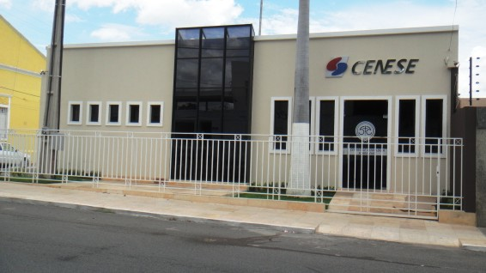

Slide 29
prsantos@fortalnet.com.br www.drpaulosantos.com.br

