Slide 1
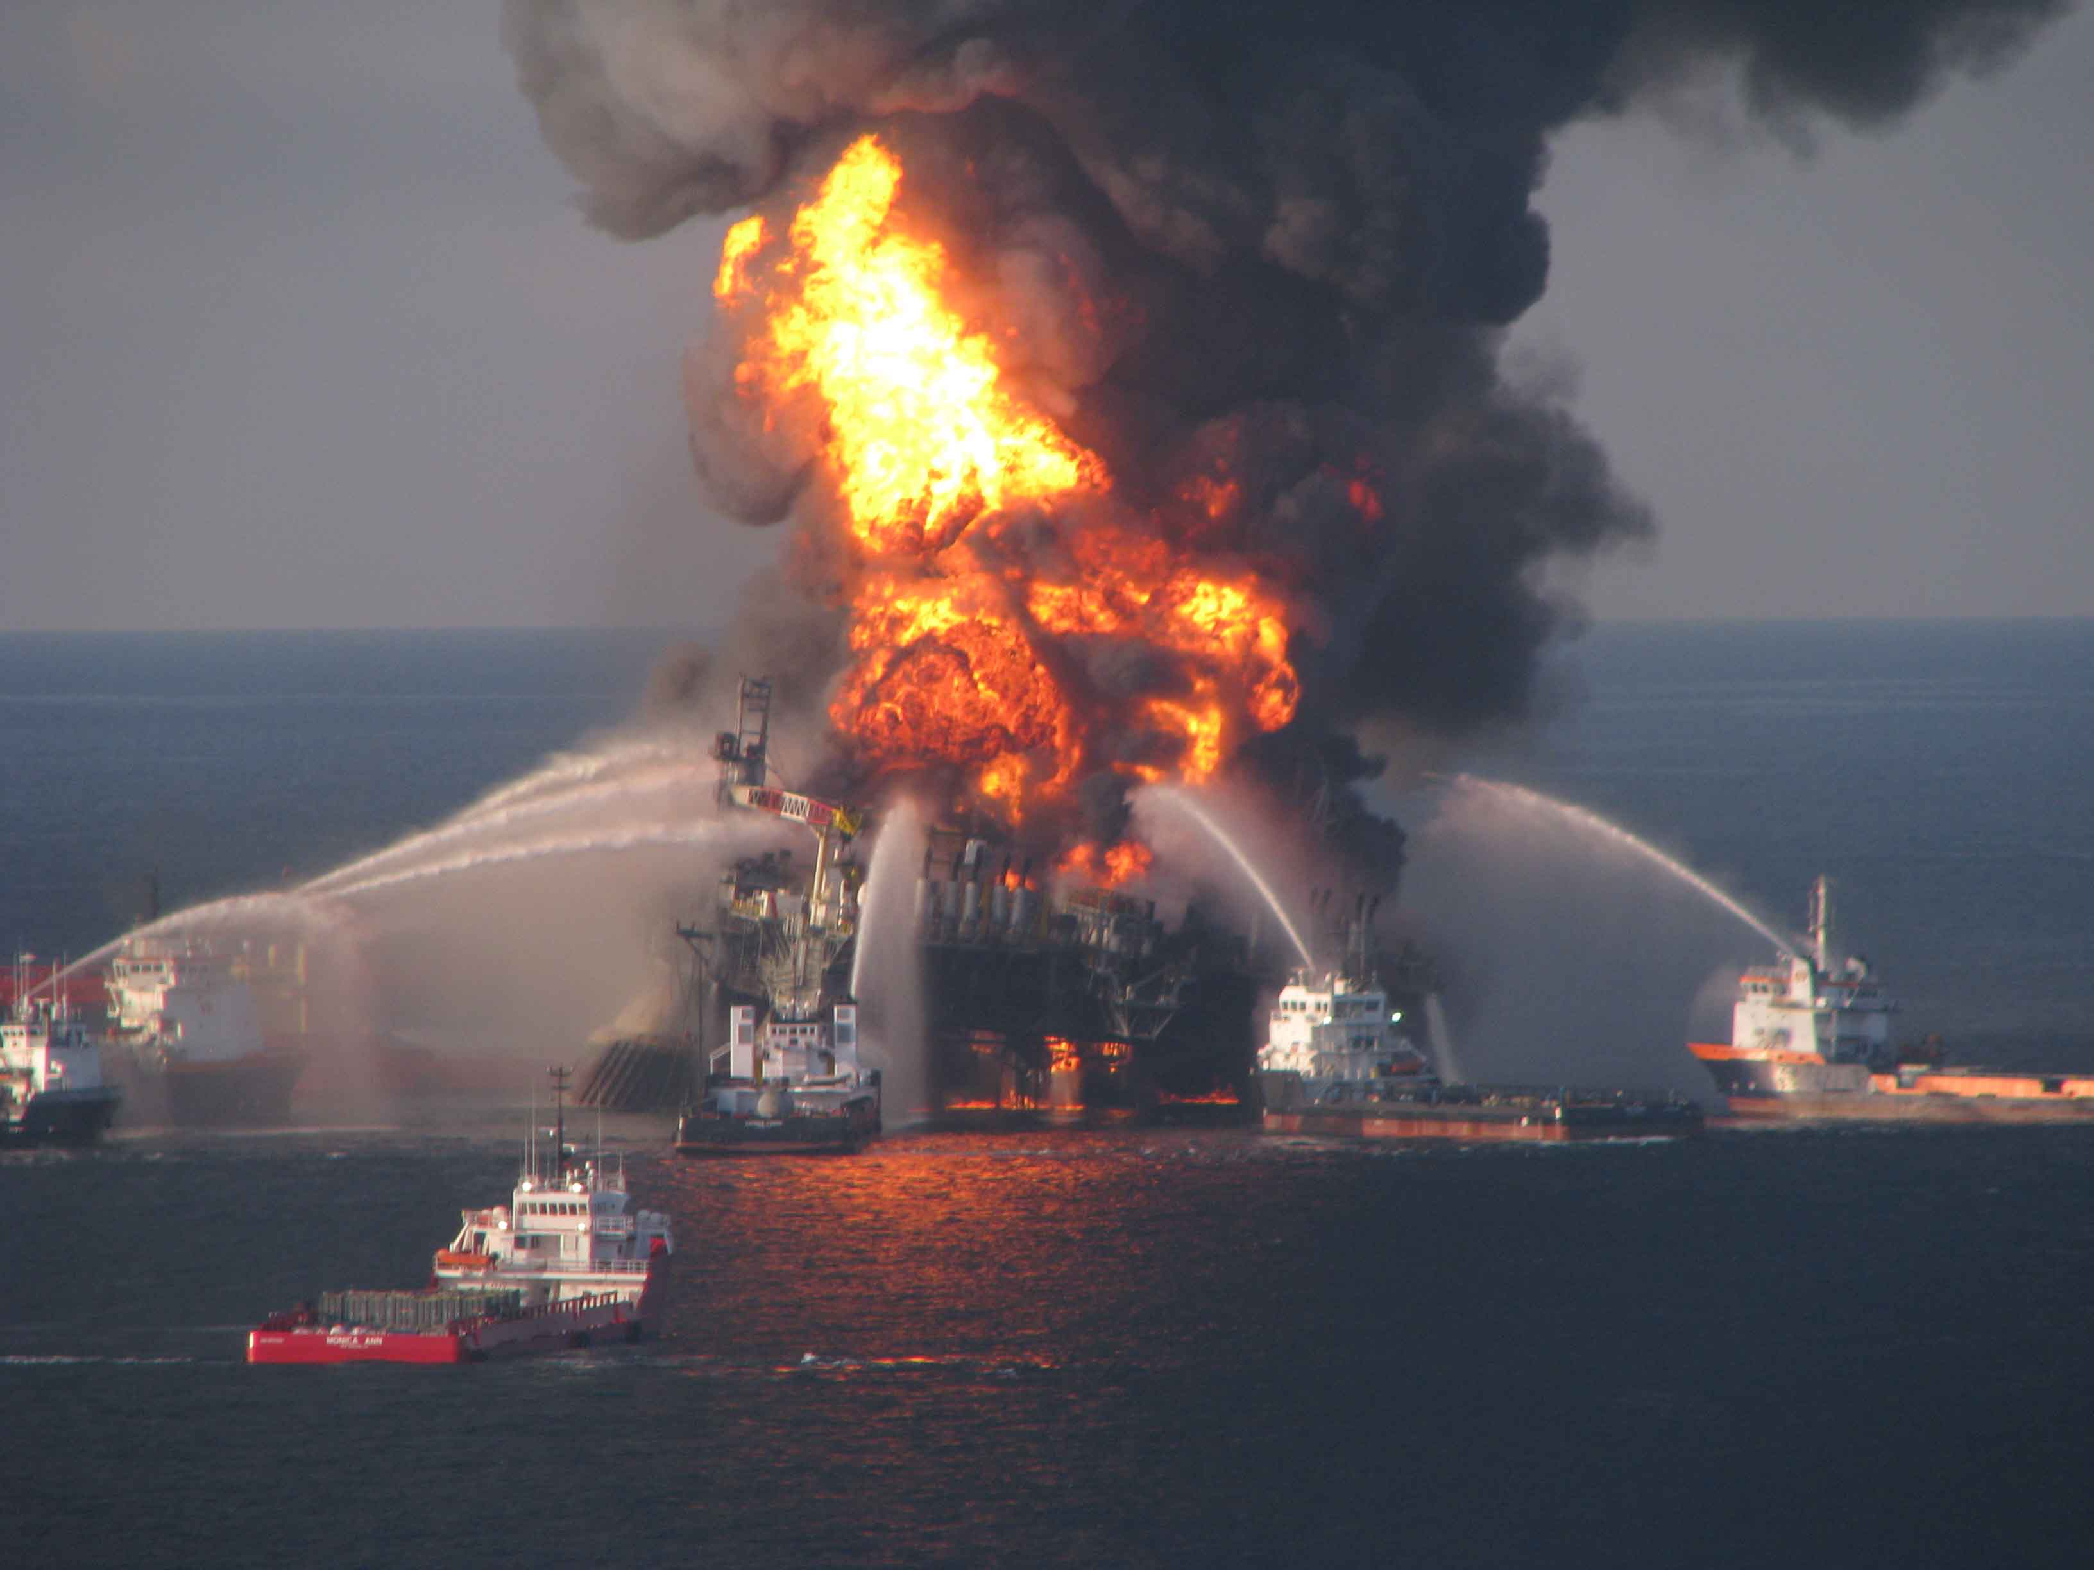
Distribution and Concentrations of Petroleum Hydrocarbons
Associated with The BP/Deepwater Horizon Oil Spill, Gulf of Mexico
http://www.eoearth.org/files/142601_142700/142604/dispersants7.jpg

Slide 2
Paul W. Sammarco
Louisiana Universities Marine Consortium (LUMCON)
Chauvin, LA
Steve R. Kolian
EcoRigs Non-Profit Org.
Baton Rouge, LA
Richard A.F. Warby
Department of Natural Sciences, Assumption College
Worcester, MA
Jennifer L. Bouldin
Ecotoxicology Research Facility, Dept. Biological Sciences
Arkansas State University
State University, AR
Wilma A. Subra
Subra Company/Louisiana Environmental Action Network (LEAN)
New Iberia, LA
Scott A. Porter
EcoLogic Environmental, Inc.
Houma LA

Slide 3
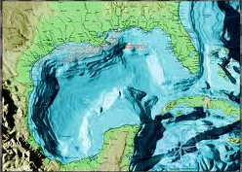
http://www.lib.utexas.edu/maps/map_sites/country_sites.html

Slide 4
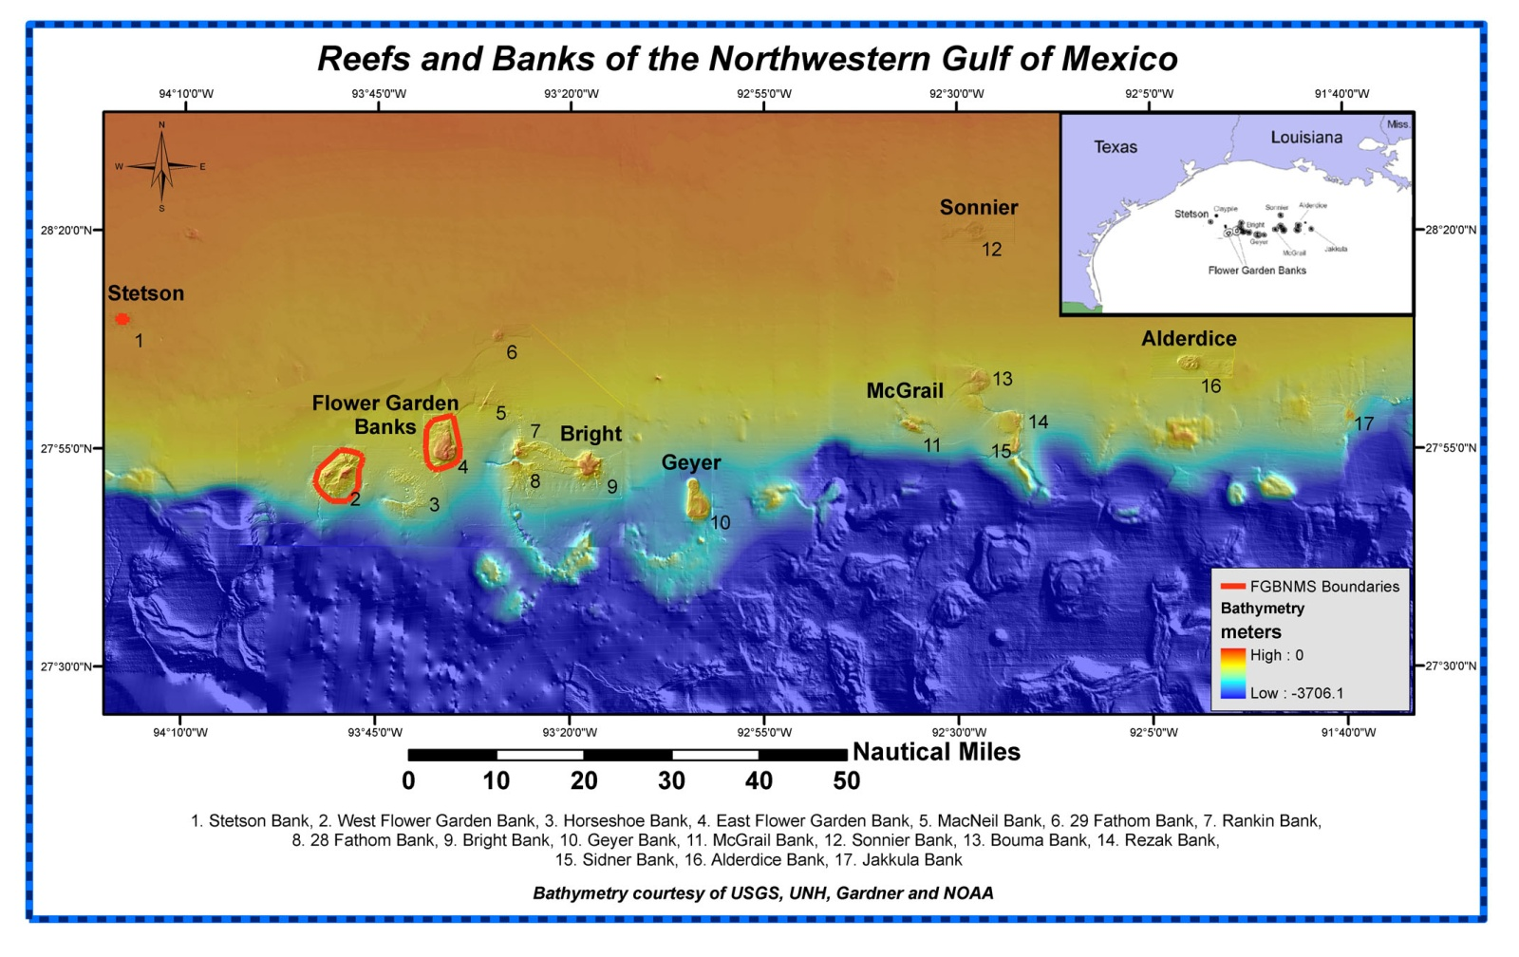
http://flowergarden.noaa.gov/about/nwgulfbanks.html

Slide 5
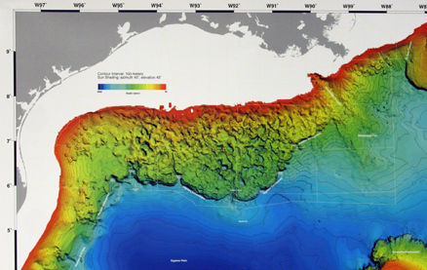
Banks off the Continental Shelf, Northern Gulf of Mexico

Slide 6
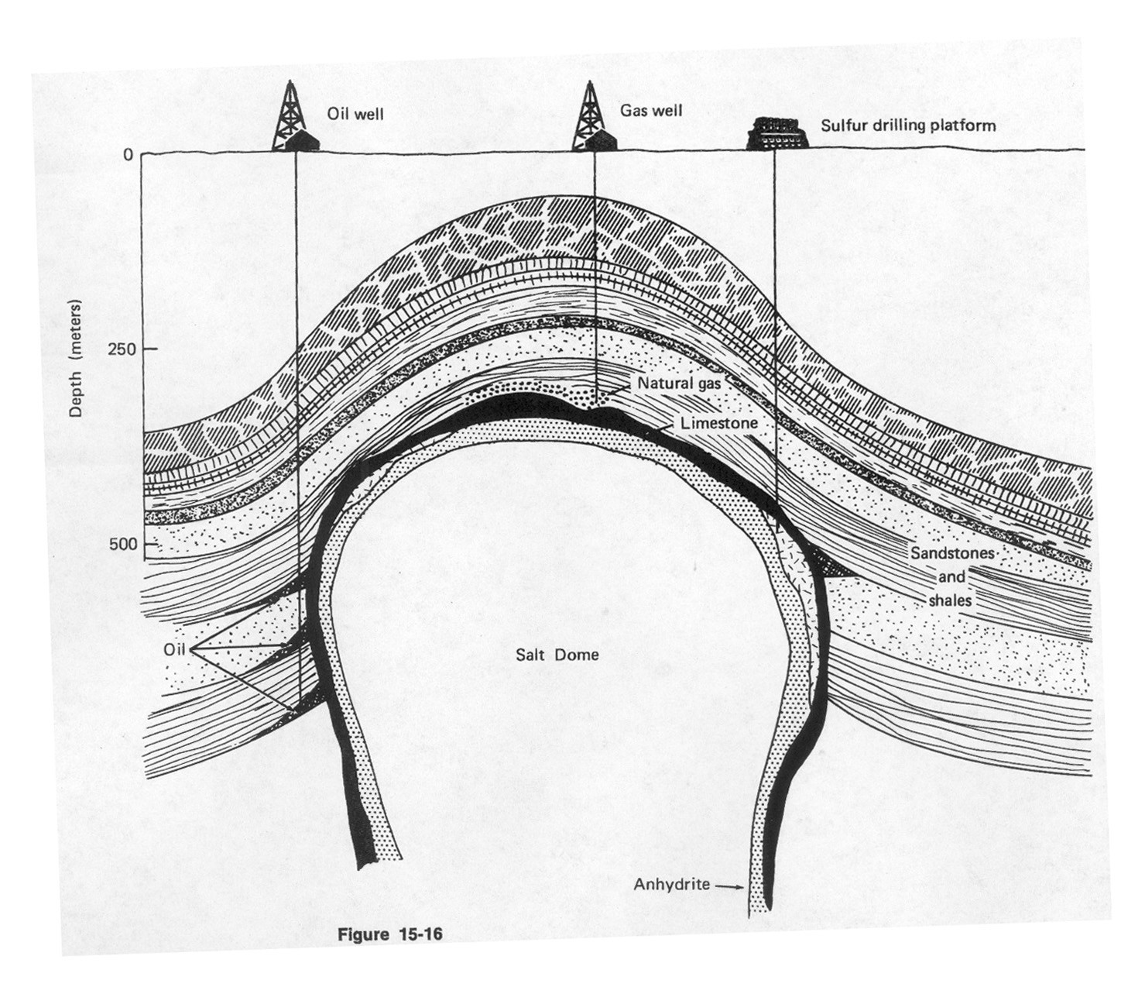
Shelf
Bottom
Salt Dome
Oil
Gross, M.G, 1977

Slide 7
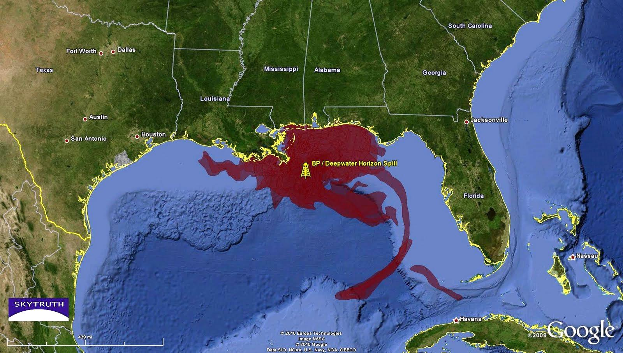
http://plotmistress.com/wp-content/uploads/bp-oil-spill-2010-f-Copy.jpg

Slide 8
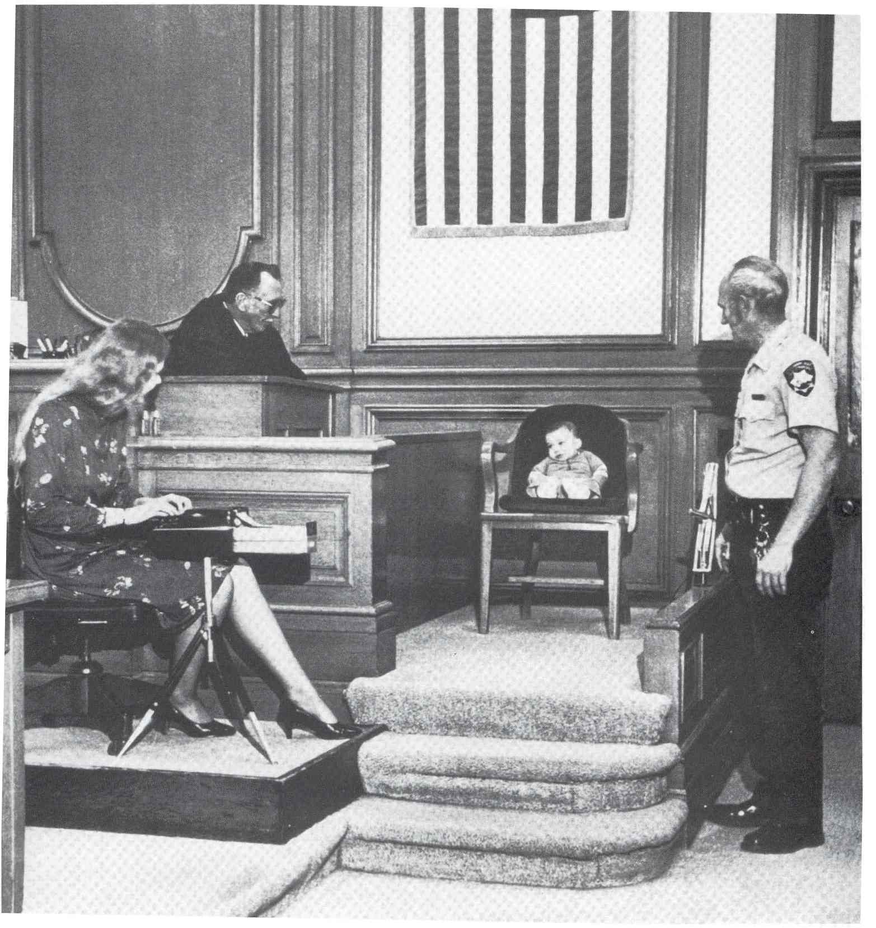

Slide 9
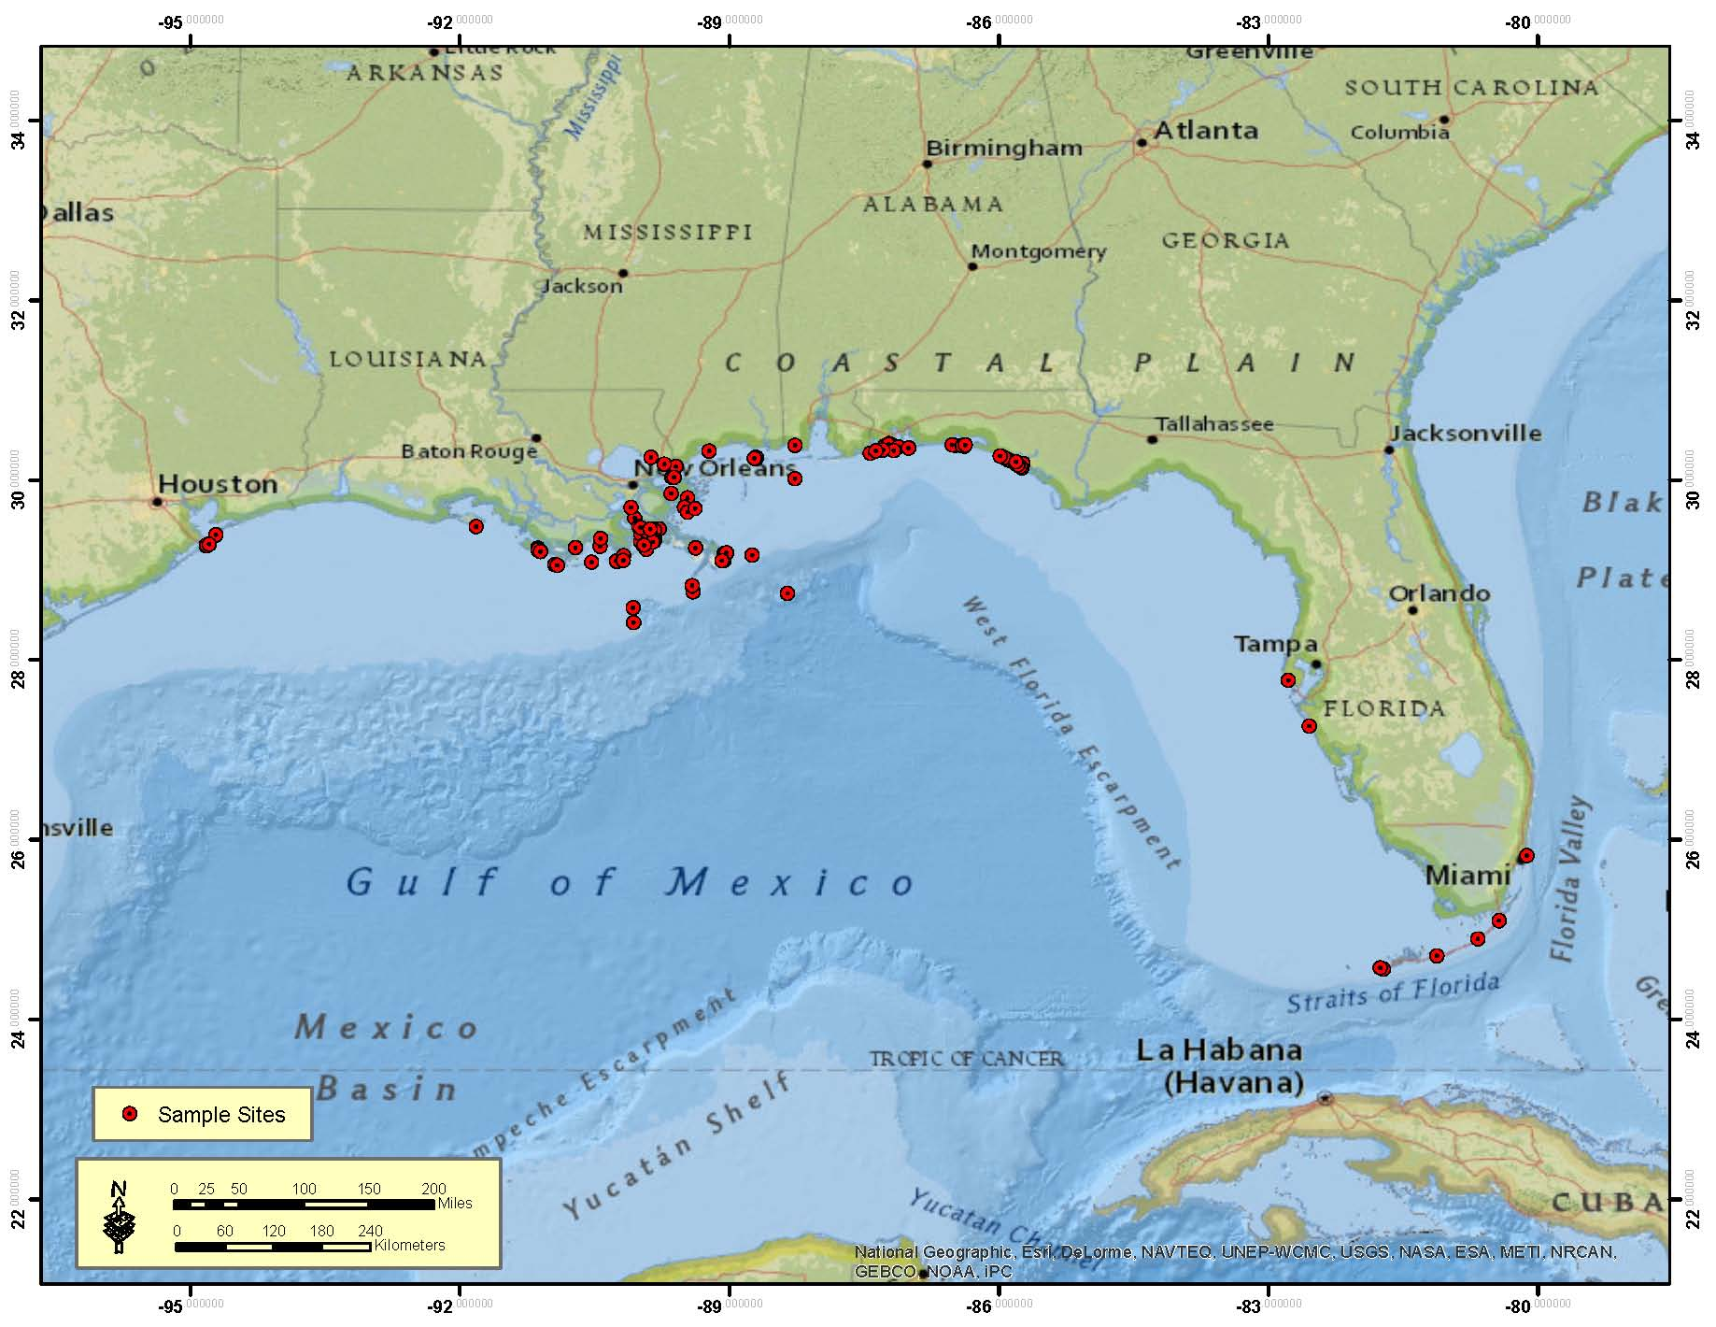
Sampling Sites

Slide 10
Compounds Examined
. TPH – C8-C40
. Total PAHs
. C-3 Napthalenes
. C-2 Phenanthrenes/anthracenes
. C-4 Phenanthrenes/anthracenes
. C-1 Benzo(a)anthracenes/chrysenes.
Also -
. C-2 Dibenzothiophenes
. C-3 Dibenzothiophenes
. C-4 Dibenzothiophenes
. C-2 Napthalenes
. C-4 Napthalenes
. C-3 Fluorenes
. C-1 Phenanthrenes/anthracenes
. C-2 Sub’d B9a)/chrysenes

Slide 11
Media Examined
. Sediment
. Seawater
. Marine Fauna and Flora
. Commercial Seafood Species

Slide 12
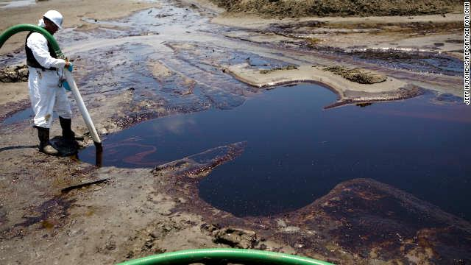
Sediment
http://www.cnn.com/2013/01/11/us/gulf-oil-spill-settlement/

Slide 13
Sediment Techniques
. TPHs - GC-FID Scan, Method Reference EPA 3550/8000-GC-FID
. PAHs and Alkylated PAHs
– Method Reference EPA 3540/8270 GC/MS
. Also by GC/MS – Method Reference EPA 8015
- Modifications – 6010, 7471, & 8260

Slide 15
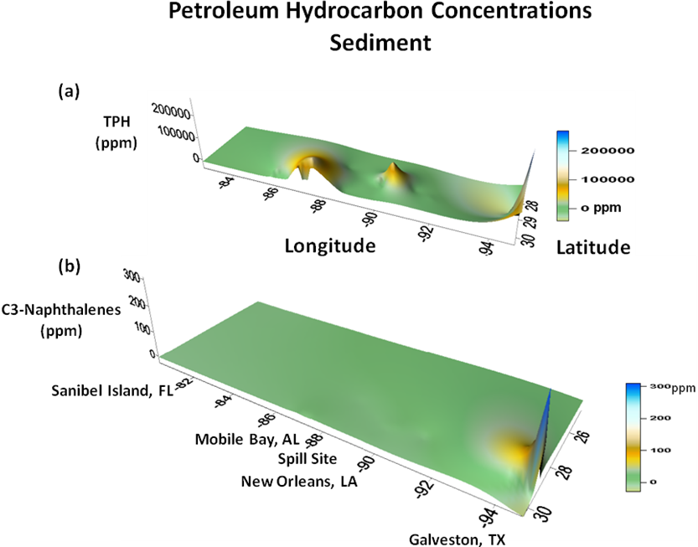

Slide 16
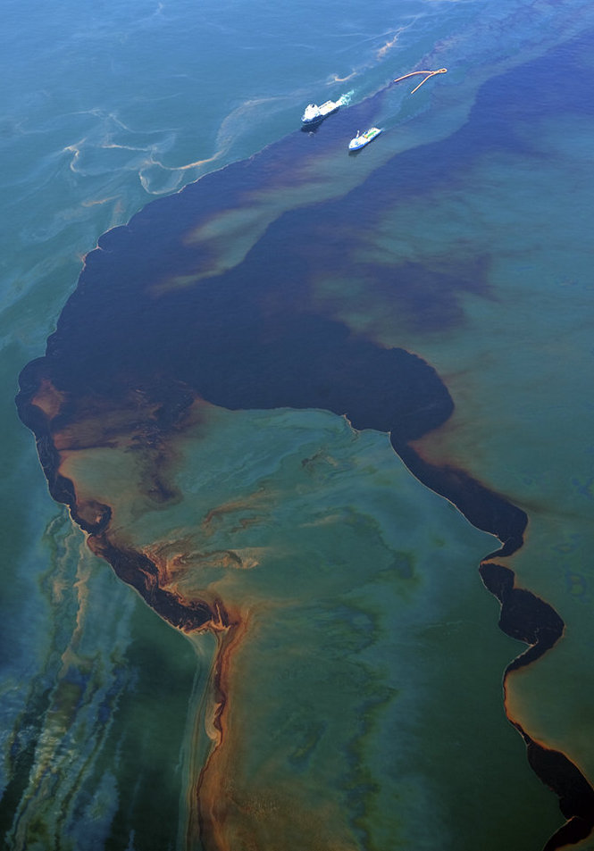
Seawater
http://www.deepwaterclaims.net/wp-content/uploads/2013/06/bp-oil-spill-2.jpg

Slide 17
Seawater Techniques
. Wildco vertical PVC seawater sampler
. Dynasorb adsorbent cloth – state-of-the-art oil adsorbent
. Processed by EPA laboratories for TPH, Total PAH, and
PAH components, by GC/MS

Slide 19
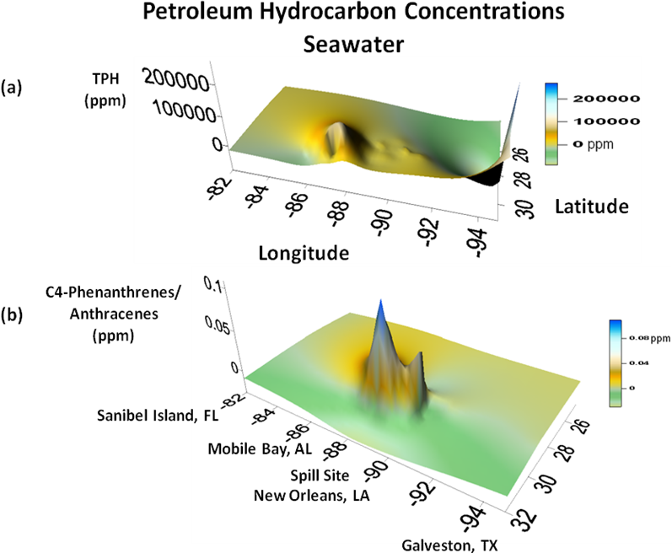

Slide 20
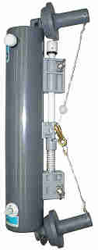
Niskin Bottle

Slide 22
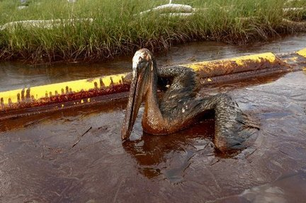
Fauna and …
http://bluelifeconservation.files.wordpress.com/2010/06/oiled-pelican-queen-bess-islandjpg-3f2c59e5902e116c_large.jpg

Slide 23
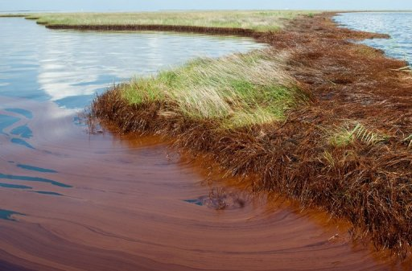
Flora
http://phys.org/news/2012-02-mitsui-fine-gulf-oil.html

Slide 24
Fauna and Flora
. Seagrass (Ruppia maritima)
. Marshgrass (Spartina alterniflora)
. Algae (Sargassum spp.)
. Coral (Tubastraea coccinea)
. Encrusting Bryozoans (Membranipora, Aeverilla,
and Parasmittina spp.

Slide 26
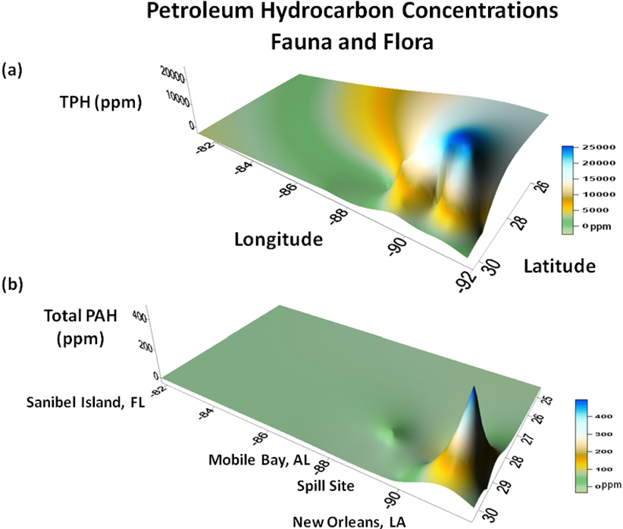

Slide 27
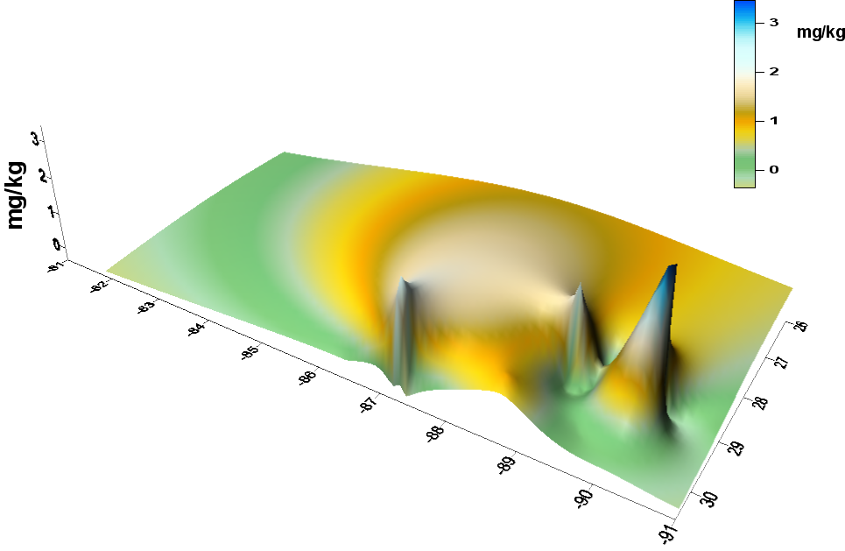
Fig. 2.
Fauna and Flora (combined)
Naphthalenes(C3)
ppm
ppm
Limit for
Consumption
of Aquatic Orgs.
St. Petersburg,
FL
Mobile Bay, AL
Latitude
Longitude
Spill Site
Terrebonne Bay, LA

Slide 28
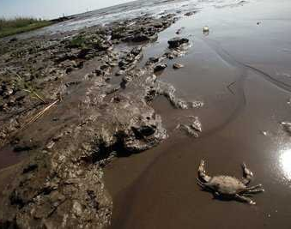
Commercial Seafood
http://www.businessinsider.com/lessons-from-deepwater-horizon-oil-spill-2012-12

Slide 29
Commercial Seafood Species
. Shrimp (Penaeus spp.)
. Blue crab (Callinectes sapidus)
. Oysters (Crassostraea virginica)
. Red snapper (Lutjanus campechanus)
. Speckled trout (Cynoscion nebulosus)
. Flounder (Paralichthys lethostigma)
. Sheepshead (Archosargus probatocephalus)

Slide 32
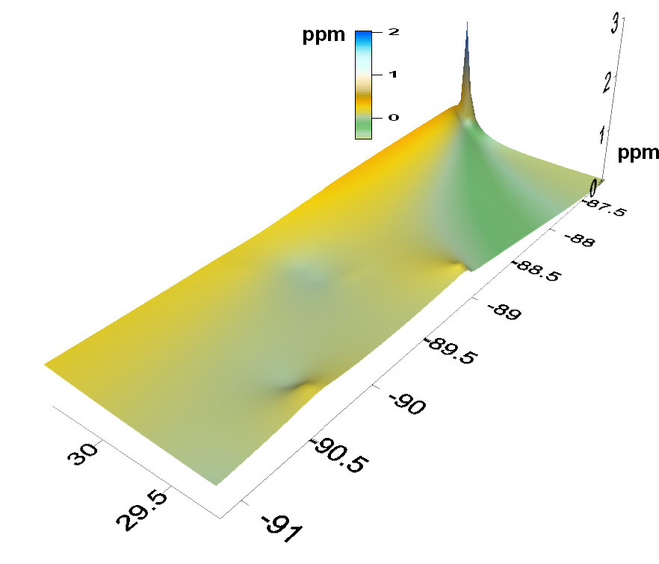
Commercial Seafood (combined)
Total PAHs
Limit for
Consumption
of Fish
Mobile Bay, AL
Spill Site
Terrebonne Bay, LA
Longitude
Latitude

Slide 33
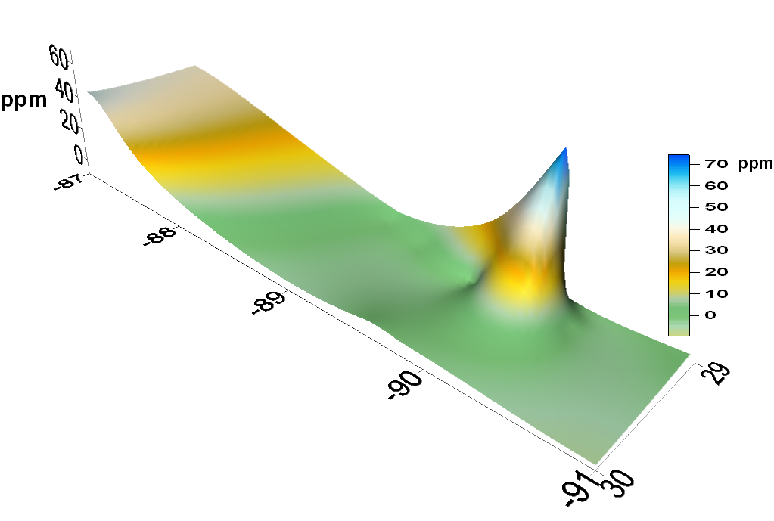
Fig. 1.
Commercial Seafood (combined)
Phenanthrenes/Anthracenes(C2)
Mobile Bay, AL
Spill Site
Limit for
Consumption
of Fish
Longitude
Latitude
Terrebonne Bay, LA

Slide 34
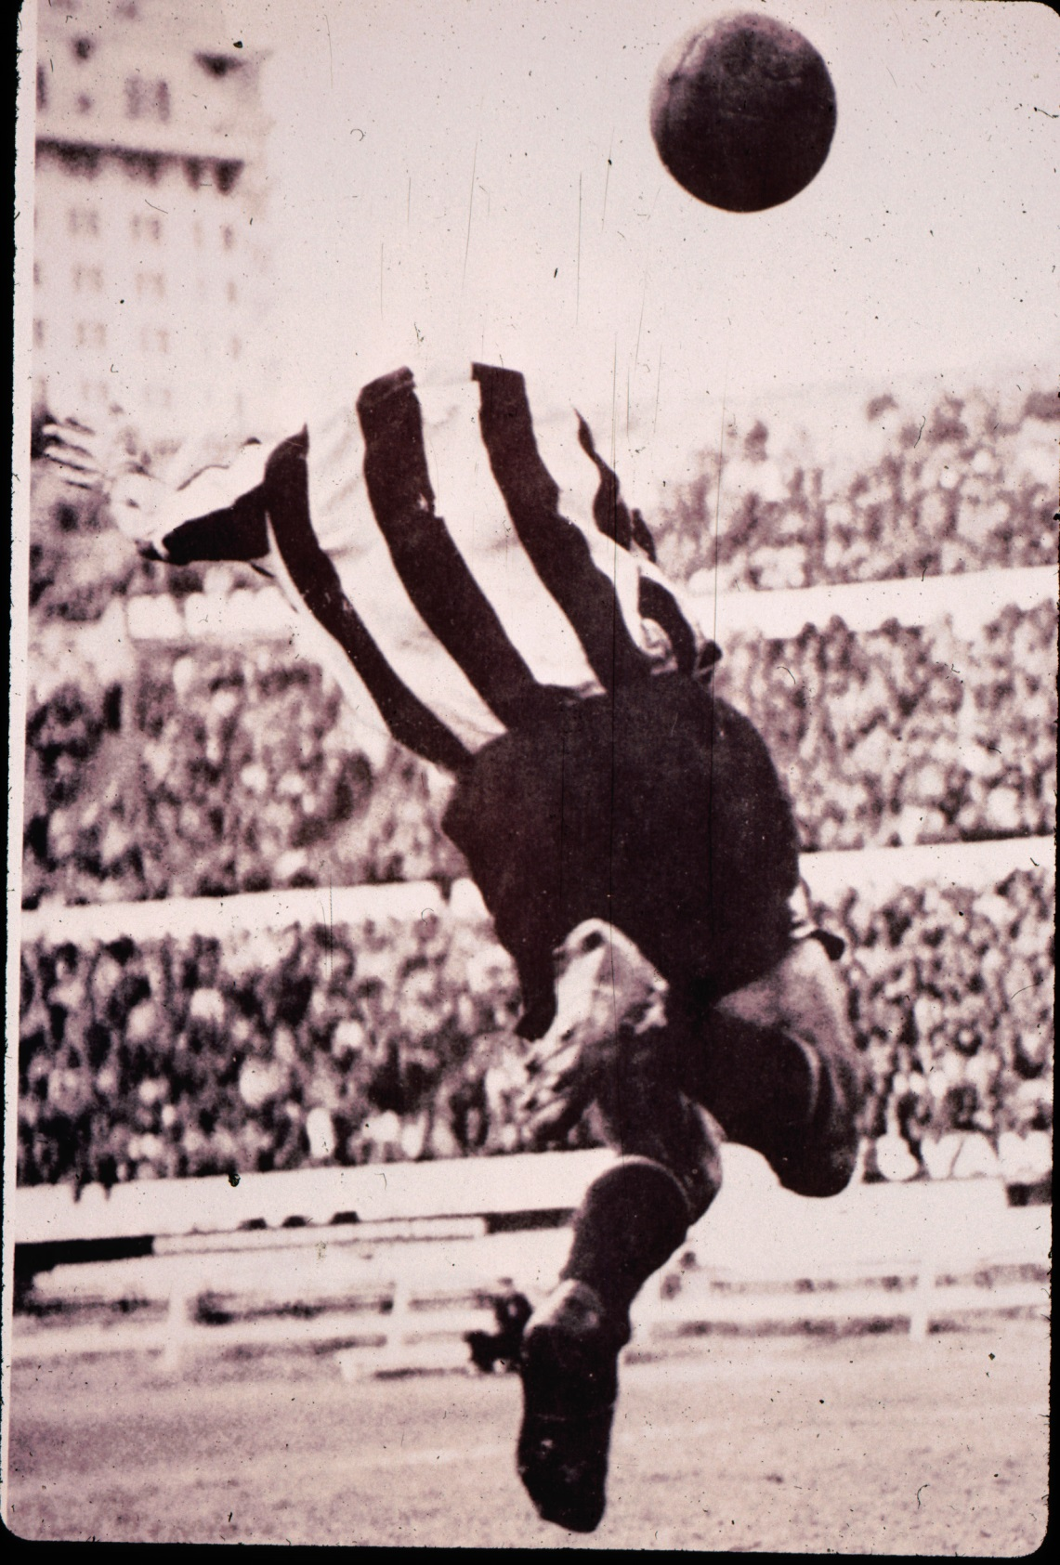

Slide 35
Conclusions
. In sediment, TPH, PAHs, and all chemical classes
examined here peaked in concentration near
Pensacola, FL and Galveston,TX
. In seawater, TPH concentrations peaked off
Pensacola, FL, and all classes examined peaked off
of the Mississippi River mouth, LA, and Galveston, TX
. In marine fauna and flora, TPH and PAHs peaked
near the Mississippi River mouth. C-3 napthalenes
peaked near the spill site.

Slide 36
Conclusions
. In commercial seafood, TPH peaked near the
spill site. PAHs and all classes examined peaked
near Pensacola, FL
. Oil concentrations should be monitored in these
media well after the spill has ceased – and prior
to fisheries being opened. Hydrocarbon levels
should be deemed at appropriate levels prior to
fisheries openings.

Slide 37
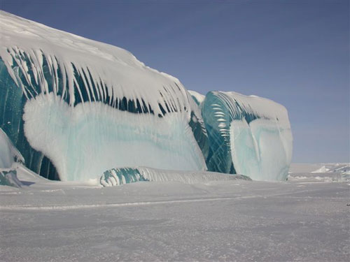
Thank you.

Slide 38
Acknowledgments
. Mark Kaltofen, Boston Chemical Data Corp.
. Mary Lee Orr, President, Louisiana Environmental Action Network (LEAN)
. Stuart Smith, Smith and Stag (LLC), Baton Rouge, LA
. Krupnick, Campbell, Malone, Buser, Slama, Hancock, Liberman,
and McKee, Attorneys-at-Law, Fort Lauderdale, FL
. Mark Moskovitz, President, Dynamic Adsorbents, Inc.
. Barbara Wiseman, President, The Lawrence Anthony Earth Organization (LAEO)
. David Fa-Kouri, President, Louisiana Economic Development Foundation
. Diane Wagenbremer, Public Relations, LAEO
. Andrew Blanchard, President, Indian Ridge Shrimp Co.
. Michael Boatright, EcoRigs.org
. Melissa Genazzio, LUMCON and Dept. Marine Sciences,
University of North Carolina at Wilmington
. Dan Beltz, LUMCON
. National Science Foundation, Grant #REU-0556208 to Arkansas State University

Slide 40
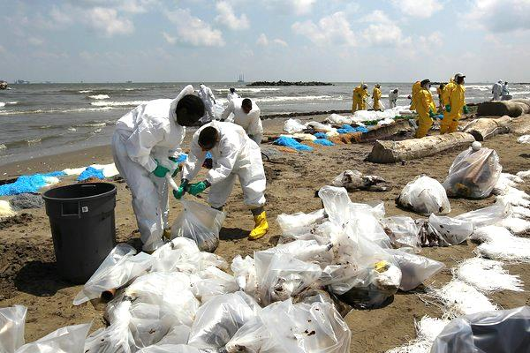
Human Blood
http://www.nytimes.com/2013/02/24/business/energy-environment/bp-and-gulf-coast-states-jockey-over-settlement-on-deepwater-horizon-oil-spill.html?pagewanted=all

Slide 41
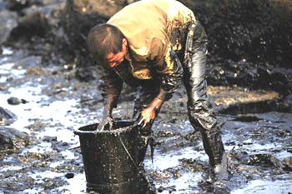
Human Blood
http://www.rsc.org/chemistryworld/News/2010/August/03081001.asp

Slide 42
Petroleum Hydrocarbons in Human Blood

Slide 44
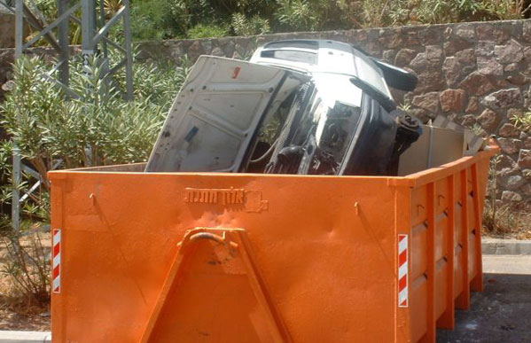
Time to toss out our old ideas of
ignoring species invasions

Slide 45
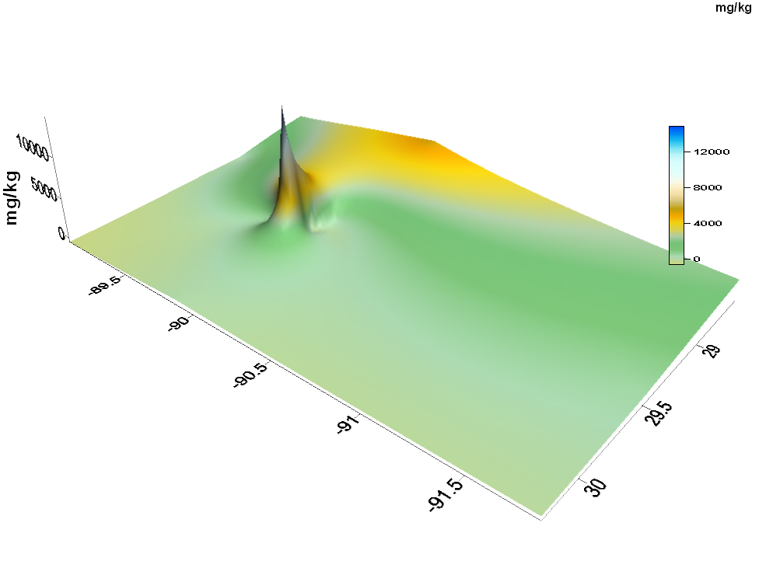
Fig. 3
Sediment
Total Petroleum Hydrocarbons (TPHs)
ppm
ppm
Spill
Site
Terrebonne Bay,
LA
Latitude
Longitude
Vermillion
Bay, LA

Slide 46
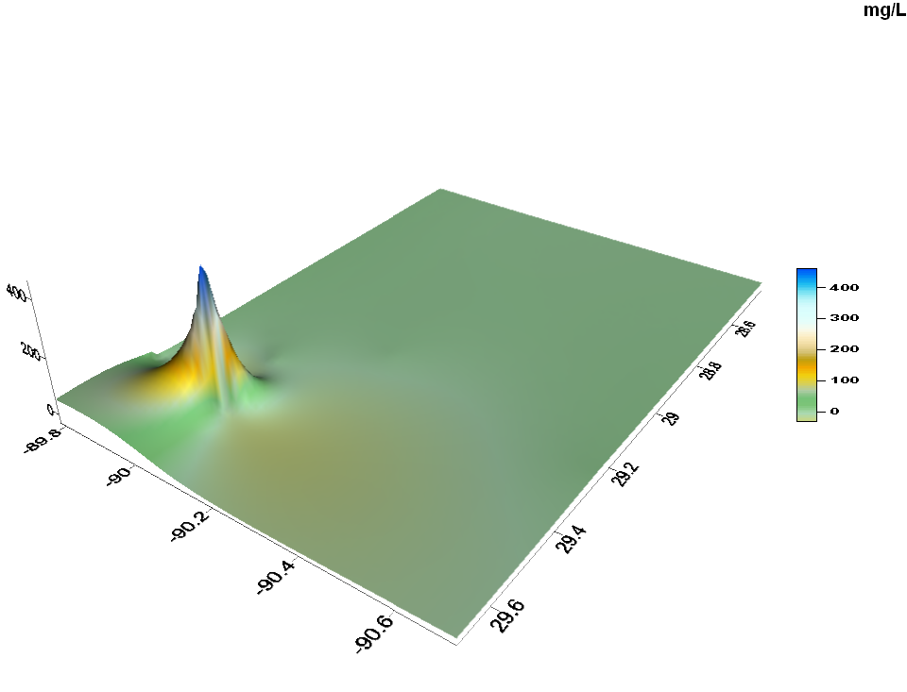
Fig. 4.
Water Samples
Total Petroleum Hydrocarbons (TPHs)
ppm
ppm
Latitude
New Orleans
Longitude
Terrebonne Bay,
LA

Slide 48
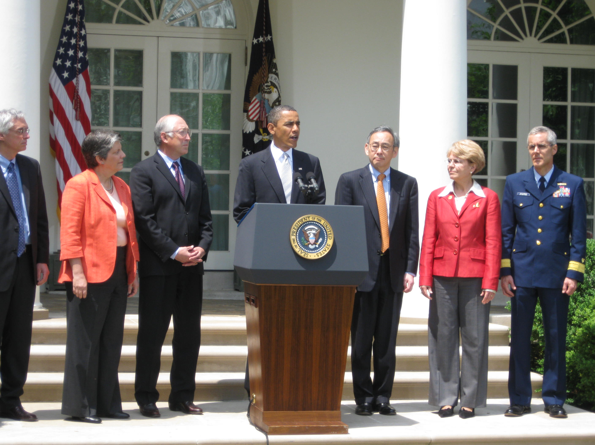
http://www.billpressshow.com/2010/05/17/president-obama-discusses-the-gulf-oil-spill/

Slide 49
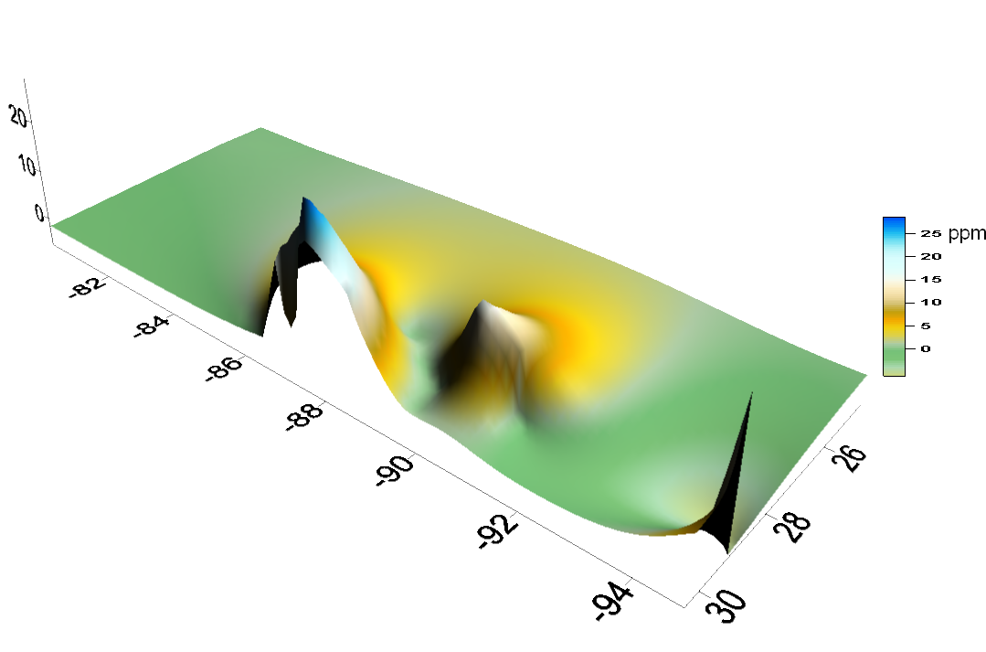
Terrebonne Bay, LA
Galveston, TX

Slide 50
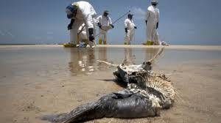
http://www.bbc.com/news/business-21609888

Slide 51
Petroleum Hydrocarbon Concentrations during and after
The BP/Deepwater Horizon Oil Spill - 2010
Spill Site
Peak Concentrations in Sediment,
Seawater, Marine Biota, or Seafood Species

Slide 52
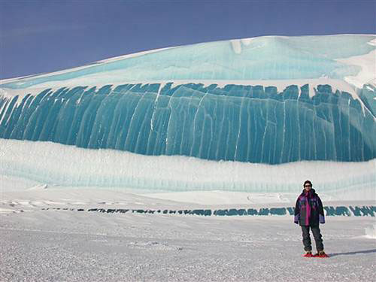
Thank you

Slide 53
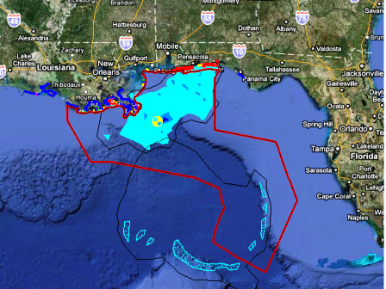
http://www.examiner.com/article/florida-bp-oil-spill-update-oil-spill-map-moves-slick-closer-to-tampa-bay-area

