Slide 1
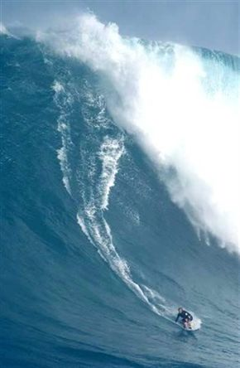

Slide 2
Relief in Mesophotic Zones of Gulf of Mexico Banks,
Incl. Geographic Patterns and Associated Species Diversity
Paul W. Sammarco¹, Lance Horn², Glen Taylor², Daniel Beltz¹,
Marissa Nuttall³, G.P. Schmahl³, and Emma Hickerson³
¹Louisiana Universities Marine Consortium (LUMCON)
Chauvin, LA
²University of North Carolina at Wilmington
Wilmington, NC
³NOAA Flower Garden Banks National Marine Sanctuary
Galveston, TX

Slide 3
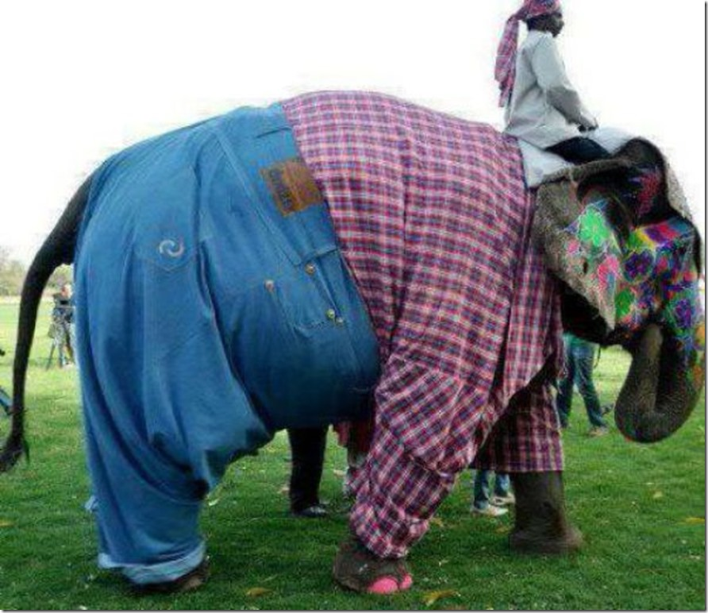

Slide 4
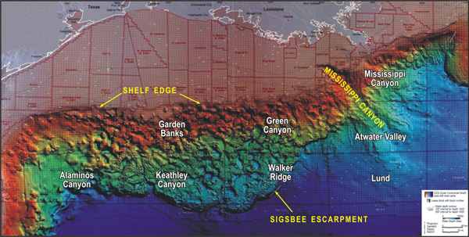
Figure 1.
http://oceanexplorer.noaa.gov/explorations/06mexico/background/geology/media/gulf_600.jpg

Slide 5
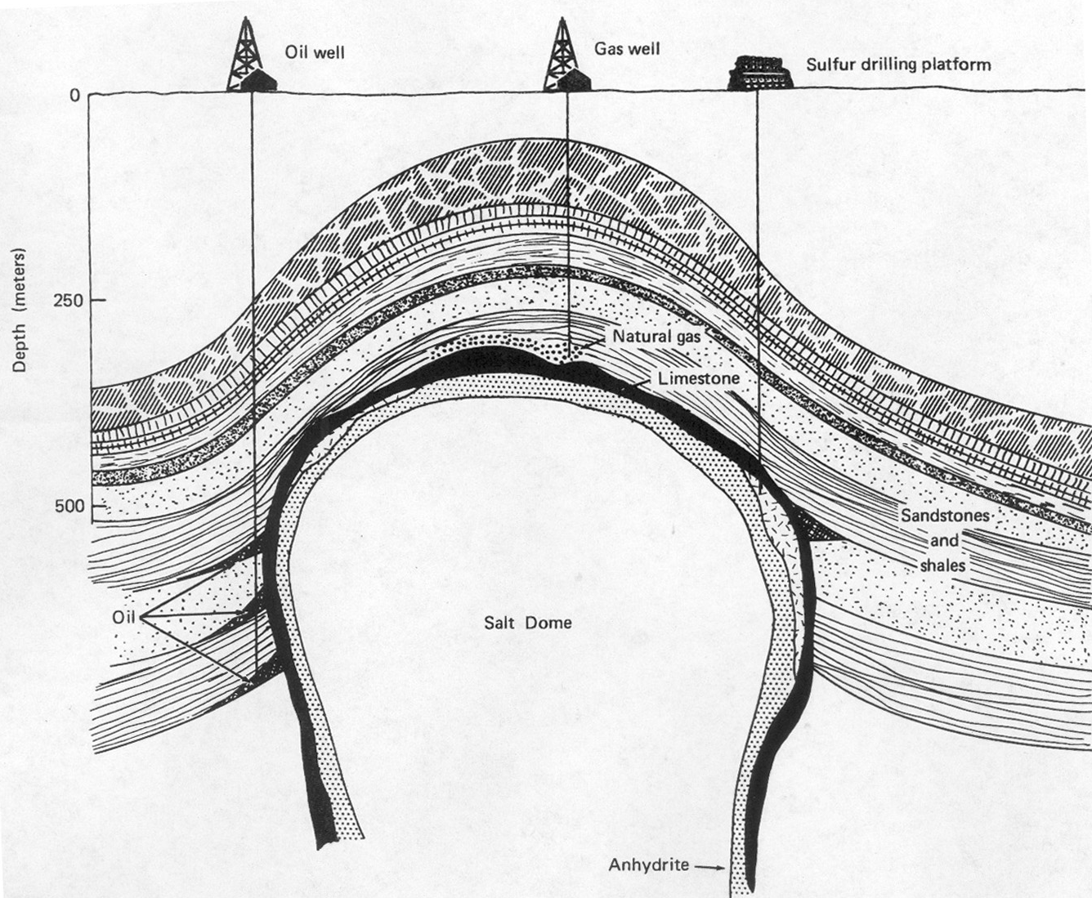
Many of the banks of the northern GOM are
the result of rising salt domes
Gross, M.G, 1977

Slide 6
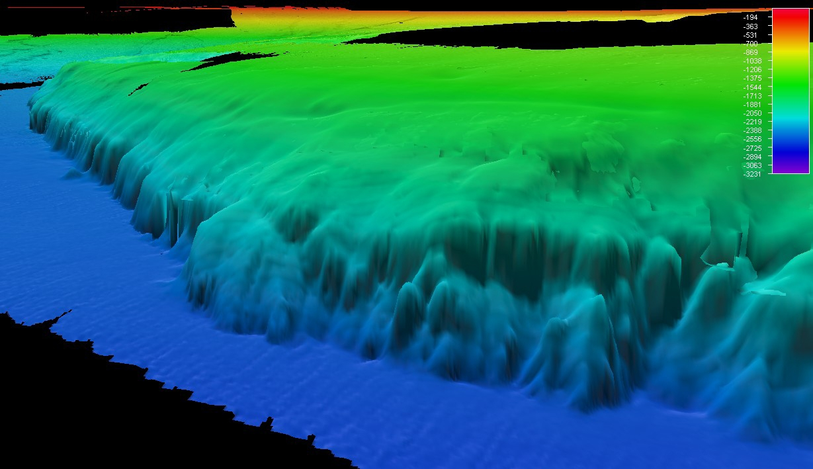
No Activity Zone (NAZ)
(<28 m
(not sampled here)
Mesophotic Zone
<190 m
http://www.noaanews.noaa.gov/stories2012/images/1-bathymetry.jpg

Slide 7
Mesophotic Coral Ecosystems (MCEs)
Light-dependent coral communities that occur in the deepest half of the photic (light-receiving) zone in tropical or sub-tropical waters. They generally occur between 30 and > 100 m depth. They are characterized by low availability of light for photosynthesis and the presence of corals, sponges, and algae as the dominant structural components.

Slide 8
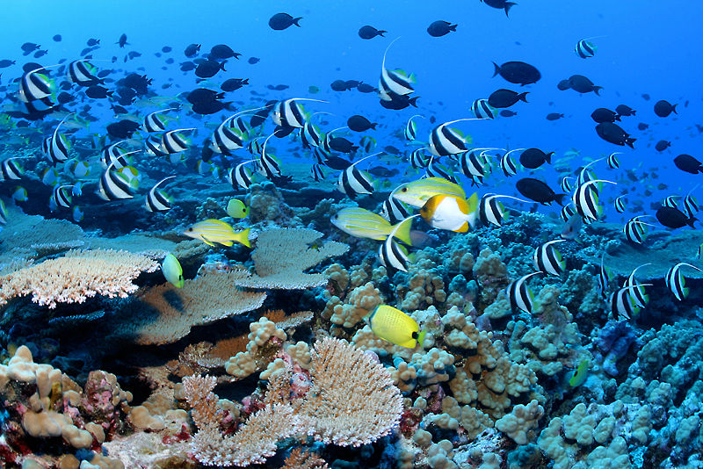
http://exploringtheenvironment.umwblogs.org/2013/04/06/human-destruction-of-coral-reefs/coral-reef-wiki/

Slide 9
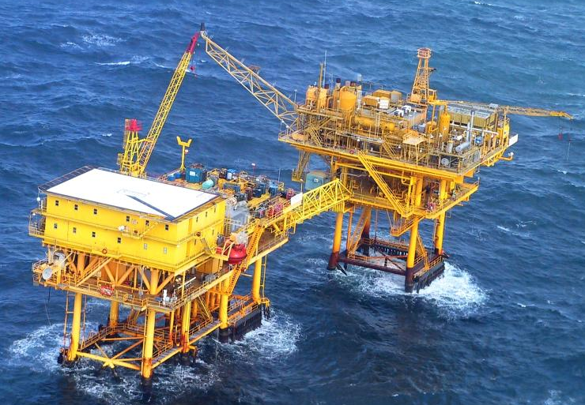

Slide 10
J. Collins

Slide 11
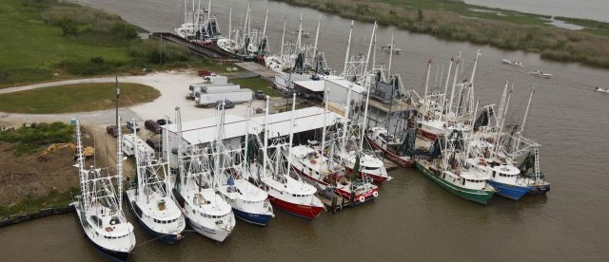
http://dailycaller.com/2012/06/04/to-protect-sea-turtles-government-pushing-pricey-regulations-on-shrimpers/

Slide 12
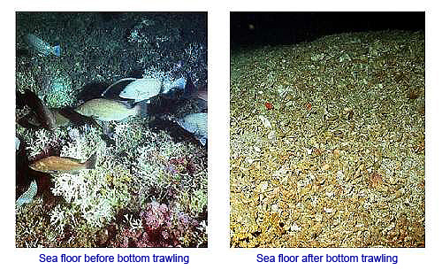
https://web.duke.edu/nicholas/bio217/durkee-eyler-franken/trawling.html

Slide 13
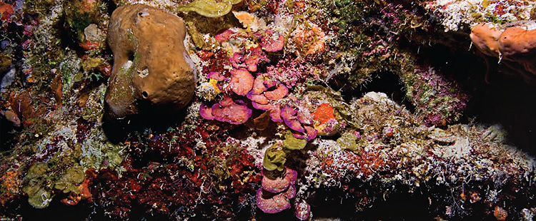
Potentially Sensitive Biological Features (PSBFs)
Mesophotic Zone Fauna and Flora
http://coastalscience.noaa.gov/research/scem/coral/mce

Slide 14
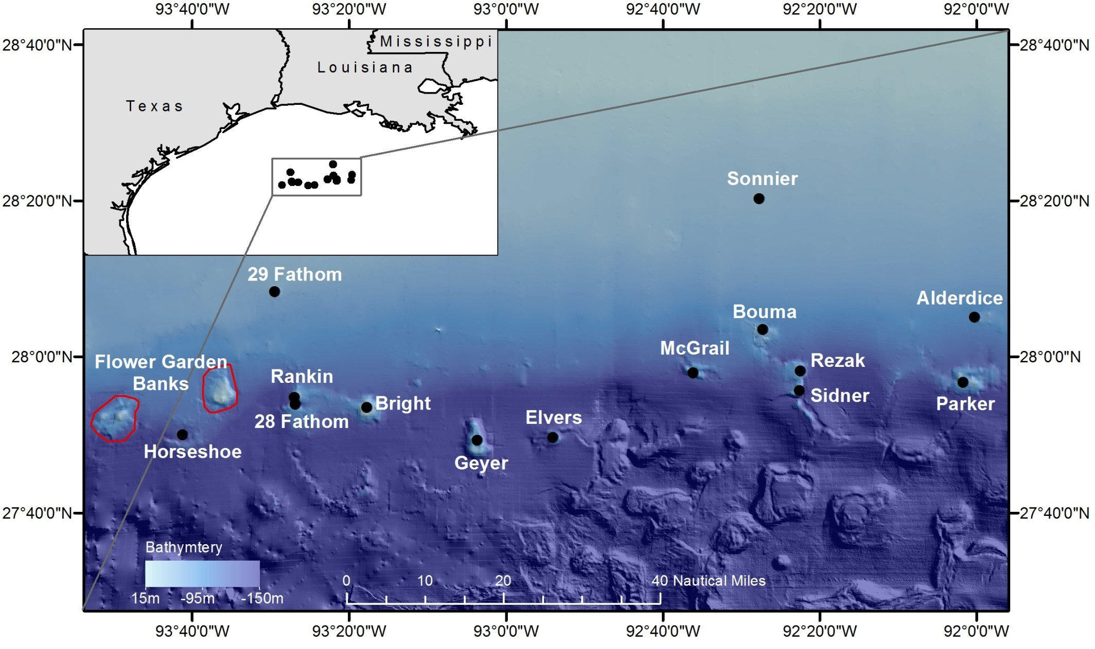

Slide 15
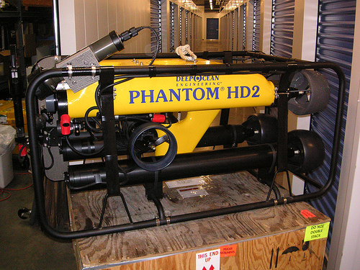
http://farm1.static.flickr.com/151/421351546_01b924e454.jpg?v=0

Slide 16
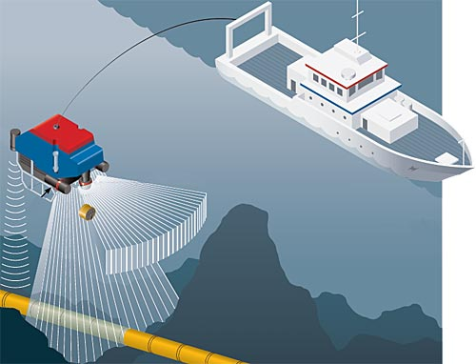
ROV Sensors
Rear Video
Depth
Sensor
Bottom,
Unit, &
Surface
Forward Video
Downward Vertical Still Camera
http://www.km.kongsberg.com/ks/web/nokbg0240.nsf/AllWeb/
4BE0E20ABCD745DFC125790600453AF6?OpenDocument

Slide 17
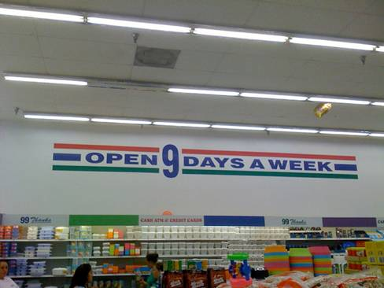

Slide 18
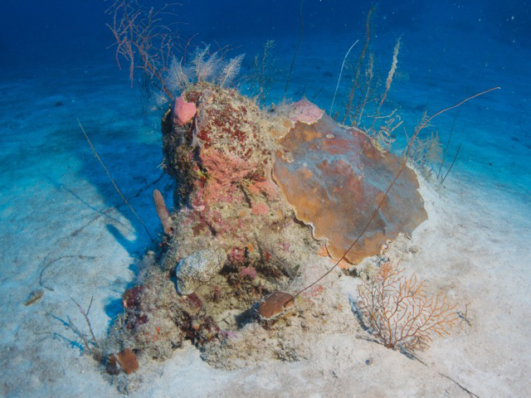
Low Relief Feature (~0.5 m)

Slide 19
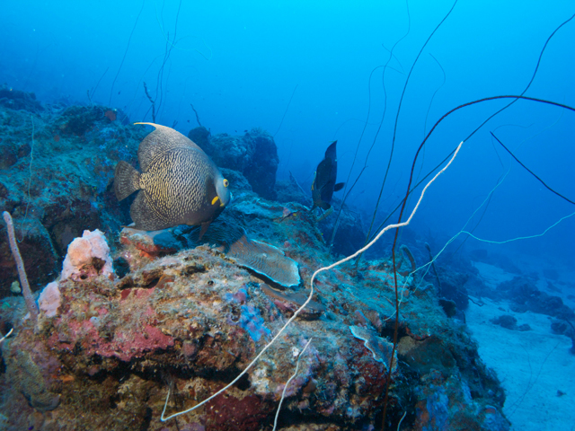
Medium Height Feature (~1-2m)
Pim Bontaerts, http://www.coralscience.org/main/articles/climate-a-ecology-16/mesophotic-reefs

Slide 20
High Relief Features
(~5-6m)
http://blogs.elpais.com/.a/6a00d8341bfb1653ef017d3e898b4f970c-pi

Slide 21
Measures of Relief
. Statistic of Location - Mean Height
. Statistic of Dispersion - Standard Deviation
Biological Species Diversity Measure
Number of Species

Slide 22
All Banks
Level of Resolution: Transects within Dropsites

Slide 23
Sidner Bank
Mean Height of Features

Slide 24
Sidner Bank
Standard Deviation of Heights of Features

Slide 25
Bright Bank
Mean Height of Features

Slide 26
Bright Bank
Standard Deviation of Heights of Features

Slide 27
29 Fathom Bank
Mean Height of Features

Slide 28
29 Fathom Bank
Standard Deviation of Heights of Features

Slide 29
Relief: Significant Differences between
Drop-sites On Each Bank Sampled
 | Relief Index
 |  | Standard
Bank | Mean | Deviation
Sidner | * | n.s.
Rankin | *** | ***
Parker | *** | ***
McGrail | n.s. | n.s.
Elvers | n.s. | *
Geyer | *** | **
Horseshoe | *** | ***
Bright | *** | ***
28-Fathom | n.s. | **
Bouma | * | **
Rezak | *** | **
Alderdice | n.s. | *
Sonnier | n.s. | n.s.
29-Fathom | n.s. | *

Slide 30
Offshore Banks by Latitude
Level of Resolution: Dropsites

Slide 31
Offshore Banks by Longitude
Level of Resolution: Dropsites

Slide 32
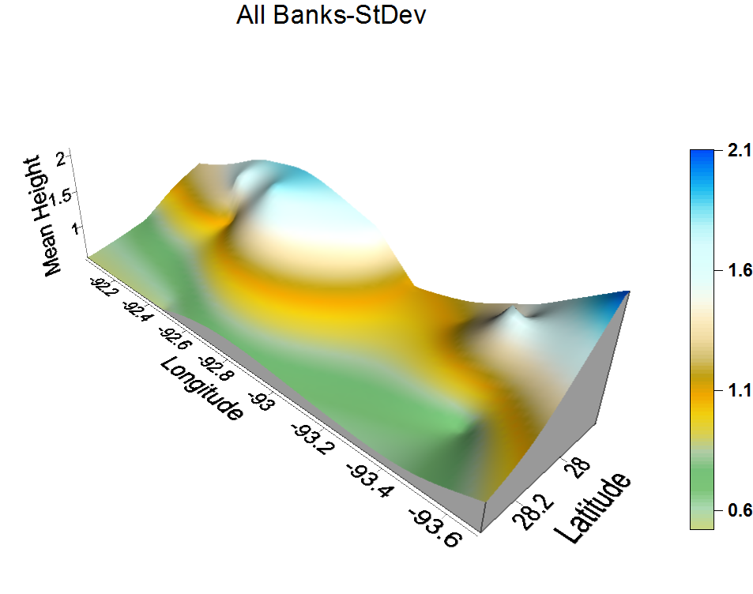
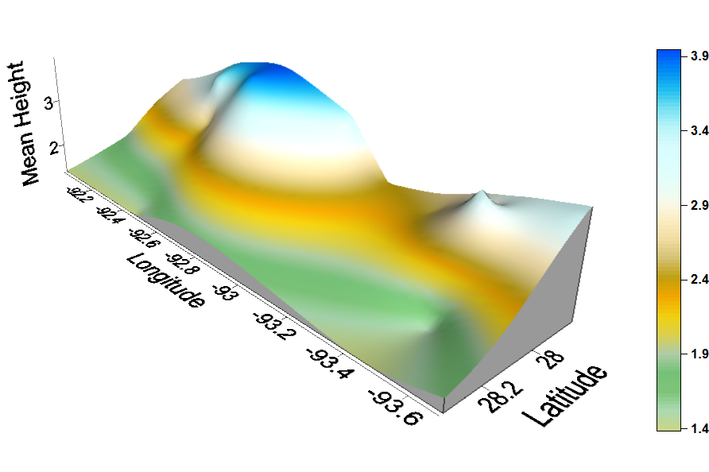
Rugosity of All Banks Surveyed
Using Mean of Feature Heights
Using Standard Deviation of
Heights of Features
Vermillion Bay, LA
Grand Chenier, LA
Calcasieu River, LA
Lake Sabine, TX

Slide 33
Processes Potentially Driving Differences in Relief
between Banks, and Influencing Geographic Patterns
. Faulting
. Dissolution of salt in a diapir and
subsequent collapse of a portion of
the bank
. Erosion
. Sediment accumulation
. Calcium carbonate accretion
. Precipitation of authigenic carbonates at
hydrocarbon seeps.

Slide 34
Relief of Banks -
Correlations with
Marine Sessile Epibenthic Species Diversity

Slide 35
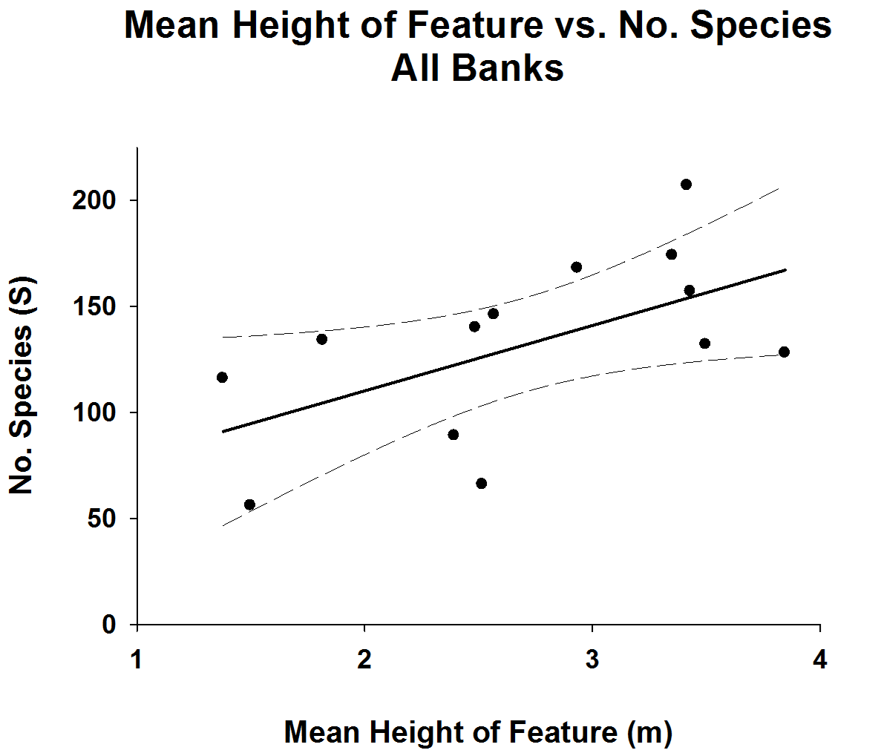

Slide 36
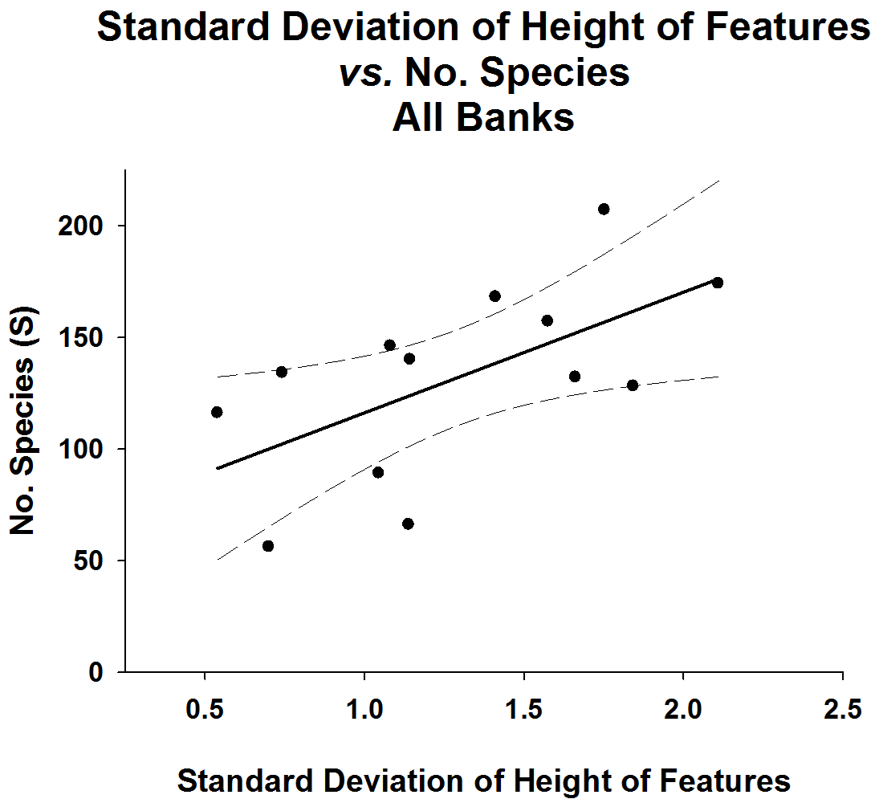

Slide 39
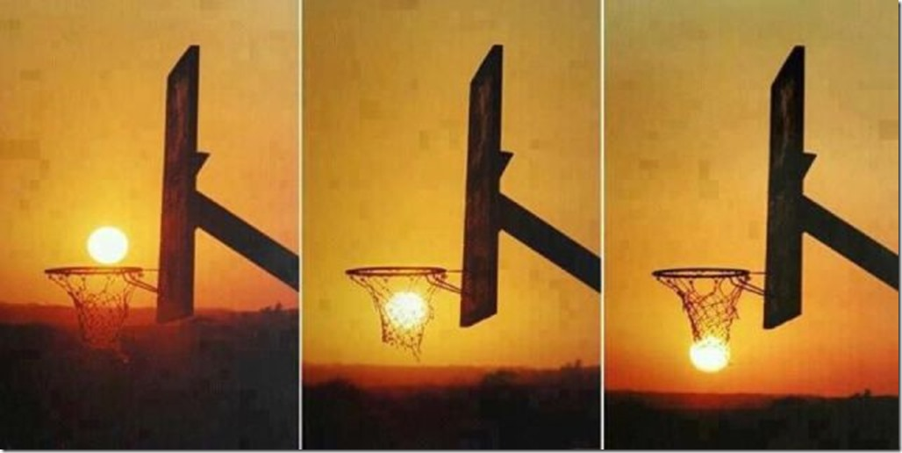

Slide 40
Summary
. 14 Banks surveyed via ROV – varying levels of spatial resolution
. Species diversity of benthos analyzed
. Relief on banks associated with mesophotic banks analyzed
. Wide variability in relief between banks, dropsites, and transects
. Low relief banks more predictable than intermediate or high relief ones
. Geographic patterns in relief latitudinally and longitudinally
. Possibly due to a number of geological and geochemical processes
. Species diversity of banks predictable via relief, but still high variability

Slide 41
Acknowledgements
Topside and
Laboratory Assistance
LSU-DOCS
Comments on ms.
R/V Manta (NOAA-FGBNMS)
V. Cardona
R. Elkert
J. Embesi
M. Evans
M. Genazzio
K. Huchton
C. Isom
A. Kuba
M. McCoin
C. Moore
B. Mayberry
S. Morgan
M. Nannen
M. Scott
A. Sterne
T. Sterne
M. Stout
O. Tobacia
M. Weekly
J. O’Hern
M. Perry
M. Pitre
A.J. Rutter
M. Shetler
T. Thompson
D. Walker
H.H. Roberts

Slide 42
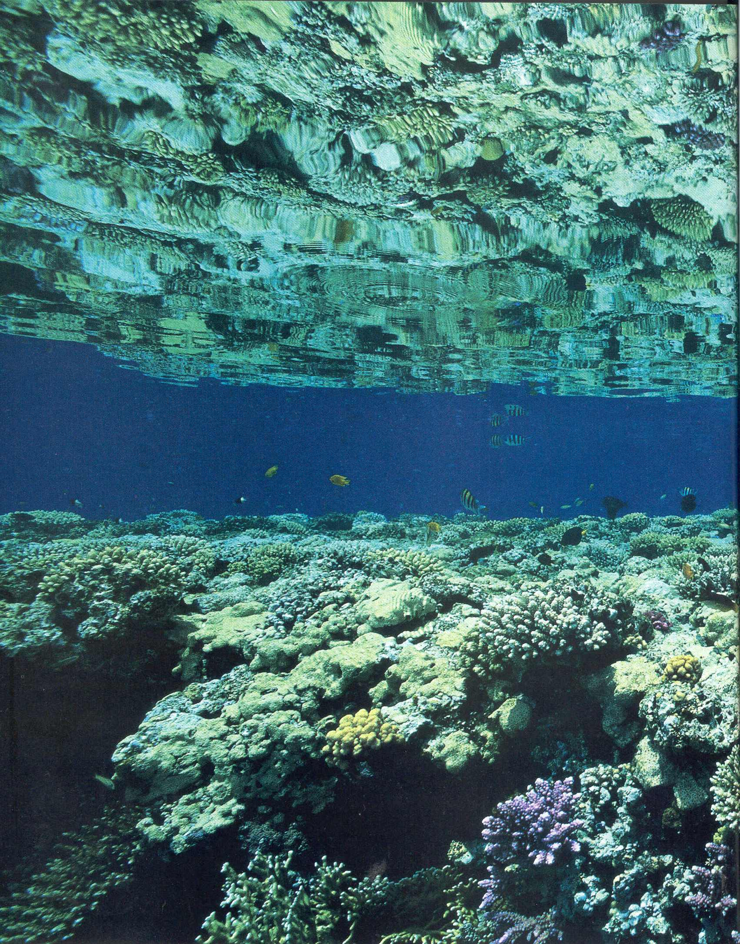
Thank you

Slide 44
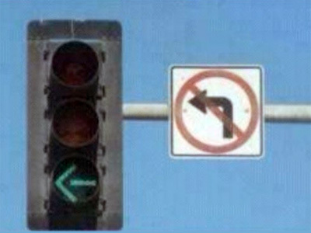

Slide 45
r = 0.577
p < 0.05

Slide 49
Mean Height of Feature
Vs.

Slide 50
Standard Deviation of Heights of Features
Vs.

Slide 51
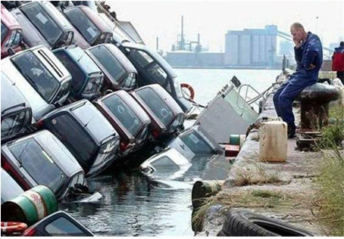

Slide 52
Rugosity Measures not Recommended:
. Variance
. Coefficient of Variation
. Chain Transect Technique

Slide 53
28 Fathom Bank
Mean Height of Features
Standard Deviation of Heights of Features
Horseshoe Bank
Level of Resolution: Dropsites

Slide 54
Sonnier Bank
Mean Height of Features
Standard Deviation of Heights of Features
Alderdice Bank
Level of Resolution: Dropsites

Slide 55
Rezak Bank
Mean Height of Features
Standard Deviation of Heights of Features
Bouma Bank
Level of Resolution: Dropsites

Slide 56
Geyer Bank
Mean Height of Features
Standard Deviation of Heights of Features
Elvers Bank
Level of Resolution: Dropsites

Slide 57
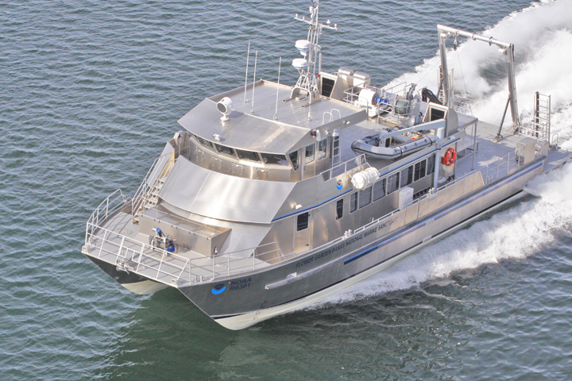
R/V Manta
https://www.google.com/search?site=&tbm=isch&source=hp&biw=1024&bih=743&q=R%2FV+Manta&oq=R%2FV+Manta&gs_l=img.12..0i24.2178.6104.0.8203.11.9.1.1.1.0.122.819.8j1.9.0....0...1ac.1.64.img..0.11.821.SY7Mj-4t9nE#imgrc=nCJ4TIykAFlpkM%253A%3BFPPTAIOtPDV5aM%3Bhttp%253A%252F%252Fwww.allamericanmarine.com%252Fwp-content%252Fuploads%252F2011%252F05%252FP114MANTApq_x.jpg%3Bhttp%253A%252F%252Fwww.allamericanmarine.com%252Fproject%252F83-aluminum-research-vessel-catamaran-manta%252F%3B720%3B480

Slide 58
McGrail Bank
Mean Height of Features
Standard Deviation of Heights of Features
Parker Bank
Level of Resolution: Dropsites

Slide 59
Rankin Bank
Mean Height of Features
Standard Deviation of Heights of Features
Level of Resolution: Dropsites

Slide 60
Coefficient of Variation (CV) of Heights of Features
Vs.

Slide 61
Variance of Height of Features
Vs.

Slide 62
Chain Transect Index
Vs.

Slide 63
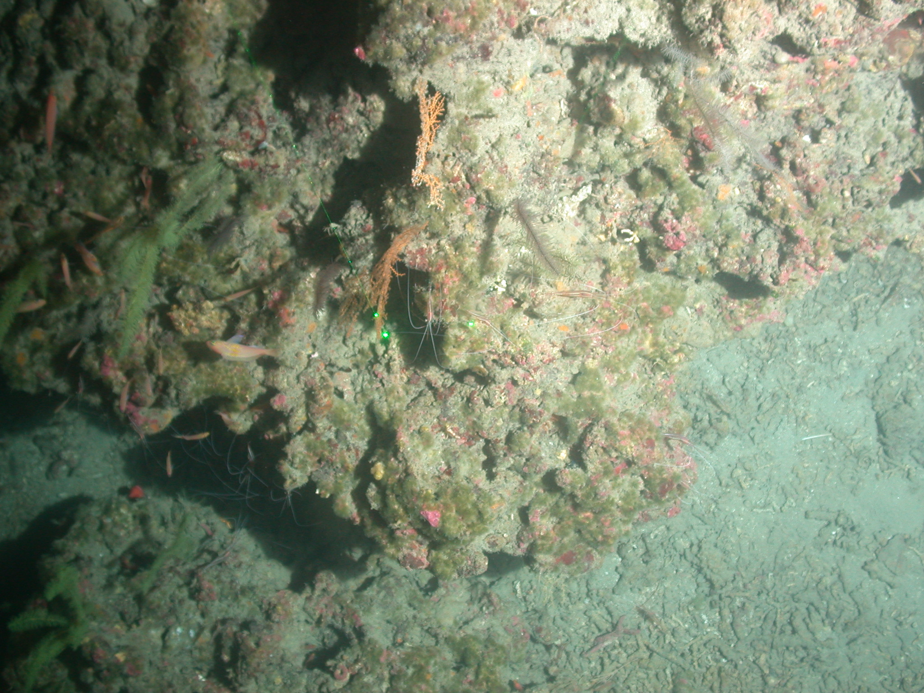
High Relief

Slide 64
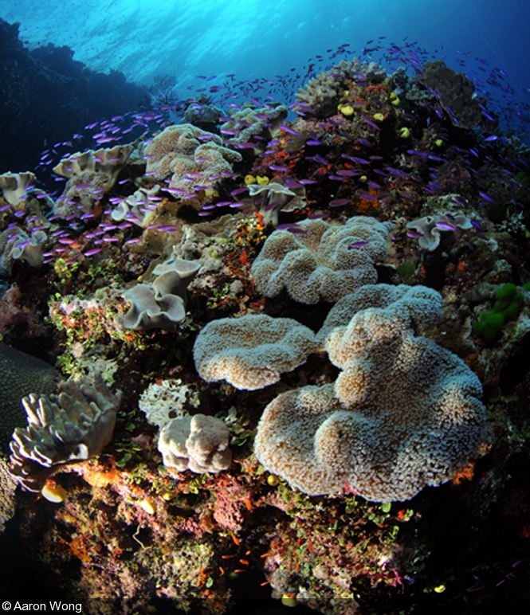
High Relief
Aaron, Wong, http://www.divephotoguide.com/underwater-photography-special-features/article/sailing-sirens-underwater-photography-fiji/

