Slide 1
Use of an innovative Technology Enabled Care service (TECS) “FLORENCE” in diabetes
Dr Parijat De
Consultant Physician in Diabetes & Endocrinology
Sandwell & West Birmingham NHS Trust
Birmingham, UK

Slide 2
FLORENCE telehealth
Florence (Flo) is a mobile phone texting system for health care.
Flo texts advice and collects patient information. This information can be accessed by clinicians from a device connected to the internet, e.g. a computer in their surgery, a tablet smartphone.
It’s cheap for the NHS and works for patients with even a basic mobile phone.
Flo uses a free text service for all patients in the UK. It doesn’t cost patient anything to use, as texts are paid for by NHS organisations.

Slide 4
FLORENCE telehealth
Innovative and practical tool to help patients help themselves by:
Improving adherence to treatment plans through encouragement, reminders and regular contact;
Regularly collecting self-reported data and providing instant feedback;
Enabling improvements in clinical team productivity and outcome quality;
Engaging patients in their own health and social care plans.

Slide 5
Introduction
Digital delivery via Simple Telehealth/Flo (STH/Flo) mobile phone service was developed by Stoke-on-Trent Clinical Commissioning Group (Stoke-on-Trent CCG) and has been evaluated as part of the Health Foundation SHINE project.
Further to the conclusion of the Health Foundation SHINE project and subsequent British Medical Journal (BMJ) open access publications, Stoke-on-Trent CCG has been encouraged to disseminate learning of the STH/Flo model to frontline practitioners to empower patients to use telehealth as an enabling tool to take more responsibility for their health and well-being.

Slide 6
Flo Protocols
The clinical protocols on offer include:
Blood pressure reminders – once weekly, once monthly, CKD & diabetes, high initial BP result
Weight management
Medication reminder adults & teenagers
Managing mood & anxiety
Blood glucose testing
rescue medication initiation for COPD
Teams can also devise their own protocols

Slide 7
Simple but effective!
Patients don’t have to rush from work, or find a parking space, so their blood pressure (BP) isn’t unduly raised – saves time yet patient is monitored!
Clinician/PN can look at the readings sent in by a relaxed patient from home or wherever they are, rather than the erratic readings that can result from attending surgery, (it takes no longer than a minute or two to do this).
And when you give advice to hypertensive patients to lose weight, stop smoking, cut down on salt, do more exercise…… they don’t always listen. Flo is a great opportunity to send these advice messages a couple of times a week, and patients may be more able to understand the drip-feed of such lifestyle.

Slide 8
Perceived benefits of Florence
Better self-management of conditions by patients
Better compliance with medication and care regimes
Improved concordance in managing conditions
Improved adjustments of medication
Higher satisfaction of patients with health service
Where additional resource for the project is provided (?respiratory):
Reduced numbers of hospitalisations
Shorter lengths of stay
Fewer A&E visits
Reduced numbers of clinician home visits
Integrated or collaborative care working

Slide 9
Florence Telehealth
Collect patient readings
Florence reminds patients to take their own readings.
They use their own mobile phone from the comfort of their own home.
View Readings on Charts
Clinicians manage patients from the simple web interface.
Florence presents all of the readings on easy-to-read charts.

Slide 10
Florence Telehealth
Get Important Alerts
Clinicians can set Florence to alert them with an email or text when patient readings don't look right or show worrying trends.

Slide 11
Florence telehealth
Patient's own Mobile Phone
No need to install App
Basic text messaging function
User friendly
Accessible
Not complicated
Flexibility and Customisation
Adaptable
Individualised
Tailored to individuals or group needs

Slide 12
Examples of Flo usage
Blood glucose check reminders
Insulin reminders
Medication reminders
Blood pressure confirmation
Blood pressure control
Lifestyle issues
Basal glucose testing reminders

Slide 13
Blood glucose protocols

Slide 14
Blood Glucose Monitoring

Slide 15
Messages & reminders

Slide 16
Medication reminder

Slide 17
Patient satisfaction measures

Slide 18
Florence Telehealth
Florence Gives Patients Their Freedom Back
Patients aren't tied to a machine at home or visits to surgery or hospital. They take readings at their convenience whether at home with family, or on holiday.
Florence Gets Patients More Involved
Regular, personalised health tips and medication reminders are sent to patients based on their readings. They become more involved and take more responsibility for their own healthcare.
Florence Gives Patients Confidence
Frequent, short messages are unobtrusive and help the patient feel more cared for, more involved, and more in control of their own healthcare.

Slide 19
What we’ve learnt so far?
Most people happy using the service
Not time consuming to explain and enrol patients
Useful information gained
Ensure patients aware of how to stop texts
Allocate time for viewing FLO data, perhaps on a weekly basis
Ensure end date agreed with patient

Slide 20
Evidence of benefits:
COPD, asthma: community nurse teams: 20% fewer home visits, patients feel more supported between visits/ consultations.
COPD: patients have more understanding of their condition; when to take rescue medication or contact their nurse as their condition requires possible change in treatment; 20% admissions to hospital avoided.
Hypertension: pre-operative patients found to be hypertensive use Flo to send in twice daily BP readings for a week – at least 6 cancelled operations avoided by acute hospital in 6 month period.
Other projects being designed to:
Enable people to remain safely in their own homes
Improve quality of life

Slide 21
FLORENCE - All protocols used by SWBHT Diabetes Team
Row Labels
Sandwell and West Birmingham Acute
Sandwell & West Birmingham Diabetes Team
E012 Motivational wt mgt messages
Gen Stop Smoking Protocol (12 weeks)
WMAHSN-07 Hypertension poor control or newly diagnosed v2
WMAHSN-08b Hypertension x1 weekly
WMAHSN-08b. Hypertension stable, weekly check
WMAHSN-09 Hypertension poor control, CKD or diabetes v2
WMAHSN-10 Medication reminder for adults and teenagers v2
WMAHSN-32 Nottingham BG monitor x5 daily
WMAHSN-52c Insulin reminder for adolescents,T1DM & Pump use
WMAHSN-53 Blood Glucose reminder for adolescents
WMAHSN-54a Blood Glucose reminder adolescents/T1DM/Pump use
WMAHSN-54c Blood Glucose reminder adolescents/T1DM/Pump use
Grand Total

Slide 22
FLO activity 2014 - SWBHT

Slide 24
Some FLO virtual consultation examples

Slide 25
T2DM & diabetic nephropathy – high BP in clinic/surgery ?real ?white coat effect

Slide 26
High BP confirmed through FLO at home!
29/10/2015 13:40:07 | 152 | 65 | Advice | This reading is too high
27/10/2015 09:30:16 | 165 | 66 | Advice | This reading is too high
26/10/2015 12:12:37 | 161 | 65 | Advice | This reading is too high
25/10/2015 09:25:14 | 145 | 64 | Advice | This reading is too high
23/10/2015 15:45:28 | 160 | 77 | Advice | This reading is too high
22/10/2015 15:08:55 | 162 | 70 | Advice | This reading is too high
21/10/2015 10:13:35 | 157 | 77 | Advice | This reading is too high
20/10/2015 12:34:14 | 160 | 72 | Advice | This reading is too high
17/10/2015 11:45:33 | 160 | 71 | Advice | This reading is too high
16/10/2015 11:41:01 | 160 | 80 | Advice | This reading is too high
15/10/2015 11:09:45 | 160 | 72 | Advice | This reading is too high
13/10/2015 17:13:30 | 160 | 75 | Advice | This reading is too high
12/10/2015 08:42:13 | 160 | 80 | Advice | This reading is too high
10/10/2015 10:20:31 | 154 | 75 | Advice | This reading is too high
09/10/2015 10:25:38 | 155 | 60 | Advice | This reading is too high
08/10/2015 15:38:56 | 174 | 68 | Advice | This reading is too high
07/10/2015 15:31:03 | 172 | 75 | Advice | Second reading is too high

Slide 27
Anti-hypertensive dose adjustments made via FLO texting without clinic appointment

Slide 28
T1DM, renal transplant patient – high BP in clinic ? white-coat effect

Slide 29
FLO home BP readings generally good!
Date | Reading1 | Reading2 | Level | Alert
24/10/2015 12:25:03 | 116 | 86 | Advice | Second reading is too high
17/10/2015 07:35:09 | 114 | 84
10/10/2015 11:19:34 | 121 | 84
02/10/2015 10:40:10 | 122 | 86 | Advice | Second reading is too high
26/09/2015 15:10:07 | 117 | 84
18/09/2015 08:15:26 | 131 | 90 | Advice | Second reading is too high
12/09/2015 22:34:19 | 114 | 81

Slide 30
FLO text advice given & discharged!

Slide 31
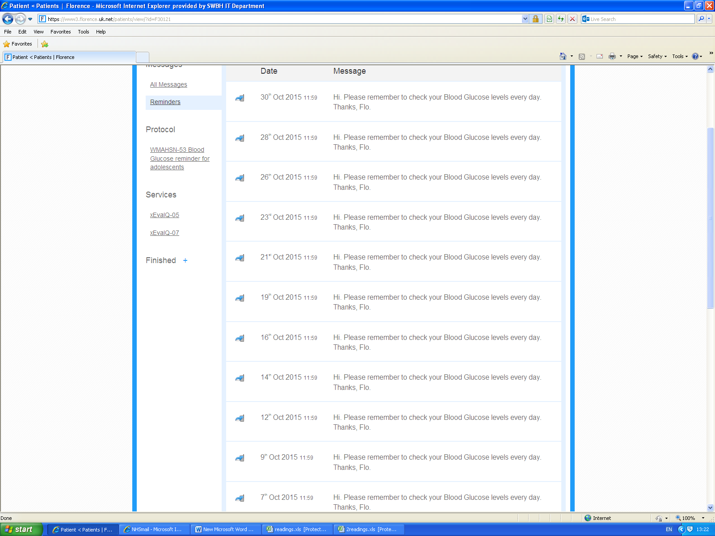
Once daily blood glucose reminder through FLO

Slide 32
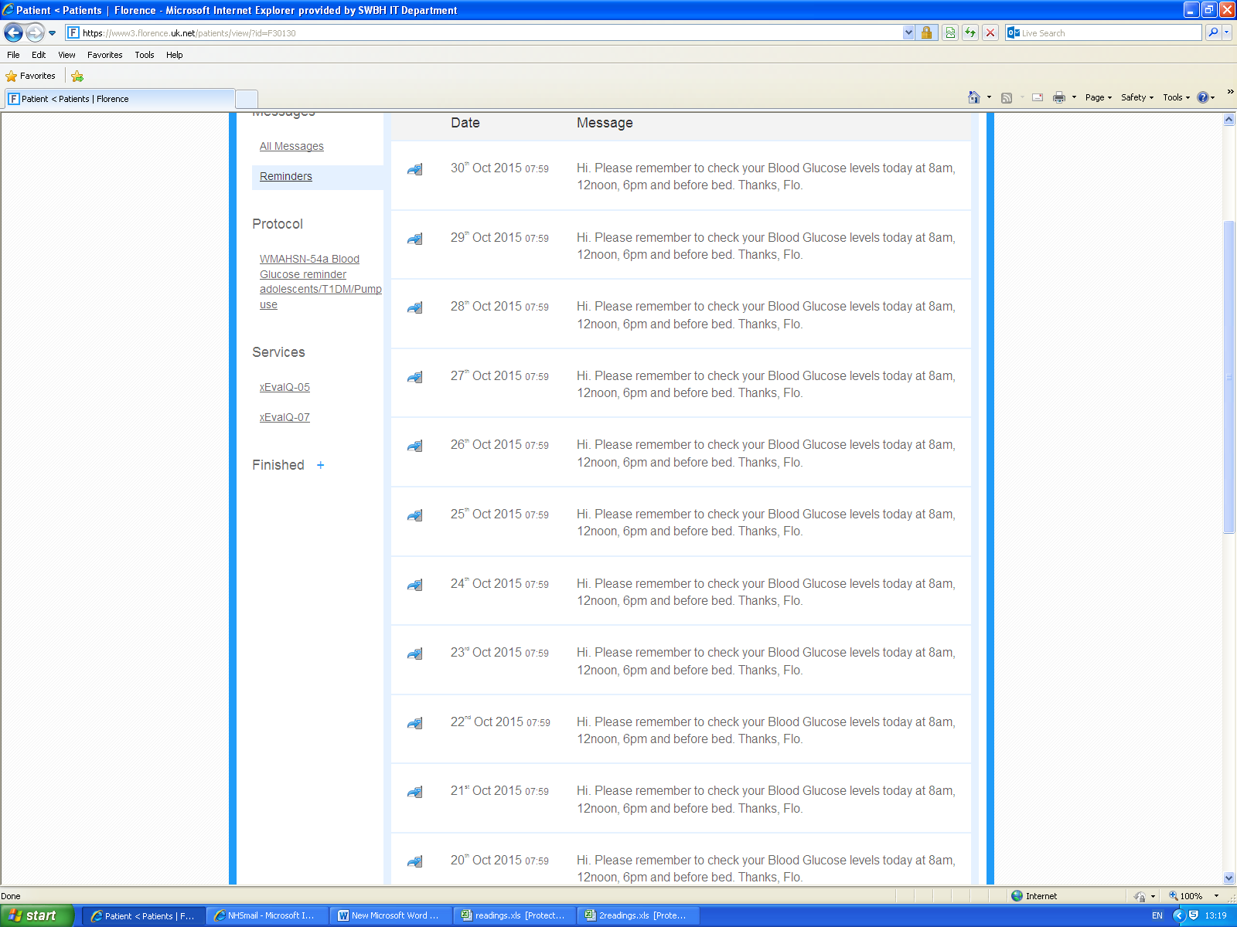
QDS blood glucose reminders via FLO

Slide 33
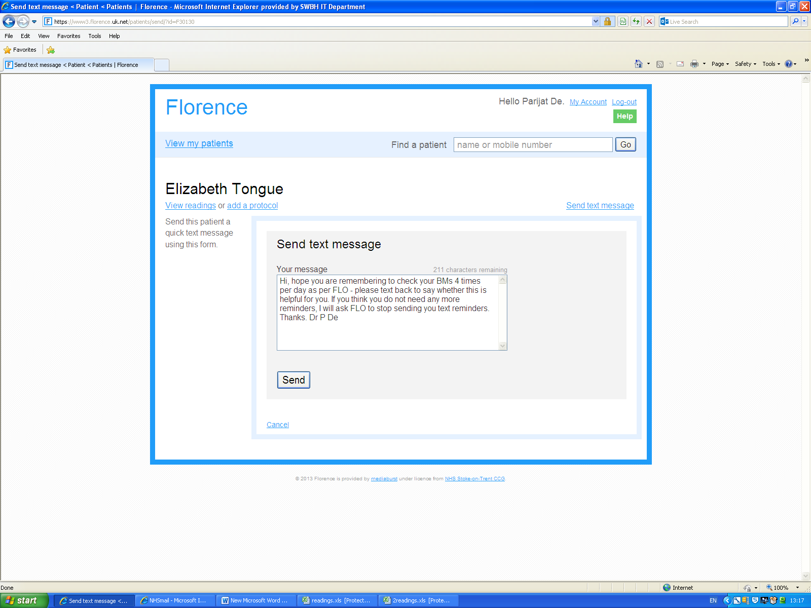

Slide 34
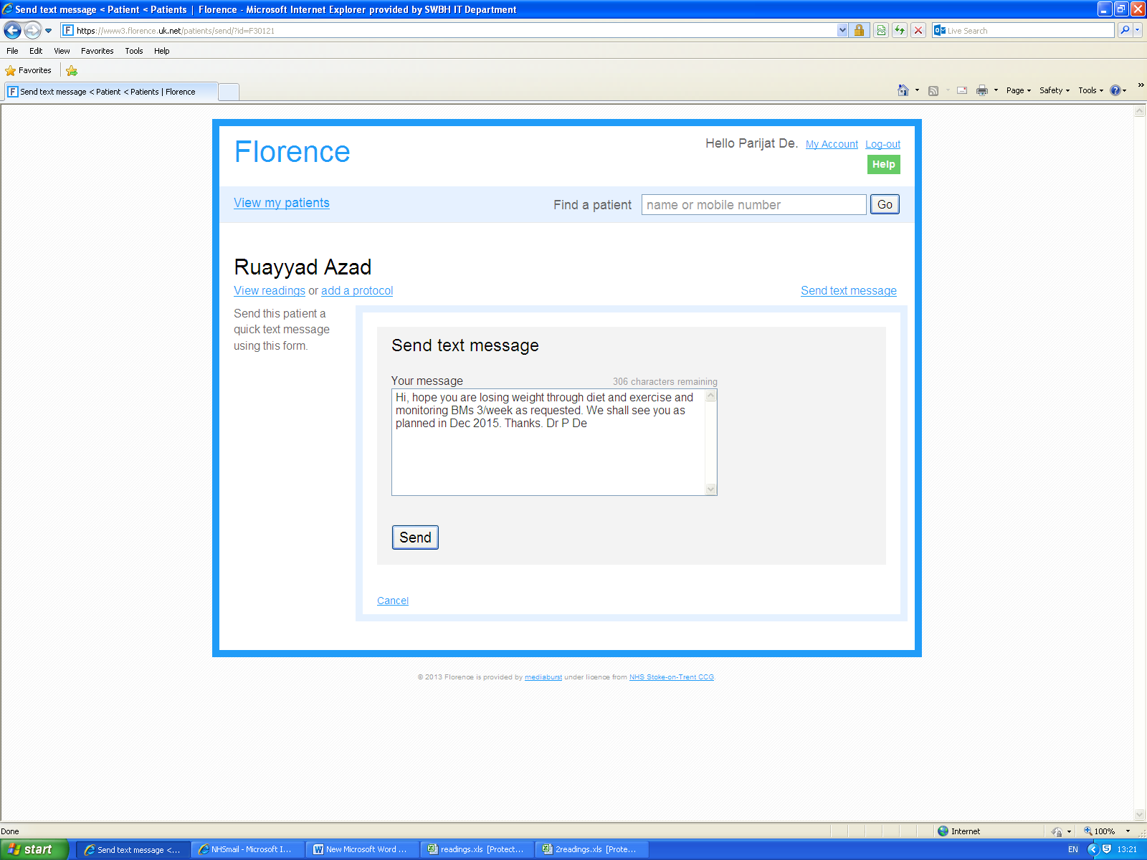

Slide 35
 | Yes | No | Unsure
SURVEY RESULTS | 120 | 9 | 5

Slide 36
SURVEY RESULTS | Yes | No | Unsure
 | 124 | 1 | 0

Slide 37
2014 FLO data
2014 | New Patients | Active Patients
Jan | 0 | 0
Feb | 0 | 0
Mar | 0 | 0
Apr | 0 | 0
May | 0 | 0
Jun | 0 | 0
Jul | 0 | 0
Aug | 0 | 0
Sep | 0 | 0
Oct | 2 | 4
Nov | 2 | 11
Dec | 1 | 10

Slide 38
2014 Flo data

Slide 39
2015 FLO data
2015 | New Patients | Active Patients
Jan | 8 | 20
Feb | 3 | 21
Mar | 7 | 29
Apr | 5 | 34
May | 3 | 33
Jun | 2 | 30
Jul | 3 | 28
Aug | 11 | 40
Sep | 12 | 47
Oct | 0 | 43
Nov | 6 | 38
Dec | 9 | 42

Slide 40
2015 FLO data

Slide 41
2016 Flo data
2016 | New Patients | Active Patients
Jan | 3 | 45
Feb | 5 | 50
Mar | 3 | 46
Apr | 3 | 42
May | 7 | 39
Jun | 3 | 33
Jul | 2 | 29
Aug | 5 | 26
Sep
Oct
Nov
Dec

Slide 42
2016 FLO data

Slide 43
Quotes from 3 patients:
“Flo messages for Blood Pressure were very motivational and helped me increase my activity levels and improve my diet”
“Using Flo on my tablet is so easy & convenient, I am partially sighted and can enlarge the text. I use Flo for BP and periodic BG testing which I have found very helpful recently changing from basal insulin”
“I have used Flo which has allowed me to send in both BP & BG readings without having to attend so many clinics – I have difficulty taking time off work and have found this service extremely useful.”

Slide 44
2 examples Recognizing Excellent Practice involving FLORENCE at SWBHT:
In the last few months we have also published a new patient case study from one of our colleagues on FLORENCE website, which I’m sure will further increase engagement in SWBH - link to the story can be found at http://www.simple.uk.net/home/casestudies/casestudiescontent/florencehelpsdomesticviolenceandabusedisclosure
In October 2015, we won the best initiative for prevention and early detection of diabetes and complications Quality in Care (QiC) national award, where FLORENCE played a big part in the nurse led diabetes renal clinic BP assessments (see screen shot next slide)

Slide 46
“Florence feels more like a friend you can trust than a computer system” was the quote patient used in the case study.

Slide 47
Current usage, impact and uptake by other specialities in SWBH:
Although the diabetes team has been using FLORENCE since 2014, there has recently been an increase in our local clinical engagement with Flo and as a result uptake in SWBH is continuing to grow, with new user accounts already set up and protocols in various stages of development to support pathways for the following new teams - Pharmacy, Respiratory, Paediatrics, Diabetes, Haematology and Occupational Therapy.
With the increase in clinical engagement and the addition of five new teams in April 2016, we expect that your patient numbers will likely increase significantly in the coming months.
Several teams have now requested training sessions which have been scheduled for in the coming weeks. Thus there is significant interest from other specialities to replicate our work and use this technology in managing various aspects of other long term conditions.

Slide 48
Quantitative outcome measures – cost savings:
Of the 100 patients enrolled so far (since April 2014) for BP management, we have adjusted BP medications (added new agent or increased dose of existing agent) in 27/100 (27%) who continue to have follow up with FLO.
We have also discharged 46/100 (46%) patients with good BP control either having just monitored their BP or following adjustment of their medications.
In total this has prevented 45 (for those we continue to follow up) and 62 ( for those that we have discharged) respectively totalling 107 out patient attendances or face to face consults thus saving us £11,663 (national average £109 per OP attendance) simply from BP management for our patients with difficult diabetes renal disease.
This is against a total cost of £2,329 assuming 75% of the 107 patients (not all have used the full protocol – some only have weekly text reminders thus needing fewer text messages) have used the WMAHSN Hypertension CKD/diabetes protocol for the full 12 weeks (equates to 364 texts/patient, cost per patient being £29.12 for the service which equates to 8p per text).
We have thus managed to save £9,334 using FLORENCE simple Telehealth service and at the same time have provided a very cost- effective and efficient service.

Slide 49
Measures of success and evidence:
Significant ease of enrolment into FLO from OP clinics directly by Consultant and nurse alike (evidenced by month on month increase in FLO enrolment).
Increase in understanding of disease process, self-confidence and compliance with medications (evidence from patient survey and BP improvements).
Improvements in BP – as a result of increase in scope of BP medication dose adjustment and addition of new BP agents as a result of remote FLO monitoring (as per evidence in 27% patients who continue to have follow up with FLO).
Readily able to diagnose “white coat hypertension” and reassure patients and GP and thereby discharge patients back without unnecessary follow up and exposure to BP medications (as seen in 46% of our patients).
Significant patient satisfaction with the FLO service (from survey and patient comments).
Reduced clinic and hospital visits saving patient’s crucial time and freeing health professionals to devote to other activities (evidence as below).
Cost savings from a lean, virtual service (nearly £10K as per outcome measures below) which is simple and costs very little (8p per text).
Apart from the above success measures and evidence, what we don’t have, and we hope to provide data in due course, is the significant impact BP improvements will have on future renal outcomes (decrease in proteinuria and progression towards ESRD) and cardiovascular morbidity & mortality.

Slide 50
Impact on patients:
Significantly engaged patients with improved medication compliance and patient satisfaction as a result of better understanding of BP control and its impact on their own health.
Improved health outcomes from lifestyle advice sent as inter active text messages on a regular basis through FLO.
Reduction in BP will hopefully translate into better long term cardio-renal outcomes - less progression to renal replacement therapy, improved CV benefits and hopefully longer survival.
Convenient service - care closer to home and not needing to go to hospital or see a doctor/nurse – less hospital DNAs.
Close rapport with doctor/nurse as a result of frequent text exchanges.

Slide 51
Impact on my Trust/Organisation:
Significant reputation for our Trust - development of a niche and a novel specialist service leading to better patient outcomes.
Effective utilisation of Consultant/Specialist Nurse time with improved New: Follow up ratio as a result of less need for OP attendances, freeing up time to see more new and complex referrals.
Cost effective service for the Trust – less routine OP appointments, reduction in DNAs, increase in number of patients managed.

Slide 52
Further Potential Pathways to Support Patients

Slide 53
Conclusion
Thus, this simple Teleheath text messaging technology can be easily replicated in any NHS Trust or CCG, as has been shown within our own Trust.
All that is required is basic funding, motivated & interested staff, willing patients who can use a mobile to text messages and most importantly, organisations ready to innovate and experiment with newer & smarter ways of working.
Given the momentum now gaining pace at SWBHT and the wider possibilities where Flo can support SWBH in the achievement of its objectives, we plan to involve the acute sector as well, recognizing the need to support patients outside of traditional face to face care typically to improve self-management resulting in achievement of faster clinical outcomes or to improve team productivity and release non-urgent capacity.

Slide 54
Questions?

