Slide 1
Influence of Environmental Conditions on the Performance of Cluster Bean Genotypes
P. Satyavathi*, Vanaja M., Gopala Krishna Reddy A., Vijay Kumar G., Manohar G.
Matrusri Engineering College, Saidabad, Hyderabad- 500059
E-mail: ganisetti.satyavathi@gmail.com

Slide 2
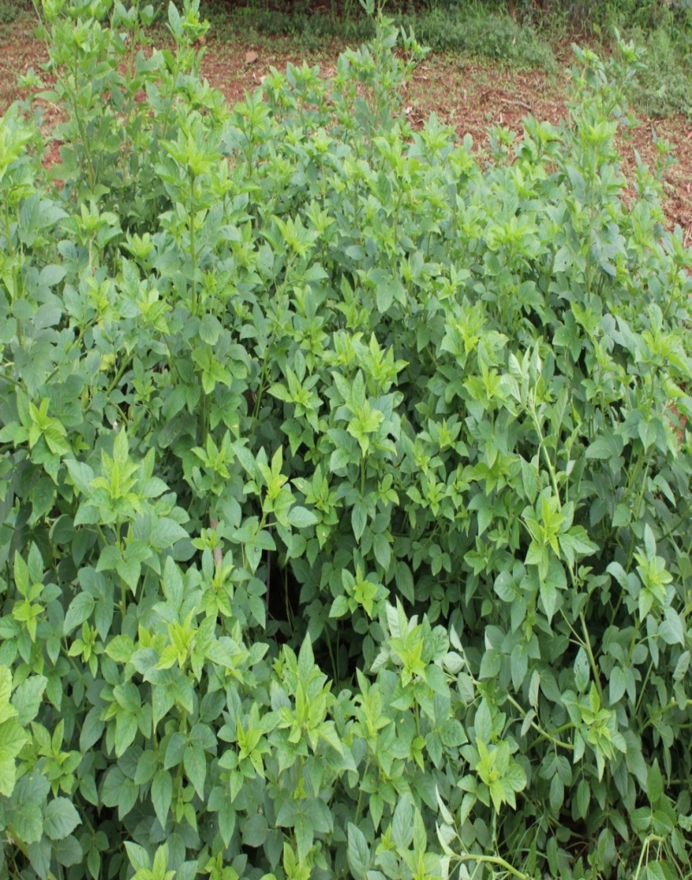
Cluster Bean (Cyamopsis tetragonoloba L. Taub)
India produces 10.0-12.5 lakh tons of guar and world leader in production of guar with 80% of world production
It is grown in arid zones of Rajasthan, some parts of Gujarat, Haryana, and Madhya Pradesh

Slide 3
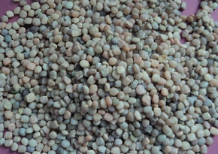
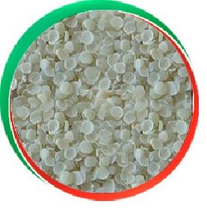
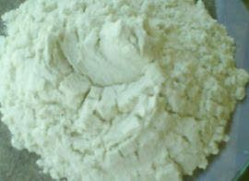
Guar gum from guar seeds
Guar gum, also called guaran, is a galactomannan
Guar gum is an extract of the guar bean
It is used in paper, textile, oil drilling, mining, explosives,
ore flotation, and other various industrial applications

Slide 4
Demand Development
The demand of this gum is high in international market as in recent past due to its application in crude oil drilling and shell gas industry, which resulted in hike in price up to Rs. 32,000/quintal of seed
The production zones are expanding to new areas where identification of suitable variety is the need of the hour

Slide 5
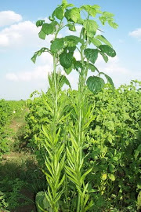
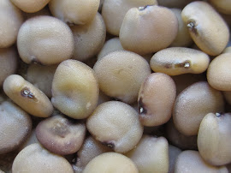
Growth conditions of Guar
Guar basically grown under arid rain fed conditions
Guar grows well under a wide range of soil conditions and has good capabilities to fix atmospheric nitrogen.
Guar tolerates high temperatures and dry conditions and is adapted to arid and semi-arid climates
Guar is susceptible to water logging. Guar is considered to be tolerant of both soil salinity and alkalinity

Slide 6
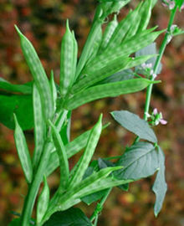
Cluster Bean (Cyamopsis tetragonoloba (L.) Taub)
The present research work aimed at addressing the issues to optimize the environmental conditions visa vis identification of suitable varieties for different locations
This will help to expand the areas of cultivation as well as improving the productivity there by enhancing the livelihood opportunities to the poor farmers

Slide 7
Five genotypes of cluster bean were obtained from Rajasthan Agricultural University (RAU)
RGC-1017
RGC-1025
RGC-936
RGC-986
HGS- 365
Growth conditions:
Two seasons- Summer and Kharif (rainy) season to have variable temperature, RH & photoperiod
Rainy (Kharif) Crop- July to October 2013
Summer Crop- March to June 2014

Slide 8
Min T Max T MIN 17.3 23.1 MAX 23.1 32.2 Average 21.32 29.37
Min T Max T MIN 14.2 25.4 MAX 28 39.5 Average 21.28 34.38

Slide 9
 | Kharif | Summer
MIN | 43 | 16
MAX | 98 | 86
Average | 63.87 | 38.40

Slide 10
No. of Rainy days=28
Total RF= 341.5 mm
No. of Rainy days=11
Total RF= 106.6 mm

Slide 11
Results
Summer Crop- March to June 2014
Rainy (Kharif) Crop- July to October 2013
Observations recorded on
Days to 50% flowering | Root biomass
Plant height | Total biomass
No. of Branches | No. of Pods
Leaf area | Pod weight
Leaf biomass | Seed number
Stem biomass | Seed Yield
Root length | 100 seed weight
Root volume | HI

Slide 12
The selected genotypes varied in their response to seasons.
Majority of the genotypes produced higher biomass during summer season as compared with kharif except HGS-365
RGC 1017 and RGC 1025 registered less reduction in total biomass during kharif
Reduction was high in RGC 986 and RGC 936 during kharif

Slide 13
Majority of the genotypes produced more pod weight during summer season as compared with kharif.
The genotype HGS 365 produced more pod weight in kharif season than in summer and RGC986 recorded lowest pod weight
In summer season the genotypes RGC936 and RGC1025 recorded highest pod weight
During Kharif there was lot of variation in pod weight

Slide 14
All the genotypes showed improved performance in seed weight in Summer season than Kharif
In summer, RGC 936 recorded highest seed weight (15.11 g/pl) followed by RGC1025 (14.78 g/pl)
In Kharif, RGC 1025 recorded highest seed weight (9.53 g/pl) followed by HGS 365 (7.3 g/pl)
Though HGS365 recorded improved total biomass and pod weight in kharif, its seed yield was reduced in kharif

Slide 15
There was non significant difference for 100 seed weight during summer season
The seeds of RGC936(3.3 g) and RGC1025 (3.4 g) were bold than all the genotypes in summer season
RGC1017 and HGS365 maintained 100 seed weight in both seasons with least reduction
RGC986 and RGC1025 showed lowest test weight than the other genotypes in Kharif

Slide 16
In summer season, the variation between genotypes was meager for Harvest Index, however it is significant in kharif
RGC1017, RGC936 and RGC1025 recorded better HI in kharif than summer season
RGC1017 recorded highest HI (22%) and RGC986 and HGS 365 (20%) recorded lower HI in summer season
RGC1025 recorded highest HI (25%) and RGC986 (13%) recorded lowest HI in Kharif

Slide 17
All the genotypes except HGS-365 recorded reduction in majority of the parameters in Kharif season
Kharif season was favoring the improvement in Total biomass, Vegetative biomass, Fodder biomass and pod wt. of HGS 365
All parameters of RGC986 reduced in kharif season
The impact of seasons was minimum on different parameters of RGC 1017 followed by RGC 1025

Slide 18
Seed weight and Test weight reduced in kharif season in all the genotypes
Total biomass, vegetative biomass, fodder biomass of HGS365 improved from 65 to 167% during Kharif than Summer season.
The reduction in pod and seed weight was higher than biomass parameters of all the genotypes except HGS365 in kharif season
The seasonal response of HI differed in different genotypes due to differential response of seed yield and total biomass of individual genotype

Slide 19
Conclusions
Performance of all the selected five cluster bean genotypes reduced in kharif season as compared with summer season
There is variation in genotype as well as parameter response to different seasons
The reduction in yield and yield parameters was more than biomass parameters in kharif season
The genotypes RGC 1017 and RGC 1025 maintained total biomass with better seed yield during kharif
The genotype HGS365 with improved biomass and moderate seed yield during kharif may serve as dual purpose crop with better fodder biomass

Slide 20
Thank You

Slide 21
Any Queries are most welcomed!

