Slide 1
Diagnostic And Therapeutic Challenges in IgG4-Related disease in the Sphenoid Sinus
Omar Abu Suliman, MBBS, SB-ORL
Senior Registrar, otolaryngology Head & neck surgery
King Abdullah Medical City,
Makkah, Saudi Arabia

Slide 4
Introduction
IgG4-related disease (IgG4-RD) is a newly recognized fibroinflammatory condition characterized by tumefactive lesions, a dense lymphoplasmacytic infiltrate rich in IgG4-positive plasma cells, storiform fibrosis, and often but not always, elevated serum IgG4 concentrations.

Slide 5
The disease was not recognized as a systemic condition until 2003, when extrapancreatic manifestations were identified in patients with autoimmune pancreatitis.
Autoimmune pancreatitis had been linked to elevated serum IgG4 concentrations as early as 2001.

Slide 6
IgG4-RD involves multiple organs, particularly exocrine organs.
When it affects the head and neck, it commonly involves the salivary, lachrymal, and pituitary glands.

Slide 7
It’s quite rare to find such a lesion in the paranasal sinuses.
We present a case of IgG4-RD in the sphenoid sinus.

Slide 8
Case Presentation
A 38 years old female 3 months post delivery who started to have headache since 42nd day of post-delivery.
The headache was progressive and unilateral involving the whole left half of the head and resistant to analgesics.
She was seen by neurologist who diagnosed her as a case of migraine and started anti migraine treatment.

Slide 9
After getting anti migraine treatment for two weeks she experienced no benefit and headache became worse.
Computed tomography (CT) brain scan done for her that showed normal brain study, but showed opacity in left sphenoid sinus.
She approached the ENT clinic for further consultation where her examination was unremarkable and CT paranasal sinuses (PNS) was requested for her.

Slide 10
One day later patient developed blurry vision and left 6thcranial nerve(CN).
She was admitted as a case of complicated sphenoditis and intravenous antibiotics, i.e., ceftriaxone and vancomycin were started.
CT PNS Done

Slide 11
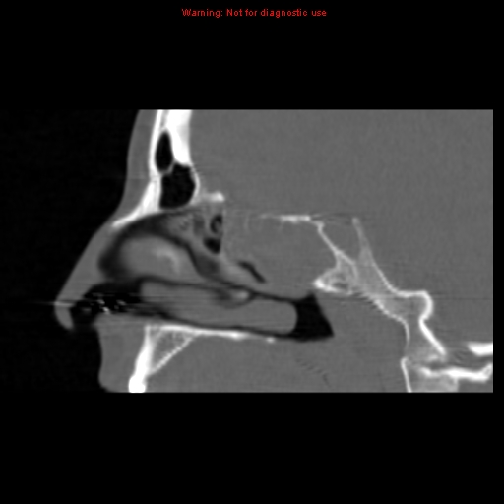

Slide 12
Magnetic resonance imaging (MRI) PNS done

Slide 14
Functional endoscopic sinus surgery (FESS) was done under general anesthesia.
Intraoperative, gritty whitish hard mass with minimal bleeding was noticed occupying the left sphenoid sinus extending to right sphenoid.
Mass was excised partially and sent for histopathology.
Histopathology report showed non specific inflammation.

Slide 15
The patient had uneventful post-operative period and was discharged.
But 1 week later she presented with difficulty in left eye movement which revealed 3rd& 4th CN palsy in addition of 6th CN.
Another biopsy was taken from deeper tissue.

Slide 16
The Slides showed in Haematoxylin and Eosin (H&E) stain a moderately dense lymphoplasmacytic infiltration accompanied with fibrosis.
Immunostaining for IgG4 show significant increase in IgG4-positive plasma cells with IgG4-IgG ratio > 40% and >100 IgG4 positive plasma cells per High Field Focus (HPF).

Slide 17
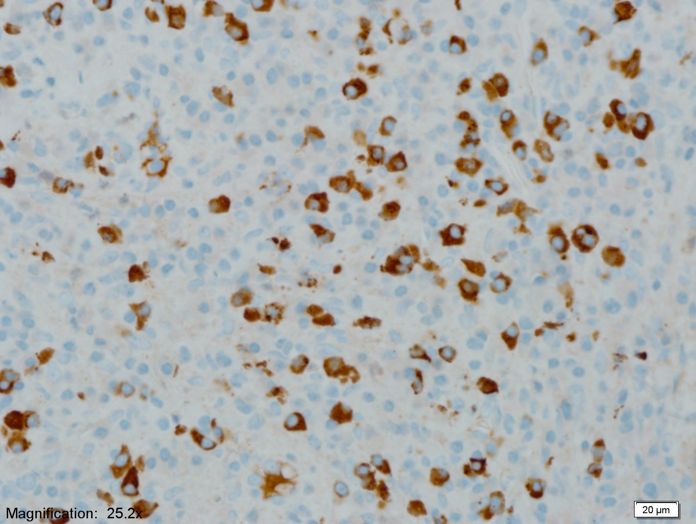

Slide 18
IgG4 serum level was elevated 0.53g/l that gave the diagnosis of IgG4-RD.
Patient was started on steroid therapy dexamethasone 4mg IV(divided t.i.d for 3 weeks) then tapered over two weeks and then stopped.
Afterwards, normal saline nasal irrigation and nasal steroid spray were started.

Slide 19
Patient markedly improved with restored eye movement and vision, with no more headache or pain and was followed regularly for 9 months with no relapse.

Slide 20
Discussion
In our case the histological diagnosis is the main stay of diagnosing the disease.
Unawareness of such disease can lead to delay diagnosis.
The diagnosis is made by histological and immunohistological findings.

Slide 21
There are varying criteria for the diagnosis of IgG4-RD; however, increased numbers of IgG4 plasma cells are required for the diagnosis and in cases with 50 IgG4cells/HPF the reported specificity and sensitivity are 100%.
The serum IgG4 titer can also be used to aid in diagnosis but is elevated in only 30% of patients with IgG4-RD and therefore not necessary for diagnosis.

Slide 22
Glucocorticoids are typically the first line of therapy.
A consensus statement from 17 referral centers in Japan suggested treating patients initially with prednisolone at a dose of 0.6 mg per kilogram of body weight per day for 2 to 4 weeks.
The authors suggested further that the prednisolone be tapered over a period of 3 to 6 months to 5.0 mg per day, and then continued at a dose between 2.5 and 5.0 mg per day for up to 3 years.

Slide 23
Another approach has been to discontinue glucocorticoids entirely within 3 months.
Glucocorticoids appear to be effective but disease flares are common.
Azathioprine, and methotrexate are used frequently as glucocorticoid-sparing agents or remission-maintenance drugs after glucocorticoid- induced remissions, but their efficacy has never been tested in clinical trials.

Slide 24
Jeremiah et al. reported the use of nasal steroid spray after sphenoidotomy with promising results.

Slide 25
In our case we used nasal steroid spray along with normal saline nasal irrigation, which was efficient with marked results.
The aim of surgery is now mainly devoted to achieve a diagnostic biopsy and an adequate airway passage to pass local steroid.

Slide 26
Conclusion
Although, IgG4-related disease of the sphenoid is extremely rare condition that rising diagnostic and therapeutic challenges.
It should be considered in the differential diagnosis of isolated sphenoid lesion with bone destruction.

Slide 27
Acknowledgment
We are thankful to Dr.Tariq Abdulfattah, Dr.Abdulrashid Bhutto from Alnoor Specialist Hospital, Makkah; Dr.Islam Herzallah, Dr.Faris AlGhamdi, Dr.Mohammad Abbas from King Abdullah Medical City, Makkah; and Dr.Jean E. Lewis from Mayo Clinic, USA, for their support in conception, acquisition of data and drafting the manuscript.

Slide 28
References
1. Stone JH, Zen Y, Deshpande V. IgG4-Related Disease.N Engl J Med. 2012;366(6):539-551.
2 Sasaki T, Takahashi K, Mineta M, Fujita T, Aburano T. Immunoglobulin G4-related sclerosing disease mimicking invasive tumor in the nasal cavity and paranasal sinuses. Am J Neuroradiol. 2012;33(2):E19-20.
3. Alt JA, Whitaker GT, Allan RW, Vaysberg M. Locally destructive skull base lesion: IgG4-related sclerosing disease. Allergy Rhinol (Providence). 2012;3(1):e41-5.
4 Ikeda R, Awataguchi T, Shoji F, Oshima T .A case of paranasal sinus lesions in IgG4-related sclerosing disease.Otolaryngol Head Neck Surg.2010;142(3):458-9.

Slide 29
