Slide 1
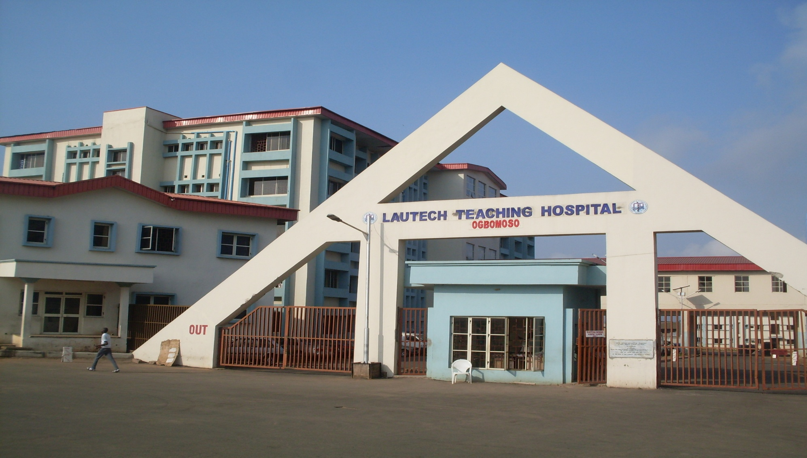
Misconceptions about HIV/AIDs and stigma associated beliefs in an urban Community, Southwest, Nigeria: Implication for intervention programs
Dr. Olugbenga-Bello A.I
Department of Community Medicine, LAUTECH Teaching Hospital, Ogbomoso

Slide 2
Background information
Nigeria is located in West Africa, with an estimated 3.7 percent of the population living with HIV (VERT, 2012)
The prevalence rate varies across the country, ranges from 0.2-15.2%
Osun state has a prevalence of 2.7% as at 2012 survey
Worldwide, Nigeria has the second highest number of new infections reported each year,
Notes:
-NAARHS, 2011 Survey.

Slide 3
Statement of problem
Stigma and discrimination against PLWHA are obstacles in the way of effective responses to the HIV epidemic
It complicates
decisions about testing,
Unwilling disclosure of HIV status,
ability to negotiate prevention behaviours, including use of family planning services, PMTCT etc
With the associated social issues-loss of marriages, livelihood etc

Slide 4
Study Objective
To identify misconceptions about HIV/AIDs and stigma associated beliefs in an urban Community, in Southwest, Nigeria
To determine respondent awareness and knowledge on HIV/AIDs.
To assess the beliefs of the respondents about HIV/AIDs

Slide 5
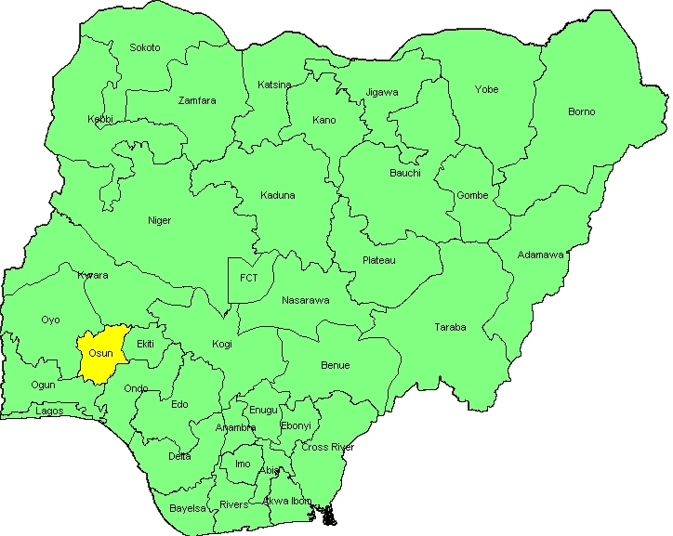
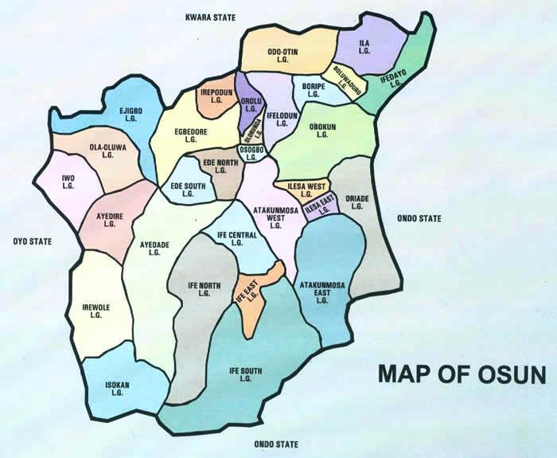
Methodology
Study Area: Osogbo metropolis in Nigeria
Study design: Cross sectional descriptive survey
Study population: Adult men and women in Osogbo Local Government Area of Osun state
Sampling technique : Multi stage sampling technique
Calculated Sample size : 501
Data collection: quantitative
Data management: Using SPSS version 17,0

Slide 6
Table 1: SOCIO-DEMOGRAPHIC CHARATERISTICS

Slide 7
TABLE 2: Awareness and knowledge of respondent of HIV/AIDS
N = 449 VARIABLES | FREQUENCY (PERCENTAGE)
 | YES | NO | NOT SURE
Ever heard of HIV/AIDS | 438(97.6%) | 10(2.2%) | 1(0.2%)
HIV/AIDS can be transmitted through; kissing | 208(46.3%) | 204(45.4%) | 37(8.3 %)
Hugging | 114(25.4%) | 295(65.7%) | 40(8.9%)
Toilet sharing | 129(28.7%) | 271(60.4%) | 49(10.9%)
Sharing of cup and spoon | 132(29.4%) | 272(60.6%) | 45(10%)
Know any symptoms of HIV/AIDS | 254(56.6%) | 151(33.6%) | 26(5.8%)
Know anyone with HIV/AIDS | 46(10.2%) | 376(83.7%) | 19(4.2%)
HIV/AIDS is curable | 102(22.7%) | 219(48.8%) | 128(28.5%)
It is a spiritual attack | 40(8.9%) | 332(73.9%) | 78(17.4%)
It is inheritable | 88(19.6%) | 291(64.8%) | 70(15.6%)

Slide 8
Table 3: Perception of the respondents about HIV/AIDS
N=449 VARIABLES | FREQUENCY(PERCENTAGE)
 | YES | NO | NOT SURE
Perception about HIV/AIDS
HIVAIDS is an act of God’s punishment | 111(24.7%) | 245(54.6%) | 68(15.1%)
Sex Education help prevent HIV/AIDS | 397(88.4%) | 32(7.1%) | 20(4.5%)
The use of condom prevent HIV/AIDS | 290(64.6%) | 80(17.8%) | 79(17.6%)
Abstinence is the best means of prevention | 310(69%) | 70(15.6%) | 69(15.4%)
Done HIV testing before | 240(53.5%) | 209(46.5%) | 0 (0%)

Slide 9
TABLE 4: Perception about PLWHA
VARIABLES (N=449) | FREQUENCY YES | (PERCENT) NO | NOT SURE
PLWHA are promiscuous | 130(29.0%) | 172(38.3%) | 147(32.7%)
can still live a normal life | 357(79.5%) | 57(12.7%) | 35(7.8%)
can live with PLWHA | 380(84.6%) | 40(8.9%) | 29(6.5%)
Suicide is the best option for PLWHA | 50(11.1%) | 370(82.4%) | 29(6.5%)
can be a friend with PLWHA | 340(75.7%) | 67(14.9%) | 42(9.4%)
can employ PLWHA | 315(70.2%) | 76 (16.9%) | 52(11.6%)
can allow PLWHA to treat you | 162(36.1%) | 215(47.9%) | 72(16.0%)
PLWHA can get married | 245(54.6%) | 140(31.2%) | 64(14.2%)
PLWHA should be secluded from the society | 74(16.5%) | 333(74.2%) | 42(9.3%)

Slide 10
TABLE 5: Effect of socio-demographic status on perception of respondents towards PLHIV
N=449 VARIABLE | FREQUENCY | PERCENTAGE | Statistics
 | WRONG PERCEPTION | RIGHT PERCEPTION | X ² | P values
Age group ( in years) Less than 20 | 13(9.5%) | 10(6.6%) | 4.657 | P=0.142
21-30 | 58 (42.4%) | 82(53.9%)
31-40 | 34(24.8%) | 39(25.7%)
41-50 | 24(17.5%) | 10(6.6%)
51-60 | 5(3.6%) | 10(6.6%)
61 and above | 3(2.2%) | 1(0.2.366%)
Gender Male | 55(40.1%) | 76(42.7%) | 6.207 | P=0.253
Female | 82(59.9%) | 102(57.3%)
Occupation Professional | 63(46.0%) | 100(56.4%) | 27.256 | P=0.142
Unskilled | 13(9.5%) | 2(1.1%)
Artisan | 11(8.0%) | 8(4.5%)
Trader | 11(8.0%) | 4(2.2%)
Farmer | 3(2.2%) | 1(0.3%)
Schooling | 33(24.1%) | 53(29.8%)
Unemployment | 3(2.2%) | 10(5.6%)
Educational Status Primary | 11(8.0%) | 5 (2.8%) | 16.987 | P=0.001
Secondary | 33 (24.1%) | 23 (12.9%)
Tertiary | 90(65.7%) | 149(84.0%)
Uneducated | 3(2.2%) | 1(0.3%)

Slide 11
Table 6: Regression of education, occupation and some selected knowledge and perception variables
 | occupation (constant=professionals group) | education (constant= uneducated)
Knowledge of any symptoms of HIV/AIDS | OR=0.66, 95%CI=0.5010-0.8660, p=0.012 | OR= 1.85, 95%CI=1.3804-2.4910, p=0.013
Agreed that the use of condom prevent HIV/AIDS | OR=0.31, 95%CI=0.2244-0.4164, p=0.001 | OR=0.96, 95%CI=0.6185-1.1947, p=0.6105
Have done HIV testing before | OR=0.96, 95%CI=0.7424-1.2540, p=0.7360 | OR=2.72, 95%CI=2.0438-3.6102, p=0.2024
Said that PLHIV should be secluded from society | OR=4.99, 95%CI=3.6471-6.8161, p=0.119 | OR=0.66, 95%CI=3.3670-5.1516, p=0.4971

Slide 12
Discussion
High level of awareness due to mass media campaigns on HIV/AIDs globally, similar to myler et al in South- Africa,2006.
Misconceptions about HIV transmission are high as significant proportions said HIV could be transmitted through kissing, hugging e.t.c
Similar misconceptions was reported by Unnikrishnan et al in india.
This if unchecked can serve as a barrier to uptake of HIV services.

Slide 13
Discussion
There was significant association between the level of education and positive perception about PLHIVs
This implies that education is important in provision of care and support to PLWHA especially at the community level
This is similar to reports from other study in Ethiopia by lifeson et al.

Slide 14
Conclusion
There is high awareness about HIV in Nigeria, with education being a predictor of correct perception about HIV and PLWHA
However, there is a an appreciable proportion of the population with misconception, discriminating and stigmatizing beliefs about people living with HIV
There is urgent need to improve the contents of information aired on the mass media to ensure that correct information is given out to the people

Slide 15
Thank You for Listening
Comments and contributions.

