Slide 1
A CONFERENCE PRESENTATION
ON
DEVELOPMENT OF COW BONE PARTICULATE REINFORCED EPOXY COMPOSITES FOR BIOMEDICAL APPLICATIONS
BY
Oladele I.O., Omotoyinbo J.A., Okoro A.M., Okikiola G.A and Ayodele T. T.
METALLURGICAL AND MATERIALS ENGINEERING DEPARTMENT,
FEDERAL UNIVERSITY OF TECHNOLOGY, AKURE.
NIGERIA
JULY, 2016

Slide 2
OUTLINE
INTRODUCTION
STATEMENT OF PROBLEMS
JUSTIFICATION
AIM
OBJECTIVES
METHODOLOGY
RESULTS AND DISCUSSION
CONCLUSION

Slide 3
INTRODUCTION
Researchers have coined the words biomaterials and biocompatibility to indicate biological performance of materials.
Materials that are biocompatible are called biomaterials, and the biocompatibility is a descriptive term which indicates the ability of a material to perform with an appropriate host response in a specific application.
This definition has been further extended by Wintermantel et al. (1995), and they distinguished between surface and structural compatibility of an implant (Wintermantel and Ha, 1998).
Surface compatibility means the chemical, biological, and physical suitability of an implant surface to the host tissues while structural compatibility is the optimal adaptation to the mechanical behaviour of the host tissues.
This work has as a focus the development of composites for optimum adaptation to the mechanical behaviour of the host tissues based on structural compatibility of the biomaterial.

Slide 4
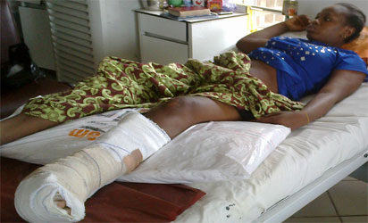
Statement of the PROBLEMS

Slide 5
JUSTIFICATION
Epoxy Resin: are available at low cost and possessed good biocompatibility with human tissues
Cow bones: are richly available in our environment as waste and are also biodegradable
These two materials can be effectively utilize to produce composites for biomedical applications
6

Slide 6
AIM
The aim of this work was to utilized calcined cow bone to reinforce epoxy material in other to develop composites that are suitable for biomedical applications
7

Slide 7
OBJECTIVES
(a) Cleaning and calcination of the cow bones;
develop calcined cow bone particulate reinforced epoxy resin composites using the particles in (a);
(c) investigate the effect of cow bone particulates on the flexural and wear properties
of the developed composites.
8

Slide 8
Contributions to Knowledge
Strengthen the application of low cost processing technology in building-up engineering materials for biomedical applications.
10

Slide 9
METHODOLOGY
Materials Sourcing
Washing and Cleaning of Cow Bones
Calcination and Pulverization of the Cow Bone
Sieving to obtained desired particle sizes
XRF
Chemical Analysis of the Calcined Cow bone Particles
Production of the Composites
Assessment of Flexural and Wear of the Developed Composites
12

Slide 10
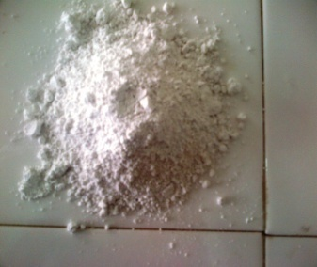
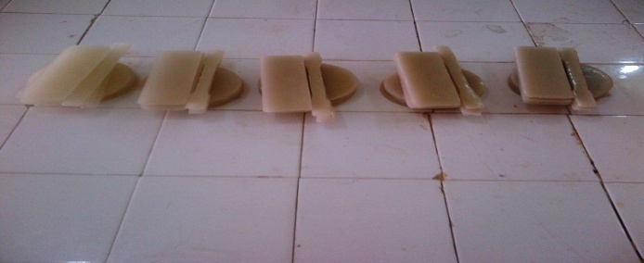
Cow bone particles
Composite Samples
Figure 2: Cow bone particles (left) and the developed composites (right)
13

Slide 11
Table 2: Shows the XRF Analysis of the Cow Bone Particles
Elements | Conc. Value (wt%) | Conc. Error
K | 2.115 | ±0.11
Ca | 55.752 | ±3.80
Ti | 0.549 | ±0.05
Cr | 0.070 | ±0.01
Mn | 0.180 | ±0.03
Fe | 16.932 | ± 1.04
Ni | 0.012 | ±0.01
Cu | 1.432 | ±0.20
Zn | 0.090 | ±0.02
Mg | 2.901 | ±0.50
Zr | 20.100 | ±2.10
Na | 1.320 | ±0.21
14

Slide 12
Figure 3: Plot of Deflection at peak against composite samples developed from -75 µm and 75 µm
Particle Sizes and the Neat Sample (CS)
15

Slide 13
Figure 4: Plot of Flexural Strength at Peak against composite samples developed from -75 µm and 75 µm Particle Sizes and the Neat Sample (CS).
16

Slide 14
Figure 6: Plot of abrasion result against composite samples developed from -75 µm and 75 µm particle Sizes and the Neat Sample (CS).
18

Slide 15
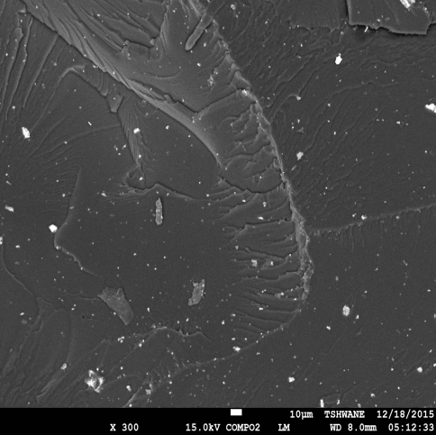
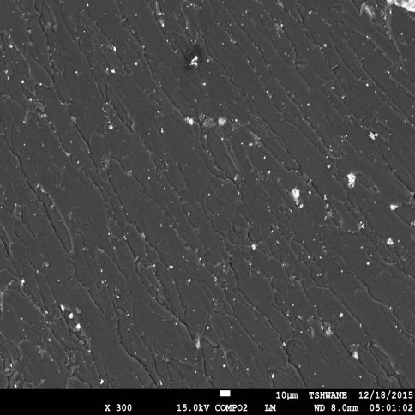
(a) -75 µm
(b) 75 µm
Figure 7: SEM of the Surface Morphology of the Cryofractured Surfaces of (a) -75 (b) 75 µm Calcined Bone Reinforced Epoxy Composites
19

Slide 16
CONCLUSION
The XRF analysis of the calcined bone revealed the presence of elements that are contained in human body which justify their use as biomedical material.
From the results, it was observed that the developed composites possessed better flexural and wear properties than the epoxy that made them to meet the structural conditions necessary for biomedical materials. However, -75 µm particle sizes gave the optimum enhancement of epoxy resin for the development of suitable bio-composites as an implant material.
20

Slide 17
THANKS FOR LISTENING
22

