Slide 1
Usual interstitial pneumonia: an overview
Ola El-Zammar, M.D.
Assistant professor of pathology
SUNY Upstate Medical University, Syracuse, NY

Slide 2
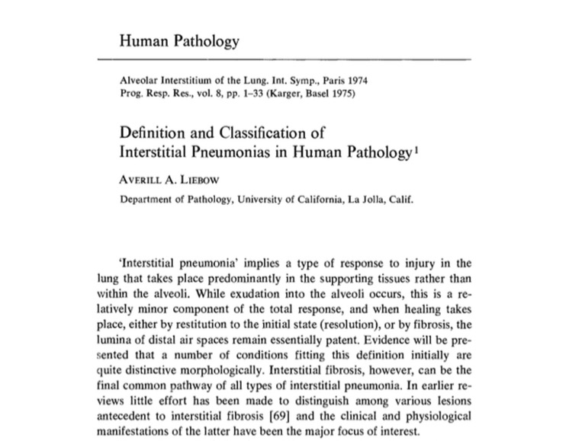

Slide 3
Interstitial Lung Disease (ILD)- Clinical Features
Bilateral lung involvement
CXR - Interstitial opacities (reticular/ reticular-nodular)
CT - Ground glass opacities, reticular infiltrates, honey-comb change
Dyspnea, cough
Restrictive pulmonary function tests

Slide 4
ILD- Clinical Classification
Connective Tissue Diseases
Treatment/Drug-Related Diseases
Primary (Unclassified) Diseases (sarcoid, LCH, pulmonary vasculitis, lipoid pneumonia, eosinophilic pneumonia, alveolar proteinosis, alveolar hemorrhage…)
Occupational and Environmental
Idiopathic Fibrotic Disorders

Slide 5
ILD
Clinical vs. Pathologic
Clinical classification of ILD includes a wide spectrum of different diseases
Morphologically many have minimal or even no interstitial involvement

Slide 6
ILD- Pathologic Definition
Defined pathologically as diseases involving predominantly the interstitium
Interstitium includes all non-airspace lung parenchyma (ie, supporting structures of lung)
(Infections excluded)

Slide 7
ILD - Pathologic Classification
Diseases that microscopically affect predominantly the alveolar septa
Relatively small number of diseases are encompassed by pathologic definition, and they tend to have similar clinical manifestations

Slide 8
ILD - Pathologic Classification
Diffuse Alveolar Damage
Interstitial Pneumonias
Sarcoidosis
Langerhans cell histiocytosis
Lymphangiomyomatosis
Miscellaneous

Slide 9
ILD - Pathologic Classification
Diffuse Alveolar Damage
Interstitial Pneumonias
Sarcoidosis
Langerhans cell histiocytosis
Lymphangiomyomatosis
Miscellaneous

Slide 10
Interstitial Pneumonia
Idiopathic Interstitial Pneumonias
Drug Reactions
Collagen Vascular Diseases
Hypersensitivity Pneumonia
Lymphoid Interstitial Pneumonia
Giant Cell Interstitial Pneumonia
Asbestosis

Slide 11
Interstitial Pneumonia
Idiopathic Interstitial Pneumonias
Drug Reactions
Collagen Vascular Diseases
Hypersensitivity Pneumonia
Lymphoid Interstitial Pneumonia
Giant Cell Interstitial Pneumonia
Asbestosis

Slide 12
Idiopathic interstitial pneumonias
Heterogeneous group of diffuse parenchymal diseases of unknown etiology
Prolonged, not acute, clinical course
Varying patterns of inflammation and fibrosis
Progressive scarring of lung parenchyma

Slide 13
Idiopathic Interstitial Pneumonias
Usual interstitial pneumonia is most common (60%), also known as Idiopathic Pulmonary Fibrosis (IPF)
Non-specific interstitial pneumonia is next most common (15%)(NSIP)
Desquamative interstitial pneumonia/Respiratory bronchiolitis interstitial lung disease (DIP/RBILD)
Acute interstitial pneumonia (AIP)

Slide 14
Idiopathic Interstitial Pneumonias
Usual interstitial pneumonia is most common (60%), also known as Idiopathic Pulmonary Fibrosis (IPF)
Non-specific interstitial pneumonia is next most common (15%)(NSIP)
Desquamative interstitial pneumonia/Respiratory bronchiolitis interstitial lung disease (DIP/RBILD)
Acute interstitial pneumonia (AIP)

Slide 15
Usual Interstitial Pneumonia (UIP/IPF/CFA)
Most common IIP
Affects adults, usually >50, M>F
Insidious onset, slowly progressive course, occasional acute exacerbation
Poor prognosis (median survival 3 -5 yrs), no effective therapy

Slide 16
Usual Interstitial Pneumonia (UIP)
“Pneumonia” in this context refers to
abnormal lung, i.e. fibrosis
“Usual” refers to the fact that UIP is the
classic, typical form of lung fibrosis
UIP can be associated with an identifiable underlying disease, or…
the cause may be unknown (idiopathic)

Slide 17
Usual Interstitial Pneumonia
UIP = pathologist’s diagnosis
IPF/CFA = pulmonologist’s diagnosis
When the pathologic diagnosis is UIP,
and no underlying disease can be found,
the clinical term used is idiopathic
pulmonary fibrosis/cryptogenic fibrosing alveolitis

Slide 18
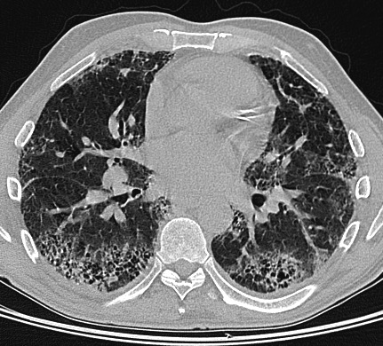
Diagnosis of UIP
HRCT findings are diagnostic in about 50% without biopsy
Peripheral reticular opacities and honey-comb change, mainly lower lobe

Slide 19
Diagnosis of UIP
HRCT findings are diagnostic in about 50% without biopsy
Bx taken mainly in pts with non-diagnostic HRCT and/or atypical clinical findings
Pathology is the gold standard!

Slide 20
Diagnostic Pathologic Features of UIP/IPF (UIP Pattern)
Interstitial fibrosis with:
Patchwork pattern of lung involvement
Architectural distortion (scars and/or honeycomb change)
Temporal variegation
And, minimal inflammation

Slide 21
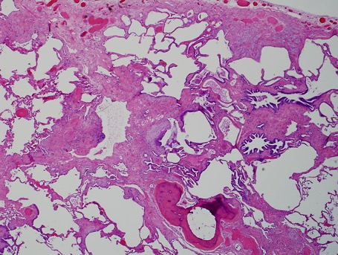
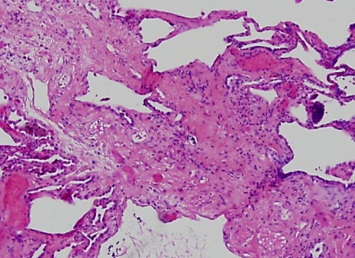
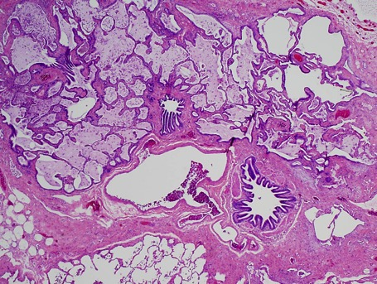
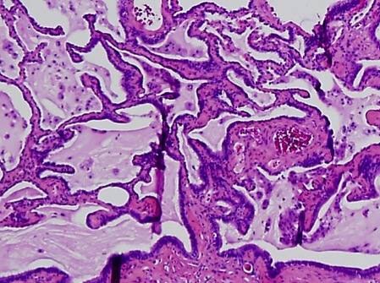
Patchwork Pattern
Architectural Distortion

Slide 22
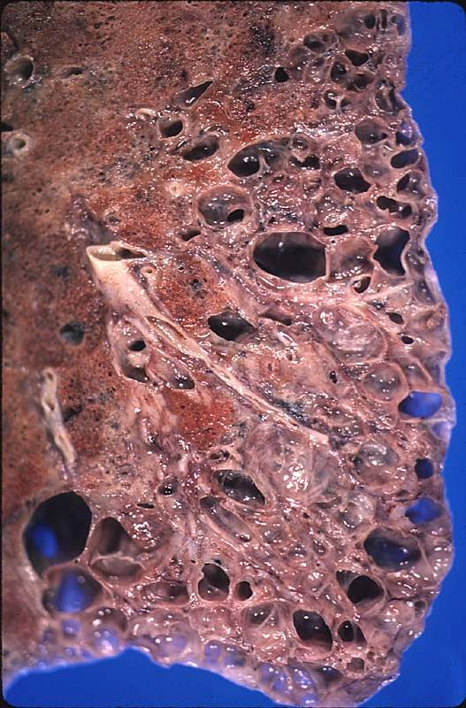
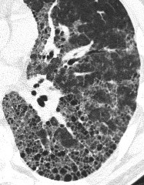
Honey-Comb Change

Slide 23
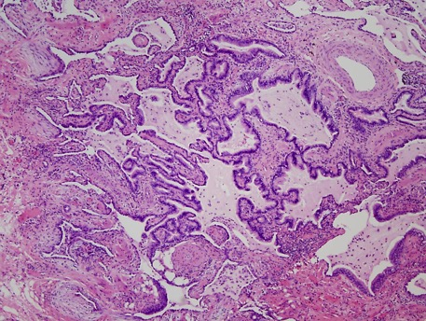
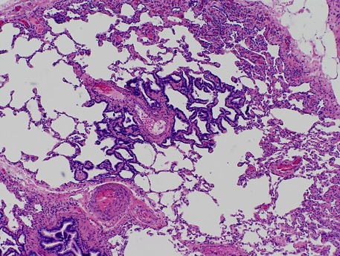
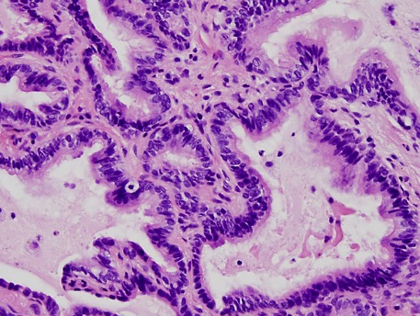
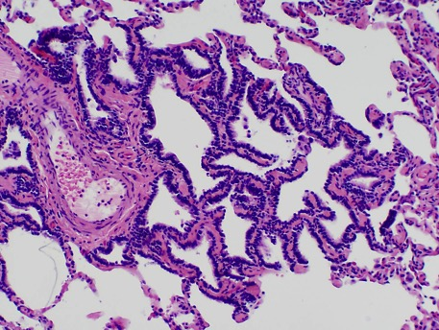
Honey-comb Change
Peribronchiolar Metaplasia

Slide 24
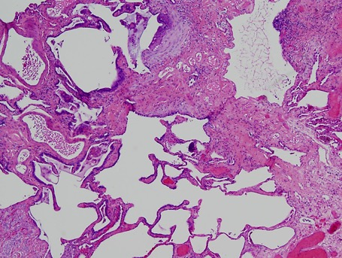
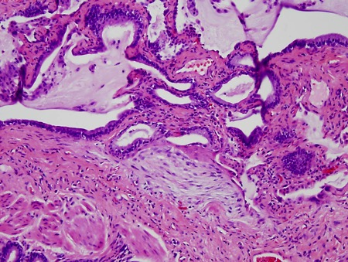
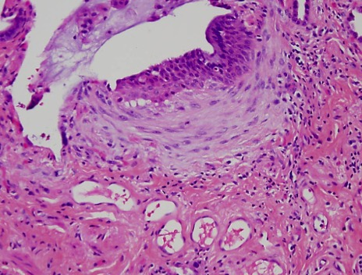
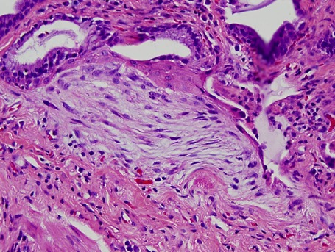
Temporal variegation

Slide 25
Fibroblast Foci
Microscopic foci of acute lung injury
Sites of active fibrosis and collagen synthesis
Earliest histologic manifestation of UIP
Number related to prognosis in some studies
Important in pathogenesis of UIP, but not specific

Slide 26
UIP - Pathogenesis
Related to microscopic foci of acute lung injury (fibroblast foci) occurring and recurring in widely separated parts of the lung over many years
Inflammation is secondary

Slide 27
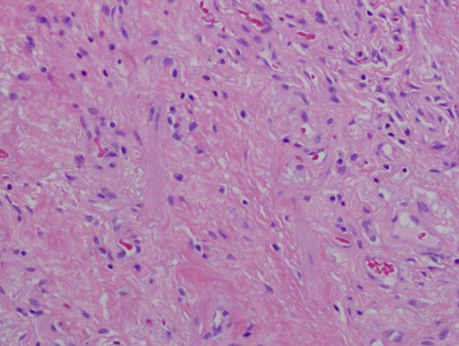
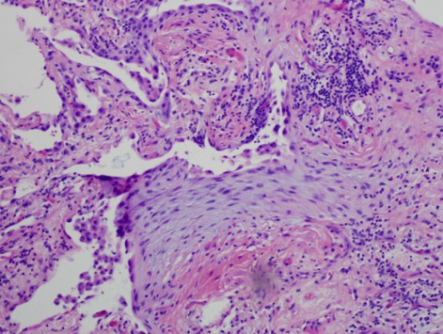
Old fibrosis (collagen)
Fibroblast focus

Slide 28
UIP - Treatment and Prognosis
Prognosis: Poor; progressive dyspnea and death
Death rate worse than that of many cancers (3-year survival, 50%)
Treatment: up until may 2014:
No effective therapy
Lung transplant may be offered

Slide 29
Nintedanib & pirfenidone are FDA-approved drugs for treatment of patients with IPF (N Engl J Med 370: 2142, 2014)

Slide 30
Difficulty in diagnosing UIP
-Whether or not a process should be considered patchy
-Whether convincing features of chronicity are present
-The fact that fibroblast foci are not unique to or diagnostic of UIP

Slide 31
Difficulty in diagnosing UIP
Is it UIP?
Is it idiopathic UIP/IPF

Slide 32
Histologic clues that may point toward some of those possibilities
marked interstitial chronic inflammation
ill-formed granulomas
prominent lymphoid aggregates
asbestos bodies

Slide 33
UIP - Differential Diagnosis
Non-specific interstitial pneumonia
Hypersensitivity pneumonia
Scarred Langerhans cell histiocytosis
Asbestosis
BOOP
Non-specific scarring

Slide 34
UIP - Differential Diagnosis
Non-specific interstitial pneumonia
Hypersensitivity pneumonia
Scarred Langerhans cell histiocytosis
Asbestosis
BOOP
Non-specific scarring

Slide 35
UIP vs fibrotic NSIP

Slide 36
NSIP – Clinical Features
Middle aged adults (mean, 52), wide age range including children, M/F 1/1
Onset is insidious to subacute
CT- ground glass opacities
Prognosis relatively good, usually responds to steroids

Slide 37
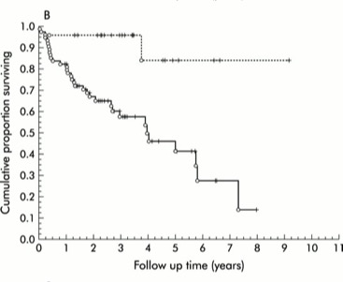
Survival in NSIP vs UIP
NSIP
UIP
Med survival NSIP – >9 yrs, 3.98 yrs for UIP
Flaherty et al, Thorax:2003;58:143

Slide 38
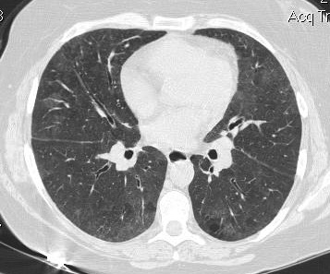
Diagnosis of NSIP
HRCT findings are non-specific
Reticular pattern, ground glass opacities, absent honey-comb change

Slide 39
Diagnosis of NSIP
HRCT findings are non-specific
Biopsy required in most cases

Slide 40
Pathologic Features of NSIP
Relatively uniform, cellular interstitial process
Variable mixture of chronic inflammation and collagen
Temporally uniform (absent/rare fibroblast foci)
No/minimal architectural distortion (scarring, honey-comb change)

Slide 41
NSIP Cellular vs. Fibrotic
Fibrotic NSIP is more common than cellular NSIP (about 5:1)
Nearly 100% 5-yr survival in cellular NSIP
Mortality is significant with fibrotic NSIP, with about 75% 5-yr survival

Slide 42
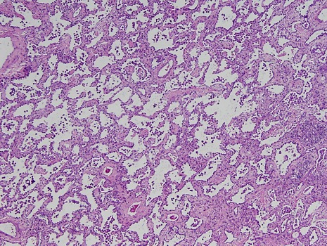
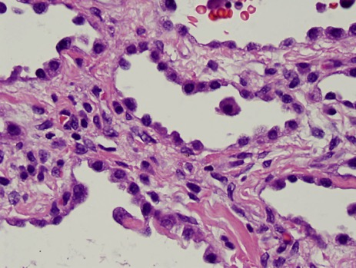
Fibrosing NSIP

Slide 43
Fibrosing NSIP vs. UIP - Pathologic Features
Mostly uniform distribution, absent patchwork pattern
Prominent cellularity
Minimal, focal architectural distortion
Rare fibroblast foci

Slide 44
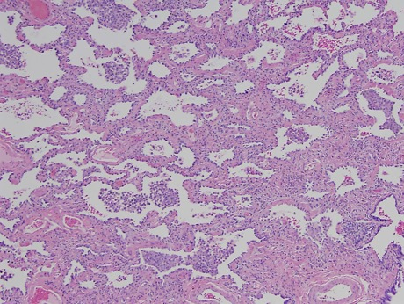
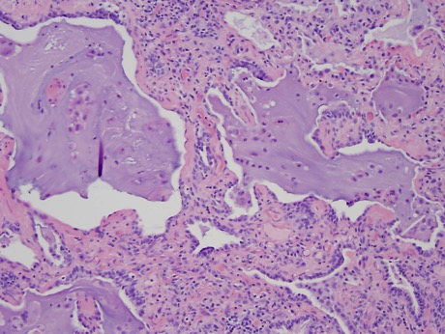
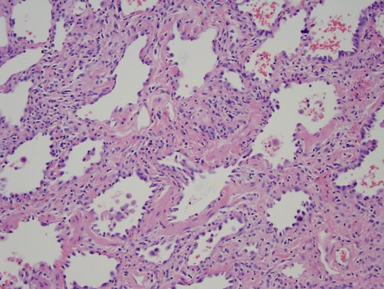
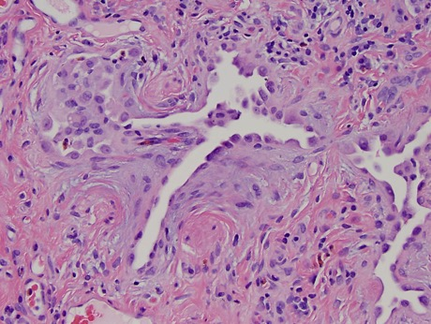
Fibrosing NSIP

Slide 45
Diagnosis of NSIP vs UIP
Easy with cellular NSIP, but can be difficult with fibrosing NSIP, especially when
fibrosis is extensive
there is some architectural distortion
occasional fibroblast foci are present

Slide 46
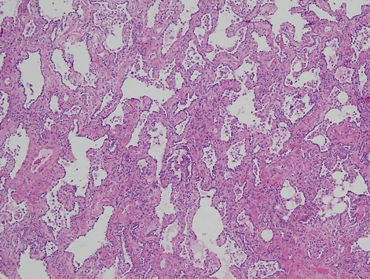
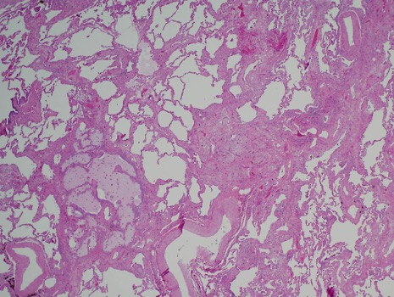
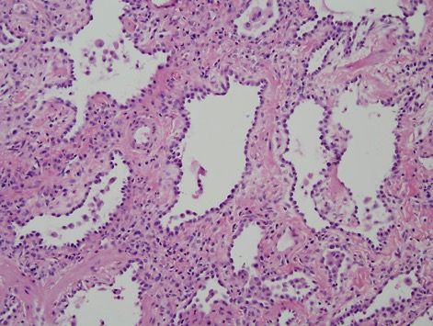
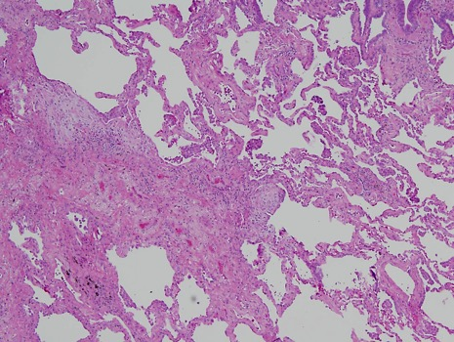
Fibrosing NSIP
UIP

Slide 47
NSIP-like Areas in UIP
Areas typical of NSIP can occur focally in other conditions
In a review of 20 explanted lungs with UIP, all but 3 showed isolated areas that were indistinguishable from NSIP (“NSIP-like areas”)
(Katzenstein et al. Am J Surg Pathol 2002; 26: 1567)

Slide 48
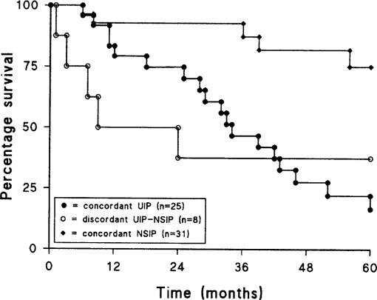
Diagnosis of NSIP vs UIP
(Monaghan et al. Chest 2004;125:522)

Slide 49
Diagnosis of NSIP (vs UIP)
absence of clinical, radiological or pathological findings to suggest an alternative
generous sampling of multiple sites for surgical lung biopsy

Slide 50
Diagnosis of NSIP (vs UIP)
absence of clinical, radiological or pathological findings to suggest an alternative
generous sampling of multiple sites for surgical lung biopsy

Slide 51
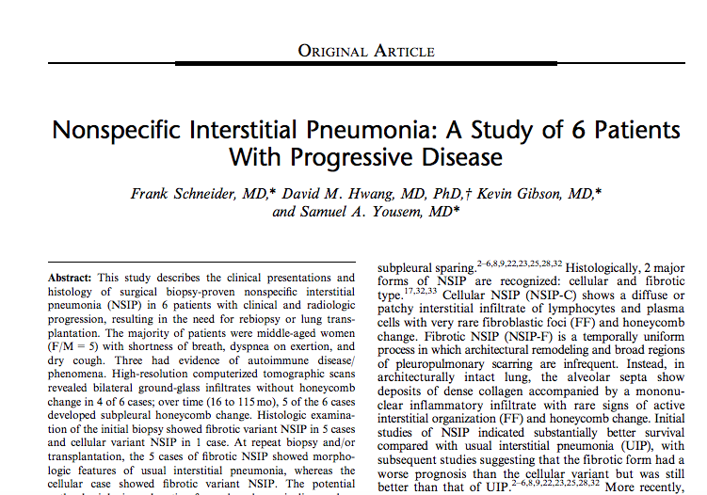
Diagnosis of NSIP (vs UIP)

Slide 52
Fibrosing NSIP vs. UIP
Diagnosis can be difficult when there are overlapping histologic features
HRCT findings can be helpful – mainly presence or absence of HCC

Slide 53
How Important is it to Differentiate Fibrosing NSIP from UIP?

Slide 54
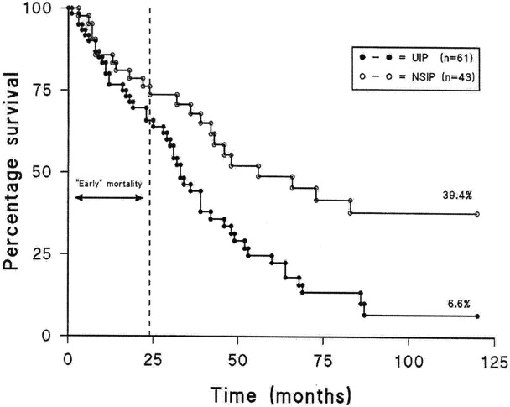
Fibrosing NSIP vs UIP-Prognosis
Medium survival 56 mos vs 33 mos (Latsi et al. AJRCCM 2003; 168:531)

Slide 55
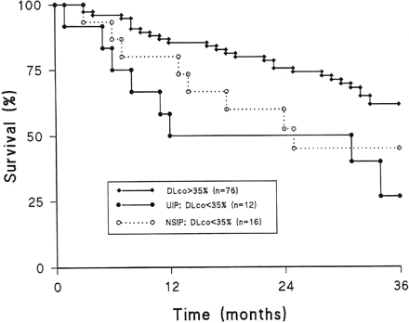
Prognosis in Advanced F-NSIP
If disease is well advanced, the outcome appears to be no different between UIP and NSIP
Latsi et al. AJRCCM 2003; 168:531

Slide 56
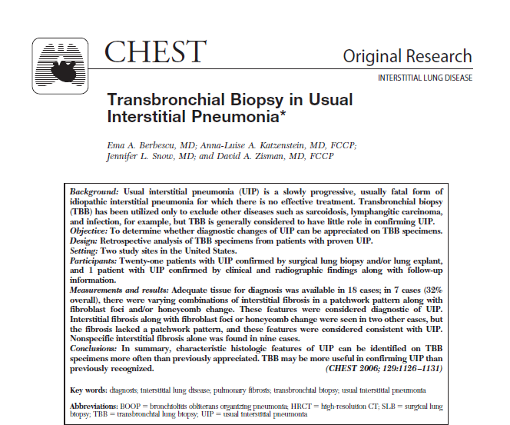
Transbronchial lung biopsy in the diagnosis of UIP

Slide 57

Transbronchial lung biopsy in the diagnosis of UIP

Slide 58
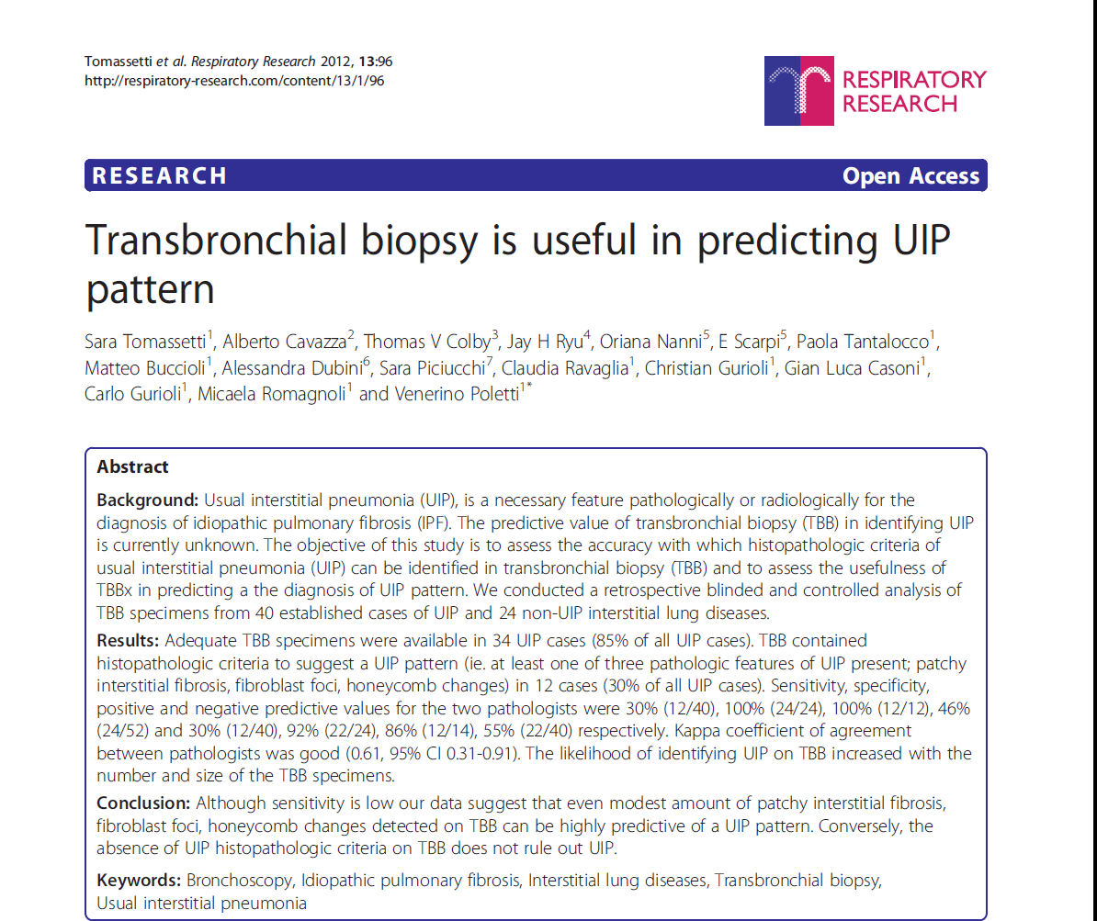
Transbronchial lung biopsy in the diagnosis of UIP

Slide 59
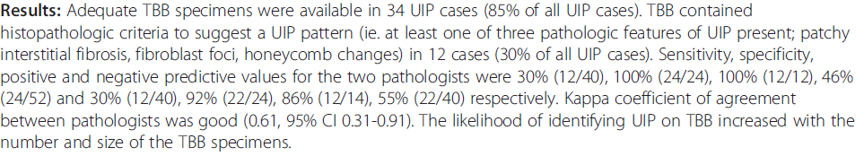
Transbronchial lung biopsy in the diagnosis of UIP

Slide 60
Should transbronchial lung biopsy be used in the evaluation of suspected IPF?
Low Sensitivity (30% for Expert Pathologists)
Low negative predictive value (50%): the presence of TBB findings consistent with alternative diagnosis (ie. DIP, NSIP, ALI) does not rule out UIP

Slide 61
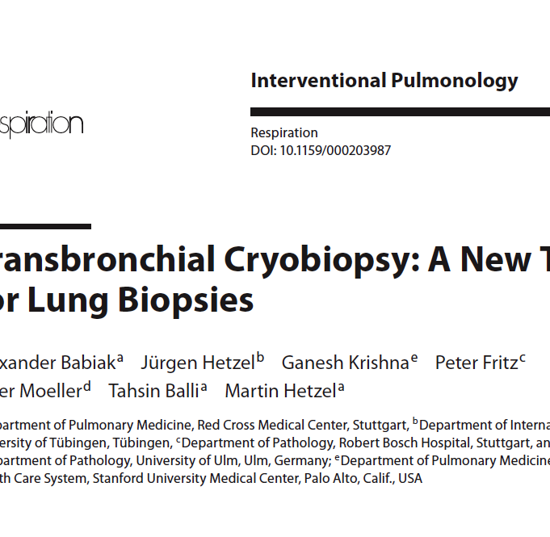
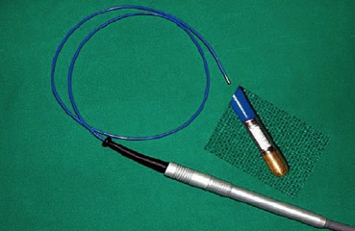
A flexible cryoprobe. The metal tip, which can be visualized under fluoroscopic control, is enlarged.

Slide 62
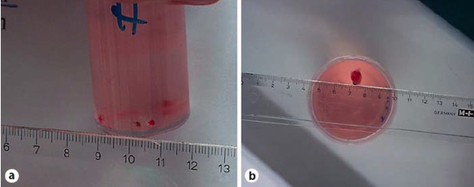
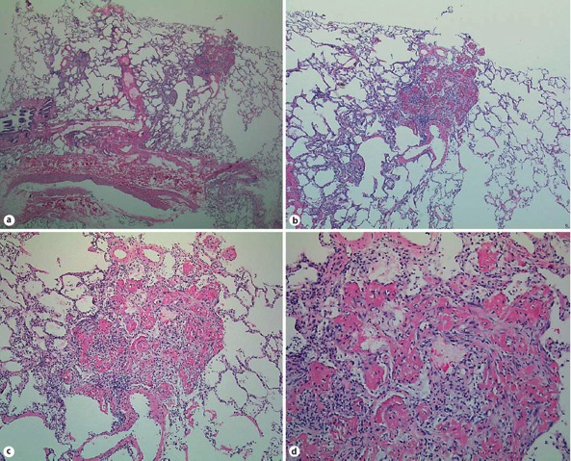

Slide 63
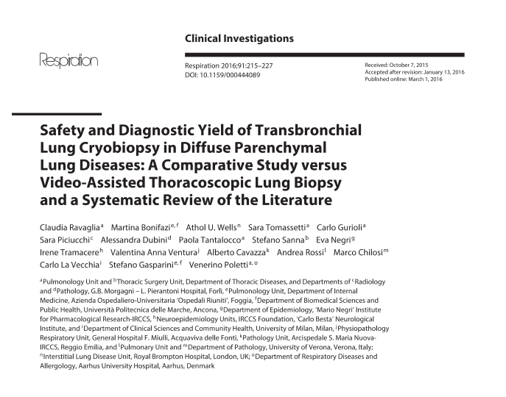

Slide 64
Future directions
Transbronchial cryobiopsy
Safety and Diagnostic Yield of Transbronchial Lung Cryobiopsy in Diffuse Parenchymal Lung Diseases: A Comparative Study versus Video-Assisted Thoracoscopic Lung Biopsy and a Systematic Review of the Literature
(Ravaglia et al. Respiration 2016;91:215)
-Cryobiopsy is safe and has lower complication and mortality rates compared to surgical lung biopsy.
-Cryobiopsy was diagnostic for 246 patients (82.8%), SLB for 148 patients (98.7%, p = 0.013)

Slide 65
Thank you

