Slide 1
The use of structural nano and micro-filtration membrane as a confine bioreactor for microbial growth and extracellular digestive enzymes secretion
By
Ofir Menashe
4th International Conference on Nanotek and Expo San Francisco, December 2014.

Slide 2
The term of structural membrane
Structural membrane: It is a semi preamble membrane that can be designed and constructed according to defined need (macro-encapsulation structures).
The aim of the lecture is to provide applicable tools for the method preparation of structural semi permeable membrane.

Slide 3
Part A – Introduction: Confine environment and
utilities in wastewater treatment process
Part B – Structural membrane characterization and
mechanism
Part C – Biocompatibility and the effect of confine
environment on the secretion of extracellular
enzymes.
Part D - Summary
Agenda

Slide 4
Original design of structural membrane
Structural membrane design utilities:
It was design to provide a confined* environment to support microorganism growth, in order to allowing a successful culture implementation within host bioreactor of wastewater treatment plant.
To induced a successful bio-augmentation treatment approach.
Bio-augmentation treatment approach: is the use of external selective microorganism culture to induce a specific biological or biochemical process.
*A confined environment is a space which is substantially enclosed (though not always entirely).

Slide 5
The needs for exogenous bacterial culture implementation in wastewater treatment facilities
Bio-augmentation treatment approach is use to reduce specific contaminants concentration into safe environmental level.
Bio-augmentation can elevate the biological stabilization process over time , thus elevating the treatment yield..
Bio-augmentation can accelerate the bio-digestion process, thus elevating the treatment yield.

Slide 6
The most successful cases of bio-augmentation occur in confined systems, such as bioreactors in which the conditions can be controlled to favor survival and prolonged activity of the exogenous microbial population
Consequently :
Elevate the probability for adaptation and prosperity
Sample for a particle that can defined as a confine environment: The SBP capsule

Slide 7
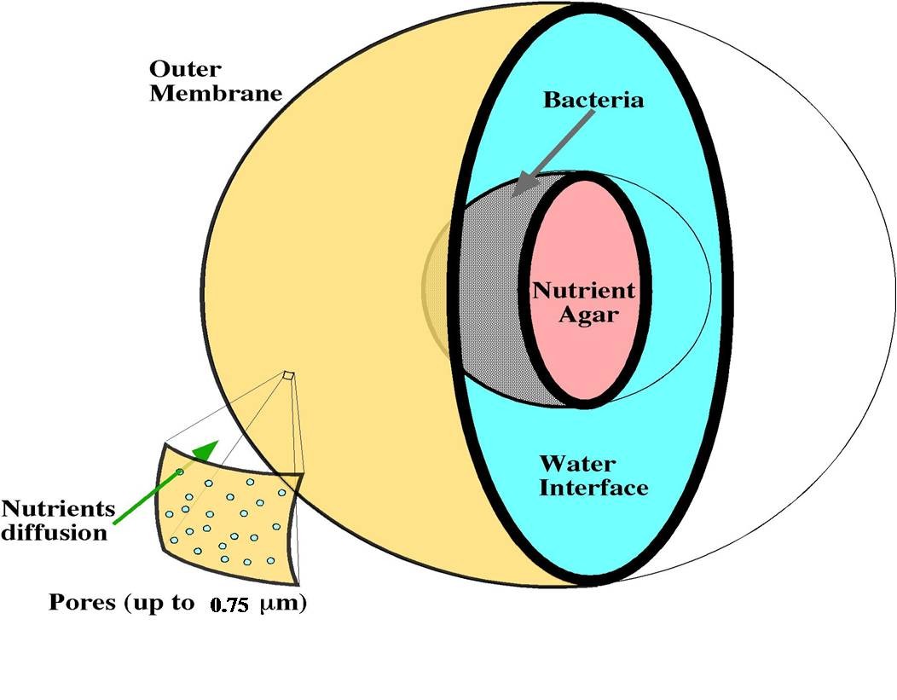
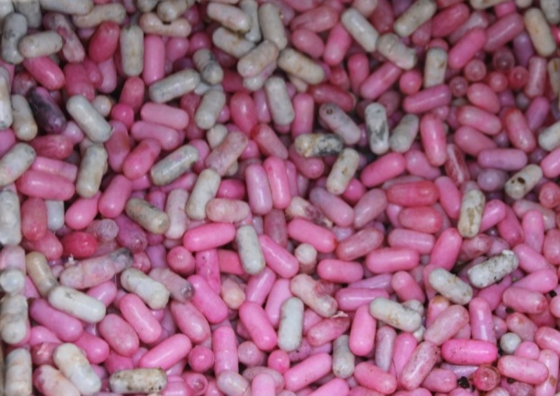
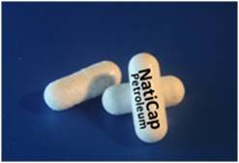
SBP Capsules
SBP capsule outline design
Aimed to protect the introduced culture , and provide favorable micro-cosmos conditions – Confine environment.
2.5 cm
The constructed particle:
Small Bioreactor Platform (SBP) technology

Slide 8
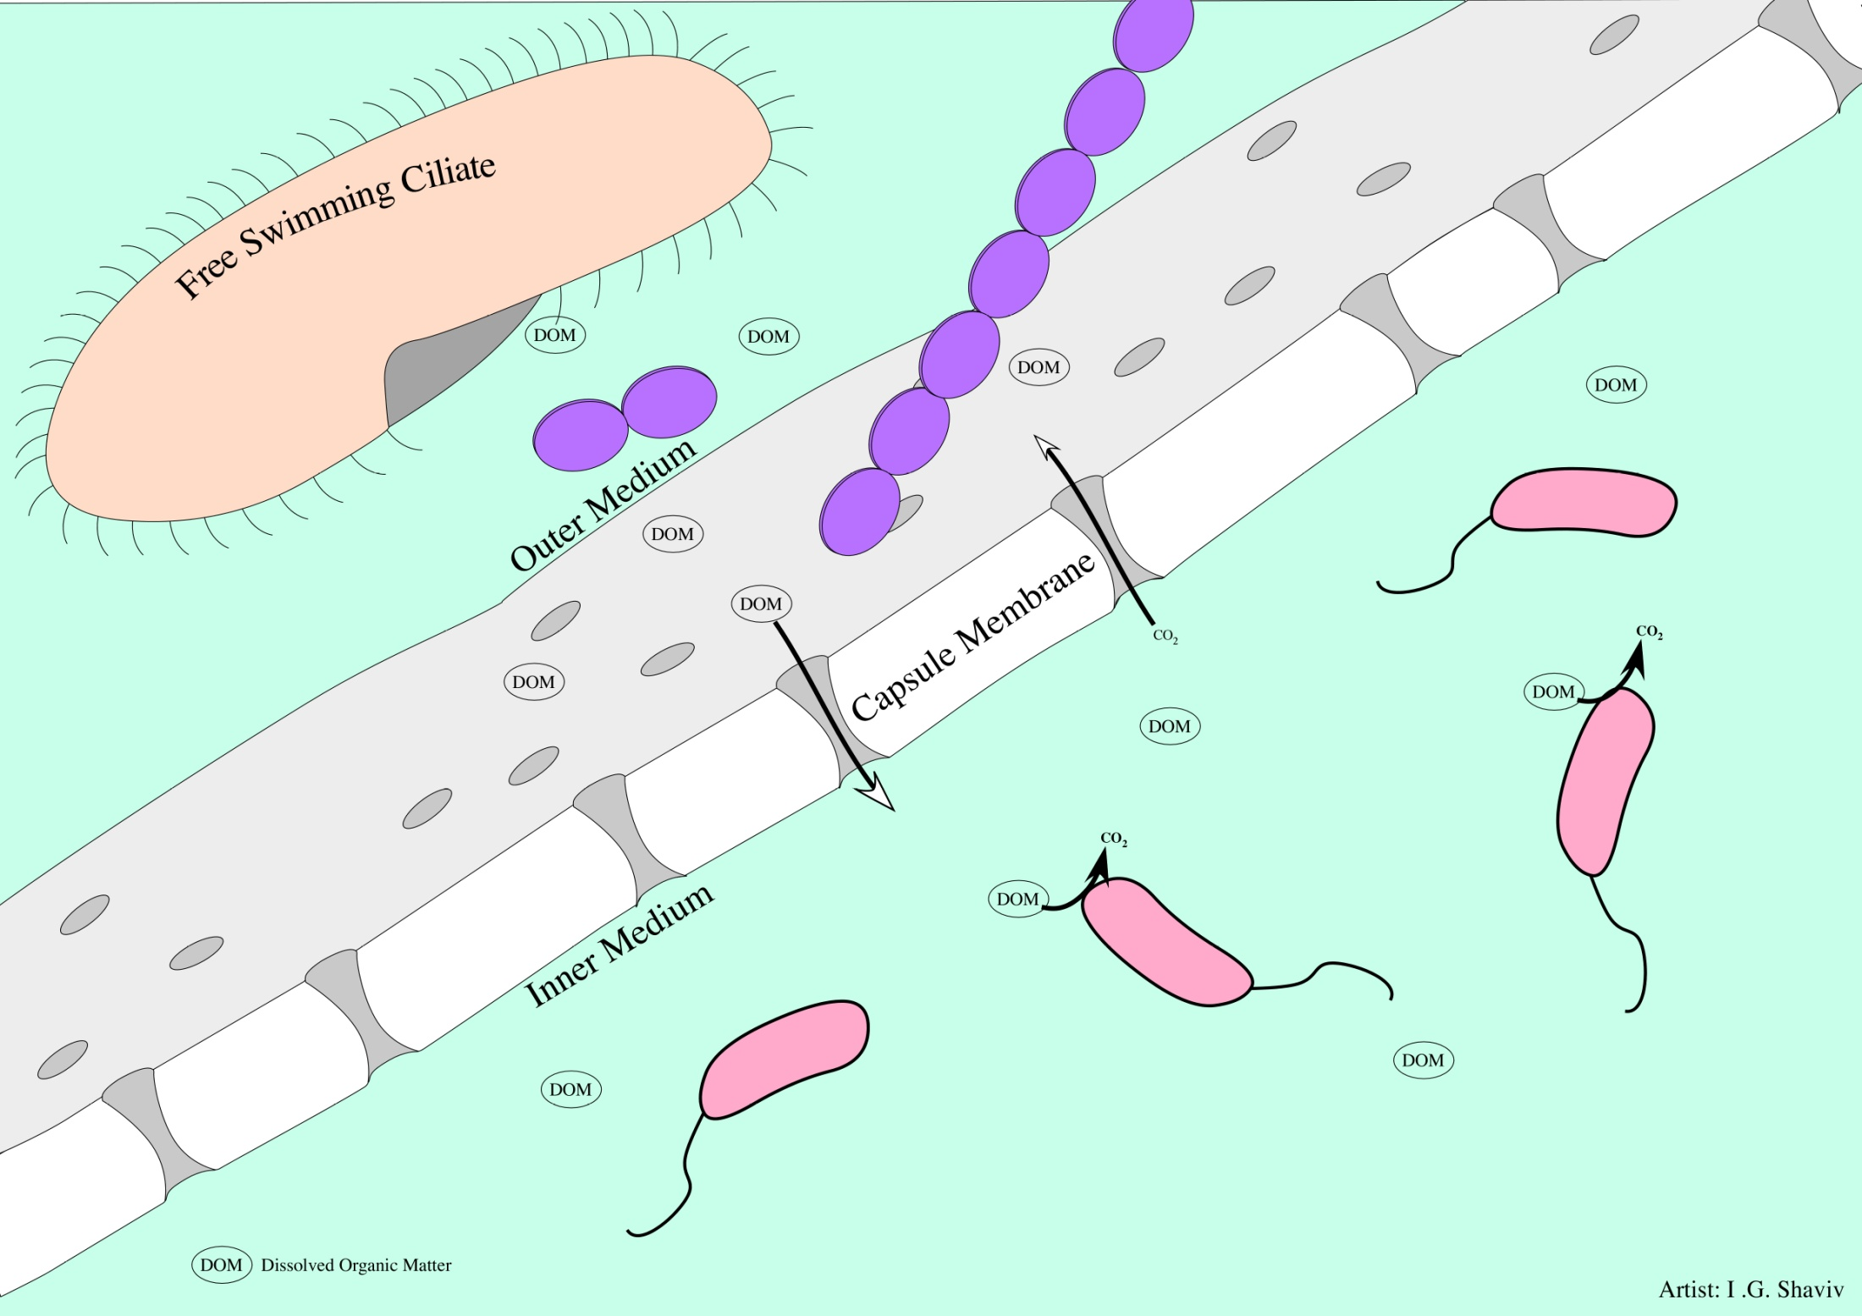
Restricted area for the introduced bacteria culture.
Bacteria culture growth in a suspended state.
Confine environment (SBP capsule)

Slide 9
Part B
Structural membrane characterization and mechanism
Structural membrane structure and forming
Structural membrane activation and viability
Structural membrane characterization

Slide 10
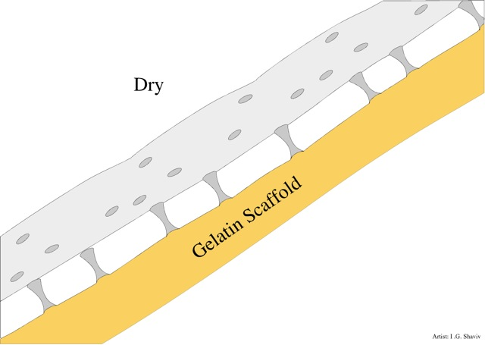
Structural membrane (particle) construction:
Cellulose Acetate polymerization activity on a solid scaffold (water dissolved polymer - Gelatin)
1-10µm
Water dissolve polymer
Cellulose Acetate membrane
0.2-0.8µm
Stage number 1: Inactivated SBP Capsule

Slide 11
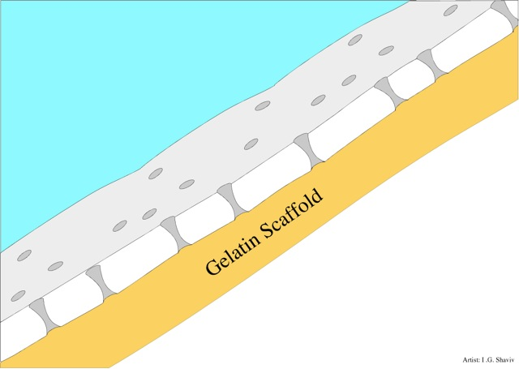
Particle activation:
Membrane functionality induction
Microorganism culture activation
Stage number 2: Activation by the exposure to aquatic medium

Slide 12
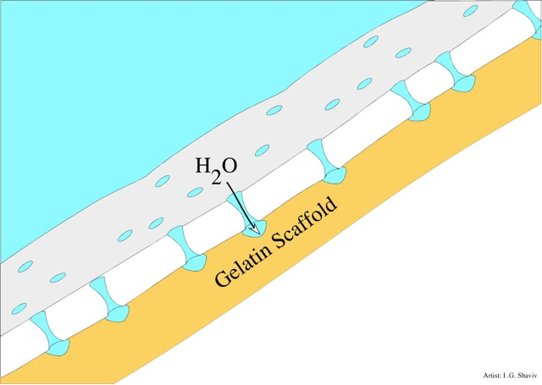
Stage number 3: Water (medium) penetration through the pores of the membrane

Slide 13
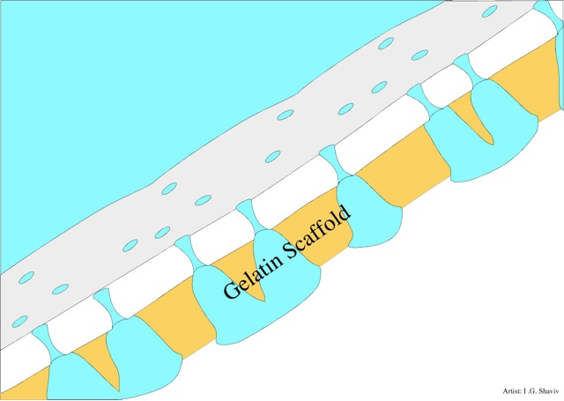
Stage number 3: The introduced water molecules are dissolving the Gelatin scaffold

Slide 14
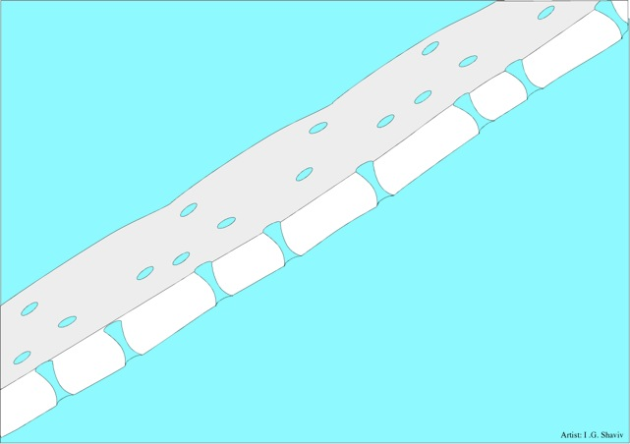
Structural membrane stand along
Stage number 4: The presence of microfiltration membrane (Activated particle)

Slide 15
Restricted area for the introduced bacteria culture.
Bacteria culture growth in a suspended state.
Functional SBP capsule within a wastewater treatment plant bioreactor medium (mix liquor)

Slide 16
Membrane characterization after long term incubation within microorganisms saturated environment (fouling membrane)
SBP capsule membrane surface – SEM (scanning electron microscope)
Pore
Bacteria
Pores
X500
X3000
* SEM and pore size analysis made by Prof. Dosoretz, Technion – Israel Institute of Technology

Slide 17
Structural membrane characterization
Membrane pore size (determined by latex beds study)
After activation (saline, disinfection environment): 0.8 µm
After a month incubation within a sanitary medium: 0.2 µm
Membrane width
Membrane width: 500µm-800µm (average 650µm)
Increasing membrane width will reduced the membrane pore size.
Average time of membrane stability (particle prolong)
Over 2 months within wastewater

Slide 18
Part C
Biocompatibility and the effect of confine environment on the secretion of extracellular enzymes.

Slide 19
Bio- compatibility study of the structural membrane to the host microbial culture

Slide 20
Extracellular protein secretion
Control system – suspended microbial blend
Test system – SBP encapsulated microbial blend
Incubation medium: saline and substrate bland of 0.25% Glycerol and 0.25% Canola oil.
The control system presents a constant protein concentration over time (average 5.7±3 µg/ml), while the test system present a continuous increase of extracellular protein concentration over time (R²= 0.98).

Slide 21
Summary
The use of structural membrane to construct a particle (SBP capsule) that can provide a confine environment for the introduced microorganisms culture.
The postulated particle significant reduced natural selection forces (grazing, shear forces), resulting in culture long term prosperity (over 2 months).
The postulated particle allowing us to enjoy the benefit of the bio-augmentation treatment approach.
Confine environment can induce extracellular proteins (enzymes?) over expression, suggesting the benefit of bio-chemical process amplification.
Structural semi-permeable membrane - other utilities?

Slide 22
Thank you

