Slide 1
Photo-induced topological phase transitions in ultracold fermions
Norio Kawakami
(Kyoto University)
Supported by
Quantum Physics 2016
March 14 - 16, 2016
London, UK
Notes:
QSS2015 total 25mins

Slide 2
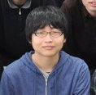
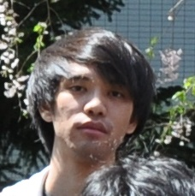
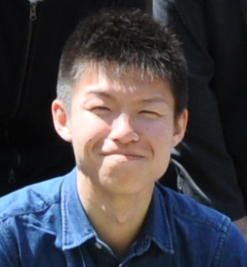
Topological / Nonequilibrium
@Kyoto Condensed Matter Theory
M. Nakagawa (D2)
M. Matsuda (D2)
K. Takasan (M2)
K. Iwahori (M2)
S. Ibe (M1)

Slide 3
Contents
1. Introduction
Non-equilibrium topological phases
2. Topological Insulators
Minimum
3. Floquet theory
Time-periodic driving
4. Topological phase transitions induced by
Rabi oscillation
Main results
5. Interaction effects
Perturbation theory
6. Summary

Slide 4
Topological / Nonequilibrium quantum phenomena
Introduction
Supported by
Quantum Physics 2016
March 14 - 16, 2016
London, UK

Slide 5
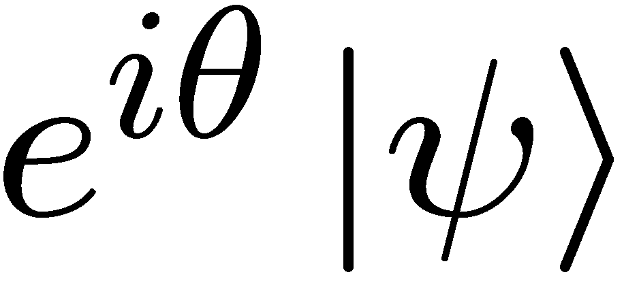
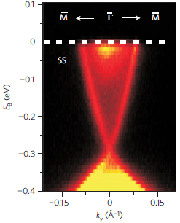
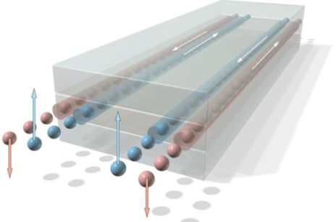
Topological quantum phenomena
● Quantum states → phase degree of freedom
→ emergent topological structure
● e.g. Topology in k-space
→ topo insulators, topo superconductors, …
● Emergence of gapless edge states
→ Hall effect, EM response, …
Topological insulators
Xia et al.
Nat. Phys.
(2009)
König et al.
Science (2007)
2D: HgTe/CdTe
Quantum well
3D: Bi₂Se₃, Bi₂Te₃, …

Slide 6
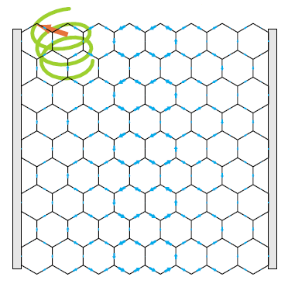
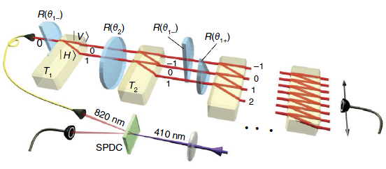
Topological quantum phenomena in non-equilibrium systems
● extension of the concepts of topological phases to non-equilibrium.
● topological phase transitions in non-equilibrium conditions
driven by dynamical phenomena
● periodically driven systems → Floquet theory
Class BDI
in 1D
(TR, chiral)
Class A
in 2D
(no TR)
Graphene under circularly polarized light
→ (quantum) Hall effect
(T. Oka and H. Aoki, PRB 2009)
Quantum walks → edge states
(T. Kitagawa et al. Nat. Commun. 2012)

Slide 7
Purpose of this study
● propose a non-equilibrium topological insulator
・Two dimensions
・Time-reversal symmetry
cf solid state HgTe/CdTe, InAs/GaSb
● what kind of dynamical phenomenon triggers?
● interaction effects ?
We construct a new example of Topo-insulator
Time-reversal symmetry, nonequilibrium
(2D class AII: Z₂ topo-insulator)
Dynamical phenomena in cold atoms
Rabi-oscillation

Slide 8
Before enjoying nonequilibrium phenomena,
Topological Insulator
minimum
Supported by
Quantum Physics 2016
March 14 - 16, 2016
London, UK

Slide 9
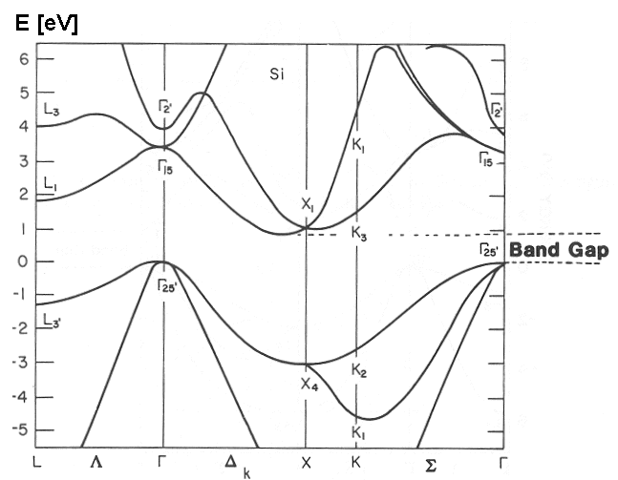
Band Insulators
e.g. semiconductor
Characterized by energy gap
Si
electron
Gap ~ 1 eV
Energy gap
energy
hole
momentum
Topological Insulators
Characterized by energy gap
◇ Quantum Hall effect,
◇ Polyacetylen,
◇ Quantum Spin Hall effect
◇ Z₂ topological insulator
Topological number (Z or Z2)
Gapless edge excitations

Slide 10
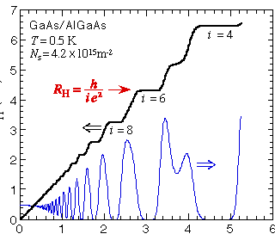
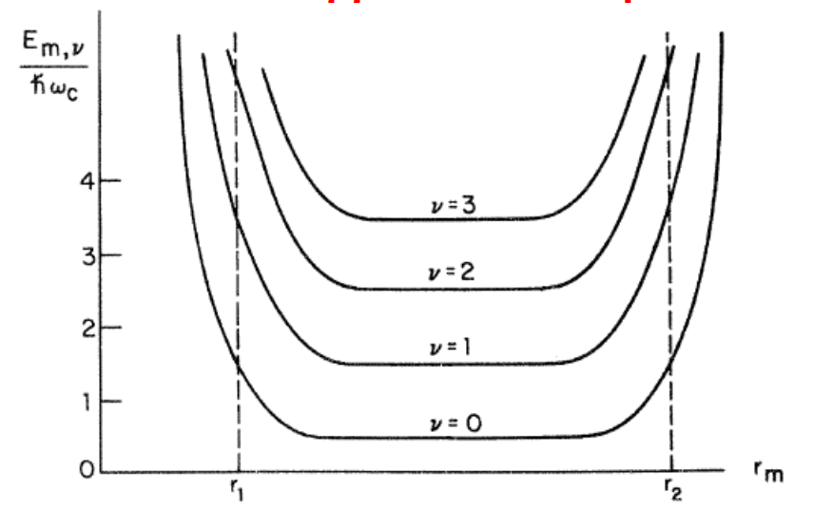
Quantum Hall effect
2D electrons in high fields
GaAs/AlGaAs
High field
B
Hall Resistance
Chiral edge state
Bulk-edge correspondence
Magentic field
Hall conductivity
bulk
σ_{xy} = n e²/h
n: Chern number
edge
edge
# of edge modes

Slide 11
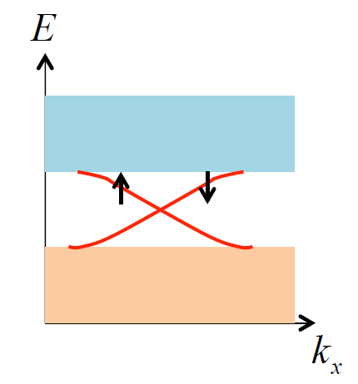
Quantum Spin Hall effect
B
up spin
■Time reversal symmetry
■Spin-orbit coupling
- B
■Gapless helical edge state
down spin
S_{z} is not conserved:
Topological index
band
Z Z₂
edge state
Integer
even-odd
band
Z₂ Topological insulator
HgTe/CdTe well (2008)
Kane-Mele, S. C. Zhang

Slide 12
Floquet Theory Time-periodic phenomena
Supported by
Quantum Physics 2016
March 14 - 16, 2016
London, UK

Slide 13
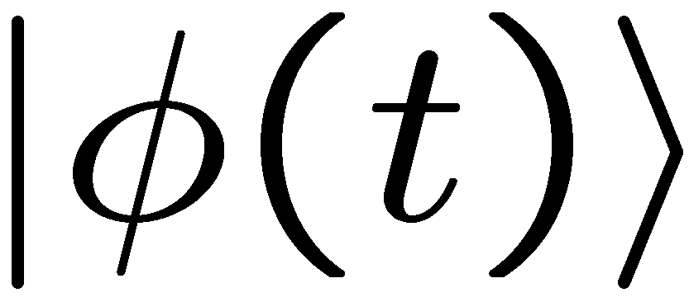
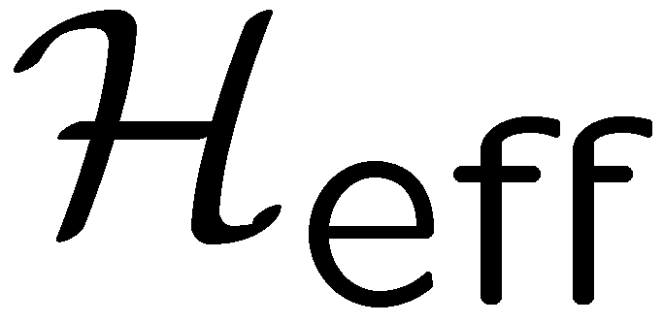
Floquet Theory
Theory for periodically driven systems
Floquet theorem → solution of the Schrö. eq.
(cf. Bloch’s theorem)
- & are obtained from the “effective Hamiltonian”
: eigenvalue (quasi-energy)
: eigenstate
of
time evolution operator
Mapping: time-dep. system -> a time-indep. system
Effective Hamiltonian: nontrivial topology,
-> topological quantum phenomena in non-equilibrium!

Slide 14
Topological phase transitions induced by
Rabi oscillation
Main results & Physical picture
Supported by
Quantum Physics 2016
March 14 - 16, 2016
London, UK

Slide 15
Key to topological phase transitions
gap → from hybridization
trivial insulator
topological insulator
Solid state material: Spin-Orbit interaction
→ Corresponding dynamical phenomenon?
→ How to realize the band inversion?
our answer: Rabi oscillation

Slide 16
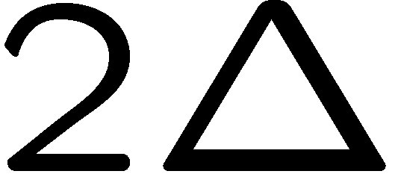
Rabi oscillation from a viewpoint of the Floquet theory
- Starting point: 2-level system coupled with an external field
Ω_{R}, ω

Slide 17
Rabi oscillation from a viewpoint of the Floquet theory
Ω_{R}, ω
(off-resonant light)
→ similarity to the band inversion phenomena

Slide 18
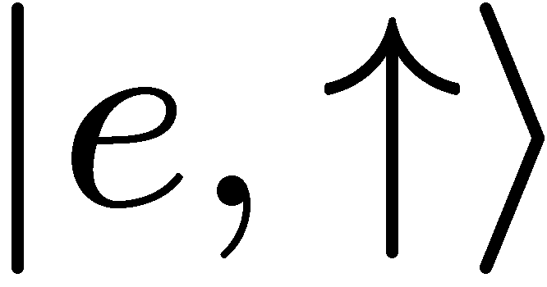
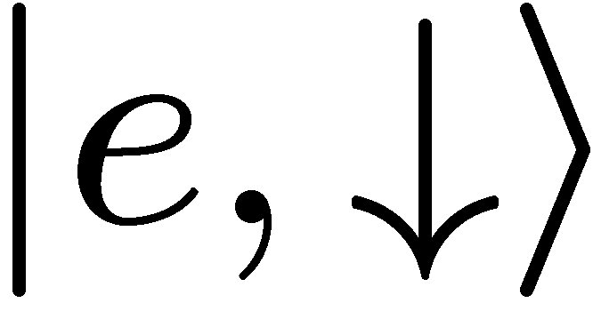
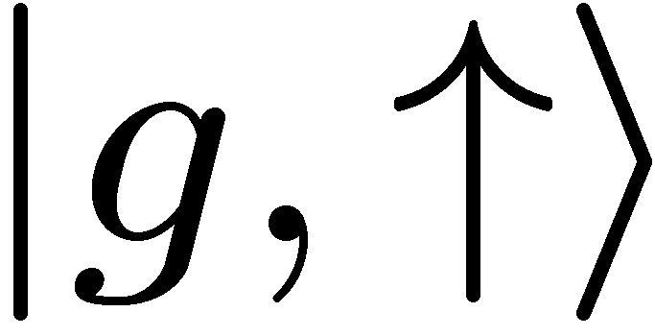
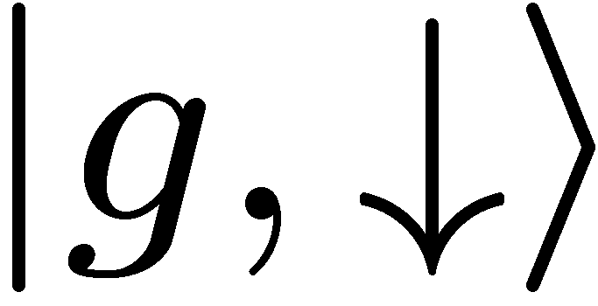
2-orbital model in optical lattices
- 2-component and 2-orbital fermions (with TRS)
upper band
Inter-orbital hybridization
(optical coupling)
lower band
2-orbital fermions
→ e.g. 1) alkaline-earth-metal(-like) atoms (¹⁷¹Yb, …)
: ground state & metastable excited state
2) multiband optical lattice: using higher band
band insulator
time-reversal symmetry:
σ＋
σ₋
π
π

Slide 19
2-orbital model in optical lattices
upper band
Inter-orbital hybridization
(optical coupling)
lower band
- add external light which causes the Rabi oscill.
note: this external perturbation preserves TRS !

Slide 20
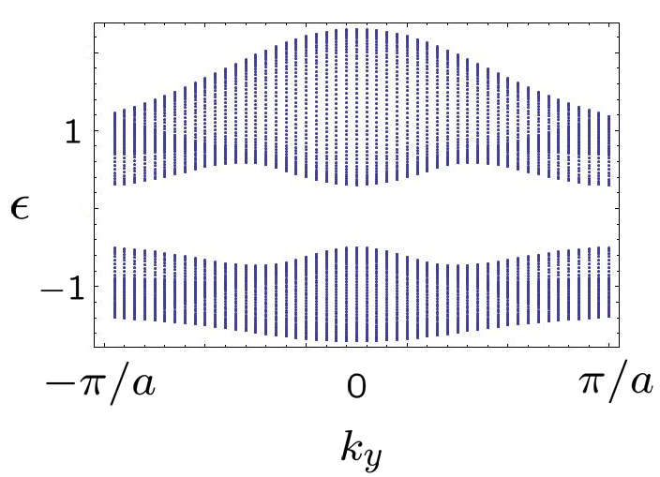
Rabi oscill. and topological phase transition
- (quasi-)energy spectrum of eff. Hamiltonian
2 dim. tight-binding model on a triangular lattice
& anisotropic interband coupling + Rabi oscill.
: off-resonant light

Slide 21
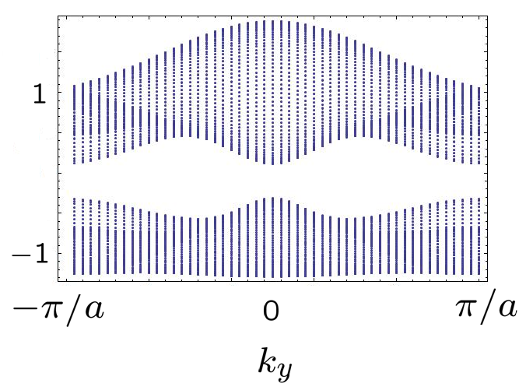
Rabi oscill. and topological phase transition
- (quasi-)energy spectrum of eff. Hamiltonian
2 dim. tight-binding model on a triangular lattice
& anisotropic interband coupling + Rabi oscill.
: off-resonant light

Slide 22
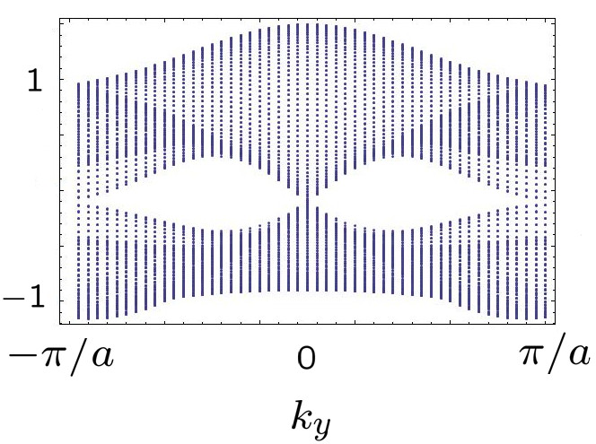
Rabi oscill. and topological phase transition
- (quasi-)energy spectrum of eff. Hamiltonian
2 dim. tight-binding model on a triangular lattice
& anisotropic interband coupling + Rabi oscill.
: off-resonant light
band gap closes

Slide 23
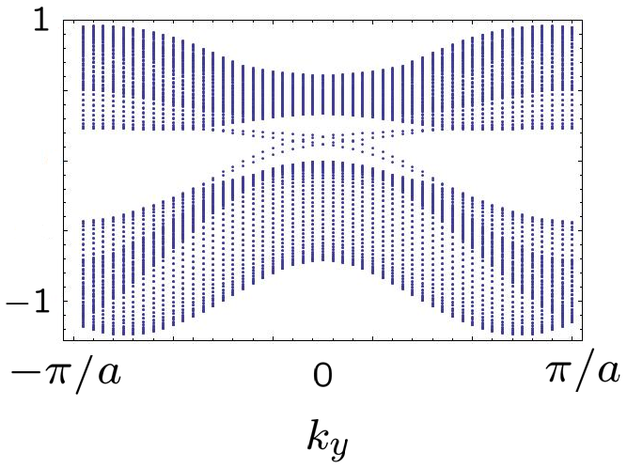
Rabi oscill. and topological phase transition
- (quasi-)energy spectrum of eff. Hamiltonian
2 dim. tight-binding model on a triangular lattice
& anisotropic interband coupling + Rabi oscill.
: off-resonant light
helical edge states appear !
→ TRS top. ins. (class AII)

Slide 24
Results
●A new example of topological insulator
in nonequlibrium conditions
●Time-reversal symmetry
2D class AII: Z₂ topo-insulator
an extension of HgTe/CdTe to nonequlibrium
●Key dynamical phenomenon in cold atoms
Rabi-oscillation
band-inversion phenomenon

Slide 25
Interaction effects
time-dependent Schrieffer-Wolff transformation
Supported by
Quantum Physics 2016
March 14 - 16, 2016
London, UK

Slide 26
Another perspective: perturbation theory
Question: Interaction effects on
non-equilibrium topo-phases?
→ difficult to solve the Schrö. eq.
However, we can approach from a perturbation-
theoretical viewpoint

Slide 27
Time-dep. Schrieffer-Wolff transformation
- idea: Floquet thm. →
→ eigenvalue problem for &
- unitary transformation of the operator
→ choose S(t) to cancel the (bare) external field

Slide 28
Time-dep. Schrieffer-Wolff transformation
- resulting S(t)
→ the time-dep. term is reduced by the factor !
neglecting the time-dep. term in high-freq. limit
→ a static approx. of the operator
→ approx. expression of eff. Hamiltonian
commutator-type contribution

Slide 29
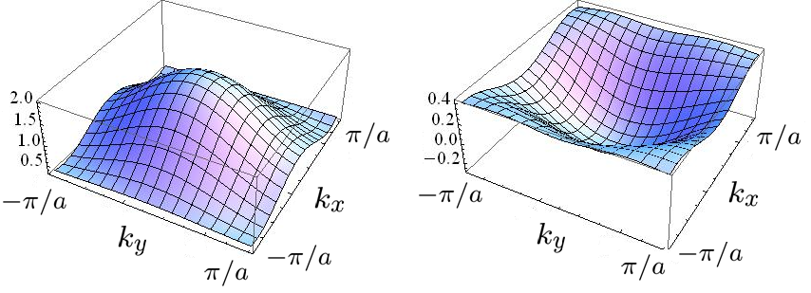
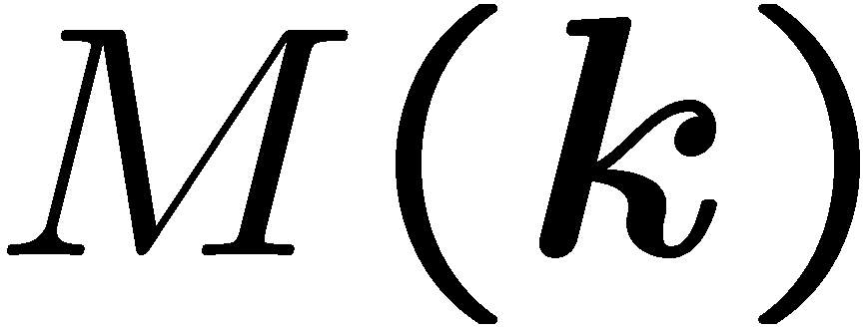
Results of the effective Hamiltonian
- for the model in the previous result
→ change of the
mass term
→ eff. terms
in the whole BZ !
component of eff. Hamil.

Slide 30
Summary and future perspectives
●Non-eq. top. phase transitions induced by Rabi oscillation
class AII nonequilibrium topological phases
(TR symmetry, HgTe/CdTe well)
●Perturbation theory with time-dep. Schrieffer-Wolff trans.
●Experimental realization?
2-orbital optical lattices with interband optical coupling
○ alkaline-earth-metal atoms (e.g. ¹⁷¹Yb)
→ excited states with long lifetime
○ multiband fermionic optical lattices

Slide 31
Thank you !
Supported by
Quantum Physics 2016
March 14 - 16, 2016
London, UK

Slide 32
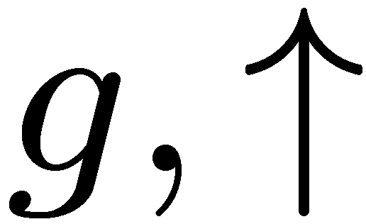
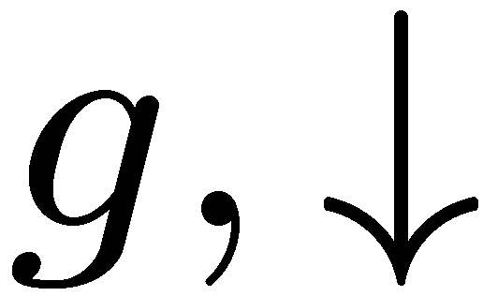
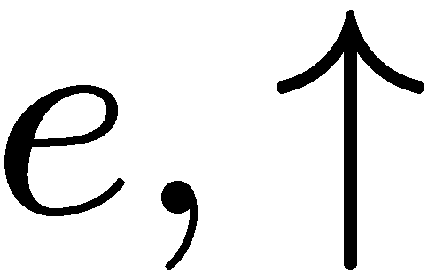
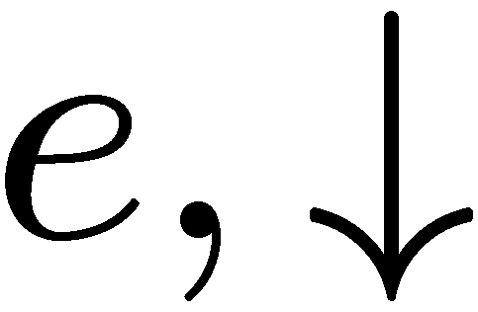
Field-induced effective interactions
→ effective interactions induced by Rabi oscillation !
bare interaction
Rabi-oscillation-induced interaction

Slide 33
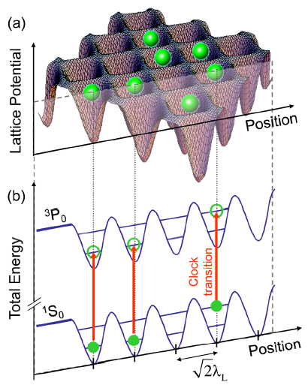
Alkaline-earth cold atoms
Two electrons in the outer shell (Ca, Yb, Sr)
electronic ground state: ¹S₀
excited state: ³P₀ → meta-stable! : “higher orbital state”
electronic state: ^{2S+1}L_{J}
(J=0 → J=0 : forbidden)
Energy diagram
“optical lattice clock”
lifetime
³P₂
15s
³P₁
875ns
³P₀
～20s
meta-stable
¹S₀
“clock transition”
(ultra-narrow)
(Derevianko & Katori, 2011)

