Slide 1
EFFECTS OF GAS FLARE FROM UTOROGU GAS PLANT ON BIOCHEMICAL VARIABLES OF CASSAVA LEAVES
(Manihot esculentum),
DELTA STATE.
R. F. NJOKU-TONY
DEPARTMENT OF ENVIRONMENTAL TECHNOLOGY
FEDERAL UNIVERSITY OF TECHNOLOGY, OWERRI
CORRESPONDING AUTHOR: Email: tonyrosefeechi@yahoo.com

Slide 2
ABSTRACT
Gas flaring is a major contributor to the emission of toxic gases and other gaseous pollutants into the atmosphere. This study investigated the impact of gas flare on leaves of cassava around Utorogu gas plant, Delta State. Three sampling locations were chosen at 1 km , 2km and 3km distance from the gas flare stack and a control location at Orerokpe 10km away. Ambient air quality was determined for methane (CH_{4) (ppm),} oxides of sulphur (SO_{x) (}ppm) oxides of nitrogen ( NO_{x) (}ppm), carbon monoxide (CO) (ppm), and hydrogen sulphide (H₂S) (ppm). Leaves collected were taken to the laboratory for analysis. Relative Leaf Water Content (RLWC)(%), Total Chlorophyll Content (TCC)(mg/m3), Leaf Extract pH( LEP)(mol/litre) and Ascobic Acid Content (AAC) (mg) were determined under standard laboratory methods. Ensuing data were subjected to standard statistical analysis. Results showed that CH4 varied from 38.00-92.00ppm, H₂S from 0.05-1.20ppm, CO from 11.00-26.40ppm, SOx from 252.00-340.00ppm and NO_{X} from 82.00-190.00ppm. RLWC varied from 30.50-56.33, TCC varied from 1.98-4.66, LEP varied from 4.50-7.00mol/litre and AAC varied from 0.03-0.15. It was revealed that NOx, SOx and CO exceeded NESREA’s short-term tolerance limits for ambient air pollutants of (40-60) ppm, 100 ppm, and 10ppm respectively. This showed that these air pollutants exerted significant inhibitory influence on biochemical activities of the leaf studied. Environmental regulatory agencies and oil exploration companies should help reduce gas flaring to avoid damages to crop production.
KEYWORDS: Air pollutants, Biochemical variables, cassava leaves, Crop growth.

Slide 3
INTRODUCTION
Gas flaring, a major source of air pollution of public and environmental concern (Mokhatab et al., 2006)
In recent past, air pollutants which have direct effect on vegetation and crop yield are causing increasing concern (Joshi and Swami, 2007).
Increasing number of industries and automobile vehicles are continuously adding toxic gases and other substances to the environment (Seyyednejad et al.,2001)
These toxic pollutants include sulphur and nitrogen oxides, carbon (II) oxide and soot particles, as well as smaller quantities of toxic metals, organic molecules and radioactive isotopes (Agbaire and Esiefarienrhe, 2009).
Effect of air pollutants on vegetation is the best and more direct determination of toxic effects of air pollution. [Rai et al.,2010 ; Joshi and Swami, 2007) .

Slide 4
INTRODUCTION
Associated gases, a mix of smoke, precisely referred to as particulate matter are routinely flared in the course of producing and processing oil. However, the Niger Delta case attracts more attention given the volume of gas flared since the beginning of commercial oil production in the country (Whittle et al., 1998)
According to Oghenejoboh (2005) Like the combustion of other carbonaceous fuels, gas flaring produces oxides of carbon (CO_{X}), sulphur (SO_{x}) and nitrogen (NO_{x}), water vapor, volatile and non-volatile forms of trace metals e.g. Pb, Hg, Cd, As, Cr, Cobalt, Zn and Nickel.
Incomplete combustion of the flared gas produces greenhouse gases such as methane Carbonmonoxide and water vapour Ogwejiofor (2000).
Manahan(2009) posited that flaring is typically incomplete releasing of substantial amount of soot and CO, Polyclic Aromatic Hydrocarbons (PAHs), small quantities of sulphur compounds like sulphur dioxide (SO₂), hydrogen sulphide(H₂S), carbon disulphide(CS₂), carbonyl sulphide(COS) and volatile organic compounds (VOCs) into the atmosphere.

Slide 5
INTRODUCTION
Royles (2010) in his work concluded that the flared gas is composed of natural gas, Methane, Propane, Ethylene, propylene, butadiene and butane to a tune of 95% and above.
Common effects of gas flaring on crops incude
CHLOROSIS: SO₂ destroys plant tissues and produces gradual yellowing of leaves as chlorophyll production is impeded (Ahkionbare, 2009),
NECROSIS: Bhatia (2009) observed that plant organs are impacted by air pollutants leading to necrosis (dead areas on leaves)
Epinasty: (downward curvature of leaves and abscission (dropping of leaves), reduction in growth rate and eventual death of plant.
Reduction in soil moisture content, in extension reducing its fertility and crop yeild. Flare pollutants such as SO_{x} and NO_{x} form acids in the presence of rain water. As inhabitants are agrarians and their farmlands located in the vicinity of the flow station, this research therefore targeted the effect of these pollutants on the biochemical variables of cassava (Manihot esculentum) leaf.

Slide 6
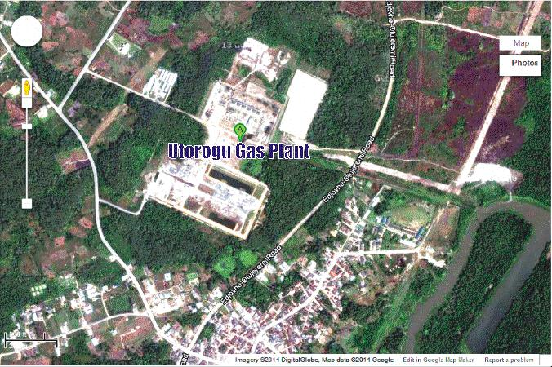
METHODOLOGY
Fig. 1. Aerial photograph of Utorogu, the study area

Slide 7
METHODOLOGY
STUDY AREA
Utorugo is situated in Ugheli south local government area of Delta State
Located between longitude 060° 01’ 34.72’’E and latitude 050° 31’ 19.59’’N.
Annual rainfall of 2,650mm.
Temperature is high throughout the year with an annual mean of 26.3⁰C monthly.
Relative humidity range from 60-80% with peak value > 80% recorded in July and August .
Surface wind is calm (1.6 – 2.1m/s) with moderate potentials for dispersing air pollutants introduced to them and is predominantly southwest during the wet season and northeast during the dry season (SPDC, 2002).
Vegetation is typical rainforest in nature.
The inhabitants are predominantly farmers and estimated total population figure is projected at 311,970 (NPC, 2006).

Slide 8
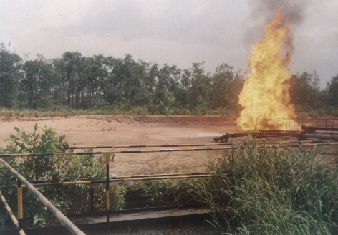
METHODOLOGY
Plate 1. An open gas flare near one of the sampling locations

Slide 9
SAMPLE COLLECTION
Leaf sample collection
With the aid of a stainless knife, leaves of cassava (Manihot esculentum) were randomly collected in three different locations at a distance of 1km, 2km, and 3km apart (L1, L2 and L3) and a control sample L4 at 10km away. Samples were carefully taken to the laboratory in a stainless container under a space of 1hour.
Air Quality Monitoring
The sampling equipment used include High Volume Sampler (HVS) (testo 350 Flue gas Analyzer) and Digital automatic gas monitors (DAGMs)
High Volume Sampler (HVS): The modified EPA gravimetric high volume method was used. This technique involved drawing a known volume of air through a pre-weighted glass fiber filter (20 X 25cm) by means of heavy duty turbine blower at flow rate of 1.3 m³/min (SPDC, 2002). This collected suspended particulate matter within the size range of 100-0.1µm diameters.
Digital Automatic Gas Monitors (DAGMs). The Crowcon Gasman Air Monitor that had been pre-calibrated using air cylinder standard (SPDC, 2002) was used in the direct detection of CH₄, CO, NO_{x}, SO_{x}, H₂S and Temperature (0^{oC}) while the Haze dust 10 µm Particulate Monitor was used for the detection of particulate matter (SPM₁₀).

Slide 10
Determination Of Variables
Determination of Biochemical variables
Relative Water Content (RLWC):
With the method as described by Singh (1997), leaf relative water content was determined and calculated with the formula:
RLWC = FW-DW*100
TW-DW Where FW = Fresh weight, DW = Dry weight, TW = Turgid weight
Total Chlorophyll Content (TCC)
This was carried out according to the method described by Rao (2006).
Leaf Extract pH
5g of the fresh leaves was homogenized in 10ml deionized water. This was filtered and the pH of the leaf extract determined after calibrating pH meter with buffer solution of pH 4 and 9 (Aremu et al., 2010)
Ascorbic Acid Content (AAC)
Spectrophotometric method (Aremu et al., 2010).

Slide 11
Statistical Analysis
Descriptive statistics (with graphical illustrations)
Pearson Product Moment Correlation Coefficient (r)
ANOVA
Linear regression

Slide 12
RESULTS
Ambient air Quality
Wide variations were observed in some of the air pollutants measured (CH₄, H₂S, SO_{X, CO} and NO_{X}) across the sampling locations. Methane varied from 38.00-92.00 (65.83±6.20), hydrogen sulphide varied from 0.05-1.20(0.52±0.13), carbon monoxide varied from 11.00-26.40(21.12 ±1.62), oxides of sulphur varied from 252.00-340.00(278.33±8.82) and oxides of nitrogen varied from 82.00-190.00(127.42±13.01), while Temperature ranged from 26.5⁰C- 35.6⁰C (30.2±0.40)
Table 1. Descriptive statistics of Air Pollutants around Utorogu gas plants (ppm)
Parameters Minimum Maximum Range Mean SE FEPA
(1991)
CH₄ 38.00 92.00 54.00 65.83 6.20 NS
H₂S 0.05 1.20 1.15 0.52 0.13 NS
CO 11.00 26.40 15.40 21.12 1.62 10
SO_{X} 252.00 340.00 88.00 278.33 8.82 100.
NO_{X} 82.00 190.00 108.00 127.42 13.01 40-60
Temp.(0⁰C) 26.5 35.6 9.1 30.2 0.40 NS
SE = standard error, NS = not specified
Oxides of nitrogen(82-190) ppm, oxide of sulphur (252-340) ppm, and Carbon (11) oxide (11-26.40) ppm. Variables measured exceeded FEPA (1991) short-term tolerance limits for ambient air pollutants of (40-60) ppm 100 ppm, and 10ppm respectively.

Slide 13
RESULTS
Biochemical Parameter of Cassava (Manihot esculentum) leaves
Slight variations were observed in the biochemical variables measured across the sampling locations. RLWC varied from 30.50-56.33 (42.65±2.08), TCC varied from 1.98-4.66(3.49±0.28), LEP varied from 4.50-7.00(5.39±0.20) and AAC varied from 0.03-0.15(0.99±0.11)
Table 2. Variation in biochemical parameters of cassava leaves around Utorogu gas plant (ppm)
Parameters Minimum Maximum Range Mean SE
RLWC 30.50 56.33 25.83 42.65 2.08
TCC 1.98 4.66 2.68 3.49 0.28
LEP 4.50 7.00 2.50 5.39 0.20
AAC 0.03 0.15 0.12 0.99 0.11
SE=standard error, RLWC = relative leaf water content, TCC = total chlorophyll content, LEP = leaf extract pH, AAC= ascorbic acid content.
Of the biochemical variables, RLWC exhibited the highest range of 25.83 ppm, while AAC recorded the least range of 0.12 ppm. However, TCC and LEP exhibited comparatively moderate ranges of 2.68 and 2.50ppm respectively.

Slide 14
RESULTS
Relationships between air pollutants and biochemical variables of crop.
At P<0.05, CH₄ and SO_{X} correlated negatively with TCC (r=-0.683) and RLWC (r=-0.652) respectively. At P<0.01 CH₄ correlated negative with RLWC (r=-0.815), H₂S correlated negatively with RLWC (r=-0.823) and TCC (r=-0.776). However, CO correlated negatively with RLWC(r=-0.740), LEP (r=-0.833), AAC (r=-0.810), while SO_{X} correlated negatively with TCC (r=-0.841). NO_{X} correlated negatively with RLWC (r=-0.808) and TCC (r=-0.733) at P<0.01.

Slide 15
RESULTS
Table 3. Correlation coefficients (r) between the air pollutants and crop leave variables
Parameters CH₄ H₂S CO SOx NOx
RLWC -0.815** -0.823** -0.740* -0.652* -0.808
TCC -0.683* - 0.776** -0.482 -0.841** -0.733**
LEP -0.522 0.387 -0.83 -0.09 -0.418
AAC -0.245 0.188 -0.810* -0.106 0.101
* = significant at P<0.05, **= significant at P<0.01, RLWC = relative leaf water content, TCC = total chlorophyll content, LEP = leaf extract pH, AAC= ascorbic acid content. RLWC and Methane Regression between Biochemical variables and Air pollutants

Slide 16
The regression scatter plot showed that relative leaf water content (RLWC) decreased with increasing methane concentration (Fig. 2).
The coefficients table shows that the expected RLWC = - 0.274 X CH4 + 60.70 …………. i,

Slide 17
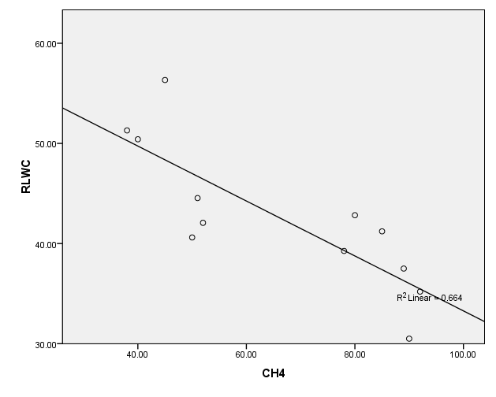
Fig. 2. Regression plot between relative leaf water content and methane concentration.

Slide 18
The regression scatter plot revealed that Total Chlorophyll Content (TCC) decreased with increasing methane concentration (Fig. 3).
The coefficients table shows that
the expected TCC = - 0.031 X CH4 + 5.521 …………ii,

Slide 19
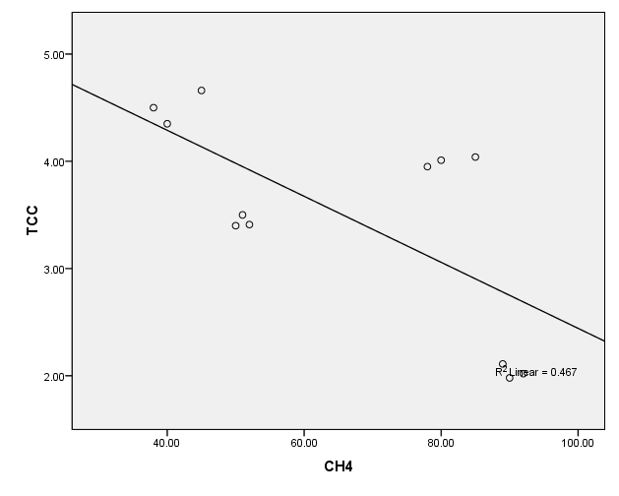
TCC and Methane
Fig. 3. Regression graph of Total Chlorophyll Content and Methane

Slide 20
Spatial Variation in biochemical variables and air pollutants
Relative Leaf Water Content (RLWC), Total Chlorophyll Content (TCC), and Ascorbic Acid Content (AAC) were highest in L 3, L 2, and L 1, respectively from the flare stack. CH4, CO, SOx and NOx were highest in cassava leaves in L 1, L 2, and L 3 respectively.
The test of homogeneity in mean variances across the sampling locations from the flare stack revealed significant differences in the air pollutants [F_{(16.59)}>F_{crit (4.10)}] and in the biochemical variables measured [F _{(5.23)}>_{Fcrit (4.17)}] at P<0.05 .

Slide 21
Fig. 4. Longitudinal variations in air pollutants around Utorogu Gas Plant
Longitudinal variations of air pollutants .
SO₂ exhibited maximum concentration, while H₂S was least at all the sampling locations (Figure 4). Highest concentration of SO₂ (340 ppm) was recorded in L 1, while the least concentration (257 ppm) was recorded in L 3.

Slide 22
Longitudinal variation of biochemical variables of Manihot esculentum around Utorogu gas plant.
The control location recorded comparatively higher concentrations in RLWC (56.33ppm), TCC (4.66 ppm) and LEP (7.00ppm). (Figure 5). However, RLWC in cassava leaves revealed maximum concentrations at all the locations while AAC revealed least concentrations.
L1
L2
L3
L4
Fig. 5. Longitudinal variations in biochemical variables of Manihot esculenta leaves.

Slide 23
DISCUSSION
Elevated concentrations of pollutants above natural ambient levels (FEPA, 1991; SPDC, 2007) was recorded.
Values slightly lower than those recorded by Oghenejoboh (2005) in ambient air samples around a gas flare station at a community in the Niger Delta. This elevation was obviously contributed by the gas flare source point of pollution. This collaborates the work of (Ogwejifor, 2000; Oghenejoboh, 2005) that gas flare fallouts contribute pollutants to the air (Hart, 2010; Adekola et al., 2010).
Polluted air could actually lead to loses in essential nutrient as well as contribute to toxic components of crop in most agricultural villages.
Rainwater containing various metals (such as Cd, Pb and Hg) had been identified as a major cause of serious health problems in the Niger Delta area (WHO, 1987). Some of these health problems include anemia, renal dysfunction, lung cancer and other neo-behavioral effects.
Acidified water in the range of pH 1-3.5 damages plant leaves(Narayanan, 2009). Other negative effects are corrosion and tarnishing of metals (including building roofs), erosion and soiling of buildings, as well as discoloration and peeling of paints (Oghenejoboh, 2005).

Slide 24
DISCUSSION
The negative effects of air pollutants on plants have been reviewed by (Seyyednejad, 2011). Mean CH4, SOx, NOx & CO concentrations in the current study were higher than values recorded by Aremu (2012) in gas flare around Sapele gas plant in Delta State (Liu, 2008).
Values recorded for H₂S by Singh (1977) (0.54-2.33 µg/kg) were higher than the current study’s (0.05-1.20µg/kg). However, values of the air quality variables were comparable to their own, except for CO and Methane which were higher in the current study.
The negative regression relationship between biochemical variables and air pollutants indicates decrease in RLWC and TCC with increase in air pollutants which explains the shrinkage observed in cassava and other plants in the area.

Slide 25
DISCUSSION
The observed spatial variation in the biochemical variables measured in plants has also been documented by other researchers (Oghenejoboh, 2005; Hart, 2010; Onyedika, 2008; Zhuang, 2009; Aremu, 2010; Seyyednejad, 2011). The consistency in lowest concentrations in Ascorbic Acid Content across the sampling locations indicates common pollutant source as well as ecological mobility and bioavailability in biotic tissues.
Pollutant concentrations were generally highest in sampling location 1, 2, and 3 horizontally from the flare stack and least in location 4 spatially, from the stack. This confirms the dispersal of aerial materials from point sources of pollution to distances in and around its vicinity. Dispersal of pollutants has been stated to be controlled by wind speed, direction as well as topography, and its concentrations affected by dilution effects over distances (Narayanan, 2007; Adesiyan, 2005).

Slide 26
CONCLUSION
CH4 & SOx showed significant negative influences on TCC and RLWC.
H₂S exerted significant negative influence on RLWC & TCC, while CO showed a significant negative influence on RLWC, LEP & AAC.
NOx exerted significant negative influence on RLWC and TCC.
Vegetation is therefore an effective indicator of the overall impact of air pollution and the effects observed is a time averaged result that is more reliable than the one obtained from direct determination of the pollutant in air over a short period
The air pollutants exerted significant inhibitory influences on biochemical variables of the crop studied.

Slide 27
REFERENCES
Adekola, F.A., Salami, N. and Lawa, S.O. (2002). Research communications in chemistry, vol.1, p. 24.
Adesiyan, S.O. (2005). “Man and his biological environment”. Ibadan University Press, Ibadan, Nigeria. p. 196.
Agbaire, P.O. and Esiefarienrhe, E. (2009). “Air pollution tolerance indices (APTI) of some plants around Otorogu gas plant in Delta State, Nigeria”. Journal of Applied Science and Environmental Management, 13, 11-14.
Akan, J.C., Abdurrahman, F.I., Ogugbuaja, V.O. and Ayodele, J.T. (2009). “Heavy metals and cation levels in some samples of vegetable grown within the vicinity of Challawa Industrial area, Kano State, Nigeria”. American Journal of Applied Sciences, 6( 3), 534-542.
Akhionbare, S.M.O(2009), Environment Concepts, issues and control of pollution, M. C. Computer Press, Nnewi, Anambra State: pp82-92, 183-224.

Slide 28
REFERENCES
Aremu, M.O., Atolaiye, B.O. and Labaran, L. (2010). “Environmental implication of heavy metal concentrations in soil, plant foods and pond in area around the derelict Udege Mines of Delta State, Nigeria”. Bulletin of Chemical Society of Ethiopia., 3 (24), 351-360.
Bhatia, S.C (2009), Environmental pollution and control in chemical process industries, 2nd Edition. Khana Publishers New Delhi. P625
Ebuna, D.O. (1987). “The environmental hazards of the natural gas industry in petroleum industry and the Nigerian environment”. Proceedings of the 1987 Seminar, NNPC, Lagos, Nigeria.
Federal Environmental Protection Agency (FEPA) (1991). “Guidelines and standards for environmental pollution control in Nigeria” FEPA. Lagos.
Hart, C. Q., Wang, Y. and Han, G.N. (2010) “The analysis about SOD activities in leaves and plants and resistant classifications of them”. Journal of Liaoning University (Natural Science Edition), 22, 71-74.
Joshi, P.C. , and Swami, A. (2007). “Physiological responses of some tree species under roadside automobile pollution stress around city of Haridwar, India”. Environmentalist, 27, 365-374.

Slide 29
REFERENCES
Liu, Y.J. and Ding, H. (2008). “Variation in air pollution tolerance index of plants near a steel factory: Implication for landscape-plant species selection for industrial areas.” Wseas Trans. Environmental Development, 4, 24-32.
Mokhatab, S, William, A., Poe, M and Speight, J(2006). Handbook of natural gas transmission and processing, Gulf Proffessional Publishing, Oxford: pp 97-122.
Narayanan, P. (2007). “Environmental pollution: Principles, Analysis and Control.” CBS Publishers & Distributors, New Delhi. p. 659.
National Population commission (NPC) (2006). Figure from Report of Nigeria Population Commission on 2006 Census.
Oghenejoboh, K.M. (2005). “The impact of acid rain deposition resulting from natural gas flaring on the socio-economic life of the people of Sapele community in Nigeria’s Niger Delta.” Journal of Industrial Pollution Control, 1(21), 83-90.
Ogwejifor, G.C. (2000). “Counting the cost of gas flaring and venting for enhanced gas resources management in Nigeria”. A paper delivered in a government forum on environmental degradation in Nigeria, Abuja.

Slide 30
REFERENCES
Onyedika, G.O. and Nwosu G.U. (2008). “Lead Zinc and Cadmuim in root crops from mineralized Galena spalerite mining areas and environment”. Paki stan Journal of Nutrition 3 (7), 418-420.
Rai, A.K., Kulshreshtha, P.K., Sri.vastava, P.K. and Mohanty, C.S. (2010). “Leaf surface structure alterations due to particulate pollution in some common plants”. Environmentalist, 30, 18-23.
Rao, C.S. (2006). “Environmental pollution control engineering”. New Age International Publishers. Revised Second Edition. pp.382-399.
Royles, A .A (2010), Gas Flaring 1984-2012. The Environmental Outreach, 4(6): 56-64
Shell Petroleum Development Company (SPDC, 2002). Shell Annual report. Retrieved 25th September, 2007. From http://www./ufro.org/science/special/spdc/iufro.spdc
Seyyednejad, S.M., Niknejad, M. and Koochak, H. (2011) “A review of some different effects of air pollution on plants”. Research Journal of Environmental Sciences, 4(5), 302- 309.
Singh S.K (1997). “Evaluation of the plants for their tolerance to air pollution Proceedings of Symposium on Air Pollution control” held at IIT, Delhi. pp 218-224.

Slide 31
REFERENCES
Singh S.K (1997). “Evaluation of the plants for their tolerance to air pollution Proceedings of Symposium on Air Pollution control” held at IIT, Delhi. pp 218-224.
Tripathi, A.K. and Gautam M. (2007). “Biochemical parameters of plants as indicators of air pollution” Journal of Environmental Biology, 28, 127-132.
Whittle, R. Hardy F. and McIntyre, A.D. (1998). “Scientific studies at future oil spill incidents in the light of past experiences”. Marine Environmental Quality Committee, International Council for the Exploration of the Sea.
World Health Organization (WHO, 1987). “Air quality guideline for Europe”. WHO Regional Publication, Series 23, WHO Regional Office for Europe, Copenhagen.
Zhuang, P. Zou, B. Li, N.Y and Li, Z.A. (2009). “Heavy metal contamination in soil and food crops around Dabaoshan mine in Guanghdong, China. Implication for human health.” Environmental Geo-chemistry and Health, 31, 707-715.

Slide 32
THANK YOU
FOR LISTENING
THE END

