Slide 1

TRANSDERMAL PATCHES BASED ON SOLID
LIPID NANOPARTICLES OF METFORMIN :
A NOVEL DRUG DELIVERY
Navneet Sharma, Rakesh Kumar Sharma, Dharam Pal Pathak
DIPSAR , University of Delhi, Delhi, India 110054

Slide 2
CONTENTS :
Introduction
Metformin & its formulations
Transdermal Drug Delivery
Preparation & characterisation
In-vitro evaluation
In-vivo evaluation
Histopathological studies

Slide 3
Metformin Brief Introduction :
Metformin is an oral antidiabetic drug in the biguanide class. It is the first-line drug of choice for the treatment of type 2 diabetes (NIDDM).
Metformin causes few adverse effects, the most common is gastrointestinal upset & has been associated with a low risk of hypoglycaemia.
Lactic acidosis (a buildup of lactate in the blood) can be a serious concern in overdose, but otherwise, there is no significant risk.
MOA : Metformin decreases glucose production in the liver, increases insulin sensitivity and enhances peripheral glucose uptake. It does not stimulate secretion of endogenous insulin.
Metformin decreases hyperglycemia primarily by suppressing glucose production by the liver.

Slide 4
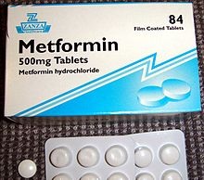
Formulations of Metformin :
Metformin IR (immediate release) :
Strenghts available : 500 mg, 850 mg, & 1000 mg tablets.
2. The liquid metformin is sold under the name Riomet. Each
5ml of Riomet is equivalent to the 500 mg tablet form of
metformin.
3. Metformin SR (slow release) or XR (extended release) :
Introduced in 2004.
It is available in 500 mg, 750 mg & 1000 mg strengths.
DEMERITS :
First pass effect.
Slow onset of action as compare to parentrals, liquid orals & capsules.
Difficult to swallow for terminally ill and geriatric patients.

Slide 5
Specific demerits of Metformin as a oral route
Metformin has the potential to stimulate lactic acid production when renal excretion is decresed.
Up to 20% of patients taking oral Metformin will experience the side effects such as anorexia, nausea, vomiting , abdominal discomfort and diarrhea.
The effects are dose related however up to 5% will discontinue thrapy due to the side effects.
The 77% of patients taking metformin will also develop the Vitamin B12 deficiency.
Metformin is absorbed over 6hrs. The biavability of the metformin is only 50-60% under fasting condition.

Slide 6
Solid Lipid Nanoparticles
Emerging field of the lipid nanotechnology.
Combine the advantages of lipid emulsion and polymeric nanoparticle systems overcoming the temporal and invivo stability issues.
Typically spherical having particle size dia. Between 10 to 1000nm.
Solid lipid core matrix that can solubilize lipophilic molecules.
Advantages:-
Use of physiological lipids & the avoidance of the organic solvents.
Improved bioavailability.
Controlled released characteristics.

Slide 7
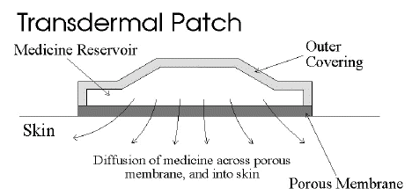
Transdermal Drug delivery :
“Topically administered medicaments in the form of patches or semisolids to deliver drugs for systemic effects at a predetermined & controlled rate.”
MERITS :
Avoidance of the first-pass effect.
Long duration of action
Ease of termination of drug action, if necessary.
Other transdermal Drugs :
1. Glipizide 3. Hyoscine
2. Glibenclamide 4. Nitroglycerine

Slide 8
Materials & Methods :
Ingredients Experimental Models
Polymethacrylic acid (polymer) Male Wistar rats (240 ± 20 gms)
Propylene glycol (Penetration enhancer) Balb C Mice (20 to 30 gms)
Soya lecithin (lipid base)
Metformin (5mg)
Methocel (film forming agent)
Acetone (Solvent)
Ethanol (Solvent)

Slide 9
Preparation Of Metformin – Solid lipid Nanoparticles (M-
SLN ) & Metformin transdermal patches :
Preparation of Nanoparticles Transdermal Patch
Metformin + water + acetone (solution 1) Polymer soaked in water for overnight
Polymer & PEG dissolved in CHCl3 addition of M-SLN
along with Soya lecithin --- (solution 2)
(solution 2 + solution 1) Mixed uniformly
Dispersion + ethanol Suspension casted on glass mould Mix
Organic Solvent drying
removed by evaporation
Cut into small pieces Different batches of nanoparticles

Slide 10
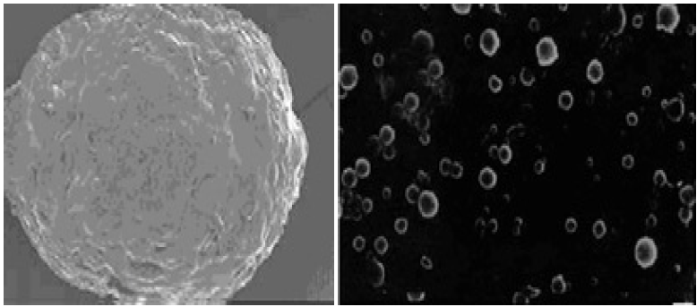
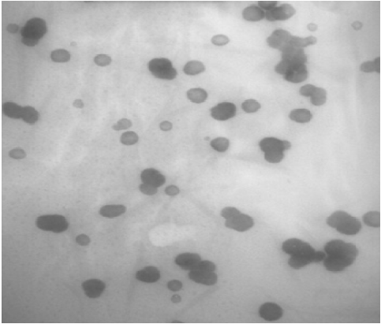
Particle size , Zeta potential & Surface morphology :
Particle size determined by Photon correlation spectroscopy
Particle size of 200-245 nm was obtained.
Determined at a detection angle of 173 at 25 ºc.
Scanning Electron Microscope :
Non aggregated microcapsules
with spherical shape were obtained.
Transmission Electron Microscope :
A Philips CM 10 TEM was used.
A conc. of 0.5% w/v of nanoparticle was
sprayed on Formwar-coated Cu grids &
air dried. M-SLP were spherical in shape.
250X
40X
46000X

Slide 11
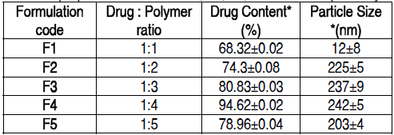
Drug Content & FT-IR Analysis :
Drug content was done by ultrafiltration-centrifugation method
* Average of three preparation ± S.D
FT-IR Analysis :
Pure metformin & drug + polymer spectra were recorded.

Slide 13
In-vitro studies :
Drug content analysis
Ex-vivo permeation study
Patches of specified area were
weighed
dissolved
100 ml ethanol
membrane filtration
Drug content analysed by HPLC
Skin samples mounted on Franz diffusion cells with stratum corneum side-up Receiver comp.filled with physiological saline (sink condition) 37±0.5ºC with 100rpm
3cm Metformin patch mounted on skin sample collection Filtration & analysed by HPLC.

Slide 15
In-vivo studies :
Preparation of animals for studies :
Male Wistar rats were used.
Animals were divided into 03 groups ;
Group I – Placebo patch (control) prepared by Methocel without nanoparticles.
Group II – Metformin oral administration
Group III- Transdermal patch with Metformin nanoparticles.
Induction Of Diabetes :
Induced by Streptozocin dissolved in 0.1 M citrate-citrate sodium buffer Ph 4.5 intraperitoneally in all 03 groups.
Blood samples were collected from tail vein to determine blood glucose levels.

Slide 16
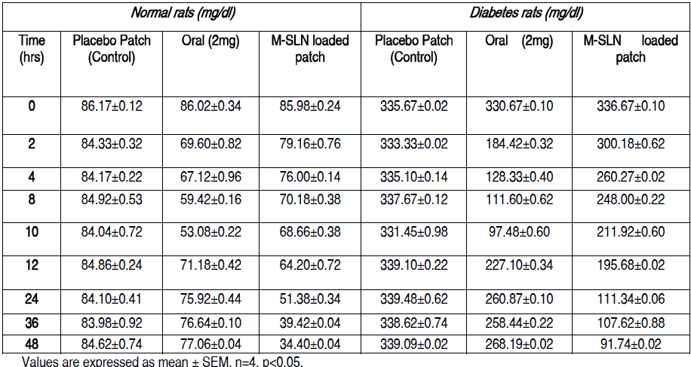

Slide 17
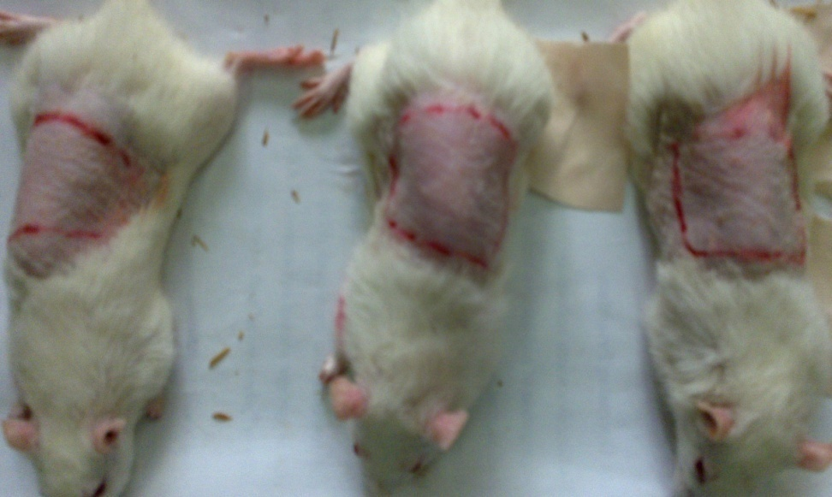
In-vivo evaluation of M-SLN Transdermal patches for biocompatibility :
M-SLN Patches were subcutaneously applied on back of mice control group was also applied with same patch without M-SLN Histopathological changes were noted at application sites.

Slide 18
Biocompatibility studies:-
A
B
FT
CF
N
7th Day
14th Day
c
21st Day
FT
(100×, N neutrocyte; CF collagenous fiber; FT fibrous tissues)

Slide 19
DISCUSSION :
M-SLN incorporated in transdermal patch possess marked hypoglycaemic activity & antihyperglycaemic activity.
Ex-vivo permeation studies predicted high cumulative amount of drug permeated by using nanoparticles made by polymethacrylic acid.
Histopathological studies confirm that M-SLN transdermal patches is biocompatible for use.
When prescribing transdermal Metformin, one advantage and key point is that the patient dose is generally only 10% of their oral dose. For ex. Instead of taking 500mg of metformin twice daily, a patient would apply 50mg topically to the inner wrists twice daily (10% of their oral dose).
To conclude, our results demonstrate the use of M-SLN in transdermal patches for the first time & show its therapeutic potential to be used as a cost effective, safe mode of drug delivery systems.

Slide 20


