Slide 1
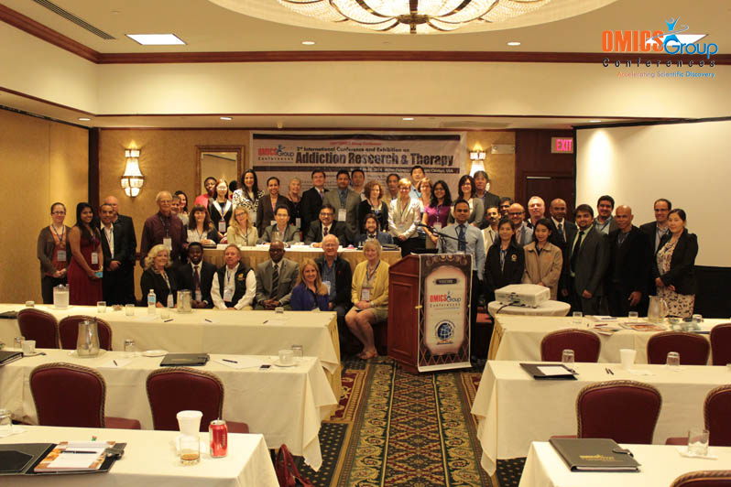
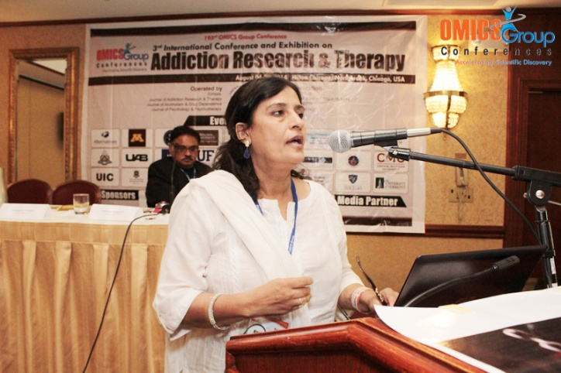
Addiction Therapy-2014 Chicago, USA August 4 - 6, 2014
Naumana Amjad

Slide 2
Beliefs about Addiction, Locus of Control and Relapse Proneness in Persons with Substance Use Disorders (PSUD’s)
Naumana Amjad, Qudsia Nashee & Rafia Rafique
Institute of Applied Psychology
University of the Punjab, Lahore, Pakistan
Contact : naumana.appsy@pu.edu.pk

Slide 3
Preface
When I first started working in the field of drug addiction, I had trouble figuring out how the various perspectives in this extensive field fit together. I felt like it was a whole paradigm shift from the concept of street addicts to users belonging to the noble families, having history of bright careers.
I realized that the missing piece in my perspective was a focus on the science of drug addiction. Putting aside the social context the perspectives about addiction among drug abusers played a significant role.
PSUDs (persons with substance used disorder ) reported their experiences regarding beliefs of counselors and how their own beliefs regarding addiction changed based on their counselors’ beliefs.

Slide 4
This Study: aims to understand beliefs about addiction and drug use, perception regarding control in drug abuse and the relation of these to relapse proneness. The beliefs of treatment providers and beliefs of PSUDs and locus of control beliefs of PSUDs in relation to the relapse proneness were tested.
The goal of present research work is to contribute in increasing awareness among society, PSUD’s, their families and service providers about role of addiction beliefs and locus of control in recovery. Moreover to highlight these factors that may increase risk of relapse. Once these factors have been highlighted preventions and interventional strategies can better support recovery

Slide 5
In Pakistan the number of drug addicts is nearly 9.6 million
which 1.5 million use opium
and 750,000 are heroin addicts
(Anti Narcotics Forces (ANF), 2012)
75,000 drug users alone in Lahore district
out of which 20,000 are those who take the drugs through injections
(United Nations Office of Drugs and Crime (UNODC), 2012)
While relapse rate for drug addiction does not differ significantly from rate for other chronic diseases
Relapse rate for addiction ranges from 50 percent for resumption of heavy use to 90 percent for a brief lapse
(National Anti-Drug Agency (NADA), 2009)
(National Survey on Drug Abuse (NSDA), 2010)

Slide 6
Understanding addiction beliefs can be useful for ensuring treatment adherence and recovery outcomes.
Persons with varying sets of addiction beliefs may differ in preferred choice of treatment settings or programs, treatment compliance, treatment satisfaction, and treatment outcome.
Evidence indicates that the subjective views of health professionals may be communicated to the patient, and subsequently inﬂuence the patient’s health outcomes (McNeil et al.,1982) .

Slide 7
Moyers and Miller (1993) found that therapists who endorsed a psychosocial model of addiction were less likely to incorporate client treatment goals into treatment plans,while those endorsing a disease model of addiction were more likely to encourage lapsed clients to return to treatment.
Addiction attitudes may influence behavior toward those with substance use disorders (SUDs) and personal decisions regarding use (Trafimow, 1996), and individual acceptance of new addiction-related information. For example, moralistic attitudes about addiction reduce tolerance and increase stigma toward those with substance use disorders (SUDs; Caplehorn, Irwig, & Saunders, 1996a; Luoma et al., 2007; Peele, 1998). Such stigma may generate a barrier to individual acceptance of personal substance abuse dependency thereby delaying onset of treatment.

Slide 8
Recent findings by the National Survey on Drug Use and Health (SAMHSA, 2009) provide an example of the influence of addiction attitudes. Of the 23 million individuals (8.3% of the total U.S. population age 12 and older)meeting diagnostic criteria for substance abuse disorders during 2008, 21 million did not receive treatment at any specialty clinic, including hospitals (inpatient only), mental health centers or substance abuse rehabilitation facility (SAMHSA, 2009). When questioned, 3.7% agreed they needed treatment but made no effort to obtain help and 95.2% refused to believe they needed treatment. Thus, user beliefs and attitudes acted as a barrier to actually receiving treatment.

Slide 9
Research has also suggested that psychologically healthy individuals have a greater sense of control than those suffering from psychological distress or impairment. Further, these healthy individuals have been found to overestimate the amount of control that they have in a situation, to be more optimistic about their ability to achieve control, to overestimate their invulnerability, and to underestimate risk in certain situations (Lewinshon, Mischel, Chaplin, & Barton, 1980; Seligman, 1991; Taylor & Brown, 1988).

Slide 10
research has shown that those who believe that there is something they can do about their disease or the resulting stresses have a more positive psychological adaptation than do those who do not have such beliefs (Shapiro et al., 1996).

Slide 11
Findings revealed that external locus of control was associated with higher levels of actual stressors, higher levels of neuroticism, the use of more emotion directed coping behaviors, and higher levels of perceived stress (Horner, 1996). Further, reported illness was predicted by locus of control, neuroticism, and the stressors examined in the study. This study concluded that external locus of control beliefs are related to the experience of illness, suggesting a strong link between external locus of control and illness (Horner, 1996). These findings support the link between stress and illness and provide additional information with regard to the relationship between locus of control and illness.

Slide 13
Relapse does not occur within a vacuum. There are many contributing factors, as well as identifiable evidence and warning signs which indicate that a patient may be in danger of returning to substance abuse.

Slide 14
Treatment success and relapse among drug abusers have been studied extensively (Brewer, et al., 1998; Hubbard, Craddock, Flynn, Anderson & Etheridge, 1997; Fletcher, Tims& Brown, 1997; Prendergast, Podus, & Chang, 1998; Simpson, Savage, & Lloyd, 1979). Some clear predictors of relapse have emerged; however, most are gross measures of a client’s demographic status, psychiatric status, or program attendance. For instance, a recent meta-analysis of treatment for opiate PSUD’s shows that unemployment, high levels of use, no prior abstinence, depression, association with drug-using peers, short treatment duration, and leaving treatment prior to completion are predictive of relapse (Brewer, et al., 1998). Longer treatment participation and participation in aftercare has been shown to improve relapse rates (Hubbard, et al., 1997; Miller, et al, 1997).

Slide 18
Beliefs about addiction of the treatment providers will be associated with behavioural outcomes (relapse proneness) of the PSUDs.
Based on theoretical background and literature it was conceptualized
(Figure1)
Beliefs about addiction of PSUDs will also be associated with relapse proneness of PSUDs.
Whereas, locus of control is the attribution that can influence the behavioural outcome and will determines the association between beliefs about addiction of PSUDs and relapse proneness of PSUDs.

Slide 19
The proposed model
Beliefs about Addiction of PSUDs
Eight Subscales
IBC= Inability to Control, CD= Chronic Disease, ROE= Reliance on Experts); & GB= Genetic Basis (Subscales representing Disease model Belief of PSUs)
RFA= Responsibility for Action, RFR= Responsibility for Recovery, COP = Coping, & MW= Moral Weakness (Subscales representing Choice model Belief of PSUDs),
Drug related Locus of Control of PSUDs
Internal Drug related Locus of Control
External Drug related Locus of Control
Beliefs about Addiction of Treatment Providers
Relapse Proneness of PSUDs
Belief on Disease Model
Belief on Choice Model
Low Relapse Proneness
High Relapse Proneness

Slide 20
Sample
Method
Treatment providers sample size was 17 that was contingent upon presence and availability of treatment providers of respective rehabilitation centers and hospitals
120 PSUDs were taken as sample from different Rehabilitation Centers and hospitals in Lahore, Pakistan.
The data of the treatment providers was used in replication for all the PSUDs of the particular treatment provider.

Slide 21
Inclusion criteria.
Only Professionally expert treatment providers(doctors, psychiatrists, psychologists, counselors, social workers and supporting nursing care staff) was taken as sample of treatment providers.
Only those PSUD’s seeking treatment in complete supervised settings (a setting that provides high clinical standards, sustained professional expertise by doctors, psychiatrists, psychologists, counselors, social workers and supporting staff) and have gone through the process of detoxification (process of neutralizing or eliminating drugs from the body) was included in the sample.
This inclusion criteria was followed to reduce the effects of extraneous variables and to ensure that sample participants are in the stage of their recovery process from drug addiction at the time of data collection.

Slide 22
Exclusion criteria.
PSUD’s with any other psychiatric illness or comorbid diagnosis (presence of two disorders or illnesses occurring simultaneously in the same person; substance use disorders with any other mental illness) was excluded from the sample.
This exclusion criteria was followed to reduce the effects of overlapping symptoms of other mental illnesses that may made a person prone for relapse beyond the effects of drug addiction after taking drug addiction treatment.

Slide 23
Beliefs about Addiction. Beliefs about Addiction are defined in the terms of a person’s view point favoring a specific model of addiction. An individual if score high on the details of a specific model then the individual hold a belief about addiction particular to that specific model (Schaler, 1995; Luke, Ribisl, Walton, & Davidson, 2002).

Slide 24
Beliefs (Disease model )
Addiction is a chronic disease that does not get better.
The only chance for management is abstinence.
Most addicts don’t know they have problem and must be forced to recognize they are addicts.
Addicted persons cannot regulate their alcohol/drug use.

Slide 25
Beliefs (choice model )
Addiction has more to do with the environment people live in than the drugs they are addicted to.
drug addiction is a way of life people rely on to cope with the world.
Addicts have a character flaw.

Slide 26
Locus of control
Locus of control is defined in terms of internal versus external control as the degree to which a person expect that an outcome of behavior is contingent on one’s own behavior or personal characteristics versus the degree of chance, luck or fate (Hall, 2001)
Some of the sample items are “A. I feel so helpless in some situations that I need to get high; B. Abstinence is just a matter of deciding that I no longer want to use drugs”, “A. Drugs aren’t necessary in order to solve my problems; B. I just cannot handle my problems unless I get high first”.

Slide 27
Relapse proneness
Relapse is characterized by some warning signs that an individual go through. An individual scoring high on these warning signs is predictable for relapse (Miller & Harris, 2000).
Some of the sample items are “I feel nervous or unsure of my ability to stay sober”, “Things don’t work out well for me”, I feel like things are so bad that I might as well do drugs”, and “I lie to other people”.

Slide 28
Measures | No of items | Rating and scoring
Addiction Belief Scale (Schaler , 1995) | 18 | ABS has 5point Likert scale that ranges from 1 (strongly disagree) to 5(strongly agree)
2. Addiction Belief Inventory (Luke, Ribisl, Walton, & Davidson, 2002) | 30 | Likert type, 5-point rating scale: 1 (strongly disagree) to 5(strongly agree)
3. Drug Related Locus Of Control Scale (Hall, 2001) | 15 | Forced-choice measure
4. Aware Questionnaire (Miller and Harris, 2000) | 28 | likert type, 7-point rating scale: 1= Never, 2= Rarely, 3= Sometimes, 4= Fairly often, 5= Often, 6= Almost always, 7= Always

Slide 29
Analyses
A series of partial correlations were conducted to find the relationship between beliefs about addiction of treatment providers, beliefs about addiction of users, locus of control of users and relapse proneness of users.
In order to interpret a partial correlation between beliefs about addiction of treatment providers and beliefs about addiction of users , zero-order (bi-variate) correlation was conducted initially then partial correlation was conducted for the variables by controlling the effect of predetermined variables according to the proposed hypothesis.

Slide 30
Findings
A series of partial correlations analyses revealed association between beliefs about addiction of treatment providers on disease model and beliefs about addiction of users on inability to control aspect of disease model when controlling for education of treatment providers and education of users.
Beliefs of the treatment providers influence the beliefs of the users while there are some variables that play role in this association as number of relapses, history of drug use as well as personal drug use history of the treatment providers also influence the beliefs of treatment providers and in turn influence the beliefs of the users.

Slide 31
Findings
Hierarchical regression analyses revealed that the relationship between beliefs about addiction of treatment providers and relapse proneness of users was mediated by inability to control, responsibility for action, responsibility for recovery and genetic basis aspect of the users’ beliefs about addiction and the relationship between users’ beliefs and relapse proneness was moderated by drug related locus of control.
beliefs of the treatment providers are associated with the relapse proneness of the users
this association is arbitrated by the beliefs of users
the beliefs of the users are also associated with Relapse proneness
Drug related Locus of control buffers this association.

Slide 32
Discussion
The Beliefs of the treatment providers influence the beliefs of the users under treatment.
when a user has external locus of control and attributes his lack of control over drug use to external causes, his beliefs have a more significant influence on bringing him closer to relapse. This has been supported by earlier recent studies in Pakistan (Tanveer, Amjad and Rafique, 2013; Liaqat & Amjad 2014)

Slide 33
Questions to take forward
What is the best way to work on beliefs of users and Beliefs of the treatment providers ?
What are mechanisms for shifting locus of control ?
What about other factors linked to relapse proneness ?

Slide 34
Implications - According to these findings...
it is important to …
focus on drug use related beliefs especially among young persons at risk for first time use
Work on drug related locus of control during interventions
Train the treatment providers for appropriate beliefs that influence their patients
Address the specific aspects of beliefs that lead to increased relapse proneness

Slide 35
References
Hall, E.A. (2001). Drug related locus of control scale. Retrieved from www.uclaisap.org.
Luke, D. A., Ribisl, K. M., Walton, M. A., & Davidson, W. S. (2002). Assessing the diversity of personal beliefs about addiction: Development of the addiction belief inventory. Substance Use & Misuse, 37(1), 89-120.
Miller, W.R. (1996). What is a relapse? Fifty ways to leave the wagon. Addiction, 91, S15–S27.
Schaler, J. (1995). The Addiction Belief Scale. The International Journal of the Addictions, 30(2),117-134.
Tanveer & Amjad.(2013). Charcetristics of recovering and using addicts. Paper presented at 2013 Addiction therapy Conference, Las Vegas.
Liaqat & Amjad. (2014). Beliefs about addiction among students and intentions to continue. University of Pubjab research project.

Slide 36
Meet the eminent gathering once again at Addiction Therapy-2015 Florida, USA August 3 - 5, 2015
Addiction Therapy – 2015 Website:
addictiontherapy.conferenceseries.com

