Slide 1
ROLE OF ANGIOTENSIN CONVERTING ENZYME INHIBITORS AND ANGIOTENSIN RECEPTOR BLOCKERS IN TYPE I DIABETIC NEPHROPATHY
DR.NASIM MUSA

Slide 2
Type I –IDDM is characterized by
The abrupt onset of symptoms
Insulinopenia
Dependence on injected insulin for life
Proneness to ketoacidosis.
Confirmed by demonstrating low plasma insulin or C- peptide levels, circulating islet cell antibodies and association with HLA DR3,DR4
Asparagines for neutral amino acids in position 57 of HLA-DQB chain.

Slide 3
Clinical distinction between type I and type II Diabetes
CRITERIA | IN FAVOUR OF TYPE I | IN FAVOUR OF TYPE II
Age at diagnosis of diabetes | <25 yrs | >40 yrs
Weight at diagnosis | 105% of ideal weight | >115%
Ketoacidosis within 2 yrs of following diagnosis | + + | - -
Long term complications at diagnosis | - - | + +
Delay between diagnosis and insulin deficiency | - - | + +
C-peptide | - - | + +

Slide 4
Diabetic nephropathy
A major micro vascular complication of diabetes mellitus.
Major cause of morbidity and mortality in both type I and type II diabetes
Represent the major cause of ESRD worldwide.
About 20-40% of all diabetic subjects develop DN
Diabetic nephropathy represents a continuum from microalbuminuria to macroalbuminuria and finally ESRD.
There is vital need to identify and target novel pathophysiological pathways to reduce the rising burden of this disease.

Slide 5
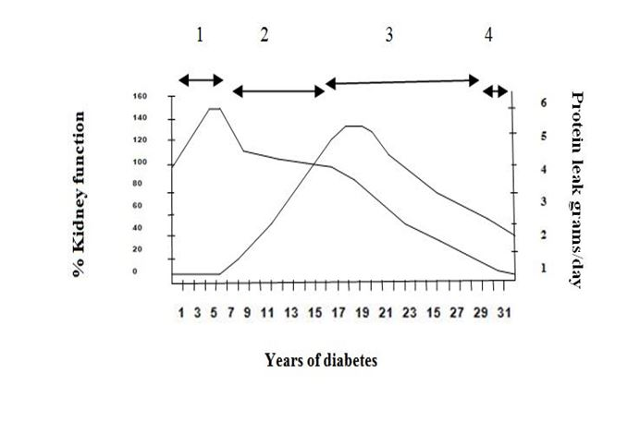
A GRAPH SHOWING RELATIONSHIP BETWEEN KIDNEY FUNCTION,PROTEIN LEAK, AND YEARS OF DIABETES

Slide 6
EPIDEMIOLOGY OF DN-
40% OF TYPE I AND 20% OF TYPE II
DIABETICS DEVELOP CLINICALLY SIGNIFICANT NEPHROPATHY.
ACCORDING TO Krolewski et al. PATIENTS
WITH IDDM HAVE 30%-50% RISK OF
DEVELOPING DIABETIC NEPHROPATHY OVER
40 YEAR OF DISEASE.
Krolewski AS, warram JH, christlieb AR, Busik EJ, Khan CR. The
changing natural history of nephropathy in type I diabetes. Am Jf Med 1985;785-94.

Slide 7
Natural course of renal disease in Diabetes
Time(yrs)
0 5 11-13 13-25 15-27
Increased Hyperfiltration Decreasing GFR
GFR Persistent MA Overt Albuminuria
Functional
Changes Reversible
albuminuria Increasing BP Hypertension
“Normal” BP
Structural Increasing GBM Mesangial Glomerulosclerosis
Changes thickness expansion
Nephromegaly
Normoalbuminuria Incipient Nephropathy Overtnephropathy
-microalbuminuria. -macroalbuminuria.
Onset of
Diabetes
End stage
Kidney disease

Slide 8
PATHOPHYSIOLOGY OF DIABETIC NEPHROPATHY-

Slide 9
STAGES OF DIABETIC NEPFROPATHY-
STAGE | GLOMERULAR FILTRATION | ALBUMIN | BP | TIME
RENAL HYPERFUNCTION | ELEVATED | ABSENT | NORMAL | AT DIAGNOSIS
CLINICAL LATENCY | HIGH NORMAL | ABSENT | WITHIN OR ABOVE NORMAL | 5-15 YRS
MICROALBUMINURIA | NORMAL | 20-200ug/min | INCREASED | 10-15 YRS
MICROALBUMINURIA OR PERSISTING PROTEINURIA | DECREASING | 200ug/min | - | -
RENAL FAILURE | DIMINISHED | massive | INCREASED | 15-30 YRS

Slide 10
MANAGEMENT-
SLOWING THE PROGRESSION OF DN INCLUDES
OPTIMISING GLYCAEMIC CONTROL
CONTROL OF HYPERTENSION
USING ACEI AND/OR ARB.

Slide 11
MANAGEMENT-
MEDICINES THAT ARE USED TO TREAT DIABETIC NEPHROPATHY ARE ALSO USED TO CONTROL BLOOD PRESSURE.
ACEI SUCH AS
CAPTOPRIL, LISINOPRIL, RAMIPRILAND ENAPRIL, HAVE BEEN SHOWN TO PROTECT THE KIDNEY FUNCTION IN PEOPLE WITH TYPE I DIABETES.

Slide 12
MANAGEMENT
ARBS, SUCH AS
CANDESARTAN, IRBESTAN, OSARTAN POTASSIUM, MAY BE GIVEN WITH ACEI TO PROVIDE GREATER PROTECTION OF THE KIDNEY.
Chavers, BM, Billus, N. Eng J Med 1989; 320:966

Slide 13
ROLE OF ACEI
ACEI Blocks The Conversion of Angiotensin I To Angiotensin II. They Lower Arteriolar Resistant And Increased Venous Capacity, Increased Cardiac Output And Lower Renovascular Resistance.
First Orally Active ACEI Was Captopril Which Was Discovered In 1975

Slide 14
ROLE OF ARB
THEY BLOCK THE ACTIVATION OF
ANGIOTENSIN II AT AT1
RECEPTORS. BLOCKADE CAUSES VASODILATATION, REDUCES SECRETION OF VASOPRESSIN, REDUCES PRODUCTION OF AND SECRETION OF ALDOSTERONE.
FIRST ORALLY ACTIVE ARB WAS LOSARTAN WHICH WAS DISCOVERED IN 1980.

Slide 15
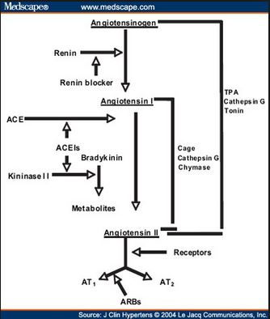
ANGIOTENSIN PATHWAY-

Slide 16
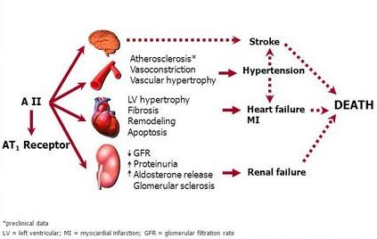
ANGIOTENSIN II PLAYS A CENTRAL ROLE IN ORGAN DAMAGE

Slide 17
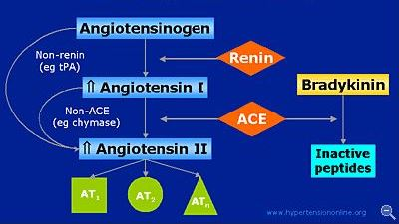
RENIN-ANGIOTENSIN CASCADE

Slide 18
WHAT ARE THE EVIDENCES?
Are The Inhibitors Of
Renin- Angiotensin
System(ACEIs or ARBs)
Really Effective?

Slide 19
ACE-I Is More Renoprotective Than Conventional Therapy In Type I
Diabetes

Slide 20
ACE-I Is More Renoprotective Than Conventional Therapy In Type I
Diabetes2

Slide 21
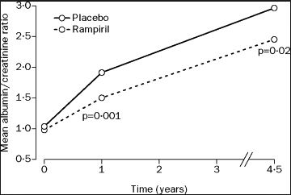
Micro Hope Study (n=3577)
24% greater decrease in progression to overt
Nephropathy in the Ramipril group than placebo

Slide 22
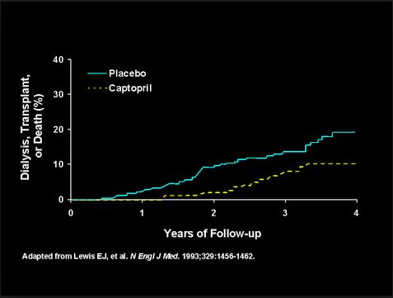
Renoprotective Effect Of Losartan In Diabetic Nephropathy (RENAAL Study, n=1513)

Slide 23
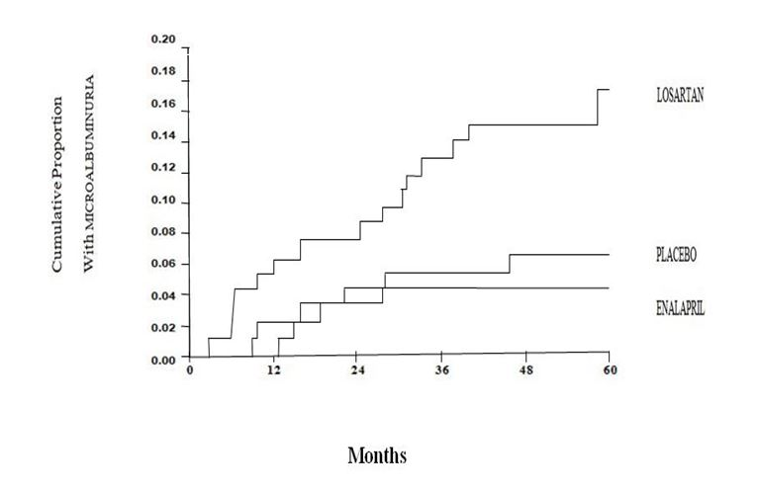
Comparison Of Losartan, Enalapril & Placebo On Microalbuminuria

Slide 24
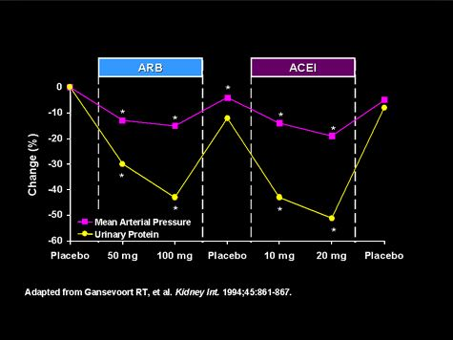

Slide 25
STUDY | STUDY DESIGN | SAMP-LE SIZE | EXPOSURE | RESULTS | CONCLUTION
Jacobsen et al | RCT Crossover Design. | 20 | ACEI &/or ARB. | Treatment with benazepril, valsartan or dual blockade significantly reduce albuminuria and BP compared with placebo. Dual blockade induced an additional reduction in albuminuria of 43% (29to 54%) compared with any type of monotherapy. | Dual blockade of the RAS may offer additional renal and cardiovascular protection in type I diabetic patients with DN
Mauer et al | RCT Multi-center Parallel design. | 285 | ACEI & ARB. | Change in mesangial fractional volume per glomerulus over 5-year period did not differ significantly between Placebo(0.016 units) and Enalapril(0.005,p=0.38) or Losartan group | Early blockade of the renin-angiotensin system in patients with type I diabetes did not slow nephropathy progression.
Lewis et al | RCT Multi-center Parallel design. | 409 | ACEI. | Total 65 patients reached endpoint, of which 23 were in captopril group and 42 were in pacebo group. Treatment with captopril is associated with 50% reduction of in risk of combined end points of death. Dialysis or renal transplantation. | Captopril protect against deterioration of renal function in IDDM Nephropathy irrespective of BP status. The therapy is effective on patient with established nephropathy rather not as prophylactic treatment.
Agarwal et al | RCT Crossover design. | 17 | ACEI & ARB. | Increase in GFR was seen 14% by the add-on Losartan therapy and fall of Plasama rennin activity by 32%. | Add on Losartan therapy didn’t improve proteinuria or ABP over one month add on therapy.
Schjoedt et al | Clinical audit. Follow-up Study. | 227 | ACEI or ARB. | With RAS blockade mean decline in UAER of 4% year. 65 patients(29%) progressed to overt Diabetic Nephropathy, about 3.1%/yrs. 29 of them regressed to normo-or microalbuminuria on intensified antihypertensive treatment. | Implementation of RAAS-blocking treatment in type I diabetic patients with microalbuminuria successfully reduced long-term progression to overt Diabetic Nephropathy.
Tarnow et al | RCT Parallel design. | 52 | ACEI vs Ca antagonist. | GFR declined in a biphasic manner with an initial(0-6months) reduction of 1.3+ 0.3ml_min _1_month_1 in the lisinopril group compared with0.2+ 0.4ml_min_1_month_1 in the nisoldipine geoup (p_0.01). | Long-term treatment with Lisinopril or Nisoldipine has similar beneficial effects on progression of diabetics nephropathy in hypertensive type I diabetic patients.

Slide 26
STUDY | DRUG | N= | CONCLUTION
Jacobsen et al | ACEI &/or ARB | 20 | Dual blockade of the RAS may offer additional renal and cardiovascular protection in type I diabetic patients with DN.
Mauer et al | ACEI & ARB | 285 | Early blockade of the renin-angiotensin system in patients with type I diabetes did not slow nephropathy progression.
Lewis et al | ACEI | 409 | Captopril protect against deterioration of renal function in IDDM Nephropathy irrespective of BP status. The therapy is effective on patient with established nephropathy rather not as prophylactic treatment.
Agarwal et al | ACEI & ARB | 17 | Add on Losartan therapy didn’t improve proteinuria or ABP over one month add on therapy.
Schjoedt et al | ACEI or ARB | 227 | Implementation of RAAS-blocking treatment in type I diabetic patients with microalbuminuria successfully reduced long-term progression to overt Diabetic Nephropathy.
Tarnow et al | ACEI vs Ca antagonist | 52 | Long-term treatment with Lisinopril or Nisoldipine has similar beneficial effects on progression of diabetics nephropathy in hypertensive type I diabetic patients.

Slide 27
CONCLUTION-
FURTHER STUDIES AS WELL AS REVIEW WITH HOMOGENEOUS SUBJECT EXPSURE AND OUTCOME COULD UNVEIL DEFINITIVE EVIDENCE REGARDING ROLE OF ACEI AND ARB FOR PREVENTION AS WELL AS FOR TREATMENT OF DIABETIC NEPHROPATHY IN IDDM PATIENT.

Slide 28
THANK YOU

