Slide 1
Vascular Access Placement in Patients with Incident CKD Stage 4 and 5 attending an Inner City Nephrology Clinic: A Cohort Study and Survey of Providers
Narender Goel et al.
Middletown Medical PC,
Montefiore Medical Center & Albert Einstein College of Medicine, New York
4th International Conference on Nephrology & Therapeutics
September 14, 2015
Baltimore, USA

Slide 2
Conflict of Interest
Dr Narender Goel: None
Dr Caroline Kwon: None
Dr Teena P. Charalel: None
Dr Carolyn Bauer: None
Dr Michal L Melamed: None
Dr. Vaughn Folkert: Member of the Fresenius Medical Advisory Board

Slide 3
Trends in the Number of Incident Cases of ESRD, in thousands, by Modality, in the U.S. population, 1980-2012
Data Source: USRDS ESRD Database (2014 Annual Date Report )

Slide 4
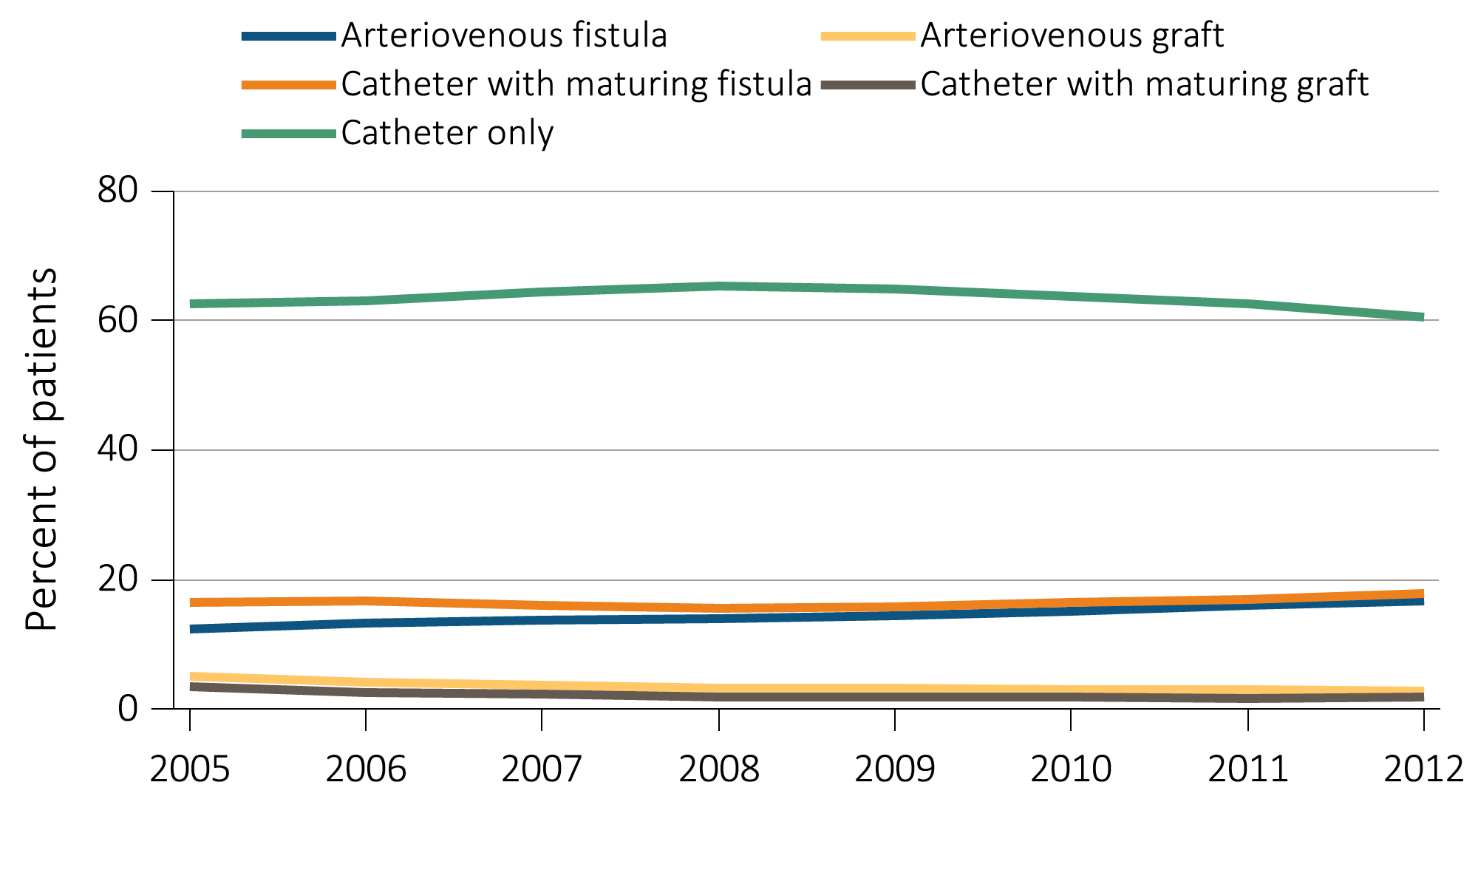
Vascular Access Use Among Hemodialysis Patients at Initiation of ESRD treatment, from the ESRD Medical Evidence Form (CMS 2728): Time Trend From 2005-2012
Data Source: Special analyses, USRDS ESRD Database (2014 Annual Date Report )

Slide 5
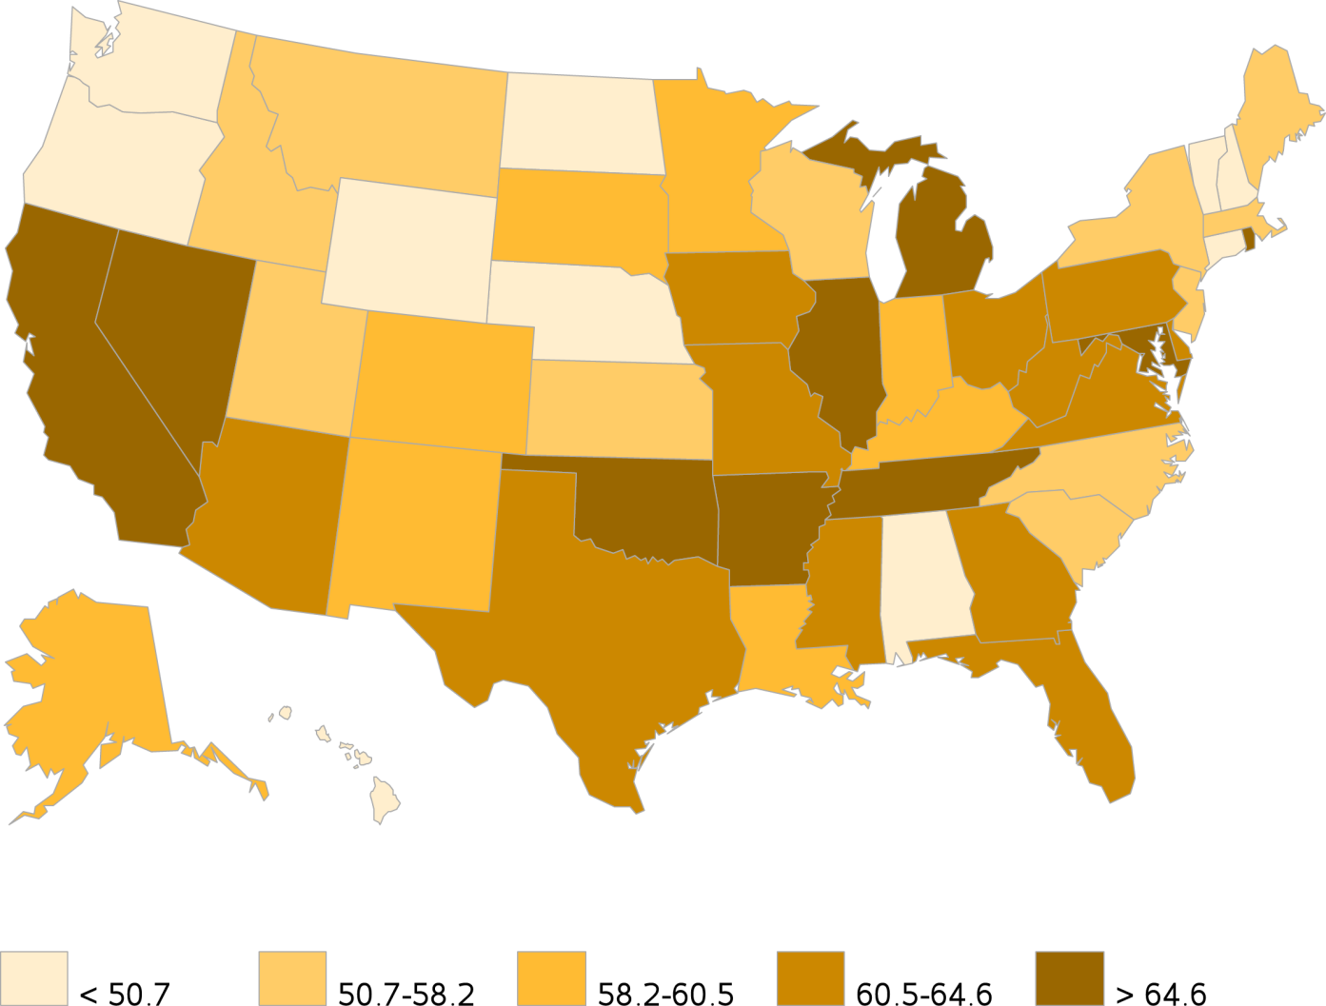
Geographic Variation in Percentage of Catheter Alone use at Hemodialysis Initiation, in year 2012, from the ESRD Medical Evidence Form (CMS 2728)
Data Source: Special analyses, USRDS ESRD Database (2014 Annual Data Report)

Slide 6
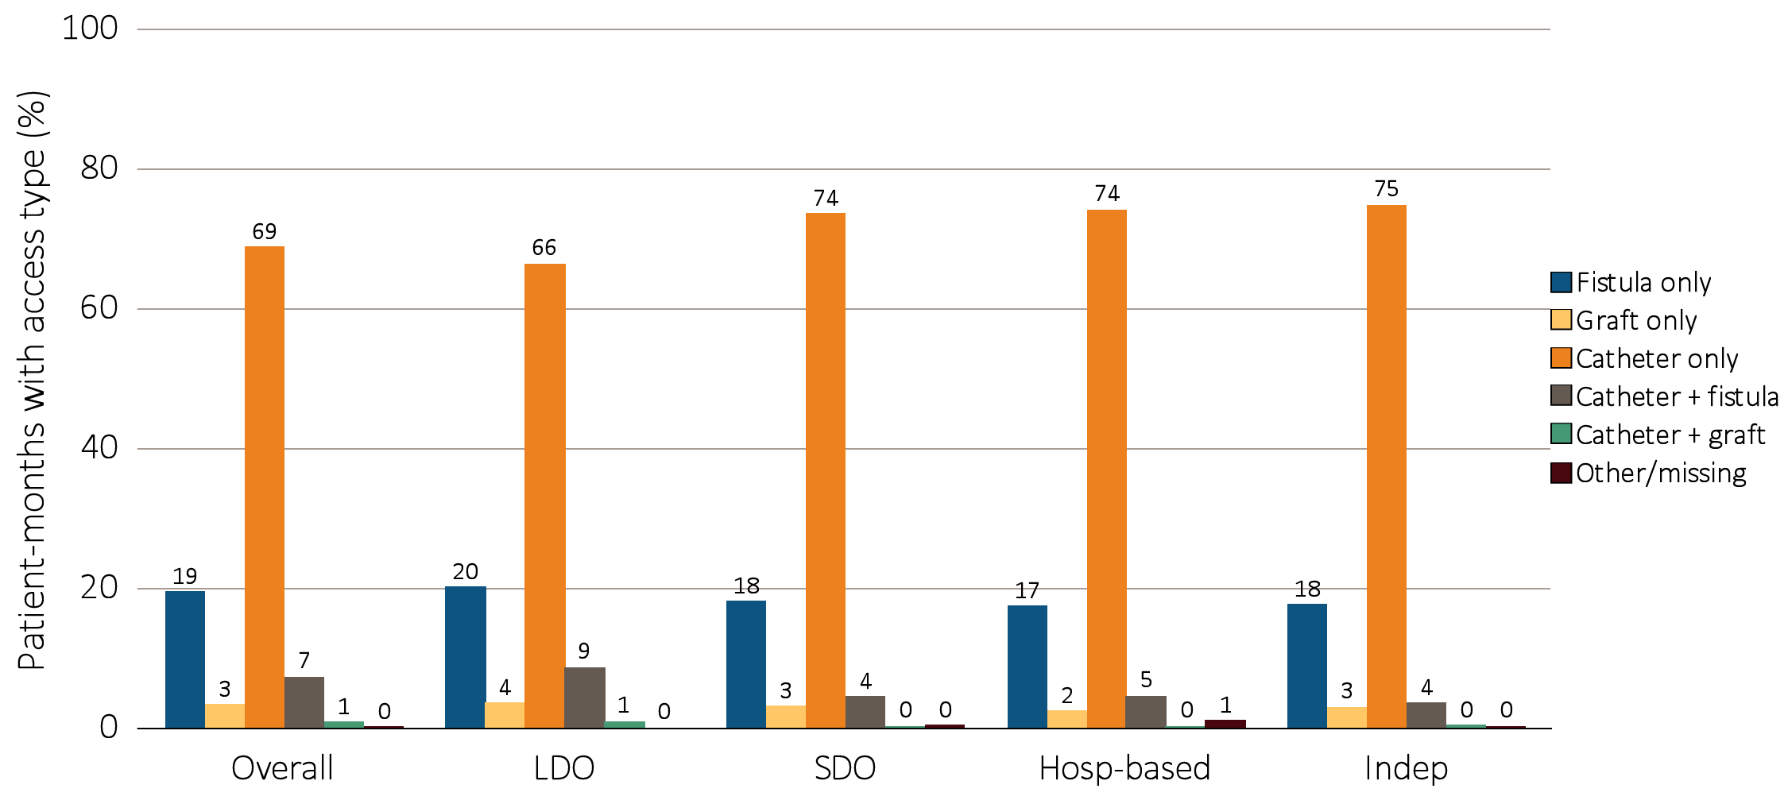
Prevalence of Vascular Access Type Among Incident Dialysis Patients by Unit Affiliation in 2012
Data source: Special analyses, USRDS ESRD Database (2014 Annual Data Report)
Abbreviations: Hosp-based, hospital-based dialysis centers; Indep, independent dialysis providers; LDO, large dialysis organizations; SDO, small dialysis organizations

Slide 8
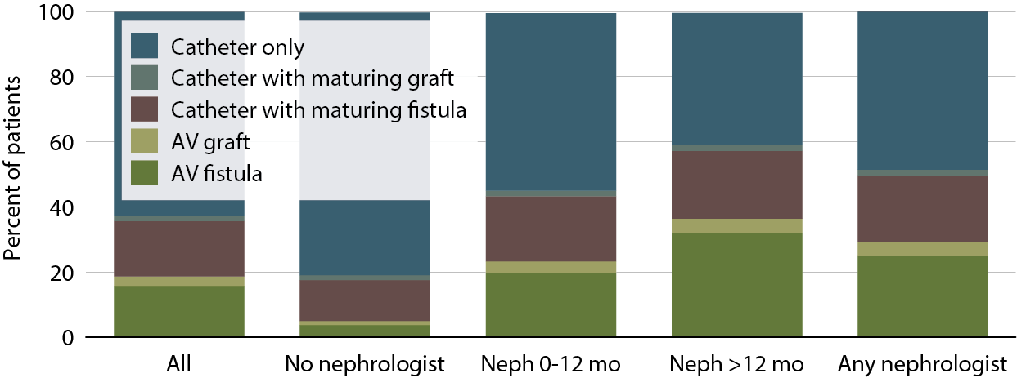
Access Use at First Outpatient Hemodialysis, by Pre-ESRD Nephrology Care, 2011
Data Source: USRDS ESRD Database (2013 Annual Date Report )

Slide 9
KDOQI/NKF Clinical Practice Guidelines
Timing of Access Placement
Patients with chronic kidney disease should be referred for surgery to attempt construction of a primary AV fistula when their creatinine clearance is <25 mL/min, their serum creatinine level is >4 mg/dL, or within 1 year of an anticipated need for dialysis. (Opinion)
Dialysis AV Fistula should be placed 6 months prior and AV grafts should be placed at least 3 to 6 weeks prior to an anticipated need for hemodialysis in patients who are not candidates for primary AVF. (Opinion)
Goals of Access Placement–Maximizing Primary AV Fistulae
Primary AV fistulae should be constructed in at least 50% of all new kidney failure patients electing to receive hemodialysis as their initial form of renal replacement therapy. (Opinion)

Slide 11
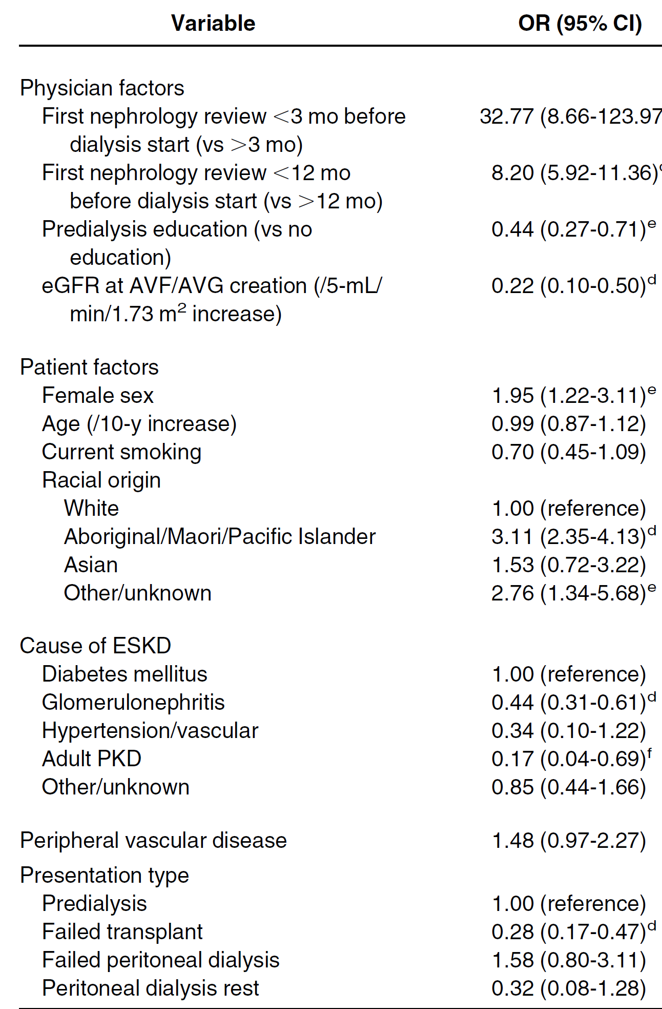
Variables Associated With Catheter Versus Permanent Access Use at Hemodialysis Start
Lopez-Vargas et al. Am J Kidney Dis, 2011 Jun;57(6):873-82.

Slide 12
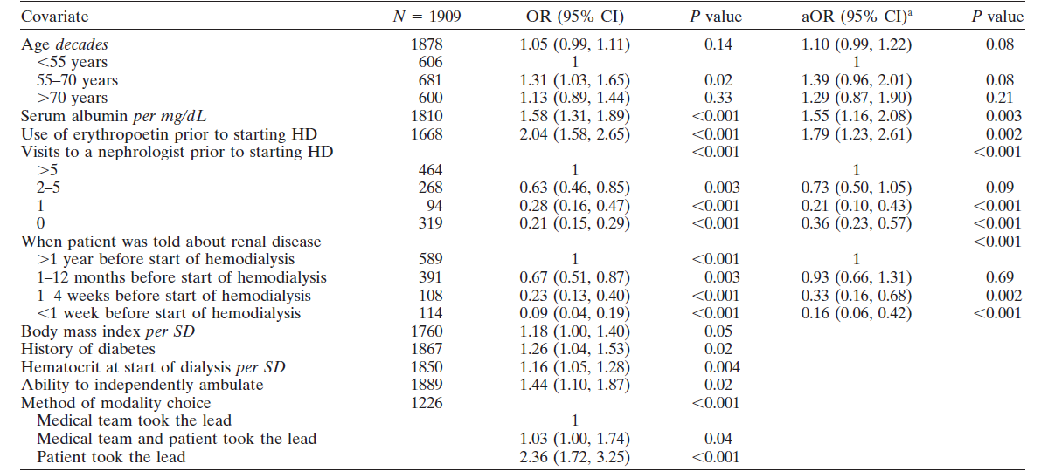
Odds of Having Functional Permanent Access at the Start of Hemodialysis
Stehman-Breen et al. Kidney Int. 2000 Feb;57(2):639-45.

Slide 13
Vascular Access Placement in Patients with Incident CKD Stage 4 and 5 attending an Inner City Nephrology Clinic: A Cohort Study and Survey of Providers
Narender Goel MD, Caroline Kwon MD, Teena P. Charalel MD, Vaughn W. Folkert MD, Carolyn Bauer MD, Michal L Melamed MD, MHS
Design
Retrospective chart review
Study Period
June 1, 2011 to August 31, 2012
Patients were followed via chart review until August 31, 2013
Objective:
Assess associations of key variables with vascular surgery referral, AV access placement and initiation of dialysis
Survey of nephrologists at our institution to assess their perceptions of the access placement process.

Slide 14
Inclusion Criterion:
All adult patients, age >18 years seeing a nephrologist with new CKD stage 4 or 5 during the study period.
Patients (n=31) who had prior nephrologist follow-up for CKD stage 2 or 3 but were seen during the study period for the first time with a diagnosis of CKD stage 4 or 5 were also included
Exclusion Criterion:
Patients choosing Peritoneal Dialysis as mode of dialysis
Patients declined to accept dialysis
Patients had arm access placed before study period
If patients were seeing a nephrologist at out institution for CKD stage 4 or 5 prior to June 1st, 2011

Slide 15
Nephrologists Survey
We also conducted a web-based anonymous survey of all of the nephrology faculty members and fellows (PGY 4 and 5)
Questions and responses in the survey included:
In your opinion, what is the main limiting factor in referring patients with CKD stage 4 and 5 to a vascular surgeon?
Possible answers:
Patients’ refusal
Patients’ non-compliance
Patients not decided about modality of dialysis
Nephrologists
Insurance status
Co-morbidities

Slide 16
In your opinion, what is the main limiting factor in obtaining timely vascular access?
Possible answers:
Nephrologists
Vascular surgeon
Hospital system and appointments
Patients
I am not sure

Slide 17
Study Flow Diagram
Total patients: 263
Patients studied*: 221
Refused dialysis: 13
Choose PD: 11
AV access before study: 17
2nd opinion only: 1
Seen with CKD 4: 180 (81%)
Seen with CKD 5: 41 (19%)
Started HD: 17
Started PD: 5
Lost follow up: 11
eGFR improved to>29: 7
Transplant: 0
Death: 4
Lost follow up: 6
eGFR improved to>29: 4
Transplant: 1
Death: 1
Initial access: Catheter: 2
AVG: 1
AVF: 14
Started HD: 32
Started HD: 16
*14% of patients (n=31) had prior follow-up with CKD stage 2 or 3 but were seen during the study period for the first time with CKD stage 4 (96.5%) or stage 5 (3.5%).
Initial Access: Catheter: 21 AVG: 5
AVF: 6
Initial access: Catheter:13
AVF: 3

Slide 18
Baseline Demographics
 | Total-221 | Faculty (141) | Fellow (80) | p-value
Age [years] | 64.8 (13.6) | 67.2 (12.9) | 60.6 (13.7) | <0.001
Female (%) | 124 (56) | 91 (64.5) | 33 (41.2) | 0.001
Mean BMI [Kg/m²] | 30.4 (7.0) | 30.7 (7.1) | 29.7 (6.9) | 0.14
Co-morbidities
Hypertension (%) | 206 (93.2) | 130 (92.2) | 76 (95) | 0.58
Diabetes Mellitus (%) | 146 (66) | 93 (65.9) | 53 (66.3) | 0.9
Congestive Heart Failure (%) | 96 (43.4) | 58 (41.1) | 38 (47.5) | 0.39
Peripheral Vascular Disease (%) | 33 (14.9) | 23 (16.3) | 10 (12.5) | 0.55
Race/ Ethnicity |  |  |  | 0.06
White (%) | 17 (7.7) | 14 (9.9) | 3 (3.7)
African-American (%) | 68 (30.8) | 49 (34.7) | 19 (23.7)
Hispanic (%) | 107 (48.4) | 63 (44.7) | 44 (55)
Other (%) | 29 (13.1) | 15 (10.6) | 14 (17.5)

Slide 19
Demographics | Total-221 | Faculty (141) | Fellow (80) | p-value
Primary Language
English (%) | 164 (74.2) | 108 (76.5) | 56 (70) | 0.3
Spanish (%) | 51 (23.2) | 30 (21.3) | 21 (26.2) | 0.4
Insurance
Medicaid (%) | 77 (34.8) | 33 (23.4) | 44 (55) | <0.001
Medicare (%) | 70 (31.8) | 54 (38.3) | 16 (20) | 0.006
Never smoker (%) | 118 (53.4) | 76 (53.9) | 42 (52.5) | 0.8
Hemoglobin, mean (SD) [gm/dL] | 10.7 (1.8) | 10.9 (1.8) | 10.3 (1.8) | 0.04
Albumin, mean [gm/dL] | 3.8 (0.6) | 3.96 (0.6) | 3.53 (0.7) | <0.001
Creatinine, mean [mg/dL] | 2.88 (1.2) | 2.7 (1.2) | 3.18 (1.2) | 0.005
Renal Clinic Visits, mean (SD) | 5.4 (4.1) | 5.3 (4.2) | 5.5 (4.1) | 0.8
eGFR [ml/min/1.73 m²] at the study entry, mean (SD) | 20.8 (6.4) | 21.3 (6.2) | 19.8 (6.5) | 0.07
Urine Albumin/creatinine ratio | 0.78 (0.18, 3.73) | 0.51 (0.13, 2.08) | 2.64 (0.44, 5.31) | <0.001
Follow up (years), median (IQR) | 1.26 (0.6-1.68) | 1.3(0.75-1.69) | 1.2 (0.4-1.6) | 0.1

Slide 20
CKD Etiology
 | N=221 | %
Diabetes Mellitus | 68 | 30.8
Hypertension | 57 | 25.8
Multi-factorial | 11 | 4.9
Acute Kidney Injury | 10 | 4.5
Glomerular disease | 9 | 4.1
Polycystic Kidney Disease | 2 | 0.9
HIV | 1 | 0.4
unknown | 40 | 18.2
Others | 23 | 10.4

Slide 21
Vascular Surgery Referral and AV Access Placement
Studied: 221
Referred to surgery: 94
Not referred to surgery: 127 (57.5%)
Not seen by surgery: 24
Seen by surgery: 70
Reasons:
Not documented in chart: 54%
Patients’ refusal: 12%
eGFR stable or >25: 27%
No Insurance: 2%
Others: 5%
AV access not placed: 9
AV access placed: 61
Access placed as inpatient: 21
Access placed as outpatient: 40

Slide 22
A total of 94 patients (42.5%) were referred to vascular surgery with a mean eGFR at the time of referral of 16.3±5.5 ml/min/1.73m².
Access surgery was done in 61 (27.6%) patients (55 AVF and 6 AVG) with mean eGFR of 14.3±6.2 ml/min/1.73m²
The median time of referral to the surgeon from the initial nephrology study visit was 28 days (IQR, 0-133)
The median time to see the surgeon from the time of referral was 52 days (IQR, 27-106).
The median time to surgery after an appointment with the surgeon was 30 days (IQR, 15-85).

Slide 23
The predominant reasons for not undergoing an access surgery (n=160) were as follows:
43% of patients were not referred for unknown reasons
20% of patients had stable eGFR or eGFR >25 ml/min/1.73m²
10% of patients refused
7% of patients missed their appointment

Slide 24
Odds Ratio of Vascular Surgery Referral and AV Access Placement
 | Vascular surgery referral (n=94) |  |  | AV access placement (n= 61) |  |  | Initiated Dialysis (n = 48)
 | OR* | 95% CI | p-value | OR* | 95% CI | p-value | OR* | 95% CI | p-value
Age, per year | 0.99 | 0.96 -1.02 | 0.33 | 0.97 | 0.94 - 1.00 | 0.06 | 0.98 | 0.95 - 1.01 | 0.27
African-American Race (compared to white) | 4.65 | 1.00 - 21.6 | 0.05 | 1.10 | 0.27 - 4.46 | 0.89 | 0.72 | 0.15 - 3.43 | 0.68
Hispanic Ethnicity (compared to non-Hispanic white) | 2.81 | 0.64 - 12.44 | 0.17 | 0.70 | 0.18 - 2.76 | 0.61 | 0.51 | 0.11 - 2.31 | 0.38
Diabetes Mellitus | 1.29 | 0.58 - 2.88 | 0.53 | 0.91 | 0.40 - 2.06 | 0.82 | 1.76 | 0.66 - 4.71 | 0.26
Log urine protein/ creatinine ratio | 1.45 | 1.13 - 1.86 | 0.003 | 1.36 | 1.05 - 1.75 | 0.02 | 1.72 | 1.28 - 2.32 | <0.001
All models for age, sex, race/ethnicity, diabetes mellitus, log urinary albumin/creatinine ratio and baseline eGFR. Renal fellow visit, number of renal visits, number of hospitalization, and the presence of AKI during a hospitalization put in individually with the above adjusters.
Abbreviations: OR-odds ratio; CI-confidence interval

Slide 25
Odds Ratio of Vascular Surgery Referral and AV access Placement
 | Vascular surgery referral (n=94) |  |  | AV access placement (n= 61) |  |  | Initiated Dialysis (n = 48)
 | OR* | 95% CI | p-value | OR* | 95% CI | p-value | OR | 95% CI | p-value
eGFR at the study entry | 0.87 | 0.82 - 0.93 | <0.001 | 0.89 | 0.83- 0.94 | <0.001 | 0.90 | 0.84- 0.97 | 0.003
Patient seen with renal fellow | 1.45 | 0.67 - 3.13 | 0.34 | 1.10 | 0.25- 1.49 | 0.82 | 1.35 | 0.56- 3.27 | 0.50
Number of nephrology visits | 1.27 | 1.12 - 1.45 | <0.001 | 1.13 | 1.01- 1.25 | 0.03 | 1.02 | 0.92- 1.14 | 0.68
Hospitalization during follow-up | 0.97 | 0.41 - 2.29 | 0.94 | 2.46 | 0.94 - 6.4 | 0.07 | 13.0 | 2.3 - 73.3 | 0.004
AKI during hospitalization | 0.78 | 0.35 - 1.72 | 0.53 | 1.84 | 0.79- 4.28 | 0.226 | 6.6 | 1.89- 22.8 | 0.003
All models for age, sex, race/ethnicity, diabetes mellitus, log urinary albumin/creatinine ratio and baseline eGFR. Renal fellow visit, number of renal visits, number of hospitalization, and the presence of AKI during a hospitalization put in individually with the above adjusters.
Abbreviations: OR-odds ratio; CI-confidence interval)

Slide 26
By the end of study, 48 patients had started hemodialysis with mean eGFR of 9.0±4.9 ml/min/1.73m ²
Out of those, 28 patients with CKD stage 4 and 16 patients with CKD stage 5 diagnosis were referred to nephrologist.
Of all the patients started on hemodialysis, 30 patients (62.5%) saw a nephrologist for less than a year and 17 patients (35%) had seen the nephrologist for <6 months.
The mean time from the study visit to hemodialysis was similar in patients with initial nephrology visit with CKD 5 vs. CKD 4 (0.68±0.5 years vs 0.83±0.5 years, p=0.4)
Of the 48 patients who started dialysis, 44 of them had a hospitalization with an AKI episode, compared to 4 such hospitalizations in 173 patients who did not start dialysis (p-value <0.001 for comparison).

Slide 27
Reasons for Non-placement of Vascular Access
Limiting Factors | Vascular Surgery Referral (n=94) |  |  | AV Access Placement (n= 61)
 | Nephrologist Survey | Observed by chart Review | p-value | Nephrologist Survey | Observed by chart review | p-value
Patients | 88.2¹ % | 15 % | <0.001 | 41.2 % | 17.5 % | 0.01
Nephrologists | 5.9 % | 51% | <0.001 | 5.9 % | 43.7 % | <0.001
Health system problems² | 5.9% | 2% | 0.19 | 41.2% | 11.2% | <0.001
Vascular surgeon | NA | NA | NA | 0% | 0% | NA
Stable GFR³ | NA | 27 % | NA | NA | 20 % | NA
Others | NA | 5 % | NA | 11.8⁴ % | 8.2 % | 0.5
¹Patient refusal (47%), patient non-compliance (29.4%) and patient not decided about modality of dialysis (11.8%);
²Health system problems include insurance problems and hospital system and appointment problems including time delay in waiting for surgery or appointment.
³It was not known to be a barrier at the time of survey hence was not included in survey;
⁴Actual answer: “I am not sure”;
Abbreviation: NA-Not applicable

Slide 28
Conclusions
Late referrals to nephrologists, limited follow-up time, and the nephrologists’ lack of prompt referrals to surgery: All together resulted in the predominant use of catheters as an initial vascular access.
One factor associated with placement of a vascular access was frequent nephrology visits, suggesting that late stage CKD patients may require more frequent clinical visits.
Nephrologists perceive patients as the major limiting factor to vascular access placement, however, our chart review showed the nephrologist as a potential barrier.

Slide 29
Nephrologists may not be referring the correct patients to get an AV access surgery.
In our late stage CKD population, hospitalizations, especially ones with an AKI episode, were strongly associated with the need for dialysis suggesting that nephrologists need to be vigilant with these patients and follow them frequently in clinic.

Slide 30
A Predictive Model for Progression of Chronic Kidney Disease to Kidney Failure
Tangri N et al. JAMA. 2011;305(15):1553-1559.

Slide 31
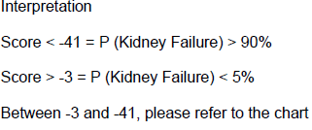
Tangri N et al. JAMA. 2011;305(15):1553-1559.
A smartphone app is available at http://www.qxmd.com/Kidney-Failure-Risk-Equation.

Slide 32
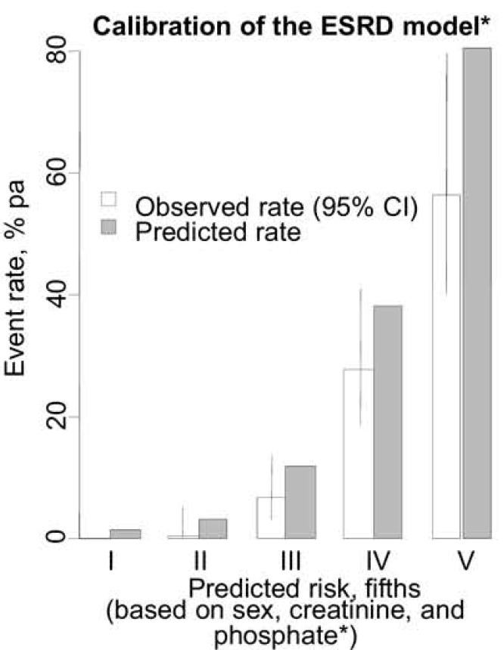
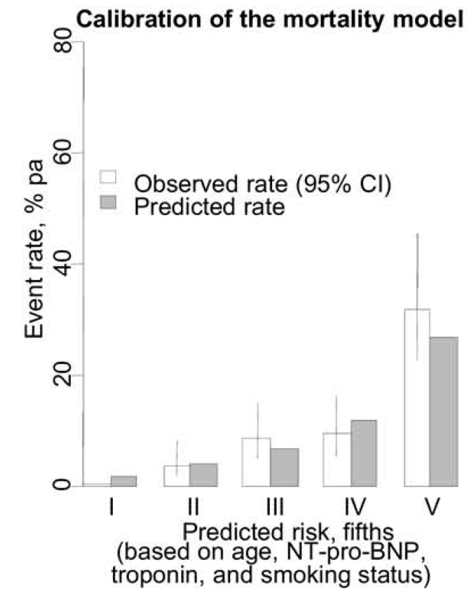
Prediction of ESRD and Death Among People With CKD: The Chronic Renal Impairment in Birmingham (CRIB) Prospective Cohort Study
Landray et al. Am J Kidney Dis. 2010 Dec;56(6):1082-94.

Slide 33
Limitations
It is a single center study with small numbers
The chart review was performed retrospectively and thus we didn’t have information on reasons for not referring to surgeon when not documented in chart.
We also lacked information on patients who may have initiated HD at other institutions or at an outpatient HD unit and were never seen at our institution thereafter.

