Slide 1


Slide 2
Evaluation of the role of ischemia modified albumin as a new biochemical marker for differentiation between ischemic and hemorrhagic stroke
BY
Nany Hassan
Lecturer of Internal Medicine
Geriatrics Department
Alexandria University
Egypt

Slide 3
Stroke in Egypt
The overall prevalence rate of stroke is high, especially in older adults, men and illiterate individuals. A higher prevalence of ischemic than hemorrhagic stroke was recorded, with hypertension and diabetes mellitus being the commonest risk factors in our community.

Slide 4
OBJECTIVE
To evaluate the role of the detection of ischemia
modified albumin (IMA) level in the differentiation
between ischemic and hemorrhagic cerebrovascular stroke.

Slide 5
Introduction
A stroke ,previously known as a cerebrovascular
accident(CVA) is the rapid loss of brain function(s)
either focal or global due to disturbance in the blood supply to
the brain, with symptoms lasting 24 hours or longer or
leading to death with no apparent cause other than of vascular
origin.
The 24 hour limit differentiates stroke from transient
ischemic attack , which is a related syndrome of stroke
symptoms that resolves completely within 24 hours.

Slide 6
Types of Strokes:
Ischemic stroke.
2. Hemorrhagic stroke.

Slide 7
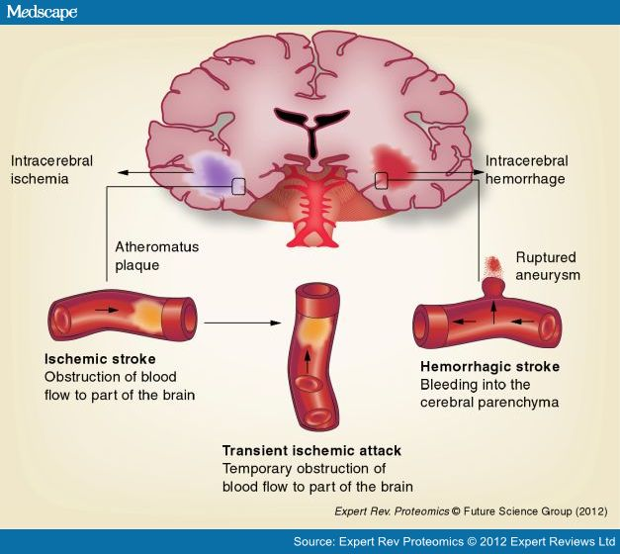

Slide 8
Ischemia Modified Albumin
A growing body of investigations supporting the potential of ischemia modified albumin (IMA) as a marker of ischemia is now available.
Human serum albumin (HSA) is the most abundant protein in the blood with a mean concentration of 0.63 m mol/L. It is synthesized in the liver and has a half life of about 19 days.(1)

Slide 9
HSA has a unique structure and amino acid sequence which is specific to human at its amino terminus (N- terminus). Previous studies have shown the N-terminus of HSA to be the primary binding site for the transitional metals cobalt and copper.
The HSA metal binding site is particularly susceptible to biochemical changes during ischemia compared to albumin from other species.(2)

Slide 10
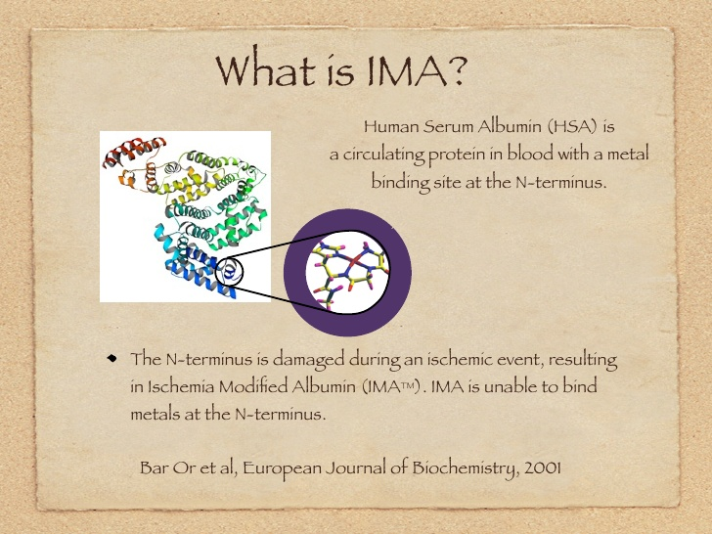

Slide 11
The precise mechanisms for production of IMA during ischemia are not known, but have localized modification in the amino terminal of HSA during ischemia which leads to reduction in cobalt binding to this modified N-terminus.
Many reports indicate that the factors involved in ischemia that can induce these in vivo changes to albumin may include:

Slide 12
a. Acidosis.
b. Free radical damage.
c. Membrane energy dependent sodium and calcium pump disruption.
d. Reduced oxygen tension and free iron and copper ion exposure.
These conditions are necessary for altering the metal binding site of HSA are known to occur within minutes of the onset of ischemia, and their effect on albumin could be detectable up to several hours after the ischemic event. (3)

Slide 13
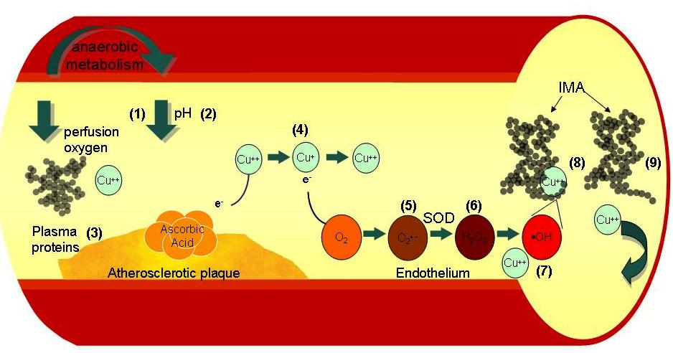
Mechanism of Ischemia Modified Albumin generation. [1]Tissue hypoxia from
anaerobic metabolism reduces ATP and causes a [2]lower localized pH inducing
acidosis. [3]Cu⁺⁺ ions are released from plasma proteins such as caeruloplasmin
. In the presence of ascorbic acid, [4]Cu⁺⁺ is converted to Cu⁺. Cu⁺ reacts with O₂ to
form [5]O₂ •–. Superoxide dismutase dismutates the O₂ •–to [6]H₂O₂, which in presence
of Cu⁺⁺ or Fe⁺, undergoes the Fenton reaction forming [7]OH•hydroxyl radicals. Free Cu
⁺⁺ is scavenged by [8]HSA, where it binds tightly to the N-terminus. OH• radicals alter the amino
acid N-terminus of [9]HSA rendering it incapable of binding Cu⁺⁺. These two altered forms are known
as IMA.

Slide 14
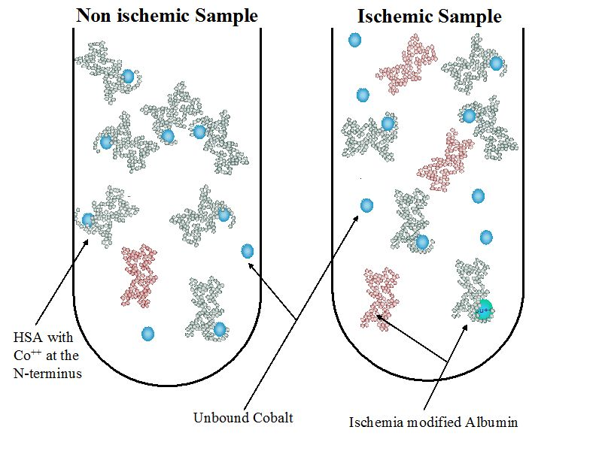

Slide 15
Gunduz, et al evaluated time course of IMA in acute ischemic stroke (AIS) patients to validate its prognostic value.
IMA level was estimated in serum samples collected
from five AIS patients at admission, 24 hours, 48 hours, 72 hours, and 144 hours after admission and also from five control subjects. There was significant increase in IMA level in AIS samples than control subjects.(4)

Slide 16
Mentese et al reported that IMA concentrations are significantly lower immediately after exercise-induced leg ischemia in patients with peripheral vascular disease.
Two previous studies have assessed the effect of skeletal muscle ischemia on serum IMA levels in apparently healthy individual. A transient decrease in IMA concentration has been observed immediately after exercise and/or skeletal muscle ischemia, followed by a delayed increase after 24 to 48 hours.
It has been hypothesized that the immediate decrease may be attributed to interference in the IMA measurement by lactate produced during skeletal muscle ischemia.(5)

Slide 17
Causes of false negative IMA:
Although IMA is a sensitive marker for ischemia, as seen in our study, its sensitivity decreases especially in:
Conditions associated with transient and reversible ischemia.
The presence of lactic acid in these patients secondary to prolonged ischemia and acidosis. Elevated lactic acid levels have been shown to be associated with decrease in IMA levels, the cause of which is not known.
May be delayed presentation to the ER.

Slide 18
Since susceptibility of the cells to ischemia may vary from one organ to another, it would be critical to determine the optimal IMA level for diagnosis of ischemia in various organs especially the heart and the brain.
Mentese et al showed that an increasing number of studies have shown that IMA levels rise in a number of acute ischemic conditions such as cerebral infarction, myocardial infarction, pulmonary infarction and mesenteric infarction, suggesting that IMA may be useful as a diagnostic marker.

Slide 19
In the current study we tried to evaluate the role of detection of ischemia modified albumin level in the differentiation between ischemic and hemorrhagic cerebrovasular stroke.

Slide 20
Methods
From May 2011 to January 2013, this study was conducted in the Internal Medicine Department, Alexandria University Hospital , Egypt ;after being approved from the local Research Ethics Committee, and informed consent was obtained from all participants.

Slide 21
We studied 40 elderly persons recruited from the emergency department with a mean age of 49.0±7.27( range40-75) years with cerebrovascular stroke who were classified into two groups:
*Group I included 25 patients with cerebral infarction.
* Group II included 15 patients with cerebral hemorrhage.
In addition, 20 apparently healthy elderly persons matched for age were included as controls.

Slide 22
The exclusion criteria
1. IHD diseases
2. Malignancy
3. Infections
4. End stage renal disease
5. Liver disease
6. Uncontrolled diabetes mellitus
7. History of treatment of thyroid disease

Slide 23
All subjects were subjected to :
Full history taking.
2. Complete clinical examination especially for signs of cerebrovascular stroke (paresis, paralysis, loss of sensation, abnormal speech).
3. Radiological investigations: Computerized Tomography (CT) for diagnosis of brain lesions.
4. Blood samples were collected by veni-puncture tubes within two hours of arrival. These samples were sent to the laboratory and processed for: routine laboratory tests( Liver function tests, renal function).

Slide 24
Blood samples were collected before any heparin/thrombolytic treatment is started. Patients received routine institutional care according to their diagnosis blind to the IMA results.
IMA was measured using spectro-photometeric albumin cobalt binding assay. The assay is based on the fact that ischemia causes changes in human serum albumin that are demonstrated by reduced exogenous cobalt binding.

Slide 26
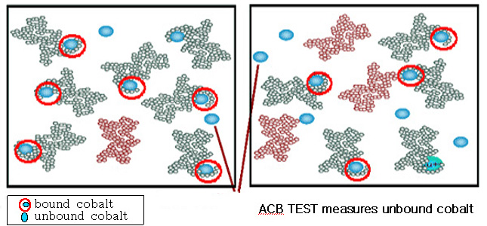

Slide 27
RESULTS
IMA was significantly higher in patient group than control group.
There was positive significant correlation between age, albumin with IMA, (P=0.000 and 0.037 respectively).
However there was no statistical significant differences between sex and diagnosis cross tabulation (0.51).
It was found that, IMA was statistically higher in infarction group than hemorrhage group(P=0.000) and IMA index was statistically higher in infarction group than hemorrhage group (P=0.013).

Slide 28
Table (1): IMA and IMA index in the studied groups
Data | Groups | Number | Minimum | Maximum | Mean | Std Deviation | F | Sig
IMA | Control | 20 | 0.10 | 0.30 | 0.1872 | 0.04940 | 150.065 | 0.000
 | Patients | 40 | 0.23 | 0.80 | 0.5083 | 0.11150 | 150.065 | 0.000
 | Total | 60 | 0.10 | 0.80 | 0.4013 | 0.17973 | 150.065 | 0.000
IMA index | Control | 20 | 87.54 | 124.42 | 104.7223 | 11.81052 | 3.785 | 0.047*
 | Patients | 40 | 87.79 | 124.80 | 110.3908 | 10.01950 | 3.785 | 0.047*
 | Total | 60 | 87.54 | 124.80 | 108.5013 | 10.88767 | 3.785 | 0.047*

Slide 30
Table(2) Sex in relation to diagnosis cross-tabulation:
 |  | Hemorrhage | Infarction | Total
Sex Male Female Total | No % No % No % | 10 66.7% 5 33.3% 15 100.0% | 16 64.0% 9 36.0% 25 100.0% | 26 65.0% 14 35.0% 40 100.0%

Slide 31
Table (3) shows relations between the diagnosis and (IMA ,IMA index)
 | Diagnosis | N | Mean | S.D. | Min | Max. | T | P
IMA | Infarction Hge | 25 15 | 0.5698 0.4059 | 0.08715 0.06033 | 0.43 0.23 | 0.80 0.49 | 40.99 1 | .0001*
IMA index | Infarction Hge | 25 15 | 112.6 107.6 | 6.98 11.3 | 87.79 88.0 | 122.0 124.8 | 2.65 | 0.013*

Slide 33
IMA is a promising marker to be considered for use in emergency department in conjunction with CT brain for the diagnostic assessment of suspected stroke.

Slide 34
Conclusion
IMA assay is a sensitive marker for early detection of stroke.
The level of IMA is higher in ischemic stroke than hemorrhagic stroke.

Slide 35
REFERENCES
1. Bhagavan NV, Lai EM, Rios PA ,et al. Evaluation of human serum
albumin cobalt binding assay for the assessment of myocardial ischemia and myocardial infarction. Clin Chem 2003;49:581-5.
2. Chan B , Dodsworth N , Woodrow J, Tucker A, and Harris R. Site specific N-terminal auto degradation of human serum albumin. Eur J Biochem 1995;227:524-8.
3. Eftihia Sbarouni , Panagiota Georgiadou, and Dimitrios TH. Ischemia modified albumin :Is this marker of ischemia ready for prime time use? Hellenic J Cardiol 2008;49:260-6.
4. Gunduz A, Turdi S, Menetese A, Karahan SC and et al. Ischemia modified albumin levels in cerebrovascular accidents. Am J Emerg Med 2011;26(11):874-8.
5. Mentese A, Turdi S, Tophas M and et al. Effect of deep vein thrombosis on ischemia modified albumin levels. Emerg Med J 2008;25(12):811-4.

Slide 36
Thank You

