Slide 1
Heme Inhibits HIV-1 Through the Induction of Heme Oxygenase-1, Ferroportin, IKBα and p21
Namita Kumari
Center for Sickle Cell Disease,
Howard University
OMICS Retroviruses and Novel Drugs, June 08-09, 2015

Slide 2
Heme Oxygenase-1 (HO-1)

Slide 3
Heme Oxygenase-1 Pathway

Slide 4
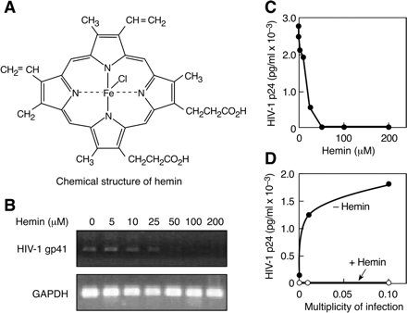
Heme Oxygenase-1 Inhibits HIV-1
Devadas and Dhawan, J. Immunol. 2006

Slide 5
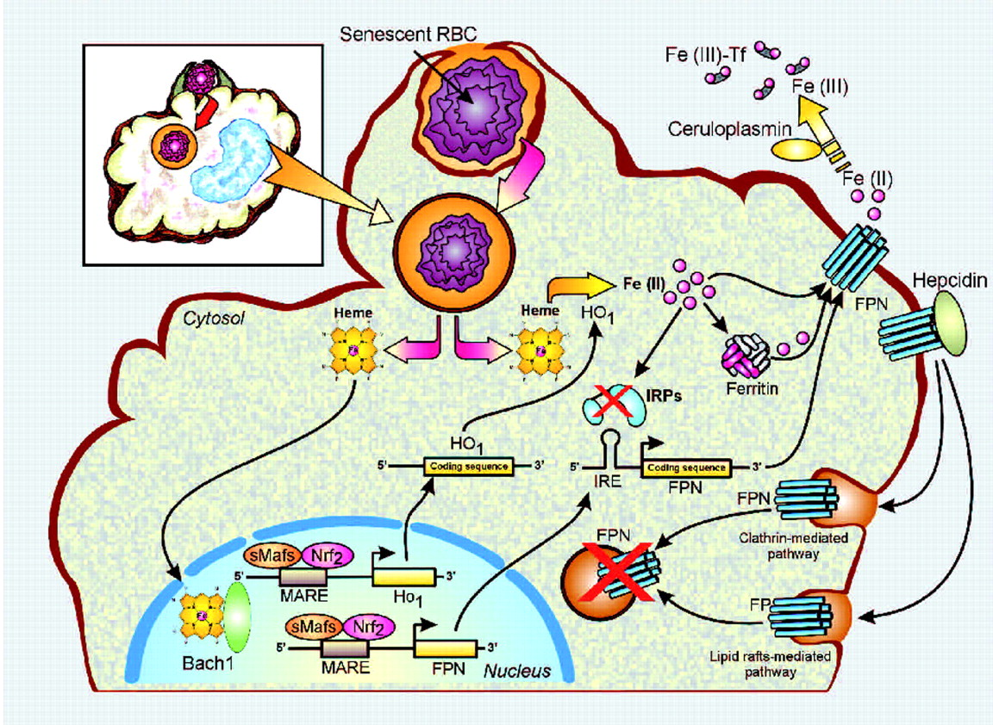

Heme Processing by Tissue Macrophages
Beaumont C Haematologica 2010;95:1233-1236
©2010 by Ferrata Storti Foundation
Notes:
Schematic representation of the different regulatory steps that control the amount of cell surface FPN expression in tissue macrophages. Following phagocytosis of a senescent red blood cell (RBC), heme is released into the cytosol. It can then enter the nucleus to inactivate Bach1 and relieve the transcriptional repression of HO-1 and FPN gene expression, allowing the recruitment of the transcriptional activator Nrf2 complexed to small Maf proteins. The HO-1 protein will subsequently degrade heme and release iron that will in turn inactive the Iron Regulatory Proteins (IRPs) and allow the translation of the Iron Responsive Element (IRE)-containing mRNAs (FPN and ferritin chains). Iron is then stored into ferritin or exported back to the plasma by FPN. Finally, serum hepcidin can bind cell surface FPN and induce its internalization and degradation by two different mechanisms. Illustration by Jean-Pierre Laigneau, INSERM.

Slide 6
Iron and HIV-1
Increased iron stores correlated with faster HIV-1 progression (Gordeuk et al., 2001)
Iron stimulates HIV-1 replication and DFO decreases it (Traore and Meyer, J. Clin Virol., Suppl. 2004)
Iron chelators inhibit HIV-1 transcription (Debebe et al, Mol Pharmacol. 2011; Kumari et al., AAC 2014)
Ferroportin inhibits and hepcidin induces HIV-1 transcription (Xu et al. Retrovirology 2010)
Heme oxygenase-1 induction by hemin inhibits HIV-1 (Devadas and Dhawan, J. Immunol. 2006)

Slide 7
Iron HIF1α And p21
Iron deprivation and oxygen deprivation (hypoxia) induce
hypoxia-inducible factors, HIF1α (Chepleve et. al, 2011)
Fe depletion induces universal cyclin- dependent kinase
inhibitor, p21 (Richardson et. al, 2007)

Slide 8
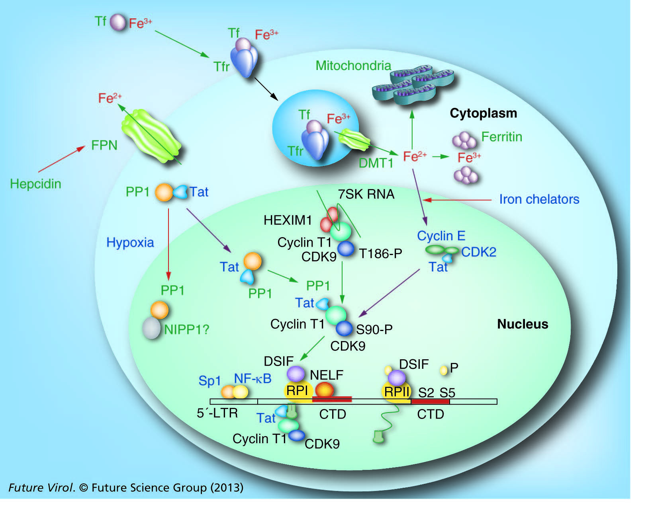
Regulation of HIV-1 Transcription by Iron and Hypoxia
Nekhai et al.

Slide 9
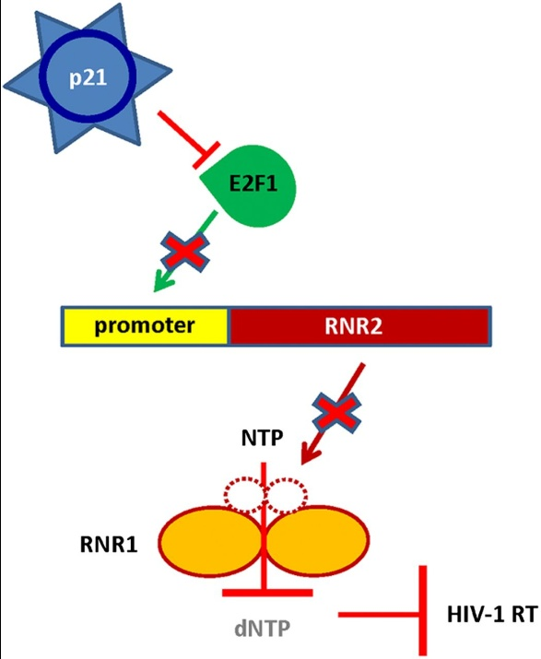
Overexpression of p21 Downregulates NTP
Allouch et al., Proc. Natl Acad. Sci 2013

Slide 10
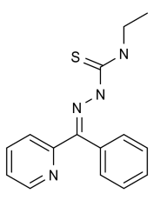
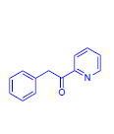
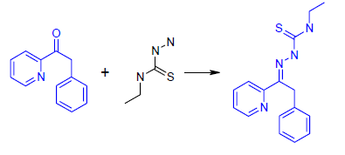
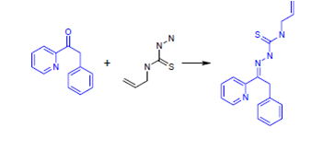
PPY (2-phenyl-1-pyridin-2yl-ethanone)-based Iron Chelators
Bp4eT
PPY
PPYeT
PPYaT
Kumari et al., Antimicrob. Agents Chem. 2014

Slide 11

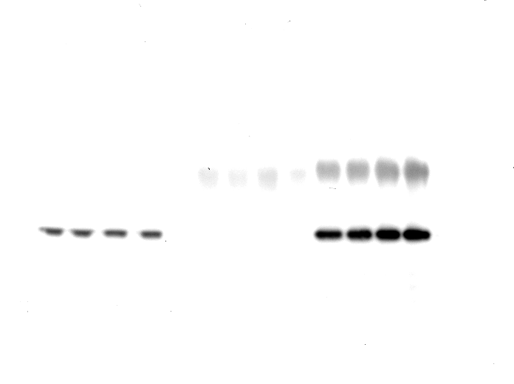
Iron Chelators Inhibit CDK2 Activity and Induce Expression of p21 and IKBα
B
A
PPY PPYaT PPYeT
³²P
histone
H1
WB:
α –CDK2
CDK2
C
Kumari et al., Antimicrob. Agents Chem. 2014

Slide 12
PPY Iron Chelators Inhibit HIV-1 Transcription
*
*
*
Kumari et al., Antimicrob. Agents Chem. 2014

Slide 13
Heme Inhibits HIV-1 in THP-1 Cells and PBMC

Slide 14
Heme Induces HO-1, Ferroportin, p21 and IKBα

Slide 15
Ferroportin Knockdown Alleviates HIV-1 inhibition by Hemin

Slide 16
HIF1α KD Induces One Round HIV-1 Infection

Slide 17
Heme Treated THP1 cells In G1 Arrest

Slide 18
IKBα and NF-kB In Heme Treated Cells
Control Hemin
IKBα
Tubulin
Nuclear Cytoplasmic
Control
Hemin

Slide 19
Conclusions
Hemin treatment induces ferroportin expression in THP-1 cells and PBMC
Low intracellular iron mimics hypoxia as it
upregulates and stabilizes HIF1α and p21
Similar to hypoxia, iron depletion inhitis HIV-1
Accumulation of inactive NF-kB in cytoplasm in
hemin treated cells may inhibit HIV-1 transcription

Slide 20
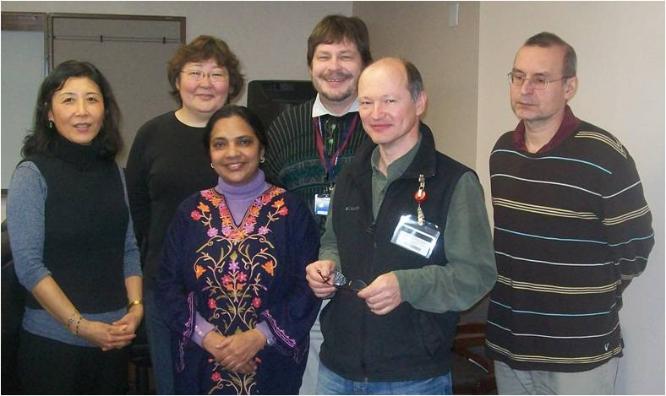
Acknowledgement
Center for Sickle Cell Disease
Howard University
Sergei Nekhai
Xiaomei Niu
Andrey Ivanov
Viral Immunology Section,
Food and Drug Administration
Subhash Dhawan
Enamine, Ukraine:
Dmytro Kovalskyy
George Mason University:
Fatah Kashanchi
Sergey Iordanskiy
NIH- NHLBI 1R01HL125005-01
NIH -NHLBI 1P50HL118006-01
NIH -NIMHD 5G12MD007597

Slide 21
Protein Network Activated in Macrophages by Hemolytic Anemia
S hemoglobin
Hemolytic
Hepcidin
anemia
Overexpression
Ceruloplasmin
Heme
HO-1
Fe2+
Fe2+
Fe3+
Overexpression
Ferroportin
Iron
chelators
Low Fe
HO
-
1 FPN
HIF-1
PP1
CDK2
p21, p27
inhibitors
CDK9
HIV-1
Ischemia
inhibitors
Low O2

