Slide 1
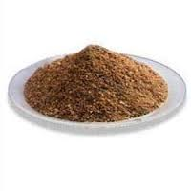
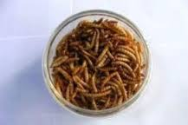
Novel feed resources for Poultry Industry:
Potentials, Problems
& Prospects
By
Naga RaJa Kumari Kallam
Assistant Professor (Poultry)
NTR CVSc, Gannavaram

Slide 2
Introduction
Poultry industry is an important aspect of the livestock subsector in India with a potential to solve the problem of mal nutrition, unemployment and augmenting rural economy.
Feed- major input (65-80% cost of production)
Good productivity depends mainly on quality of feed.

Slide 3
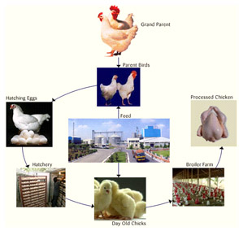

Slide 5
(BAHS 2010)
TOTAL POPULATION
648.78MM
27.6 MM
617.77 MM
3.5 MM

Slide 6
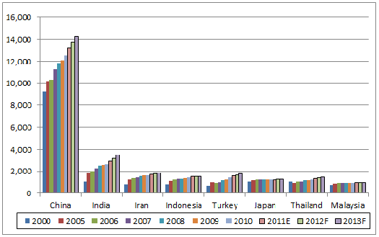
Population trend( Leading broiler meat producers in Asia )

Slide 7
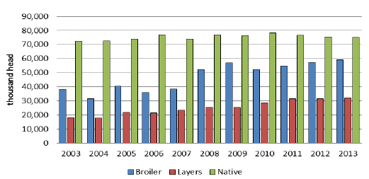
Layer populations

Slide 8
Chicken
95.2 %
Duck
2.5 %
Others
2.3 %
TOTAL EGGS PRODUCED

Slide 9
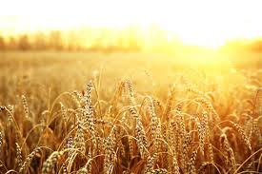
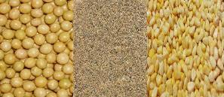
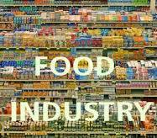
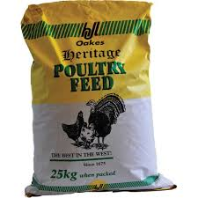
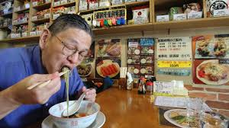
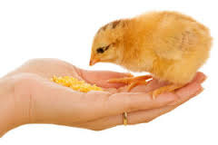
Competition between food and feed industries for using available resources
Increased production cost and added pressure on poultry producers.

Slide 10
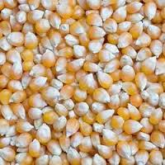
Feed ingredients

Slide 11
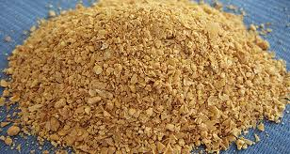
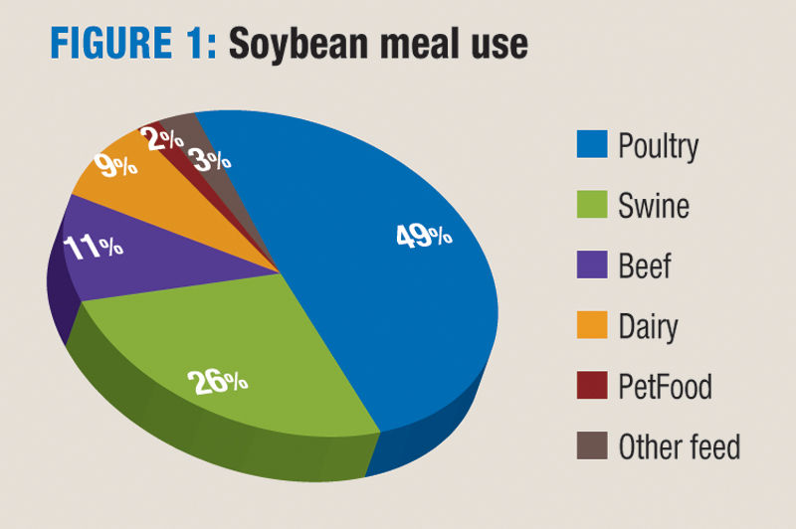

Slide 12
Frequent monsoon failure
Low productivity
Insects, weeds
Cost efficiency
Sustainability
Declining area under cultivation
Globalization
Diversion of farmers to cash crops or commodity crops.

Slide 13
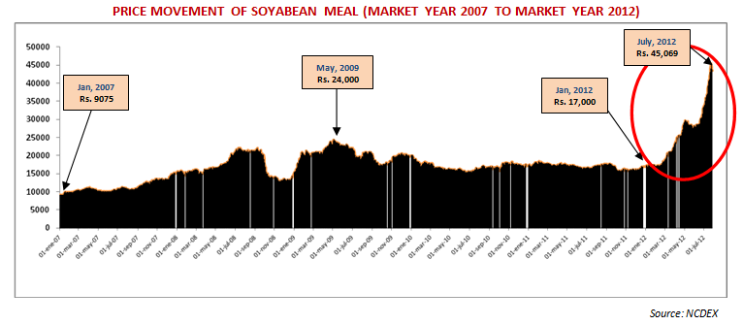
Feed Prices

Slide 14
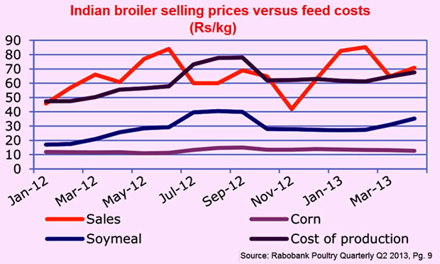
Feed ingredient trend

Slide 15
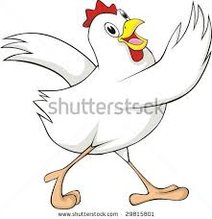
Objectives
Problems
Potentials
Prospects

Slide 16
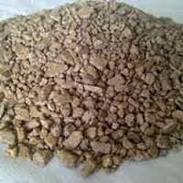
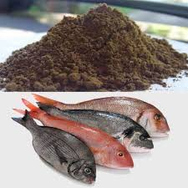
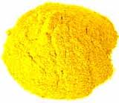
.
Energy sources
Vegetable protein sources
Deoiled salseed meal
Tapioca meal
Molasses
Small millets
Mustord cake
Seseme meal
Cluster bean
Linseed meal
CSM, SFM
Animal protein sources
Protein cum energy sources
Fish meal
Meat cum bone meal
Blood meal
Feather meal
Poultry byproduct meal
Corn gluten feed
Sugar cane press mud
Corn germ meal
Guar meal
.

Slide 17
Potentially interesting sources
Category
Oil seeds | Proteins of defatted soybeans, rapeseed and sunflower seed
Grain legumes | Peas, lupines and their concentrated, chick peas
Cereals and pseudo cereals | Proteins from oat and quinoa or cereal co-products
Leaf proteins | Grass , sugar beet leaves
Aquatic protein | Algae, both macro and microalgae , duckweed Mussel meal
Insects | Meal worm , housefly, black soldier fly
Microbial proteins | Bacterial protein meal

Slide 18
Non conventional ingredients/importance
Energy Source
Source |  | ANF | Max
De oiled salseed meal | Sal fruits | Tannins | 5%
Tapioca meal | Tubers of tapioca | Cynogenic substance | 3%
Dried poultry waste | Caged layer droppings | Pathogenic organisms | 3%
Molasses | Sugarcane | High mineral content | 3-5%
Bajra | Def.Lys. | No pigments | Up to 50% of maize
Sorghum | Def in lys, Met, Arg | Tannins | Up to 60% of maize

Slide 19
Non conventional ingredients/importance
Protein sources (Vegetable)
Source | ANF | Max in %
Mustard cake | Glycosides , goitrogens | 5 ---10
GNC | Trypsin inhibitors, toxins | 25-35
Sesame meal | Oxalates and phytates | 15
Cluster bean | Trypsin inhibitors | 3-5
SFM | Fiber | 10-20
Copra meal | High variability in oil , mycotoxins | 3-5
Safflower meal | High fiber | 5-10
CSM | Gossypol | 10-15
MGM | Prone to mycotoxins | 10-20
Pencillium Mycelium Waste | Residual antibiotic activity | 2-3
Linseed meal | Cyanogenic glycoside, antipyridoxial factors | 3-5

Slide 20
Contd…
Animal protein sources
Blood meal | Un palatable | 2-3
Silkworm pupae meal | High fiber Poor protein digestibility | 2-3
Hatchery byproduct meal | Pathogenic oranisms | 2-3
Feather meal | Not easily digetible | 2-3
Poultry by product meal | Pathogenic oranisms | 5
Meat cum bone meal | Phosphorus content & adultration | 5
Fish meal | Histamine & Gizzarosine | 10

Slide 21
Novel feed resources
Item | Chi. | Adv/ANF | Max | Ref
Spirulina | Broilers | 60-70% Protein | 0.1% | Kathirvelan & Purushothaman 2014.
Karanj cake | Layers | Karanjin , tannins & trypsin inhibitors | 9% | Raju et al 2014.
Corn germ meal | Broilers | 20-23% protein | 25% | Lakshmi et al 2014.
Sugarcane press residue | layers | Minerals /major elements | 15% | Suma et al 2014
Fruits and fruit by products | Broilers | Citrus, pineapple, plantain and mango | 2-5% | Ojebiyi et al 2009

Slide 22
Contd…..
Miscellaneous
Leafy plants | Leaf meal , green algae, plankton, aquatic plant meal, duck weed | Alikwe et al.2012 Durunna et al 2007.
Insects | Larva, termites and flies | Ijaiya et al 2009 b
Worms | Earth worms and maggots | Okah and Onwujiariri 2011.
Mollusk | Snail meal , oyster meal and shells | Olomu 2011.
Synthetic a.a, Vitamin premix, Mineral supplements, Enzymes , Probiotics, Prebiotics , Dried yeast, Skim milk powder |  | Adeyemi et al 2009, Lala et al 2009.

Slide 23
Limitations to the utilization of alternative feedstuffs
Feed stuff origin | Limitation | Inclusion levels
Cereal | High non starch PS – viscosity problems | 50-65% depending on the source, age breed of poultry and processing technique
Cereal by products | High fiber High risk of rancidity | 5-40% depending on the source and processing technique
Roots and tubers | High starch content with low protein , powdery texture, needs detoxification to reduce ANF | 5-40% depending on the source and processing technique Class of poultry
Fruits and fruit by products | Low palatability and high amounts of ANF | 5-20% depending on source and nutritive improvement strategy.
Oil seed meals | High fiber content, ANF, risk of mycotoxins, poor texture and low palatability. | 5-30% depending on the source and processing technique , age and Class of poultry
SOURCE : FAO

Slide 24
Feed stuff origin | Limitation | Inclusion levels
Green meals | High fiber and moisture contents thus requires extensive drying procedure | ≤5%
Dried fish silage | Requires drying, inconsistent nutrient profile due to offal: fresh ratio. | ≤5%
Blood meal | Deficient in essential amino acids, poor palatability and risk of zoonotic diseases | ≤5%
Hydrolyzed feather meal | Deficient in EAA and risk of transmissible diseases | ≤5%
Skimmed milk powder | Obtained from rejected milk thus high risk of zoonotic diseases and not readily available. | ≤5%
Insects worms and mollusks | No commercial production and harvesting system yet | 50% depending on availability
SOURCE : FAO

Slide 25
Potentials
Very cheaply available, Not require extensive processing .
Sufficient quantity available
Good quality protein
Have functional effect
Medicinal property
Lower the cost of production

Slide 26
Problems
Technical aspects
Seasonal and unreliable supply (need for storage)
Bulkiness , wetness and /or powdery texture
Processing requirements
Lack of research and development efforts
(Sogunle et al., 2010)

Slide 27
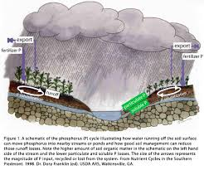
Contd….Problems
Nutritional problems
Variability in nutrient levels and quality
Presence of naturally occurring anti nutritional and or toxic factors
Presence of pathogenic micro-organisms
Need for supplemetation of enzyems or extensive processing… results in added cost
(Bruneton ,1999; D’ Mello, 2000).

Slide 28
Contd….Problems
Socio economic problems
Poor prices relative to other arable crops could discourage the involvement of most people in producing such ingredients.
Where processing is required, more cost are incurred which may not commensurate with the cost per gram of energy, protein or other nutrients sources in conventional feedstuffs (Sonaiya 2009).

Slide 29
Prospects
Nutritional composition
Use of enzymes to improve their nutritional quality
Most of the ANF present below the thresh hold levels
Abundant sunshine could facilitate prompt drying – in turn ANF can kept below the thresh hold levels.

Slide 30
Contd….Prospects
Organization of orientation programme to create awareness about novel feed stuffs for production that will fast track animal agriculture in a challenged economy
Increased local production of alternative nutrient sources from unconventional feed ingredients to eradicate competition for feed and food stuff between the poultry industry and human population

Slide 31
Need of the hour
Scientific documentation
Identification of more & newer resources
Maximum and minimum level of incorporation
Identifying the incriminating factors
Supplementation of critical micro nutrient
Biotechnology innovations & processing techniques

Slide 32
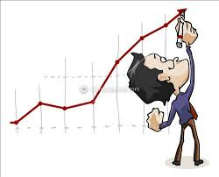
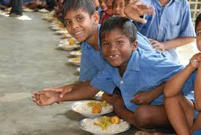
Adoption of alternative feed resources in poultry nutrition will be a sure way to achieve the strategic plans on suitable animal production for national food security and poverty alleviation.

Slide 33
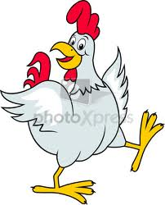
Thanks for your attention

