Slide 1
New Findings in the Geomorphology of
Egyptian Sand Dunes
Nabil S Embabi
Professor of Desert Geomorphology
Department of Geography
Faculty of Arts, Ain Shams University
Cairo, Egypt
E-mail: nabilsayedembabi@gmail.com

Slide 2
Present-Day Knowledge on Egyptian Sand Dunes
I) Sand Accumulations:
According to previous studies, sand accumulations are Classified into sand seas and dune fields, depending on two criteria: area and % of sand / dune coverage. In Egypt, a precise definition to differentiate between sand seas and dune fields is presented in 1998 (Embabi, 1998). In this study, a sand sea is an area of windblown sand of over 5,000 sq.km, with a sand coverage of more than 50%, whereas dune fields cover smaller areas with dune coverage less than those of sand seas. Accordingly, there are 6 sand seas and 7 dune fields in Egypt. The accompanied map shows that most of these sand accumulations are developed to the west of the Nile Valley (The Western Desert).
II) Dune Forms:
Known major dune forms in Egypt are linear/longitudinal and crescent/ barchans. These two forms are developed in all sand seas and dune fields (Beadnell, 1910; Bagnold. 1954; Embabi, 2000). Other forms, but less significant are transverse dunes and sand sheets.

Slide 3
I) Exploration of Desert Dunes
History of exploration of desert dunes in Egypt can divided into three
stages:
1- Field Stage: It started from Late 19th Century to Mid 20th Century. In this stage, there was no other means to get any information on dunes except ground survey.
2- Aerial Photography Stage: After World War II, air photos became a significant source of information not only for dunes, but also for other landforms. They were used also as a tool for map production. Therefore, aerial photography and field survey stood side by side in exploring sand seas and dune fields in this stage.
3- Space Imagery Stage: Since they cover wide areas, space images were used first to explore regions / wide areas, providing better information on sand accumulations. With the availability of high resolution images, it became possible to explore deserts for
unknown dune forms, and for small dune fields.

Slide 4
New Findings in the Geomorphology of Egyptian Sand Dunes
The search on high resolution images and field investigations revealed three unknown new findings in Egyptian sand dunes:
1) A new small dune field in the extreme southern part of the Eastern Desert.
2) Rows of Mega Ripples in Ghard Abu Moharik parallel to the main trend of the sea.
3) The presence of star dunes at the southern fringes of S Qattara Sand Sea and the
northern fringes of the Great Sand Sea.

Slide 5
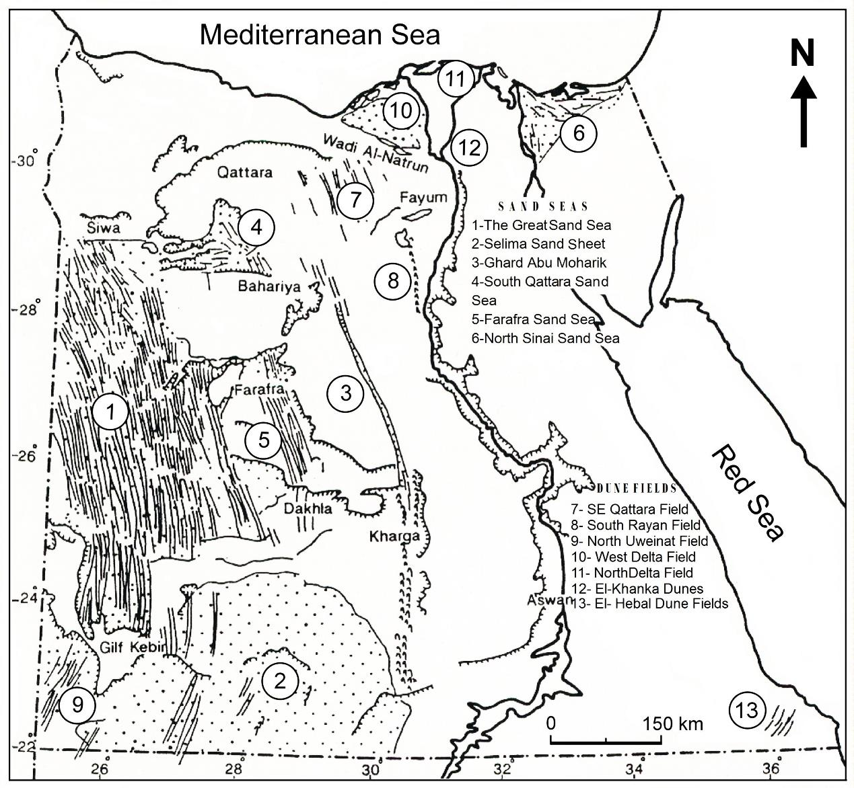
Distribution of Sand Seas & Dune Fields in Egypt and Location of New Findings
New Findings
1- El-A’llaqi Dune
Field
2- Giant Ripples
of Ghard Abu
Moharik
3- Star Dunes:
a-South Qattara
b- North Great
Sand Sea
3b
3a
2
14- El-A’llaqi Dune Field
1

Slide 6
(i) El-A’llaqi Dune Field
1- Location, Dimensions, and Size
2- Dune Forms
3- Sediments

Slide 7
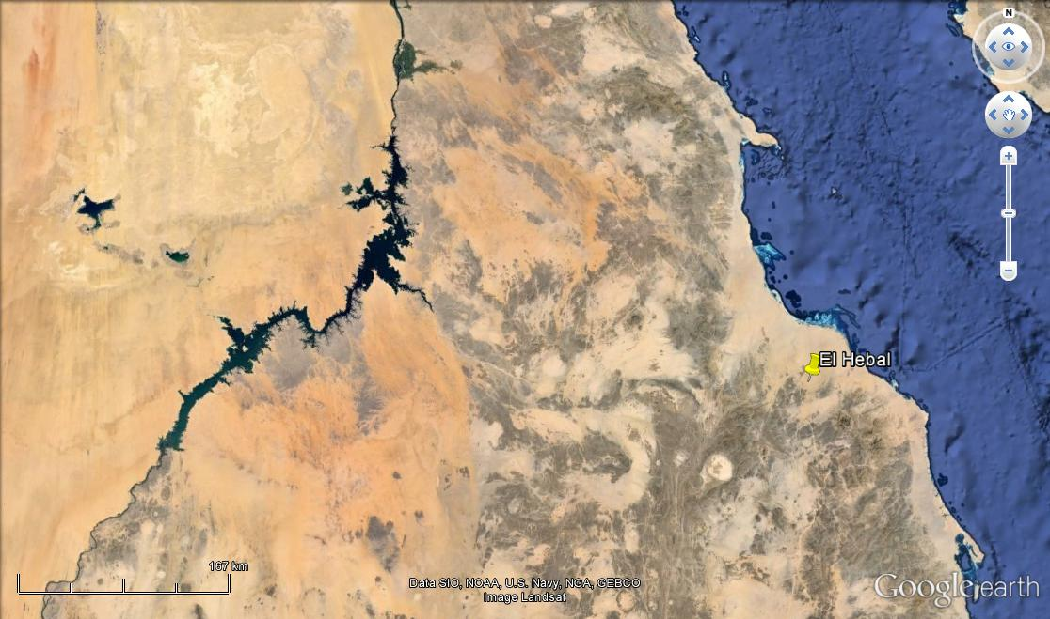
1- Location of El-A’llaqi Dune Field
W E S T E R N
R E D
D E S E R T
E A S T E R N
S E A
D E S E R T
E G Y P T
Political Boundary
Location of El-A’llaqi
Dune Field
22o
S U D A N

Slide 8
2- Dune Forms
Dune Forms recognized on Google Earth Images are as follows:
1- Linear Dunes: Simple & Compound.
2- Crescent Dunes: Simple & Compound.
3- Lee Dunes: at the leeward side of granitic hills / plant bushes.

Slide 9
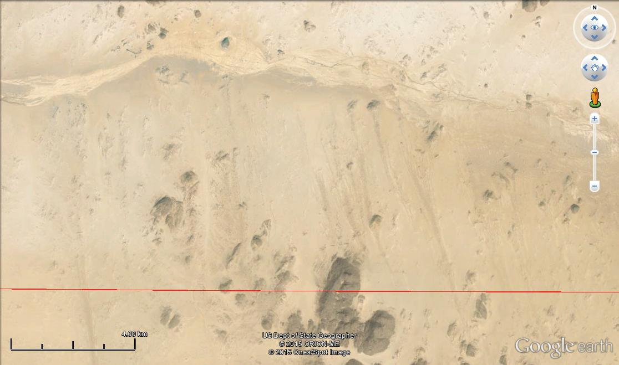
Linear Dunes developed in the Lee Side of some Hills
Along the Southern Side of Wadi EL – Allaqi
W A D I
E L -
A’ L L A Q I
E g y p t i a n - S u d a n e s e B o u n d a r y
22o

Slide 10
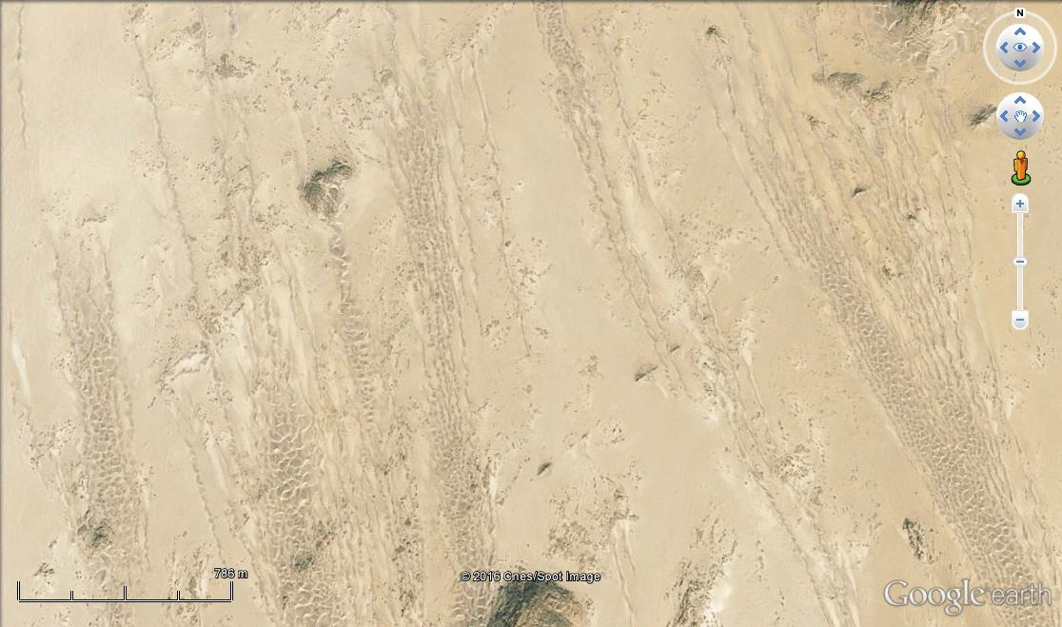
Details of some Linear Dunes
B r a n c h I n g
P a t t e r n
P a r a l l e l P a t t e r n

Slide 11
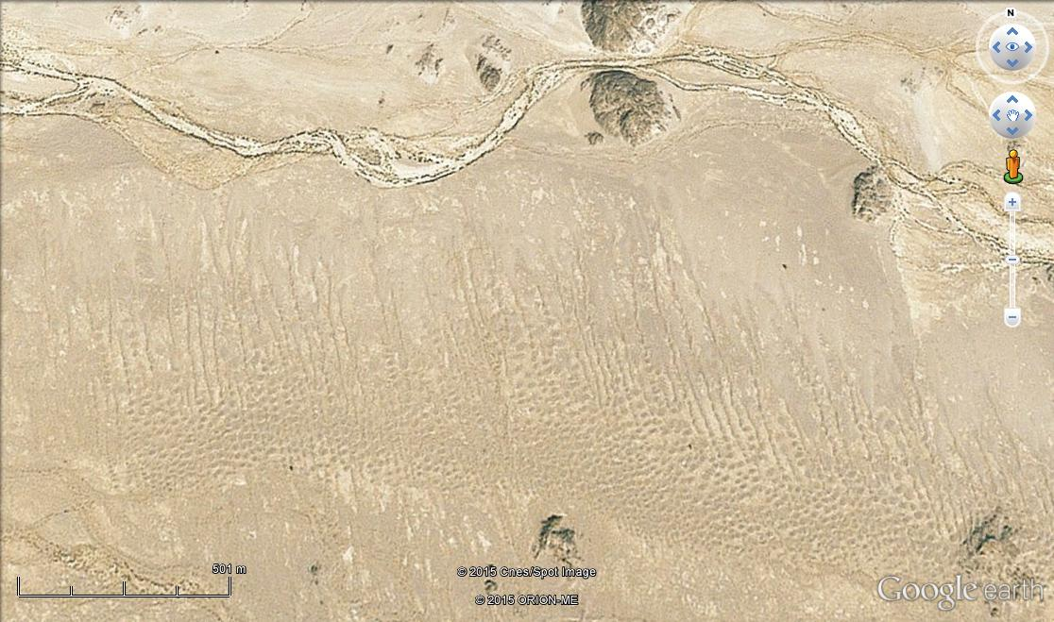
Linear, Domal and Crescent Dunes in
El-A’llaqi Field
E L - A’ l l A Q I
W A D I
P a r a l l e l L I n e a r P a t t e r n
D o m a l & C r e s c e n t D u n e s

Slide 12
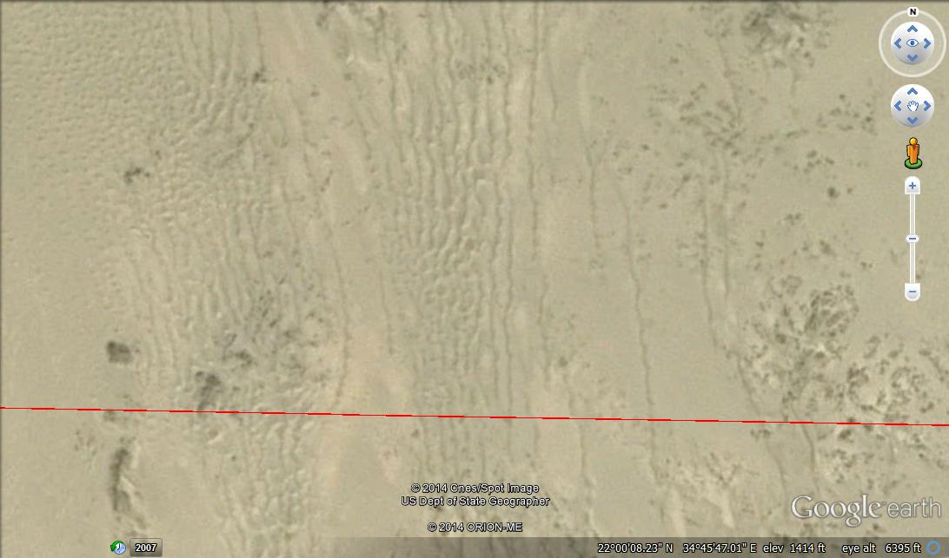
Sinuous, Branching Linear Dunes
E G Y P T I A N - S U D A N E S E B O U D A R Y

Slide 13
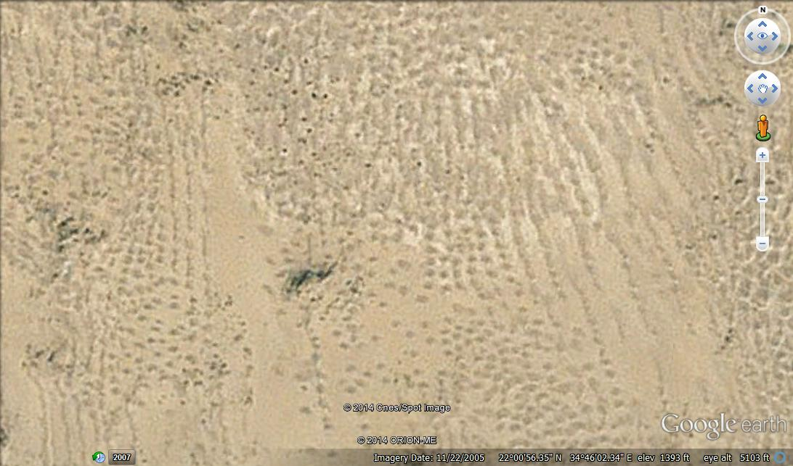
Domal and Crescent Dunes

Slide 14
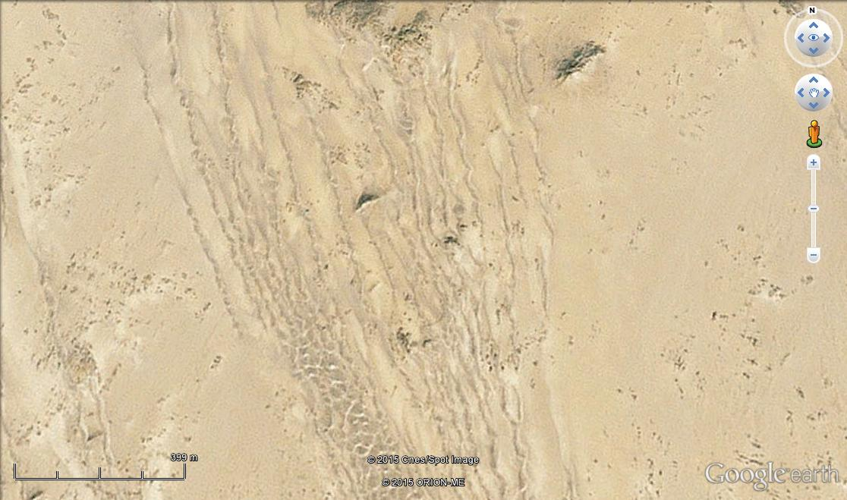
Sinuous, Branching Linear Dunes

Slide 15
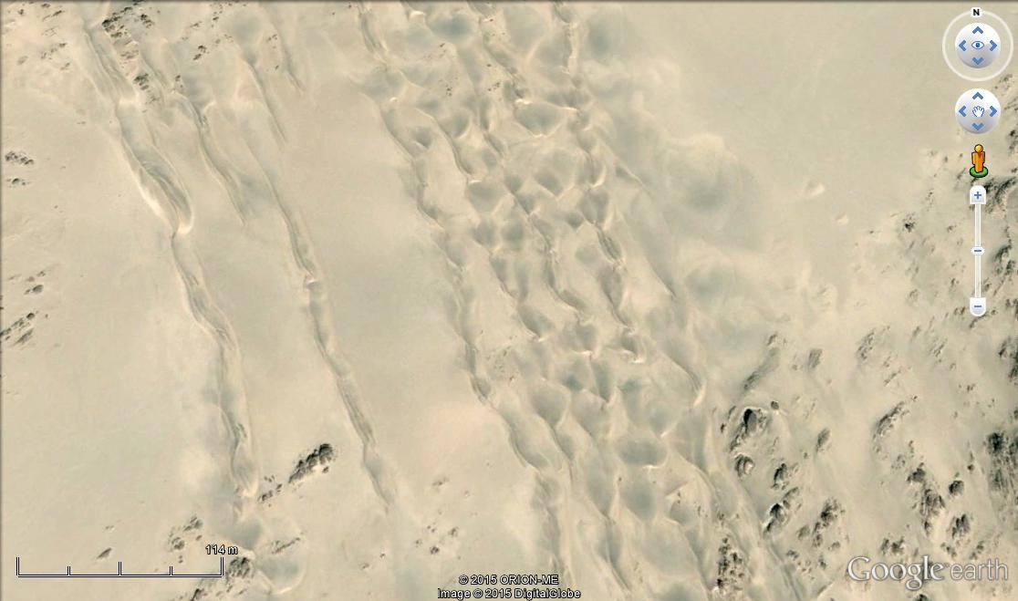
Dismantling Linear Dunes into Barchans

Slide 16
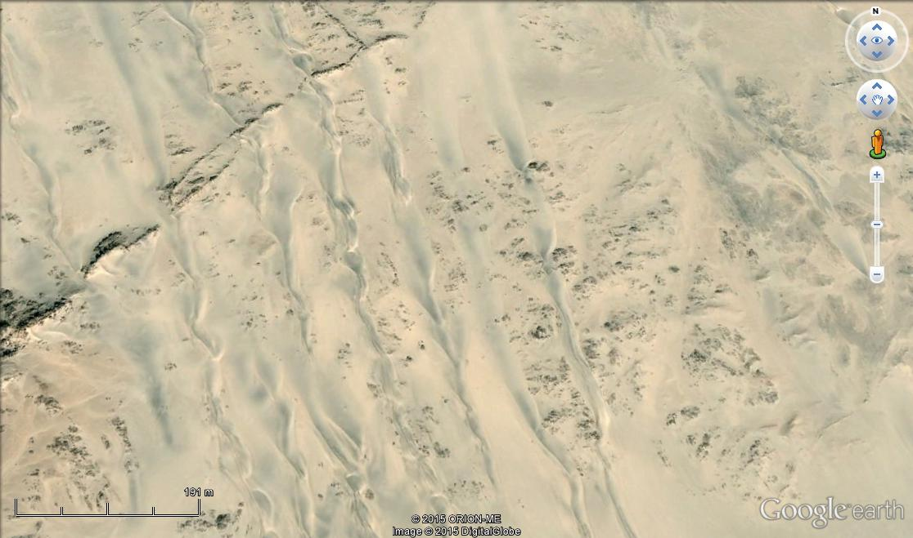
Parallel Pattern of Linear Sinuous Dunes

Slide 17
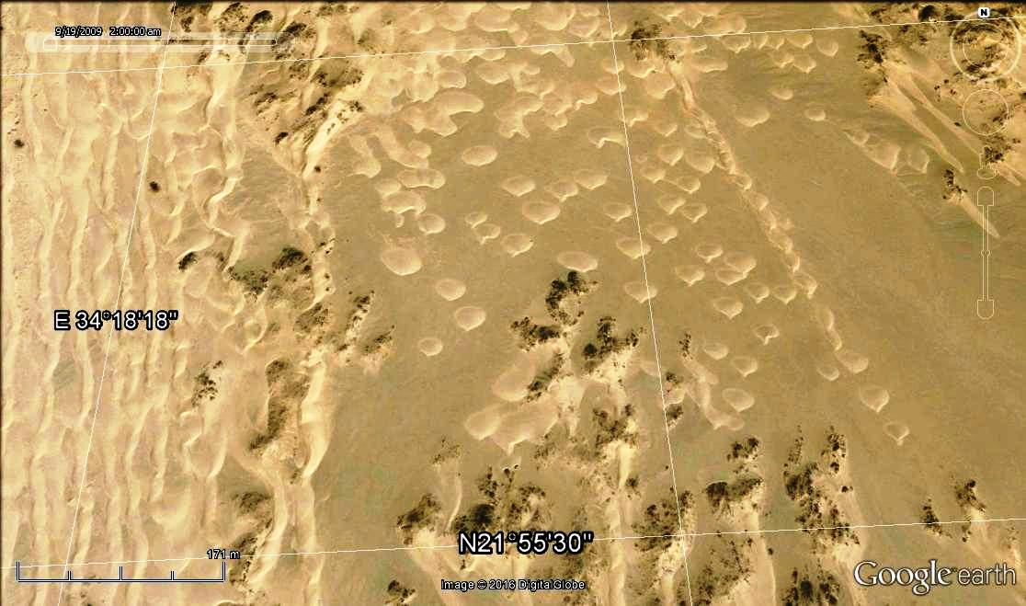
Linear Dunes and Embryonic Barchans Developed side by side

Slide 18
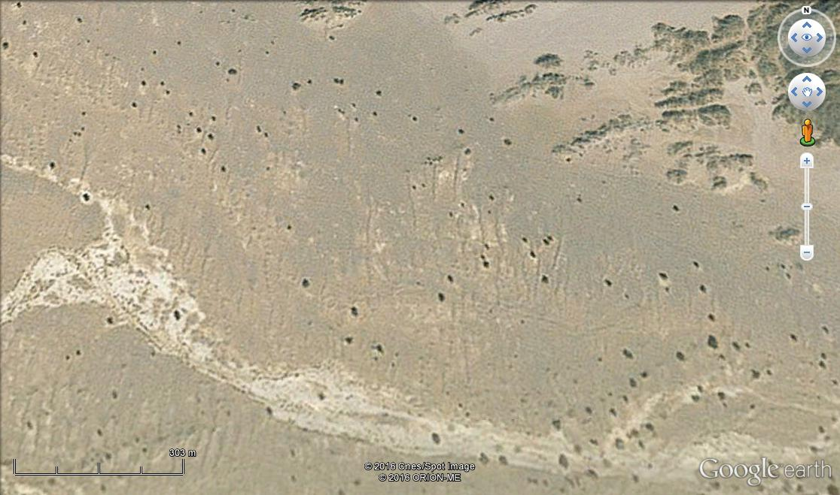
Small Lee Dunes Developed at the leeward Side of some Vegetation Bushes
W a d i
E l -
A’ l l a q i

Slide 19
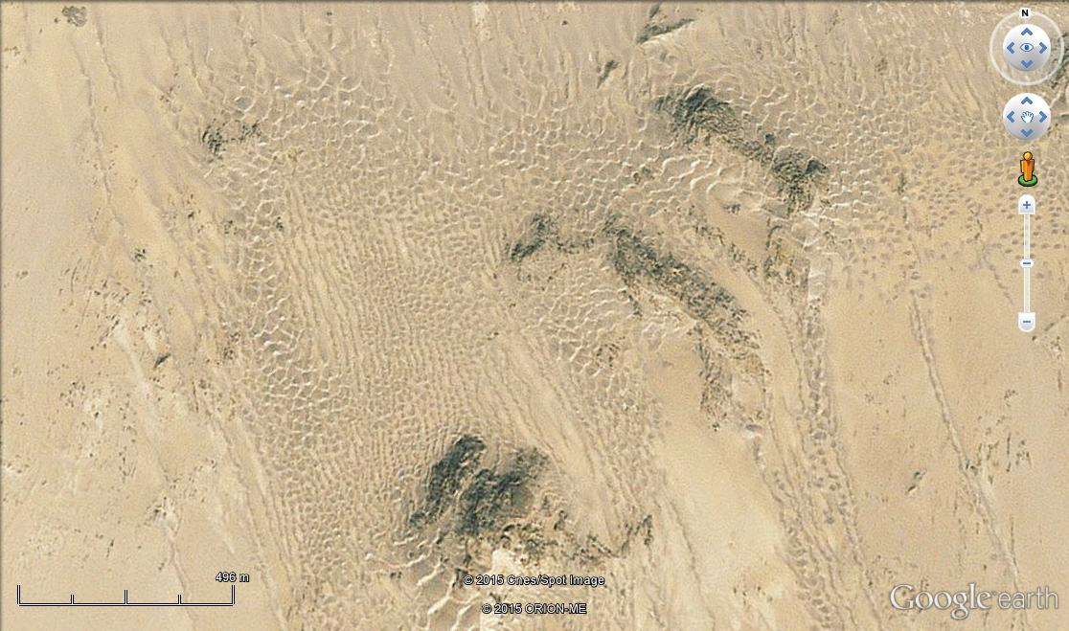
A Small Basin? In El-A’llaqi Dune Field, with all Dune Forms

Slide 20
Sediments of El-A’llaqi Dunes
1. Due to its location in the extreme southern part of the Eastern Desert no field work was carried out and consequently no information is available about dune sands properties. However, some information can be inferred from Google Earth images.
2. These images show two facts:
2.1. Most of the El-A’llaqi Dune Field lies directly to the south of the southern side of Wadi El-A’llaqi.
2.2. Only a small sub-field of small lee dunes lies to the north of the Wadi El-A’llaqi on the surface of some wadi fans in the extreme eastern part of the Field.
From these two facts, it can be inferred that the sands of El-A’llaqi Dune Field are derived from the fluvial sediments either of Wadi El-A’llaqi or other wadis.

Slide 21
(ii) Giant Ripples
1- Location
2- Morphology
3- Sediments

Slide 22
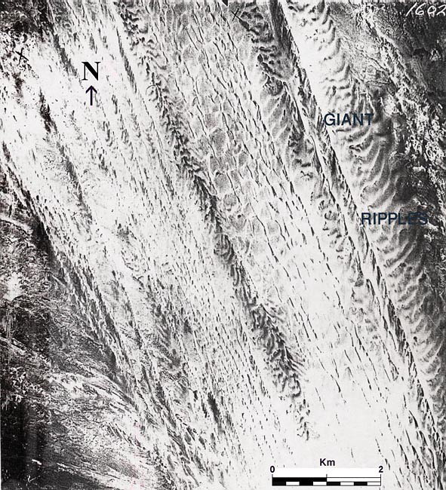
An Air Photo Showing
Giant Ripples in the Central Section of Ghard Abu Moharik
GIANT
Gi A N T
RIPPLES
RIPPLES

Slide 23
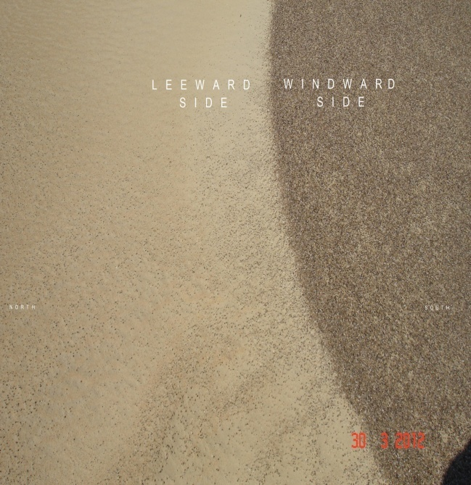
A Field Photo for a Giant Ripple in Ghard Abu Moharik
N o r t h
S o u t h

Slide 24
Sediments of Giant Ripples
Due to field difficulties, only two samples of sand were taken to investigate the
properties of sediments of Giant Ripples: one from the windward side and the
other from the leeward side of one of these ripples.
1- Grain Size:
Coarse Sand (1-3mm) Medium Sand (0.5-0.25 mm) Fine Sand (≥ 0.25 mm)
Windward side: 88.00 % 10.00 % 0.48 %
Leeward side: 1.92 % 45.58 % 52.94 %
2- Mineral Composition:
Epidote Zircon Tourmaline Garnet Kyanite
Windward side: 60 % 15 % 25 %
Leeward side: 70 % 15 % - 10 % 5 %

Slide 25
(iii) Star Dunes
1- Location
2- Morphology
3- Wind Environment

Slide 26
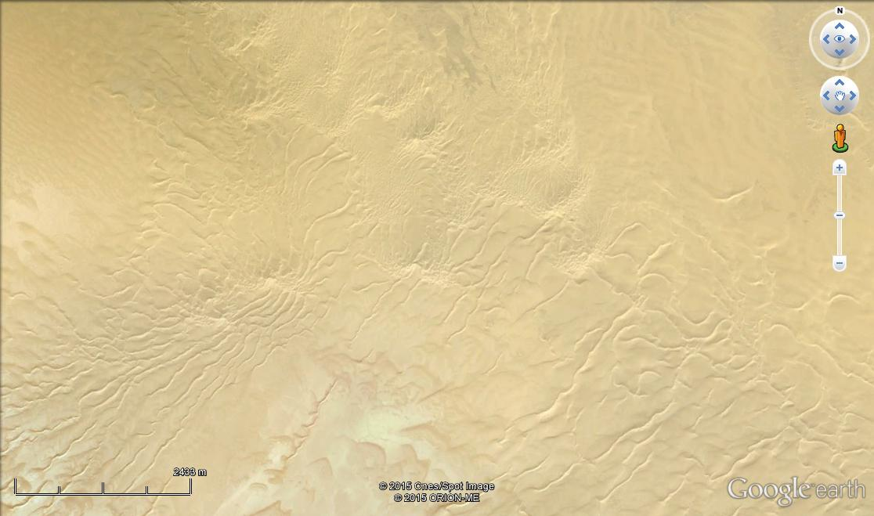
Aaaa
A Field of Star Dunes, South Qattara Sand Sea

Slide 27
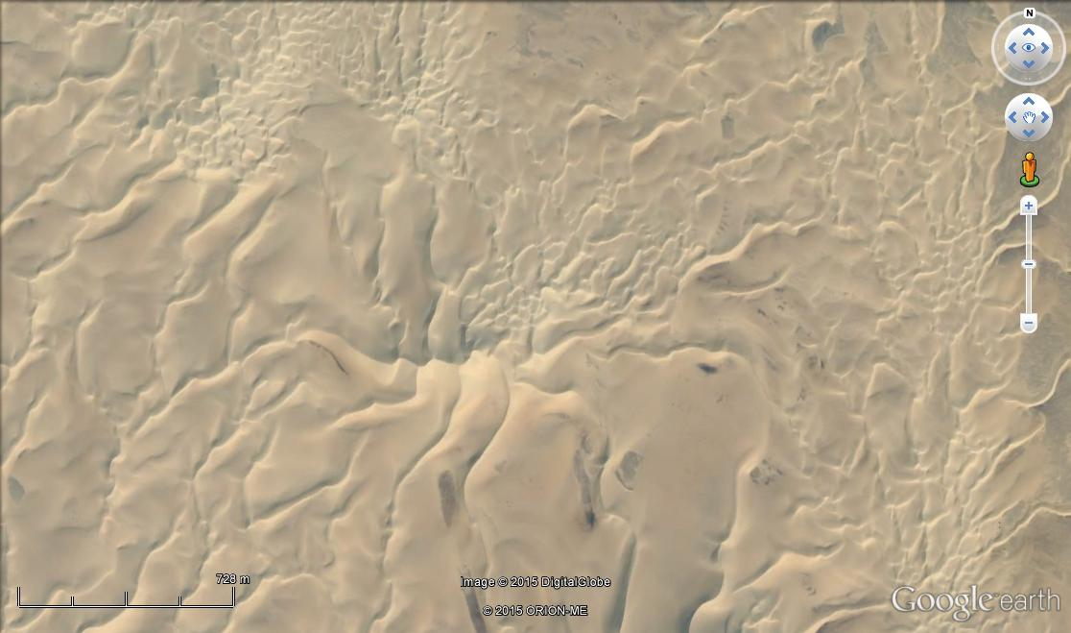
A Star Dune with Several Sinious Arms
South Qattara Sand Sea

Slide 28
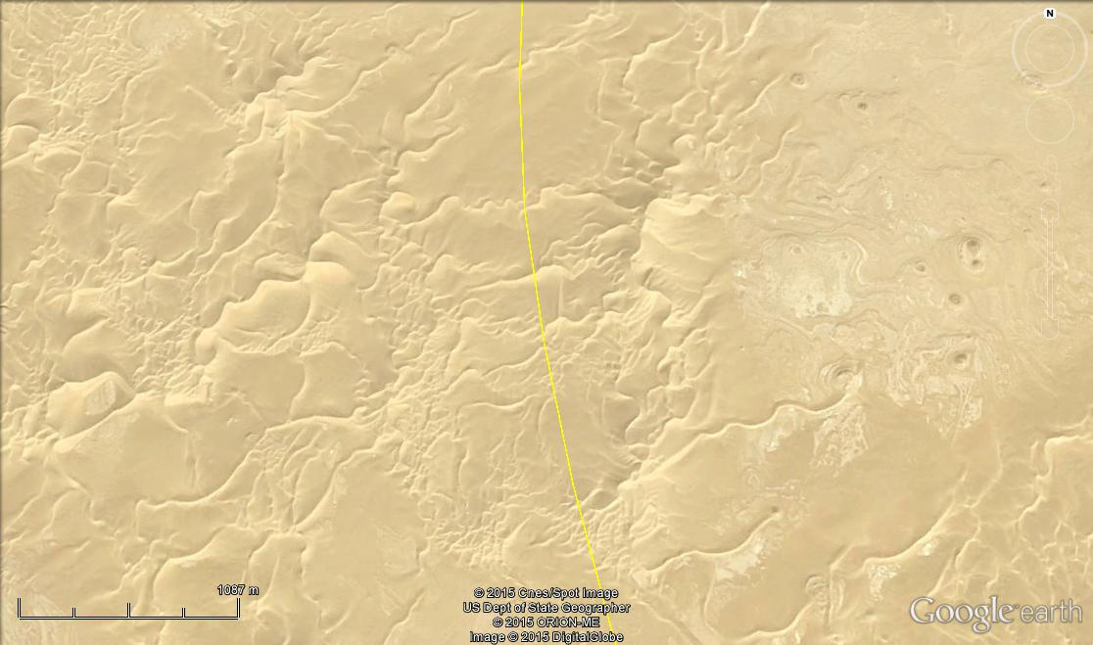
Star Dunes in The Northern Part of the Great Sand Sea, along the Egyptian-Libyan Borders
L I B Y A
E G Y P T

Slide 29
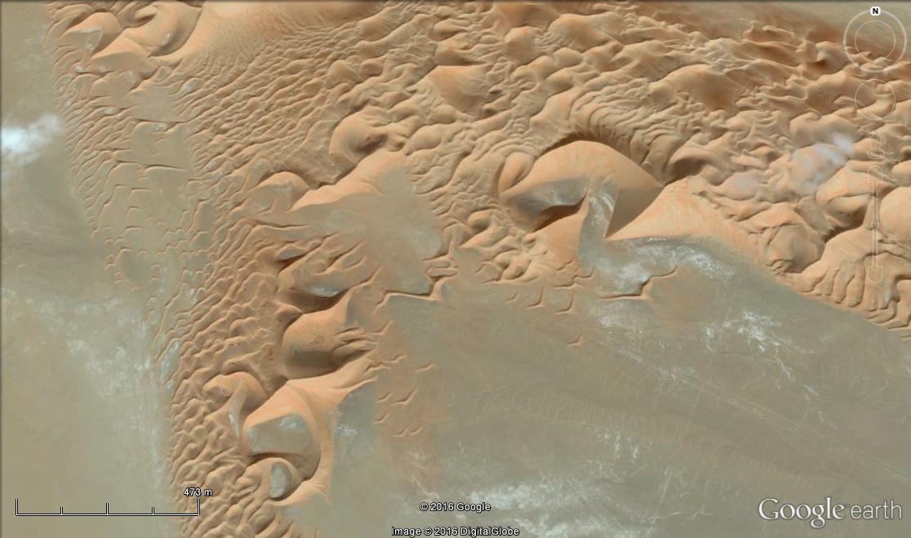
A Field of Star Dunes Along the N Margins of the Empty Quarter in UAE

Slide 30
Conclusion and Discussion
The previous presentation shows the following aspects:
1- Exploration of Egyptian deserts by high resolution space images and aerial photographs revealed the presence of new sand forms in some existing sand seas, which were unknown to desert researchers. It also revealed the presence of a new field of dunes in the extreme south of the Eastern Desert along Egyptian – Sudanese borders.
2- The necessity of field work to verify the information extracted from aerial photographs and space images, and collecting new information which cannot be extracted from images / photos.
3- Past and present climatic conditions were responsible for the development of present-day sand dunes in Egypt.
Our discussion will concentrate on these three aspects or any other aspect which could be suggested.

