Slide 1
Multipurpose Weed Removal Tool Prof.Dr.M.lakshman Rao Principal Prakasam Engineering College ,kandukur A.P.,523105 Affiliated to JNTU Kakinada

Slide 2
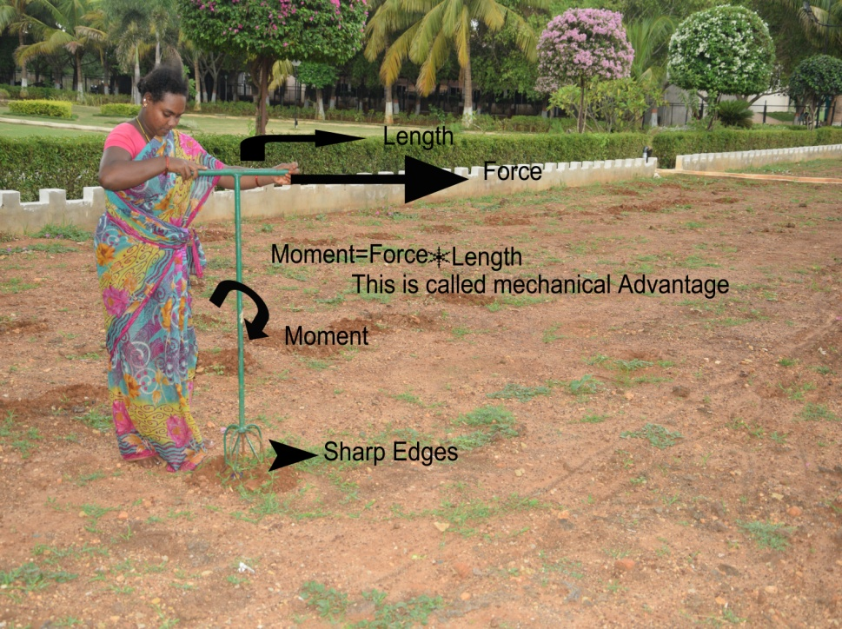
Abstract: Around the Globe every sector except agricultural sector by producing heart touching outcomes in all respects including Highly affordable and competitive price, crossing the expectations of customers in Quality, Durability of the product, Serving the purposes of end user and providing after sales service stands as a standing example for unimaginary advancements that are happening at a faster rate in the Technology. But much to our knowledge a sea of changes we cannot acknowledge in agricultural sector. The reasons one can attribute for low productivity are low utilisation of state of the art technology available in the market and unawareness of farmers. Hence I have designed and fabricated the weed removal tool with mechanical advantage. Farmers are utilising this tool in their fields successfully.

Slide 3
In India, after witnessing so many developments in every field, still we are depending a lot on conventional and traditional farming which includes alarming levels of man power utilisation, thus leads to ill health and high costs.
To overcome the above mentioned menaces, we have developed a farmer friendly Tool with low cost called “Multipurpose Weed Removal Tool”.
It Reduces Maintenance cost of Farm Fields, Reduces Labour Cost, and Removes weed. Tool is Portable, Easy to Carry and Handle, Low Price, Affordability by weaker section of farmers, Eco-friendly, Economical in weed removal, planting vegetables leafs and Tilting the soil. House holders can use for their home crafts.

Slide 4
Design principle: The weed removal tool is designed on the basis of Mechanical Advantage formula
M=F *L , M=Moment F=Force, L= Length
“small effort more work”
Fabrication:
Two feet 1.5 inch pipe horizontal. 3 feet 1.5 inch vertical pipe joined together with arc welding . Four rods with sharp edges with semi circle shape welded under the 3 feet rod .Cost of the tool is 500 rupees.

Slide 5
Advantages
Multipurpose weed removal tool is indigenously designed and developed to suit world farming in general, and Indian farming in particular.
It is handy for small and medium range farmers in all cultivation related activities.
In proper conditions, a single person with this tool can cover 1 to 2 acres in a day while discharging any one of the above mentioned cultivation work.
In case of any problem with the tool , it can easily be repaired on the field or off the field, and a single person irrespective of gender can carry this tool on shoulder.
The Main purpose of this tool is removing the weed tilting the soil and planting the vegetables etc.,

Slide 6
Conclusions:
Small effort more work has been proved with the Tool
Cost is less
Framers are using in thier fields
Tool can be helpful for home made cultivation
Rural vs Urban people can utilize this tool

Slide 7
Acknowledgements
This Tool is fabricated by Dr.M.Lakshman Rao Principle, Dept of Mechanical Engg, Prakasam engg college kandukur. Special thanks to sri veerabhadra rao garu for his encouragement in the development of the tool.

Slide 8
References
S.S.Bhavakatti “ Engineering Mechanics” New age international ltd Edition 2013
Raghavan “ Material science” New age international ltd Edition 2010
www. Agriculture in india.com

Slide 9
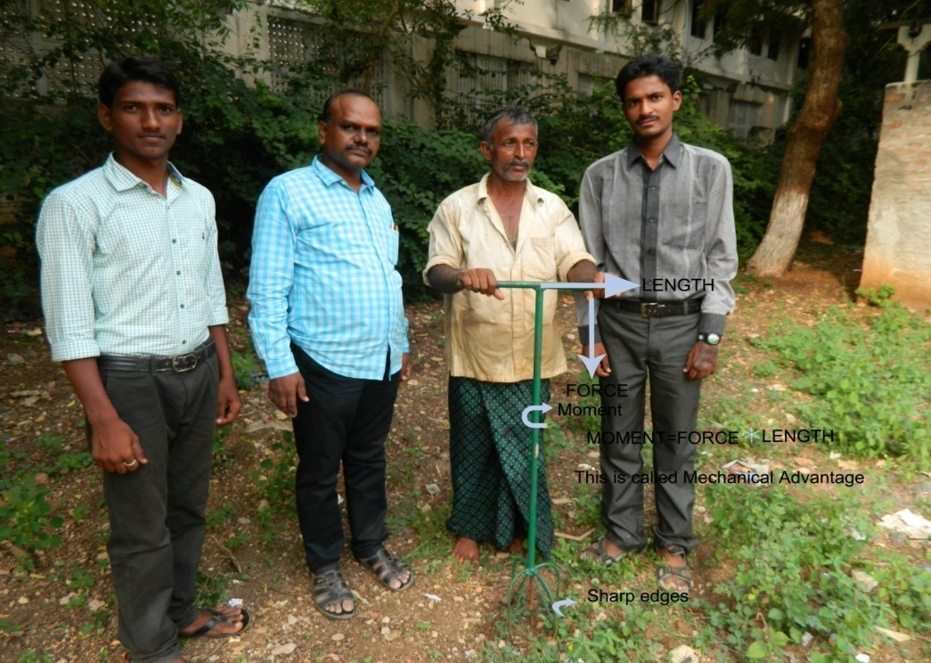
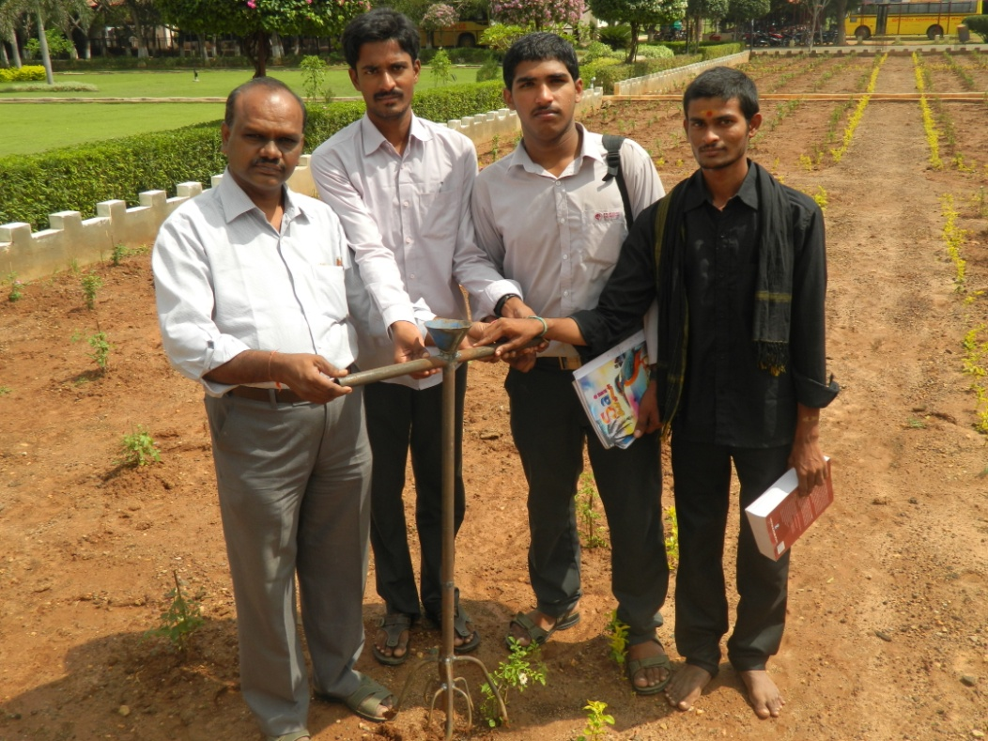
Developed tool with
pouring fertilizer,
water through funnel
Notes:
Thanking you

Slide 10
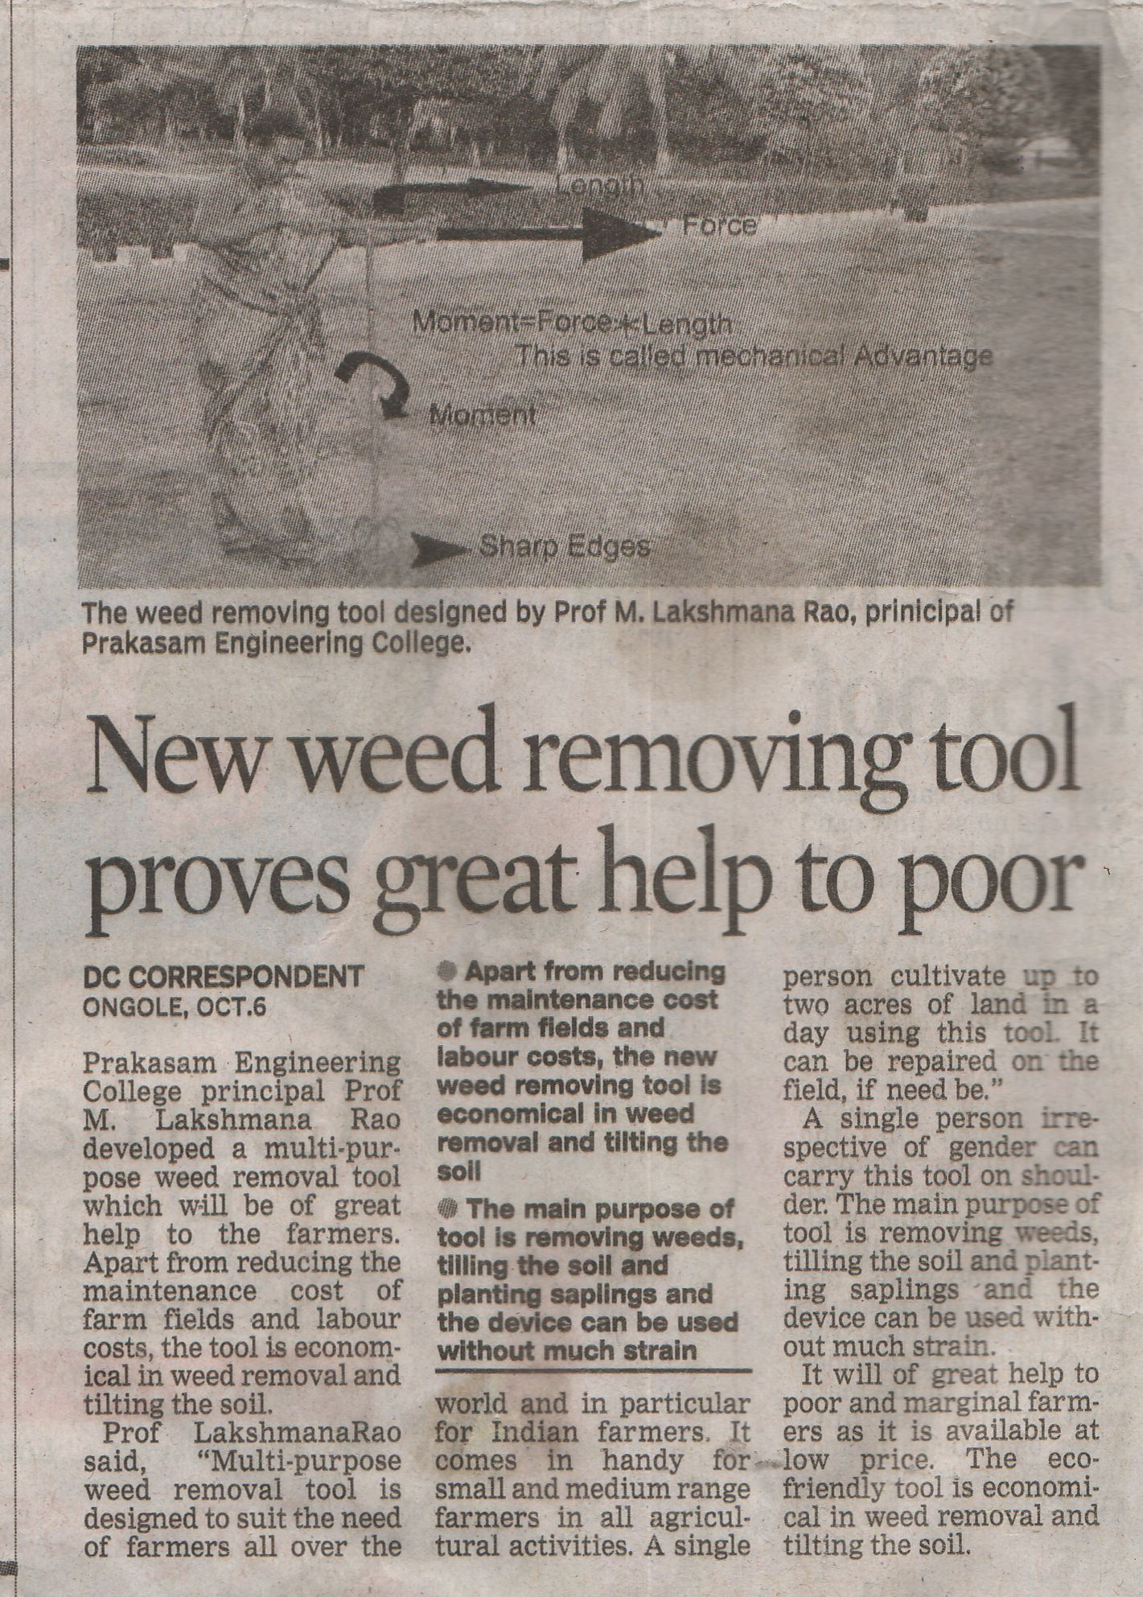
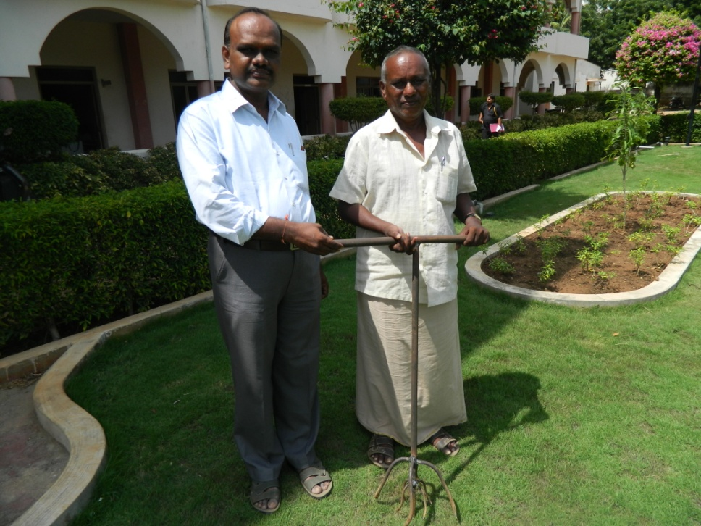
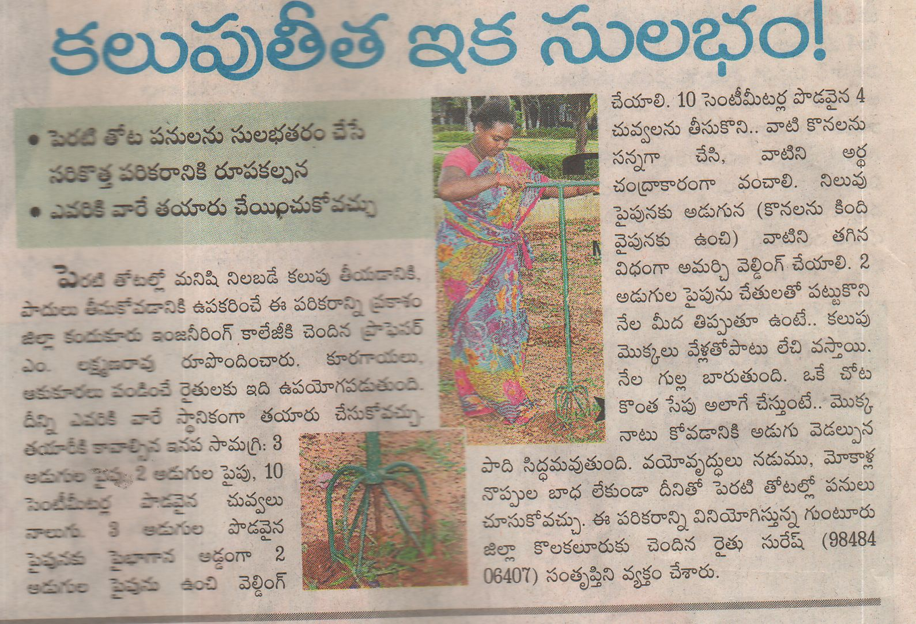

Slide 11
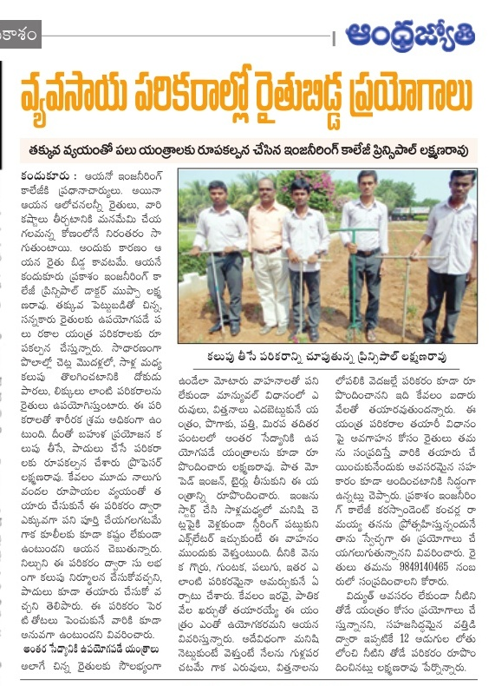
29/10/2014 Andhra jyothi daily telugu news paper

Slide 12
Thanking you

