Slide 1
DQCM Beating the Standard Coagulometer in the Domain of Sensitivity Range and Information for Hemostasis of Human Plasma
Dr. Munawar Hussain
Biosensor Research Group

Slide 2
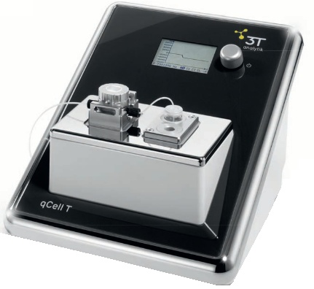
Instrumentation: qCell T
Photograph with permission from 3T Analytik

Slide 3
Instrumentation: qCell T
10 MHz QCM (mass and visco-elastic sensitive transducer)
Equally suitable for real time liquid and gas phase sensing
Equipped with efficient thermostat with fast temperature control
Powerful pumping system that eliminates any chance of bubble/ fluctuation in liquid phase analysis
Fast and excellent baseline stability in few seconds
The only DQCM instrument suitable for Hemostasis because of excellent baseline stability
User friendly software with latest features for data handling

Slide 4
Literature
Some reports on fibrinogen concentration calculation using QCM*
No method for cumulative study of aPTT with fibrinogen concentration in a single set of measurement.
No study on comparison of aPTT with standard coagulometer.
* Y. Chunyan, Q. Ling, F. Weiling, Sensors. 2013, 13(6), 6946.
* R. S. Lakshmanan, V. Efremov, S. M. Cullen, A. J. Killard, Sens. Act. B. 2014, 192, 23.

Slide 5
Experimental
VP-DVB
polymerization
under UV
λmax 350 nm
Spin coated
QCMs coated
with thin film
5000 rpm
UV λmax 350 nm
aPTT
qCell T
measurements
UV hardened
QCMs
Measurements
Standard
Coagulometer

Slide 6
DQCM Exemplary aPTT Curve

Slide 7
aPPT for Heparin Induced Plasma

Slide 8
DQCM Vs Standard Coagulometer

Slide 9
aPTT for Heparin 1 IU/mL Plasma

Slide 10
Bland Altman Plot

Slide 11
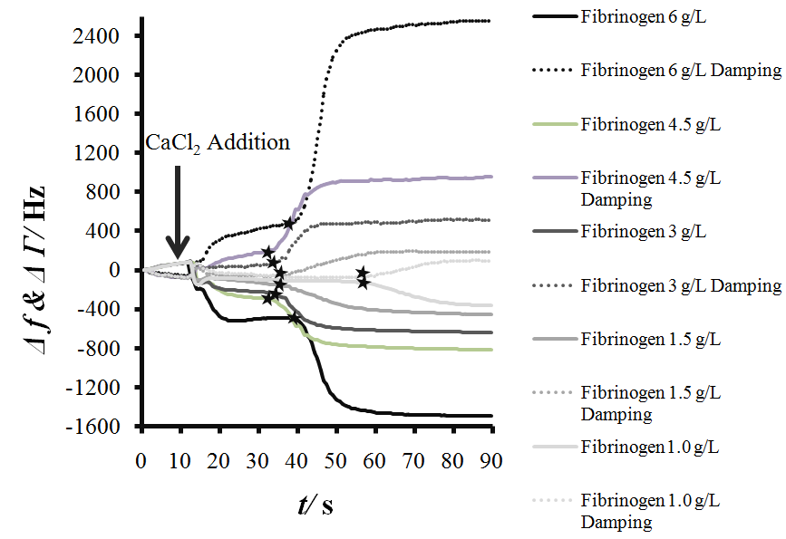
Fibrinogen Gradient Curves for PPP

Slide 12
Fibrinogen Calibration Curves

Slide 13
Fibrinogen Calibration Curves

Slide 14
Fibrinogen Calibration Curves

Slide 15
Summary:
Excellent correlation at lower and mid range aPTT with respect to standard mechanical coagulometer
Plasma-1 IU/mL heparin mechanical coagulometer N/A.
aPTT+Fibrinogen data from a single set of measurements.
Sensing layers are stable can be reused (10 times tested)
qCell T a suitable instrument for coagulation
DQCM has bright future of relevant clinical applications

Slide 16
Thanks for your kind attention

Slide 18
Fibrinogen Gradient Curves

