Slide 1
FISTULA IN ANO
Presentation and postoperative outcome of the different surgical procedures in low type
Published in Professional Medical J 2013;20(5): 783-786

Slide 2
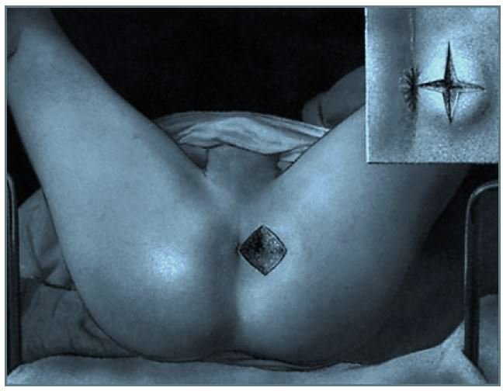

Slide 3
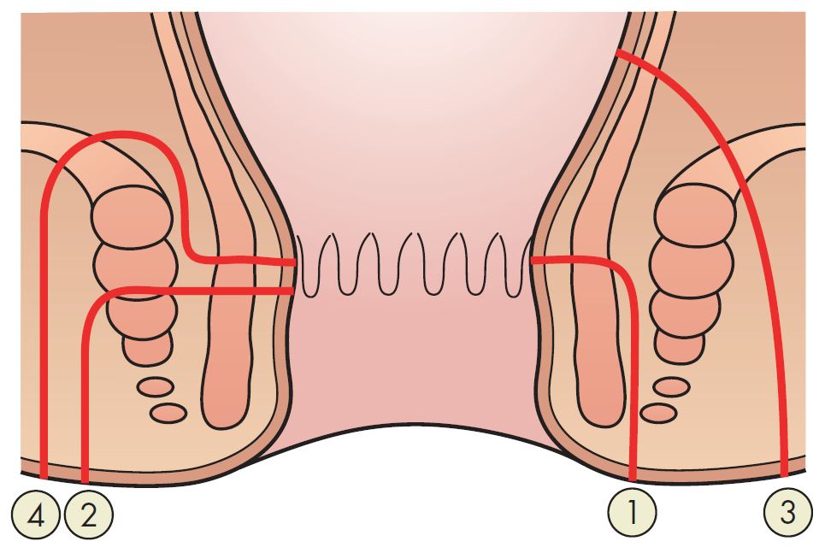

Slide 4
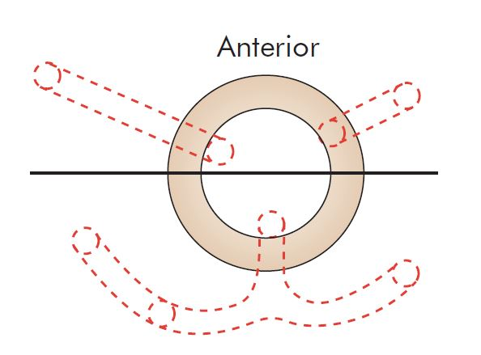

Slide 6
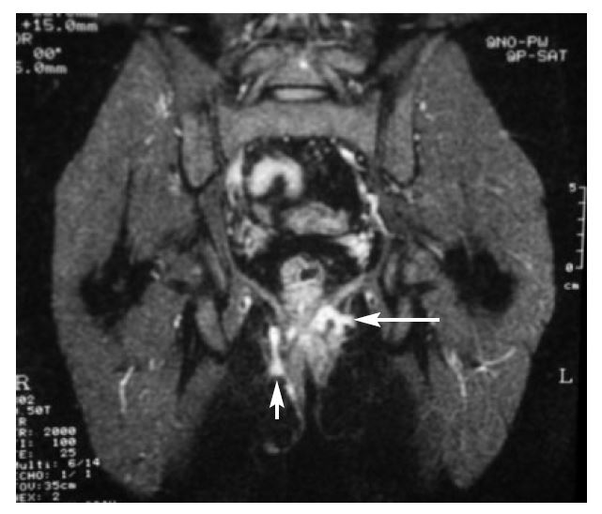

Slide 8
Objective
Due to common surgical problem in our country, the study was planned to find out the clinical presentation and postoperative outcome of different surgical procedures in low type Fistula in Ano.

Slide 9
Design
PROSPECTIVE OBSERVATIONAL STUDY.

Slide 10
Place and duration of the Study
Teaching Hospital at LUMHS Jamshoro.
Ziauddin Teaching Hospital Karachi.
DHQ Teaching Hospital Charsadda.
Liaquat University in Surgical Unit-1 Jamshoro.
Duration: May 2010 to June 2012

Slide 11
Patients Methods
One seventy two cases of low type fistula in Ano with single external opening, irrespective of age and sex admitted in general surgical units, were examined.
Patients with range 15-60 years - Mean age was 37 years.
Patients having high type fistula in Ano were identified pre and per operatively and patients who lost follow up were excluded from study.
Fistulectomy and Fistulotomy performed in all these cases and patients were followed up Fistulogram done in selected case.

Slide 12
Results
Maximum number of cases were seen in 3rd, 4th, decade of life 50(29.6%) and 64 (37%) respectively. Mean age was 37 ranges from 15 to 60 years.
Out of 172 patients 142 (85.7%) male and 24 (14.3%) female.
Male to female ratio was 6.1:1
Underwent fistulectomy, 38 (22%) of the patients got fistulotomy and 12(%) of patients underwent fistulectomy along with haemorrhoidectomy and fissurectomy.
A total of 72 (41.4%) patients experienced different post operative, surgical and anesthetic complications.

Slide 13
Table – 1: Clinical Presentations of patients (N=172)
Symptoms | Frequency | %age
Dishcarge at anal canal | 142 | 82.5%
Swelling along with discharge | 132 | 76.7%
Itching around anus | 70 | 40.4%
Bleeding per anum | 26 | 15.1%

Slide 14
Table – 2: Age Distribution
Age | Frequency |  | %age
 | Male | Female | Male | Female
11-20 y | 28 | - | 16.2% | -
21-30y | 46 | 4 | 26.7% | 2.9%
31-40y | 56 | 8 | 32.5% | 4.6%
41-50y | 12 | 6 | 6.9% | 3.4%
51-60y | 6 | 6 | 3.4% | 3.4%
Total=172 | 148 | 24 | 85.7% | 14.3%

Slide 15
Table – 3 : N=172
Procedure | Frequency | %age
Flstulectomy | 112 | 65%
Flstulotomy | 38 | 22%
Fistulectomy + Haemorrhoidectomy | 16 | 9.3%
Fistulectomy + Fissurectomy | 6 | 3.4%

Slide 16
Table IV : Post Operative Complications (N=172)
Complications | Frequency | %age
Post spinal headache | 24 | 13.9%
Retention of urine | 20 | 11.6%
Wound infection | 16 | 9.3 %
Recurrence of fistula | 06 | 3.4%
Anal stenosis | 04 | 2.1%
Hyper trophic scar | 02 | 1.1%

Slide 17
Discussion
The fistula-in-ano is a common perianal condition in surgical practice.
Talpur K.A have described the average age of presentation 37.2 years, with maximum incidence in 3rd, 4th and 5th decade.
Hill in his series of 626 patients also noted highest incidence in 4th , 5th and 6th decade of life.
Present study incompatible with above studies as highest incidence(59.2%) was seen in 3rd and 4th decade of life.
This study was based on low type fistula-in-ano. Majority of fistulas are simple in nature and may be assessed accurately during clinical examination by experienced coloproctologist
However normal anatomy, perianal fistula tract and sphincter defect are now a days better assessed by endosonography and MRI

Slide 18
Discussion (Continued)
Dynamic contrast enhanced magnetic resonance (DCEMRI) have more sensitivity (97%) and specificity (100%) in detection of fistula.
The majority of anal fistula are anatomical simple (low variety) and easy to treat but a significant number are of high variety and anatomically complex and difficult to treat.
All low type fistula in this study were treated by fistulectomy 77.7% and fistulotomy (22.3%) low lying anal fistulae responded well to simple fistulectomy.
Histopathological examination of fistulous tracts revealed non-specific chronic inflammation in 95.3% of cases, remaining (4.7%) patient having tuberculosis.
Tuberculosis involving anal and perianal region is very rare in western countries. It has diversity of clinical presentation inducing acute perianal abscess, chronic anal ulcers and fistula – in – ano.

Slide 19
Conclusions
Incidence of low type Fistula in Ano is higher in 3rd and 4th decade of life.
The disease was found more common in male, discharge, pain , itching are common symptoms of low type Fistula in Ano.
In low type fistula in Ano Fistulotomy is safe procedure.
Post operative complications can be prevented by careful treatment efforts.

Slide 20
Take Home Message
Prevention is better than cure.
All Predisposing factors for Fistula in Ano must be avoided.
Fistula in Ano may be found in association with:
Crohn’s disease.
Tuberculosis
Lymphogranuloma
Vnereum
Actinomycosis
Rectal duplication
Foreign body
Malignancy

Slide 21
Perspective of Provisioning Medical Education and Healthcare in Khyberpakhtunkhwa and FATA, Pakistan.

Slide 22
Khyberpakhtunkhwa & FATA
Khyber Pakhtunkhwa is one of the poorest and most backward provinces of the country.
There is general belief that this province should go for its own comparative advantages instead of waiting for others to help it out.
Development strategy, experts point out, should be prepared in the light of major challenges, constraints and opportunities of the provincial economy.
The reasons for its less developed economy are many.
The main resource-generating sectors of its economy have been badly affected by the negative effects of terrorism inside and outside its borders.
There is a sluggish economic growth.
Natural disinclination of local and foreign entrepreneurs to invest in Khyber Pakhtunkhwa due to growing insecurity and the inflow of millions of refugees has harmed its prospects.
Power to gain education and health facility have decreased. The increased joblessness has caused a surge in poverty.
The province has been badly affected by terrorist activities in the last 14 years.

Slide 23
Suicide Attacks by Terrorists
The province of KPK has been badly affected by terrorist activities in the past years.
S.No. | Year | No of terrorists attacks | Persons injured | Persons Killed
1 | 2014 | 8 | 142 | 46
2 | 2013 | 21 | 635 | 350
3 | 2012 | 21 | 265 | 140
4 | 2011 | 376 | 1658 | 1144
5 | 2010 | 720 | 904 | 1433
6 | 2009 | 695 | 1713 | 869
7 | 2008 | 118 | 1394 | 751
8 | 2007 | 94 | 1482 | 743
9 | 2006 | 12 | 113 | 50
10 | 2005 | 3 | 43 | 5
 | Total | 2068 | 8349 | 5531

Slide 24
No of Suicide attacks in Peshawar
S.No. | Year | No of attacks | Persons injured | Person s Killed
1 | 2014 | 08 | 142 | 46
2 | 2013 | 21 | 335 | 650
3 | 2012 | 21 | 265 | 140
4 | 2011 | 35 | 1068 | 576
5 | 2010 | 68 | 1986 | 1168
6 | 2009 | 87 | 2756 | 949
7 | 2008 | 54 | 896 | 1843
8 | 2007 | 45 | 1677 | 765
9 | 2006 | 7 | 161 | 352
10 | 2005 | 4 | 219 | 84
 | Total | 350 | 9505 | 6573

Slide 25
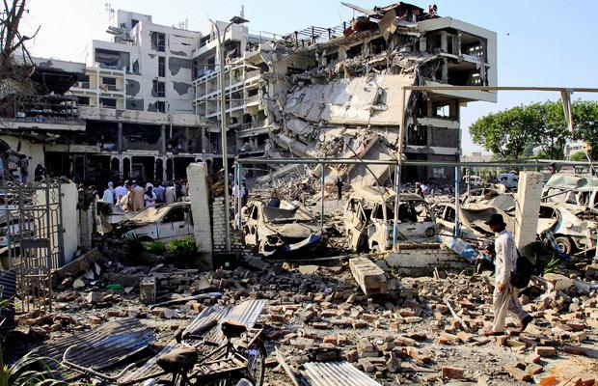

Slide 27
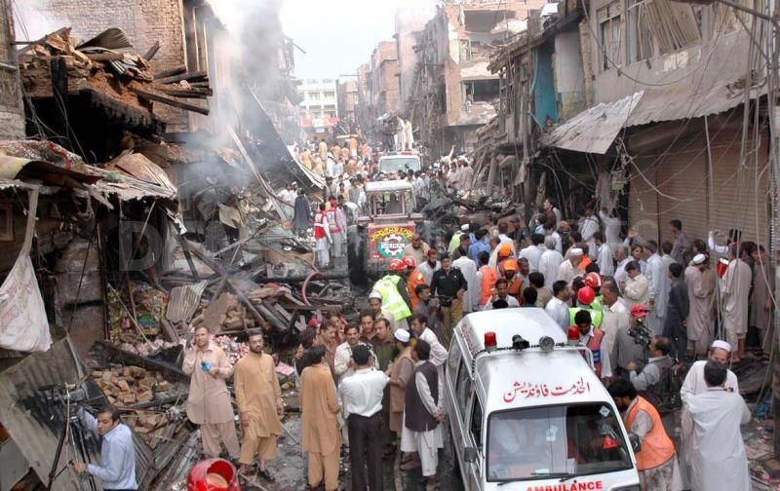

Slide 28
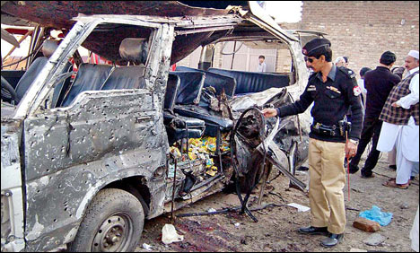

Slide 29
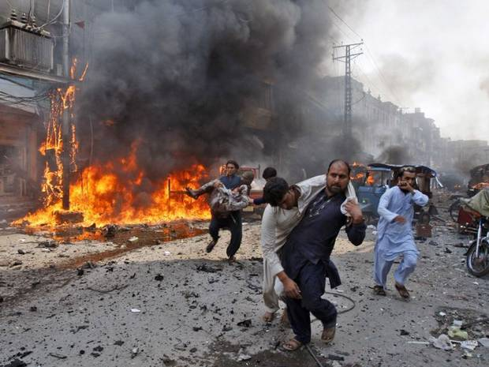

Slide 30
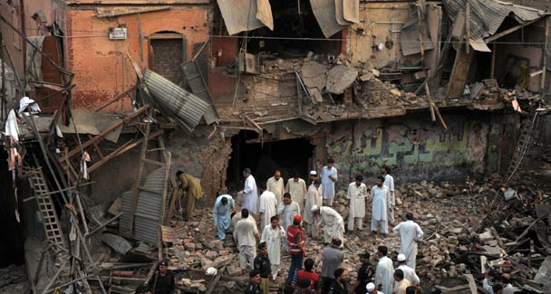

Slide 31
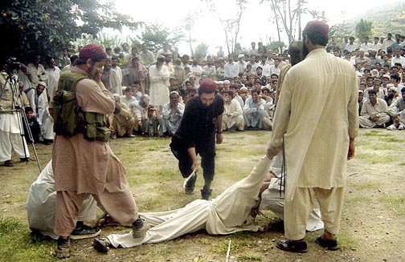

Slide 32
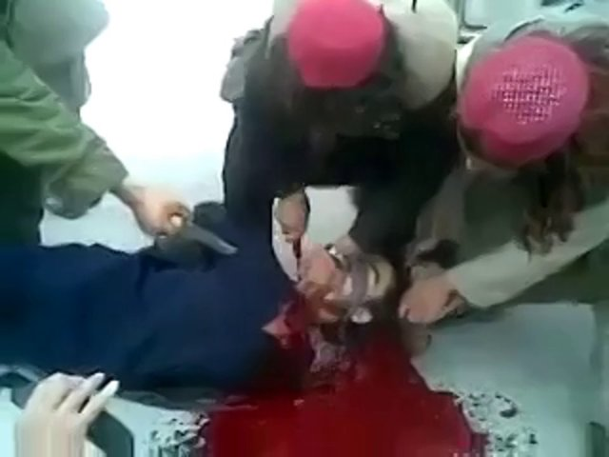

Slide 33
Challenges & Constraints
Terrorism
Extreme Poverty because of non availability and
developmental programs.
Lack of Education
Lack of Communication Infrastructure
Non-Availability of Health Education and Health Care Facilities

Slide 34
Role of Jinnah Medical College in countering the constraints and challenges
Jinnah Medical Complex Peshawar is a purely welfare medical school and hospital which was established on 16th January 2009.
The aim is to provide Medical Education to the poor and provide health care facilities in the province of KPK which has a big lack of medical education and well being facilities.
The students of Jinnah Medical College Peshawar have shown excellent results in the annual university examinations.
Jinnah Medical College Peshawar is attached for clinical practice with public sector’s hospitals namely District Head Quarter Teaching Hospital, Charsadda & NaseerUllah Khan Babar Memorial Teaching Hospital Peshawar paying a huge amount of money to these hospitals for provision of the health care facilities to the poorest and downtrodden people of the region.
The mission of the Jinnah Medical Complex is to provide better & valuable health & education services to the students as well as to the society.
For the provision of Free Health care facilities and Medical education to the larger number of the poorest segment of KPK and FATA Jinnah Medical college aims to establish its own 500 bed free hospital in the region of KPK and FATA which is infested with multifarious challenges and constraints.

Slide 35
Best Medical Education

Slide 36
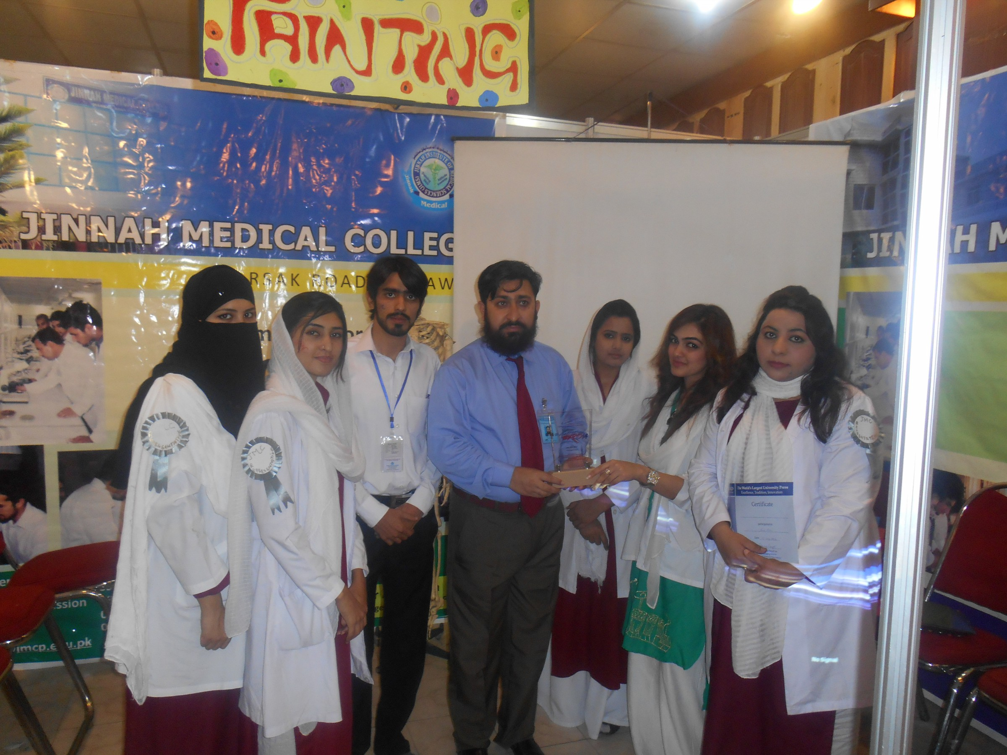
Best Performance of Jinnah Medical College in Expo 2013 & 2014

Slide 37
Few Glimpses of Education Expo 2013

Slide 38
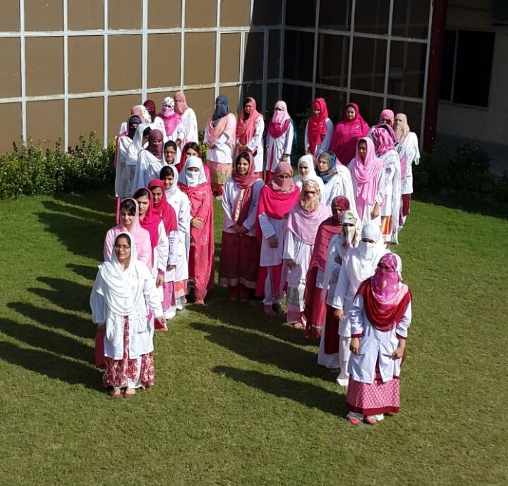
Celebration of Pink Day In Jinnah Medical College

Slide 39
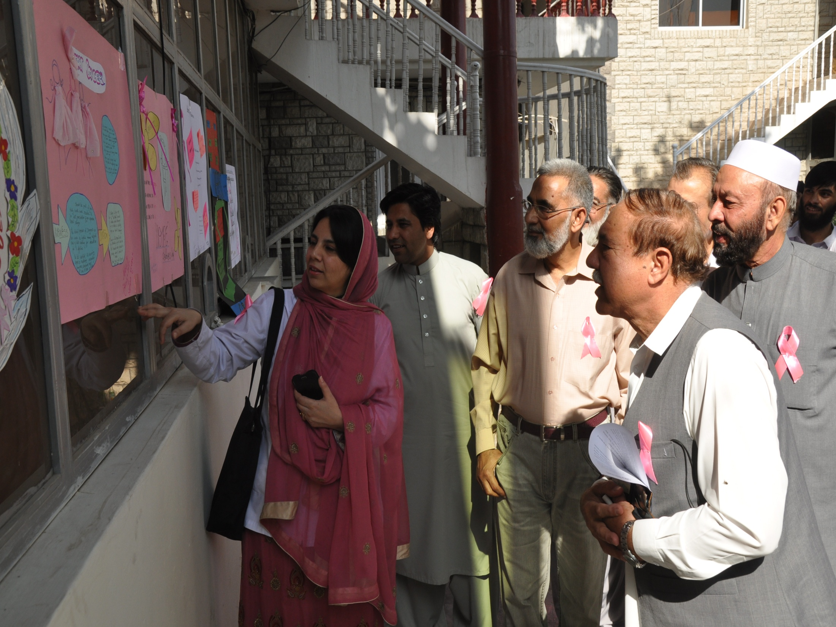

Slide 40
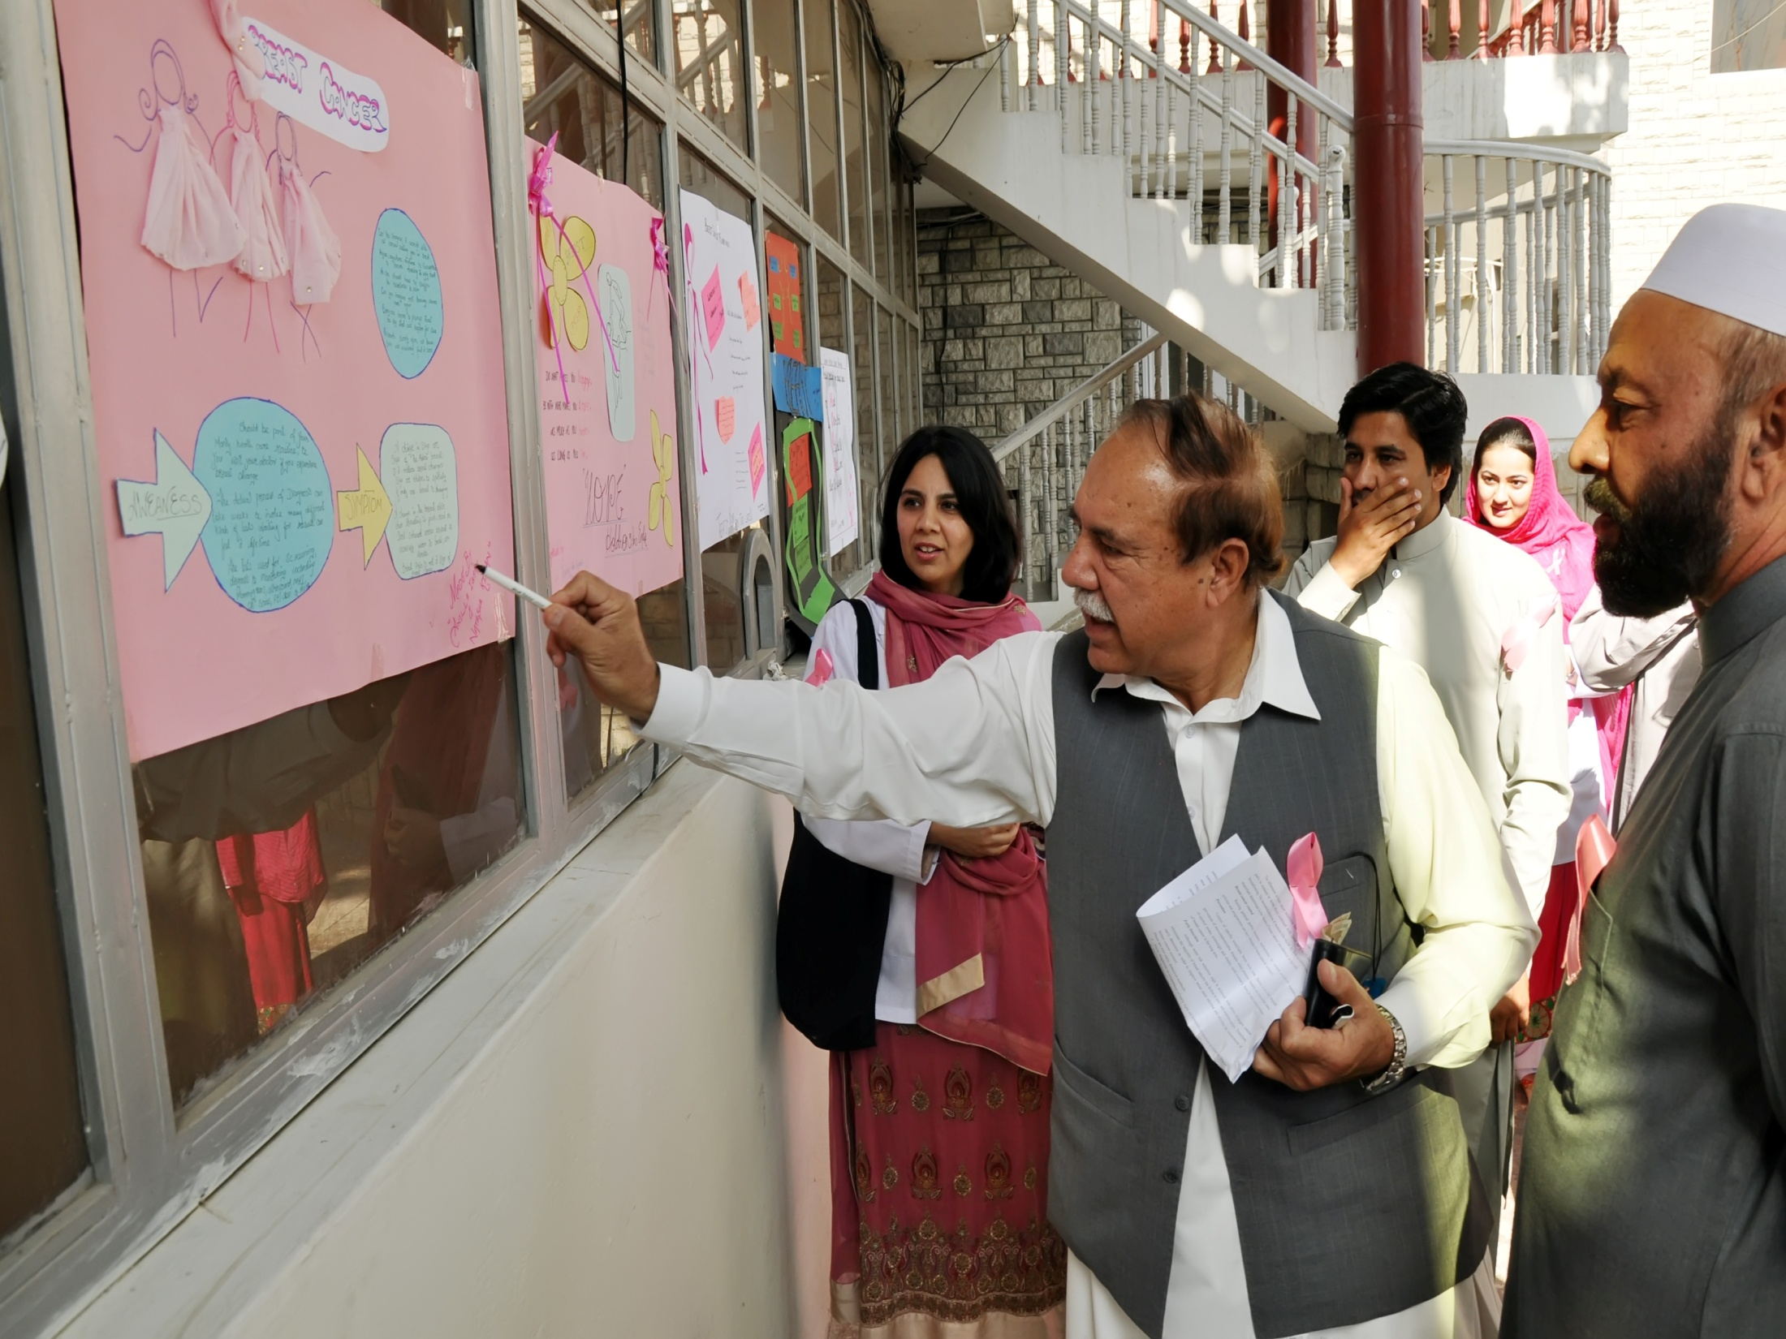

Slide 41
World’s AIDS day In Jinnah Medical College

Slide 42
World’s Diabetes Day

Slide 43
Medical Conferences and Seminars

Slide 44
Future Planning Of Jinnah Medical College

Slide 45
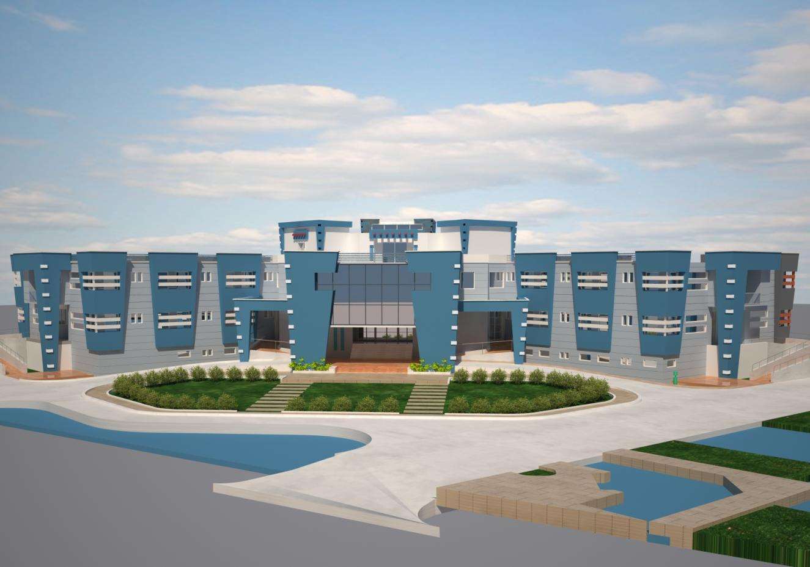
Jinnah Medical College Peshawar 500 Beded Free Hospital

Slide 46
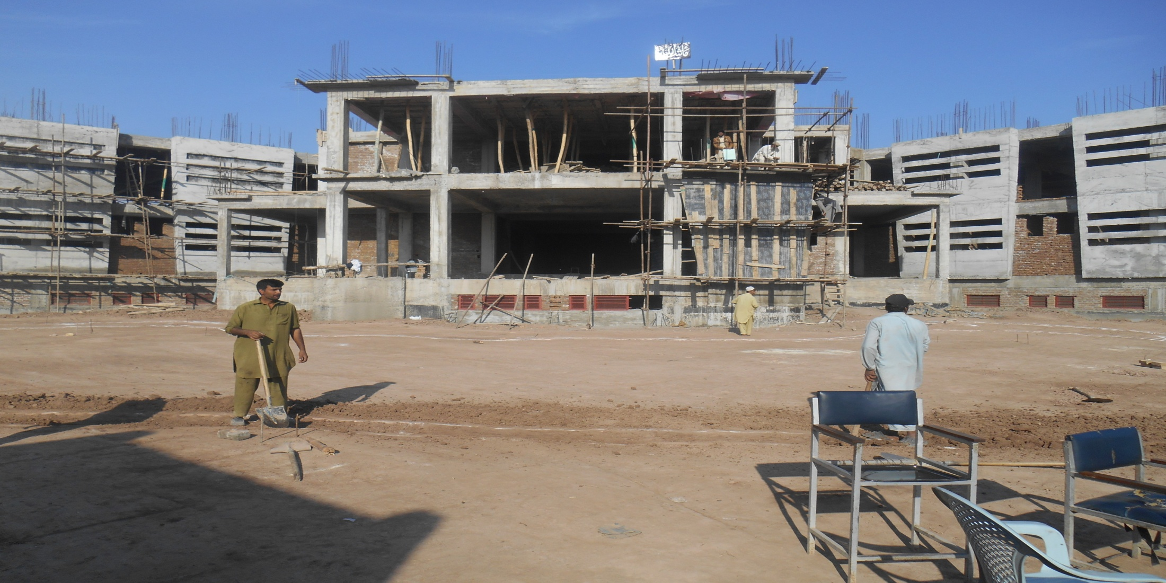
Underconstruction Hospital
Construction of Jinnah medical College

Slide 47
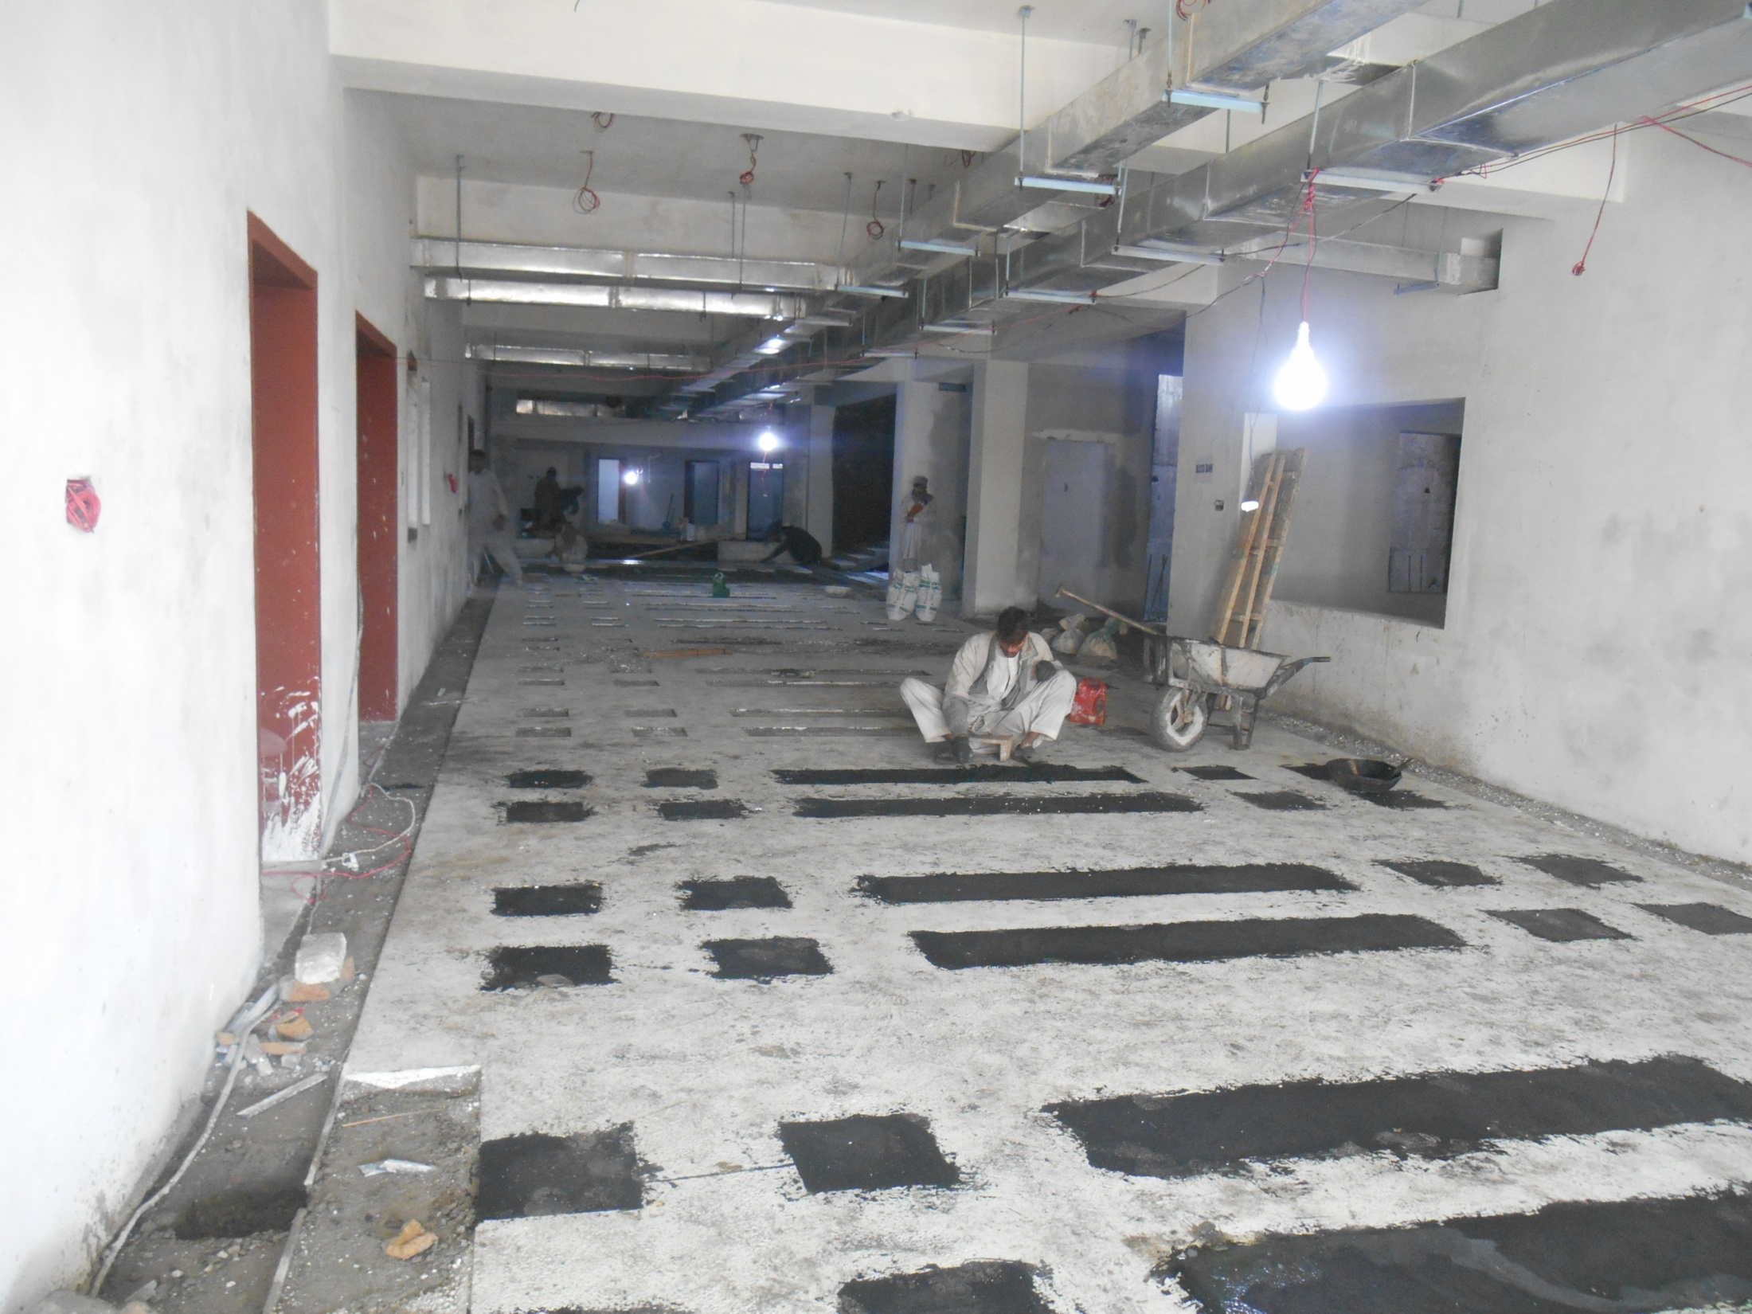

Slide 48
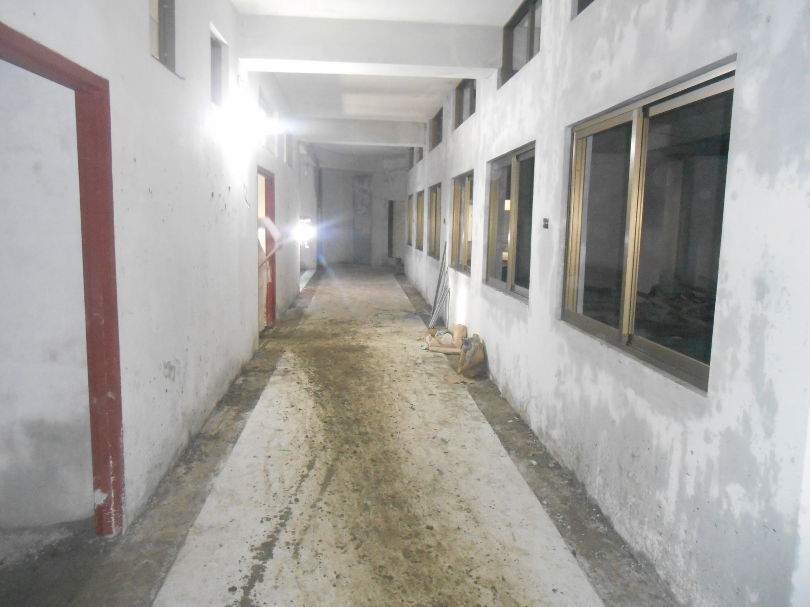

Slide 49
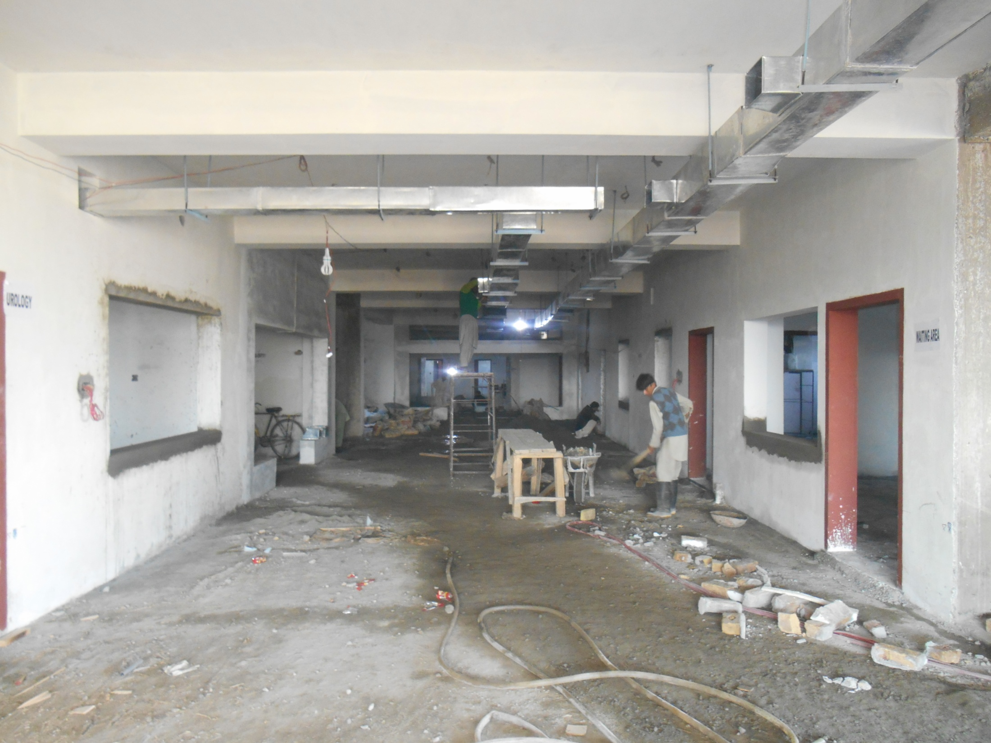

Slide 50
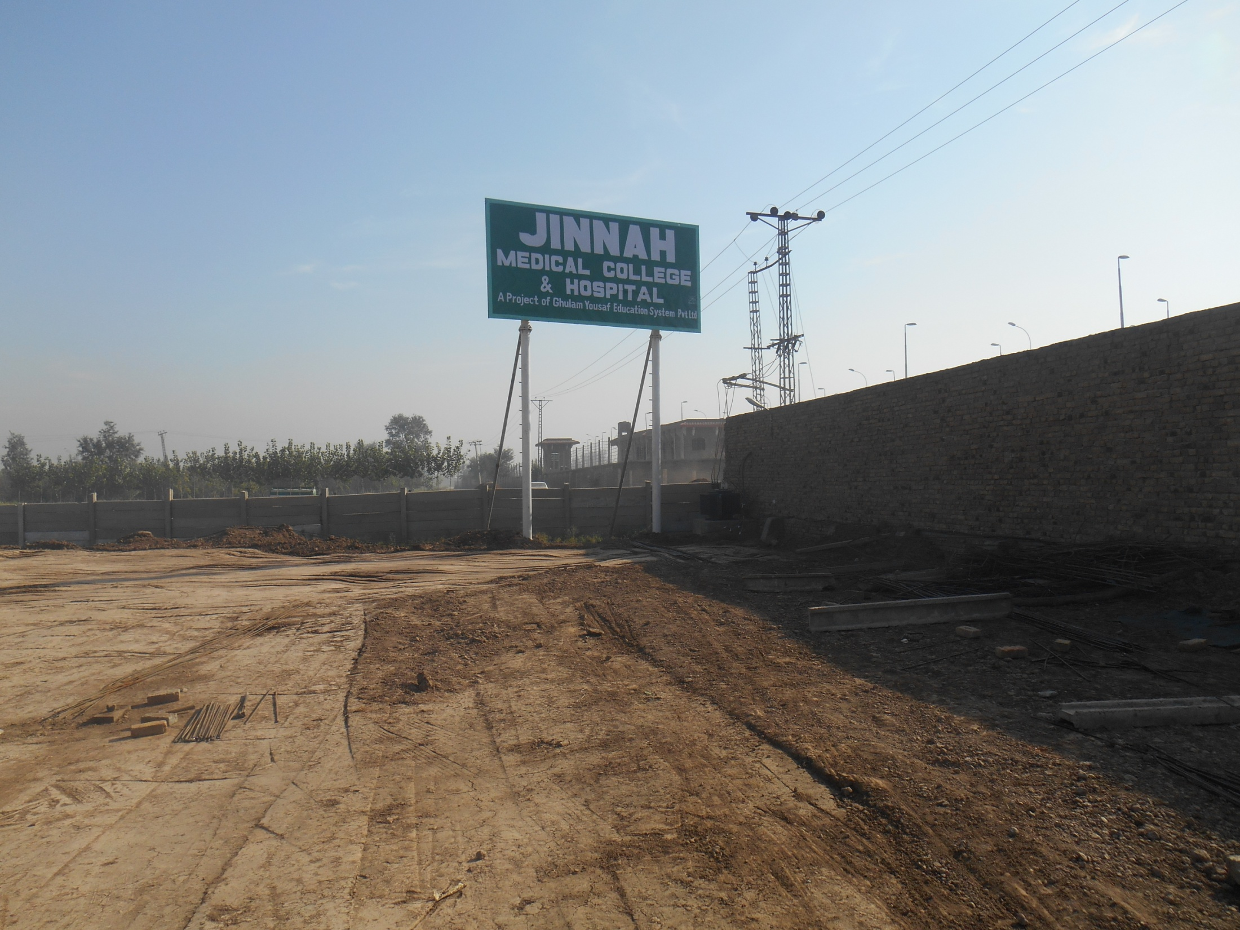

Slide 51
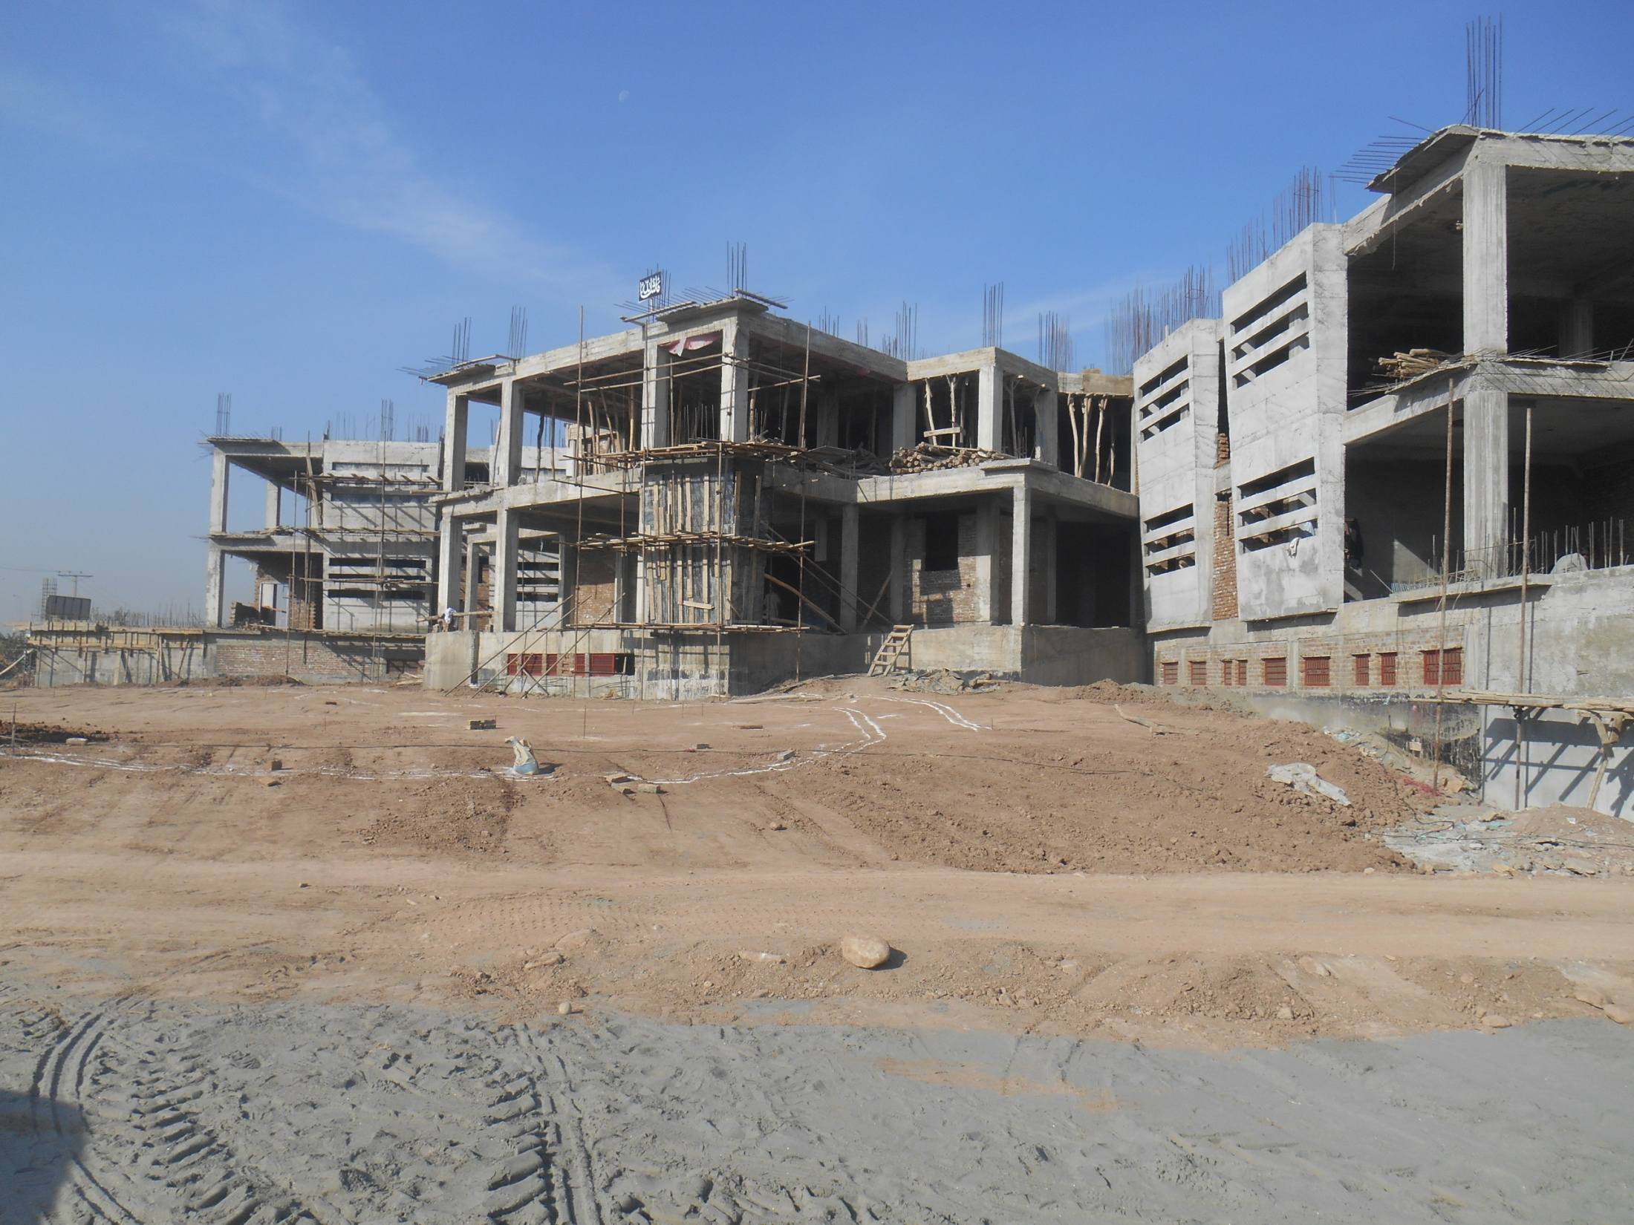

Slide 52
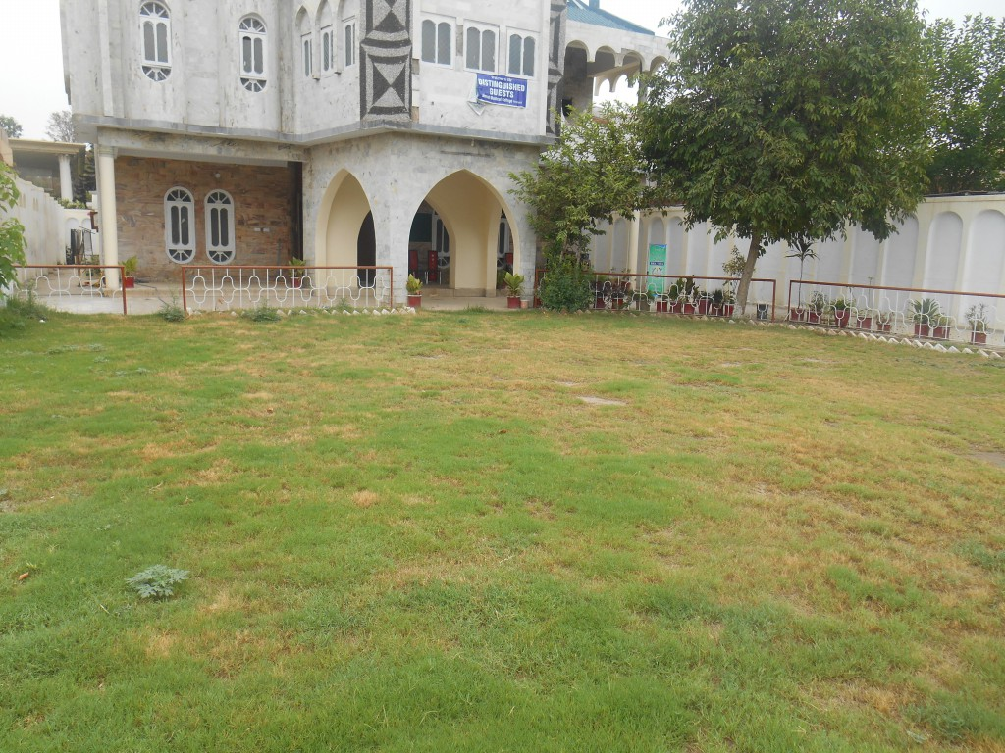
Ghulam Yousuf University

Slide 53
Shortfall of Resources
We are grossly confronted with the short of resources in terms of finances as well as medical equipment. Just to name few :-
MRI
CT Scan Machine
Ultrasound Machine
Laboratory Equipments
Blood Bank Equipments

Slide 54
Point for Consideration of the Audiences
To enable Jinnah Medical College in producing the enlightened and professional doctors and provision of free health care facility to the poorest people of the terrorism ridden region of Pakistan, all the honorable and generous/magnanimous participants of this forum are welcome for donation in terms of financial help or in any shape like provisioning of MRI, CT Scan, Ultrasound , Laboratory Equipments, Blood bank equipments etc.
This help will go a long in producing modern enlightened doctors in the area of KPK/FATA and will also help in provisioning of free and better health care facilities to the poorest of the region.
The Contact can be made on the following address:-
Jinnah Medical College,
Warsak Road, Peshawar.
info@jmcp.edu.pk
ishaq@jmcp.edu.pk
Phone: +92915602471-73 Fax: +92915602475
Account No: 00094006 (Khyber Bank Warsak Road)

Slide 55
Thank You

