Slide 1
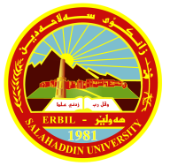
Cathodoluminescence petrography for provenance studies of the sandstones of Ora Formation (Devonian- Carboniferous), Iraqi Kurdistan Region, northern Iraq.
By
Dr. Muhamed F. Omer
Post-doctoral / Warsaw University 2014 Salahaddin University- Science College, Geology Department
Iraqi Kurdistan Region-Erbil
muhfakhri2005@ gmail.com Tel. 009647701348322
Journal of African Earth Sciences, 109 (2015) 195-210

Slide 2
Talk outline
Background on the Ora Formation
Geological setting
Sampling and Methodology
Goal of the study
- Sandstone petrography
Provenance analysis
Albitization of feldspar
Cathodoluminescence of quartz
Discussion
Conclusions
Journal of African Earth Sciences, 109 (2015) 195-210

Slide 3
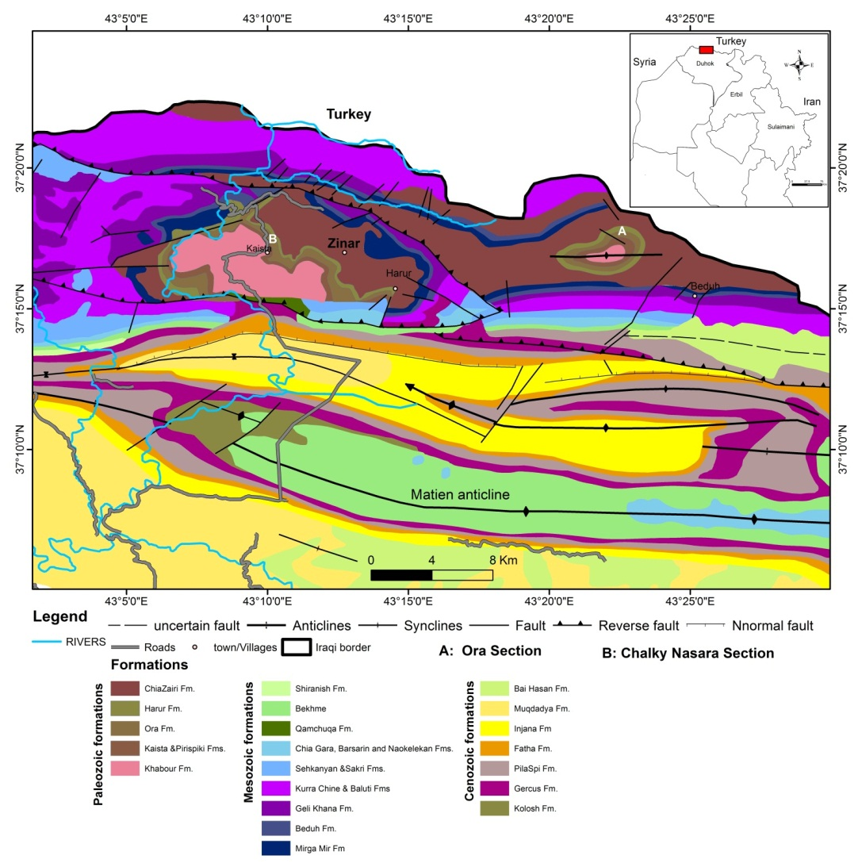
Background of the Formation
Ora Formation is located in Northern Iraq close to the Iraqi-Turkish border (Fig.1). Its outcrops are located within the Northern Thrust Fault Zone of northern Iraq. Geologically, northern and northeastern Iraq is part of the Alpine Mountain Belt of the Near East, represented by the Taurus-Zagros Fold Belt which was developed as a result of collision between the Afro-Arabian and the Eurasian continents (Sharland et al., 2001).
1- A Total 32 fresh samples were collected from thinto medium bedded of Chalky Nasara section (longitude 43° 10′ 00″ E, latitude 37° 17′ 45″ N"), in the core of Chiazinar fold where Paleozoic formations are successively well exposed. (Fig.1).
2- 18 samples were collected from Ora section (longitude 43º 22' 51"E, latitude 37º 17' 57″ N).
Figure 1: Location and geological map showing Ora Formation and other Paleozoic rocks (Modified after Sissakian, 2000).

Slide 4
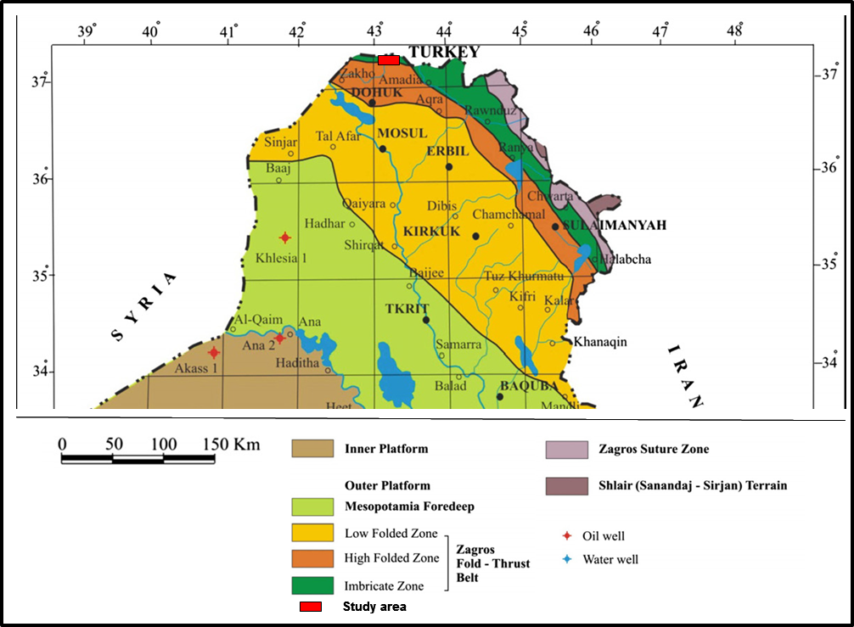
Geological setting
Geologically, northern and northeastern Iraq is part of the Alpine Mountain Belt of the Near East, represented by the Taurus-Zagros Fold Belt which was developed as a result of collision between the Afro-Arabian and the Eurasian continents (Sharland et al., 2001). Iraq is tectonically situated in the northeastern sector of the Arabian Plate which is in a collision state with the Eurasian (Iranian) Plate; this collision resulted in the creation of the Zagros Foreland Basin which is divided into four tectonic zones. These zones are (1) Imbricate Zone, (2) High Folded Zone, (3) Low Folded Zone, and
(4) Mesopotamia Foredeep
(Fouad, 2010: Fig. 2).
Figure 2: Main tectonic zones in Iraq
(after Fouad, 2010).

Slide 5
Sampling and Methodology
Fieldwork was carried out on two outcrops of Ora Formation in northern Iraq (Fig.1). Both lithostratigraphic sections were measured and described in the field (Figs. 1 and 3).
1-Fifty polished thin sections were prepared from sandstone samples from Ora and Chalky Nasara sections and studied under a standard Nikon Eclipse LV 100 Polorizer petrographic microscope with automatic stage at Warsaw University.
2-The feldspar-rich thin sections were stained by HF and sodium cobaltnitrate that helps easy identification of potassium feldspar (Chayes, 1952).
3-Scanning electron microscopy (SEM) was performed, using a ∑│GMA™│VP- ZEISS with EDX, BRUCKER X Flash 6/10. The microscope was operated at 20kV electron acceleration voltage, using AsB® detector and backscattered electron (SEM-BSE) modes. SEM-CL images is used to recognize microcracks, healed fracture, zonation, or deformation features (Seyedolali et al., 1997; Bernet and Bassett, 2005; Boggs and Krinsley, 2006).
4-Electron microprobe analysis (EMPA) was used for quantitative determination of the composition of coexisting feldspars. The analyses were carried out at 15kV and 10-20nA probe current, and electron beam of 5 microns diameter.
5-X-ray diffraction (XRD) analyses were performed for studied samples using Philips (PW3710) diffractometer (Cu Kα radiation, 35 kV, 28.5 mA). All these studies were performed at Warsaw University-Poland.
6-A total of 200 quartz grains were counted using hot cathode microscope HC1-LM at the Institute of Paleobiology, Polish Academy of Sciences for visual and spectroscopic CL-analyses (Neuser et al., 1996). Electron energy of 14 kV and a beam current density of 0.1 μA mm ² were used for both CL microscopy and spectroscopy.

Slide 6
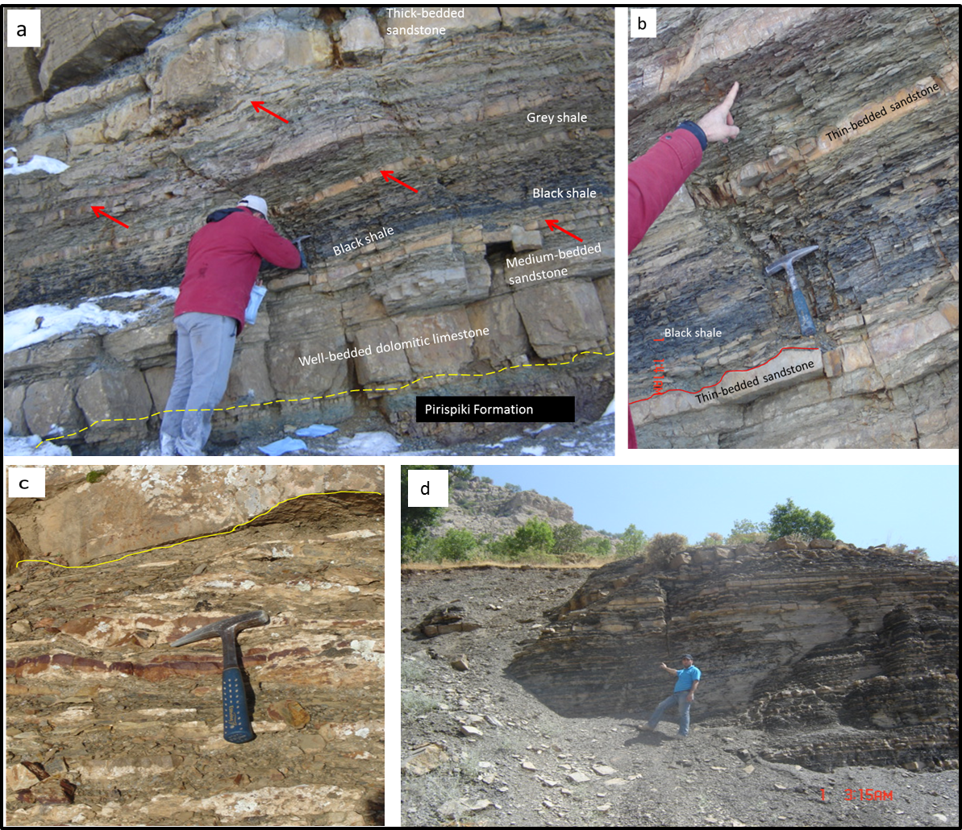
Figure 4: Field photographs of Ora Formation showing (a) sandstones intercalated with black to grey shale in Ora section; the red arrows show the location of collected samples from the thinly bedded sandstones. The lower contact with Pirispiki Formation is conformable; (b) close-up view of (a) showing fissility of the black shale and current ripples in the thinly bedded sandstone units; (c) channel-fill dominated by lenticular bedding with isolated lenses in the Chalky Nasara section; (d) quartzarenite sandstones interbedded with black shale in the Chalky Nasara section.

Slide 7
Goal of the study
1- The main goal is to study detail petrography and paragentic history of the sandstones Ora Formation.
2-The amount and influence of quartz cement in thin-bedded sandstones comparing with thick-bedded sandstones.
3- We characterize and interpret the albitization of detrital K-feldspar and plagioclase in the sandstones of Ora Formation as a diagenetic but provenance-related.
4-Provenance analysis of the (Devonian-Carboniferous) sandstones of the Ora Formation by study individual quartz grains and using hot-CL as well as study textural features on the same of individual quartz grains.
Journal of African Earth Sciences, 109 (2015) 195-210

Slide 8
Sandstone petrography
-The detrital composition of the sandstones is dominated by monocrystalline quartz.
The proportion of the monocrystalline quartz (Qm) ranges from 48.3 to 61.4% and 51.2 to 62.3% in Chalky Nasara and Ora sections respectively . In medium grained sandstones, the monocrystalline quartz ranges in size from ~0.20 mm to 0.30 mm, and show subrounded to rounded shape (Fig. 4a). In fine-grained sandstones it ranges from ~0.10 mm to 0.19and is subrounded in shape. In very fine-grained sandstones it ranges from 0.05 mm to 0.80 mm and are mostly subangular.
-K-feldspar (orthoclase, microcline and microperthite, Fig. 4c)
is more abundant than plagioclase in both sections of the Ora Formation. The average grain size of feldspars range between 0.07 mm and 0.17mm. Many plagioclase grains have distinctive albite twinning (Fig.4d).
-Based on the Folk et al. (1970) scheme, Ora sandstones are classified into mature quartzarenite, subarkose and immature sublitharenite (Fig. 5a). The Q-F-L diagram of Dickinson et al. (1983) indicated that the Ora Sandstones fall mainly in the field of “Craton Interior”, while few samples plot in the field of “Recycled Orogen” (Fig. 5b). This indicates that these sandstones were derived from the stable parts of the craton, with possible minor contribution from recycled orogen (Dickinson et al., 1983).

Slide 9
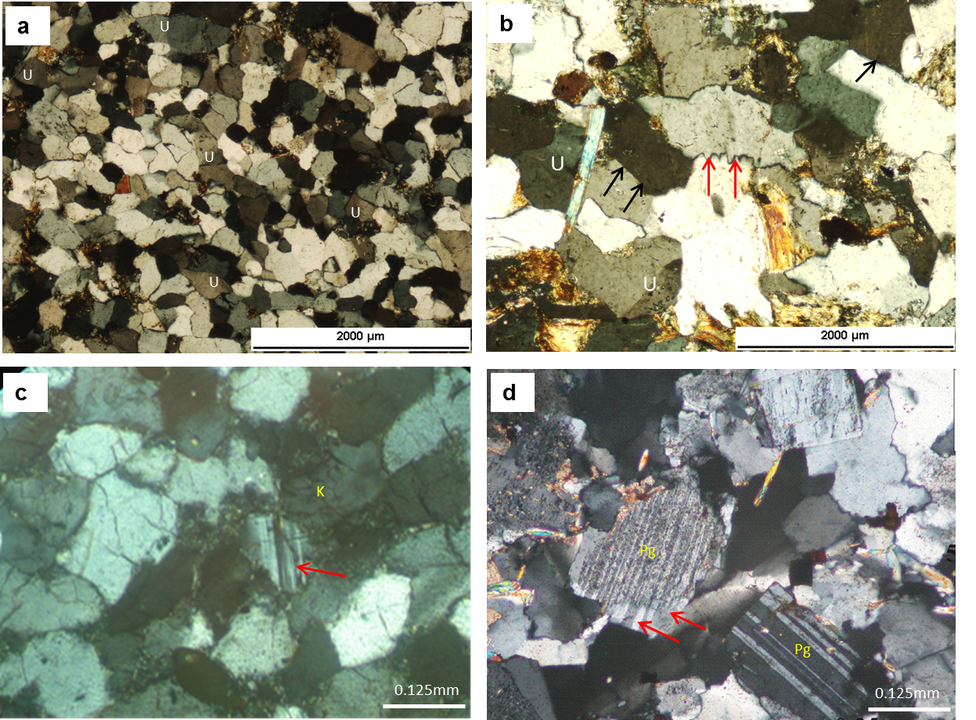
Figure 4: Photomicrographs of framework grains of Ora sandstones under cross-polarized light (XPL). (a) packed subrounded nature of moderately sorted sandstone, with slightly undulose extinction (U); tidal flat environment (Chalky Nasara section, sample 25); (b) long contact (black arrow) and suture contact (red arrow) between monocrystalline quartz grains showing slight undulose extinction (U) (Chalky Nasara section, sample 20); (c) microcline with well-developed grid twinning (red arrow), surrounded by chlorite (albitized K-feldspar (K), Ora section, sample 9); (d) albitized polysynthetic plagioclase grain (Pg) showing well developed overgrowths (red arrow) (Chalky Nasara section, sample 5).

Slide 10
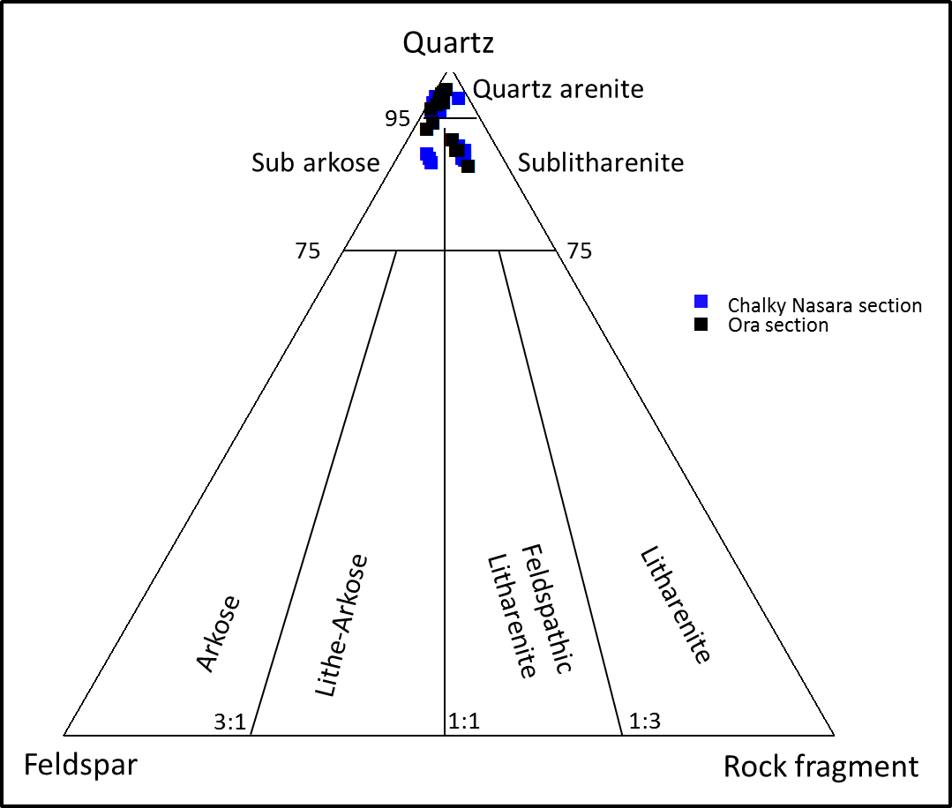
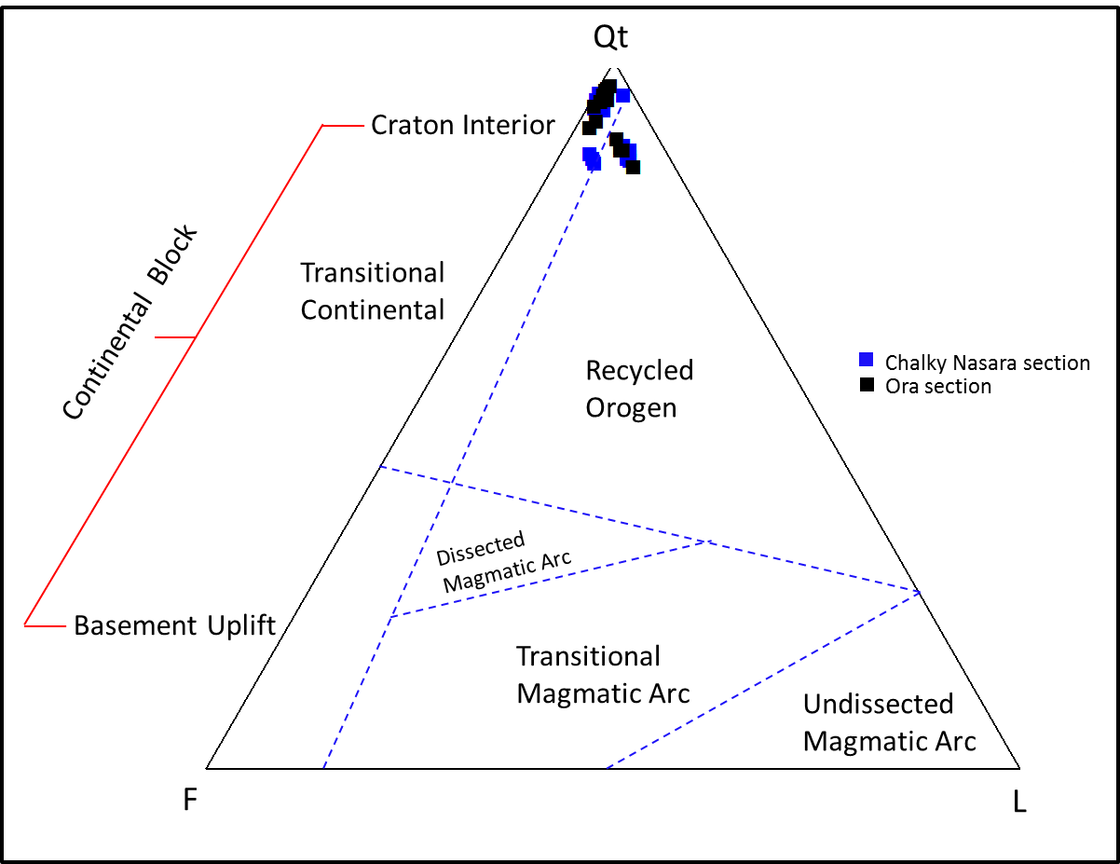
a
b
Figure 5: (a) classification of the sandstones of the Ora Formation according to Folk et al., (1970); (b) QtFL tectonic discrimination diagram of Dickinson et al., (1983) applied on the detrital components of the Ora sandstones (Qt is the total quartz, F is the total feldspar, L is the total rock fragments; the dotted lines mark the boundaries between the major fields of tectonic provenances).

Slide 11
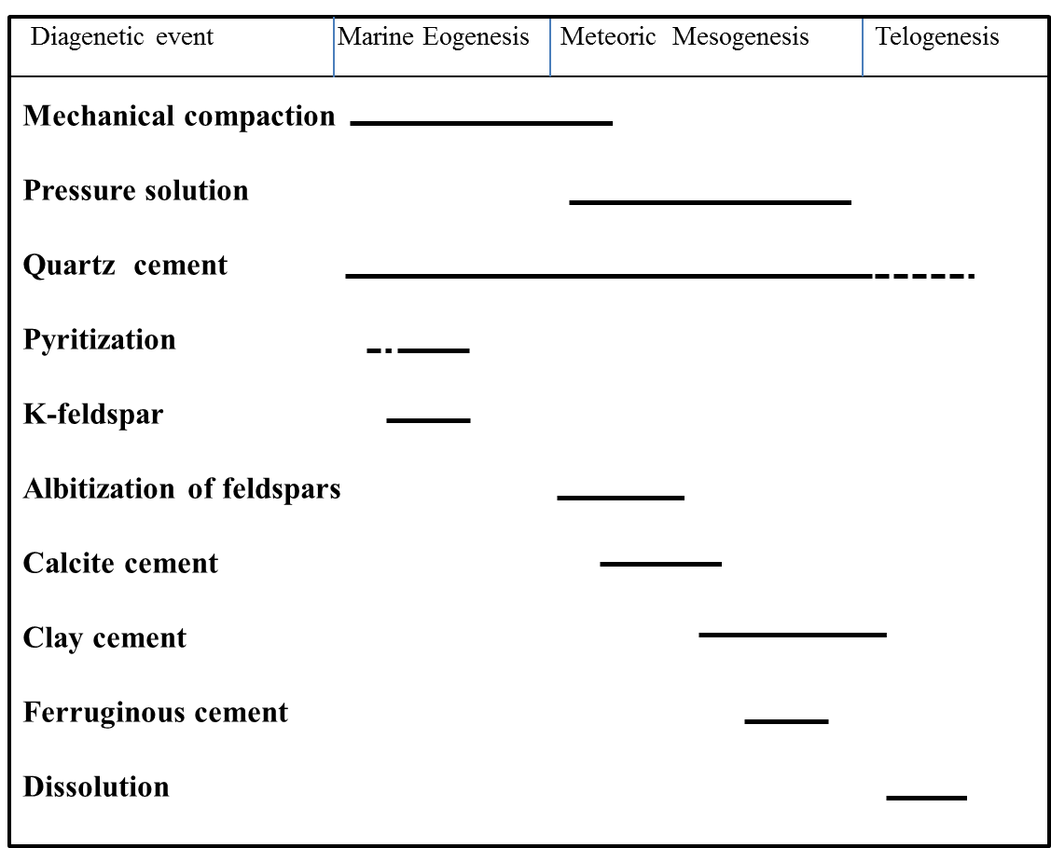
Diagenetic Evolution
Petrographic analysis of the Ora sandstones indicates diagenetic modification including compaction, cementation, dissolution, and alteration of feldspars. The diagenetic processes occurred during early eogenesis, middle mesogenesis and late stage of telogenesis close to fractures and faults. The characterization of the paragenetic history is based on petrographic observations and cathodoluminescence investigation (Fig. 6, 7).
Figure 6: Paragenetic history of the sandstones of Ora Formation, Northern Iraq.

Slide 12
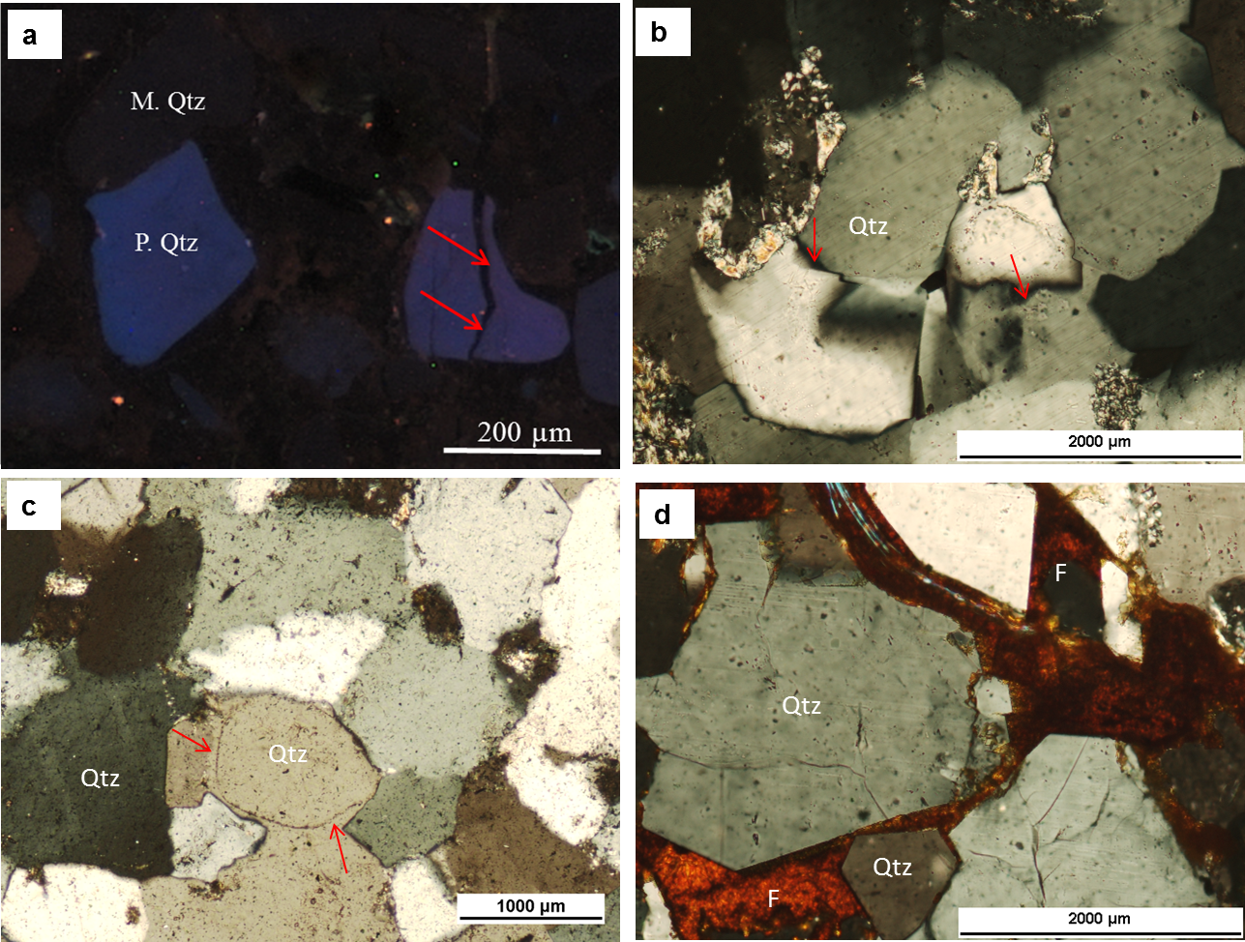
Figure 7: SEM-CL images and photomicrographs of quartzarenite (a) heavily compacted sandstone showing pervasive fracturing partly due to compaction (red arrow) and partly by pressure solution effect that produced post-compaction quartz cement representing non- luminescent phase (Ora section, sample 1; CL image); (b) pressure solution and suture contacts between detrital quartz grains. (Ora section, sample 1; XPL); (c) sandstone showing thin iron oxide films surrounding quartz grains as early cement followed by authigenic quartz cement overgrowth filling the open spaces indicated by arrows (Chalky Nasara section, sample 2; XPL); (d) ferruginous cement (F) filling intergranular pore spaces between euhedral quartz grains that postdated quartz cementation (Chalky Nasara section, sample 3; XPL).

Slide 13
Provenance analysis
1-Albitization of Feldspar
Two types of feldspars were identified in Ora sandstones,
type-1 is untwined, turbid K-feldspar of medium (0.25 mm) and fine (0.15 mm)
grain sizes (Fig.4c).
type-2 is polysynthetic twinned plagioclase containing fluid inclusions which commonly
exhibit optical continuity between polysynthetic twins and their authigenic
overgrowths (Fig. 4d).
-Electron microprobe analysis carried out on fresh feldspar crystals with little or no replacement textures show that they are abundantly perthitic orthoclase or microcline that were altered to albite .
-The composition of alkali feldspar in the sandstones of Ora Formation ranges between Ab_{9.79}An_{0.32}Or_{89.88} to Ab_{3.60}An_{0.08}Or_{96.32}.
Some of the feldspars in subarkosic sandstones have been partially or extensively albitized (Fig. 8a).
-The composition of plagioclase feldspar in the Ora sandstones varies between Ab_{91.57}An_{0.41}Or_{8.02} to Ab_{99.91}An_{0.00}Or_{0.09} (Table 1).
Journal of African Earth Sciences, 109 (2015) 195-210

Slide 14
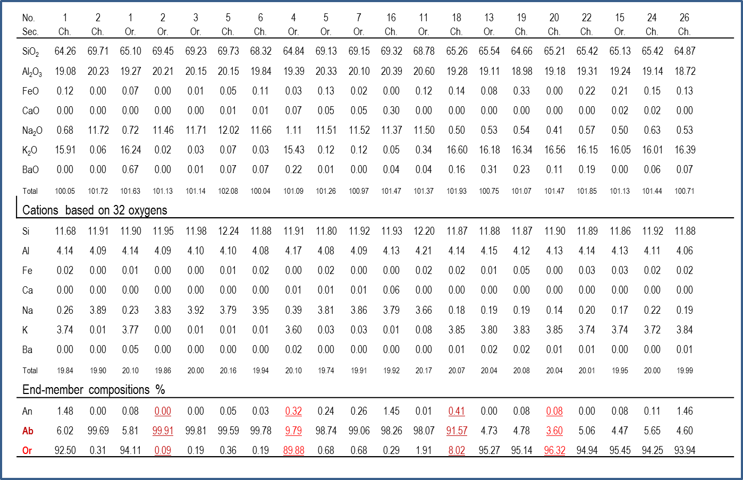
Table 1. Representative EMP analysis of detrital feldspar grains from the sandstones
of Ora Formation.
Journal of African Earth Sciences, 109 (2015) 195-210

Slide 15
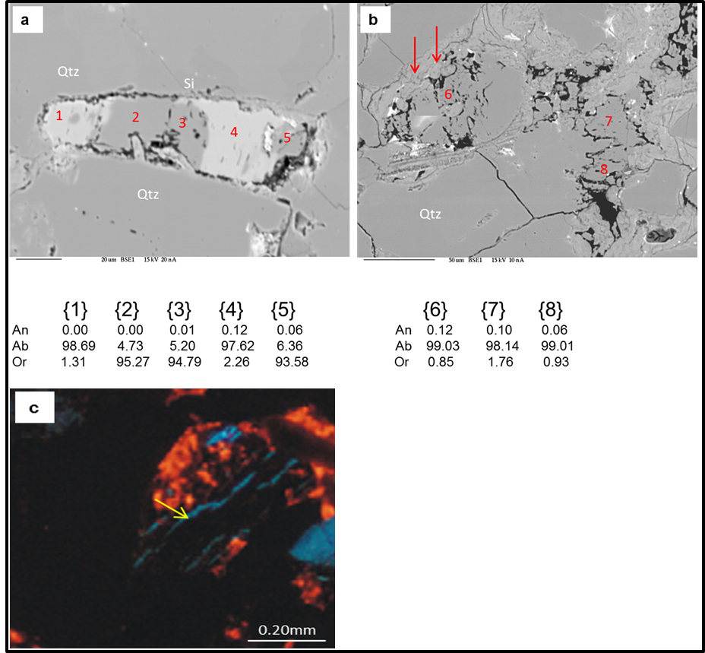
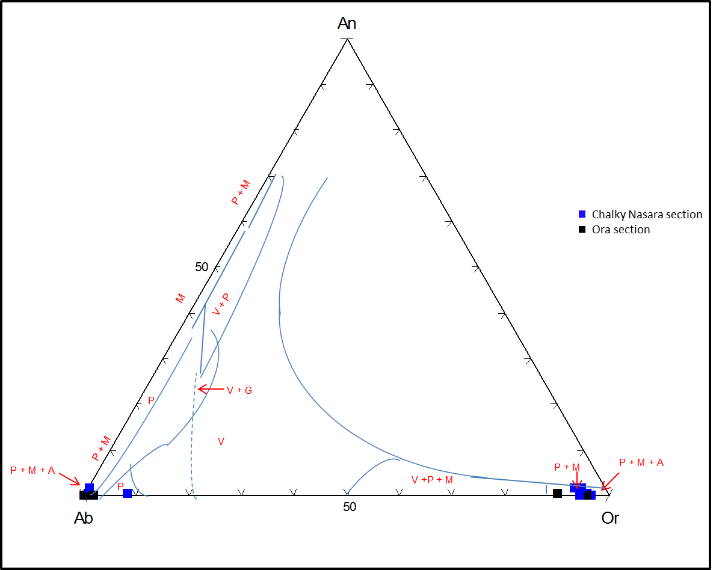
d
Figure 8: BSE images showing (a) partially albitized detrital K-feldspar of type 1 feldspar (1, 2, 3, 4 and 5 are analyzed spots); Si is silica cement (Chalky Nasara section, sample 18); (b) albitized plagioclase showing relics of the original feldspar; the illite cement has postdated albitization (arrow) (Ora section, sample 5); CL image (c) albitized K-feldspar with relicts of the original blue following exfoliation lines (yellow arrow) (Ora section, sample 15).; (d) discrimination diagram of Trevena and Nash (1981) applied to sandstones of Ora Formation.

Slide 16
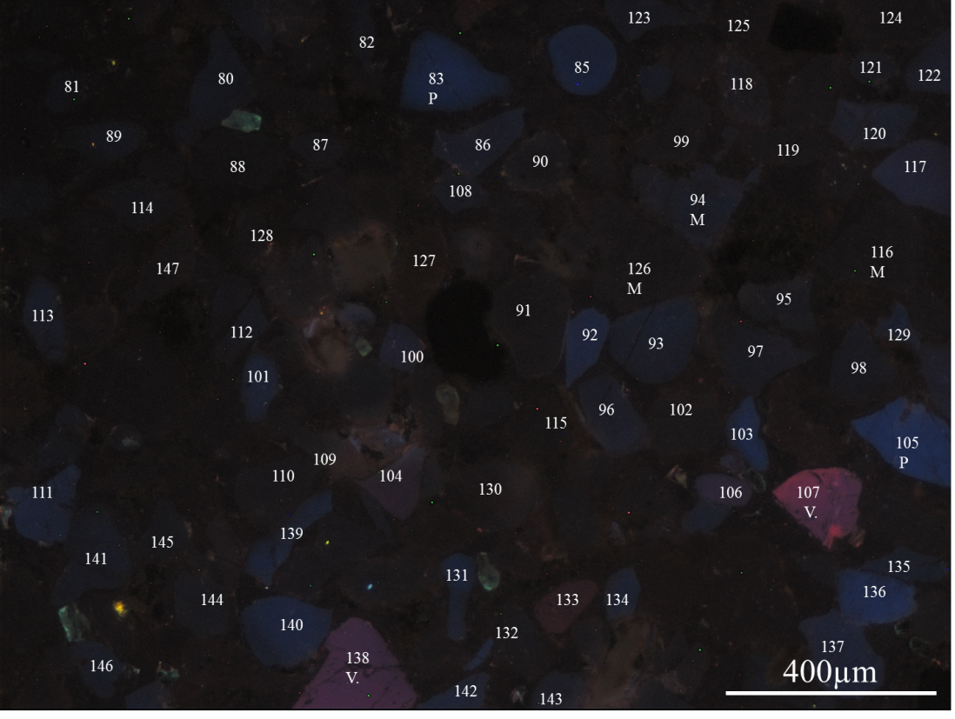
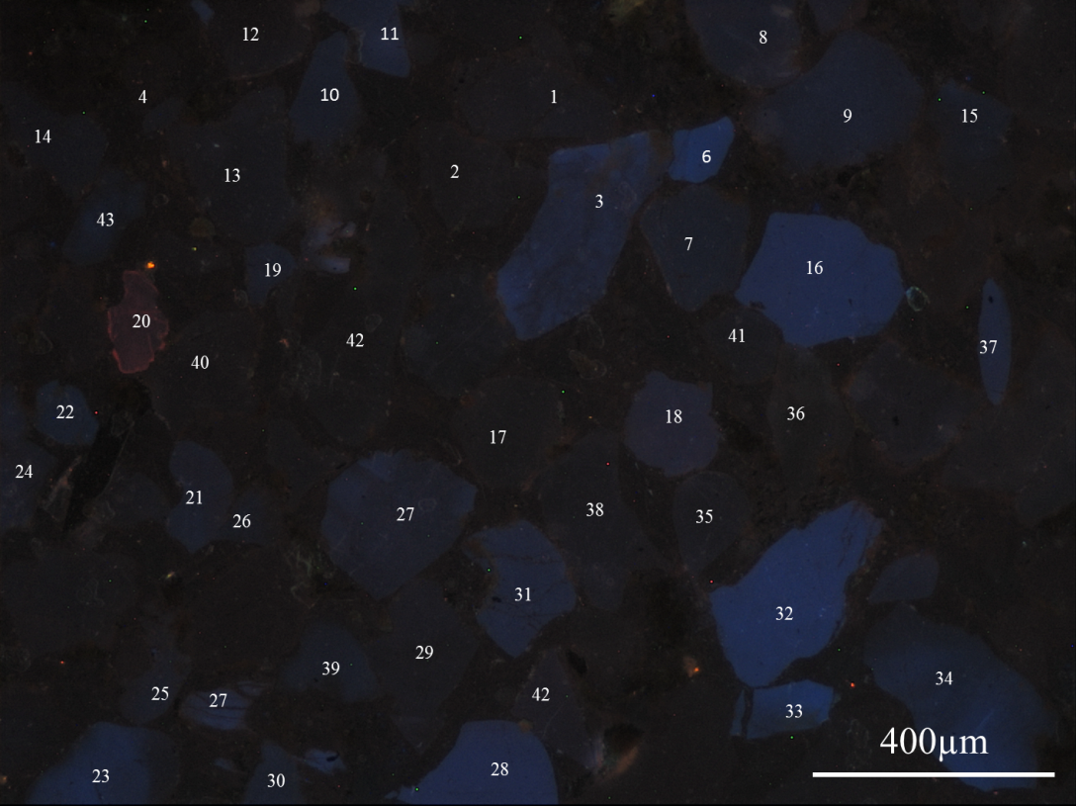
Provenance analysis
2-Cathodoluminescence of quartz
The CL properties of quartz grains that depend on changes in temperature and pressure as well as geochemistry of the depositional environment during the growth of such quartz grains and post-dated geological events and can be implied as provenance indicator (Götze and Zimmerle, 2000).
-Based on such facts, the CL signal of assumingly unchanged single quartz grains since deposition in the source area can be used as provenance indicator (Marshall, 1988; Götze et al., 2001; Augustsson and Bahlburg, 2003).
- Walderhaug and Rykkje (2000) observed variations in the CL color of quartz from violet to blue brown in plutonic rocks and from yellow brown to violet brown and violet in metamorphic rocks. Most quartz grains in the sandstones Ora Formation show brown, dark brown or brownish CL colors (Fig. 9a,b).
a
b
Figure 9: CL images of detrital quartz grains showing point counts (a) brown quartz grains which dominated in studied sandstones representing metamorphic origin , plutonic quartz displaying dark blue, bright blue color and red violet volcanic origin. (Chalky Nasara, sample 9); (b) Ora section, sample 1.

Slide 17
-Integrated SEM-CL study applied on randomly selected 200 grains in each of 25 quartzarenite samples from Ora Formation are shown in Table 3 and Figure 11. The results showed three different quartz types accounting for ~56% of metamorphic sources, ~43% of plutonic origin, and ~1% of volcanic provenances.

Slide 18
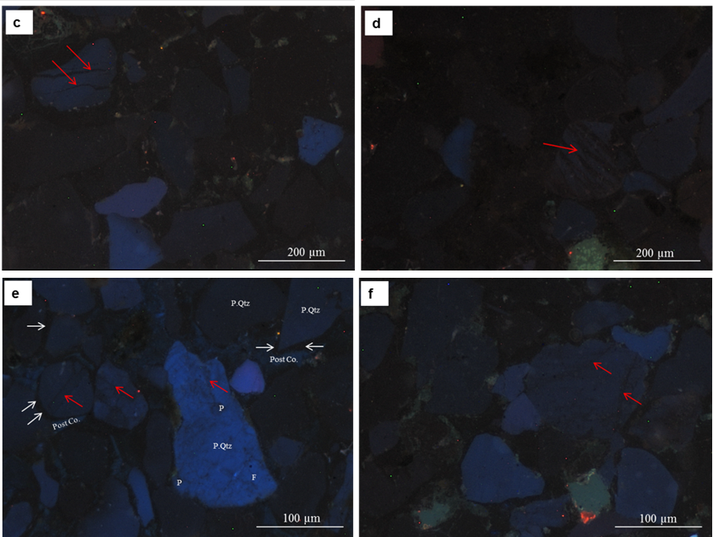
Four characteristic CL features of detrital quartz were observed in the sandstones of Ora Formation comprising healed fractures, mottled textures, streak patches and shocked quartz.
1-The healed fractures are particularly common in plutonic quartz (Fig.10c)(Boggs and Krinsley, 2006).
2-The mottled textures may be caused by incomplete recrystallization or annealing that accompany
metamorphism or it may be the result of deformation during metamorphism (Fig.10 d)(Boggs and
Krinsley, 2006; Boggs, 2009).
3-The dark CL streak (red arrow) and patches (P); thin rims of inherited quartz cement (white
arrow)around detrital quartz grains and post compactional .
Figure 10: CL images of quartz features

Slide 19
Discussion
1-Two styles of sandstone diagenesis were recognized in the Ora Formation. The first one concerns the texturally supermature sandstones, which are fine to medium grained, well- to sub-rounded and well-sorted. The second one concerns the texturally immature sandstones that consist of very fine to fine-grained, rounded to subangular and poorly sorted grains, and enriched in mica.
2-Minor amounts of pore-filling, calcite replacement, and quartz overgrowths have taken place during early until late stage of diagenesis. Mechanical compaction started to reduce pore spaces during burial. Compaction is dominated by tight grain supported fabric of sandstones as it is evident from close packing of detrital framework which caused reduction of primary porosity.
3-The chemical compaction was activated during this stage allowing pressure solution to provide the necessary silica for quartz cementation.
4-The thin shale laminae interbedded with thinly bedded sandstones within the Ora Formation have probably acted as an extra source for quartz cement; similar case has been observed by Čyžienė et al (2006) in the sandstones of Cambrian Deimena Group in Lithuania. The loss of SiO₂ requires addition of K₂O and Al₂O₃ during shale diagenesis which is an open system process (Land et al., 1997; Lynch et al., 1997).
5- Additional silica sources for post compactional quartz cement in quartzarenites can be produced during alteration and dissolution (Worden and Morad, 2000).

Slide 20
Conclusions
1-The sandstones of Ora Formation are quartzarenite to subarkose and sublitharenite.
The detrital grains are dominated by monocrystalline quartz with slightly undulose
extinction.
2-Framework mineralogy and quartz types petrography suggests that the metamorphic
and igneous rocks of Bitlis Massif in southeastern Turkey may have contributed as
source rocks of the sandstones of Ora Formation.
3-The thin shale laminae interbedded with thinly bedded sandstones within the Ora
Formation have probably acted as an extra source for quartz cement; similar case has
been observed by Čyžienė et al (2006) in the sandstones of Cambrian Deimena Group
in Lithuania. The loss of SiO₂ requires addition of K₂O and Al₂O₃ during shale
diagenesis which is an open system process (Land et al., 1997; Lynch et al., 1997).
4-Diagenetic changes in the sandstones followed two styles depending on texture and
mineralogy. Low CL intensity (non-luminescence) of dark brown color of quartz cement
surrounding detrital quartz grains are considered an early quartz cement diagenesis
and slightly blue color of post compactional quartz cement of late diagenesis. The
primary porosity of the sandstones is reduced due to intense mechanical compaction
and due to filling of early quartz cement.

Slide 21
5-The composition of plagioclase feldspar in the Ora sandstones varies between
Ab_{91.6}An_{0.4}Or_{8.0} and Ab_{99.9}An_{0.0}Or_{0.1}. The feldspars in the sandstones of Ora
Formation are of metamorphic and plutonic origin as indicated by Or-Ab-An
provenance diagram.
6-The CL characteristics of quartz grains of the Ora Formation sandstones also suggest
derivation from multiple provenances. The major sources are metamorphic and plutonic rocks with notable contribution from volcanic rocks.
7-paragenetic events of Ora Formation has taken place in the following order:
mechanical compaction - pressure solution- quartz cementation – pyritization - K
feldspar authigenesis - albitization of feldspars- calcite cementation – clay
cementation -ferruginous cementation and dissolution.

Slide 22
Acknowledgements
The author would like to thank Erasmus Mundus Action Program of European Union for funding this research project as a postdoctorate fellowship, project number SALA1206157 at Warsaw University- Poland. We would like to express our thanks to Professor Boguslaw Bagiñski for their assistance and making all research facilities SEM available for this project at Geology Faculty, University of Warsaw (Poland). Thanks also to Professor Jarosław Stolarski at the Polish Academy of Sciences for making the hot-CL available for this study.

Slide 23
Thank you

