Slide 1
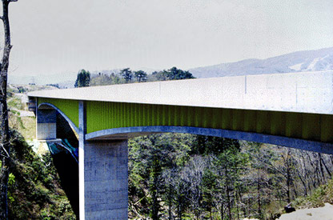
ADVANCES ON SHEAR STRENGTH AND BEHAVIOR OF BRIDGE GIRDERS WITH STEEL CORRUGATED WEBS
HONDANI BRIDGE
Dr. MOSTAFA FAHMI HASSANEIN
Associate Professor
Department of Structural Engineering; Faculty of Engineering; Tanta University, Tanta; Egypt
Tuesday – 17 Nov., 2015

Slide 2
Introduction
Objectives
Validation of finite element models
Contents
Parametric study
Results and discussion
Recommendations

Slide 3
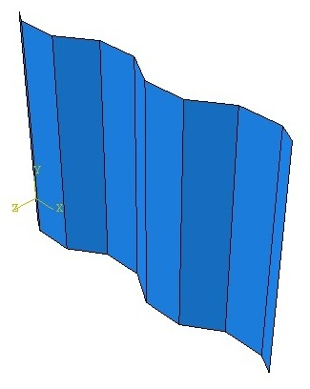
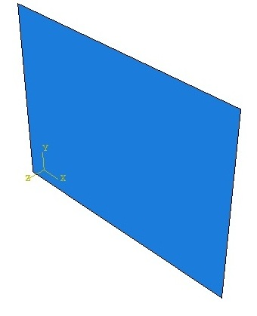
Introduction
1. Advantages of corrugated web plates
They have much higher buckling strengths.
The own significant out-of-plane stiffness.
They act as continuous stiffeners, so no need to use stiffeners.
Their thickness is significantly reduced.
Less weight of flat web plate with the same capacity
Hamada et al.
(1984)
9-13%
Chan et al.
(2002)
10.6%

Slide 4
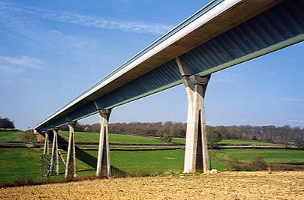

Introduction
1. Advantages of corrugated web plates
They have much higher buckling strengths.
The own significant out-of-plane stiffness.
They act as continuous stiffeners, so no need to use stiffeners.
Their thickness is significantly reduced.
Maupré Bridge
Hondani Bridge
Structural efficiency
Aesthetical appearance

Slide 5
Introduction
2. Interaction between shear and flexural behaviors
Corrugated webs do not carry significant longitudinal stresses from the primary flexure of the girders and, consequently, the bending moment can reasonably be assumed to be carried totally by the flanges. Hamilton (1993) and Driver et al (2006)
This is called the “accordion effect” and it is characterized by negligible axial stiffness.
Therefore, the shear is carried entirely by the webs.

Slide 6
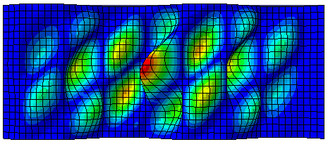
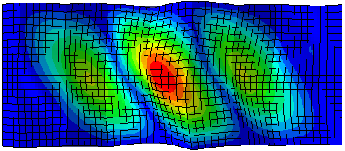
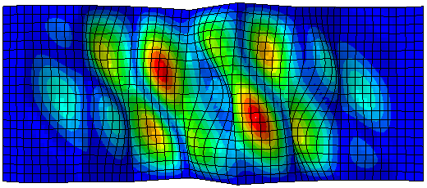
Introduction
3. Elastic shear buckling
Local buckling
Global buckling
Classical plate buckling theory
Orthotropic-plate buckling theory
Lindner and Aschinger (1988)
Interactive buckling

Slide 7
Introduction
4. Interactive shear buckling stresses
Several researches were conducted to find the best exponent
Paper | Year | Interactive shear buckling stress predictions
Bergfelt and Leiva | 1984
Yi et al. | 2008
El-Metwally | 1998
Abbas et al. | 2002
Hiroshi | 2003
Sayed-Ahmed | 2005

Slide 8
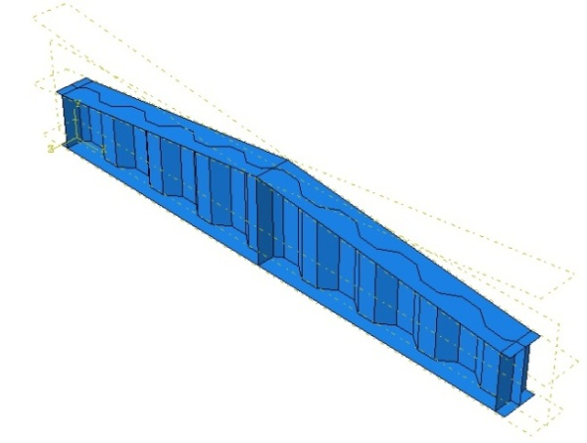
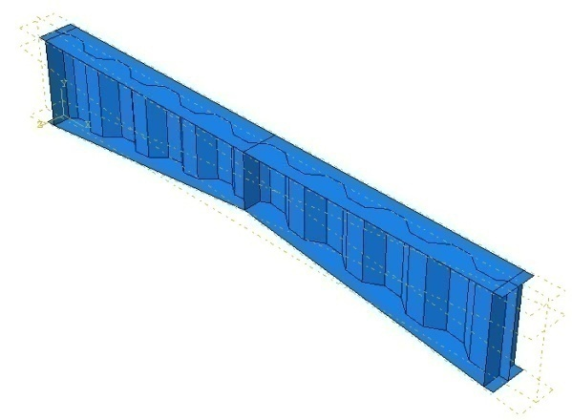
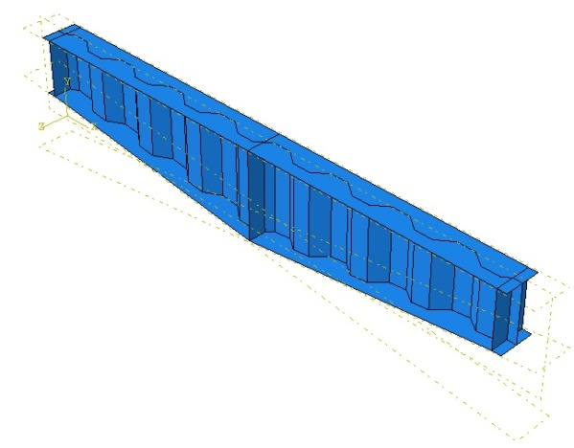
Introduction
5. Types of tapered web panels
B.M.D.
S.F.D.
1
6
2
3
4
5
II
I
III
Direction of Tension Field
Tension on tapered flange
Compression on tapered flange

Slide 9
Introduction
Objectives
Validation of finite element models
Contents
Parametric study
Results and discussion
Recommendations

Slide 10
Objectives
1. Research objectives
is to provide additional data to engineers and the scientific community about the shear strength and behavior of:
Prismatic bridge girders with corrugated webs.
Tapered bridge girders with corrugated webs.
In detail, to
find the real behavior at the juncture between the corrugated web and the flanges of Prismatic girders. Never been studied
provide new critical stress formula.
suggest a more suitable strength than those available in literature.

Slide 11
Objectives
1. Research objectives: Continue
is to provide additional data to engineers and the scientific community about the shear strength and behavior of:
Prismatic bridge girders with corrugated webs.
Tapered bridge girders with corrugated webs.
In detail, to
Investigate the effect of different junctures between the corrugated web and the flanges of Tapered girders.
provide new critical stress formulas for different tapered typologies.
get the appropriate design strengths of Tapered girders.

Slide 12
Introduction
Objectives
Validation of finite element models
Contents
Parametric study
Results and discussion
Recommendations

Slide 13
Validation of FEM
1. Flat web plates
Simple juncture
Fixed juncture

Slide 14
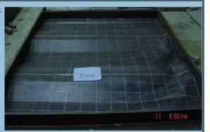
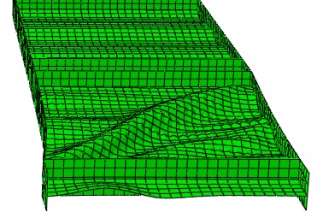
Validation of FEM
2. Prismatic girders with corrugated webs
τ_{FE}/τ_{y}
Τ _{[Mpa]}
G7A: Driver et al. (2006)
M12: Moon et al. (2009)
Deflection (mm)
Deflection (mm)
M12: Moon et al. (2009)

Slide 15
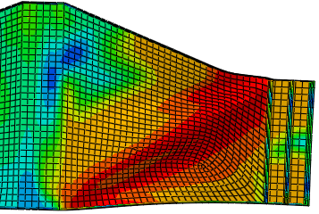
Validation of FEM
3. Tapered girders with flat webs
Τ _{[Mpa]}
Bedynek et al. (2013)
Deflection (mm)

Slide 16
Introduction
Objectives
Validation of finite element models
Contents
Parametric study
Results and discussion
Recommendations

Slide 17
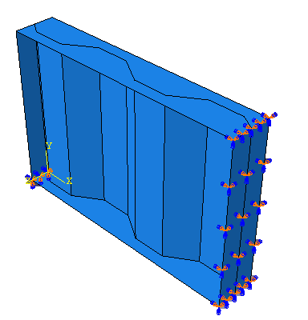
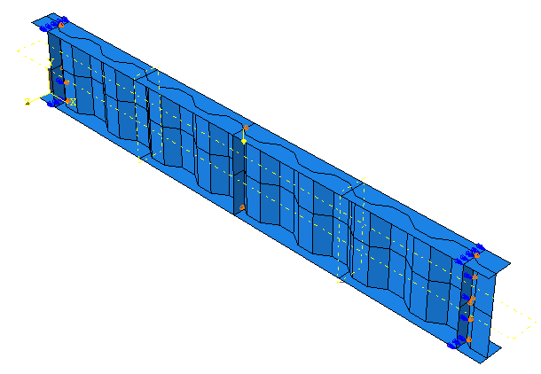
Parametric study
Prismatic
t_{w}
c
Tapered
h_{r}
α
b
d
b
d
Plates
Panels
Girders
Bridge name | b [mm] | d [mm] | c [mm] | h_{r} [mm] | t_{w} [mm] | h_{w} [mm] | α [º]
Shinkai | 250 | 200 | 250 | 150 | 9 | 1183 | 36.9
Matsnoki | 300 | 260 | 300 | 150 | 10 | 2210 | 30.0
Hondani | 330 | 270 | 336 | 200 | 9 | 3315 | 36.5
Cognac | 353 | 319 | 353 | 150 | 8 | 1771 | 25.2
Maupre | 284 | 241 | 284 | 150 | 8 | 2650 | 31.9
Dole | 430 | 370 | 430 | 220 | 10 | 2546 | 30.7
IIsun | 330 | 330 | 386 | 200 | 18 | 2292 | 31.2
Average | 325 | 284 | 334 | 174 | 10 | 2281 | 32

Slide 18
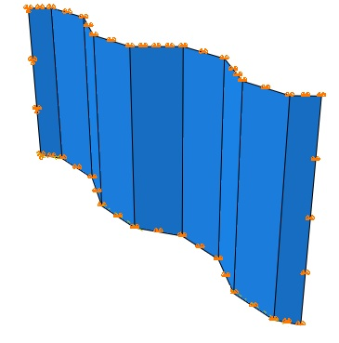
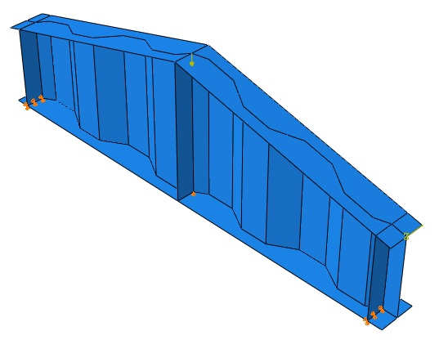
Parametric study
Prismatic
t_{w}
c
Tapered
h_{r}
α
b
d
b
d
Plates
Girders
Bridge name | b [mm] | d [mm] | c [mm] | h_{r} [mm] | t_{w} [mm] | h_{w} [mm] | α [º]
Shinkai | 250 | 200 | 250 | 150 | 9 | 1183 | 36.9
Matsnoki | 300 | 260 | 300 | 150 | 10 | 2210 | 30.0
Hondani | 330 | 270 | 336 | 200 | 9 | 3315 | 36.5
Cognac | 353 | 319 | 353 | 150 | 8 | 1771 | 25.2
Maupre | 284 | 241 | 284 | 150 | 8 | 2650 | 31.9
Dole | 430 | 370 | 430 | 220 | 10 | 2546 | 30.7
IIsun | 330 | 330 | 386 | 200 | 18 | 2292 | 31.2
Average | 325 | 284 | 334 | 174 | 10 | 2281 | 32

Slide 19
Introduction
Objectives
Validation of finite element models
Contents
Parametric study
Results and discussion
Recommendations

Slide 20
Results and discussion
Prismatic - Plates
1. Effect of simple and fixed boundary conditions
No. | [mm] | [mm] | Buckling mode |  | [N/mm²] |  | [10]/[11]
 |  |  | S | F | S | F
[1] | [2] | [3] | [8] | [9] | [10] | [11] | [12]
1 | 1000 | 6 | L | L | 366 | 377 | 0.97
2 | 1000 | 8 | I | I | 612 | 636 | 0.96
3 | 1000 | 10 | I | I | 889 | 932 | 0.95
4 | 1000 | 12 | I | I | 1184 | 1255 | 0.94
5 | 1000 | 14 | I | I | 1489 | 1579 | 0.94
6 | 1000 | 16 | I | I | 1782 | 1904 | 0.94
7 | 1000 | 18 | I | I | 2085 | 2235 | 0.93
15 | 1400 | 6 | I | I | 351 | 354 | 0.99
16 | 1400 | 8 | I | I | 578 | 590 | 0.98
17 | 1400 | 10 | I | I | 818 | 853 | 0.96
18 | 1400 | 12 | G | I | 1070 | 1119 | 0.96
19 | 1400 | 14 | G | I | 1329 | 1391 | 0.96
20 | 1400 | 16 | G | I | 1594 | 1673 | 0.95
21 | 1400 | 18 | G | I | 1864 | 1962 | 0.95
 |  |  |  |  |  | Ave | 0.96
 |  |  |  |  |  | COV | 0.014

Slide 21
Results and discussion
Prismatic - Plates
2. Comparison with the available interactive critical stress (n=1.0)
No. | [mm] | [mm] | Simple |  | Fixed |  | Fixed
 |  |  | k_{G}=36 | k_{G}=31.6 | k_{G}=68.4 | k_{G}=59.2 | k_{G}=68.4 | k_{G}=59.2
[1] | [2] | [3] | [4] | [5] | [6] | [7] | [8] | [9]
1 | 1000 | 6 | 1.12 | 1.13 | 0.68 | 0.69 | 0.83 | 0.85
2 | 1000 | 8 | 1.08 | 1.09 | 0.66 | 0.67 | 0.85 | 0.87
3 | 1000 | 10 | 1.04 | 1.05 | 0.64 | 0.65 | 0.85 | 0.87
4 | 1000 | 12 | 0.99 | 1.01 | 0.61 | 0.63 | 0.84 | 0.87
5 | 1000 | 14 | 0.95 | 0.97 | 0.59 | 0.60 | 0.82 | 0.86
6 | 1000 | 16 | 0.90 | 0.92 | 0.56 | 0.57 | 0.80 | 0.84
7 | 1000 | 18 | 0.86 | 0.89 | 0.54 | 0.55 | 0.78 | 0.82
15 | 1400 | 6 | 1.13 | 1.14 | 0.67 | 0.68 | 0.88 | 0.90
16 | 1400 | 8 | 1.10 | 1.12 | 0.66 | 0.67 | 0.90 | 0.94
17 | 1400 | 10 | 1.05 | 1.08 | 0.64 | 0.65 | 0.91 | 0.95
18 | 1400 | 12 | 1.01 | 1.04 | 0.61 | 0.63 | 0.90 | 0.94
19 | 1400 | 14 | 0.98 | 1.02 | 0.59 | 0.61 | 0.89 | 0.93
20 | 1400 | 16 | 0.95 | 1.00 | 0.57 | 0.60 | 0.88 | 0.93
21 | 1400 | 18 | 0.94 | 0.98 | 0.56 | 0.59 | 0.87 | 0.92
 |  | Ave | 1.12 | 1.17 | 0.67 | 0.70 | 0.99 | 1.05
 |  | COV | 0.130 | 0.149 | 0.066 | 0.076 | 0.131 | 0.150

Slide 22
Results and discussion
Prismatic - Panels
3. Limit of fixed juncture
when the flanges are rigid enough (tf / tw ≥ 3.0), shear failure mechanisms occurs.
if they are relatively rigid (tf / tw < 3.0), the strength becomes controlled by the deformation of flanges.
flange
t_{w} [mm] | t_{f}/t_{w} | Relative critical stresses
 |  | RF/S | RF/F | RF/S | RF/F | RF/S | RF/F | RF/S | RF/F | RF/S | RF/F
 |  | h_{w}=1.6m |  | h_{w}=1.8m |  | h_{w}=2.0m |  | h_{w}=2.2m |  | h_{w}=2.4m
6 | 3 | 1.00 | 0.99 | 1.01 | 0.99 | 1.01 | 0.99 | 1.00 | 0.99 | 1.01 | 0.99
6 | 4 | 1.00 | 0.99 | 1.02 | 1.01 | 1.01 | 0.99 | 1.00 | 0.99 | 1.01 | 0.99
6 | 5 | 1.00 | 0.99 | 1.02 | 1.01 | 1.01 | 0.99 | 1.03 | 1.01 | 1.01 | 1.00
8 | 3 | 1.02 | 1.00 | 1.03 | 0.99 | 1.05 | 1.00 | 1.04 | 1.00 | 1.04 | 1.01
8 | 4 | 1.02 | 1.00 | 1.04 | 1.00 | 1.05 | 1.01 | 1.05 | 1.01 | 1.05 | 1.02
8 | 5 | 1.03 | 1.01 | 1.05 | 1.01 | 1.05 | 1.01 | 1.05 | 1.01 | 1.06 | 1.02
10 | 3 | 1.04 | 1.00 | 1.04 | 1.00 | 1.04 | 1.00 | 1.04 | 1.00 | 1.04 | 1.01
10 | 4 | 1.05 | 1.00 | 1.05 | 1.01 | 1.06 | 1.01 | 1.06 | 1.02 | 1.06 | 1.02
10 | 5 | 1.06 | 1.01 | 1.07 | 1.02 | 1.07 | 1.02 | 1.07 | 1.03 | 1.07 | 1.04
 | Ave | 1.04 | 1.00 | 1.05 | 1.01 | 1.04 | 1.01 | 1.04 | 1.01 | 1.04 | 1.01
 | COV | 0.024 | 0.012 | 0.018 | 0.011 | 0.020 | 0.014 | 0.018 | 0.012 | 0.019 | 0.013
web
The realistic support condition at the juncture is nearly fixed for the case of (t_{f} / t_{w} ≥ 3.0).

Slide 23
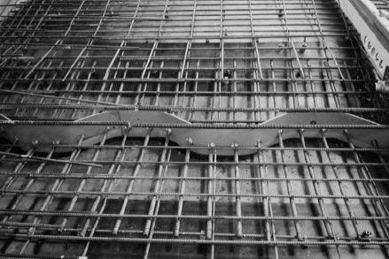
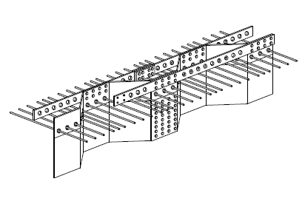
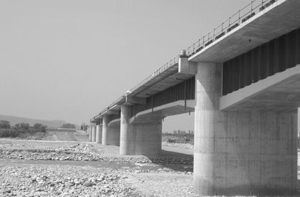
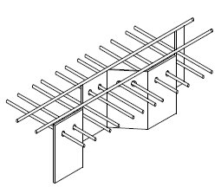
Results and discussion
Prismatic - Panels
4. Recommended validity limit of the proposed formula
For cases of girders with steel flanges having (t_{f} / t_{w} ≥ 3.0).
In composite girders with Embedded shear connections.
Embedded connections
Ikeda and Sakurada (2005)
Hondani Bridge
Kurobegawa Bridge

Slide 24
Results and discussion
Prismatic - Girders
5. Comparison with available shear strengths
Moon et al.
Driver et al.
Design manual for PC bridges with corrugated steel webs
Sause and Braxtan

Slide 25
Results and discussion
Prismatic - Girders
5. Comparison with available shear strengths
Girder ( - ) | Failure modes
1600-6 | I | 0.85 | 0.86 | 0.71 | 0.63 | 0.91 | 1.80 | 0.77 | 0.91
1600-8 | I | 0.92 | 1.00 | 0.71 | 0.63 | 1.00 | 2.86 | 0.79 | 0.85
1600-10 | I | 0.79 | 1.00 | 0.71 | 0.63 | 1.00 | 4.02 | 0.79 | 1.00
1600-12 | G | 0.85 | 1.00 | 0.71 | 0.63 | 1.00 | 5.27 | 0.79 | 0.93
1800-6 | I | 0.90 | 0.86 | 0.71 | 0.63 | 0.90 | 1.70 | 0.77 | 0.86
1800-8 | I | 0.91 | 0.97 | 0.71 | 0.63 | 0.99 | 2.66 | 0.79 | 0.87
1800-10 | I | 0.80 | 1.00 | 0.71 | 0.63 | 1.00 | 3.71 | 0.79 | 0.99
1800-12 | G | 1.01 | 1.00 | 0.71 | 0.63 | 1.00 | 4.81 | 0.79 | 0.78
 | Ave | 0.85 | 0.95 | 0.71 | 0.63 | 0.97 | 3.00 | 0.78 | 0.93
 | COV | 0.077 | 0.066 | 0.000 | 0.000 | 0.051 | 1.150 | 0.012 | 0.090
Elgaaly et al. (1996)

Slide 26
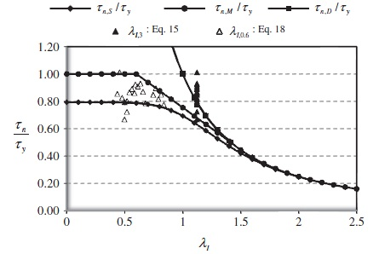
Results and discussion
Prismatic - Girders
5. Comparison with available shear strengths

Slide 27
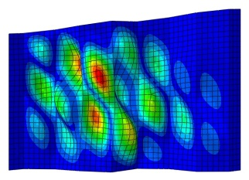
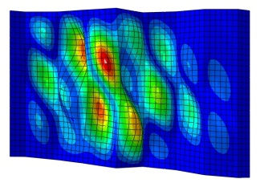
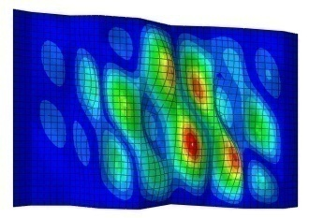
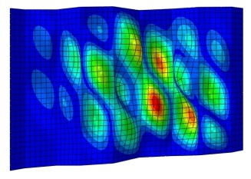
Results and discussion
Tapered - Plates
1. Effect tapered web typology on interactive critical stress
Case I
Case II
Case III
Case IV
Case I
Case II
Case III
Case IV
Case I
Case II
Case III
Case IV

Slide 28
Results and discussion
Tapered - Plates
2. Proposed interactive critical stress of tapered webs
The recommendation of the current design code for plated structural elements EN 1993-1-5 (2007) to determine the ultimate shear resistance of tapered plate girders with flat web plates as prismatic ones CANNOT BE USED.
Applicable for different boundary conditions
Case I
Case III
Case II
Case IV

Slide 29
Results and discussion
Tapered - Girders
3. Nonlinear strengths – Parametric study results
Type | [mm] |  | [kN] | Buckling mode
Case I | 6 | 0.683 | 944 | I
 | 8 | 0.533 | 1318 | G
 | 10 | 0.445 | 1693 | G
 | 12 | 0.386 | 2144 | G
 | 14 | 0.346 | 2619 | G
Case II | 6 | 0.696 | 1097 | I
 | 8 | 0.544 | 1619 | G
 | 10 | 0.453 | 2010 | G
 | 12 | 0.394 | 2147 | G
 | 14 | 0.352 | 2295 | F
Case III | 6 | 0.602 | 652 | I
 | 8 | 0.470 | 917 | I
 | 10 | 0.392 | 1146 | G
 | 12 | 0.341 | 1450 | G
 | 14 | 0.305 | 1686 | G
Case IV | 6 | 0.624 | 634 | I
 | 8 | 0.487 | 894 | I
 | 10 | 0.406 | 1136 | G
 | 12 | 0.353 | 1397 | G
 | 14 | 0.316 | 1666 | G
0.96
1.00
1.03
1.09
1.14
1.12
1.23
1.23
1.09
1.00
0.66
0.70
0.70
0.74
0.73
0.64
0.68
0.69
0.71
0.73
This means that neither the type of the axial force in the inclined flange (tension or compression) nor the direction of the developed tension field (short or on the long web diagonal) has any effect on the strength of these girders (Cases III and IV)

Slide 30
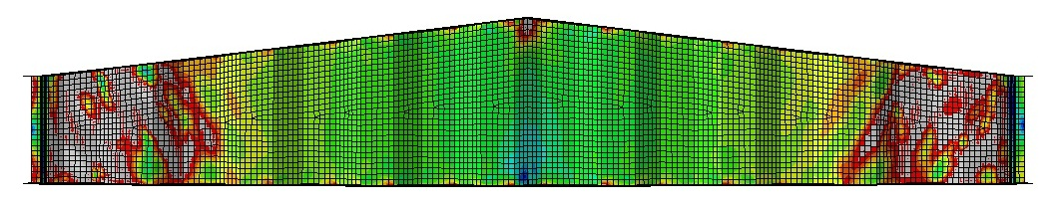
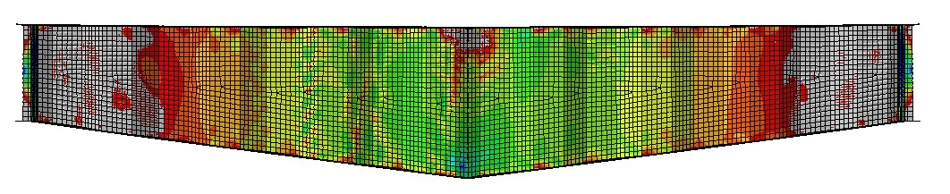
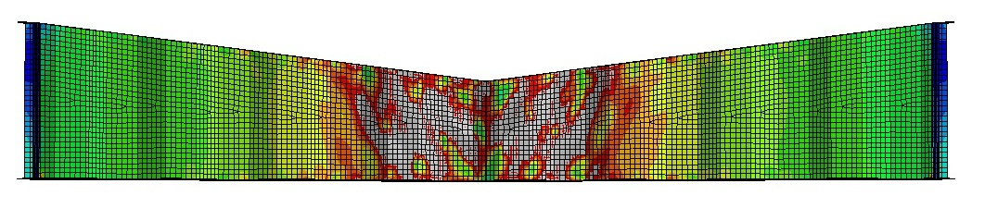
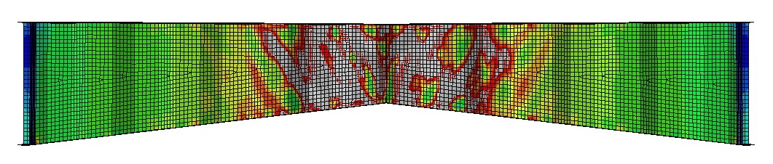
Results and discussion
Tapered - Girders
4. Failure modes and stress distributions
Case I
Case II
Case III
Case IV

Slide 31
Results and discussion
Tapered - Girders
5. Comparison with available shear strengths
Moon et al.
Design manual for PC bridges with corrugated steel webs
Sause and Braxtan

Slide 32
Results and discussion
Tapered - Girders
5. Comparison with available shear strengths
Type | [mm] |  | [kN] | Buckling mode
Case I | 6 | 0.683 | 944 | I
 | 8 | 0.533 | 1318 | G
 | 10 | 0.445 | 1693 | G
 | 12 | 0.386 | 2144 | G
 | 14 | 0.346 | 2619 | G
Case II | 6 | 0.696 | 1097 | I
 | 8 | 0.544 | 1619 | G
 | 10 | 0.453 | 2010 | G
 | 12 | 0.394 | 2147 | G
 | 14 | 0.352 | 2295 | F
Case III | 6 | 0.602 | 652 | I
 | 8 | 0.470 | 917 | I
 | 10 | 0.392 | 1146 | G
 | 12 | 0.341 | 1450 | G
 | 14 | 0.305 | 1686 | G
Case IV | 6 | 0.624 | 634 | I
 | 8 | 0.487 | 894 | I
 | 10 | 0.406 | 1136 | G
 | 12 | 0.353 | 1397 | G
 | 14 | 0.316 | 1666 | G
0.96 | 0.98 | 0.81
1.00 | 1.00 | 0.79
1.03 | 0.97 | 0.77
1.09 | 0.92 | 0.72
1.14 | 0.88 | 0.69
1.12 | 0.89 | 0.71
1.23 | 0.81 | 0.64
1.23 | 0.81 | 0.64
1.09 | 0.92 | 0.72
1.00 | 1.00 | 0.79
0.66 | 1.50 | 1.20
0.70 | 1.43 | 1.13
0.70 | 1.43 | 1.13
0.74 | 1.35 | 1.07
0.73 | 1.37 | 1.08
0.64 | 1.48 | 1.22
0.68 | 1.47 | 1.16
0.69 | 1.45 | 1.14
0.71 | 1.41 | 1.11
0.73 | 1.37 | 1.08
0.97
0.91
0.91
0.86
0.88
0.97
0.94
0.93
0.90
0.88

Slide 33
Results and discussion
Tapered - Girders
6. Recommended design shear strengths
Case I
Case II
Case III
Case IV

Slide 34
Introduction
Objectives
Validation of finite element models
Contents
Parametric study
Results and discussion
Recommendations

Slide 35
Recommendations
Recommendations
New experimental results on girders with corrugated webs with real bridge dimensions should be conducted.
New work should be made on checking the available buckling and design equations on all available bridge corrugated web profiles. An MSc is under preparation now by Elkawase, A.A. at Tanta University.
The real behaviour of continuous tapered girders with corrugated webs , containing different web typologies, should be carried out by means of experimental tests. A thesis is under preparation now by Hassanein and El Hadidy at Tanta University.
Concentration on the behaviour of tapered girders’ behaviour should be made. A paper is under review now by Zevallos et al. (Zevallos, E., Hassanein, M.F., Real, E. Mirambell, E.) as a collaboration between Tanta University and Universitat Politècnica de Catalunya, UPC of Spain.

Slide 36
Recommendations
Recommendations
Composite girders with corrugated webs in negative bending moment zones should be checked by using fibre reinforced polymers. An MSc is under preparation know by Elshinrawy, T. at Tanta University.

Slide 37
For more information:
Hassanein, M.F., Kharoob O.F., (2015), "Linearly Tapered Bridge Girder Panels with Steel Corrugated Webs near Intermediate Supports of Continuous Bridges", Thin-Walled Structures, Vol. 88, pp. 119-128.
Hassanein, M.F., Kharoob O.F., (2014), “Shear buckling Behavior of Tapered Bridge Girders with Steel Corrugated Webs”, Engineering Structures, Vol. 74, pp. 157-169, 2014.
Hassanein, M.F., Kharoob O.F., (2013), “Behavior of Bridge Girders with Corrugated Webs: (II) Shear Strength and Design”, Engineering Structures, Vol. 57, pp. 544-553.
Hassanein, M.F., Kharoob O.F., (2013), “Behavior of Bridge Girders with Corrugated Webs: (I) Real Boundary Conditions at the Juncture of the Web and Flanges”, Engineering Structures, Vol. 57, pp. 554-564.

Slide 38
Thank you for listening
Contact details:
Dr. MOSTAFA FAHMI HASSANEIN
Department of Structural Engineering; Faculty of Engineering; Tanta University, Tanta; Egypt
E-mail: mostafa.fahmi@yahoo.com
mostafa.fahmi@f-eng.tanta.edu.eg
Mobile Tel: +201228898494
Fax: +20403315860

