Slide 1
Epigenetics in glioma - MGMT, ABCB1 and ABCG2 methylation in glioma
HKS
Tumore
Moritz C. Oberstadt, PhD
HKS
Tumore

Slide 2
Tumor diseases
One of the leading death causes
HKS
Tumore
US Mortality Files, National Center for Health Statistics, Centers for Disease control and Prevention
High maligne tumors with low 5 years overall survival (OS):
- Brain tumors (13%/15%)
- Stomach- (12%/13%) and Oesophaguscarcinoma (7%/8%)
- Lung carcinoma (6%/6%)
- Pancreas carcinoma (3%/2%) http://info.cancerresearchuk.org

Slide 3
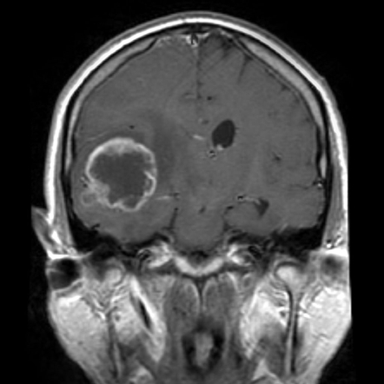
Glioblastoma multiforme
Glioblastoma multiforme is the most frequent and aggressive
primary brain tumor in adults
Referring to WHO cassification of brain tumors: Grade IV
All other Gliomas
10.1 %
Ependymoma
5.6 %
Oligodendroglioma
9.2 %
Glioblastoma
50.7 %
Pilozytic Astrocytoma
5.7 %
Diffuse Astrocytoma
1.7 %
Anaplastic Astrocytoma
7.9 %
All other Astrocytomas
9.1 %
www.radiopaedia.org
www.medscape.org

Slide 4
Glioblastoma multiforme
Multimodal therapy with resection, radiotherapy and chemotherapy with
temozolomide leads to a median OS of 14.6 months
2 year OS rate of patients with glioblastoma just 26,5%
Glial progenitor cells
Glial progenitor cells
IDH1 mutation (>85%)
Common precursor cells
TP53 mutation (>65%)
Loss of 1p/19q
(>75%)
Diffuse astrocytoma
Oligodendroglioma
Grade II
EGFR amplification (≈35%)
TP53 mutation (≈30%)
Anaplastic astrocytoma
Anaplastic Oligodendroglioma
Grade III
PTEN mutation (≈25%)
NF1 changes (≈20%)
LOH 10p (≈70%)
LOH 10q (≈70%)
LOH 10q (>60%)
Primary
Glioblastoma
Secondary
Glioblastoma
Grade IV
Ohgaki et al., 2011

Slide 5
Glioblastoma multiforme
Markers: High cellular proliferation rate, diffuse infiltration, necrosis,
angiogenesis, apoptosis resistence and genomic instability.
D.P. Agamanolis
PD Dr. Vogelgesang, Greifswald
Necrotic centers typically surrounded by hypercellular zones:
pseudopallisades

Slide 6
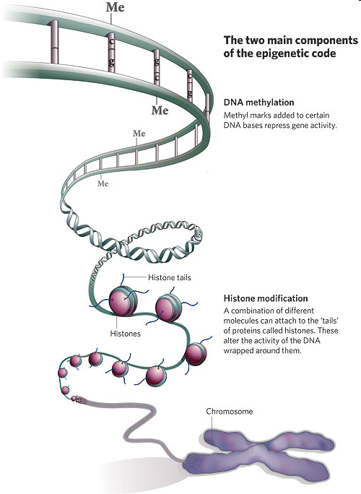
Epigenetic mechanisms
DNA-Methylation
Histone modification

Slide 7
DNA methylation
Cytosine
Methyl-Cytosine
DNA-Methyl-
transferase
S-Adenosylmethionine
(SAM)
S-Adenosylhomocysteine
(SAH)
Vitamin B12, Folate, Vitamin B6

Slide 8
DNA methylation
Clusters of CpG sites: CpG islands
CpG islands in promoters of about 60% of all human genes
Loss of methylation throughout the genome in cancer cells

Slide 9
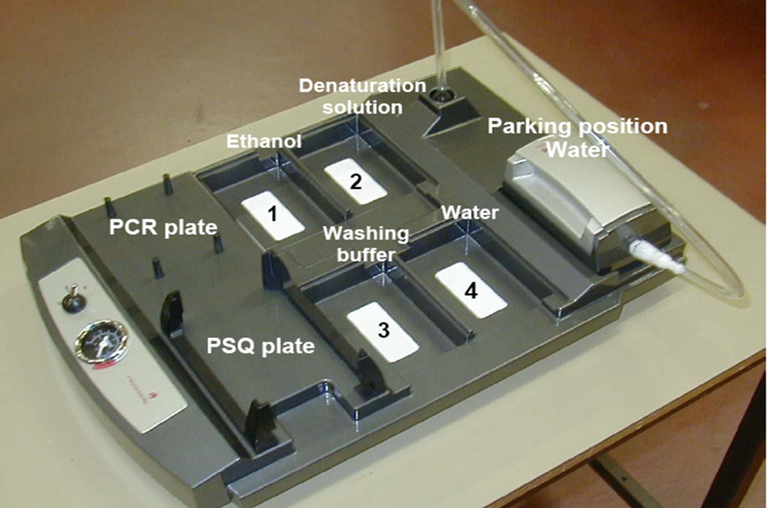
Analysis of methylation
Pyrosequencing
Pyrosequencing after
Bisulfite treatment

Slide 10
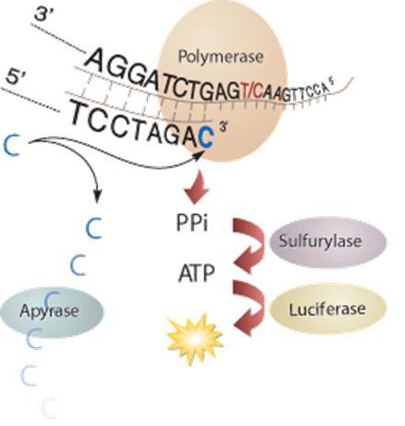
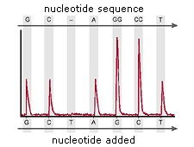
Analysis of methylation
Pyrosequencing

Slide 11
Genes to analyze
MGMT (O6 methylguanine methyltransferase)
ABCB1 (P-gp)
ABCG2 (BCRP)

Slide 12
Genes to analyze
MGMT (O6 methylguanine methyltransferase)
ABCB1 (P-gp)
ABCG2 (BCRP)

Slide 13
MGMT
DNA repair enzyme, removing mutagenic adducts from the O6 position of guanine
MGMT causes resistance to alkylating drugs
Survival of patients with gliomas is significantly better in previous
publications, if the promoter of MGMT is methylated
Weller, M. et al. (2009) MGMT promoter methylation in malignant gliomas: ready for personalized medicine? Nat. Rev. Neurol. doi:10.1038/nrneurol.2009.197

Slide 14
Genes to analyze
MGMT (O6 methylguanine methyltransferase)
ABCB1 (P-gp)
ABCG2 (BCRP)

Slide 15
Transport proteins
tumor cell
endothelium
blood
Effluxtransporter, e.g. ABCB1, ABCG2
Influxtransporter, e.g. OATP2B1

Slide 16
Clinical characteristics

Slide 17
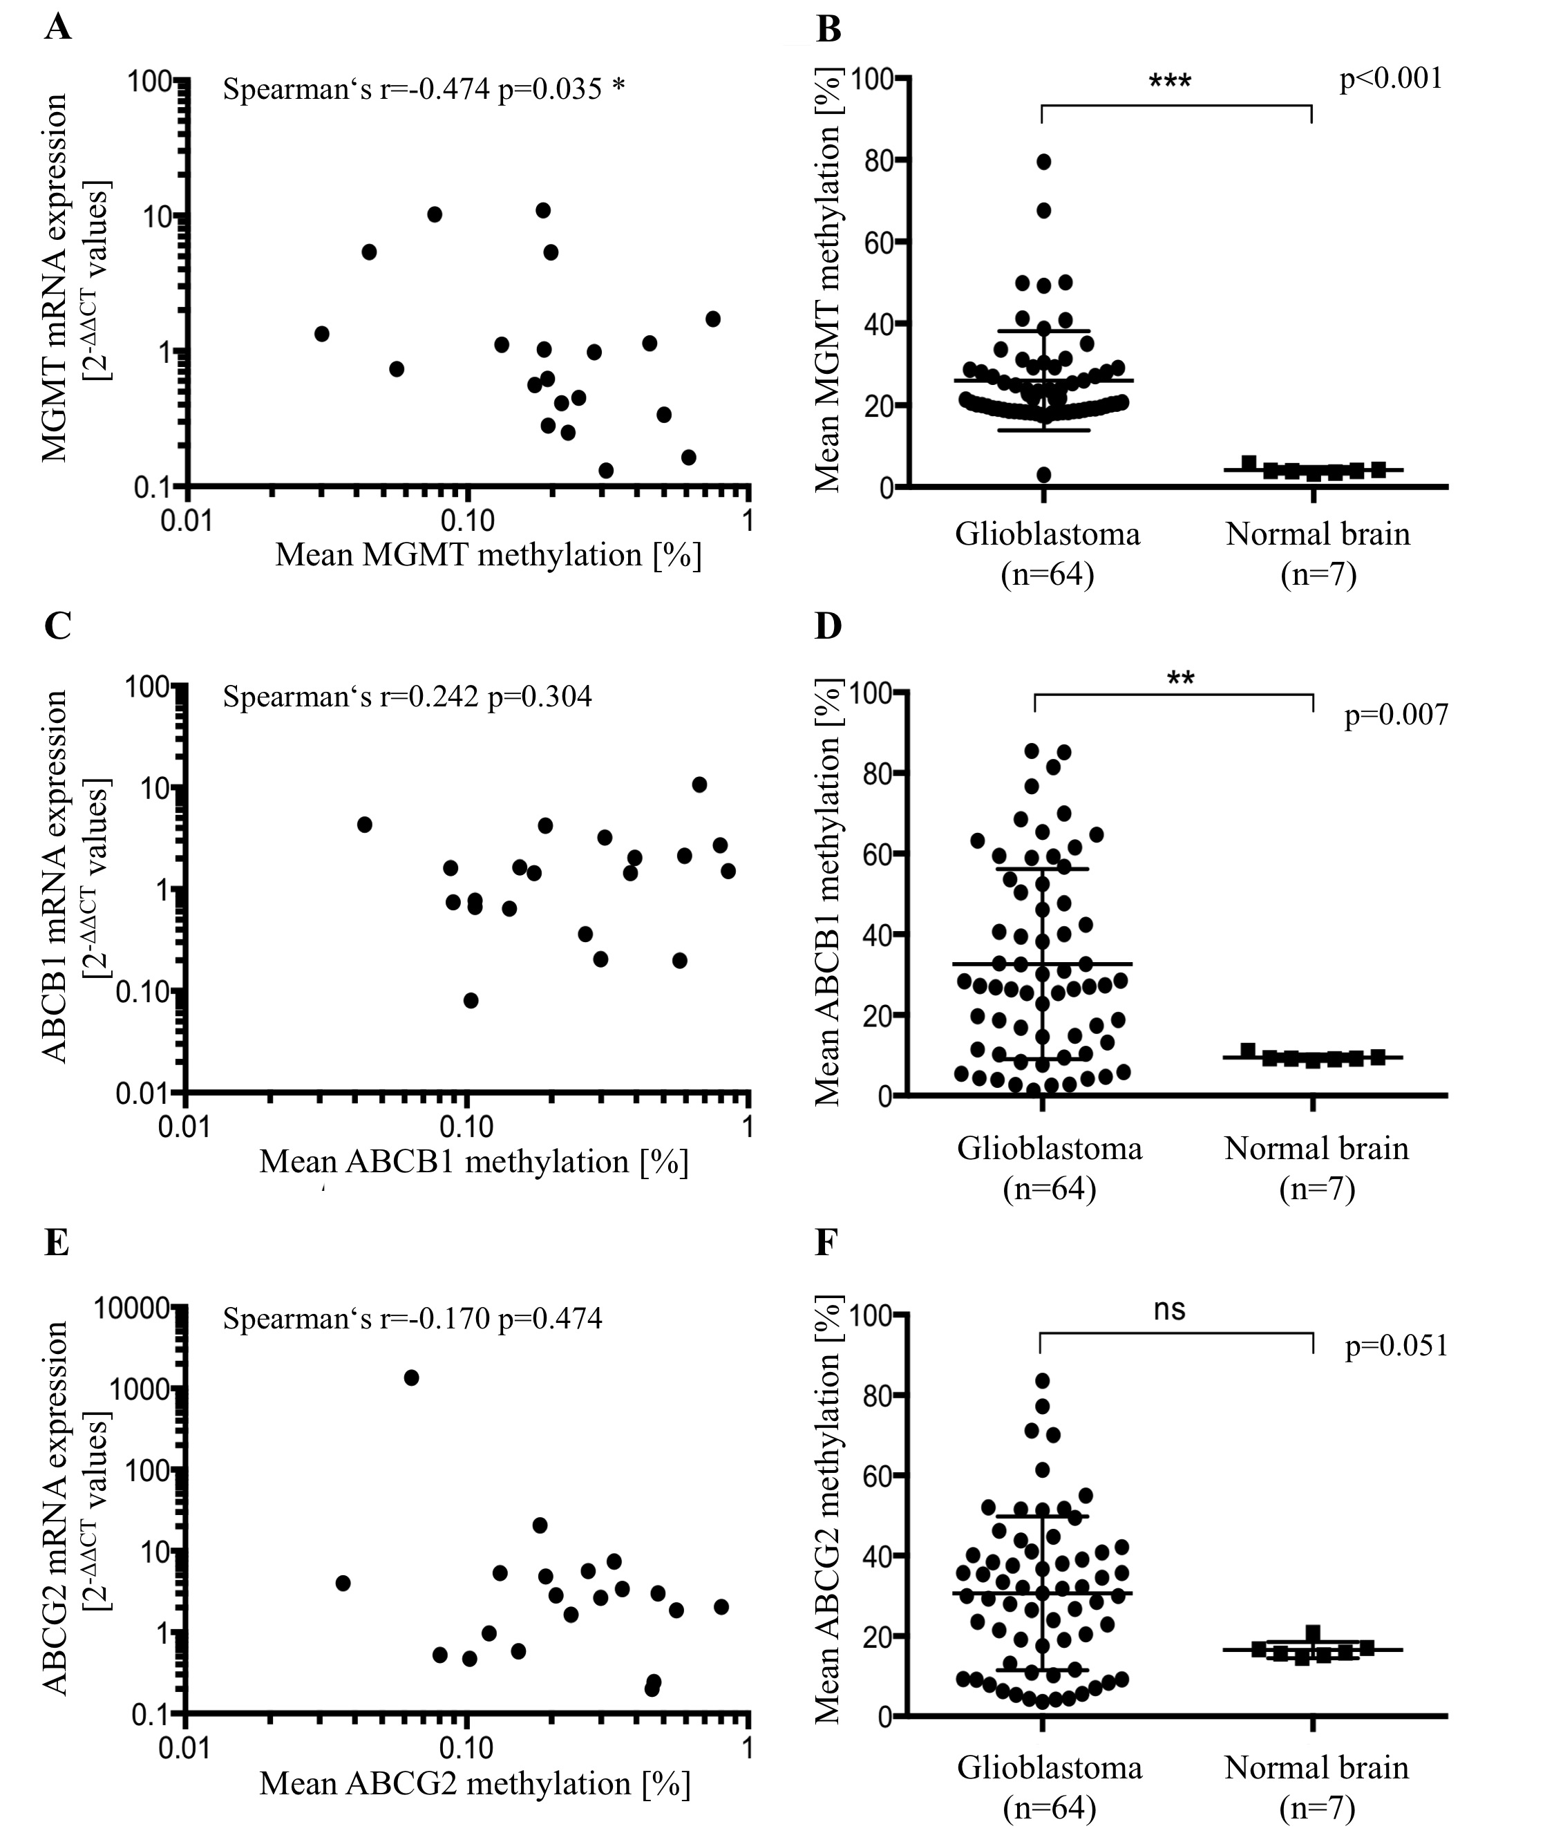
Methylation and expression

Slide 18
MGMT methylation and OS

Slide 19
ABCB1 methylation and OS

Slide 20
ABCG2 methylation and OS

Slide 21
Methylation and Polymorphisms

Slide 22
Methylation in relapses

Slide 23
Conclusions
Methylation of MGMT, ABCB1 and ABCG2 have no prognostic
impact for OS in glioblastoma multiforme
Significant negative correlation between MGMT methylation and expression
Markedly elevated MGMT and ABCB1 methylation in glioblastoma specimens
Significant correlation between MGMT methylation and MGMT C-56T polymorphism
Significant correlation of ABCG2 methylation in primary tumors and relapses

Slide 24
Acknowledgements
Heyo K. Kroemer, PhD
S. Bien-Möller, PhD
S. Herzog
M. Ricker
and all members of
the Kroemer Lab
Eric C. Holland, MD, PhD
E. Bazzoli, MD
M. Squatrito, PhD
N. Schultz
B. Wee Trent
and all members of
the Holland Lab
Henry W. S. Schroeder, MD
PD Dr. Vogelgesang
Acknowledgements for the financial support by
- Gerhard-Domagk-Program of the University medicine Greifswald, Germany
- Rottendorf Foundation, Ennigerloh, Germany

