Slide 1
Hyperglycemia Alters Maternal-Fetal Transport Kinetics of Manganese, Chromium and Vanadium in Diabetic Model Placental Lobule In Vitro: Implications for Diabetes Mellitus
Professor Nandakumaran M.
Obstetrics & Gynecology Department
Faculty of Medicine, University of Kuwait

Slide 2
Diabetes mellitus in pregnancy well known to contribute to increased maternal and neonatal mortality as well as morbidity

Slide 3
Many Reports (Nandakumaran et al, 1999, 2002) have also implicated altered status of essential trace elements in diabetic state to be partly responsible for inducing congenital malformations in in infants of diabetic women as well (Eriksson& Borg 1991 ; 1993 ; Willhoite et al, 1993)

Slide 4
Importance of a variety of trace elements in maintenance of health (Mertz W , 1981 ; Peerebom 1985 ; Gibson 1989) has been highlighted by several international research groups.

Slide 5
More recently, many research groups have emphasized the importance of trace elements such ac chromium, manganese and vanadium both animal and human studies

Slide 6
We had reported (Nandakumaran et al, 2004, 2005, 2006) altered maternal-fetal disposition of some essential trace elements in human diabetic pregnancies as well as in experimentally-induced diabetic rats as well

Slide 7
More recently, many research groups have emphasized the importance of trace elements such as chromium and vanadium in both animal and human studies

Slide 8
Chromium, has been reported to be an essential trace element for human nutrition, required for normal carbohydrate and lipid metabolism (Mertz 1993 ; Anderson, 1993).

Slide 9
Severe signs of chromium deficiency such as nerve and brain disorders have been reported to be reversed by supplemental Cr in patients on total parenteral nutrition ( Jeejeebhoy 1977 ; Brown et al, 1986).

Slide 10
Further, chromium supplementation has been shown to have beneficial effects on people with varying degrees of glucose intolerance (Anderson, 1998)

Slide 11
Another trace element Vanadium, has been proposed to be one of the nutritionally essential mineral elements for human health ( Nielson FH 1997 ; Barceloux 1999).

Slide 12
Vanadium has been shown to have an insulin-like effect ( Dunai &Saminathan, 1997 ; Crans 2000) and has been reported to be useful in overcoming insulin resistance (Cusi et al, 2001 ; Goldfine et al,1995) in humans.

Slide 13
However data on maternal-fetal disposition and transport and disposition of above essential trace elements in human placenta in control as well as diabetic pregnancies have not been explored by any research group so far

Slide 14
Considering the relatively high incidence of diabetes mellitus in obstetric population all over the world, we thought it interesting to investigate this crucial problem in a specially designed diabetic human placental model

Slide 15
Mn is an esssential co-factor for enzymes hexokinase, superoxide dismutase and xanthine oxidase and the trace element has been shown to scavenge free radicals in vitro in animals. However, no detailed study has been done, to our knowledge on the association between Mn level and diabetes in pregnancy in humans.

Slide 16
To Assess the probable impact on the developing fetus which could possibly help the obstetrician and neonatologist in better management of the diabetic mother and her offspring.

Slide 17
MATERIAL & METHODS
Human Placentae were collected immediately after delivery and transported to our laboratory and suitable isolated lobule perfused within 60 minutes using an in vitro perfusion system.

Slide 19
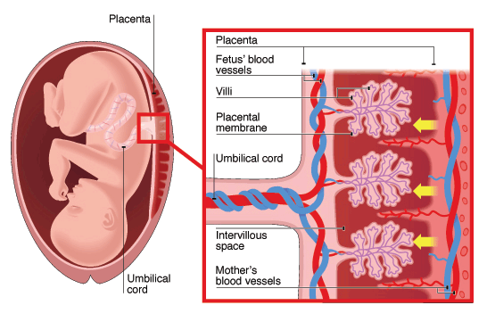

Slide 20
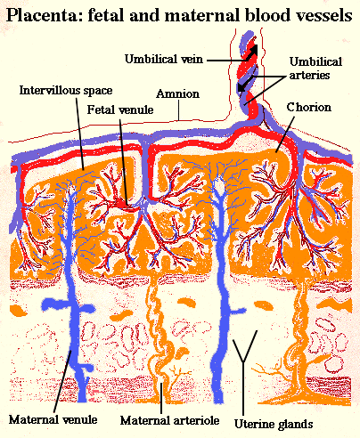

Slide 21
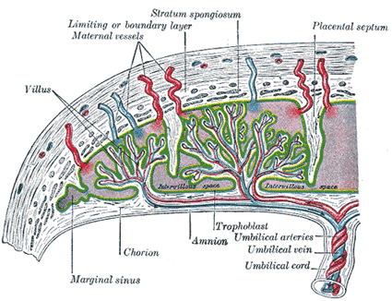

Slide 22
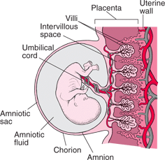

Slide 23
Schematic Representation of Perfusion Assembly

Slide 24
Control perfusions was done, as per the technique described (Nandakumaran et al, 1981, 1984, 1999, 2002, 2006) using NCTC Medium containing euglycemic load (1 g/L) and containing physiological concentrations of amino acids and free fatty acids, albumin, etc

Slide 25
Perfusion of isolated human placental lobules from diabetic and uncomplicated control pregnancies was performed as per the technique described ( Nandakumaran et al, 1981, 1984, 1999, 2002, 2006)

Slide 26
Control perfusions was done using NCTC Medium containing euglycemic load (1 g/L) and conatining physiological concentrations of amino acids and free fatty acids and protein,etc

Slide 27
Transport kinetics of trace elements were explored in in separate series of experiments, using a diabetic model placentae with hyperglycemia of 200 g/L , mimicking a moderate hyperglycemic state

Slide 28
Circulation of the perfusate was effected by Harvard digital pump and fetal and maternal flow rates was assessed by BROOKS R-215 flowmeters. Fetal and maternal flow rates were maintained within physiological range and pressure in both the circuits were monitored by mercury manometers.

Slide 29
After a wash-out phase of 10 minutes. trace elements ( Cr & Mn& V) at concentrations twice the normal concentrations reported in in vivo state, were injected as a 100 ul bolus along with antipyrine (1g/L) as an internal reference marker.

Slide 30
And perfusate samples were collected every 15 seconds from fetal and maternal circuits after a lag period of 1 minute, for a period of 5 minutes.

Slide 31
Viability of perfusions was assessed by assessing oxygen consumption of perfused tissue as well as by assessing absence of lactic dehydrogenase (LDH) enzyme in the perfusate samples before and after perfusion.

Slide 32
Diabetic Model Hyperglycemic Perfusions were done separately in the case of above Trace Elements (Cr,Mn&V) by increasing glucose concentration to twice the normal (2 g/L) in maternal perfusate and perfusate sample s collected from maternal and fteal venous outflow as described earlier

Slide 33
Concentration of trace elements in perfusate samples and injectate were determined by atomic absorption spectro­photometry (Kosenko 1964 ; Krachler et al 1996, 1999 ; Walter et al, 1991) .

Slide 34
Antipyrine, reference marker concentration in various samples was assessed by a colorimetric technique (Nandakumaran et al, 1981, Brodie et al, 1949)

Slide 35
Maternal-fetal transport parameters and kinetics were assessed by using the following parameters.
Differential transport rates of test and reference substances were computed as described.
(Nandakumaran et al, 1991 ; 1999, 2002).

Slide 36
Briefly, the fraction of trace element in the fetal perfusate was plotted cumulatively as a function of perfusion time and the time required in minutes for 10, 25, 50, 75 and 90% of substance efflux in the fetal vein calculated using the plotted curve.

Slide 37
Transport of various trace elements studied were expressed as transport rate indices of different efflux fractions, as ratio of corresponding reference marker transport rates.

Slide 38
EFS
Efflux Fraction = -----------
TEFV5
Where EFS=Concentration of the element studied in fetal venous sample;TEFV5=Total inorganic element concentration of the element studied in fetal venous outflow for period of 5 min.

Slide 39
Transport fraction (TF) of substances studied was calculated as per the following formula (Nandakumaran et al, 1984, 2002, 2005, 2009)
Total study/ref. substance conc. in the fetal vein
TF = -------------------------------------------------------
Total study/ref. substance load in the injected bolus

Slide 40
A TF index of study substance was computed by expressing the TF value as a ratio of that of the reference.

Slide 41
To assess the transport rate of the trace element and reference marker were assessed by plotting their concentrations as a function of perfusion time
(Nandakumaran et al, 1999, 2001, 2002, 2008 ).

Slide 42
Area under the curve (AUC) of substances studied was computed using trapezoid rule (Rey, Nandakumaran et al,1984, Nandakumaran et al, 1999, 2002) assuming a two-compartment model.
n [C(1+1)+ C (I)] x [ t(i+1)-t(i)] C (n)
AUC = ∑ ------------------------‑----------- + ------
i=1 2 Kel

Slide 43
Parameters as clearance, Kel (elimination constant), Tmax (time of maximum response), absorption rate and elimination rate was determined using a computer programme.

Slide 44
Calculations are based on specialized software such as PK2 Solutions (USA) or using IMSL FORTRAN SUBROUTINE software or using appropriate software (Pharmaco-kinetic Software Package, PK2 Solutions, USA).

Slide 45
To minimize experimental artifacts and to minimize inter-experimental variability, kinetic indices of trace elements studied was calculated, expressing the parameter value of the study substance as ratio of corresponding reference.

Slide 46
Data Analysis
Data are presented as Means+ s.e.m or and Statistical Analysis of Data done using SPSS and other appropriate statistical software.
Pharmacokinetic analysis of data are done by trapezoid rule and using the formula indicated earlier

Slide 47
Appropriate statistical package such as PK2 Solutions, etc. was used to verify accuracy of our computations
Tests for significance was done using Student's t-test, Fischer Exact Test, Analysis of Variance, Analysis of Co-variance or other appropriate tests.

Slide 48
Patient details and characteristics
File no. | Age | Weight (kg) | Height (cm) | Parity | Gestation age (weeks+ days) | Apgar score 1’5’ | New born weight (kg) | Sex | Placental weight (grams)
1 | 36 | 85 | 164 | P0+0+0+0 | 37+0 | 7/9 | 3.440 | F | 790
2 | 25 | 78 | 158 | P0+0+0+0 | 39+0 | 8/9 | 2.47 | M | 620
3 | 35 | 68 | 152 | P1+0+0+1 | 36+5 | 8/9 | 2.95 | F | 820
4 | 33 | 90 | 165 | P2+0+0+2 | 37+0 | 9/9 | 2.90 | F | 640
5 | 43 | 78.5 | 160 | P5+2+0+7 | 38+0 | 9/9 | 3.55 | F | 670
6 | 32 | 80.5 | 162 | P1+0+0+1 | 38+0 | 9/9 | 2.99 | M | 640
7 | 25 | 75.6 | 163 | P4+0+0+4 | 39+0 | 8/9 | 3.10 | M | 650
8 | 16 | 70.2 | 163 | P0+0+0+0 | 41+2 | 8/9 | 3.14 | F | 530
9 | 28 | 74 | 165 | P2+0+0+2 | 38+3 | 9/9 | 2.88 | M | 575
10 | 28 | 89 | 166 | P1+0+0+1 | 39+6 | 8/9 | 3.53 | M | 520
11 | 33 | 84 | 168 | P3+0+0+3 | 37+3 | 8/9 | 3.120 | F | 650
12 | 29 | 90 | 168 | P0+0+0+0 | 37+2 | 8/9 | 3.48 | M | 680
Mean ±SEM | 30.93±1.8 | 79.85±2.2 | 163.2±1.18 | P1.6+0+0+1.7 | 38+2 | 8/9 | 3.2±0.11 |  | 655±38.2

Slide 49
VANADIUM 1 G/L Differential transport rate of antipyrine and vanadium in normoglycemia
 | 10 | 25 | 50 | 75 | 90 | Cotyledon wt
antipyrine | 0.611± 0.06 | 1.317 ± 0.05 | 2.494± 0.04 | 3.672 ± 0.03 | 4.37 ± 0.03 | 31.67 ± 1.8
vanadium | 0.572 ± 0.04 | 1.292 ± 0.04 | 2.491 ±0.05 | 3.688 ±0.07 | 4.40 ±0.08 | 31.67 ± 1.8
Significance | NS | NS | NS | NS | NS

Slide 50
Pharmacokinetic parameters of Antipyrine and vanadium in normoglycemia
 | AUC (ug-sec/l) | clearance (l/sec)*10⁷ | kelsec⁻¹ | Tmax (sec) | absorption rate ug/sec *10⁷ | Elimination rate ug/sec
Antipyrine | 4853.49 ± 2716.76 | 0.006 ± 0.001 | 0.27 ± 0.01 | 150.0 ± 47.86 | 0.094 ± 0.05 | 1.24 ± 0.72
VANADIUM | 8774.7 ± 840.02 | 0.000011 ±0.0000 | 0.279 ± 0.0062 | 150.0 ± 13.8 | 0.00027 ± 0.00004 | 0.00350 ± 0.0003
Significance | P<0.0001 | P<0.0001 | NS | NS | P=0.01 | P<0.0001

Slide 51
Transport fraction of vanadium, Antipyrine and index of vanadium over Antipyrine expressed as Mean±SEM. T - test value:NS

Slide 52
Mean ± Sem, Statisitcal significance p>0.05, so NS

Slide 53
VANADIUM 2 G/L Differential transport rate for vanadium and Antipyrine in hyperglycemia
 | 10 | 25 | 50 | 75 | 90 | Cotyledon wt
antipyrine | 0.493 ± 0.04 | 1.22 ± 0.04 | 2.44 ± 0.05 | 3.66 ± 0.05 | 4.39 ± 0.06 | 31.67 ± 1.8
vanadium | 0.57 ±0.053 | 1.300 ± 0.05 | 2.511 ± 0.06 | 3.72 ± 0.07 | 4.45 ± 0.08 | 31.67 ± 1.8
Significance | NS | NS | NS | NS | NS

Slide 54
Pharmacokinetic parameters of Antipyrine and vanadium in hyperglycemia
 | AUC (ug-sec/l) | clearance (l/sec)*10⁷ | kelsec⁻¹ | Tmax (sec) | absorption rate ug/sec *10⁷ | Elimination rate ug/sec
Antipyrine | 2750.95 ± 620.3 | 0.0056 ± 0.0006 | 0.285 ± 0.024 | 150 ± 47.8 | 0.045± 0.013 | 0.581± 0.140
VANADIUM | 11617.97 ± 1405.9 | 0.000011 ±0.000 | 0.277 ±0.006 | 150.0 ± 13.8 | 0.00029 ± 0.0002 | 0.0035 ± 0.0004
Significance | P<0.0001 | P<0.0001 | NS | NS | P<0.0001 | P<0.0001

Slide 55
Transport fraction of vanadium, Antipyrine and index of vanadium over Antipyrine expressed as Mean±SEM. T - test value: NS

Slide 56
Mean ± Sem, Statisitcal significance p>0.05, so NS

Slide 57
CHROMIUM 1 G/L Differential transport rate of antipyrine and chromium in normoglycemia
 | 10 | 25 | 50 | 75 | 90 | Cotyledon wt
antipyrine | 0.611± 0.06 | 1.317 ± 0.05 | 2.494± 0.04 | 3.672 ± 0.03 | 4.37 ± 0.03 | 31.67 ± 1.8
chromium | 0.486 ± 0.05 | 1.20 ± 0.06 | 2.41 ± 0.07 | 3.62 ± 0.08 | 4.34 ± 0.09 | 31.67 ± 1.8
Significance | NS | NS | NS | NS | NS

Slide 58
TR 50 of chromium, Antipyrine and index of chromium over Antipyrine expressed as Mean±SEM.

Slide 59
Transport fraction of chromium, Antipyrine and index of chromium over Antipyrine expressed as Mean±SEM. T - test Significance p=0.013

Slide 60
Mean ± Sem, Statisitcal significance p<0.001, so statistically significant.

Slide 61
Pharmacokinetic parameters of Antipyrine and chromium in hyperglycemia
 | AUC (ug-sec/l) | clearance (l/sec)*10⁷ | Kel sec⁻¹ | Tmax (sec) | absorption rate ug/sec *10⁷ | Elimination rate ug/sec
antipyrine | 2750.95 ± 620.3 | 0.0056 ± 0.0006 | 0.285 ± 0.024 | 150 ± 47.8 | 0.045± 0.013 | 0.581± 0.140
chromium | 286.76 ± 258.94 | 5.41 ± 0.46 | 0.27 ± 0.023 | 150 47.86344 | 6.91 ± 6.75 | 0.0006 ± 0.0007
Significance | P<0.0001 | P<0.0001 | NS | NS | P=0.0019 | P<0.0001

Slide 62
TR 50 of chromium, Antipyrine and index of chromium over Antipyrine expressed as Mean±SEM.

Slide 63
Transport fraction of chromium, Antipyrine and index of chromium over Antipyrine expressed as Mean±SEM. T - test Significance p=0.017

Slide 64
Mean ± Sem, Statisitcal significance p<0.001, so statistically significant

Slide 65
CHROMIUM PERFUSIONS

Slide 66
VANADIUM PERFUSIONS

Slide 67
CHROMIUM PERFUSIONS

Slide 68
VANADIUM PERFUSIONS

Slide 71
DISCUSSIONS
Previous research from our laboratory had demonstrated maternal -fetal transport kinetics of selenium and zinc were compromised in placentae of gestational diabetic patients compared to control pregnant women as well as in experimentally induced diabetic pregnant rats (Nandakumaran et al, 2006, Al-saleh, Nandakumaran et al, 2004, Al-saleh, Nandakumaran et al, 2005)

Slide 72
Our Data show for the First Time detailed transport kinetics of relatively newly recognized essential trace elements in the human placenta in vitro

Slide 73
Chromium transport from maternal to fetal circulation is relatively lower compared to vanadium and this was surprising since both are low molecular weight elements and hence the possibility of a carrier mediated transport cannot be ruled out in their transport across the human placenta in vivo as well

Slide 74
The data on antipyrine or reference marker transport are consistent with the free permeability of the marker reported by us in the human placenta in vitro (Nandakumaran et al, 1981, 2004) as well as with those of other international research groups (Meschia et al, 1967, Challier et al, 1986).

Slide 75
We further speculate that vanadium is actively transported from mother to fetus and this is corroborated by the lower T50 values in all our perfusion conditions compared to antipyrine and the situation is likely to be compromised in hyperglycemic states as well

Slide 76
Moderate hyperglycemia of 11 mmol/L was shown to decrease transport of chromium, manganese as well as vanadium compared to euglycemic state in our perfusion conditions.

Slide 77
We report for the First Time in literature maternal-fetal transport of Mn from maternal to fetal circulation in human placenta in vitro.Considering the Restricted transport of this element despite its small atomic weight, we believe that like Cr&V, Mn too is actively transported from mother to fetus in humans.Further studies are on

Slide 78
Both the transport fractions and areas under the curves and absorption rates of above elements were significantly lowered in hyperglycemic states

Slide 79
Predictably antipyrine or reference marker transport was not affected by the hyperglycemic state .

Slide 80
Experiments are underway to establish whether higher glucose load as in uncontrolled diabetes of say 27mmol/L of glucose can lower the maternal fetal transport of above elements.

Slide 81
This further could seriously impair the fetus or neonatal metabolism and carbohydrate metabolism in particular in those states.

Slide 82
The above possibility has been established in 2 perfusions from highly diabetic patients and more studies are underway to ascertain the veracity and statistical significance of above findings

Slide 83
We recommend that chromium and vanadium and manganese levels of pregnant women need to be monitored carefully particularly in pregnant diabetic patients and those liable to have gestational diabetes.

Slide 84
Control of blood sugar in pregnancy deserves to be done more aggressively to prevent compromised transport of essential trace elements such as vanadium and chromium as well

Slide 85
Further studies are underway to evaluate the possible effect of binding of above trace elements to placental tissue proteins in control and diabetic pregnancies.

Slide 86
Furthermore assessment of the probable effect or relationship of vanadium and chromium levels to the antioxidant enzyme activity in control and diabetic pregnancies are to be studied

Slide 87
Acknowledgement
This Research Work was supported by KFAS Research Grant # 2010
Dr. Mariam Dossary,
Dr. Majed Al-Shammari,
Dr. Rachana Chibber and
Prof. Eyad Al- Saleh.
Ms. Anju Nair,
Ms. Susan George and
Ms. Asiya Tasneem.

Slide 89
Water towers

Slide 90
Green island

Slide 91
The Kuwait Towers

Slide 92
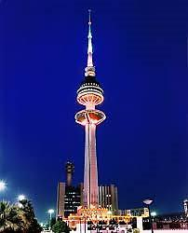
Liberation tower

Slide 93
Al-Kout Mall

Slide 94
Date palm

Slide 95
Grand Mosque Kuwait

Slide 96
The Kuwait Airport

Slide 100
360 mall

Slide 101
Avenues mall

Slide 102
Oil plant

