Slide 1
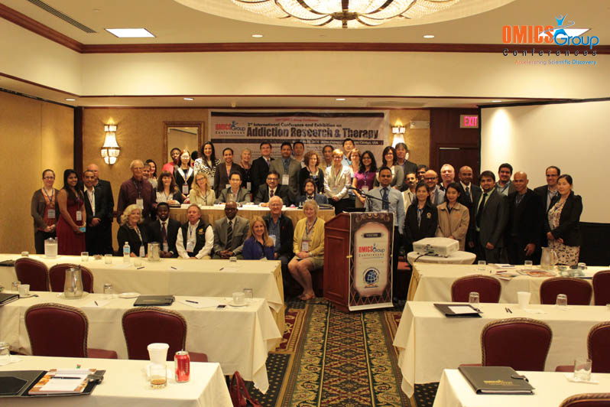
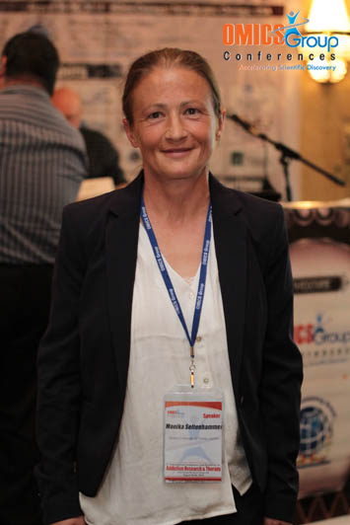
Addiction Therapy-2014 Chicago, USA August 4 - 6, 2014
Monika H. Seltenhammer

Slide 2
Detecting Highly Stabilized Cumulative ~35-37 kD Isoforms of ΔFosB in Postmortem Human Brain Tissue Samples of the Nucleus Accumbens (NAc) of Chronic Opioid Abusers
3rd International Conference and Exhibition on
Addiction Research & Therapy
August 04-06, 2014 Chicago, USA
Monika H. Seltenhammer, Christine Fitzl, Martin Stichenwirth, Selma Hönigschnabl, Nikolaus Klupp, Fabian Kanz, Walter Vycudilik, Daniele U. Risser
Department of Forensic Medicine of Vienna

Slide 3
Overview – Addiction a Global Affair
Illegal use of drugs still remains a global affair
Accompanied with rampant health problems (blood borne infections such as HIV, hepatitis B & C), increasing rate of morbidity and mortality (AIDS, liver cirrhosis and liver cancer)
People of younger ages are concerned particularly: in 2009 ~ 150-270 millions (» 3.3-6.1% of global population aged 15-64 yrs) used illicit substances (World Drug Report of 2011, UNODC)

Slide 4
Overview – Addiction a Global Affair
12-21 (midpoint 16.5) million people are chronic opioid (opiates, morphines, heroin, methadone, …) addicts
Co-Morbidity
Co-Mortality
Co-Criminality
Relapse rate is > 90% (!!!) – again leading to a vicious circle of severe medical, social & other problems

Slide 5
Table 1: Amount of Immediate Drug-Related Deaths (DRDs) according to Cause of death, Austria 2002-2011 (Annually Drug Report of Austria)
Cause of Death | 2002 | 2003 | 2004 | 2005 | 2006 | 2007 | 2008 | 2009 | 2010 | 2011
Intoxications with Opioids | 17 | 40 | 38 | 31 | 27 | 9 | 13 | 18 | 13 | 11
Mixed Intoxications with Opioids | 119 | 115 | 133 | 134 | 137 | 138 | 136 | 153 | 148 | 151
Mixed Intoxicatons with Illicit Drugs or NPS* without Opioids | 3 | 8 | 4 | 4 | 5 | 5 | 4 | 1 | 0 | 8
Non-verifiable Intoxications | 0 | 0 | 10 | 22 | 28 | 23 | 16 | 15 | 9 | 7
Total Amount of directly verified DRDs | 139 | 163 | 185 | 191 | 197 | 175 | 169 | 187 | 170 | 177
*: new psychoactive substances

Slide 6
Stages of Drug Addiction
1) First Use of Drugs – Experimentation entrance into drug using
2) Misuse of Drugs risky behaviors, unexplained violence, symptoms of depression and anxiety
3) Abuse of Drugs craving, preoccupation with the drug, and symptoms of depression, irritability and fatigue if the drug is not used
4) Drug Addiction & Dependency withdrawal symptoms and compulsive use of the drug despite severe negative consequences to his or her relationships, physical and mental health, personal finances, job security and criminal record

Slide 7
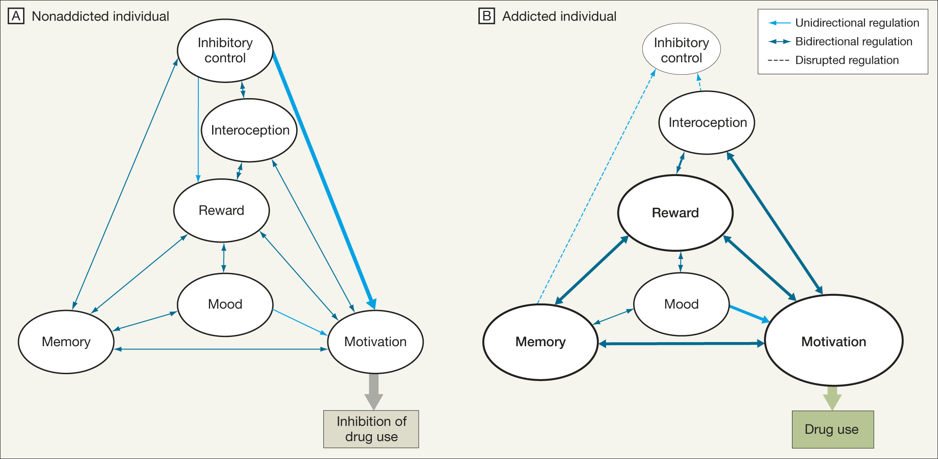
Stages of Drug Addiction – Nonaddicted vs addicted individual
Nestler E.J., 2013

Slide 8
Chronic Drug Abuse / Addiction
Long-lasting adaptations in specific brain regions (reward system): Neuroplasticity, Synaptic plasticity, Structural plasticity, Brain plasticity
Development of Sensitization
Development of Tolerance
Vulnerability to Relapse

Slide 9
Reward System of the Brain
Mesocorticolimbic and nigrostriatal dopaminergic (DA) pathway regulating behavior, motor activity, reward, and reinforcement in the brain
Mesolimbic: ventral tegmental area – medial prefrontal cortex – ventral striatum (Nucleus Accumbens or NAc) and amygdala; locomotor stimulant, rewarding & sensitizing properties of drugs of abuse
Nigrostriatal: substantia nigra – dorsal striatum (caudate putamen or CPU); movement initiation, learning of motor patterns and drug-related habit learning

Slide 10
Induction of ~35-37 kD Isoforms of ΔFosB in the reward system of the brain
Induction of high levels in region-specific manner following chronic, but not acute, exposure to variety of psychoactive stimuli:
Drugs of abuse (opiates, cocaine, amphetamine, nicotne, ethanol, cannabinoids,…)
Natural rewards (compulsive running, stress, certain lesions)
Antipsychotic & antidepressant drugs
Complex transcriptional effects which are still not fully understood and therefore remains elucive

Slide 11
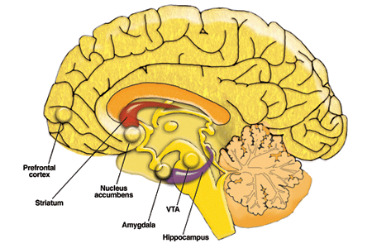
Transcription Factor ΔFosB
Kasanetz et al., Science, June 24, 2010 DOI: 10.1126/science.1187801

Slide 12
Fos Family Transcription Factors – Immediate Early Genes
c-fos-Gene
fosB-Gene
fra1-Gene
fra2-Gene
c-Fos
(380 amino acids)
62-69 kDa
FosB
(338 amino acids)
46-50 kDa
FRA-1
45-46 kDa
FRA-2
45-46 kDa
Alternative
splicing at
c-terminus
∆FosB
(237 amino acids)
33 kDa
∆FosB Isoforms
35 & 37 kDa
Phosphorylation at
Ser27
Additonal Mechanisms?

Slide 13
Biochemical basis of ΔFosB´s unique stability
ΔFosB is generated by alternative splicing and lacks the C-terminal 101 amino acids present in FosB
Two mechanisms for ΔFosB´s unique stability: a) ΔFosB lacks two degron domains present in the C-terminus (one targets for ubiquilation and degradation in the proteasome – the other for degradation by ubiquitin- and proteasome-independent mechanism) → ~33 kD Mr ΔFosB b) ΔFosB is phosphorylated by several protein kinases at its N-terminus leading to further stabilization → ~35-37 kD Mr ΔFosB

Slide 14
Biochemical basis of ΔFosB´s unique stability
FosB (338 aa, Mr ~ 46-50 kDa)
Transactivation domain
1
Basic
338
Leu-Zip
DNA
binding domain
Dimerisation
domain
Non-proteasomal degration
Ubiquitylation and proteasomal degradation
ΔFosB (237 aa, Mr ~ 33 kDa)
1
Basic
Leu-Zip
237
Ser27 (main phosphorylation site)
Several kinases
→ Further protection from proteolytic degradation
Modified according Nestler E.J., 2013

Slide 15
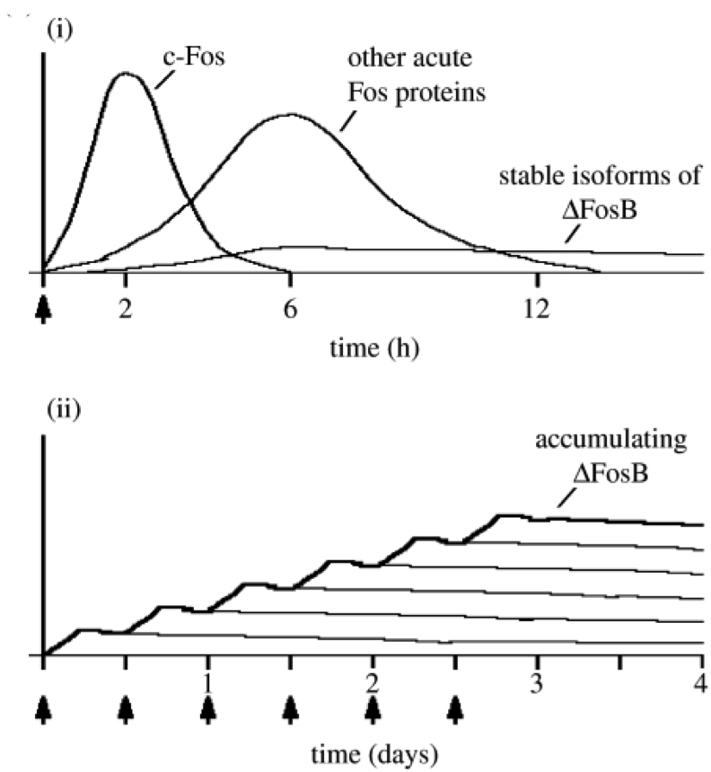
Nestler E.J., 2013

Slide 16
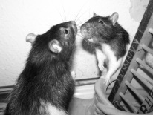
... Almost all studies on FosB and ΔFosB were performed using animal models so far

Slide 17
Table 2: Detection of ΔFosB Protein in Postmortem Human Brain Tissue
Parameter | Opioid Group (n=15) | Control Group (n=15)
Age (years): Mean/Std Deviation | 27.0 / ± 7.05 | 26.87 / ± 6.80
Median | 26.0 | 24.0
Range | 18.0 | 21.0
p=0.96
PMI (days): Mean/Std Deviation | 8.47 / ± 2.61 | 9.33 / ± 3.87
Median | 8.0 | 11.0
Range | 9.0 | 10.0
p=0.48
Morphine (ng/g): Mean/Std Deviation | 230.5 / ± 92.5 | 0.0 / ± 0.0
Median | 196.5 | 0.0
Range | 590.0 | 0.0
p≤0.001
Gender Distribution (F/M) | 2 / 13 | 4 / 11
p=0.65

Slide 18
Drug Testing
Determination of morphine concentration in: a) Medulla oblongata b) Cerebellum c) Blood d) Urine e) Hair
6-Monoacetylamine (6-MAM) and other psychoactive substances (e.g. cannabis, benzodiazepine, etc.) performing quantitative toxicological analysis using Gas Chromatography-Mass Spectrometry (GC-MS)

Slide 19
Protein Isolation & Immunoblotting
Brain tissue samples NAc – flash frozen – storage at -80°C
Protein extraction according to Korner as described by Hope et al. (1994) with modifications
Homogenization in lysis-buffer containing Triton®X-114 (removing lipids – phase separation)
Precipitation of proteins to purify & enrich
SDS-polyacrylamide gel electrophoresis – Ponceau-S staining

Slide 20
Protein Isolation & Immunoblotting
Immunoblotting with following antibodies: a) monoclonal mouse anti-FosB (SantaCruz, #sc-8013) b) monoclonal mouse anti-Delta FosB (Cell Signaling, #9890) c) polyclonal rabbit anti-panFRA (SantaCruz, #sc-253)

Slide 21
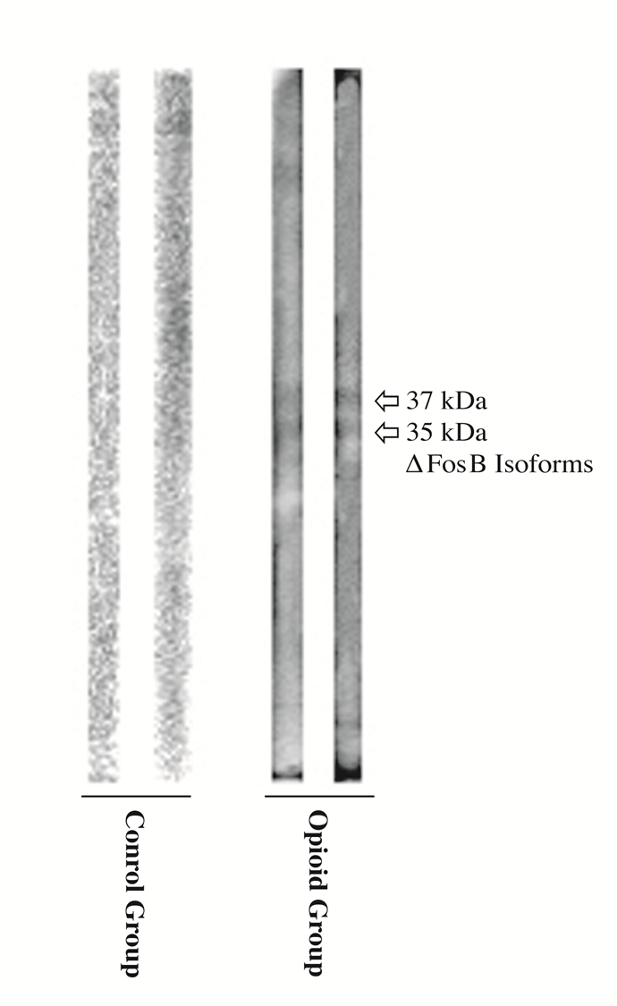

Slide 22
Summary and Outlook
Enormous stability of ΔFosB isoforms
Substantial impact on regulation and expression of numerous key-position genes in the brain e.g. GluA2 (decreased sensitivity to glutamate, silent synapses), Dynorphin (downregulation of ƙ-opioid feedback loop), Cdk5 (expansion of dendritic processes), NF- ƙB (expansion of dendritic processes; regulation of cell survival pathways), c-Fos (molecular switch from short-lived Fos family proteins induced acutely to ΔFosB induced chronically)

Slide 23
Summary and Outlook
ΔFosB is stable even after cessation of drug administration or chronic stimulus for several weeks, months or even much longer
Leading to sustained neuronal plasticity
Its stability makes it detectable even in postmortem human brain tissue samples with a prolonged PMI of 8.47 / ± 2.61 days
Represents a key factor concerning vulnerability & relapse

Slide 24
Summary and Outlook
ΔFosB itself - or any of the numerous genes it regulates - represents potential targets for development of fundamentally novel treatment strategies for drug addiction with particular attention to more personalized therapies when thinking of the high relapse rates.

Slide 25
Aknowledgements
Prof. Mario Herrera-Marschitz (BNI & ICBM Medical Faculty, University of Chile)
Prof. Johann Sölkner (University of Natural Resources & Life Sciences of Vienna)
Prof. Tibor Harkany (Center for Brain Research, Medical University of Vienna)
Sigurd Krieger, MSc (Department of Clinical Pathology, Medical University of Vienna)
Vienna Mayoral Medical-Scientic Fund Grant No.2137, who supported this study
Finally: Prof. Daniele U. Risser (Department of Forensic Medicine, Medical University of Vienna) who enabled me visiting this conference!

Slide 26
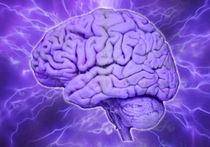
Thank you for your attention!

Slide 27
Meet the eminent gathering once again at Addiction Therapy-2015 Florida, USA August 3 - 5, 2015
Addiction Therapy – 2015 Website:
addictiontherapy.conferenceseries.com

