Slide 1
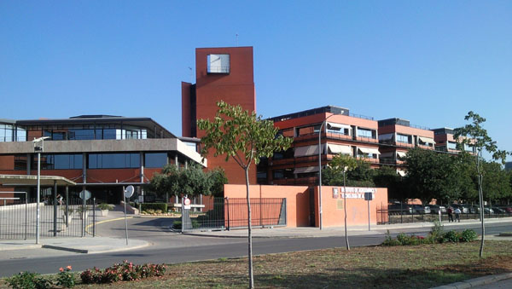
USE OF ANCIENT LATIN-AMERICAN CROPS IN BREAD. EFFECT ON MINERAL AVAILABILITY AND GLYCEMIC INDEX
Haros, C.M.*; Iglesias-Puig, E. and Laparra, M.
Institute of Agrochemistry and Food Technology (IATA-CSIC), Av. Agustín Escardino 7, Parque Científico, 46980 - Paterna-Valencia, Spain, *e-mail: mharos@iata.csic.es

Slide 2
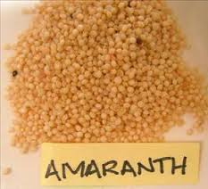
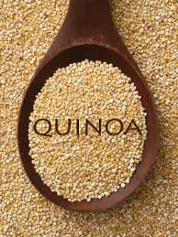
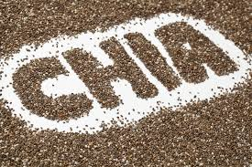
INTRODUCTION
Products with whole grains generally have a lower glycaemic index (GI) than their fibre-free counterparts, maintaining better control of blood sugar levels.
However, whole grains contain significant amounts of phytates, a well-known inhibitor of mineral, proteins and trace elements bioavailability.

Slide 3
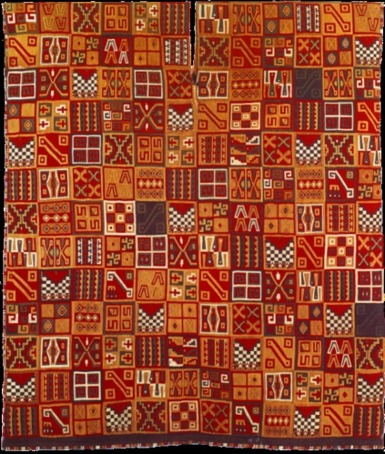
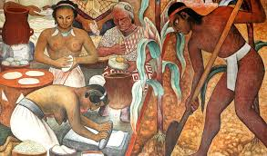
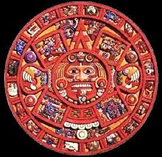
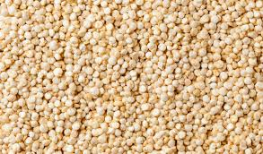
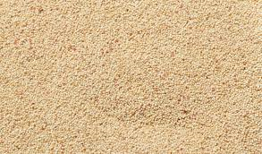
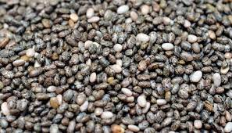
The Ancient Grains
QUINOA
AMARANTH
CHIA
Origins: Incas (Peru and Bolivia)
Age: 3000 years
Originating in the Andean region of South America around 3000 years ago, Quinoa, was called by Incas “mother seed” and was considered sacred. The ancient wisdom: quinoa is very high in protein and has every one of the nine essential aminoacids.
Origins: Aztecs (Mexico)
Age: 6000 – 8000 years
One of the earliest known food plants, it was cultivated by the Aztecs, who domesticated it between 6,000 and 8,000 years ago. Amaranth contains more than three times the average amount of minerals than in cereals.
Origins: Mayans and Aztecs (Mexico-Guatemala) - Age: 3500 years
Chia seeds, the world’s richest plant-based source of Omega-3, come from a flowering plant in the mint family. Its history suggests it was a very important food crop for the Aztecs and Mayans (Chia means “strength” in the language of the Mayans).
PSEUDOCEREALS
OILSEED

Slide 4


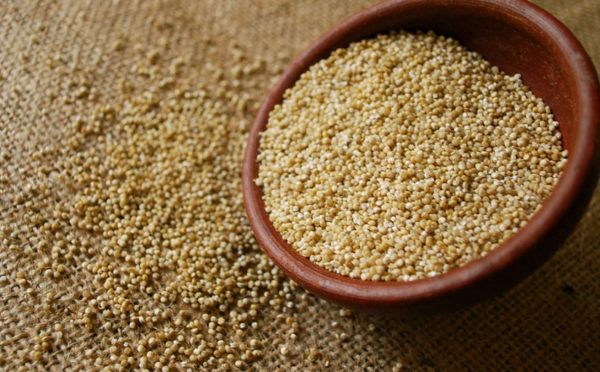
The year 2013 has been declared "The International Year of the Quinoa" by FAO, recognizing the high value of this Andean crop. Quinoa (Chenopodium quinoa) has an important role in biodiversity (FAO, 2011). Also, its exceptional nutritional qualities, its adaptability to different agro-ecological soils and its potential contribution to the fight against hunger and malnutrition are characteristics to highlight.
Figure 1. Quinoa spike
Therefore, this crop may contribute to poverty eradication, supporting thus the achievement of the internationally agreed development goals, including the Millennium Development Goals.

Slide 5
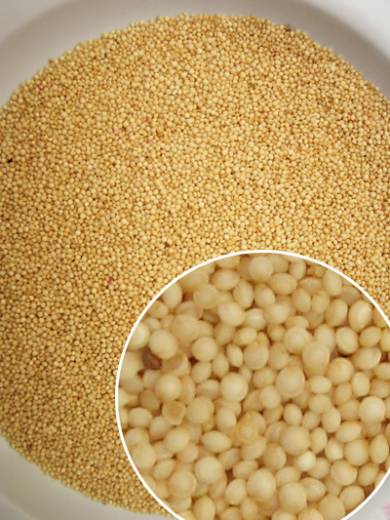
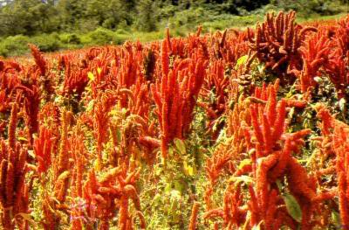
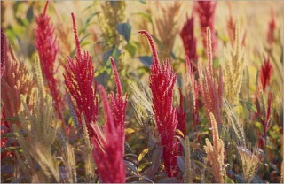
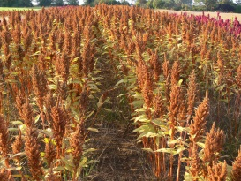
Amaranth is an old cultivated crop originating on American continent. The Aztecs, Incas and Mayas considered amaranth as their staple food together with maize and beans. It used to be one of the most important crops in America before Spanish colonialists conquered it and further cultivation of the crop was banned. Amaranth was preserved on hard to reach places of mountainous Central and South America.
In India, China and under the harsh conditions
of Himalayas this plant became important grain
and/or vegetable crop.
Amaranth
This pseudocereal has different nutritional qualities that make it a valuable ingredient in several products such as baking goods. The grains have high biological value proteins, high starch, oil, dietary fibre and vitamin content as well as minerals such as calcium, magnesium, phosphorus, iron, potassium, zinc, copper and manganese.

Slide 6
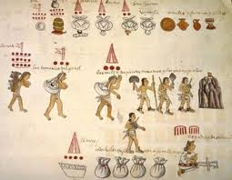
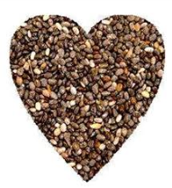
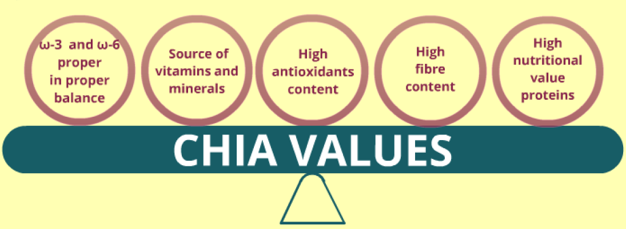
Nutritional Properties
High oil content (Ayerza 1995, Ayerza, 2010)
25-38% oil, which contains a high content of omega-3 and omega-6
(50-67% α-linolenic acid and 17-27% linoleic acid)
Antioxidants content (Taga et al., 1984; Reyes-Caudillo et al., 2008)
Phenolic compounds
Tocopherol , Beta-carotene chlorogenic acid, Caffeic acid, Flavonids as quercitin, myricetin, kaempferol
Vitamins and Minerals (Bushway and Belyea, 1981)
Riboflavin, niacin and thiamine
Calcium, phosphorus, potassium, zinc, magnesium, and copper
Fibre content (Reyes -Caudillo et al., 2008; Vazquez-Ovando et al., 2009)
30-54% Fibre content. Its fibre contains mucilage which absorb large amounts of water to influence the intestinal functioning.
CHIA
Chia as a core element of the diet of pre-Columbian civilisations, mainly the Aztecs.
This seeds was used as a raw material in making several medicinal and nutritional compounds, and even paints.
Today the seeds are cultivated with commercial purpose in Mexico, Bolivia, Argentina, Ecuador and Guatemala in high territori.

Slide 7
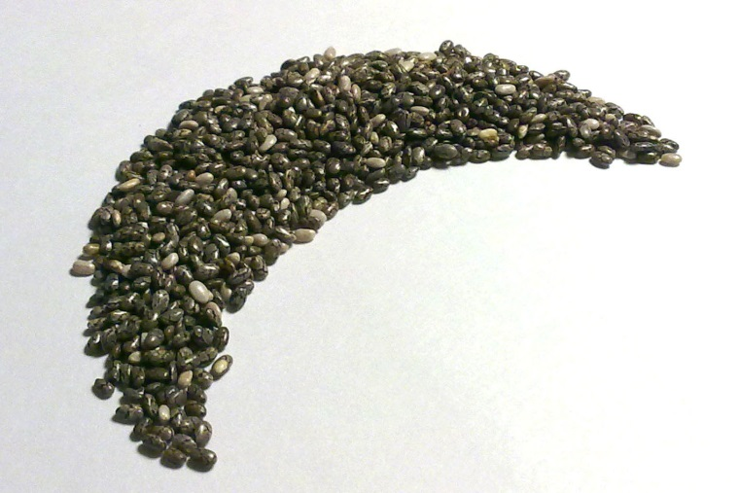
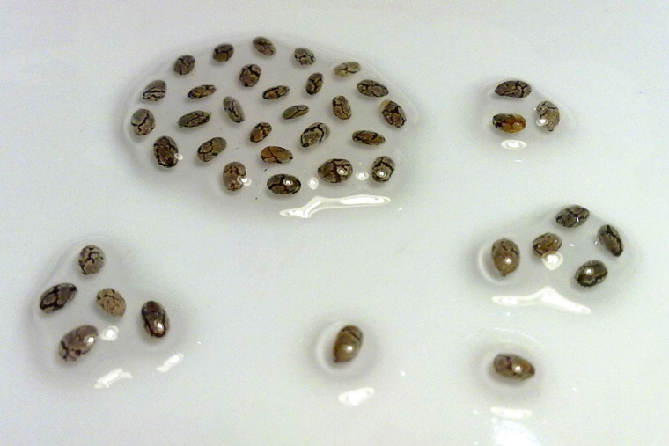
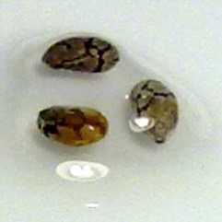
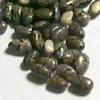
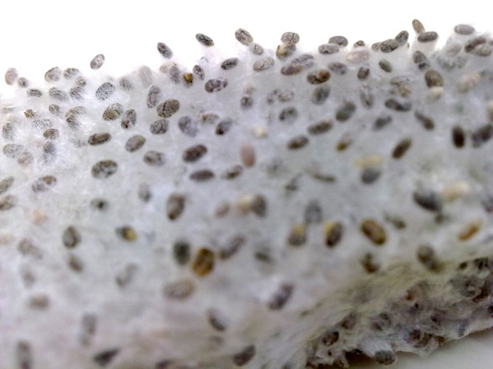
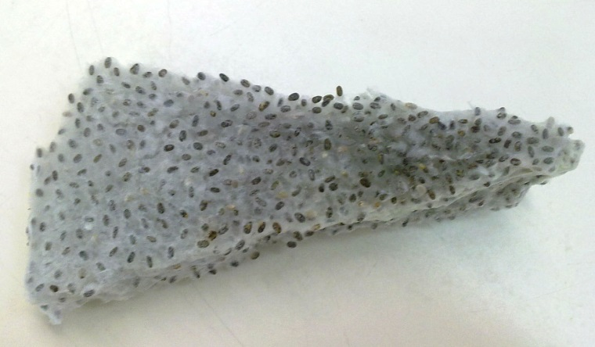
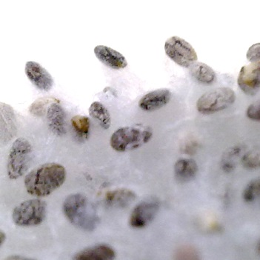
CHIA SEEDS BEFORE AND AFTER HYDRATION AND FREEZE DRYING
1.Hydration 2. Freeze Drying 3. Freeze dried chia detail
1
B
A
2
D
3
C
A. Chia Seeds, B. Mucilage gel after hydration, C. Freeze dried seeds, D. Freeze dried seeds detail
Iglesias-Puig and Haros, Alimentaria, 420:74-77, 2011

Slide 8
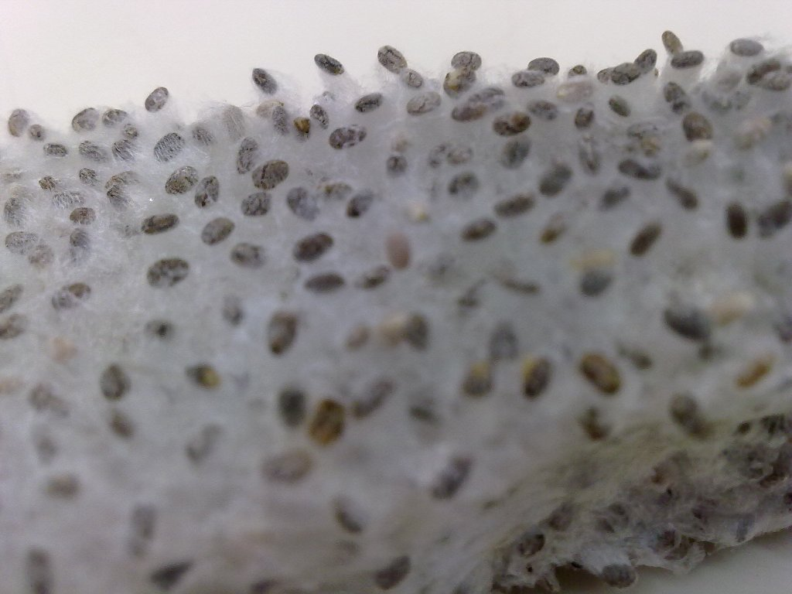
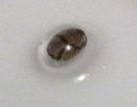
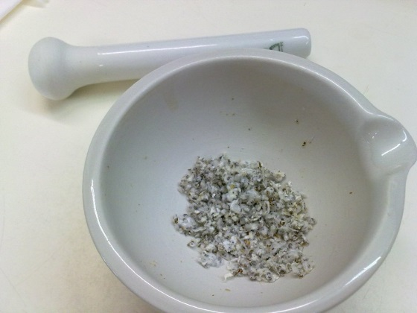
HYDRATION DETAIL OF LYOPHILIZED GEL

Slide 9
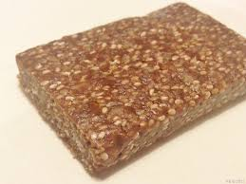
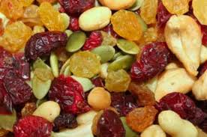
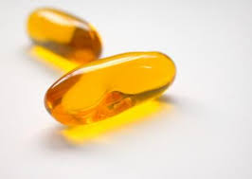
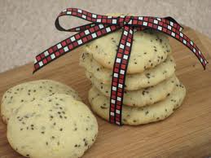
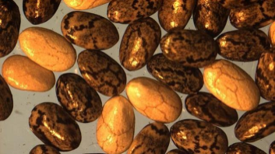
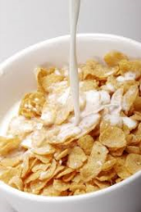
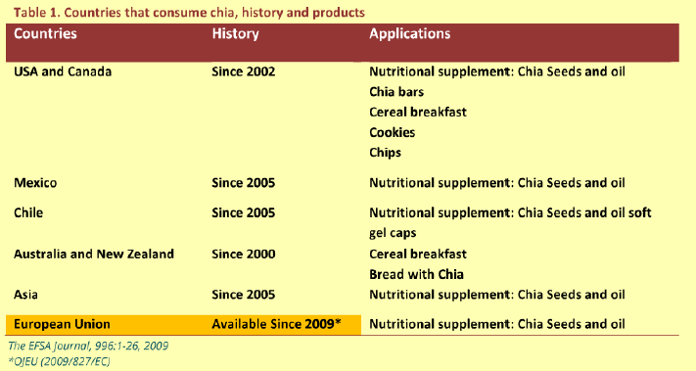
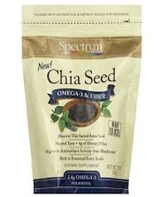
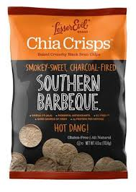
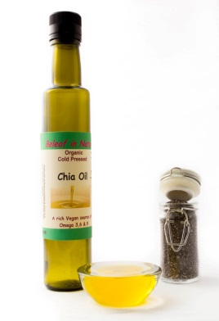
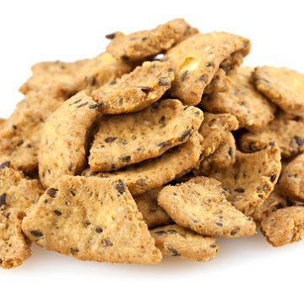
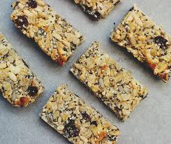
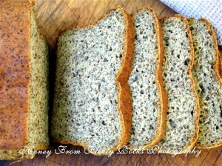
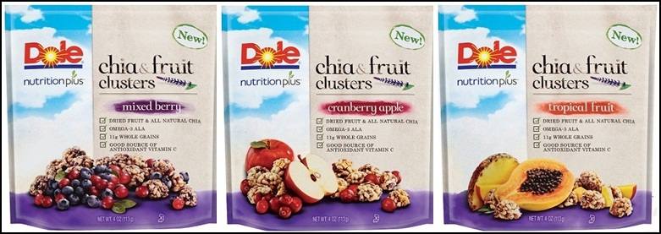

Slide 10
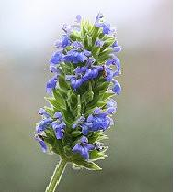

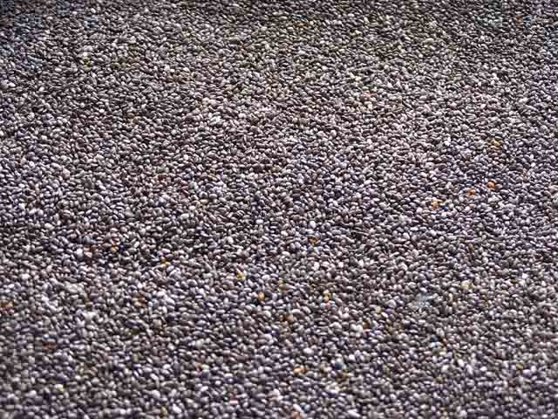
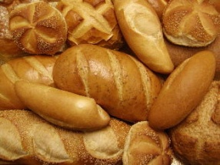
Article 1
Chia seed (Salvia hispanica) and grounded Chia seed as specified in the Annex may be placed on the market in the Community as a novel food ingredient to be used in bread products with a maximum content of 5 % Chia (Salvia hispanica) seeds.
Official Journal of the European Union, 2009

Slide 11
HAS ADOPTED THIS DECISION
Article 1
Chia (Salvia hispanica) seed as specified in Annex I may be placed on the market in the Union as a novel food ingredient for the uses listed in Annex II.
ANNEX II
USES OF CHIA (SALVIA HISPANICA) SEED
Baked products not more than 10 %
Breakfast cereals not more than 10 %
Fruit, nut and seed mixes not more than 10 %
Pre-packaged Chia seed not more than 15 %
as such
Official Journal of the European Union, 2013

Slide 12
Objective
This study evaluates the effect of replacing wheat flour by amaranth, quinoa or chia, three ancient Latin-American crops, on nutritional and functional bread features. GI (AUC, %) and iron bioavailability were studied using in vitro and in vivo methodologies, and wheat- and whole-wheat bread as controls.

Slide 13
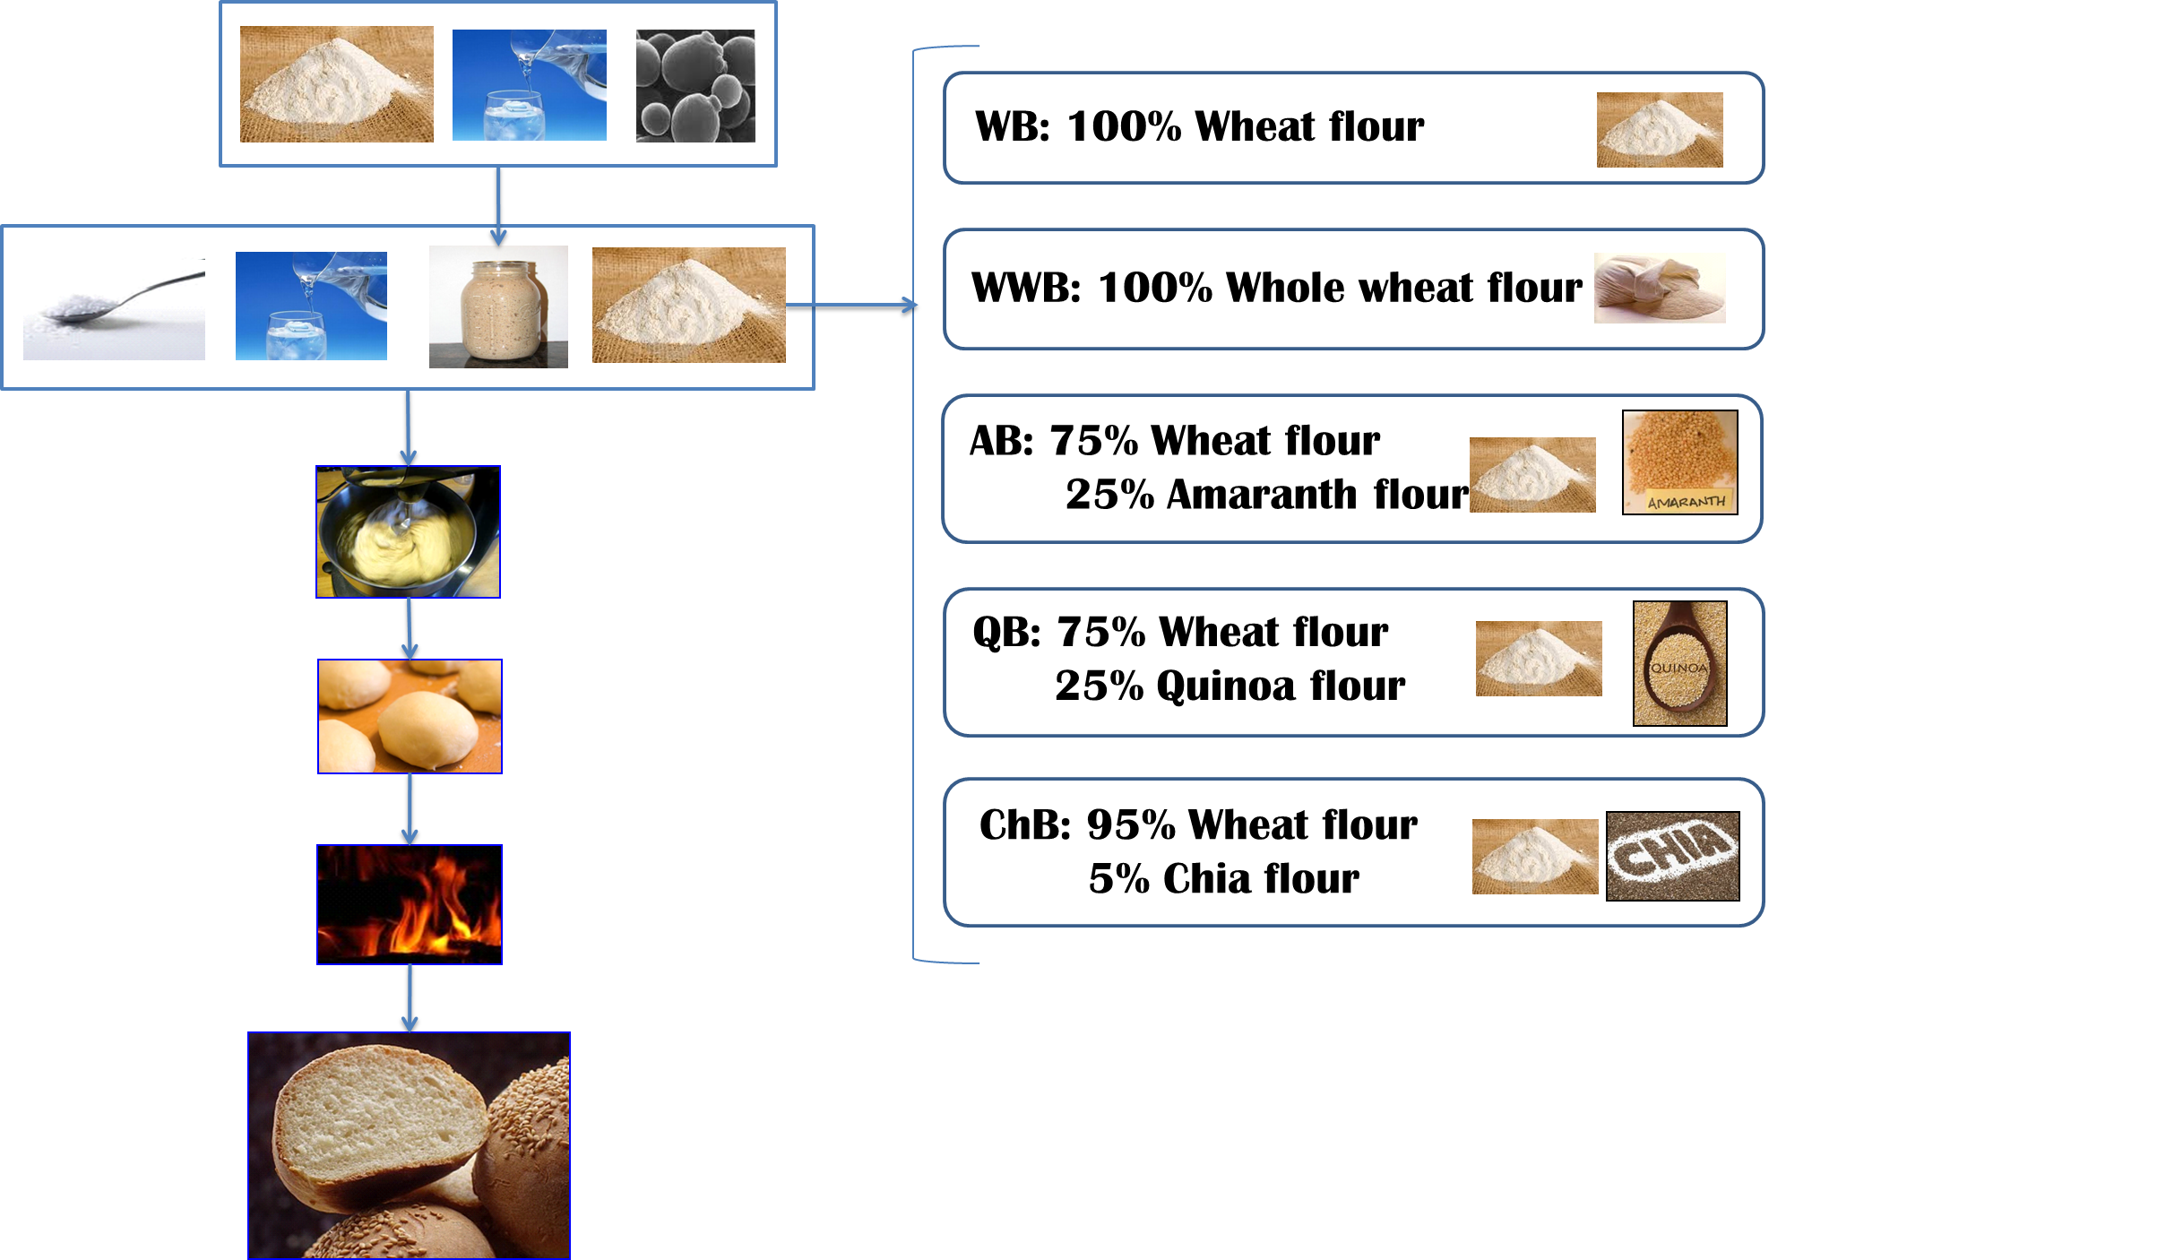
MATERIALS AND METHODS

Slide 14
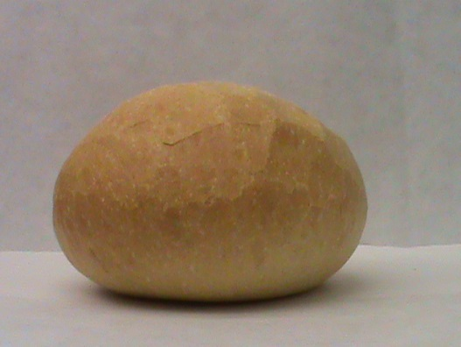
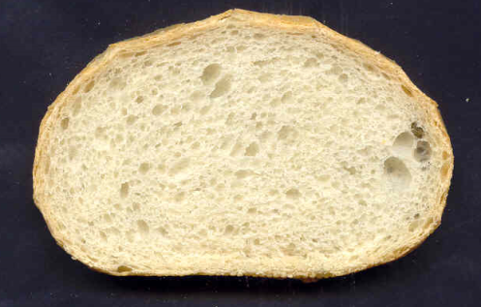
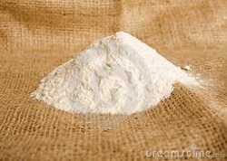
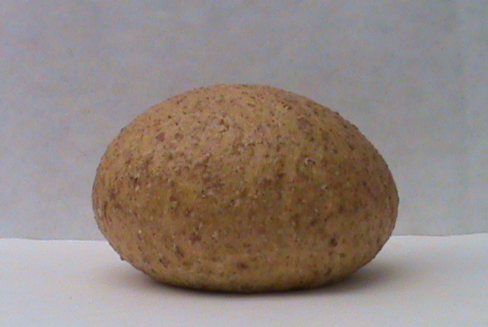












RESULTS
WB: 100% Wheat flour
WWB: 100% Whole wheat flour
AB: 75% Wheat flour
25% Amaranth flour
QB: 75% Wheat flour
25% Quinoa flour
ChB: 95% Wheat flour
5% Chia flour

Slide 15




MATERIALS AND METHODS
Experimental Models
All animal experiments were performed according to the University of Valencia Ethics Committee Guidelines for Animal Experiments, (SCSIE, University of Valencia, Spain).
Experimental animals were female Wistar rats. The adult females were date-mated, and fed ad libitum with an iron-deficient diet (Harlan Bioproducts, Indianapolis, USA).
At day 21, animals were randomly distributed in different groups of treatment (n=6)
Hematological parameters. Animals were fed intragastrically (200 µL) with the different bread formula in a single dose (50 mg) /day for 10 days.
GI.Animals were fasted for 6h and serum glucose concentrations were determined by using an automated Glucometer (ACCU-CHEK® Advantage meter system)
Notes:
La técnica: medir concentraciones de glucosa LIBRE en suero de animales o en el compartimento basal del método in vitro. Las medidas in vivo se hicieron con un glucómetro (ACCU-CHEK® Advantage meter system) y en el medio basal utilizando un kit enzimático (Glucosa-TR, Spinreact).

Slide 16



Blood collection: whole-blood samples were preserved in EDTA-treated tubes to prevent coagulation.
Hemoglobin (Hb) measurement. Hb concentrations were measured photometrically using cyanmethemoglobin standard solution according to the manufacturer’s instructions (Sigma-aldrich). This method is based on the oxidation of Hb and its derivatives (except sulfhemoglobin) to methemoglobin in the presence of potassium ferricyanide to form cyanmethemoglobin. The absorbance, measured at 540 nm, is proportional to the total Hb concentration.
Hematological parameters
Number of erythrocytes was calculated by using a Neubauer improved cell counting chamber and hematocrit (%) was estimated by centrifugation of whole blood in microcapillar tubes.
Mean corpuscular volume (MCV) was calculated (hematocrit x 10)/nº erythrocytes (10⁶/mm³ blood)
Mean corpuscular Hb (MCH) (%) as: [hemoglobin (g/dL)x100]/hematocrit.

Slide 17








RESULTS
Figure 1. Effect of different bread formulations on blood glucose levels in rats
Fast first step for glucose uptake
Quinoa presents a significant 2nd step for glucose uptake
Figure 2. Glycaemic index of different breads
b
b
Bread formulations present advantages concerning glycaemic index in relation to WB
a
a
a
Notes:
- El efecto que se observa en la Quinoa hay que estudiarlo con mayor profundidad (podría deberse a que proporciona disacáridos, un pico de insulina, etc.).
- Yo no me calentaría la cabeza utilizando la figura pequenya (comparación de los datos in vitro e in vivo) porque no sabemos muy bien porque la Chia y Qunioa dan perfiles diferentes. Los datos relevantes son los in vivo.

Slide 18





Table. Iron and myo-inositol (InsP₆) content (µmol/g) in breads formulated with flours from different origin.
Sample | Iron | InsP₆ | Molar ratio InsP₆/Iron
WB | 0.42 ª | n.d. | --
WWB | 0.66 ^{b} | 2.6 ^{b} | 4.1 >1.0
AB | 0.77 ^{c} | 3.7 ^{c} | 6.7>1.0
QB | 0.61 ^{ab} | 2.0 ^{b} | 5.0>1.0
ChB | 0.48 ª | 0.8 ª | 2.5>1.0
Values are expressed as mean ± standard deviation (n=3). ^{a-e} Different superscript letters indicate statistical differences (P<0.05)

Slide 19





Table . Haematological parameters in iron-deficient (ID) and animals fed with FeCl₃ alone or together with different bread samples.
 |  | Treatment
 | ID | FeCl₃ª | WB | WWB | AB | ChB | QB
Haemoglobin (Hb, g/dL) | 11.1 ± 2.7ª | 16.2 ± 0.2^{b} | 12.3±0.2ª | 14.7±1.3^{ab} | 16.4±2.2^{b} | 17.4±2.8^{b} | 13.4±2.9^{ab}
Haematocrit | 49 ± 2ª | 49 ± 1ª | 52 ± 2ª | 49 ± 3ª | 54 ± 4ª | 56 ± 5ª | 61 ± 7ª
MCV¹ (x10⁻⁴) | 1.64± 0.04ª | 1.71± 0.04ª | 1.69± 0.04ª | 1.70± 0.04ª | 1.97± 0.04^{bc} | 1.91± 0.04^{b} | 2.07± 0.04^{c}
MCH² (pg) | 20.3 ± 5.5ª | 28.9 ± 0.3^{b} | 25.3 ± 5.9^{ab} | 27.9 ± 4.6^{ab} | 26.2 ± 4.1^{ab} | 31.2 ± 5.0^{b} | 21.9 ± 4.8^{ab}
Values are presented as mean ± standard deviation (n=5). ^{a-e} Different superscript letters indicate statistical differences (P<0.05). PC, white bread; PI, whole bran; PA, amaranth flour; PCh, Chia flour; PQ, Quinoa flour.
ª FeCl₃ dosed at 2.5 µg; ¹MCV. mean corpuscular volume; ²MCH. mean corpuscular Hb

Slide 20
CONCLUSIONS
The replacement of wheat flour by Andean grains significantly increased the content of proteins, lipids, dietary fibre and minerals in the final product compared to control sample. Amaranth and quinoa flours made wheat flour replacement possible, increasing nutritional value of bread with slight depreciation its quality, whereas chia showed higher technological and sensory quality than wheat bread.
GI was lower in breads with chia, amaranth and whole wheat bread, whereas the formulation with quinoa did not modify this parameter.
Breads formulated with whole grains had higher levels of minerals relative to controls. Their bioavailability depends on the formulation and breadmaking process, basically because of the presence of phytates, as predicted by inhibitory threshold values for mineral absorption phytate/mineral molar ratios.
Animals fed with whole wheat-, chia- and amaranth-bread showed significantly higher haemoglobin concentration than those fed with control bread. Only animals fed with samples with chia had values of mean corpuscular haemoglobin significantly higher than controls.

Slide 21
Thank you for your attention

