Slide 1
About OMICS Group
OMICS Group is an amalgamation of Open Access publications and worldwide international science conferences and events. Established in the year 2007 with the sole aim of making the information on Sciences and technology ‘Open Access’, OMICS Group publishes 500 online open access scholarly journals in all aspects of Science, Engineering, Management and Technology journals. OMICS Group has been instrumental in taking the knowledge on Science & technology to the doorsteps of ordinary men and women. Research Scholars, Students, Libraries, Educational Institutions, Research centers and the industry are main stakeholders that benefitted greatly from this knowledge dissemination. OMICS Group also organizes 500 International conferences annually across the globe, where knowledge transfer takes place through debates, round table discussions, poster presentations, workshops, symposia and exhibitions.

Slide 2
About OMICS International Conferences
OMICS International is a pioneer and leading science event organizer, which publishes around 500 open access journals and conducts over 500 Medical, Clinical, Engineering, Life Sciences, Pharma scientific conferences all over the globe annually with the support of more than 1000 scientific associations and 30,000 editorial board members and 3.5 million followers to its credit.
OMICS Group has organized 500 conferences, workshops and national symposiums across the major cities including San Francisco, Las Vegas, San Antonio, Omaha, Orlando, Raleigh, Santa Clara, Chicago, Philadelphia, Baltimore, United Kingdom, Valencia, Dubai, Beijing, Hyderabad, Bengaluru and Mumbai.
.

Slide 3
Integrative Image and RNA-seq Data Analysis
Momiao Xiong
University Of Texas School of Public Health

Slide 4
Transcriptome analysis: Unveiling the Layers of Expressions

Slide 5
Resequencing and De novo sequencing
Association Studies (Population and Pedigrees)
Discrete and Continuous Genomic Models
Imaging
Disease Subtype
Image-RNA
eQTL
miRNA-seq
RNA-seq
Differential Expression, Co-expression Networks, Allele specific expression
(Population and Pedigrees)
Disease risk and drug response prediction
Discrete and Continuous Genomic Models
Methylation-seq
Differential methylation
(Population and Pedigrees)
Discrete and Continuous Genomic Models
ChIP-seq
Histone Modification
Epigenomics

Slide 6
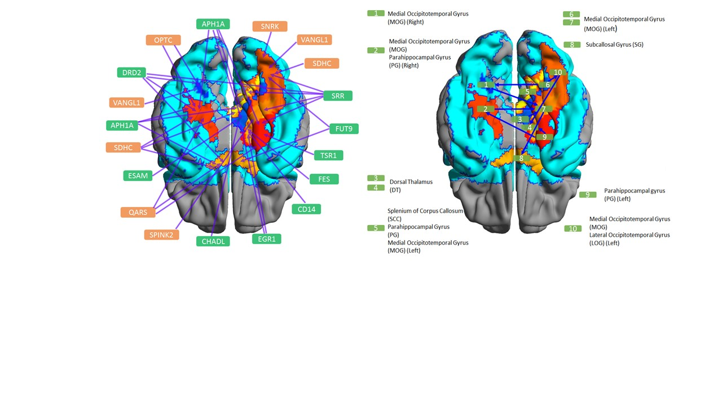
Image – Genetics
DTI

Slide 7
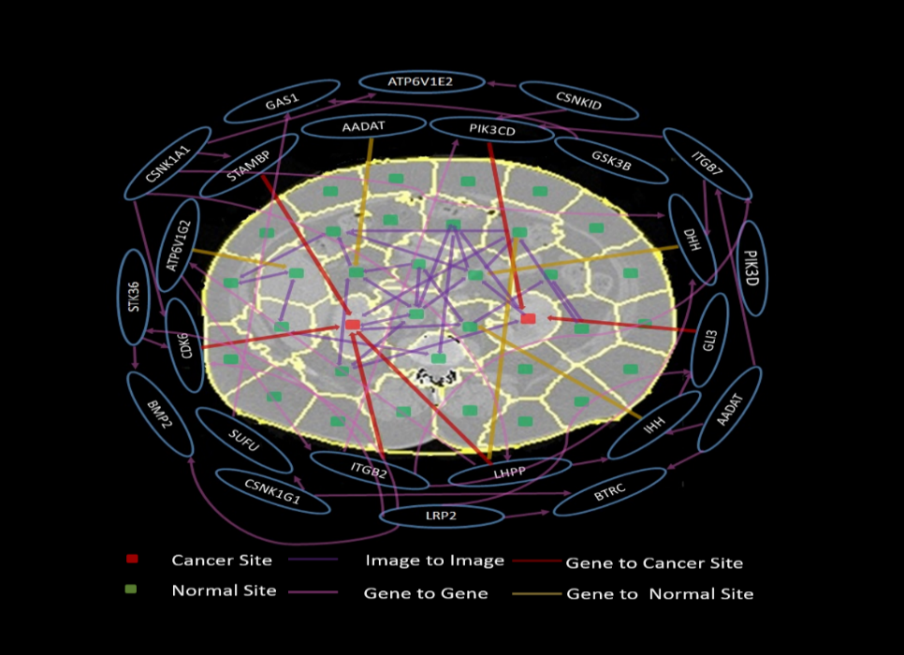
Image – Gene Expressions
CT

Slide 8
Kidney Normal and Tumor Image
Kidney Tumor
Kidney Normal

Slide 9
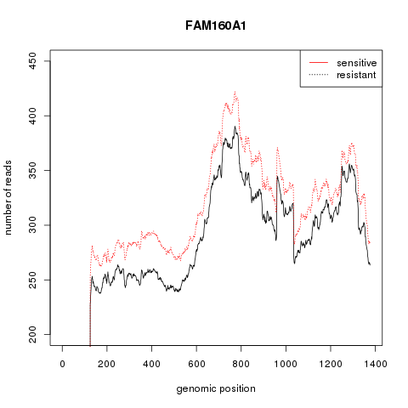
RNA-seq Data
(Ovarian Cancer)

Slide 10
Methods for Imaging-Genetic Data Analysis
Single Variate Regression Analysis
  Summary Statistics for imaging data
  Signal in pixel or voxel for imaging data
Multivariate Analyses
- (Liu J, Calhoun VD. A review of multivariate analyses in imaging genetics. Front Neuroinform. 8:29).
- PCA, multifactor dimensionality reduction, independent component analysis (ICA), and clustering.
Sparse Canonical Correlation Analysis
- voxel-based morphometry
- Chi EC, Allen GI, Zhou H, Kohannim O, Lange K, Thompson PM. IMAGING GENETICS VIA SPARSE CANONICAL CORRELATION ANALYSIS. Proc IEEE Int Symp Biomed Imaging. 2013:740-743.

Slide 11
Limitations
Imaging data reduction methods do not consider imaging signal space variation.
Current methods for RNA-seq data analysis ignore genomic positional level variation and allele specific variation

Slide 12
Procedures of Image-RNA-seq Data Analysis
Image Feature Selection
Descriptor
Functional Principal Components
Multivariate Functional Linear Models

Slide 13
Two dimensional Functional Principle Component Analysis
a weight function centered random function
covariance function
integral equation

Slide 14
Functional Expansion
Random Functions
Eigenfunctions
Functional Principal Component Score

Slide 15
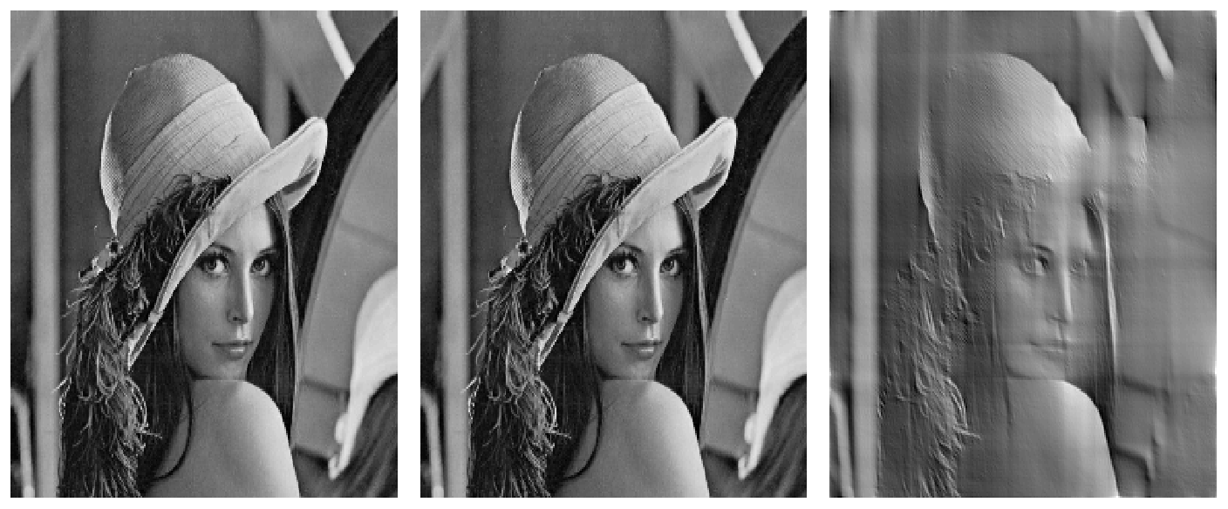
Comparison Between FPCA Scores and Fourier Coefficients
a
b
c
Original Images
Reconstruction of the images with 6 FPCA scores
Reconstruction of the images with first 16129 Fourier coefficients.

Slide 16
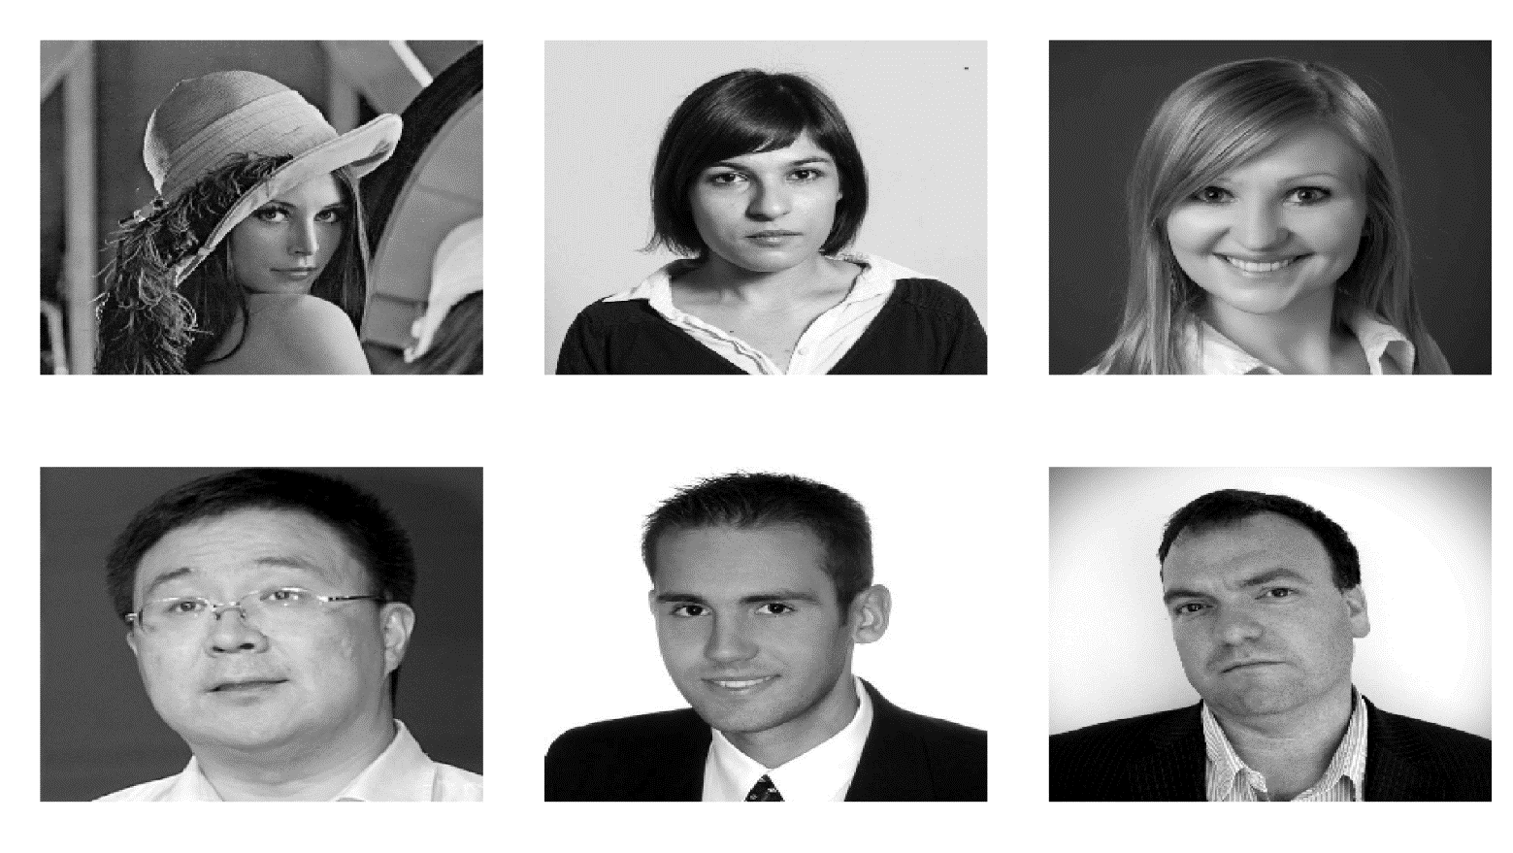
Reconstructed Image by FPCA
Six FPC

Slide 17
CT PANC Normal
Original Image
Reconstruction Image

Slide 18
IPMN
Original Image
Reconstruction Image

Slide 19
PANC Adenoma Ca Advanced
Original Image
Reconstruction Image from FPCA

Slide 20
Multivariate Functional Linear Models
Model:
RNA-seq profile (number of reads)
K-th trait (FPC score)
Ith individual
genetic additive effect
Genomic Position
Eigenfunctional Expansion

Slide 21
Reduced Multivariate Model

Slide 22
Test Statistic
Null Hypothesis
Number of traits
Number of components in expansion

Slide 23
Position matters
Bad idea to treat all reads equally, ignoring their genomic positions. Therefore, they cannot detect differentially expressed gene.

Slide 24
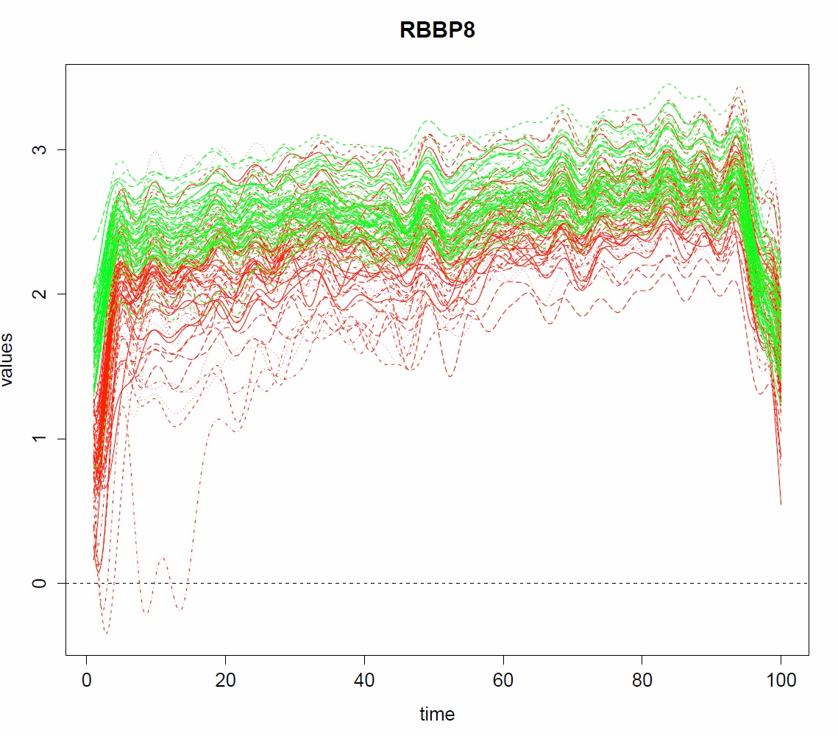
Green: Normal
Red: Tumor

Slide 25
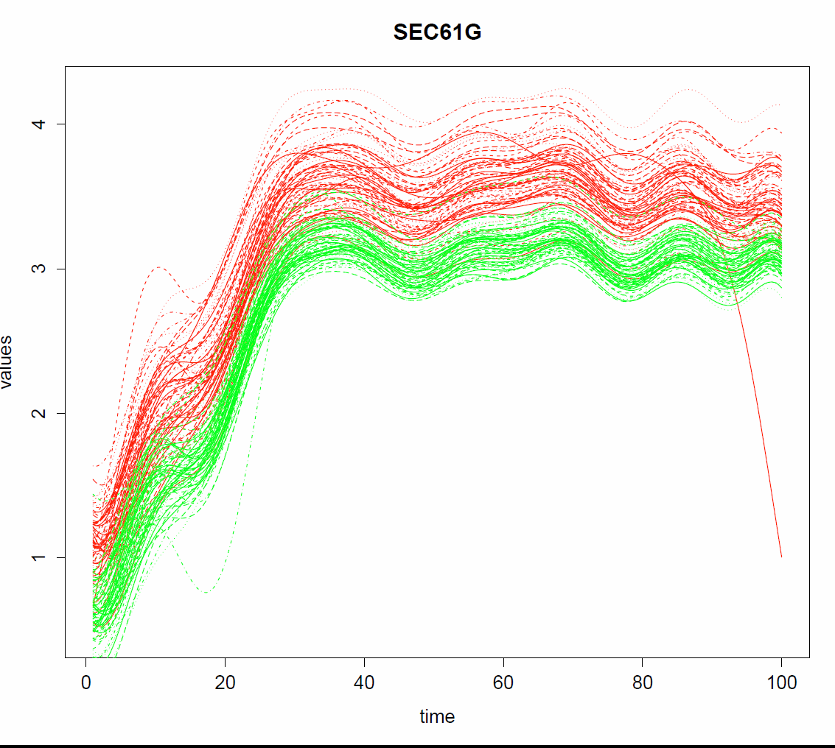

Slide 27
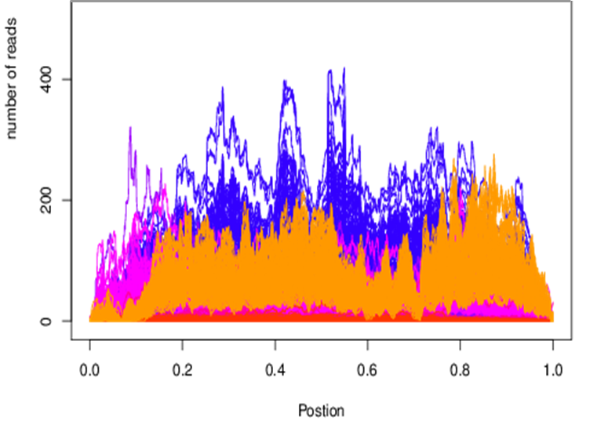
RNA-seq Data
Cluster Analysis using FPCA

Slide 28
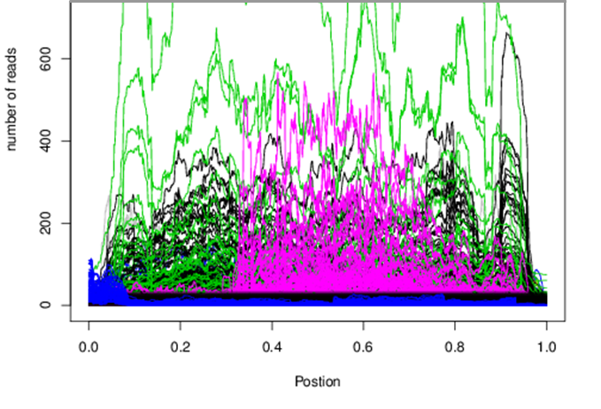
RNA-seq Data
Cluster Analysis using Level 3

Slide 29
Application

Slide 30
Ovarian Cancer
(TCGA Data)
Histology Images
Total Samples: 176
Drug Sensitive: 106
Drug Resistant: 76
All these images are sampled and resized to the dimension of 128*128 = 16,384
Number of Genes: 13,357
Significance of P-value=3.74E-06
Total Number of Significant Genes: 21

Slide 31
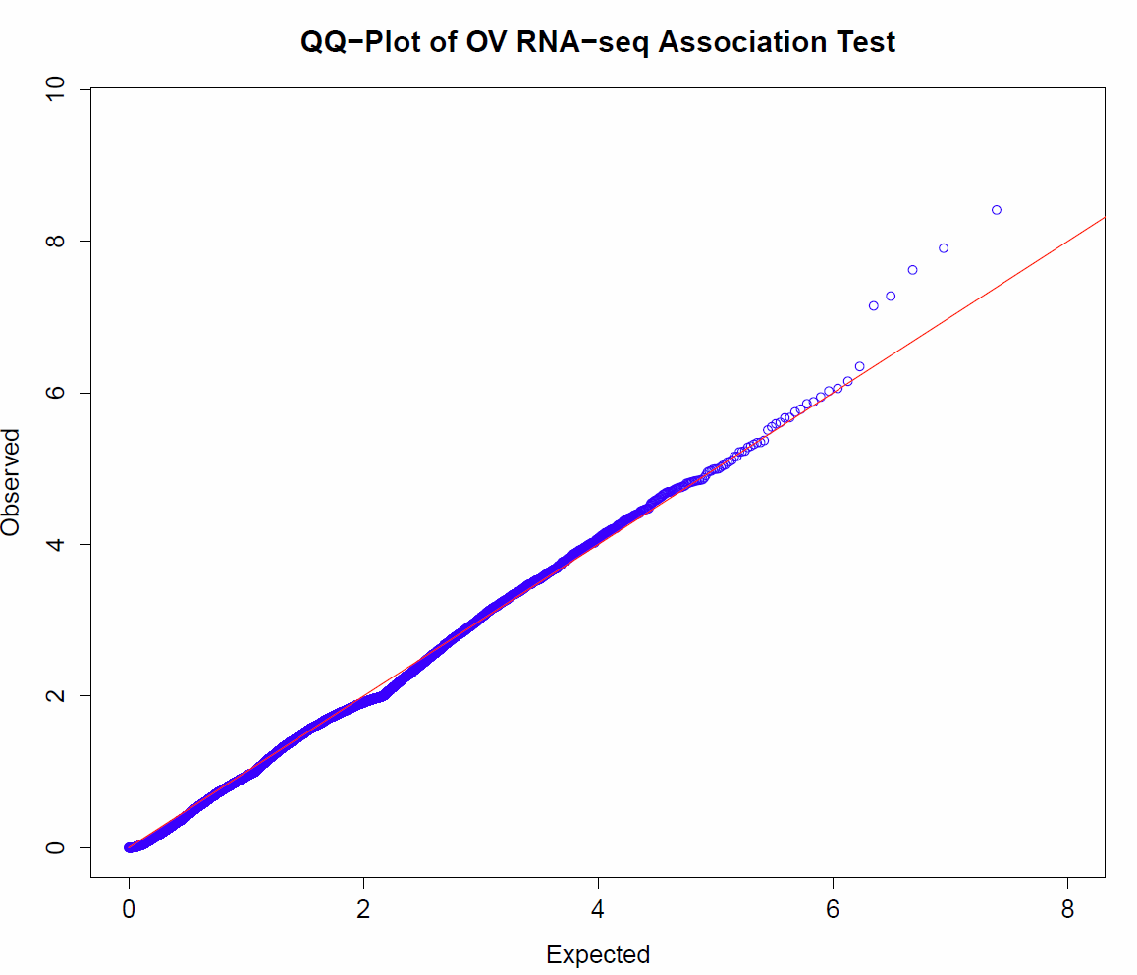

Slide 32
Table 1. List of 21 RNA-seq significantly associated with image.
Gene | P-value |  |  | Gene | P-value
 | MFLM |  | Regression |  | MFLM |  | Regression
 | FPCA | Descriptor | Level 3 |  | FPCA | Descriptor | Level 3
ZNF805 | 2.31E-10 | 4.34E-01 | 9.33E-01 | PHKA1 | 1.31E-06 | 2.80E-02 | 7.15E-01
LOC653501 | 3.86E-09 | 2.49E-02 | 9.04E-01 | PTPRG | 1.39E-06 | 9.50E-01 | 6.58E-01
TMEM170B | 1.23E-08 | 6.18E-03 | 9.11E-01 | IFT88 | 1.64E-06 | 1.09E-05 | 8.11E-01
DRP2 | 2.38E-08 | 9.76E-02 | 5.89E-01 | PARD3B | 1.78E-06 | 8.89E-01 | 4.49E-01
OR6V1 | 5.27E-08 | 2.07E-03 | 1.76E-01 | LIMD1 | 2.11E-06 | 4.69E-01 | 8.71E-01
GPR113 | 7.09E-08 | 3.67E-07 | 5.70E-01 | FAM73A | 2.13E-06 | 3.97E-03 | 9.28E-01
ZNF484 | 4.47E-07 | 6.77E-03 | 9.34E-01 | CAPN14 | 2.45E-06 | 1.78E-02 | 4.80E-01
DNAL1 | 7.00E-07 | 6.64E-03 | 8.59E-01 | CPEB3 | 2.55E-06 | 2.62E-02 | 9.88E-01
ITGA10 | 8.72E-07 | 2.01E-01 | 6.41E-01 | CDCA2 | 2.80E-06 | 9.73E-01 | 3.74E-01
NBEAL1 | 9.43E-07 | 7.67E-03 | 7.12E-01 | PUS3 | 3.08E-06 | 7.81E-01 | 9.22E-01
C16orf52 | 1.13E-06 | 2.10E-02 | 9.06E-01

Slide 33
Real Data Analysis
Kidney Renal Clear Cell Carcinoma (KIRC)
Total Images: 188
Case: 121, Control: 67
Normal
Tumor

Slide 34
kidney cancer (KIRC)
Images: 188
Cancer:121
Normal: 67
Number of Genes:16,774
P-value (significance)= 2.98E-06
Number of Significant Genes=84

Slide 35
FPCA
 | Test Set |  |  | Training Set
 | Sensitivity | Specificity | Accuracy | Sensitivity | Specificity | Accuracy | Num of FPCA
CV1 | 0.9200 | 0.6190 | 0.7826 | 0.8333 | 0.8043 | 0.8239 | 3
CV2 | 0.9091 | 0.7000 | 0.8438 | 0.8990 | 0.7719 | 0.8526 | 11
CV3 | 0.8800 | 0.9091 | 0.8889 | 0.8646 | 0.7857 | 0.8355 | 5
CV4 | 0.9444 | 0.6250 | 0.8462 | 0.8835 | 0.7458 | 0.8333 | 5
CV5 | 0.7742 | 0.8235 | 0.7917 | 0.9000 | 0.7600 | 0.8500 | 6
Mean | 0.8855 | 0.7353 | 0.8306 | 0.8761 | 0.7736 | 0.8391 | 6
CV1: fpca_1, fpca_4, fpca_38
CV2: fpca_1, fpca_2, fpca_4, fpca_18, fpca_31, fpca_38, fpca_49, fpca_87,
fpca_96, fpca_171, fpca_182
CV3: fpca_1, fpca_2, fpca_4, fpca_22, fpca_45
CV4: fpca_1, fpca_2, fpca_4, fpca_38, fpca_182
CV5: fpca_1, fpca_2, fpca_4, fpca_17, fpca_18, fpca_38

Slide 37
Table 2. P-values of three statistics for testing association of expression with images in KIRC study.
Gene | P-value |  |  | Gene | P-value
 | MFLM (FPC) | MFLM (Descriptor) | MLM |  | MFLM(FPC) | MFLM(Descriptor) | MLM
HELZ | 6.62E-16 | 6.08E-01 | 8.79E-01 | ZNF81 | 9.95E-08 | 2.06E-07 | 7.25E-01
9-Mar | 2.12E-15 | 1.02E-06 | 7.58E-01 | GAB2 | 1.04E-07 | 1.34E-02 | 6.38E-01
SLC2A12 | 2.52E-12 | 9.94E-03 | 2.76E-08 | LOC647859 | 1.43E-07 | 8.56E-02 | 1.23E-03
BRWD1 | 1.26E-11 | 5.61E-03 | 9.54E-01 | C2orf68 | 1.49E-07 | 4.83E-03 | 7.84E-01
RFX7 | 5.29E-11 | 1.00E+00 | 9.58E-01 | SDR39U1 | 1.57E-07 | 8.83E-04 | 5.88E-01
C22orf39 | 6.55E-11 | 1.29E-03 | 5.77E-01 | ZRANB3 | 1.66E-07 | 1.03E-03 | 9.59E-01
NSD1 | 7.06E-11 | 1.67E-02 | 9.74E-01 | PSMC4 | 1.71E-07 | 1.39E-02 | 8.87E-01
RTF1 | 1.82E-10 | 9.49E-01 | 8.58E-01 | FLJ12825 | 1.74E-07 | 1.39E-04 | 7.08E-01
MBD5 | 3.00E-10 | 1.08E-04 | 9.33E-01 | ARHGEF11 | 2.26E-07 | 8.24E-03 | 8.55E-01
ZSCAN16-AS1 | 4.16E-10 | 6.08E-02 | NA | LOC100289019 | 2.61E-07 | 8.50E-04 | NA
SESN1 | 4.84E-10 | 3.42E-01 | 6.71E-01 | SUFU | 2.79E-07 | 1.99E-01 | 5.84E-01
ITGA9 | 5.12E-10 | 2.11E-02 | 9.52E-01 | ZNF555 | 3.75E-07 | 2.16E-02 | 3.75E-01
PPM1K | 5.60E-10 | 1.48E-01 | 1.11E-04 | KHNYN | 3.85E-07 | 1.54E-01 | 4.62E-01
USP42 | 1.39E-09 | 9.79E-01 | 9.06E-01 | ANKRD11 | 4.80E-07 | 1.00E+00 | 8.92E-01
FAM47E-STBD1 | 1.77E-09 | 1.11E-02 | NA | BOLA2 | 4.82E-07 | 9.88E-02 | 8.33E-01
ZNF710 | 2.05E-09 | 1.22E-01 | 9.82E-01 | BOLA2B | 4.82E-07 | 9.88E-02 | NA
TECPR2 | 3.59E-09 | 9.53E-04 | 5.63E-01 | SAPCD1 | 4.97E-07 | 4.24E-01 | NA

Slide 38
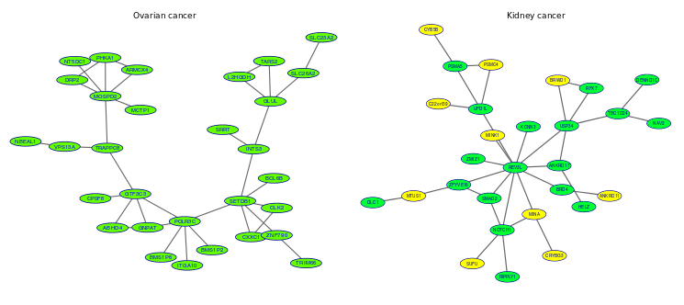
Protein-Protein Interaction Networks

Slide 40
Ovarian Cancer

Slide 41
Alternative splicing
Activator and alternative splicing
Alternative splicing and complete proteome
Atp-binding and cataract
3d-structure and coiled coil
Activator and alternative splicing
3d-structure, actin-binding and alternative splicing
Transmembrane and transport
Alternative splicing and complete proteome
KIRC
Alternative splicing and chemotaxis
Alternative splicing and complete proteome
3d-structure and complete proteome
Alternative splicing and complete proteome
3d-structure and alternative splicing
3d-structure and pathways in cancer
3d-structure and alternative splicing
Pathways in cancer
3d-structure and acetylation
Alternative splicing and atp-binding
3d-structure and alternative splicing
Alternative splicing and complete proteome
Transmembrane and transport
3d-structure, alternative splicing and atp-binding
3d-structure, alternative splicing, complete proteome
Alternative splicing and atp-binding
Acetylation and alternative splicing
Transmembrane and transport
3d-structure and coiled coil
Alternative splicing and coiled coil
Alternative splicing and ank repeat
RNA Splicing, 3d-structure and alternative splicing
Cell morphogenesis
Regulation of cell shape
Microtubule-associated tumor suppressor 1
Complete proteome and polymorphism,
Complete proteome and phosphoprotein
Alternative splicing and complete proteome
Transmembrane and transport
Alternative splicing and coiled coil
Acetylation and alternative splicing
Acetylation and alternative splicing
Transmembrane and transport
Acetylation and complete proteome
3d-structure and acetylation
Alternative splicing and complete proteome

Slide 42
Acknowledgment
UT School of Public Health
Junhai Jiang
Nan Lin
Shicheng Guo
UT MD Anderson Cancer Center
Jane Chen

Slide 43
Let Us Meet Again
We welcome you all to our future conferences of OMICS International
Please Visit:
http://transcriptomics.conferenceseries.com/
http://conferenceseries.com/
http://www.conferenceseries.com/genetics-and-molecular-biology-conferences.php

