Slide 1
The effect of upper extremities massage on reaction time and anticipatory skill in male athletes
SHAHID BEHESHTI UNIVERSITY (MC)
Presenter : Mohammad reza kasnavi,Msc,PT
Shahid Beheshti University of Medical Sciences ,Tehran,Iran
mohamadkasnavi@yahoo.com

Slide 2
The purpose
The main aim of the study was:
to evaluate the effect of massage on neurocognitive parameters in male athletes

Slide 3
Out line
Introduction
Methods of teaching
Results
Conclusion and suggestions

Slide 4
Introduction importance role of neurocognitive tasks
Reaction time
anticipatory skill
Improve motor control
speed of decision making
athlete's success
prevention of injury

Slide 5
Introduction importance role of neurocognitive tasks
Indirect assessment of brain function
Involving central and prepheral parameters
Correction of the complex coordination between information levels
Necessary for motor control
Essential for activities that require rapid response

Slide 6
Introduction
Reaction time
proprioception
age, gender
exercise
Attention
Arousal
Intelligence
Awarenes
Massage????

Slide 7
Introduction
Neuromuscular control
Awarenes
Arousal
Attention
proprioception
Neurocognitive
Functions
Integration of somatosensory , cortical , subcortical

Slide 8
Introduction
The purpose of the study:
was to investigate the effect of massage on neurocognitive parameters in male athletes.

Slide 9
Materials & methods
Sampling method & study design:
Comparative,Descriptive and analytical experimental study
volunteered and non-randomly sampling
30 volleyball and basketball players were analyzed by Speed Anticipation Reaction Test software(SART).

Slide 10
Materials & methods
INCLIUSION CRITERIA
EXCLUSION CRITERIA
disturbed individual and the inability to continue testing.
taking stimulants like coffee and alcohol drinks
Taking any medication affecting the motor function and cognition
not have vision or hearing problems and eyeglasses, contact lenses and hearing aids do not use.
No history of acute or chronic diseases such as neurological, cardiovascular or metabolic
Right handed
practicing at least 3 times a week, and at least 2 hours each time

Slide 11
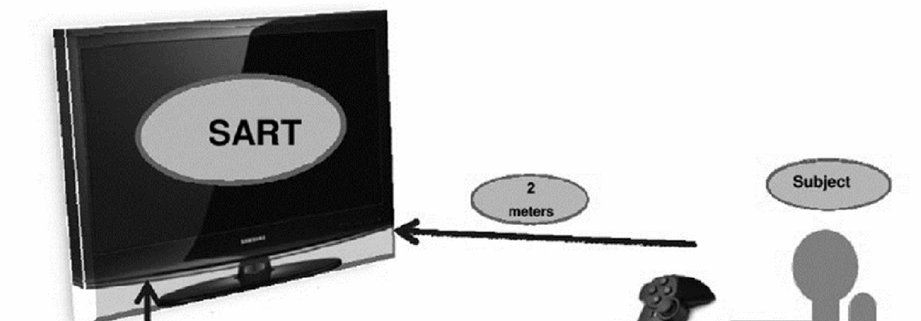
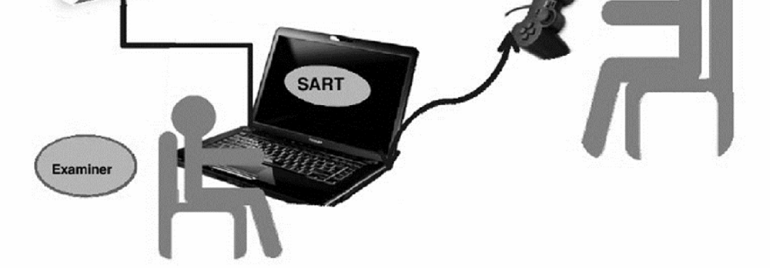
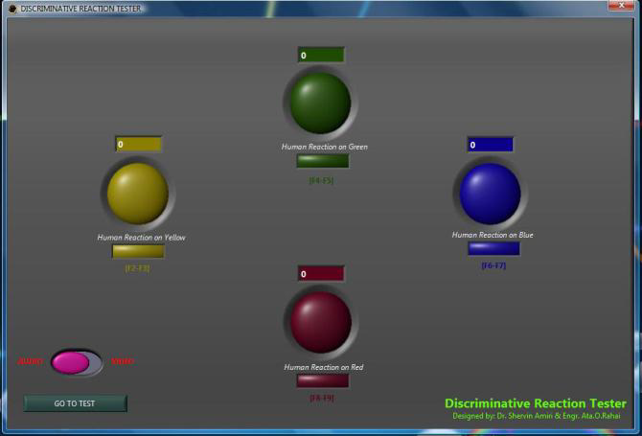
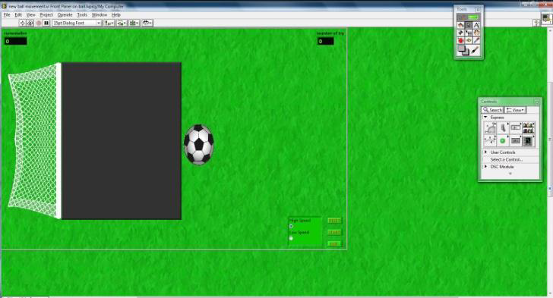
Procedure & data collection
1
Measurement of reaction time and anticipatory skill before intervention, by the SART software
2
Massage in the intervention group
REST in control group
3
Re-measuring reaction time and anticipatory skill,
by the SART software
Massage protocol
5 minutes
2.5 minutes of palmar, 2.5 minutes dorsal of forearm and hands
Stroke at the rhythm of 1 time per second for 60 seconds
Petrissage technique on the inner and outer sides of Palmar and Dorsal's forearm and hand for 180 seconds
Tapotement technique like percussion 60 seconds

Slide 12
Results
Statistical Analysis:
SPSS Version 22
Kolmogorove – Smirnov Test
Shapiro-wilk Test
Independent T- Test

Slide 13
Findings
Table 1 Anthropometrical Characteristics of participants in the experimental (n=15) & control groups (n=15) (mean± SD).
Control group | Experimental group | Variable
25.73±2.91 | 25.07±2.92 | Age (years)
74.53±2.85 | 72.87±3.58 | Weight (Kg)
177.73±3.88 | 175.27±5.38 | Height (cm)

Slide 14
Table 2 Mean percentage changes (%) (± SE) in the auditory & visual RT tests in experimental (n=15) & control groups (n=15).
p-value | Control group | Experimental group | Tests
0.006 | 0.67±12.29 | 43.63±7.82 | V. C. R. Tª
0.001 | -3.67±5.94 | 37.33±5.99 | V. C. C. R. T^{b}
0.045 | -30.73±3.88 | 73.70±30.25 | A. C. R. T^{c}
0.001 | 24.70±34.63 | 145.77± 34.70 | A. C. C. R. T^{d}
0.825 | 27.93±15.92 | 37.53± 39.98 | A. S. L. S^{e}
0.177 | 17.90±18.91 | -28.47± 27.60 | A. S. H. S^{f}
a Visual Choice Reaction Time(Ms). b Visual Complex Choice Reaction Time(Ms). c Auditory Choice Reaction Time(Ms). d Auditory Complex Choice Reaction Time(Ms). e. Anticipatory Skill Of Low Speed (Ms). f. Anticipatory Skill Of High Speed (Ms).

Slide 15
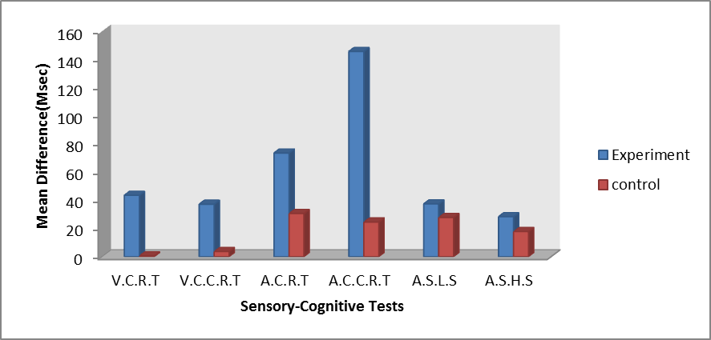

Slide 16
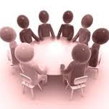
Discussion

Slide 17
Relation between Arosual, Attention, Alertness, and proprioception training with improved reaction time
Ceylan(2015)
Massage and improvement of proprioception
Henriksen(2004)
Shin(2015)
Massage and improvement of Arosual,Attention,Alertness
Field(1996)
Diego(2004)
Kasinski(2008)
Etnyre(2002)

Slide 18
Massage
Input Beta
&
alpha
input afferent &
Mechanoreceptors
Proprioceptive
Arosual
Attention
Alertness
Change in tunig,timing and integration sensory motor system
Neurocognitie Function
Neuromuscular control

Slide 19
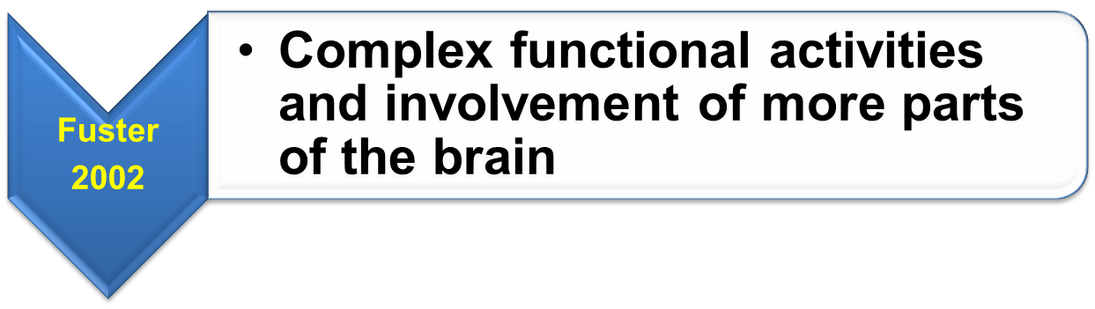
Anticipation skill

Slide 20
Conclution
The results showed the improvement in the choice and complex visual and auditory reaction times after massage.
It seems that this massage protocol has been effective in the neurocognitive functions of athletes
it can be suggested that these techniques be used as a valuable tool in physiotherapy to improve the performance of athletes.

Slide 21
Difficulties & Limitation
Long duration of the test
Audio frequency range

Slide 22
Suggestions
The effect of massage on neurocognitive tasks in women
Long-term effects and other techniques of massage

Slide 23
Thank you for your attention

