Slide 1


Slide 2
Small non-coding RNA fact sheet
In recent years, numerous studies have documented transcription across 70–90% of the human genome.
2% of the total genome encodes protein-coding genes, suggesting that non-coding RNAs represent most of the human transcriptome.
around 21,000 protein-coding genes, the human transcriptome includes about 9,000 small RNAs, about 10,000–32,000 long non-coding RNAs (lncRNAs) and around 11,000 pseudogenes.
Non-coding RNA generally be divided into several classes based on their size and function:
Transfer RNAs: which are involved in translation of messenger RNAs
MicroRNAs (miRNAs) and small-interfering RNAs (siRNAs), which are implicated in post-transcriptional RNA silencing;
Small nuclear RNAs: which are involved in splicing.
Small nucleolar RNAs: which are implicated in ribosomal RNA modification.
PIWI-interacting RNAs: which are involved in transposon repression
Promoter-associated small RNAs: which may be involved in transcription regulation.
LncRNAs can vary in length from 200 nucleotides to 100 kb, and have been implicated in a diverse range of biological processes.
One of the best-studied and most dramatic examples is XIST, a single RNA gene that can recruit chromatin-modifying complexes to inactivate an entire chromosome.

Slide 3
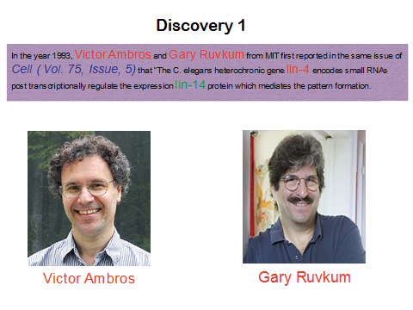
Discovery 1: 1993
Discovery 2: 1998

Slide 4
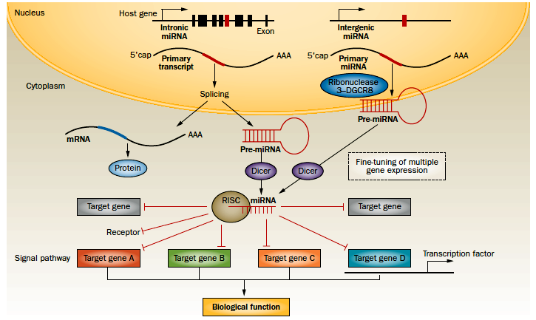
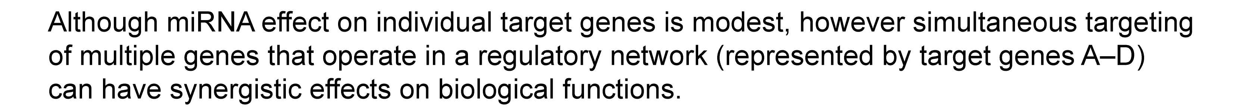
Macro view of microRNA Function

Slide 5
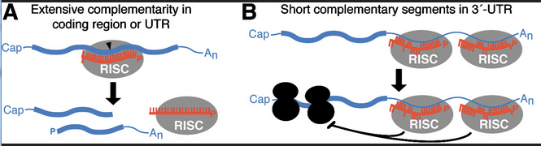
Mechanism of miRNA Function

Slide 6
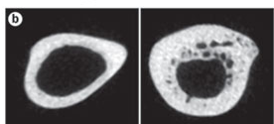
MicroRNA: Control of Genetic Information
WT
Bone specific
Dicer KO
Loss-of-function of mature miRNAs in this population results in increased bone mass potentially by relieving repression of Runx2 miRNAs (n = 11) and collagen protein levels. Courtesy of J. B. Lian and MQ Hassan, University of Massachusetts Medical School, USA.
Gaur et al. 2010
Reviews
Kapinas & Delaney 2011
Taipaleenmaki & Kassem 2012
Lian et al Nature Rev Endo 2012

Slide 7
Osteoarthritis

Slide 8
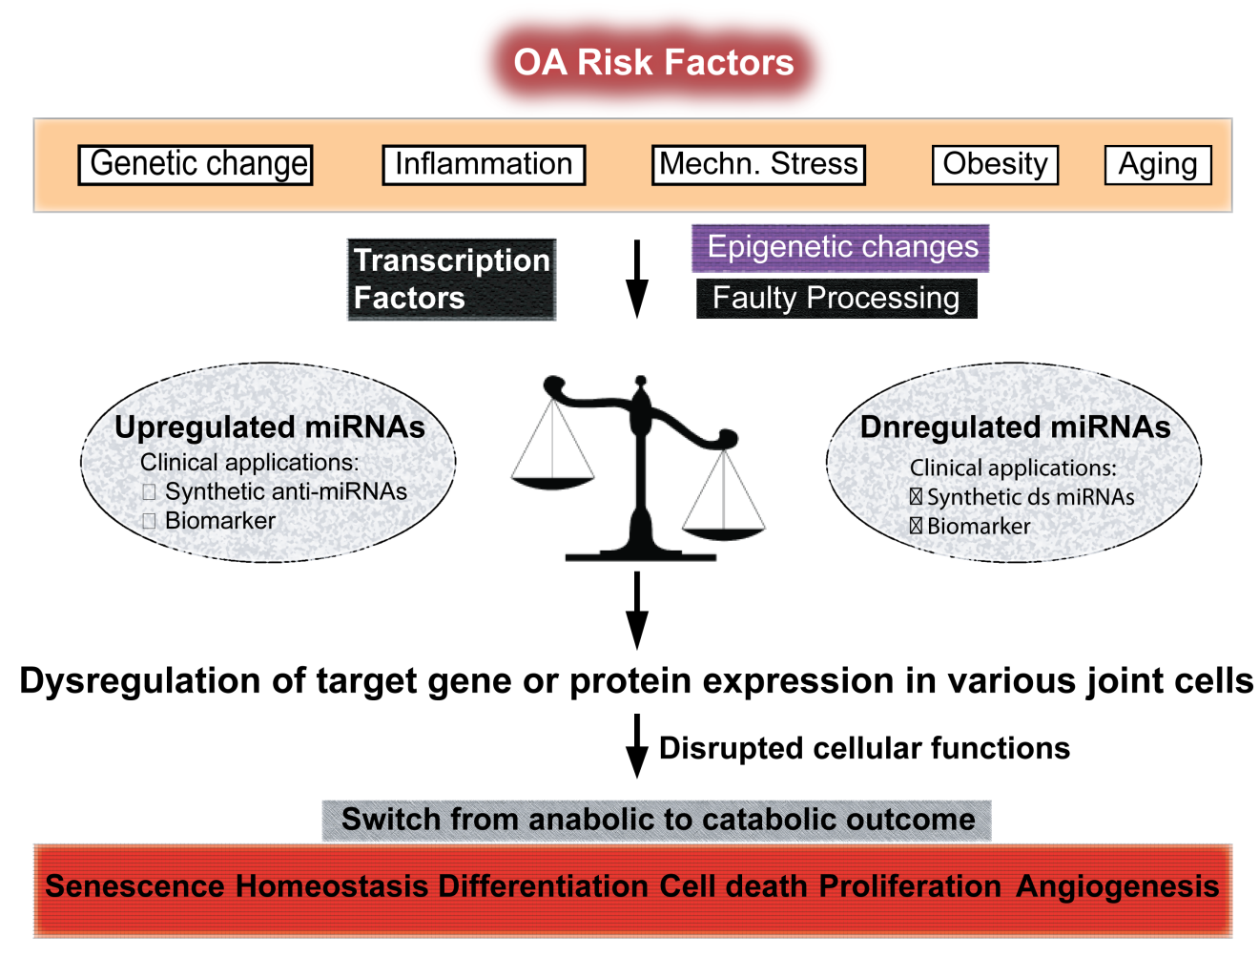
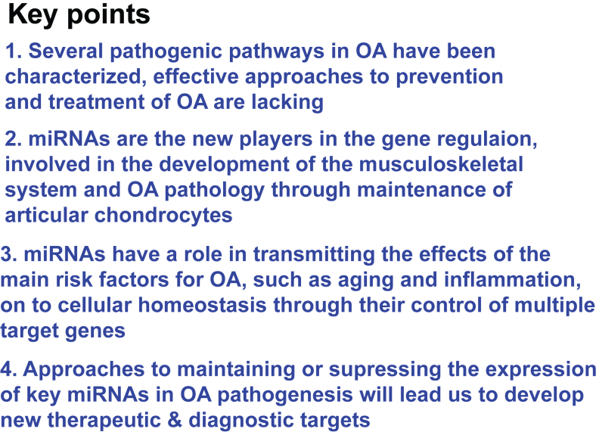
Miyaki and Asahara, Nat. Reviews Rheumatology, 2012

Slide 9
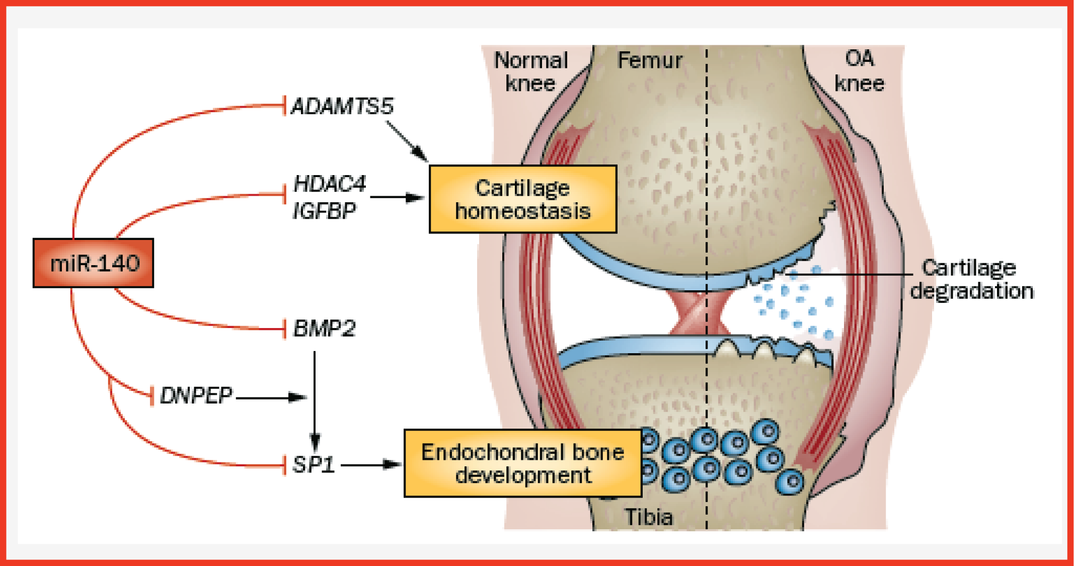
miR-140 and Joint health

Slide 10
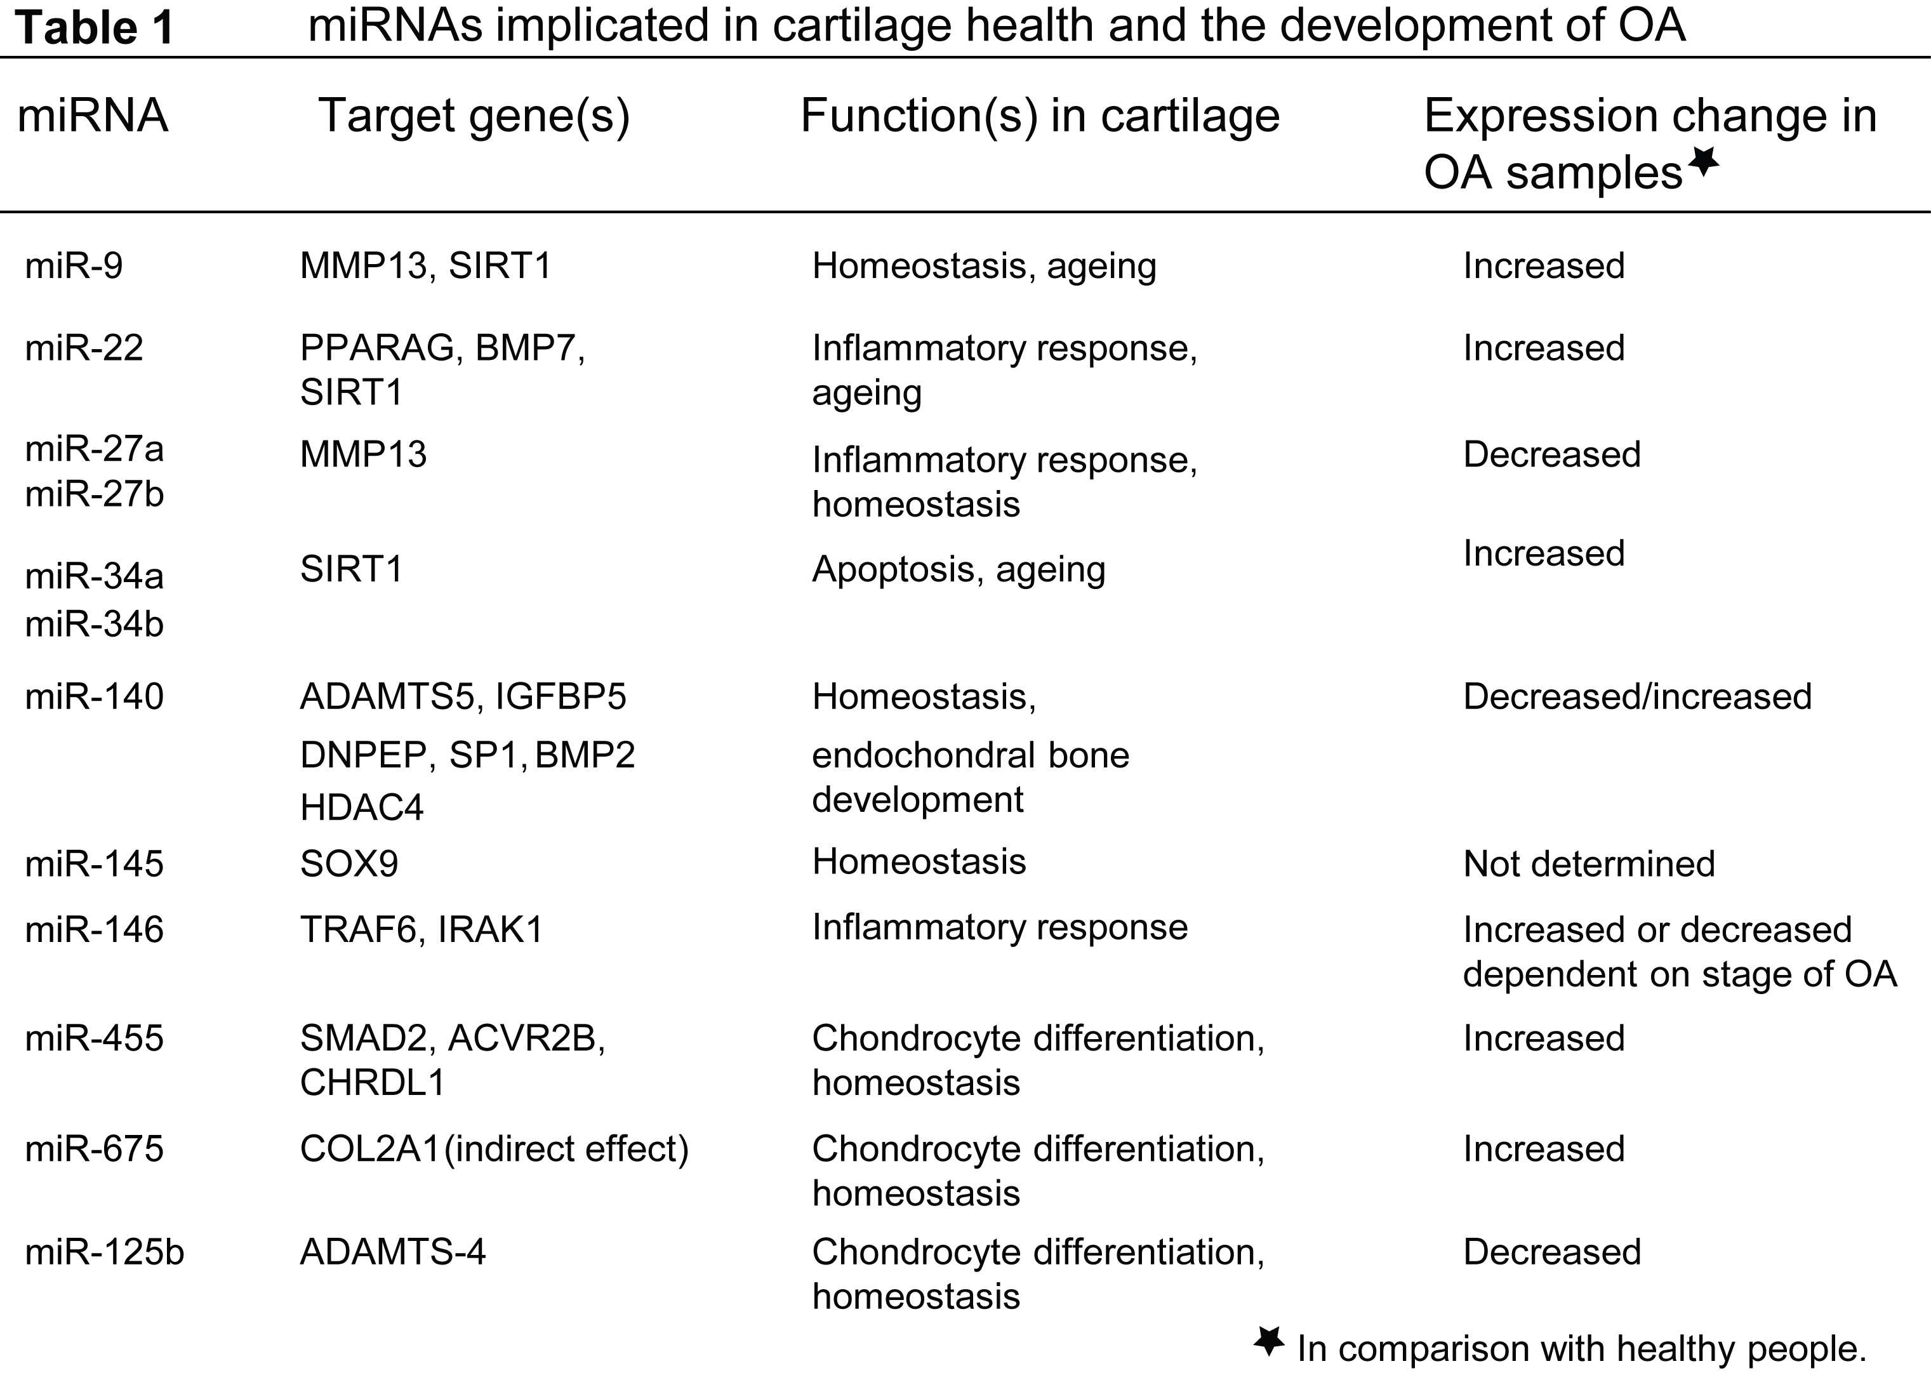

Slide 11
Synovial fluid miRNA analysis

Slide 12
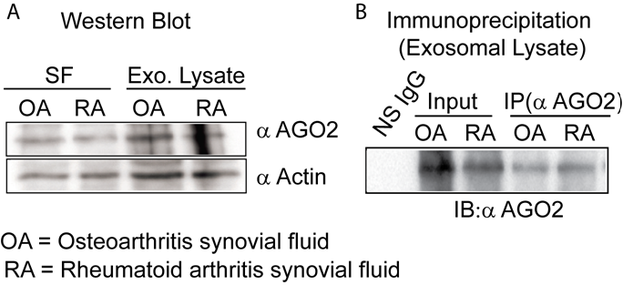
MicroRNAs are present in osteoarthritic synovial fluid

Slide 13
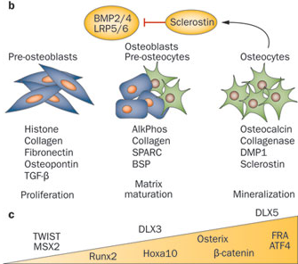
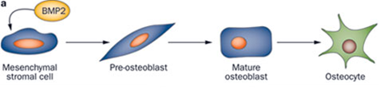
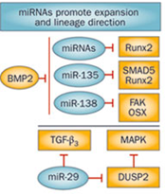
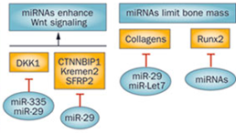
Osteoblast differentiation and effect of microRNAs on osteoblast differentiation

Slide 14
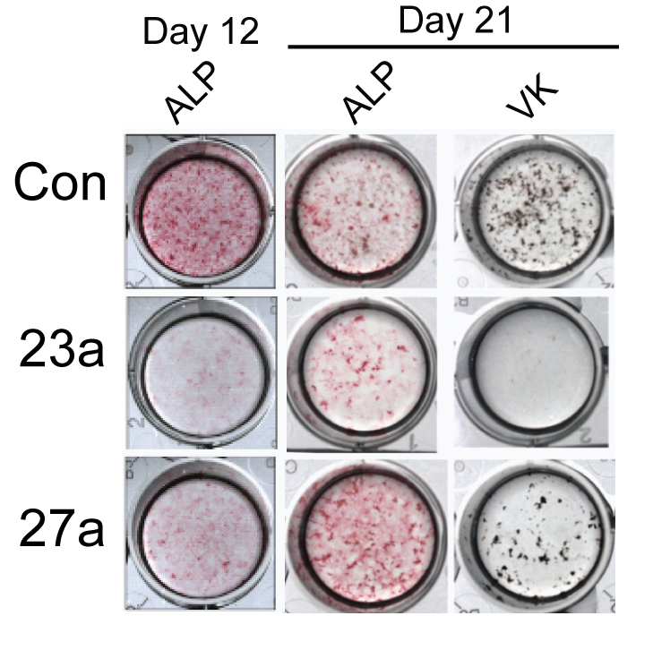
A network connecting Runx2, SATB2 and the miR-23a cluster regulates the osteoblast differentiation program.

Slide 15
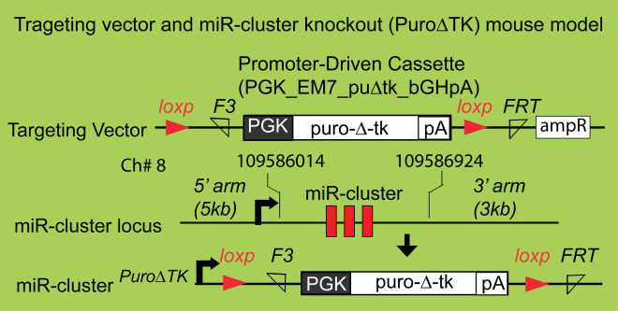
In vivo deletion of the miR-23a cluster: The PuroΔTK primary mouse model

Slide 16
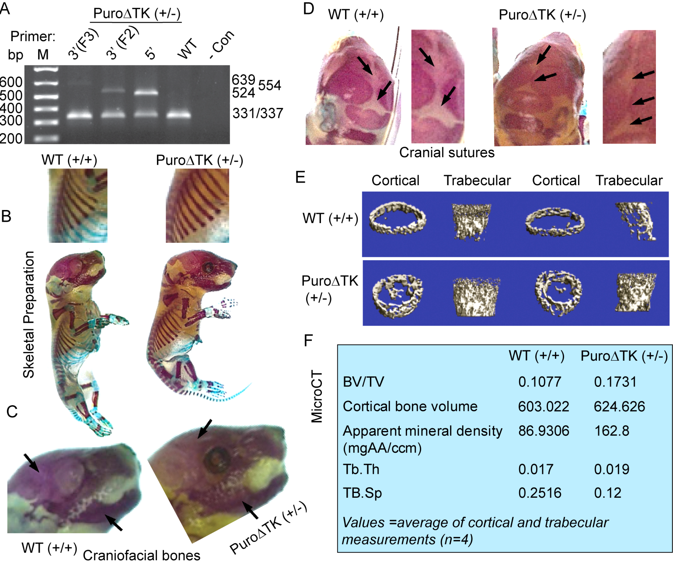
MiR-23a Cluster global Knockout Displayed High Bone Mass

Slide 17
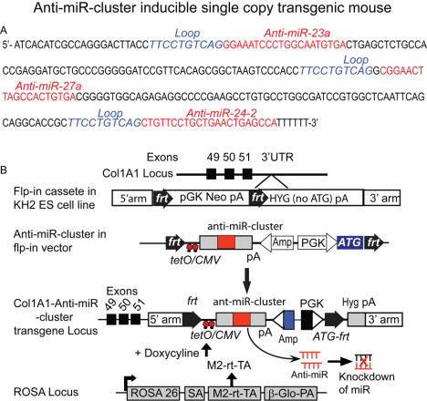

Slide 18
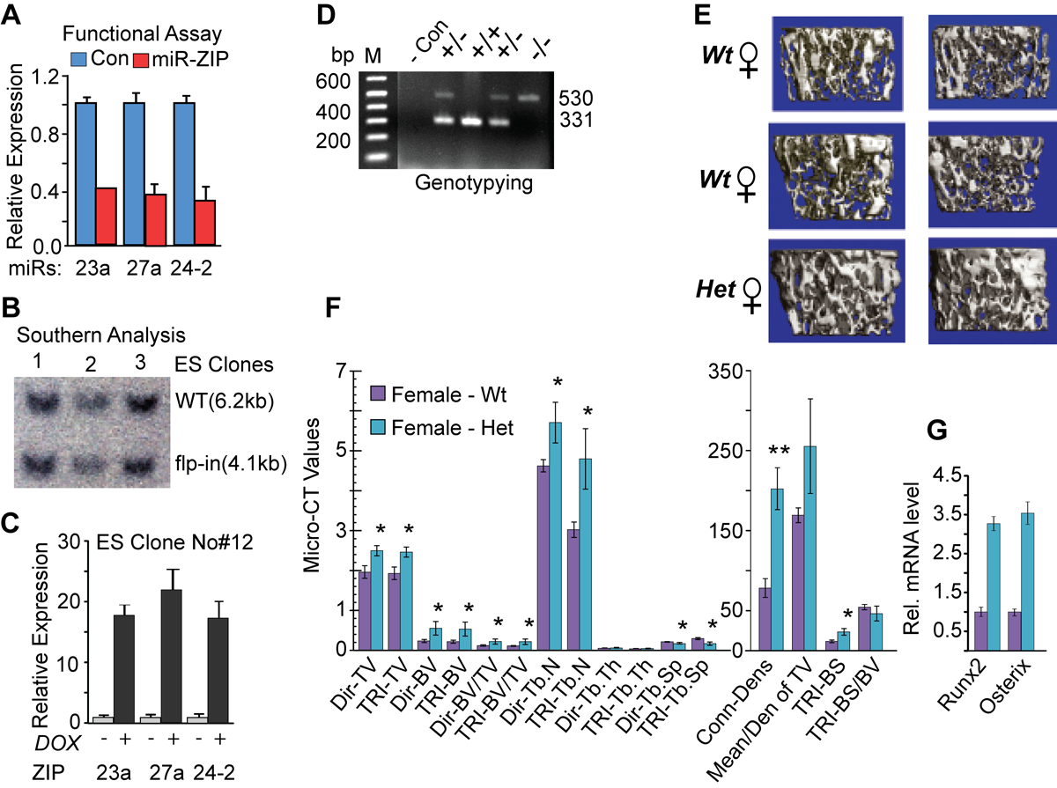
MiR-23a Cluster Knockdown Displayed High Bone Mass

Slide 19
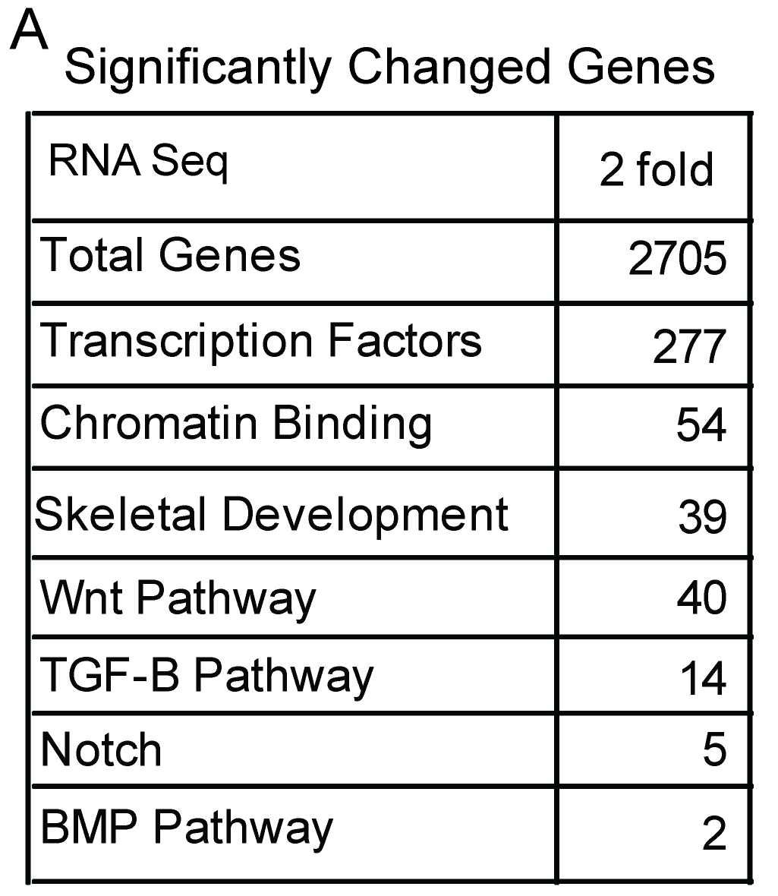
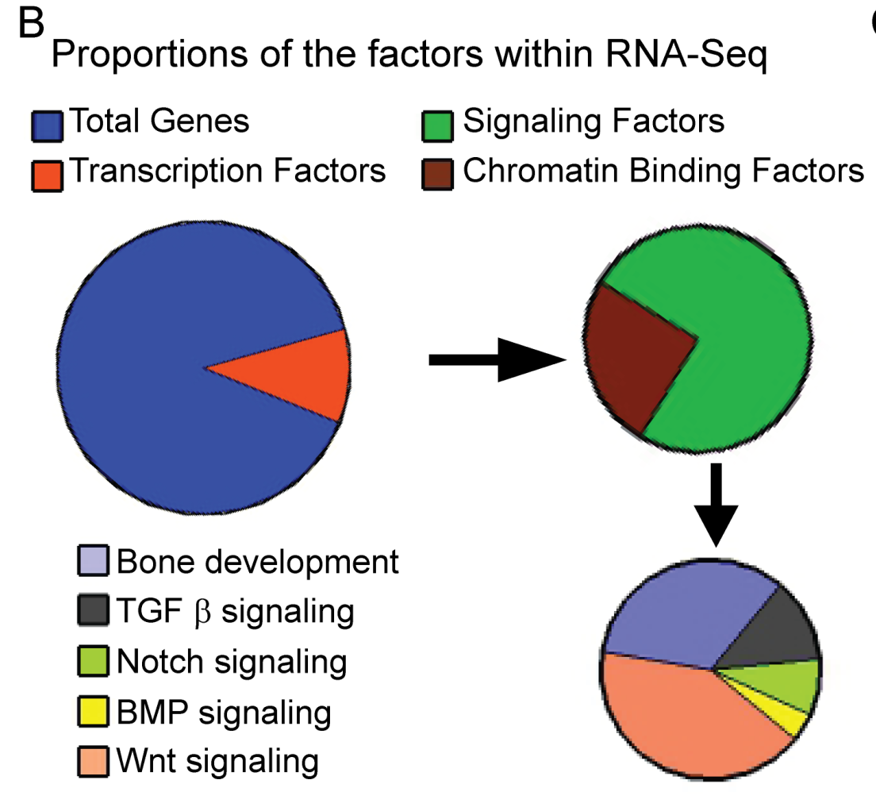
High-throughput RNA sequencing and targets for miR-23a cluster

Slide 20
Key chromatin binding factors analysis in miR-23a cluster knock down het mice

Slide 21
Key factors confirmed by three different analysis

Slide 22
Conclusion:
MiR-23a cluster knockdown mice have high bone mass phenotypes.
MiR-23a cluster deregulates osteoblast growth and inhibits osteoblast differentiation in vitro and in vivo.
MiR-23a cluster regulates the expression of the chromatin remodeling factors, crucial for bone formation and development.
This tiny biologically processed RNA represses gene expression and represents a power approach for treating skeletal disorders including osteoporosis and osteoarthritis.

Slide 23
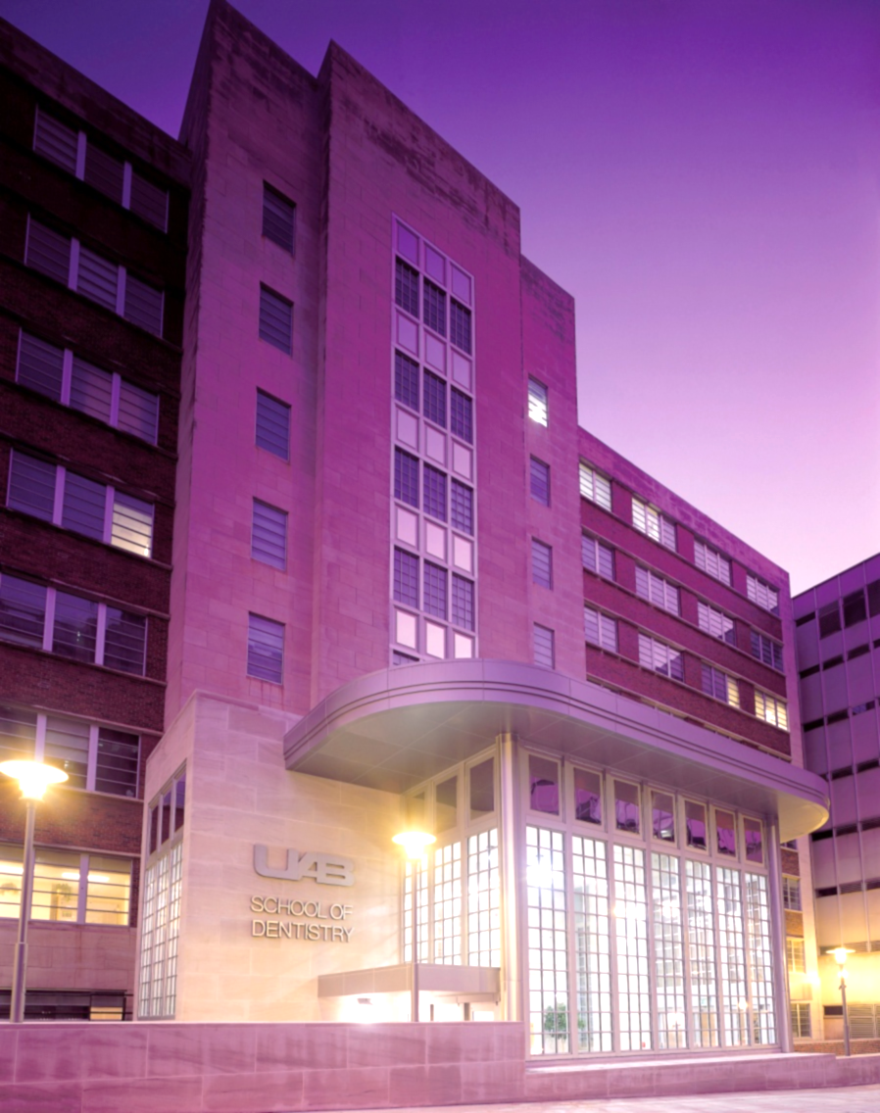

Sincere Thanks to…..
UAB School of Dentistry
Michael S Reddy, DMD, DMSc
Mary J MacDougall, PhD
Peter D Waite, D.D.S., M.D
Lab members:
Hannah Heair
Austin Kemper
Helena Lopes
NIDCR
Collaborators:
Bob Kesterson, Ph.D.
Director, Transgenic Mouse Facility
Michael R Crowley, PhD
Genetics Research Div.

