Slide 1
Rapid accelerated Hemodialysis in Children with End Stage renal Disease, randomized clinical trial on its anticoagulant role and effects on the efficiency
Mohamed Khaled El Hatw
(M.D. Pediatrics), (MPH, Liverpool)
Pediatric Consultant; NAAFH, Saudi Arabia
Pediatric Nephrology Consultant; Cairo University Children Hospital
Notes:
What is an invention? An Invention is a new product that performs a new function
2) Types of the AHD lines ?
According to the mode of control of differential blood flow rate:
Type [AHD] No mode of control
Type [ AHD-V] Valve (s) in the patient and recirculation line.
Type [AHD-PR] A blood pump in the Patient segment of the arterial line & Additional pump in the recirculation line
.

Slide 2
Rapid accelerated Hemodialysis in Children with End Stage renal Disease, randomized clinical trial on its anticoagulant role and effects on the efficiency
Mohamed Khaled El Hatw (MD),
Fatina Fadel (MD)
Ramzy El Baroudy (MD)
Notes:
What is an invention? An Invention is a new product that performs a new function
2) Types of the AHD lines ?
According to the mode of control of differential blood flow rate:
Type [AHD] No mode of control
Type [ AHD-V] Valve (s) in the patient and recirculation line.
Type [AHD-PR] A blood pump in the Patient segment of the arterial line & Additional pump in the recirculation line
.

Slide 3
Introduction

Slide 4
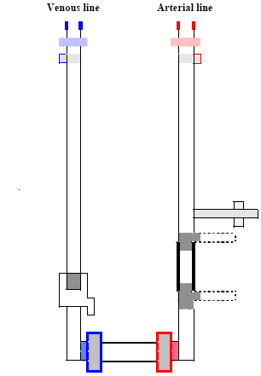
Introduction
Heparin
Routine heparin DNHD.
Increasing the blood flow rate (BFR) is a recommended strategy to improve efficiency of hemodialysis and to prevent blood clotting.
Rapid BFR “low dose heparin” and "no heparin" hemodialysis can achieve anticoagulation with low risk of anticoagulants induced bleeding, especially in patients with bleeding tendency. ^{1,2}

Slide 5
Introduction
Heparin
Routine heparin DNHD.
Without increasing the BFR, system coagulation occurred in no heparin dialysis in 13 of 296 (4 %) adults ³ and in 7 out of 28 (25 %) children. ⁴
Increasing the BFR carries the risk of heart failure and hypotension, especially in children, which might result in the interruption of treatment ¹

Slide 6
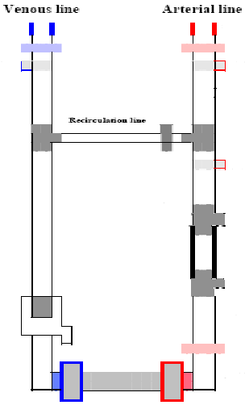
Introduction
AHD
Accelerated hemodialysis (AHD) is a hemodialysis technique where partial blood recirculation is used to selectively accelerate the BFR in the filter compared to the patient BFR

Slide 7
Introduction
Routine BFR
Selective Increase
R - AHD
Rapid accelerated hemodialysis (R-AHD) indicates that partial recirculation selectively increases the filter BFR.
PBR was reported by (1) Emura et al. 1985 cited in Yuji, 2008 ⁵ in hemodialysis sessions to achieve low-dose heparinization and by (2) El Hatw, 1999 ⁶ in 10 R-AHD sessions.

Slide 8
Introduction
Selective Decrease
Routine BFR
S - AHD
Slow accelerated hemodialysis (S-AHD) indicates selective reduction of the patient BFR. It was reported by (1) Brendolan et al, 1994 cited in (Yuji, 2008) ^{5,} who called it "double pass hemodialysis". (2) El Hatw, in 1999⁶ reported five S-AHD sessions for one patient with a patient BFR of 65 ml/minute and a recirculation BFR of 65 ml/ minute and (3) El Hatw et al ⁷ reported in 2007 65 Long S-AHD sessions, 8 hours each, for 5 patients and lastly (4) Yuji in 2008 ⁵ reported a case of continuous hemodiafilteration (CHDF) with unstable patient BFR and a recirculation BFR of 30 ml/ minute.

Slide 9
Introduction
AHD Connections
AHD is carried out through H shaped AHD connections.
The 2 vertical lines of the “H” are the inflow (arterial) blood line that drains blood from the vascular access to the dialyser, and the outflow (venous) blood line that returns blood from the dialyser back to the vascular access ¹⁰.
Notes:
Accelerated hemodialysis (AHD) ^{8, 9} is carried out through H shaped AHD connections.
The 2 vertical lines of the “H” are the inflow (arterial) blood line that drains blood from the vascular access to the dialyser, and the outflow (venous) blood line that returns blood from the dialyser back to the vascular access ¹⁰.

Slide 10
Introduction
AHD Connections
AHD is carried out through H shaped AHD connections.
The 2 vertical lines of the “H” are the inflow (arterial) blood line that drains blood from the vascular access to the dialyser, and the outflow (venous) blood line that returns blood from the dialyser back to the vascular access ¹⁰.
Notes:
Accelerated hemodialysis (AHD) ^{8, 9} is carried out through H shaped AHD connections.
The 2 vertical lines of the “H” are the inflow (arterial) blood line that drains blood from the vascular access to the dialyser, and the outflow (venous) blood line that returns blood from the dialyser back to the vascular access ¹⁰.

Slide 11
Introduction
AHD Connections
(2) The recirculation line (R) forms the transverse limb of the H and divides the arterial line into the filter segment (Fª) and the patient segment (Pª) of the arterial line and divides the venous line into the filter segment (F^{v}) and the patient segment (P^{v}) of the venous line.

Slide 12
Introduction
AHD⁰ Connections
AHD^{V} Connections
AHD^{PR} Connections
AHD^{FR} Connections
AHD^{FP} Connections
AHD connections are available in 5 models; named according to the mode of control BFR of its different parts.

Slide 13
Introduction
AHD⁰ Connections
AHD^{V} Connections
AHD^{PR} Connections
AHD^{FR} Connections
AHD^{FP} Connections
Model AHD⁰ has a single blood pump the filter portion of the arterial line (Fª)

Slide 14
Introduction
AHD⁰ Connections
AHD^{V} Connections
AHD^{PR} Connections
AHD^{FR} Connections
AHD^{FP} Connections
Model AHD^{V} has a single blood pump segment at the filter portion of the arterial line (Fª) in addition to 2 valves at the recirculation line (R) and the patient segment of the arterial line (Pª)

Slide 15
Introduction
(Pª)
(R)
AHD⁰ Connections
AHD^{V} Connections
AHD^{PR} Connections
AHD^{FR} Connections
AHD^{FP} Connections
Model AHD^{PR} has one pump at Patient segment of arterial line (Pª) & the second at the recirculation line (R)

Slide 16
Introduction
(R)
(Fª)
AHD⁰ Connections
AHD^{V} Connections
AHD^{PR} Connections
AHD^{FR} Connections
AHD^{FP} Connections
Model AHD^{FR} has one pump at Filter segment of arterial line (Fª) & the second at the recirculation line (R)

Slide 17
Introduction
(Pª)
(Fª)
AHD⁰ Connections
AHD^{V} Connections
AHD^{PR} Connections
AHD^{FR} Connections
AHD^{FP} Connections
Model AHD^{FP} has one pump at Filter segment of arterial line (Fª) & the second at the Patient segment of the arterial line (Pª)

Slide 18
Introduction
(P^{v})
(Pª)
Closed Circuit AHD
Closing the patient segment of the arterial line (Pª) and of the venous line (P^{v}) clamps during the AHD session will create a closed circuit involving the (R), (Fª), the filter and (F^{v}) and allow adjustment of the bypassed fistula needles by the operator.

Slide 19
Introduction
Patent no. 21587 Egyptian patent office
The AHD connections are registered inventions by El hatw in the Egyptian patent office ⁸ and the USA patent office ⁹.

Slide 20
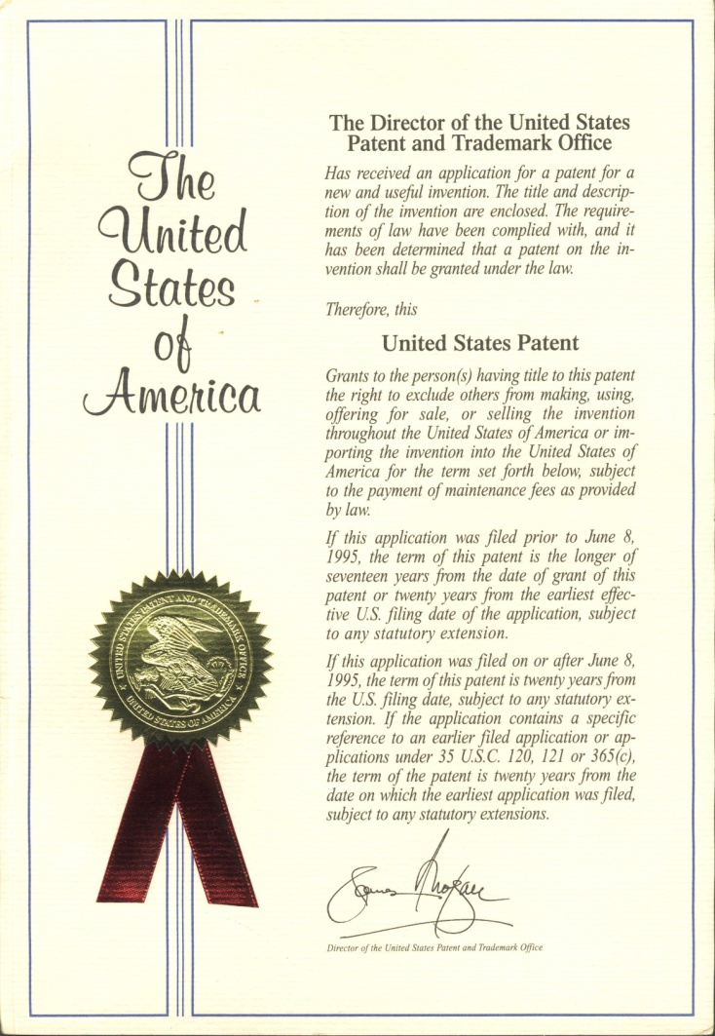
Introduction
Patent no. 6610027 USPTO
The AHD connections are registered inventions by El hatw in the Egyptian patent office ⁸ and the USA patent office ⁹.

Slide 21
Objectives

Slide 22
Objectives
Objectives: Assess R-AHD with regards to anticoagulation effect and effect on the dialysis efficiency.

Slide 23
Objectives
(Pª)
(Pª)
(R)
(R)
(Fª)
(Fª)
AHD⁰ Connections
AHD^{V} Connections
AHD^{PR} Connections
AHD^{FR} Connections
AHD^{FP} Connections
The main objectives of this study were to
(1) Explore the 5 different models of AHD connections with regards to their ability to decrease the heparin dose during hemodialysis and their effect on the dialysis efficiency.

Slide 24
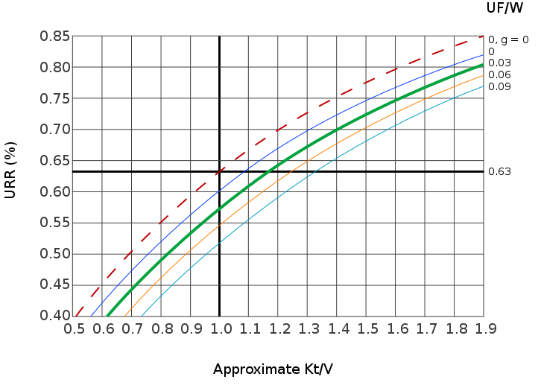
Objectives
The main objectives of this study were to
(1) Explore the 5 different models of AHD connections with regards to their ability to decrease the heparin dose during hemodialysis and their effect on the dialysis efficiency.

Slide 25
Objectives
The main objectives of this study were to
(1) Explore the 5 different models of AHD connections with regards to their ability to decrease the heparin dose during hemodialysis and their effect on the dialysis efficiency.

Slide 26
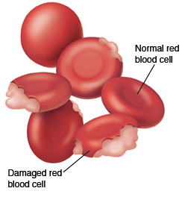
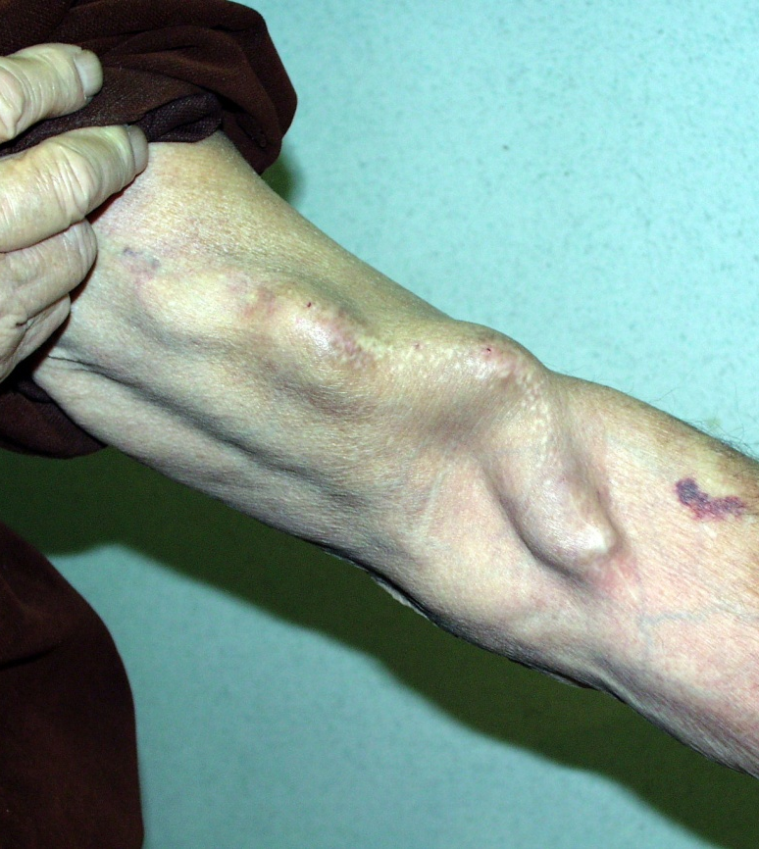
Objectives
RBCs Integrity
AV Fistula Integrity
Hollow Fiber In
(2) Test safety of R-AHD on the integrity of the Red Blood Cells (RBCs), the arteriovenous (A-V) fistula and the hollow fibers of the filter.

Slide 27
Objectives
RBCs Integrity
AV Fistula Integrity
Hollow Fiber In
(2) Test safety of R-AHD on the integrity of the Red Blood Cells (RBCs), the arteriovenous (A-V) fistula and the hollow fibers of the filter.

Slide 28
Objectives
RBCs Integrity
AV Fistula Integrity
Hollow Fiber In
(2) Test safety of R-AHD on the integrity of the Red Blood Cells (RBCs), the arteriovenous (A-V) fistula and the hollow fibers of the filter.

Slide 29
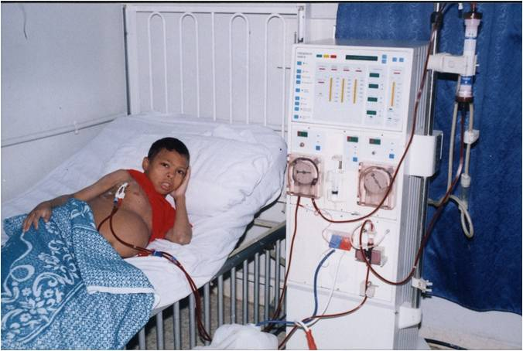
Objectives
Clinical Feasibility
(3) Assess the clinical feasibility of carrying out and maintaining children with end Stage renal disease (ESRD) on R-AHD.

Slide 30
PATIENTS & METHODS

Slide 31
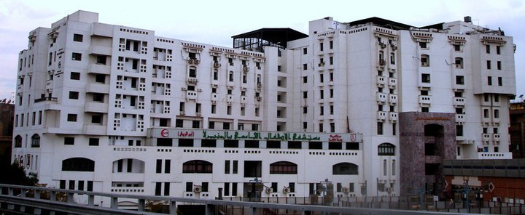
Methods - Setting and Study design
This study was carried out at Cairo University Children's Hospital, a quaternary referral urban hospital in Egypt. The hospital operates a hemodialysis unit with 25 hemodialysis machines.

Slide 32
Methods - Setting and Study design
The trial was part of a project to study “the outcomes of the invention AHD connections sponsored by the academy of Scientific Research, Egypt. where hydraulic and experimental studies preceded the clinical trial in addition to a clinical trial on S-AHD.

Slide 33
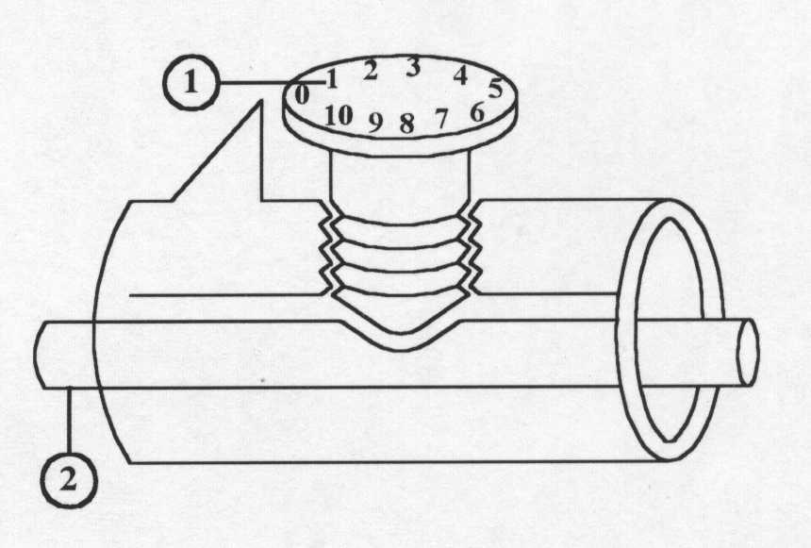
Methods - Setting and Study design
The hydraulic study of the project included calibration of the valve of AHD^{V} connections and development of a new instrument for measurement of the patient BFR in the (Pª) during AHD⁰ and AHD^{V} sessions called “air bubble speed”; whereby the patient BFR rate is estimated from the time needed for an air bubble injected at the injection site of (Pª) to reach the junction of (Pª) and (R).

Slide 34
Methods - Setting and Study design
The proposal of the project was revised, modified and finally approved by
The scientific committee of the sponsoring governmental non profit organization “Academy of scientific research and technology” and by
The scientific committee of the pediatric department of Cairo University hospital where the trial was conducted.

Slide 35
Methods - Setting and Study design
The report of the project was disclosed, but not published, in 2006 ¹¹ and the clinical trial on S-AHD was published in 2007⁷.

Slide 36
Methods - Setting and Study design
Quantitative
RCT
Open
Prospective
Exploratory
The clinical trial was
Quantitative
Exploratory: It explored the feasibility, benefits & drawbacks of carrying R-AHD using 5 models of the invented AHD connections.
Prospective
Randomized, Controlled
Open to the operators and to the patients as blinding the intervention was impossible but the blood tests were blindly assessed outcomes.
The primary and secondary endpoints were objective.

Slide 37
Methods - Setting and Study design
R - AHD⁰
R - AHD^{V}
R - AHD^{PR}
R - AHD^{FR}
R – AHD^{FP}
Each Stage of the clinical trial was intended to study R-AHD, using one of the 5 models of AHD connections.

Slide 38
Methods - Setting and Study design
R - AHD⁰
R - AHD^{V}
R - AHD^{PR}
R - AHD^{FR}
R – AHD^{FP}
1) R-AHD^{V} Stage was aborted due to difficulties in adjusting the manual valve in a clinical session

Slide 39
Methods - Setting and Study design
R - AHD⁰
R - AHD^{V}
R - AHD^{PR}
R - AHD^{FR}
R – AHD^{FP}
(2) R-AHD^{FR} and the R-AHD^{FP} Stages were aborted due to a threat of air embolism as the blood pump attached to (Fª) while returning blood to the patient at the end of the session.

Slide 40
Methods - Setting and Study design
R - AHD⁰
R - AHD^{V}
R - AHD^{PR}
R - AHD^{FR}
R – AHD^{FP}
Two AHD models were ultimately studied
R-AHD⁰ sessions in Stage 1 and
R-AHD^{PR} sessions in Stage 2.

Slide 41
Methods - Setting and Study design
Stage 1
Stage 2
Sub Stage 1
Sub Stage 2
Sub Stage 3
Sub Stage 1
Sub Stage 2
Sub Stage 4
Sub Stage 3
Each Stage was carried out in sequential sub-Stages of a particular Hemodialysis session designed to answer a particular research question.
At the end of each Stage an interim analysis was done and recommendations for the coming Stage were given.

Slide 42
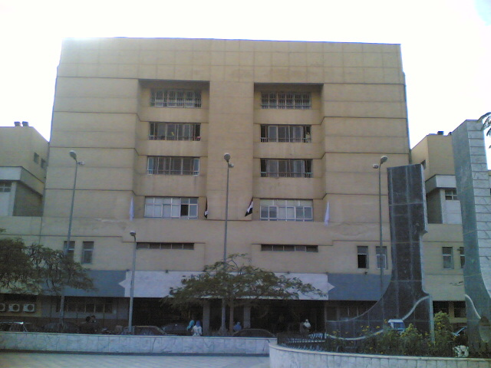
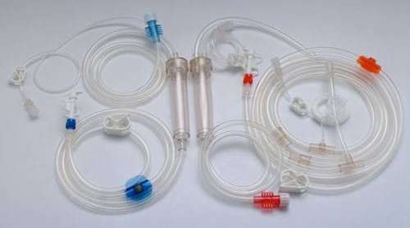
Methods - Materials
Connections were manufactured with a special order by Hydalina Medical© company, Egypt, from the same material as the traditional connections. The cost was around 2.7 $ , per piece, compared to 1.8 per piece for the standard connections. Model AHD^{V} was assembled by adding 2 external valves at (R) and (Pª) to model AHD^{0.}

Slide 43
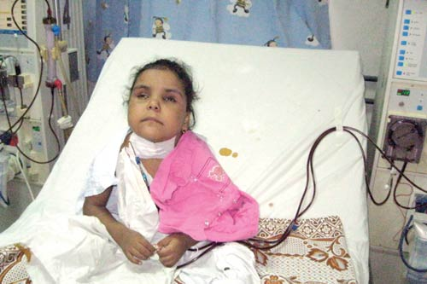
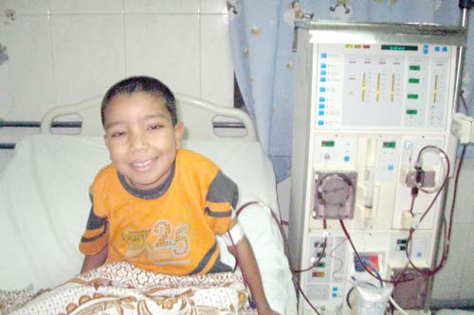
Methods - Methods and Patient allocation
Criteria for Inclusion:
Children were included in the trial if:
They had ESRD
Were on routine hemodialysis for at least 3 months
Had stable general condition
No associated major cardiovascular or neurological illness
They and their parents were willing to be included in the trial.

Slide 44
Methods - Methods and Patient allocation
Sampling
Ten children with ESRD were randomized to be enrolled in the trial using a random-number table. Children who fulfilled the selection criteria were allocated in 2 sequential Stages. Informed Verbal consent was obtained.

Slide 45
Methods - Methods and Patient allocation
Out of around 50 children with ESRD on a chronic hemodialysis program, 10 children were enrolled in the study. The 10 children (6 boys and 4 girls) aged 8 - 16 years (mean= 10.93 years) with a dry body weight 15.5 - 26.6 kilogram (mean =22.14 kilogram). They were on the chronic hemodialysis program for 0.7 to 3.5 years (mean= 2.05 years). Dialysis was done using Freseinus hemodialysis filter. The session time was 3-3.5 hours (mean =3.2 hours).

Slide 46
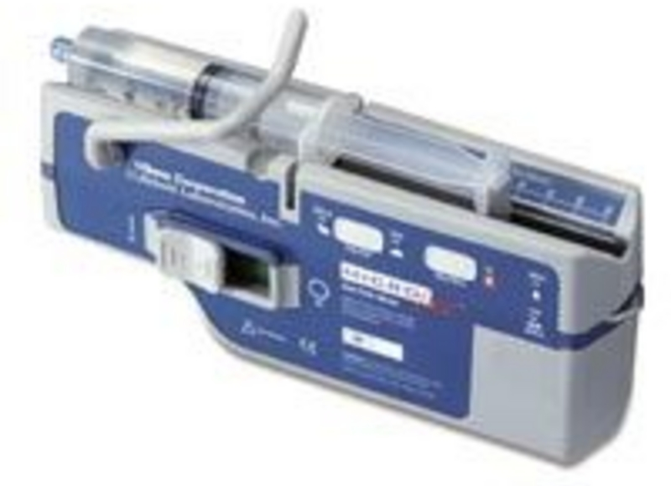
Methods - Methods and Patient allocation
No heparin R-AHD^{PR} | Half heparin | Routine heparin
Just flush | 0.1 units/kg/minute | 0.2 units/kg/minute
In this article ;
“Routine heparin” indicates a dose of 0.2 units/kg/minute.
“Half heparin” indicates a dose of 0.1 units/kg/minute.
“No heparin R-AHD^{PR}” indicates sessions without the use of heparin but the circuit was regularly flushed with normal saline.

Slide 47
Stage 1

Slide 48
Methods - Methods and Patient allocation
R - AHD⁰
Stage 1 (R-AHD⁰) was carried out using the AHD⁰ connections

Slide 49
Methods - Methods and Patient allocation
AHD⁰ connections were connected to a calibrated single blood pump Fresenius 4008B® hemodialysis machines.

Slide 50
Methods - Methods and Patient allocation
Target Patient BFR
Target Patient BFR X 3
R - AHD⁰
The blood pump speed was initially adjusted to 3 folds the target patient BFR ,as the average patient/filter fluid flow rate of R-AHD⁰ in vitro was 1:3

Slide 51
Methods - Methods and Patient allocation
R - AHD⁰
The blood pump speed was then readjusted guided by the speed of an air bubble through the patient portion of the arterial line as previously described by EL Hatw in 2006¹¹.

Slide 52
Methods – Stage 1
Heparin
Heparin
Heparin
Heparin
In Stage 1, the ten children passed 4 sequential sub-Stages
Stage 1d | Stage 1c | Stage 1b | Stage 1a
Routine heparin | Routine heparin | Half heparin | Routine heparin
DNHD sessions | R-AHD⁰ sessions | R-AHD⁰ sessions | R-AHD⁰ sessions
One month of trice weekly sessions for 10 children (Control) | One month of trice weekly sessions for 10 children (Total = 145 Sessions) | 10 children were treated with 10 sessions | 10 children were treated with 10 sessions
At the end of the month URR, HB% and HT were measured. | At the end of the month URR, HB% and HT were measured. | Urea Reduction Ration (URR) of each session was measured | Urea Reduction Ration (URR) of each session was measured

Slide 53
Methods - Stage 1
Heparin
Heparin
Heparin
Heparin
Stage 1d | Stage 1c | Stage 1b | Stage 1a
Routine heparin | Routine heparin | Half heparin | Routine heparin
DNHD sessions | R-AHD⁰ sessions | R-AHD⁰ sessions | R-AHD⁰ sessions
10 children were treated with trice weekly for 1 Mo. | 10 children were treated with trice weekly for ≈ 1 Mo (Total = 145 Sessions) | 10 children were treated with 10 sessions | 10 children were treated with 10 sessions
Efficiency of the AHD; was studied by comparing the URR in R-AHD⁰ (Stage 1a,b) and in DNHD sessions (Stage 1d) measured in the same patient. URR carries a possibility errors in calculating efficiency due to errors in post dialysis sampling or due to residual renal function.

Slide 54
Methods - Stage 1
BUN_{pre}
BUN_{post}
BUN_{pre}
BUN_{post}
Heparin
Heparin
R-AHD⁰ session
Stage 1a,b
DNHD session
Stage 1d
URR = BUN_{pre} – BUN_{post} / BUN_{pre} X 100
Urea reduction ratio of the tested session that was calculated as:
URR = Arterial BUN before the session – Arterial BUN after the session / Arterial BUN before the session X 100
Notes:
The primary endpoint with respect to efficacy of the "R-AHD⁰ sessions" and the "DNHD sessions" was the (URR) of the tested session that was calculated as
[URR = BUN_{pre} – BUN_{post} / BUN_{pre} X 100] , where
(BUN_{pre}) was the Blood Urea Nitrogen (BUN) before the session and
(BUN_{post}) was the BUN after the session.

Slide 55
Methods - Stage 1
Heparin
Heparin
Heparin
Heparin
Stage 1d | Stage 1c | Stage 1b | Stage 1a
Routine heparin | Routine heparin | Half heparin | Routine heparin
DNHD sessions | R-AHD⁰ sessions | R-AHD⁰ sessions | R-AHD⁰ sessions
10 children (Controls) trice weekly for 1 Mo. | 10 children trice weekly for ≈ 1 Mo (Total = 145 Sessions) | 10 children were treated with 10 sessions | 10 children were treated with 10 sessions
(B) The Anticoagulant effect of the AHD was studied by comparing incidence of blood clotting in : The "Routine heparin R-AHD⁰“ (Stage 1a) and "½ dose heparin R-AHD⁰" sessions (Stage 1b) .
Notes:
Anticoagulant effect of the AHD was studied by comparing the "Routine heparin R-AHD⁰“ (Stage 1a) and "½ dose heparin R-AHD⁰" sessions (Stage 1b) . The long clotting time before starting the sessions indicates that the used "Routine dose heparin was actually a "high dose" of heparin with a prolonged residual anticoagulant effect.

Slide 56
Methods - Stage 1
Heparin
Heparin
Heparin
Heparin
Stage 1d | Stage 1c | Stage 1b | Stage 1a
Routine heparin | Routine heparin | Half heparin | Routine heparin
DNHD sessions | R-AHD⁰ sessions | R-AHD⁰ sessions | R-AHD⁰ sessions
10 children (Controls) trice weekly for 1 Mo. | 10 children trice weekly for ≈ 1 Mo (Total = 145 Sessions) | 10 children were treated with 10 sessions | 10 children were treated with 10 sessions
The long clotting time before starting the sessions indicates that the used "Routine dose heparin was actually a "high dose" of heparin with a prolonged residual anticoagulant effect.
Notes:
Anticoagulant effect of the AHD was studied by comparing the "Routine heparin R-AHD⁰“ (Stage 1a) and "½ dose heparin R-AHD⁰" sessions (Stage 1b) . The long clotting time before starting the sessions indicates that the used "Routine dose heparin was actually a "high dose" of heparin with a prolonged residual anticoagulant effect.

Slide 57
Methods - Stage 1
Heparin
Heparin
Heparin
Heparin
Stage 1d | Stage 1c | Stage 1b | Stage 1a
Routine heparin | Routine heparin | Half heparin | Routine heparin
DNHD sessions | R-AHD⁰ sessions | R-AHD⁰ sessions | R-AHD⁰ sessions
10 children (Controls) trice weekly for 1 Mo. | 10 children trice weekly for ≈ 1 Mo (Total = 145 Sessions) | 10 children were treated with 10 sessions | 10 children were treated with 10 sessions
(C) The safety and efficiency of using R-AHD^{O} for chronic dialysis, (the clinical feasibility) was studied by comparing HB% and URR after: One month of R-AHD^{O} (Stage 1c) & One month of DNHD (Stage 1d)

Slide 58
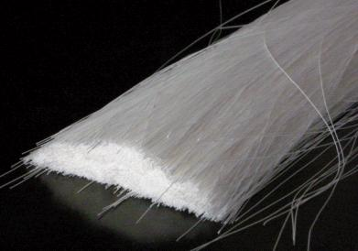
Methods - Stage 1
A-V fistula Integrity
Hollow fibers integrity
Drop of HB
The primary endpoint with respect to safety of using a high filter BFR were
Maintaining integrity of the A-V fistula
Absence of blood leak alarms reflects integrity of the hollow fibers during the sessions
Measuring the drop of HB after one month of trice weekly sessions.

Slide 59
Methods - Stage 1
URR
HB - HT
URR
HB - HT
Heparin
Heparin
R-AHD⁰ session
Stage 1c
DNHD session
Stage 1d
To assess the clinical feasibility of maintaining children with ESRD on routine R-AHD sessions, URR, HB% and HT were measured for each patient after one month of R-AHD⁰ sessions and after one month of DNHD sessions.
Notes:
The primary endpoint with respect to efficacy of the "R-AHD⁰ sessions" and the "DNHD sessions" was the (URR) of the tested session that was calculated as
[URR = BUN_{pre} – BUN_{post} / BUN_{pre} X 100] , where
(BUN_{pre}) was the Blood Urea Nitrogen (BUN) before the session and
(BUN_{post}) was the BUN after the session.

Slide 60
Methods - In Stage 1, the ten children passed 4 sequential sub-Stages
Heparin
Heparin
Heparin
Heparin
Stage 1d | Stage 1c | Stage 1b | Stage 1a
Routine heparin | Routine heparin | Half heparin | Routine heparin
DNHD sessions | R-AHD⁰ sessions | R-AHD⁰ sessions | R-AHD⁰ sessions
10 children (Controls) trice weekly for 1 Mo. | 10 children trice weekly for ≈ 1 Mo (Total = 145 Sessions) | 10 children were treated with 10 sessions | 10 children were treated with 10 sessions
(C) Prove the efficiency and safety of using R-AHD^{O} for chronic hemodialysis by comparing the end of month URR and HB % after 1 month of: R-AHD^{O} (Stage 1c) DNHD (Stage 1d)

Slide 61
Stage 2

Slide 62
Methods - Methods and Patient allocation
(Pª)
(R)
R - AHD^{PR}
Stage 2 was carried using the AHD^{PR} connections.
The patient blood pump speed was adjusted to the target patient BFR.
The recirculation blood pump speed was adjusted to achieve a
Filter blood flow rate, equals the sum of patient and recirculation blood flow rate, of 500 ml/minute.

Slide 63
Methods - Methods and Patient allocation
AHD^{PR} connections were connected to a calibrated double blood pump Fresenius 2008B® hemodialysis machine. The software of this relatively old model allows direct operation and adjustment of the 2nd pump that is used as a recirculation pump.

Slide 64
Methods - Stage 2
Heparin
Heparin
Heparin
DNHD (15 min.)
R – AHD^{FR} (15 min.)
DNHD
Stage 2a
Then DNHD was restored till the end of the session. | 15 minutes of R-AHD⁰ where the recirculation pump was switched on to achieve a sum filter BFR of 500 ml/minute | An initial 15 minutes of DNHD where the recirculation blood pump was switched off to close (R) and the patient BFR was adjusted to 5-10 ml/ kilogram/minute, then

Slide 65
Methods - Stage 2
Heparin
Heparin
No Heparin
Heparin
In Stage 2, the 10 children passed 4 sequential sub-Stages…
Stage 2d | Stage 2c | Stage 2b | Stage 2a
Routine heparin | No heparin | Low heparin | Routine heparin
DNHD sessions | R-AHD^{PR} | Low heparin R-AHD^{PR} | mixed DNHD/AHD^{PR} sessions
10 children were treated with | One patient was treated with 10 subsequent sessions | 8 children were treated with 8 Sessions. | 10 children were treated with 10 Sessions

Slide 66
Methods - Stage 2
Heparin
Heparin
No Heparin
Heparin
In Stage 2, the 10 children passed 4 sequential sub-Stages
Stage 2d | Stage 2c | Stage 2b | Stage 2a
Routine heparin | No heparin | Low heparin | Routine heparin
DNHD sessions | R-AHD^{PR} | Low heparin R-AHD^{PR} | mixed DNHD/AHD^{PR} sessions
10 children were treated with | One patient was treated with 10 subsequent sessions | 8 children were treated with 8 Sessions. | 10 children were treated with 10 Sessions
(A) Stage 2a was designed to study the Efficiency of the R-AHD^{PR} , by comparing F-URR in R-AHD^{PR} period with F-URR in DNHD period in the same session.

Slide 67
Methods - Stage 2
BUN _{arterial}
BUN _{venous}
BUN _{arterial}
BUN _{venous}
Heparin
Heparin
R-AHD^{PR} period
Stage 2a
DNHD period
Stage 2a
F- URR = BUN _{arterial} – BUN _{venous} / BUN _{arterial} X 100
F-URR was is calculated as the difference between the arterial and venous BUN, divided by the arterial BUN, expressed in the percentage . Comparison of F-URR in the 2 periods of the same session overcomes errors due to post-dialysis blood sampling or due to the effect of the residual renal functions that may arise on comparing URR of 2 different sessions.
Notes:
The primary endpoint with respect to efficacy of the "R-AHD⁰ sessions" and the "DNHD sessions" was the (URR) of the tested session that was calculated as
[URR = BUN_{pre} – BUN_{post} / BUN_{pre} X 100] , where
(BUN_{pre}) was the Blood Urea Nitrogen (BUN) before the session and
(BUN_{post}) was the BUN after the session.

Slide 68
Methods - Stage 2
Heparin
Heparin
No Heparin
Heparin
Stage 2d | Stage 2c | Stage 2b | Stage 2a
Routine heparin | No heparin | Low heparin | Routine heparin
DNHD sessions | R-AHD^{PR} | R-AHD^{PR} | mixed DNHD/AHD^{PR} sessions
10 children were treated with | One patient was treated with 10 subsequent sessions | 8 children were treated with 8 Sessions. | 10 children were treated with 10 Sessions
Connections were flushed with normal saline and the dose of the infused heparin throughout the session was adjusted to keep the prothrombin time (PTT) just above 140% of the initial values. Blood clotting data were collected in this session.

Slide 69
Methods - Stage 2
Heparin
Heparin
No Heparin
Heparin
Stage 2d | Stage 2c | Stage 2b | Stage 2a
Routine heparin | No heparin | Low heparin | Routine heparin
DNHD sessions | R-AHD^{PR} | R-AHD^{PR} | mixed DNHD/AHD^{PR} sessions
10 children were treated with | One patient was treated with 10 subsequent sessions | 8 children were treated with 8 Sessions. | 10 children were treated with 10 Sessions
Connections were regularly flushed with normal saline, three times per week for a period of approximately 3 weeks. Blood clotting data were documented.

Slide 70
Methods - Stage 2
Heparin
Heparin
No Heparin
Heparin
Stage 2d | Stage 2c | Stage 2b | Stage 2a
Routine heparin | No heparin | Low heparin | Routine heparin
DNHD sessions | R-AHD^{PR} | R-AHD^{PR} | mixed DNHD/AHD^{PR} sessions
10 children were treated with trice weekly sessions | One patient was treated with 10 subsequent sessions | 8 children were treated with 8 Sessions. | 10 children were treated with 10 Sessions
The total dose of heparin was measured. Arterial and venous samples were taken simultaneously to measure BUN _{arterial} and BUN _{venous}

Slide 71
Methods - Stage 2
Heparin
Heparin
No Heparin
Heparin
In Stage 2, the 10 children passed 4 sequential sub-Stages…
Stage 2d | Stage 2c | Stage 2b | Stage 2a
Routine heparin | No heparin | Low heparin | Routine heparin
DNHD sessions | R-AHD^{PR} | Low heparin R-AHD^{PR} | mixed DNHD/AHD^{PR} sessions
10 children were treated with | One patient was treated with 10 subsequent sessions | 8 children were treated with 8 Sessions. | 10 children were treated with 10 Sessions
 | where connections were also regularly flushed with normal saline, three times per week for a period of approximately 3 weeks. The details of the technique of the sessions are explained in (Appendix 1). Blood clotting data were documented. | The patient blood pump speed was adjusted to the target patient BFR. The recirculation blood pump speed was adjusted to achieve a filter blood flow rate, equals the sum of patient and recirculation blood flow rate, of 500 ml/minute. Connections were Routinely flushed with normal saline and the heparin was infused throughout the session in a dose adjusted to keep the prothrombin time (PTT) just above 140% of the initial values. Blood clotting data were collected in this session. | efficiencies of AHD^{PR} and of DNHD periods were compared in the same session.

Slide 72
Methods - Data collection
BUN _{arterial}
BUN _{venous}
BUN _{arterial}
BUN _{venous}
Heparin
Heparin
R-AHD^{PR} period
Stage 2a
DNHD period
Stage 2a
F- URR = BUN _{arterial} – BUN _{venous} / BUN _{arterial} X 100
The primary endpoint with respect to efficacy of the R-AHD^{PR} and DNHD periods in the “Routine heparin mixed (DNHD/AHD^{PR}) sessions” was the ratio of reduction of BUN between the arterial and the venous ends measured after 15 minutes of each test period. In this article ,this ratio was referred to as The Filter Urea Reduction Ratio (F-URR) and was calculated as BUN in the arterial blood – BUN in the venous blood / BUN in arterial blood X 100
Notes:
The primary endpoint with respect to efficacy of the "R-AHD⁰ sessions" and the "DNHD sessions" was the (URR) of the tested session that was calculated as
[URR = BUN_{pre} – BUN_{post} / BUN_{pre} X 100] , where
(BUN_{pre}) was the Blood Urea Nitrogen (BUN) before the session and
(BUN_{post}) was the BUN after the session.

Slide 73
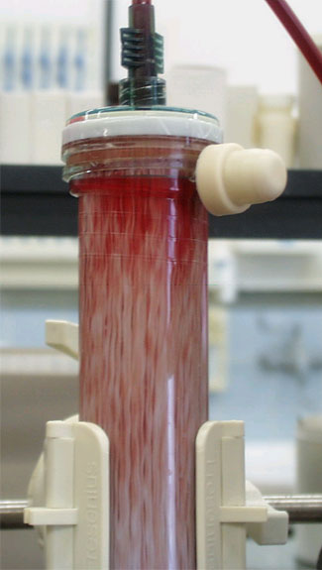
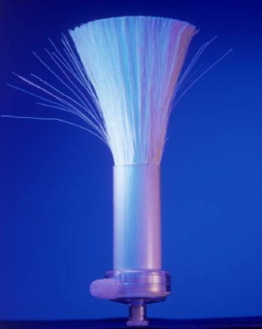
Methods - Stage 2
The primary endpoint of successful anticoagulation of a particular R-AHD sessions was the absence of evidence of blood clotting as
increased venous or arterial pressures
Darkening of blood in the filter and connections during the session or
Residual clots in the hollow fibers after the sessions.

Slide 74
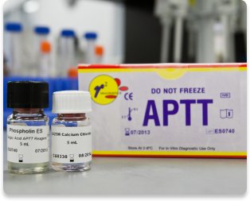
Methods - Stage 2
Additional relevant data were
The clotting time before the hemodialysis session to criticize the lasting effect of Routine heparin dose used in the previous dialysis session
The deviation of the achieved PTT values from the target value of 140% of the initial PTT to criticize the low heparin sessions as regards the accuracy in achieving the target PTT
The total dose of heparin per kg to criticize the low heparin sessions as regards to actual reducing of the heparin dose.

Slide 75
Methods - Data collection
Measure PTT in Stage 2b
Carrying out the hemodialysis sessions and collecting the blood samples were done by two assigned paid hemodialysis nurse in Stage 1 and by a third nurse in Stage 2 who was assisted by a laboratory technician to measure PTT in Stage 2b. All sessions were done under the supervision of one of the researchers and the patients received the routine monitoring and care as per the unit protocol.

Slide 76
Methods - Statistical methods
Descriptive statistics were used to summarize the data. Frequencies (number of patients or number of sessions) and relative frequencies (percentages) were used when appropriate.
Matched t-test was performed to compare continuous data . Composition of quantitative variables between the study groups in the present trial was carried out using Kruskal Wallis analysis of variance (ANOVA) test with multiple Mann Whiteny posthoc multiple 2- group comparisons.
Chi square (χ2) test was performed to compare categorical data, .
Yates correction was used instead when the expected frequency is less than 5.
A probability value (ρ value) less than 0.05 was considered statistically significant.
All statistical calculations were carried out using computer programs Microsoft Excel version 7 (Microsoft Corporation, NY, USA) and SPSS (Statistical Package for the Social Science; SPSS Inc, Chicago IL, USA) statistical program.

Slide 77
Results

Slide 78
Results
Blood clots appeared in 4 out of 165 R-AHD⁰ sessions but in none of the 28 R-AHD^{PR} sessions.
In Stages 1; mean URR was 0.597, 0.601 and 0.697 compared to 0.711 for the control (P>0.05).
In Stage 2, the arterial BUN was reduced by 0.6592 ± 0.14555 after a R-AHD^{PR} period, compared 0.7869 ± 0.17722 after a DNHD period (P=0.059).

Slide 79
Results In R-AHD⁰ sessions (Stage 1)
Heparin
Heparin
Heparin
Heparin
Stage 1d | Stage 1c | Stage 1b | Stage 1a
Routine heparin | Routine heparin | Half heparin | Routine heparin
DNHD sessions | R-AHD⁰ sessions | R-AHD⁰ sessions | R-AHD⁰ sessions
BFR = 100 -150 ml/ min. (mean 124.5 ml/min.) | Filter BFR = 400 - 450 ml/min. (mean = 444 ml/min.) Estimated patient BFR = 100 - 175 ml/ min. (mean 137.4 ml/min.)
(P>0.05)
In Stage 1, there was no significant difference (P>0.05) between the patient blood flow rate between the accelerated sessions (Stages 1a, 1b, 1c) and the DNHD sessions Stage 1d (control)

Slide 80
Results In R-AHD⁰ sessions (Stage 1)
Heparin
Heparin
Heparin
Heparin
Stage 1d | Stage 1c | Stage 1b | Stage 1a
Routine heparin | Routine heparin | Half heparin | Routine heparin
DNHD sessions | R-AHD⁰ sessions | R-AHD⁰ sessions | R-AHD⁰ sessions
The venous pressure: Range: 60-240 mm Hg Mean: 117.4 mm Hg | The venous pressure: Range: 82.5-143 mm Hg Mean: 125.4 mm Hg
(P>0.05)
In Stage 1, there was no significant difference between the venous pressure between the accelerated sessions (Stages 1a, 1b, 1c) and the DNHD sessions (Stage 1d) in Stage 1

Slide 81
Results In R-AHD⁰ sessions (Stage 1)
Heparin
Heparin
Heparin
Heparin
Stage 1d | Stage 1c | Stage 1b | Stage 1a
Routine heparin | Routine heparin | Half heparin | Routine heparin
DNHD sessions | R-AHD⁰ sessions | R-AHD⁰ sessions | R-AHD⁰ sessions
No Blood Clotting | blood clotting appeared in 4 out of 145 sessions" (2.76%) sessions: Minor blood clots were detected at the venous blood fistula needle at the end of 3 sessions A major clotting in the filter was detected near the end of the 4th session after which this Stage was terminated. | No Blood Clotting | No Blood Clotting

Slide 82
Results In R-AHD⁰ sessions (Stage 1)
Heparin
Heparin
Heparin
Heparin
Stage 1d | Stage 1c | Stage 1b | Stage 1a
Routine heparin | Routine heparin | Half heparin | Routine heparin
DNHD sessions | R-AHD⁰ sessions | R-AHD⁰ sessions | R-AHD⁰ sessions
 |  | Clotting time = 300 - 1543 sec. (mean = 933 sec.) before the sessions | Clotting time = 300 - 789 sec. (mean= 481 sec.) before the session
Clotting time was very high before the sessions in Stage 1a and in Stage 1b that reflects a high dose of heparin used in the previous session.

Slide 83
Results In R-AHD⁰ sessions (Stage 1)
Heparin
Heparin
Heparin
Heparin
Stage 1d | Stage 1c | Stage 1b | Stage 1a
Routine heparin | Routine heparin | Half heparin | Routine heparin
DNHD sessions | R-AHD⁰ sessions | R-AHD⁰ sessions | R-AHD⁰ sessions
HB% (8.6 - 12.6 ) gm% mean 10.3 gm% HT (24.4- 37.7 ) gm% mean= 30.5 gm% | HB% (8-12.4) gm% mean 9.8 gm% HT (22.2- 35.4 )gm% (mean=28) gm%
(P>0.05)
There was no significant difference between the HB and the HT after 1 month of accelerated sessions (Stage 1c) and the DNHD sessions (Stage 1d).
(P>0.05)

Slide 84
Results In R-AHD⁰ sessions (Stage 1)
Heparin
Heparin
Heparin
Heparin
Stage 1d | Stage 1c | Stage 1b | Stage 1a
Routine heparin | Routine heparin | Half heparin | Routine heparin
DNHD sessions | R-AHD⁰ sessions | R-AHD⁰ sessions | R-AHD⁰ sessions
Mean URR = 0.711 | Mean URR = 0.697 | Mean URR = 0.601 | Mean URR = 0.597
(P>0.05)
There was no significant difference between the mean URR in the AHD sessions (Stage 1a, 1b and 1c) compared to the DNHD session (Stage 1d) (control).

Slide 85
Results In R-AHD^{PR} sessions (Stage 2)
2
Heparin
Heparin
No Heparin
Heparin
Stage 2d | Stage 2c | Stage 2b | Stage 2a
Routine heparin | No heparin | Low heparin | Routine heparin
DNHD sessions | R-AHD^{PR} | R-AHD^{PR} | mixed DNHD/AHD^{PR} sessions
No Blood Clotting | No Blood Clotting | No Blood Clotting | No Blood Clotting
Blood clotting did not appear in Stages 2a, 2b or 2c.

Slide 86
Results In R-AHD^{PR} sessions (Stage 2)
2
Heparin
Heparin
No Heparin
Heparin
Stage 2d | Stage 2c | Stage 2b | Stage 2a
Routine heparin | No heparin | Low heparin | Routine heparin
DNHD sessions | R-AHD^{PR} | R-AHD^{PR} | mixed DNHD/AHD^{PR} sessions
 |  | The PTT was widely fluctuating around the target PTT, as shown in the Figure:

Slide 88
Results In R-AHD^{PR} sessions (Stage 2)
Heparin
Heparin
No Heparin
Heparin
Stage 2d | Stage 2c | Stage 2b | Stage 2a
Routine heparin | No heparin | Low heparin | Routine heparin
DNHD sessions | R-AHD^{PR} | R-AHD^{PR} | mixed DNHD/AHD^{PR} sessions
The mean dose of heparin used was 67.5 ± 15.1 Unit/kg |  | The mean dose of heparin used was 63.6 ± 17.4 Unit/kg
(P = 0.64
There was no significant difference between the mean dose of heparin used in Stage 2b compared to Stage 2d (control).

Slide 89
Results In R-AHD^{PR} sessions (Stage 2)
Heparin
Heparin
No Heparin
Heparin
Stage 2d | Stage 2c | Stage 2b | Stage 2a
Routine heparin | No heparin | Low heparin | Routine heparin
DNHD sessions | R-AHD^{PR} | R-AHD^{PR} | mixed DNHD/AHD^{PR} sessions
 |  |  | F-URR was 0.6592 ± 0.15 after R-AHD^{PR} periods, compared to 0.79 ± 0.18 after DNHD periods . The mean difference was 0.13 ± 0.06 The 95% Confidence Interval of the difference ranged from - 0.005to 0.26
(P = 0.059

Slide 90
Results In R-AHD^{PR} sessions (Stage 2)
Heparin
Heparin
Heparin
DNHD (15 min.)
Stage 2a
R – AHD^{FR} (15 min.)
Stage 2a
DNHD
Stage 2a
F-URR = 0.7869 ± 0.17722
F-URR = 0.6592 ± 0.14555
F-URR was 0.6592 ± 0.14555 after R-AHD^{PR} periods, compared to 0.7869 ± 0.17722 after DNHD periods in Stage 2a. The mean difference was 0.12768 ± 0.06495 and the 95% Confidence Interval of the difference ranged from - 0.00536 to 0.26072 (P=0.059).

Slide 91
Results In R-AHD^{PR} sessions (Stage 2)
Heparin
Heparin
Heparin
Stage 2a
After DNHD period
After R-AHD^{PR} period
F-URR = 0.7869 ± 0.17722
F-URR = 0.6592 ± 0.14555
F-URR was 0.6592 ± 0.14555 after R-AHD^{PR} periods, compared to 0.7869 ± 0.17722 after DNHD periods in Stage 2a. The mean difference was 0.12768 ± 0.06495 and the 95% Confidence Interval of the difference ranged from - 0.00536 to 0.26072 (P=0.059).

Slide 92
Results In R-AHD^{PR} sessions (Stage 2)
Neither Hypotension nor arterio-venous fistula complications were encountered nor were arterial pressure, venous pressure or blood leak alarms displayed on the hemodialysis machine monitor during the trial.

Slide 93
Results In R-AHD^{PR} sessions (Stage 2)
Heparin
Heparin
Children were more compliant to R-AHD⁰, which was performed in the main dialysis room, compared to R-AHD^{PR} which was performed with an older hemodialysis machine in a smaller dialysis room.

Slide 94
Discussion

Slide 95
Discussion
No Heparin
Heparin
No heparin R-AHD^{PR}
Routine heparin R-AHD⁰
The current study emphasized the clinical feasibility of AHD. This was declared in the earlier study by El Hatw (1999) ⁶ where 10 R-AHD^{V} sessions and 5 S-AHD^{V} were carried on for one girl and the problem of blood clotting was not detected and the technique was said to be safe .

Slide 96
Discussion
No Heparin
Heparin
No heparin R-AHD^{PR}
Routine heparin R-AHD⁰
AHD models, differ in their ability to prevent extracorporeal blood clotting. AHD^{PR} in the safest model .

Slide 97
Discussion
R-AHD^{PR} sessions | R-AHD⁰ sessions
Not observed in Routine, low or no heparin Sessions. | Was observed even with Routine heparin dose. | Blood clotting
There was an insignificant decrease (not increase) of the efficiency compared to the DNHD. |  | Efficiency
None | Not observed even after a month of continuous R-AHD⁰ sessions | Anemia
None | None | AV fistula complications
None | None | blood leak problems
Notes:
All R-AHD^{PR} sessions with Routine, low and no heparin were not associated with blood clotting whereas serial R-AHD⁰ sessions with Routine heparin dose was associated with significant increase in incidence of blood clotting. There was an insignificant decrease, not increase, of the efficiency of the R-AHD⁰ and R-AHD^{PR} compared to the DNHD. Maintaining the children on R-AHD⁰ for a month was not associated with significant increase in the degree of anemia. No Arterio-venous fistula complications or blood leak problems were encountered in the trial.

Slide 98
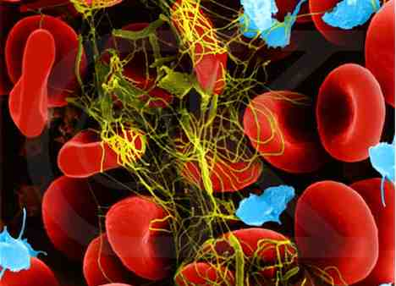
Discussion
“Blood stasis is an essential factor in the formation of a haemostatic plug”^{. 12}

Slide 99
Discussion
“No heparin R-AHD^{PR}“ was carried out successfully for children with normal coagulation profile using a low patient BFR of 100 ml/min. Partial blood recirculation (PBR) selectively accelerates the BFR the intracircuit flow in the filter and the air trapping chamber, which are the widest and the most vulnerable points for clotting of blood, increases the shear forces in the capillary fibers, diminishes protein layering, and retards membrane clotting” ⁵

Slide 100
Discussion
No Heparin
No heparin R-AHD^{PR}
“No heparin R-AHD^{PR}“ is a promising mode for avoiding blood clotting in hemodialysis.
It spares cost and complications of heparin and the cost of adding the (R) with 2 “T” shaped connections at its ends used to construct AHD^{PR} connections was minimal.
It is superior to other modes of dialysis.

Slide 101
Discussion
No Heparin
Heparin
Routine heparin DNHD | No heparin R-AHD^{PR}
Cost and the potential complications of heparin. | Spares the cost and the potential complications of heparin.

Slide 102
Discussion
No Heparin
No Heparin
No heparin DNHD | No heparin R-AHD^{PR}
Needs a patient blood flow rate of at least 300 ml/min. | Does not need increasing the patient blood flow

Slide 103
Discussion
No Heparin
Heparin
Routine heparin R-AHD⁰ | No heparin R-AHD^{PR}
The single blood pump can not accurately adjust and maintain the patient BFR. Lacks alarm if the venous fistula is accidentally obstructed. | Can detect accidental obstruction of the venous line: Creates a negative venous pressure at the venous pressure monitors Produce the audible sheering sound of the blood pump that alerts the operator to fix the problem
In our study, blood clotting was not due to hypercoagulable blood “Routine heparin R-AHD⁰ as the clotting time was normal or high before the sessions. Although clotting occurred in the early sessions of the Stage 1c where a dry fistula needle was used and not in the later sessions when needles were flushed with heparinized saline, yet the results were not encouraging for proceeding to the “low heparin R-AHD⁰” and “no heparin R-AHD⁰” Stages.

Slide 104
Discussion
No Heparin
Low Heparin
Low heparin DNHD | No heparin R-AHD^{PR}
Needs a bedside PTT monitoring, which is: Costly as it needs a coagulometer, a centrifuge and a trained personnel. Risk of Anemia & infection from repeated sampling. Inaccurate as the PTT was widely fluctuating around the target PTT Ultimately useless as reduction of the total dose of heparin/kilogram body weight was insignificant, where a smaller dose of heparin was infused through out the session, compared to the “Routine heparin sessions” where heparin was discontinued in the last hour of the session. | Technically easy Does not need sophisticated bedside laboratory monitoring.

Slide 105
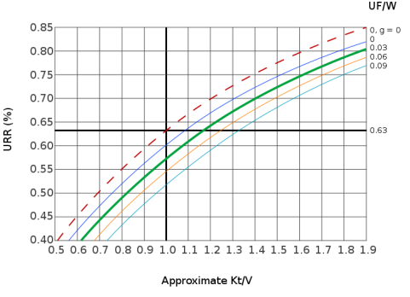
Discussion
BFR to & from the patient
Filter BFR
R - AHD^{PR}
“The possibility that the rapid filter BFR in R-AHD will increase the dialysis efficiency and decrease the dialysis session time was attractive but actually PBR was associated in both R-AHD⁰ and R-AHD^{PR} with insignificant decrease in the hemodialysis efficiency, indicating that the efficiency depends on the BFR to & from the patient not on the filter BFR.

Slide 106
Discussion
BFR to & from the patient
Filter BFR
R - AHD^{PR}
Increasing the filter BFR in R-AHD (both R-AHD⁰ and R-AHD^{PR}) did not increase the dialysis efficiency. The efficiency depends on the BFR to & from the patient not on the filter BFR.

Slide 107
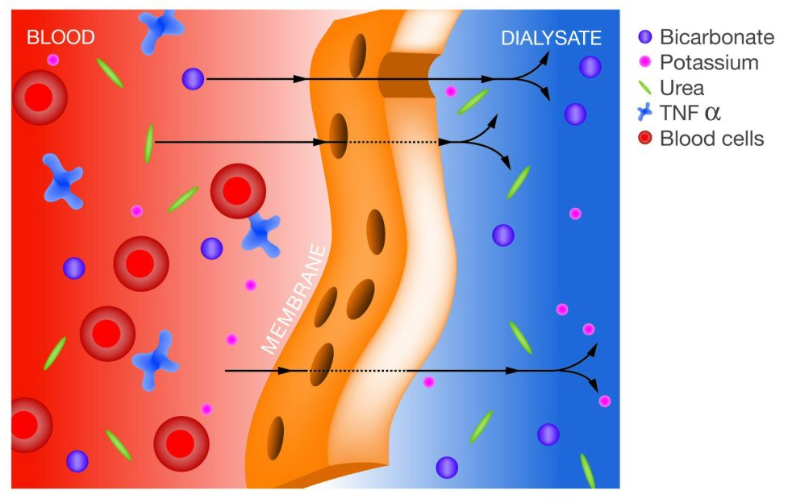
Discussion
PBR was associated with insignificant decrease in the hemodialysis efficiency, possibly due to influx of uremic toxins from the dialysate to the recalculating blood in the filter. Increasing the dilayste flow rate may prevent this possible influx and improve the efficiency.

Slide 108
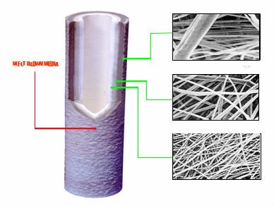
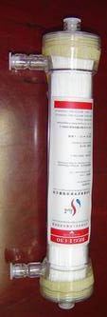
Discussion
4 hours
----------
4 hours
----------
4 hours
----------
----------
2 hours
2 hours
2 hours
2 hours
2 hours
2 hours
----------
Anyhow,
Increasing the dialysis efficiency in the traditional chronic hemodialysis sessions that are carried for 4 hours, three times per week is of limited value as the target efficiency can be achieved by the commercially available filters.

Slide 109
Discussion
4 hours
----------
4 hours
----------
4 hours
----------
----------
2 hours
2 hours
2 hours
2 hours
2 hours
2 hours
----------
The use of high flux filter remains the recommended approach if the efficiency is a concern as in daily dialysis where 2 hours sessions are carried out 5-6 days every week. ^{13, 14}

Slide 110
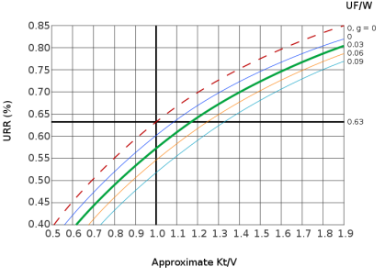
Discussion
AHD
DNHD
The results on effect on efficiency in the current study is compatible with the results of an earlier study by El Hatw on 1999 ⁶ who stated that “The efficiency of AHD was not increased by increasing the filter BFR in both pediatric and adult filters”.

Slide 111
Discussion
AHD
DNHD
Yuji, (2008) ⁵ reported that “the clearance of solutes calculated either with or without PBR, was not substantially different with and without PBR".
Another clue that the efficiency of the AHD depends on the patient BFR rate, not the filter BFR rate, was that in S-AHD, efficiency decreased with the decrease of patient BFR⁶ and that in Long sessions of S-AHD, the slow patient BFR decreased the efficiency per unit time and prevented over-dialysis in the long, 8 hours, hemodialysis sessions. ⁷.

Slide 112
Discussion
30 ml/min.
500 ml/min.
Our Study (2005)
Yuji et al (2008)
Yuji et al (2008) ⁵ used a low recirculation rate of 30 ml/minute as they were “afraid that PBR might increase the intracircuit pressure”.
In our study blood recirculation was adjusted to achieve a filter BFR of 500 ml/minute with no mechanical drawback on the hollow fibers, the arteriovenous fistula or the integrity of the RBCs, issues that worried the reviewers of the proposal of the project. This goes with the experience in adult hemodialysis that is routinely carried out with a high BFR of 400-500 ml/ minute.
Yuji et al (2008) ⁵ reported a similar result that the hemogram did not show any significant differences whether PBR was used or not.

Slide 113
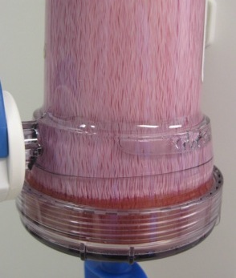
Discussion
The “no heparin R-AHD^{PR}” is a promising strategy of no heparin hemodialysis in children in whom achieving a fast BFR is not possible with the traditional hemodialysis sessions. More cases have to be studied before its recommendation in clinical practice. Financial and logistic difficulties limited number of the studied “no heparin R-AHD^{PR}” sessions in this study. “No heparin R-AHD^{PR} “sessions were the last Stage to be studies when the budged was exhausted and were carried out using an old version calibrated double blood pump Fresenius 2004B® hemodialysis machine that was about to be condemned from the unit that were fixed in the small and “unpleasant” acute hemodialysis room where trials for entertainment were not fruitful to attract the children. These confounding factors affected the compliance of children to the R-AHD^{PR}, compared to R-AHD⁰, where 2 of the 10 patients skipped Stage 2b and only one child accepted to be maintained on R-AHD^{PR} for 10 continuous sessions.

Slide 114
Discussion
“R-AHD^{PR}
Double Pump HD machines
To test reproducibility of the study and for further studies on R-AHD^{PR},
The corresponding author is willing to arrange in the supply of the AHD^{PR} connections.
Most hemodialysis machines can be modified to be used in R-AHD^{PR} without changing its software by adding a 2nd blood pump, for around 3000 $, and directly connect it to the Alternating Current outlet.

Slide 115
Discussion
No Heparin
“No heparin-AHD^{PR} X higher number
Potential fields for further studies on R-AHD^{PR} includes
Study a bigger number of “no heparin R-AHD^{PR}” children and adults for a longer period.

Slide 116
Discussion
No Heparin
“No heparin-AHD^{PR} + No Flush
(2) Study “no-flush no-heparin R-AHD^{PR}" to rule out the role of the concomitant flushing of the lines with saline in the inhibition of the blood coagulation. “No-flush No-heparin R-AHD^{PR}" can be used even in patients without bleeding tendency to spare the potential complications of heparin and spares cost of heparin and the saline flush

Slide 117
Discussion
No Heparin
“No heparin-AHD^{PR} + S-AHD^{PR}“
(3) Study a combination of “no heparin-AHD^{PR} and S-AHD^{PR}“ where
The filter BFR is increased to avoid clotting whereas
The patient BFR is decreased simultaneously Study Patient BFR less than 100 ml/ minute. to fit patients with low body weight, compromised cardiac function or poor vascular access or is very low as in continuous arteriovenous or venovenous hemofiltration or hemodialysis (CAVH/D and CVVH/D) as “the no heparin regiment is ineffective in this setting due to the low BFR rates with these techniques and their continuous nature increases the likelihood of side effects with prostacyclin or protamine” ².

Slide 118
Discussion
Heparin
“R-AHD^{PR} + High dialysate flow rate + Big filter
(4) Study the effect of "R-AHD^{PR}" with high dialysate flow rate and with bigger filters on the efficiency. Bigger filters will still increase the extra corporeal blood compartment, but PBR increase the BFR per single hollow fiber to prevent blood stagnation.

Slide 119
Conclusion

Slide 120
Conclusion
R-AHD^{PR} allowed successful low heparin and no heparin hemodialysis in children without increasing the patient BFR but did not increase the efficiency.

Slide 121
Conclusion
It is concluded that
"no heparin R-AHD^{PR}" is an applicable and safe hemodialysis method in children
R-AHD does not increase dialysis efficiency.

Slide 122
Thank
you

Slide 123
Methods - Setting and Study design
R-AHD⁰
Stage 1a,b
DNHD
Stage 1d
Efficiency of the AHD: Was measured by comparing the URR in R-AHD⁰ (Stage 1a,b) and in DNHD sessions (Stage 1d) measured in the same patient. URR carries a possibility errors in calculating efficiency due to errors in post dialysis sampling or due to residual renal function.
Notes:
Two changes in methodology were made after interim analysis of Stage 1.
To nullify possible errors in calculating efficiency due to errors in post dialysis sampling or due to residual renal function; efficiencies of AHD^{PR} and of DNHD periods in the same sessions were compared in Stage 2 rather than comparing the efficiencies of R-AHD⁰ and of DNHD sessions of the same patients in Stage 1.
PTT was monitored to adjust the heparin infusion dose in "low dose heparin R-AHD^{PR}" in Stage 2, rather than comparing the "routine heparin R-AHD⁰" and "½ dose heparin R-AHD⁰" sessions in Stage 1. The long clotting time before starting the sessions indicates that the used "routine dose heparin was actually a "high dose" of heparin with a prolonged residual anticoagulant effect.

Slide 124
Methods - Setting and Study design
Heparin
½ dose
Heparin
Routine heparin R-AHD⁰
Stage 1a
½ dose heparin R-AHD⁰
Stage 1b
(B) Anticoagulant effect of the AHD was studied by comparing the "Routine heparin R-AHD⁰" and "½ dose heparin R-AHD⁰" sessions. The long clotting time before starting the sessions indicates that the used "Routine dose heparin was actually a "high dose" of heparin with a prolonged residual anticoagulant effect.
Notes:
Two changes in methodology were made after interim analysis of Stage 1.
To nullify possible errors in calculating efficiency due to errors in post dialysis sampling or due to residual renal function; efficiencies of AHD^{PR} and of DNHD periods in the same sessions were compared in Stage 2 rather than comparing the efficiencies of R-AHD⁰ and of DNHD sessions of the same patients in Stage 1.
PTT was monitored to adjust the heparin infusion dose in "low dose heparin R-AHD^{PR}" in Stage 2, rather than comparing the "Routine heparin R-AHD⁰" and "½ dose heparin R-AHD⁰" sessions in Stage 1. The long clotting time before starting the sessions indicates that the used "routine dose heparin was actually a "high dose" of heparin with a prolonged residual anticoagulant effect.

