Slide 1


Slide 2
Immobilization of Cd and Pb in Polluted Soils Using Nano Particles
by
Dr. Mohamed . I. D. Helal
Prof. Soil Sci. Dept., Fac. of Agric.,
Cairo University

Slide 3
Contents
Nano science and nanotechnology
Nanotechnology tools
Properties of Nano materials
Nano materials: Carbon Sixty, Carbon
Nanotube, nZVI
Introduction
Remediation of Heavy Metals Polluted Soils
- Remediation Techniques:
- Immobilization of Cd and Pb in polluted soils
- Methods of production of nano particles
- Characteristics of the prepared nano particles
- Capacity of nano particles to adsorb and retain Cd &Pb.

Slide 4
INTRODUCTION

Slide 5
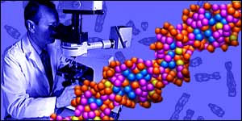
What is Nano?
The word nano comes from the Greek and Latin words, nanos or nanus which means Dwarf.
1 Nano = 10⁻⁹ m (one billionth(.

Slide 6
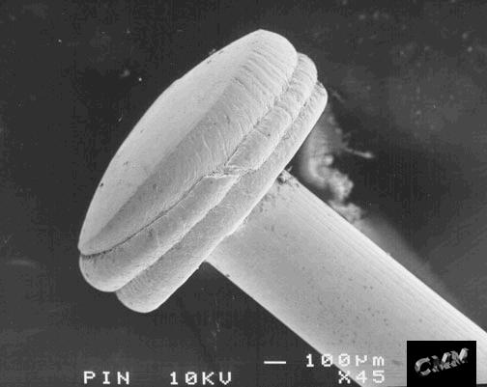
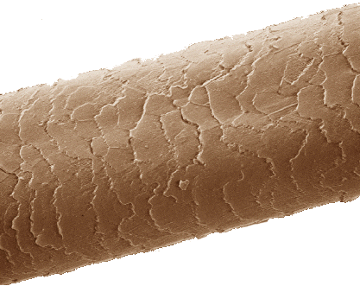
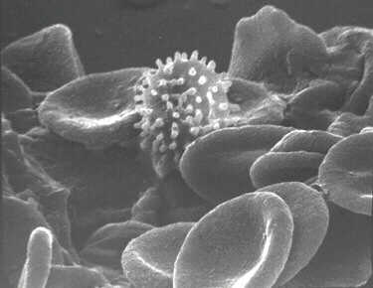
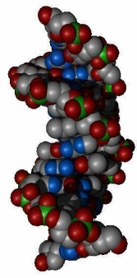
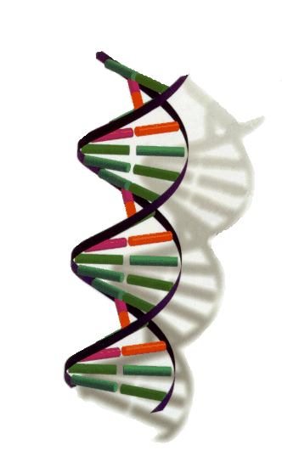
How small is Nano?
10⁻² m
1 cm
10 mm
0.1 cm
1 mm
Head of a pin 1mm=1,000,000nm
10⁻³ m
Microbial cell: (1000 nm)
Virus: 10-100 nm.
Hemoglobin: 7 nm.
Water (H₂O): 0.2 nm
10⁻⁴ m
0.1 mm
100 μm
thickness of a human hair
10,000 nm
10⁻⁵ m
0.01 mm
10 μm
10⁻⁶ m
1 μm
1000 nm
Visible
spectrum
Length of the red
blood cell
2,000 nm
0.1 μm
100 nm
100 nanometers
10⁻⁷ m
10⁻⁸ m
0.01 mm
10 nm
DNA
~2.5 nm width
1 nanometer (nm)
10⁻⁹ m
1 nm
10⁻¹⁰ m
0.1 nm

Slide 7

Origin of Nano Science and Nano Technology?
“Plenty of Rooms at the Bottom” (Feynman 1959).
- Arrange atoms the way we want, the very atoms, all the way down!.
Feynman 1959
- There is enough room
on the head of a pin to
store all pages of 25 volume of
Encyclopedia Britannica.

Slide 8
Feynman 1959
- Feynman described a process for manipulating individual atoms and molecules using one set of precise tools to build and operate another proportionally smaller set, and so on down to the nth scale.
In 1981, Feynman’s radical vision became feasible after invention of Scanning Tunneling Microscope (STM). Then, the scientists are able to see individual atoms, and move the atoms using Electrical field and infinitesimal small probe.

Slide 9
Nano-science :
is an emerging science which comprises the world of atoms, molecules, macromolecules, quantum dots, and macromolecular assemblies.

Slide 10
Nano-technology
Nanotechnology is the technology for design, fabrication and manipulation of nanometre scale systems, in the scale of 1-100 nm.
Is any technology which exploits phenomena and structures that can only occur at nanometer scale.
Nanotechnology could be defined as “the understanding and control of matter at dimensions roughly ranged from 1 to 100 nanometer, where unique phenomena enable novel applications.

Slide 11
What is Nanotechnology?
Nanotechnology deals with the creation of USEFUL materials, devices and systems using the particles of nanometer length scale and exploitation of NOVEL properties (physical, chemical, biological) at that length scale

Slide 12
Properties of Nano materials

Slide 13
Properties of Nano materials
Familiar materials can have completely different properties at nanoscale.
The familiar classical physics guideposts of magnetism and electricity are no longer dominant.
The applicable laws of physics shift as Newtonian mechanics give way to quantum mechanics.

Slide 14
Properties of Nano materials
- Nanoscale sizes can lead to different physical and chemical properties:
  Melting point
  Boiling point
  Band gap
  Optical properties
  Electrical properties
  Magnetic properties
  Surface Reactivity
For example, metals with a so-called grain size of around 10 nanometers are as much as seven times harder and tougher than their ordinary counterparts with grain sizes in the micro meter range.

Slide 15
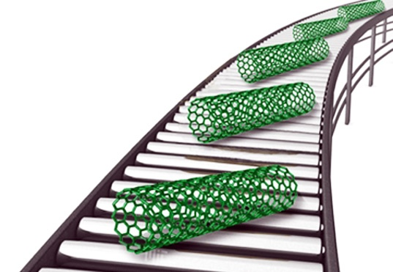
Surface Reactivity:
The vastly increased ratio of surface area to volume opens new possibilities in surface-based science, such as catalysis.
Interactions of individual atoms and molecules take place
Surface effects such as
Van der Waals force attraction,
hydrogen bonding,
electric charge,
ionic bonding,
covalent bonding,
hydrophobicity,
hydrophilicity and quantum mechanical tunneling.

Slide 16
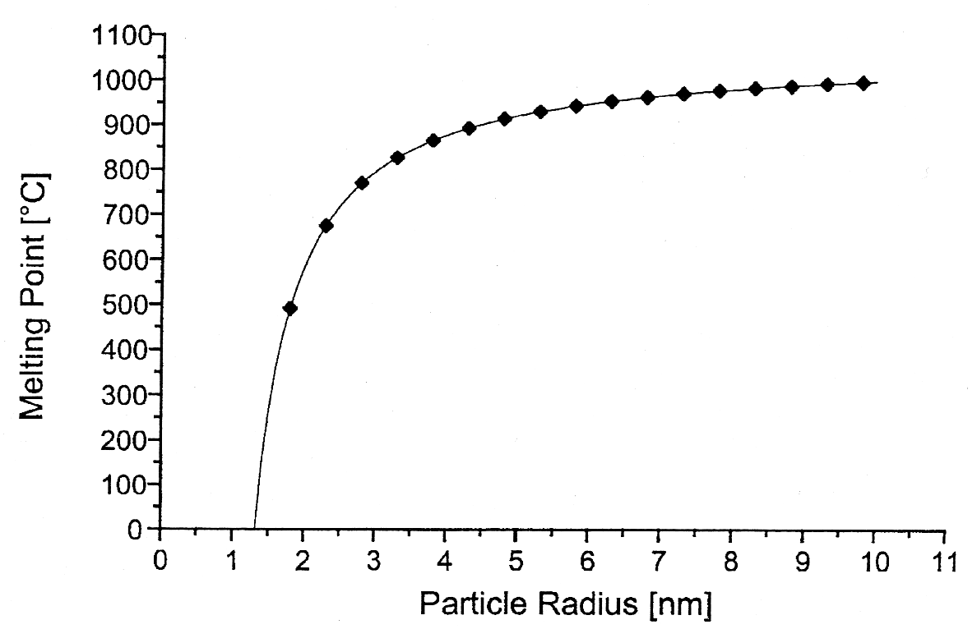
Properties of Nano materials
The melting point of gold particles decreases dramatically as the particle size gets below 5 nm
Melting Point
Source: Nanoscale Materials in Chemistry, Wiley, 2001

Slide 17

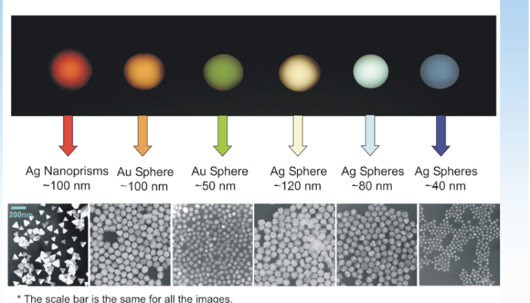
Properties of Nano materials
  Optical properties – color changes with size

Slide 18
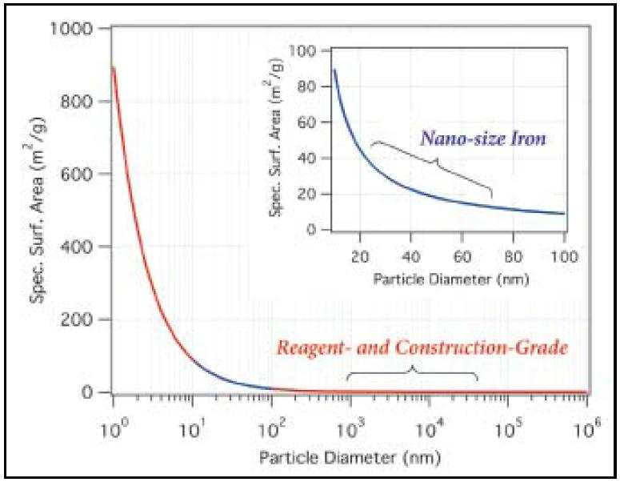
Properties of Nano materials Surface area dependence on particle size

Slide 19
Nano Materials
- Nano particles are of interest because of the new properties (such as chemical reactivity and optical behaviour) that they exhibit compared with larger particles of the same materials.

Slide 20
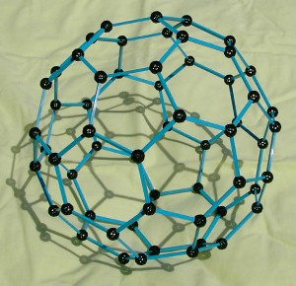
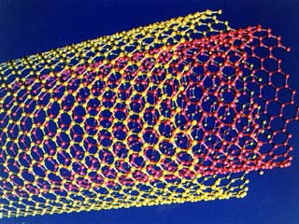
Carbon Nano Tube and Carbon Sixty
C60 : The Fluorine (discovered 1985)
Carbon Nano Tube (discovred,1991)

Slide 21
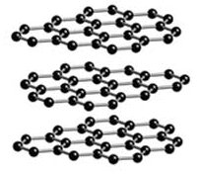

Diamond
Graphite

Slide 22
Carbon Nanotubes (CNT)
It is now known that carbon molecules at nanoscale can form cylindrical tubes, called carbon nanotubes (CNT), which are much stronger (100 times) than steel, and conduct electricity (even at higher degrees, 100 ˚C) neither of which is possible with the carbon found in coal or diamonds.
Since their discovery (1991), carbon nanotubes have fascinated scientists because of their extraordinary properties.
CNT may one day provide the key breakthroughs in medicine and electronics.

Slide 23
Nanotechnology Tools
The Scanning Tunneling Microscope (STM),
- Atomic Force Microscope (AFM)
Scanning Probe Microscope (SPM)
Transmission Electron Microscope (TEM)

Slide 24
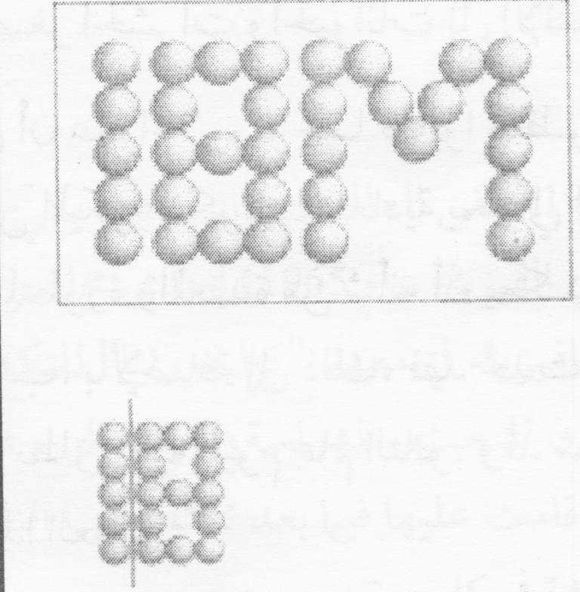

Slide 25
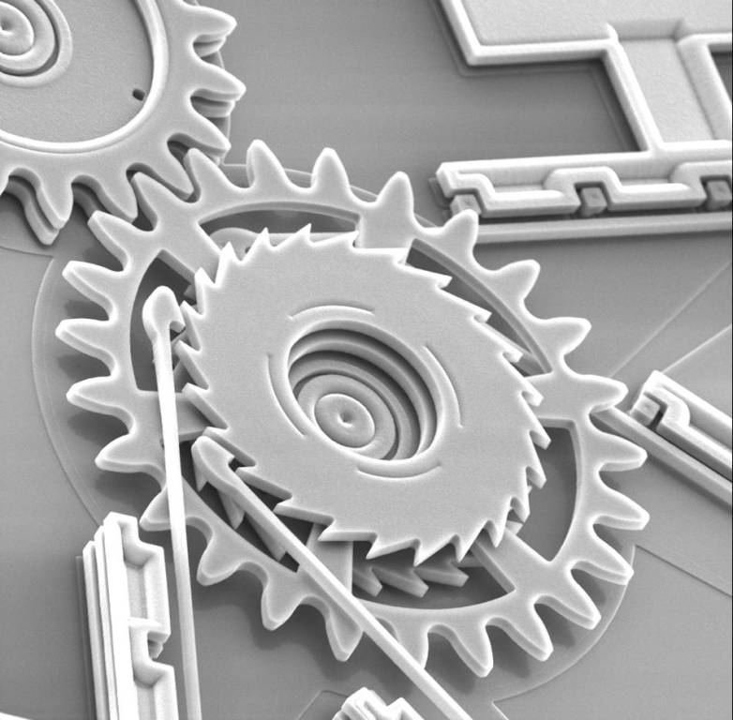

Slide 26
Applications of Nanotechnology
Nanoscience and nanotechnology encompass a range of rather than a single discipline, touching,
medicine,
physics,
engineering, and
chemistry.

Slide 27
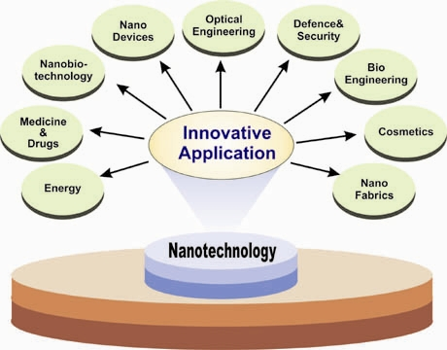
Applications of Nanotechnology

Slide 28
Remediation of Heavy Metals Polluted Soil

Slide 29
Remediation of Heavy Metals Polluted Soil
Definition:
Heavy metals are widely defined as metallic elements that have a
specific gravity of 5.0 g/cm³ or more.
Heavy metals are the most toxic inorganic pollutants exist in
soils.
They can be of natural or anthropogenic origin
(Bradl, 2004 and Sedgwick, 2005).
- There are about 50 elements can be classified as heavy metals, but only 17 are considered to be very toxic, e.g., Hg,, Pb, Cd, Ni and Cr.

Slide 30
Risks of Cd and Pb on human health:
Cd and Pb are non-essential and toxic elements for human, and have no use for plant or animals either.
Cd can damage the kidneys, causing excess production of proteins in the urine
Cd is associated with skeletal damage, evidenced by low bone mineralization, a high rate of fractures, increased osteoporosis and intense bone pain.
Exposure to Pb during the early stages of children’s development is linked to a drop in intelligence

Slide 31
Remediation of Heavy Metals Polluted Soil
- Remediation technologies are scientific techniques used to remove pollutants and/or rehabilitate polluted natural materials.
Tow different techniques are employed.
I - Removing of pollutants:
A – Leaching the soil which can be done in situ (on-site), or ex situ (removed and treated off-site). Water and suitable solution are used to extract pollutants from the soil matrix (FRTR, 2001).
Both are extremely expensive and/or cause pollution of the ground water (in situ) .
:

Slide 32
Remediation of Heavy Metals Polluted Soil
B- Phyto-remediation:
in which hyper accumulator plants that tolerate and accumulate high contents of heavy metals by translocating the metals from soil to shoot tissues, allowing the metals to be removed from the soil through harvesting (Brown et al. 1994).
II - Immobilization/Stabilization of pollutants in soil:
In which chemical amendment are used to reduce the leachability and/or bioavailability of metals in polluted soils (Ramply and Ogden 1998). Immobilize the metal pollutants within the soil matrix through a combination of chemical reaction.

Slide 33
Remediation of Heavy Metals Polluted Soil
The concept of immobilization technique based on:
The soluble/mobile form of an element in soil is considered to be a better indicator of the risk associated with heavy metals (e.g. leaching, bio-uptake) than the total metal concentration.
- Heavy metals are immobilized in soil through different processes, e.g., specific adsorption, cation-exchange and precipitation (carbonates, phosphates, sulfides, ….).

Slide 34
Immobilization of pollutants:
- Several nano particles are used ;
1- nZVI,
2 - bentonite supported nZVI (bent-nZVI),
3 - nano carbon,
4 - nano alginit, and
5 – Poly amidoamine (dendrimer) , are prepared and used in immobilization of heavy metals in polluted soils.

Slide 35

Methods of Production
of Nanoparticles

Slide 36
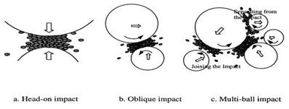
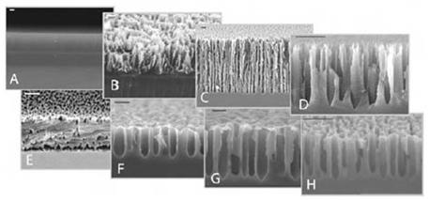
General Methods:
First : (top-down) method
Start from bulk until you reach the nano-cutting through the following:
1 – Milling method
2 - Scratching or etching method :
This method is used to produce particles of silicon nano particles

Slide 37
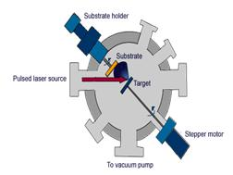
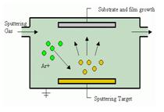
3- Laser ablation method : use of a laser pulse with a high-energy focused on the goal of the heart
4- (Sputtering) method :
Used to make thin film
Second : (Bottom-up) method
This method starts from the bottom of any of the atoms begin to separate them and then aggregated up to the level of nano scale methods used :
1 - (sol-gel) method
2- Aerosol method
3- Chemical vapour deposition method ( CVD )

Slide 38
Methods of production of Nano Particles
Nano particles used in our research are prepared using chemical (e.g., nZVI, bent-nZVI, Dendrimers) and/or physical methods (e.g., nano alginit) as the following:
A - Nano-scale Zero Valent Iron (nZVI): 1- Chemical methods:
Synthesis of nZVI is based on reduction of Fe (II) using borohydride (Wang and Zhang, 1997 and Wang et al., 2006).
FeCl₂. 4H₂O and NaBH₄ were used. The proposed reaction is:
Fe⁺² + 2BH⁻ + 6H₂O → Fe⁰ + 2B(OH)₃ + 4H₂ ↑
- Sample of the product was inspected using TEM, and the particle size ranged from 13- 103 nm.

Slide 39
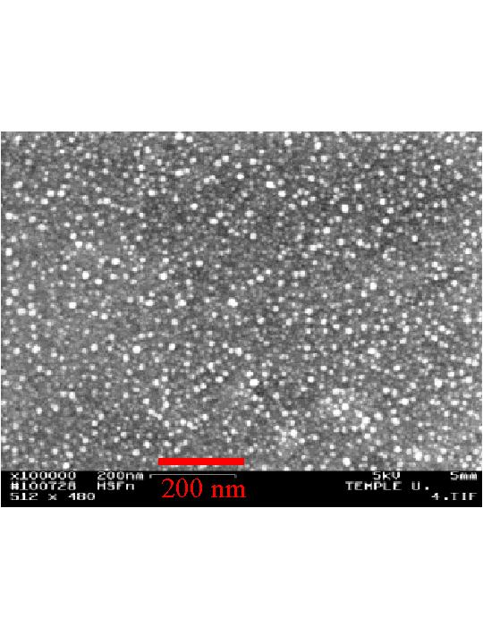
Iron Nano Particle

Slide 40
Methods of production of Nano Particles
II- Physical methods:
Nano alginite:
Alginite is a naturally occurring rock. It is greyish-green, it has high specific surface area, high number of functional groups and high cation exchange capacity value.
Nano alginit was prepared in lab by ball-milling (Photon company, Egypt). Portions of alginit were placed in a stainless steel canister with metal balls of different three size, and stirred for 27 hour at speed of 1000 rpm/minute.
A sample of milled alginite was inspected using TEM, and the size of the alginite particle ranged from 13 – 23nm.

Slide 41
Reaction Mechanisms of Nanoscale Zero Valent Iron (nZVI)

Slide 42
Reduction Power of nZVI
nZVI has been used extensively to reduce (dehalogenate) chlorinated solvents and sequester metals.
The small particle size and high surface area make iron nano particles highly reactive and extremely versatile.
Nano-particles can remediate more material at a higher rate and with a lower generation of hazardous byproducts (Zhang, 2003).

Slide 43
Oxidation of Organic Contaminants using Nanoparticles Zero Valent Iron (ZVI)
In an experiment with the pesticide molinate and ZVI, no change was observed in the concentrations of either one when bubbling nitrogen gas through the solution.
Air showed a marked reduction in molinate.

Slide 44
Oxidative Power of nZVI
Oxygen reacts with ZVI in two fashions.
In the useful pathway : Fe0 reacts with O2 to form Fe+2 and O2-2. The O2-2 reacts with hydrogen to form hydrogen peroxide which reacts with Fe+2 to form Fe+3 and hydroxyl radicals (Fenton's reaction) that are highly reactive oxidants.
The usefulness of the reaction depends on the efficiency of the branching process to favor hydroxyl radical formation.

Slide 46
Nano particles characterization
Particle size: The average particle size distribution and morphology of nano particales, were studied using JEOL Transmission Electron Microscope (JEM-1400 TEM, Japan).
Cation exchange capacity (CEC): Cation exchange capacity of nano particles were determined using ammonium acetate method as described by Page et al. (1982).

Slide 47
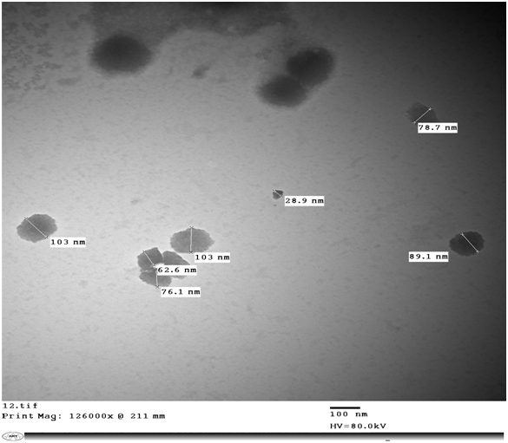
Figure1.Transmission Electron Microscopy “TEM” images of nZVI

Slide 48
. Nano particle characterization
- Specific surface area(SSA): Specific surface area of nano particles were determined using O-phenanthroline method (Sparks, 1998).

Slide 49
Nano particles characterization
Table 1. Important characteristics of nano particles
Nano Particles | Particle Size Range (nm) | Surface area (m²/g) | CEC (Cmol_{(c)}/kg)
nZVI | 12.7 – 103 | 235.7 | 42.5
bent-nZVI | 27.8 - 110 | 225.4 | 47.7
Nano alginite | 12.9 – 23.9 | 194.2 | 47.7
nano carbon | 53.5 – 63.1 | 259.7 | -

Slide 50
Adsorption Capacity of Nano particle
Adsorption of Cd and Pb on nano particles
Adsorption:
  Portions of 0.1g of studied nano particles were gently shaked with 50 ml 0.01 M CaCl₂ containing Cd or Pb concentrations of 1.0, 5.0, 10, 20, 50, and 100 mg l⁻¹ for 24h at 25C° ±1.
  The adsorbed quantity was calculated as the difference between the initial concentration and equilibrium one and presented as mg metal /kg adorbent

Slide 51
Fig 2 : Adsorption Isotherms of Cd on Nano particles (Langmuir Isotherm, x/m = kbc/1+kb)

Slide 52
Fig 3 : Adsorption Isotherms of Pb on Nano particles (Langmuir Isotherm, x/m = kbc/1+kb)

Slide 53
Fig 4 : Linear form of Adsorption Isotherms of Pb on Nano particles
(Langmuir Isotherm,C/x/m= 1/kb + C/b)

Slide 54
Table 2 : Maximum Adsorption capacity (b) and affinity (k) calculated from Linear form (C/(x/m) = 1/kb+C/b) of Langmuir
No. | Nano Particles | Maximum Adsorption Capacity (gCd kg⁻¹)(b) | Affinity (k) l g¹⁻ | Maximum Adsorption Capacity (gPb kg⁻¹)(b) | Affinity (K) l g¹⁻
1 | nZVI | 93.45 | 0.048 | 25.97 | 0.123
2 | Bent–nZVI | 37.45 | 0.234 | 24.74 | 0.024
3 | NanoAlginite | 41.15 | 0.006 | 24.87 | 0.037
4 | Nano Carbon | 76.92 | 0.006 | 17.85 | 0.050

Slide 55
Efficiency of Nano Particles to Retain Adsorbed Heavy Metals
Desorption: A solution of 1.0 M MgCl₂, pH 7.0 is used for desorption of the previously sorbed Cd and Pb at solid: solution ratio equals to that used for adsorption experiment. The suspension was shaked gently for reaction period of 2 h at 25±1C°. After centrifugation, Cd and Pb concentrations were determined in the clear solution, as the above mentioned.

Slide 56
Fig 5: Adsorption/desorption of Cd on nano particles

Slide 57
Table 3: Adsorption/Desorption of Cd on nano-particles.
Nano particles | Cd
 | Adsorbed Quantities (mg kg⁻¹ ) | Desorbed Amounts (mg kg⁻¹ ) | Des. /Ads. ( % )
nZVI | 435 - 37550 | 96 - 4038 | 10.8 - 22.1
bent- nZVI | 435 - 32000 | 92 - 4475 | 14.0 - 21.2
nanoalginite | 285 - 20000 | 90 - 2708 | 13.5 - 33.4
nano carbon | 235 - 18500 | 88 - 4000 | 21.6 - 93.9

Slide 58
Fig 6 : Adsorption/desorption of Pb on nano particles

Slide 59
Table 4 : Adsorption/Desorption of Pb on nano-particles.
Nano particles | Pb
 | Adsorbed Quantities (mg kg⁻¹ ) | desorbed Amount (mg kg⁻¹ ) | Des. /Ads. ( % )
nZVI | 305 - 22300 | 68 - 4020 | 13.7 – 23.4
bent- nZVI | 200 - 14300 | 61 - 4200 | 22.9 – 33.4
nanoalginite | 220 - 16800 | 64 - 4400 | 18.9 - 35.6
nano carbon | 255 - 13300 | 70 - 4826 | 21.9 – 36.3

Slide 60
Immobilization of Cd and Pb in polluted soil

Slide 61
Immobilization of Cd and Pb in polluted soil
- The heavy metals polluted soils were treated with nano particles at different ratios, 0, 0.1, 0.5 and 1%, and incubated for one month. During this period the samples were submitted to four cycling of wetting and drying.
- The samples were extracted using DTPA solution which is recommended to extract amount of metal represent the so called “ plant available Cd and Pb” in polluted soil

Slide 62
Table 5 : Plant available Cd (mg/kg) in polluted soils before and after treating with Nano particles .
DTPA- extractable Cd (mg/kg )
Treatment | Rate of addition % | Soil 1 | Soil 2 | Soil 3 | Soil 4
nZVI | Initial | 3.24 | 12.85 | 3.74 | 7.61
 | 0.1 | 1.56 | 6.05 | 1.48 | 3.14
 | 0.5 | 0.78 | 3.83 | 0.62 | 2.39
 | 1.0 | 0.15 | 2.79 | 0.15 | 1.51
Level of non polluted soil (Aboulroos et al,1988) |  | 0.06 | 0.06 | 0.06 | 0.06

Slide 63
Table 6: Plant available Pb (mg/kg) of polluted soils before and after treating with nano particles .
DTPA- extractable Pb (mg/kg )
Treatment | Rate of addition % | Soil 1 | Soil 2 | Soil 3 | Soil 4
nZVI- bentonite | Initial | 6.28 | 6.49 | 6.31 | 5.72
 | 0.1 | 2.73 | 2.63 | 2.81 | 2.78
 | 0.5 | 1.83 | 1.48 | 1.70 | 2.05
 | 1.0 | 1.04 | 0.64 | 0.80 | 1.03
Level of non polluted soil (Aboulroos et al, 1988) |  | 2.2 | 2.2 | 2.2 | 2.2

Slide 64
Distribution of Cd and Pb among different fractions:
A sequential extraction procedure was employed to study the effect of immobilizing agents on the distribution of Cd and Pb among various soil chemical forms; exchangeable (EXCH), bound with carbonate (CARB), organic matter (OM), oxides (OX) and residual (RES).

Slide 65
Table 7. Different fractions of Cd sequentially extracted from the tested soils before and after treating with nano particles
Treatment |  | Cd fractions (mg/kg)
 |  | Exch. | Carb. | Oxide. | Orga. | Res. | Sum
 | Initial | 2.80 | 0.80 | 1.30 | 0.63 | 2.70 | 8.23
 | nZVI | 0.4 | 1.85 | 2.52 | 0.62 | 3.0 | 8.39
 | bent-nZVI | 0.56 | 2.66 | 1.42 | 0.71 | 3.2 | 8.55

Slide 66
Table 8: Different fractions of Pb sequentially extracted from the tested soils before and after treating with nano particles
Treatment |  | Pb fractions (mg/kg)
 |  | Exch. | Carb. | Oxide. | Orga. | Res. | Sum
 | Initial | 22.3 | 29.6 | 36 | 17.5 | 73.8 | 179.2
 | nZVI | 9.77 | 22.43 | 70.5 | 20.31 | 54.6 | 177.61
 | bent-nZVI | 9.1 | 36.22 | 67.5 | 20.31 | 47.7 | 180.83

Slide 67

THANK YOU

