Slide 1
Factors of participation in prenatal education
among nulliparous women in South Korea
2015. 10. 6.(Tue)
Mi Young Kim, MSN, RN, doctoral student
Yonsei University, College of Nursing
4th International Conference on Nursing & Healthcare, October 05-07, 2015 San Francisco, USA
Notes:
I’m delighted to be here and thank you for being with me this afternoon.
My name is Mi Young Kim.
I’m a doctoral student of Yonsei University, College of Nursing.
I’d like to talk about Factors of participation in prenatal education among nulliparous women in South Korea.

Slide 2
Contents
I. INTRODUCTION
1. Statement of the Problem
2. Purpose of the Study
II. METHODS
1. Design
2. Population and Sample
3. Procedures for Data Collection
4. Measurements
5. Human Subjects and Consent Process
6. Data Management and Analysis
III. RESULTS
IV. CONCLUSION
Notes:
The Contents are as follows.

Slide 3
I. INTRODUCTION
Notes:
I want to start by giving you some background information about this study.

Slide 4
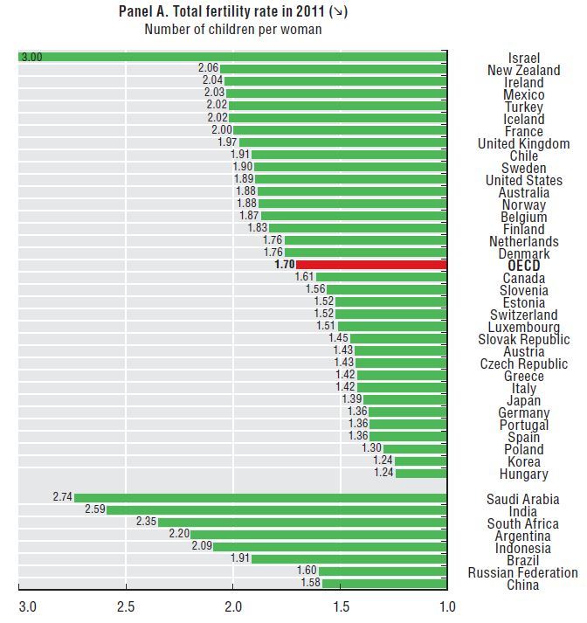
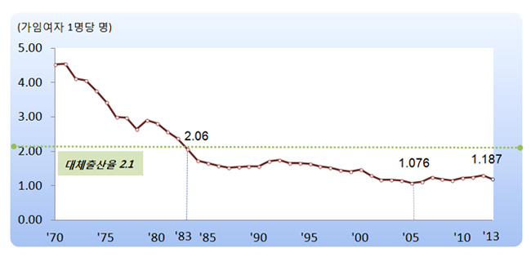
I. INTRODUCTION
1. Statement of the Problem (1)
Total Fertility Rate of South Korea
Reference: Vital Statistics, 2014
Reference: Society at a Glance 2014 OECD Social Indicators
4
Notes:
Since the nineteen eighties(1980년대), total Fertility Rate has continuously and rapidly dropped in South Korea.
South Korea has recorded a very low total fertility rate of 1.18(one point one eight in Twenty Thirteen(2013)
And, The lowest level compared to the OECD average
(OECD 평균 대비 최하위 수준)
합계출산율=Total Fertility Rate
여성 1명이 평생 동안 낳을 것으로 예상되는 평균 출생아 수를 나타낸 지표, 출산력 수준을 나타내는 대표적 지표임.

Slide 5
I. INTRODUCTION
1. Statement of the Problem (2)
higher marriage age
advanced maternal age
pregnancy complications
preterm births
congenital malformations
Reference: Vital Statistics, 2014
5
Notes:
Higher marriage age leads to increasing pregnancy of advanced maternal age, and pregnancy complications, preterm births and congenital malformations are increasing.(Vital Statistics, 2013).
As a result, the number of people is declining steadily.
인구의 수 감소 -> 건강한 임신 중요 -> 산전교육 참여율 & 영향 요인 분석

Slide 6
I. INTRODUCTION
1. Statement of the Problem (3)
Pregnant women need prenatal care to improve maternal-fetal health during pregnancy.
Nulliparous women are strongly recommended to participate in prenatal education, because pregnancy and delivery is their first experience(Hwang, 2010; Buckley, & Gaskin, 2009).
According to the previous studies, pregnant women who participated in prenatal education got prenatal care more compared to pregnant women who didn’t(Song, et al., 2010; Kim & Jung, 2007).
Regular prenatal care can reduce the perinatal complications among pregnant women and newborns(Song, et al., 2010; Jung & Jung, 2011).
6
Notes:
For this reason, the importance of better foundations for the lifelong health of the pregnant women are emerging.(Hwang, 2010).
Pregnant women need prenatal care to improve maternal-fetal health during pregnancy.
Especially, Nulliparous women are strongly recommended to participate in prenatal education, because pregnancy and delivery is the first experience.
According to previous studies, pregnant women who participated in a prenatal education were higher get prenatal care compared to pregnant women who didn’t participate(Song, et al., 2010; Kim & Jung, 2007).
Regular prenatal care can reduce the perinatal complications in pregnant women and newborns(Song, et al., 2010; Jung & Jung, 2011).

Slide 7
I. INTRODUCTION
2. Purpose of the Study
This study aimed
To identify the contents of prenatal education conducted
To examine the level of participation in prenatal education
To determine influencing factors of participation in prenatal education
7
Notes:
Therefore, This study aimed
To identify the contents of prenatal education conducted,
To examine the level of participation in prenatal education,
To determine influencing factors of participation in prenatal education.

Slide 8
II. METHODS
Notes:
Let me explain method of this study.

Slide 9
II. METHODS
1. Design
A cross-sectional, exploratory study design
2. Population and Sample
134 nulliparous women
Living in metropolitan area
Gestational age ≥32 weeks
See a health care provider at hospital or OB/GYN clinic
No physical and psychological disorders
3. Procedures for Data Collection
Survey data were collected by face to face interviews using structured questionnaire.
9
Notes:
This cross-sectional, exploratory study recruited one hundred thirty four(134) nulliparous women living in metropolitan area in South Korea. Gestational age were 32 weeks or more, See a health care provider at hospital or OB/GYN clinic, And No physical and psychological disorders.
Survey data were collected by face to face interviews using structured questionnaire.
본 연구의 표적모집단은 출산을 앞둔 임부로서, 근접모집단은 현재 시행되는 산전교육에 대한 포괄적 조사가 가능한 임신 32주 이상의 여성으로,
산전검진을 위해 서울시나 경기도에 소재한 병․의원 중 하나를 이용하고 있는 출산을 앞둔 미산부였다. 구체적인 대상자 선정 기준은 다음과 같다.
(1) 본 연구의 목적을 이해하고 설문에 동의한 20세 이상, 45세 이하의 국적이 대한민국인 임신 32주 이상의 여성
(2) 의사로부터 진단받은 신체적․정신적 질환이 없는 여성
(3) 출산 경험이 없는 여성
(4) 본 연구 참여에 자발적으로 동의한 여성

Slide 10
II. METHODS
4. Measurements
Degree of participated in prenatal education: Prenatal care and childbirth, Self-care of puerperium , Newborn care.
Knowledge: Knowledge related to delivery (Choi, 1983), postpartum care (Park, 2003), newborn care (Lee et al., 2004).
Attitudes: Self efficacy for delivery (Lee, 2004), Postpartum care self-efficacy (Shin et al., 2000), Parenting confidence (Lee et al., 2004).
5. Data Management and Analysis
Using SPSS/WIN 20.0 and STATA 13.0 program
Descriptive statistics, Multiple Linear regression
10
Notes:
This slide shows the Measurements this study used.
Experience of prenatal education measures by Degree of participated in prenatal education
Knowledge measured by Knowledge related to delivery (Choi, 1983), postpartum care (Park, 2003), newborn care (Lee et al., 2004)
Self efficacy for delivery (Lee, 2004), Postpartum care self-efficacy (Shin et al., 2000), Parenting confidence (Lee et al., 2004) indicate about Attitude.

Slide 11
III. RESULTS
Notes:
Let’s move on to the RESULT part.

Slide 12
III. RESULTS
1. Characteristics of subjects (1)
(N=134)
Variable |  | Category | n(%)†
Age(year) |  | 21-25 | 10(7.5)
 |  | 26-30 | 28(20.9)
 |  | 31-35 | 81(60.4)
 |  | ≥36 | 15(11.2)
Education level |  | ≤High school | 32(23.9)
 |  | ≥College | 102(76.1)
Occupation |  | Housewife | 66(49.3)
 |  | Profession | 26(19.4)
 |  | Office worker | 27(20.1)
 |  | Others | 15(11.2)
Variable |  | Category | n(%)†
Marial status |  | Married | 130(97.0)
 |  | Single | 4(3.0)
Household income (10,000won/Month) |  | <200 | 16(11.9)
 |  | 200-400 | 62(46.3)
 |  | >400 | 56(41.8)
Gestational age(week) |  | 32-35 | 67(50.0)
 |  | ≥36 | 67(50.0)
Type of pregnancy |  | Natural | 126(94.0)
 |  | Intrauterine insemination | 6(4.5)
 |  | In vitro fertilization | 2(1.5)
Plan for pregnancy |  | Planned | 84(63.2)
 |  | Non-planned | 49(36.8)
†exclude from nonresponse
12
Notes:
This slide displays detailed descriptions of Characteristics of subjects.
Lots of subjects were from 31 to 35years old, The average age was 32years old
Education level was More than college graduate, Housewives were forty nine(49)%.
Planed pregnancy were almost two thirds(2/3).

Slide 13
III. RESULTS
1. Characteristics of subjects (2)
The reason about non-participated in prenatal education
Participants in Prenatal education
(N=62)
(N=134)
13
Notes:
Participations of Prenatal education rate were fifty four(54)%,
Subjects who did not participate in prenatal education is the most common response by thirty six(36)% ‘Difficult to meet the time due to job’

Slide 14
III. RESULTS
2. Prenatal education: Participation and Distribution (1)
(N=72)
14
Notes:
The total number of prenatal education contents were thirty five(35) items.
I reviewed homepage of Ministry of Health & Welfare, five(5) community health centers, 9 medical centers, and then deducted thirty five(35) items.
Items for Prenatal care and childbirth were 15, items for Self-care of puerperium were 10, and items for newborn care were 10.
Content Validity conducted by face validity.
The items for Prenatal care and childbirth showed a high participation were Overview of Prenatal Care,
The importance of breastfeeding and preparation,
Physical and emotional changes during pregnancy,
and Understanding the stages of labor.
<질문 있는 경우 설명>
Taekyo is korean traditional prenatal care at home, which includes listening to music, seeing beautiful paintings or pictures, and reading fairytales in order to make good influences on fetus.

Slide 15
III. RESULTS
2. Prenatal education: Participation and Distribution (2)
(N=72)
15
Notes:
The items for Self-care of puerperium displayed a high participation were
Preparing for breast feeding and Meaning and importance of puerperium.

Slide 16
III. RESULTS
2. Prenatal education: Participation and Distribution (3)
(N=72)
16
Notes:
The items for Newborn care showed a high participation were
Breast feeding & belching, Management of umbilical, Bathing,
Growth and Development

Slide 17
III. RESULTS
3. Factors of participation in prenatal education
Variables | β | SE | p
Age | -.023 | .014 | .812
Education level | .104 | .075 | .267
Income | -.012 | .061 | .909
Occupation | .028 | .045 | .769
Planned pregnancy | -.032 | .095 | .732
The first source related to pregnant | .223 | .033 | .012
 | R²=0.022, F=1.49, p=0.1874
1. Internet
2. Family or friends
3. Book
4. Health care provider
17
Notes:
Women using books and healthcare provider as the first information source were more likely to participate in prenatal education compared to those preferring internet website or family.
산전교육 참여에 영향을 미치는 요인을 살펴본 결과, 연구대상자의 인구학적 특성 중에는 영향요인이 없었으나 임신과 관련된 첫번째 정보원이 전문가와 서적일수록 산전교육 참여 정도가 높다는 흥미로운 결과가 도출되었다.
한국은 IT 강국으로 인터넷 접근성이 좋다.
So, lots of pregnant woman get their information about pregnancy, delivery, parenting from the internet café or blog, ask to friends or family, and then to share personal experience and non-professional information.

Slide 18
III. RESULTS
4. Factors associated with Knowledge and Attitude
 | Knowledge (delivery, postpartum care, newborn care) |  |  | Attitude (Self efficacy for delivery , Postpartum care self-efficacy, Parenting confidence)
Variables | β | SE | p | β | SE | p
Age | .153 | .102 | .104 | -.197 | .011 | .042
Education level | .013 | .564 | .882 | .129 | .059 | .164
Income | .212 | .459 | .032 | .242 | .048 | .017
Occupation | -.187 | .340 | .044 | -.046 | .035 | .632
Planned Pregnancy | .022 | .716 | .808 | -.100 | .074 | .285
Participated in Prenatal education | .227 | .651 | .007 | -.067 | .068 | .435
 | R²=0.099, F=3.447, p=0.003 |  |  | R²=0.048, F=2.110, p=0.056
18
Notes:
Multiple linear regression showed that knowledge about delivery, postpartum self-care, newborn care among nulliparous women were predicted by levels of participation in prenatal education, occupation,
and income.
An attitude about self- efficacy for delivery, postpartum care, and parenting confidence were predicted by age and income.

Slide 19
IV. CONCLUSION
Individual characteristics and participate in prenatal education are critical for the success of preparing nulliparous women as a new mother.
The findings of this study suggest that nurses and physicians should emphasize the importance of prenatal education and should establish strategies to improve participation in prenatal education especially for working pregnant women.
Notes:
To conclude, Individual characteristics and participate in prenatal education are critical for the success of preparing nulliparous women as a new mother.
The findings of this study suggest that nurses and physicians should emphasize the importance of prenatal education and should establish strategies to improve participation in prenatal education especially for working pregnant women.

Slide 20
reference
Buckley, S. J., Buckley, S., & Gaskin, M. I. (2009). Gentle birth, gentle mothering: a doctor's guide to nNatural childbirth and gentle early parenting choices. Ten Speed Press, 36(3), 264-265.
Hwang, N., M. (2010). The necessity for establishing a public prenatal health promotion and education system. Health Welf Policy Forum, 163, 50–64.
Jung, S., S.,& Jung, K., H. (2011). Comparative Study on Predictors of Maternal Confidence between Primipara and Multipara. Journal of Korean Academy of Child Health Nursing, 17(3), 181-189.
Kim, H., and Jeong, I. (2007). Effects of a newborn care education program on newborn care confidence and behavioral accuracy of primiparas in a postpartum care center. Taehan Kanho Hakhoe Chi, 37(1), 125-34.
Song, et al. (2010). Perinatal Complications of Mothers and Neonates Resulting from Inadequate Prenatal Care. Korean J Perinatal, 21(4), 347-355.

Slide 21
THANK YOU

