Slide 1
International Conference on Animal And Dairy Science Hyderabad
Advances in Anaerobic Fermentation Techniques for Conservation of Forages for
Small Holders
Veterinary College Mumbai
Maharashtra Animal and Fishery Science
University Nagpur

Slide 2
Present livestock Scenario
Livestock sector plays a crucial role in the National Economy.
This enterprise provides sustainable income and employment in rural sector for small holders, marginal farmers, and landless population .

Slide 3
Cont.
Demand for livestock products are increasing in the country especially for milk and meat.
Livestock industry contribute to more than Rs 900 million annually to the national income
Population of Livestock is increasing at @ 4% annually.

Slide 4
Cont.
On the other hand demand and supply ratio of green and dry fodder is very wide.
Livestock population
Cattle 210 million
Buffalo 112 million
Sheep 62 millions
Goat 125 million

Slide 5
Demand /supply
 | Demand (in million tones) | Supply (in million tones) | Deficit( percent)
Green fodder | 1097 | 400 | 63.53
Dry Fodder | 609 | 466 | 23.48

Slide 6
Importance of green fodder
* Cost of the feed and fodder constitute more than 60% of total expenditure of a productive animal.
This expenditure can be substantially reduced if emphasis is given to cultivation of home grown high yielding varieties of leguminous and non leguminous fodder and its proper conservation and utilisation.

Slide 7
Cost cutting strategy
Another way is to reduce reliance on concentrate feeding to bare minimum.
The cattle and buffalo with producing capacity of 4 to 5 lit of milk can be sustain only on good quality hay and green fodder dry there by reducing the the cost incur on concentrate.

Slide 8
Types of forages
Leguminous crops are Lucerne, bersem, cowpea etc.
Non leguminous are maize, sorghum, bajra oats etc.
Perennial grasses like Napier, hybrid Napier, gajraj , yashwant DHN 6 and many others.

Slide 9
Ensuring of maximum functions of green fodder
To Supply of uniform quality (in terms of its nutrients) of green fodder throughout the year is essential.
Right stage of harvesting of fodder crop is utmost essential to ensure availability all the essential to the animal.
Ensuing the conservation of nutrient ( in the forage)

Slide 10
Problem areas
How a small holder will be supply green forages to high quality
How to conserve the limited amount of quality fodder available with him.
The Traditional methods of silage making like pits or tower silo are labour intensive and need fodder in bulk Quatity.

Slide 11
Possible Alternative
BATCH CONTAINERS
&
COMPOSITE SILAGE

Slide 12
Anaerobic fermentation or silage in batch containers
Bamboo boxes
Plastic bags
Plastic Drums

Slide 13
Anaerobic fermentation techniques ( silage) developed

Slide 14
Bamboo boxes
Bamboo Boxes /bamboo make containers
Size -5x5x5 ft. or 7x7x7 ft
Capacity--- 1500 to 2000 kg.
Internal lining with polyethin of 200 micron
Compaction manually and air tight sealing

Slide 16
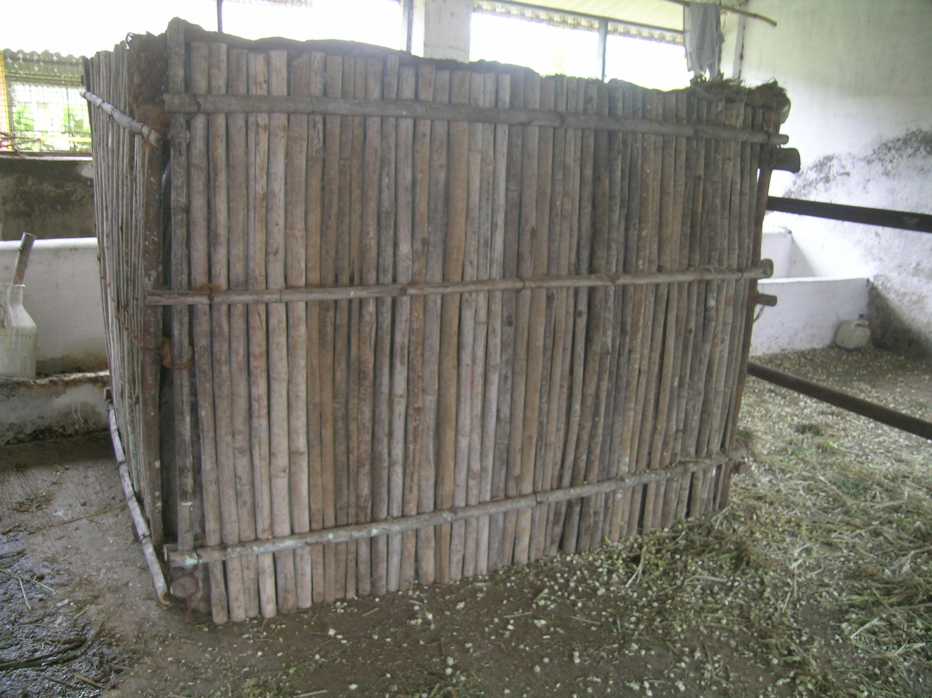

Slide 17
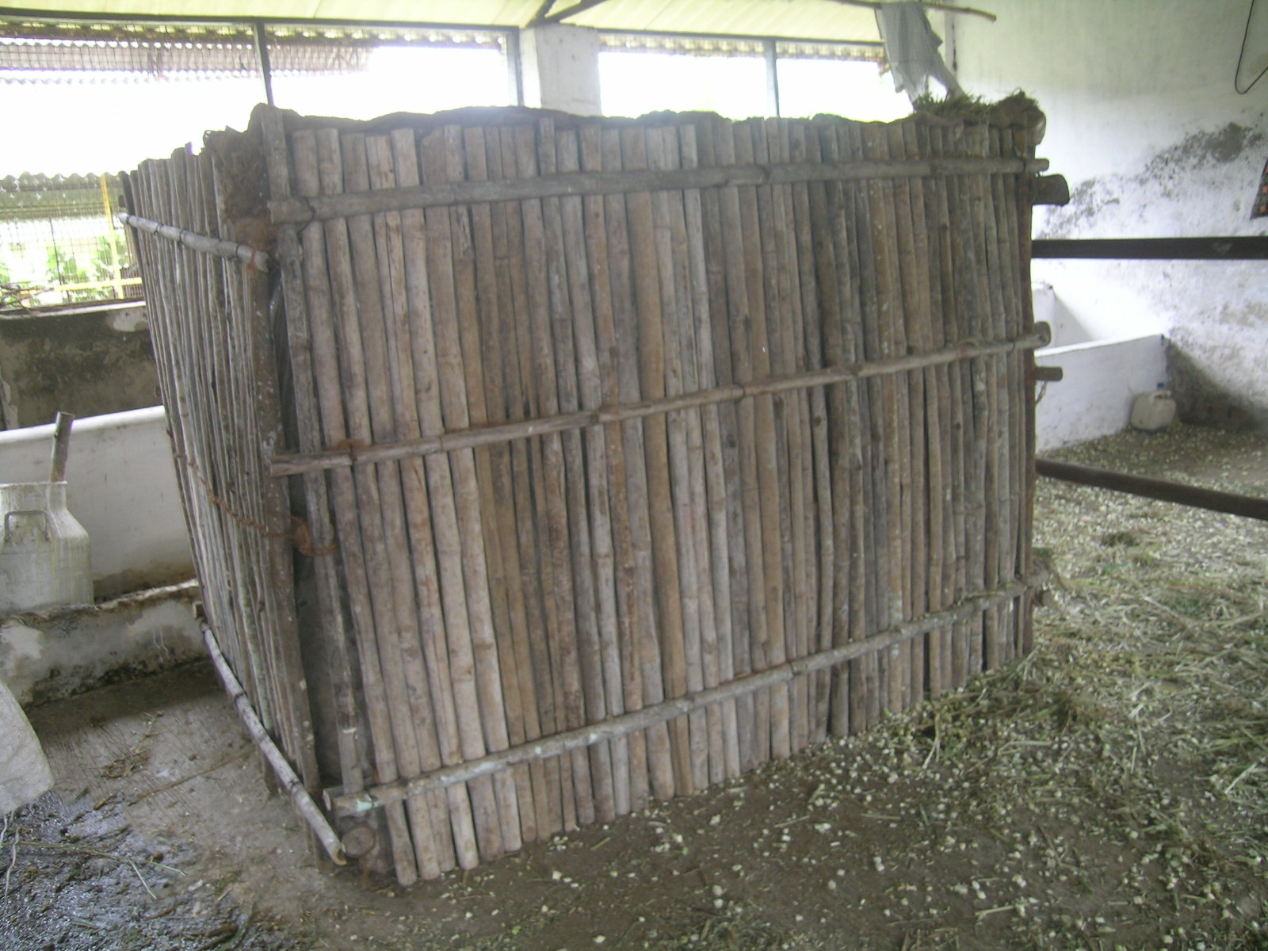

Slide 18
Bamboo Boxes

Slide 19
Easy to fabricate

Slide 20
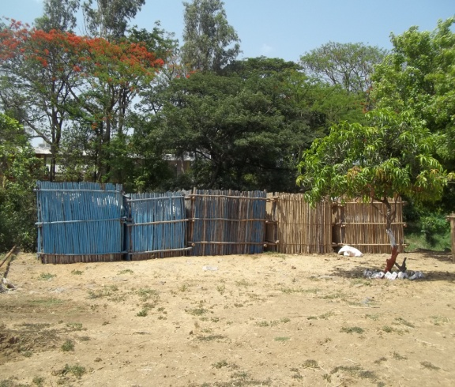
No. of bamboo box as per need can be prepared.
Bamboo boxes

Slide 21
Special design plastic bags Size– 3.5x 3.0x 4.0 ft. Capacity --- 600 to 800 kg.

Slide 22
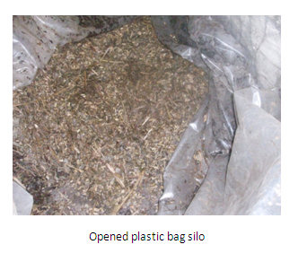
Physical and chemical quality as good as traditional type silage

Slide 23
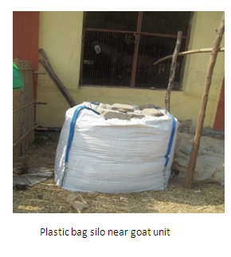
Plastic Bag

Slide 24
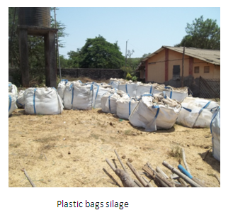
Multiple bags can used as per the
availability of green fodder

Slide 25
Plastic drums Capacity 120 to 160 kg of green fodder.

Slide 26
Reusable plastic drums

Slide 27
Composite Silages
Availability of large quantity of vegetable waste can be a cheap source of nutritive feedstuff and can be conserve by anerobic fermentation mixed with main crops.
Distillery Waste – Miaze bran / barley bran
Rich source of energy –
Highly perishable
But can be conserve by this technique with main crop.

Slide 28
Vegetable waste as a ingredient for composite silage

Slide 29
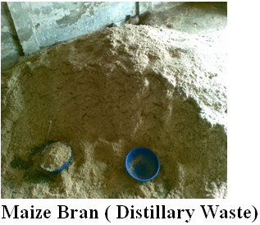
Maize bran ( distillery waste)
Rich source of carbohydrate for composite siagelage

Slide 30
Norms of silage making
Optimum stage of harvesting
Moisture percent in the crop or other ensiling material
Size of the particles
Proper impaction
Anaerobic condition
Safety of batch containers

Slide 31
Thanks

