Slide 1

Innate immunity in cardiology: vessel (coronary spasm) and valve (aortic stenosis)
Ming-Yow Hung, MD, FACC
Division of Cardiology, Department of Internal Medicine
Assistant Professor of Medicine, Taipei Medical University

Slide 2
Disclosure
None

Slide 3
(Heart attack) Myocardial infarction
Thygesen K, et al. Third universal definition of myocardial infarction. Circulation. 2012;126:2020-35.

Slide 4
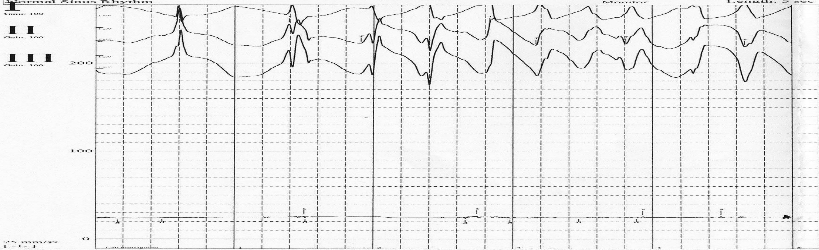
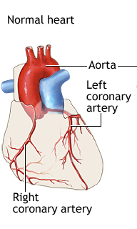
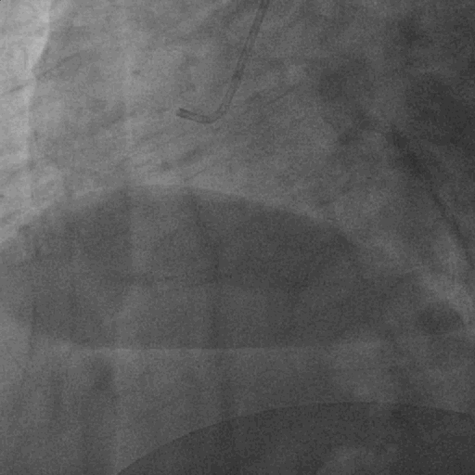

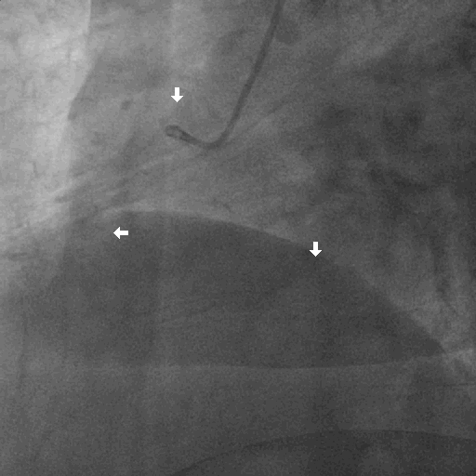

Slide 6
Frequency: Racial Hetereogeneity
In the US: 2-3% of all patients undergoing diagnostic cardiac catheterization for chest pain will subsequently be classified as having variant angina.
Internationally: In Italy, where rigorous inpatient electrocardiographic monitoring is frequently used, the incidence of variant angina in patients admitted with chest pain is approximately 10%.
Variant angina is particularly common in Japan with 20-30% of patients who undergo coronary angiography for chest pain assigned a diagnosis of vasospastic angina. Of these patients, 40-80% have angiographically normal coronary arteries. In Taiwan, 25% of unstable angina/myocardial infarction is due to coronary spasm. Among these patients, 57% is due to coronary spasm.
Andrew P Selwyn, Professor of Medicine, Harvard Medical School. 2005 online.

Slide 7
Sex and Age
The major prognostic studies of patients with variant angina confirm that 69-91% are male. Variant angina may be relatively more common in white female patients (22%) than in Japanese patients (11%).
Age: The mean age of patients with variant angina is 51-57 years.
Andrew P Selwyn, Professor of Medicine, Harvard Medical School. 2005 online.

Slide 8
Diagnosis
EKG and Exercise Tolerance Test: highly variable.
Coronary angiography is the criterion standard for the diagnosis of variant angina
Of the provocative test agents shown to induce coronary artery spasm in susceptible patients, ergonovine maleate, methylergonovine maleate, acetylcholine, or hyperventilation are the most useful. Ergonovine maleate for injection is no longer available.
Andrew P Selwyn, Professor of Medicine, Harvard Medical School. 2005 online.

Slide 9
Hung MJ, et al. Am J Cardiol. 2004;93(5):620-4.

Slide 10
Hung MJ, et al. Am J Cardiol. 2005;96(11):1484-90.

Slide 11
Hung MY, et al. Am J Med Sci. 2009 Dec;338(6):440-6.

Slide 12
Hung MY, et al. Eur J Clin Invest. 2010 Dec;40(12):1094-103.
JCS Joint Working Group. Circulation Journal. 2014;78(11): 2779-2801

Slide 13
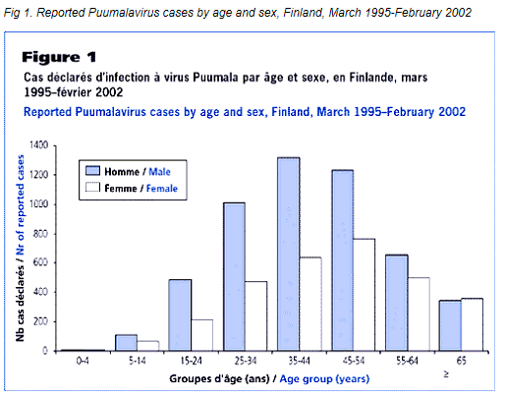

Slide 14
Hung MY,et al. Int J Med Sci. 2013;10:255-64.

Slide 15
Hung MJ, Hsu KH, Hu WS, Chang NC, Hung MY. PLoS One. 2013;8:e77655.

Slide 16
Hung MJ, et al. Int J Med Sci. 2014;11:1161-71.

Slide 17
Hung MJ, Hsu KH, Chang NC, Hung MY. J Am Coll Cardiol. 2015;65(18):2047-8.

Slide 18
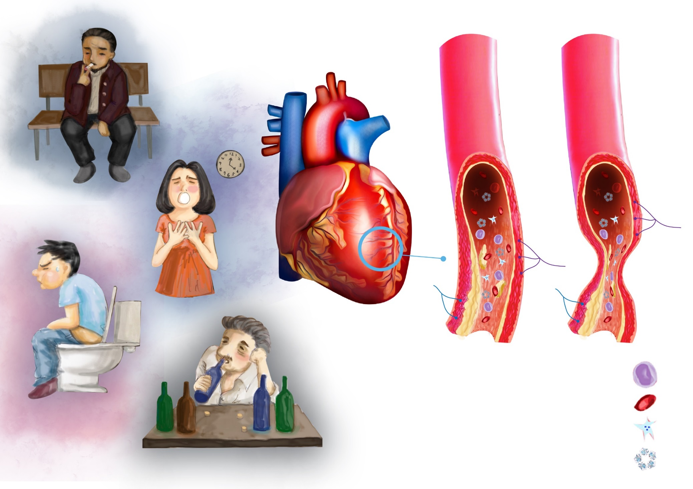
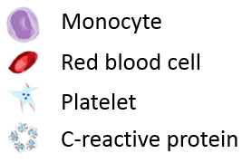
Summary
Monocyte
Red blood cell
Platelet
C-reactive protein

Slide 19
Aortic valve stenosis

Slide 20
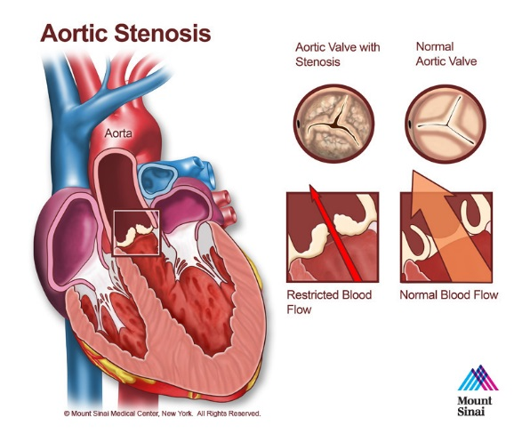
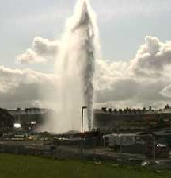
Notes:
In aortic stenosis, the amount of blood flow through the valve becomes less than that in normal aortic valve. It would appear like a cracked water pipeline through which the blood was forced out!

Slide 21
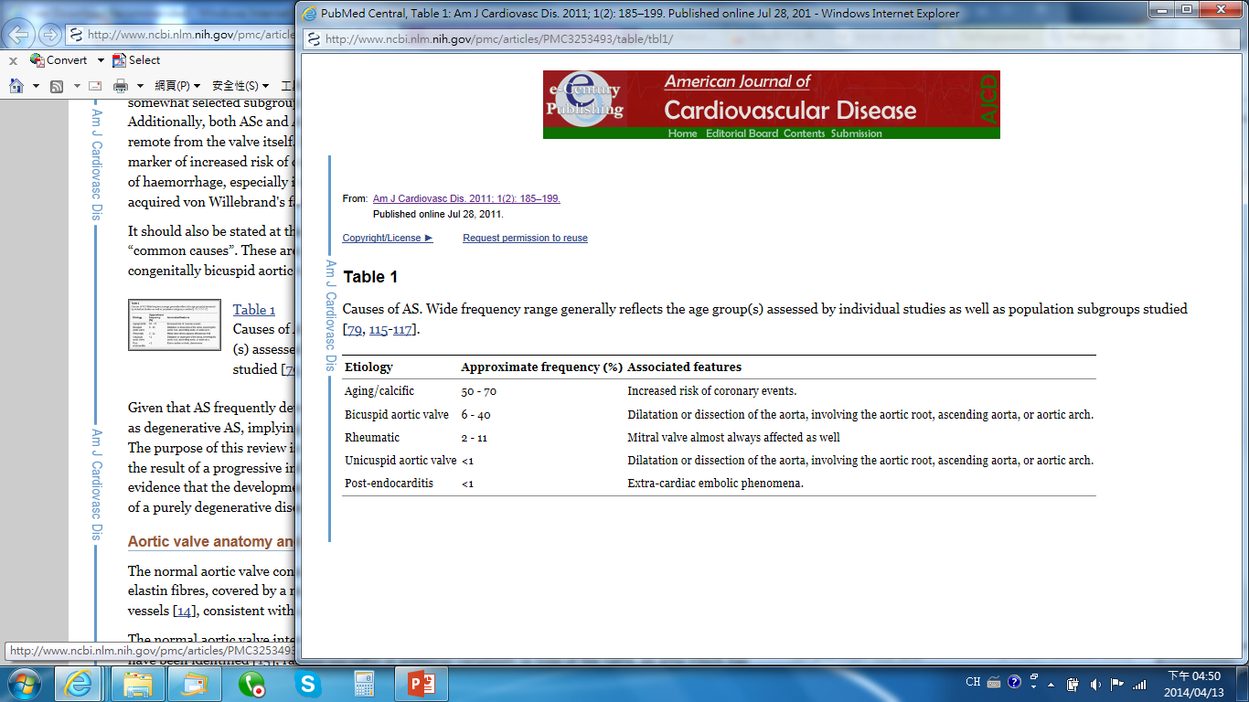
Aortic stenosis is the most common valvular heart disease in Western World
Manning, WJ (October 2013). "Asymptomatic aortic stenosis in the elderly: a clinical review". JAMA 310 (14): 1490–1497.

Slide 22
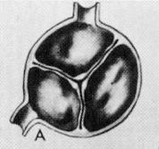
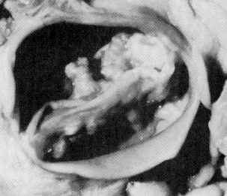
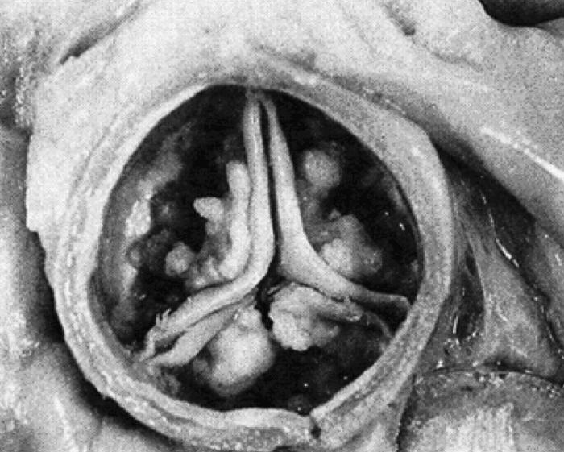
Aortic Stenosis: Etiology
Normal
Bicuspid calcific valve:
In many cases, it will cause no problems.
However it may become calcified later in life, leading to varying degrees of severity of aortic stenosis
Degenerattive calcific valve

Slide 23
Calcific Aortic Valve Stenosis (CAVS)
Can cause heart failure and sudden death.
Epidemiology: 2-3% over 75 y
  however, aortic valve sclerosis, not stenosis: 25 % over 65 y
  The earliest stages of CAVS is aortic sclerosis.
Risk factor: similar to atherosclerosis
  However, 50% CAVS don’t have clinical sig. atherosclerosis
  Exp. Models: 2 models in mice
    Other models develop only valve sclerosis
Hung MY, Witztum JL, Tsimikas S. J Am Coll Cardiol. 2014;63(5):478-80.

Slide 24
Interventions to retard progression of CAVS
Statins:
  No effect on CAVS progression
  Oxidative stress
    ?
Angiotensin Converting Enzyme Inhibitor (ACEI)
  No efftect
Angiotensin receptor-1 blocker (AT1r)
  Prevents inflammatory cell infiltration.
  Conflicting results, needs further study
  PPARγ
    prevent differentiation to osteoid cells, slow progression
    needs further study
Hung MY, Witztum JL, Tsimikas S. J Am Coll Cardiol. 2014 Feb 11;63(5):478-80.
Miller JD, et al. Circ Res. 2011 May 27;108(11):1392-412
Miller JD, et al. Circ Res. 2011 May 27;108(11):1392-412
Miller JD, et al. Circ Res. 2011 May 27;108(11):1392-412

Slide 25
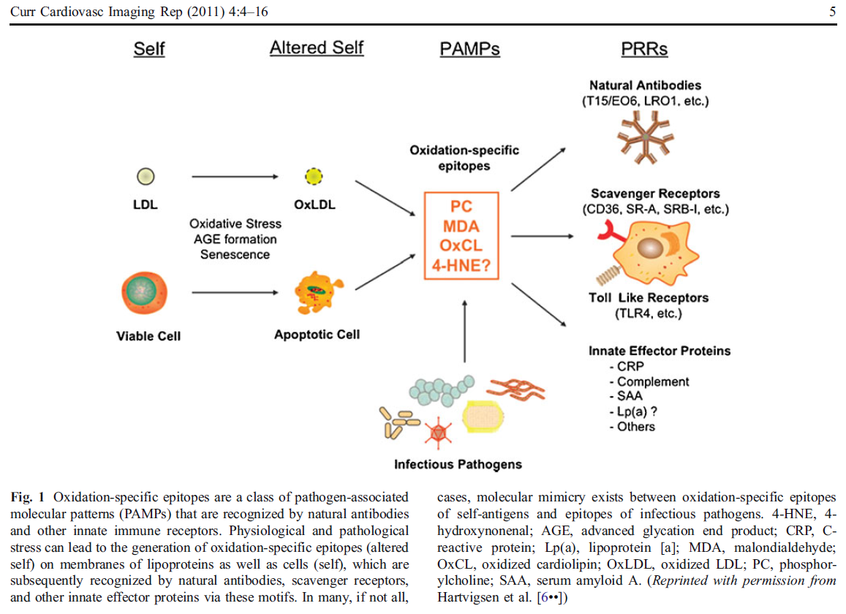

Slide 26
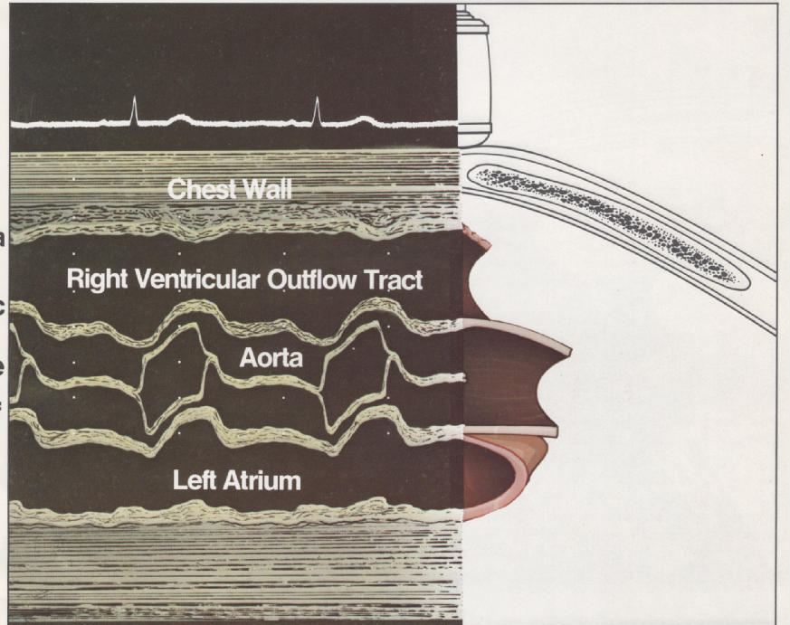
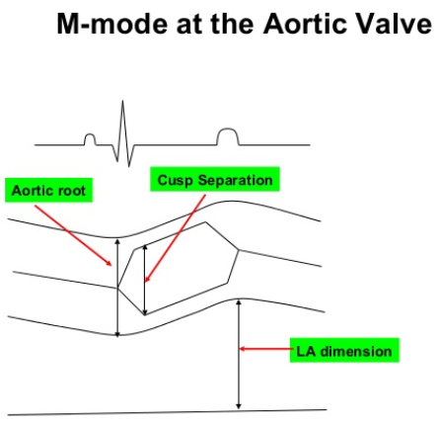
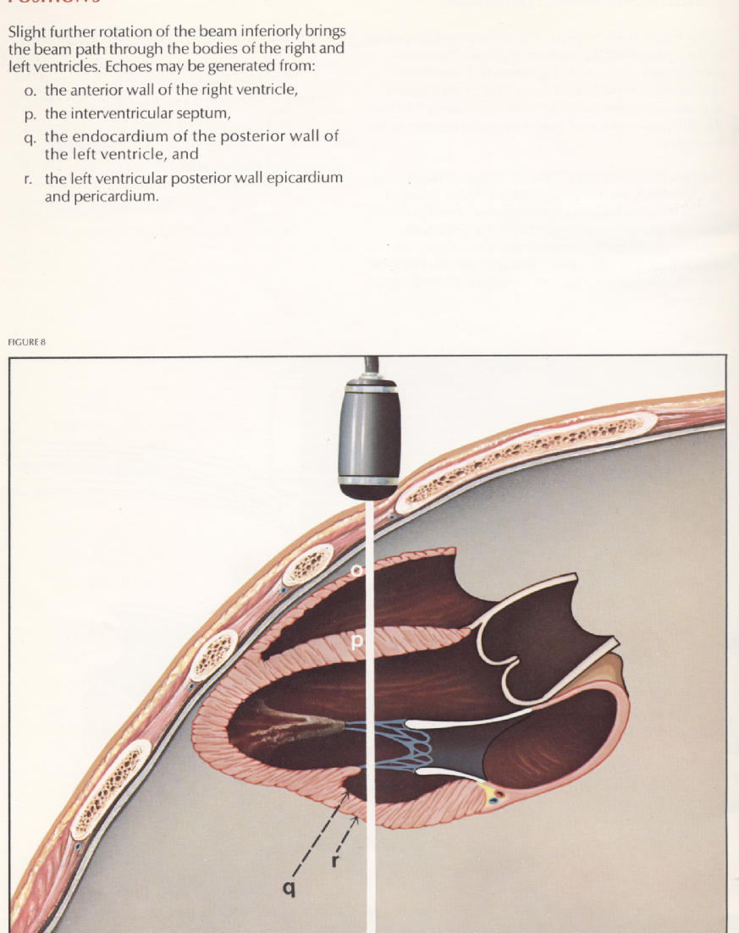
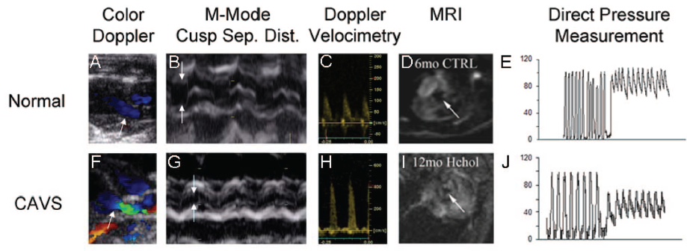
Echocardiography
B & G
LV
AO
200
100
LV
AO
Pressure drop
400
200
aliasing color flow
Miller JD, et al. Circ Res. 2011 May 27;108(11):1392-412

Slide 27
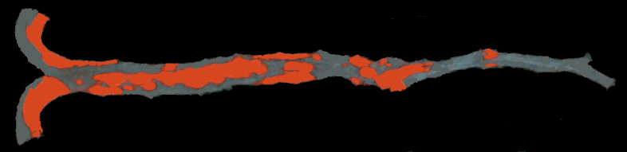
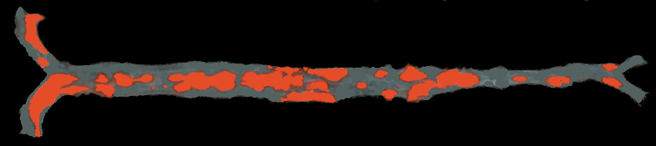
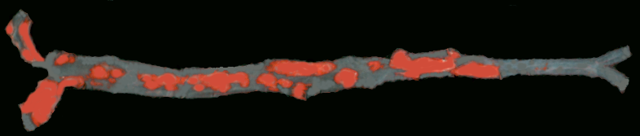
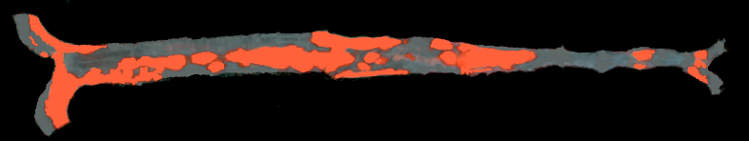
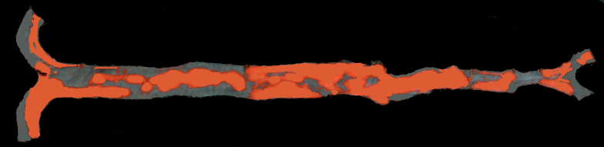
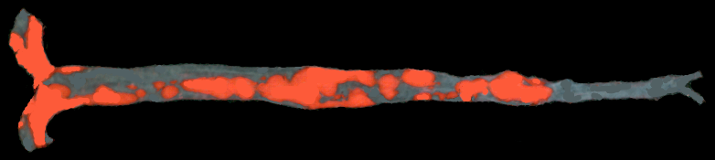
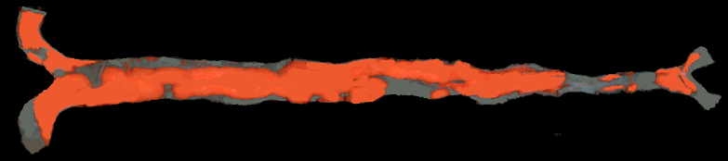
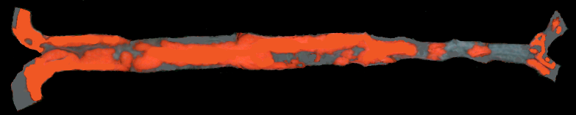
AS cohort 1
LDLR-KO/EO6-tg
1 2 3 4
LDLR-KO
UCSD.
Unpublished data
1 3 6 7

Slide 28
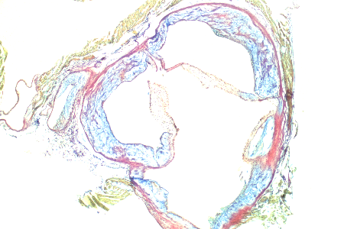
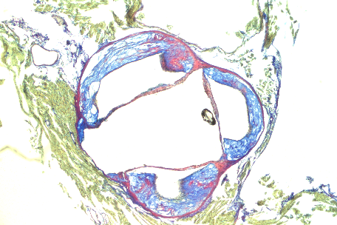
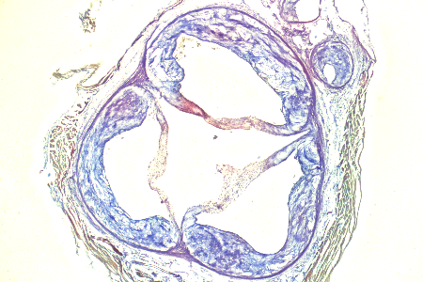
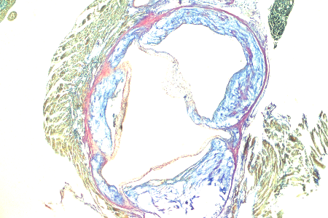
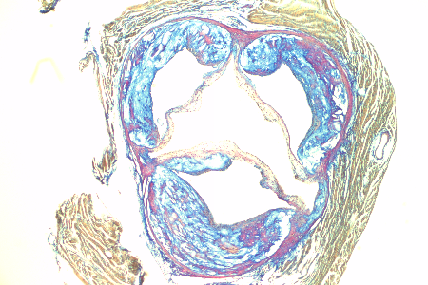
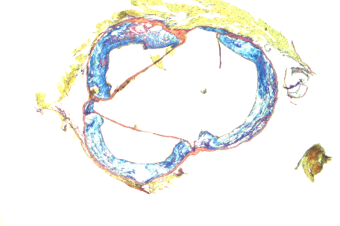
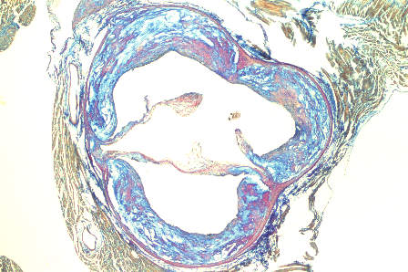
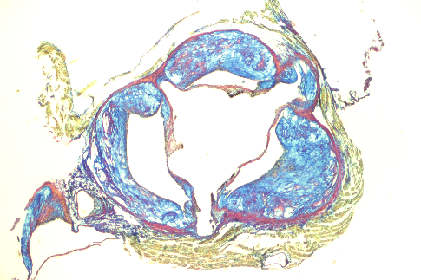
AS cohort 1
LDLR-KO/EO6-tg
LDLR-KO
UCSD.
Unpublished data

Slide 29
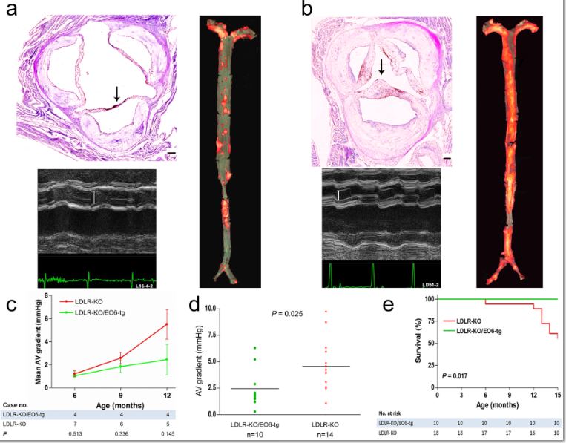
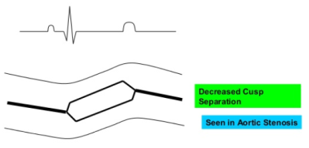
LDLR-KO/EO6-tg
LDLR-KO
Cohort 1
Cohort 1+2+3
UCSD.
Unpublished data
Notes:
Figure 1. Profile of aortic valve hemodynamics and atherosclerotic lesions. ). (a, b) Representative photographs of the LDLR-KO/EO6-tg (a) and LDLR-KO mice (b). M-mode echocardiograms (left upper panels) demonstrate larger aortic cusp separation (vertical white bar) in the LDLR-KO/EO6-tg mouse than that in the LDLR-KO mouse (1.1 vs. 0.9 mm, respectively). Verhoeff-Van Gieson stained sections (left lower panels) show the increased thickness of the valve leaflets in LDLR-KO mouse. Mineralization of tissue appears as discreet dark foci. Bar = 100 μm. En face preparations (right panels) of Sudan IV-stained aortas reveal significantly increased atherosclerotic lesion size in the LDLR-KO mouse than in the LDLR-KO/EO6-tg mouse (P = 0.007 between 2 groups). (c) Changes in peak transvalvular systolic pressure gradients over time. A trend was seen towards significantly higher gradient in the LDLR-KO mice (n = 18) than in the LDLR-KO/EO6-tg mice (n = 10). (d) Peak transvalvular systolic pressure gradient at the age of 12 months. Each symbol represents one animal; bars represent means. The mean value of the gradient in the LDLR-KO mice (n = 14) was significantly higher than in the LDLR-KO/EO6-tg mice (n = 10 (e) Kaplan –Meier survival curve for LDLR-KO and LDLR-KO/EO6-tg mice. P value was derived from log-rank calculation.

Slide 30

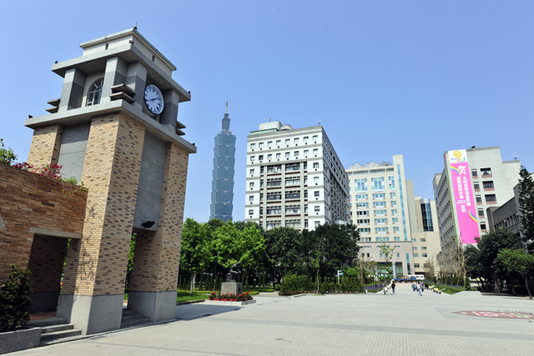


Sotirios Tsimikas, MD
Director of Vascular Medicine
Professor of Medicine
University of California, San Diego
Joseph L. Witztum
University of California, San Diego
LIPID MAPS Bridge Director
Ming-Yow Hung, MD, FACC
Email: myhung6@ms77.hinet.net

