Slide 1
Cytotoxic Necrotizing Factor-1 Toxin in Uropathogenic E. coli
Is There a Role for Virulence Factors in Urinary Tract Infection?
MH Wang, JE Michaud, W Harty, and KS Kim
Ming-Hsien Wang, MD
Spiegel/Nichols Assistant Professor of Pediatric Urology
Brady Urological Institute
Johns Hopkins Medical Institutions

Slide 2
Acknowledgements
This work was supported in part by NIH grants, NS26310 and AI84984
The authors declare no conflict of interest

Slide 3
Background
UTI is common in children, accounting for 1 million visits to the pediatrician yearly (NIH)
Incidence of UTI in children <6 years old:
3-7% in girls
1-2% in boys
Risk of recurrence is 40-60%
Studies on pediatric UTIs are important because of risk of hypertension, chronic kidney disease

Slide 4
Prevalence of UTI in the Pediatric Population
Utilization of Care for UTIs in the U.S.
Rate of visit per 100,000
Freedman A. Journal of Urology. Vol. 173, 949–954, March 2005
Notes:
Rates of visits for UTI per 100,000 from national insurance and medicare databases.
Most visits to pediatrician.

Slide 5
Prevalence of UTI in the Pediatric Population
Byington C, Rittichier K, et. al. Pediatrics 2003;111;964
Notes:
Etiology of Neonates <90 days old admitted to children’s hospital with fever.

Slide 6
Renal Consequences of Pyelonephritis
Age Distribution and Renal Scarring in Patients with Pyelonephritis
No. of Patients
Age at Diagnosis of Pyelonephritis
Jakobsson B, Berg J, et. al. Archives of Disease in Childhood 1994; 70: 111-115

Slide 7
Challenges
Rising incidence of antibiotic-resistant bacteria
Widespread use of antibiotics
Pathogenesis of UTI is multifactorial
Host and bacterial phenotypes play critical roles
Therefore, it is important to be able to examine bacterial pathogenicity in a variety of ways, including in vivo models

Slide 8
E. coli
Most common pathogen in UTI
50-80% of all culture-proven UTIs
UTI-associated pathogenic E. coli (UPEC) isolates express cytotoxic necrotizing factor 1 (CNF-1)
CNF-1 expressing E. coli have been shown in vitro to release proinflammatory cytokines and to exhibit resistance to host neutrophil and monocyte phagocytosis

Slide 9
Virulence factors in Uropathogenic E. coli isolates
cnf-1 and hly are inherited as a pathogenicity island and are part of the prs operon
E. Moreno et al. / Diag. Micro. ID. 53 (2005) 93–99

Slide 10
CNF-1
Found in strains of E. coli implicated in UTI and neonatal meningitis
CNF-1 belongs to a group of cytotoxins that cause activation of Rho guanosine triphosphatases (GTPases)
Alters host cell actin cytoskeleton
Promotes bacterial invasion of endothelium that comprises blood-brain barrier
Wang MH, Kim KS. Cytotoxic Necrotizing Factor 1 Contributes to Escherichia coli Meningitis. Toxins. 2013; 5(11): 2270-2280.

Slide 11
CNF-1
However, there have been conflicting reports on the exact role of the E. coli cytotoxic necrotizing factor-1 (CNF-1) in the pathogenesis of UTI

Slide 12
Goals
Establish a murine model for examination of uropathogenic E. coli in the urinary tract
Elucidate the role of CNF-1 in UTIs

Slide 13
Materials/Methods
Targeted deletion of cnf-1 in the isolate of UPEC (cnf-1-null strain)
Comparative studies in several mouse strains, with transurethral inoculations of wild-type or cnf-1-null strain UPEC
1-2 x 10⁷ CFU/ mouse in 50 µl of PBS
Urine samples were collected and plated to verify pre-inoculation sterility
At various time points, kidney and bladder tissues were harvested and analyzed for inflammation and bacterial burden

Slide 14
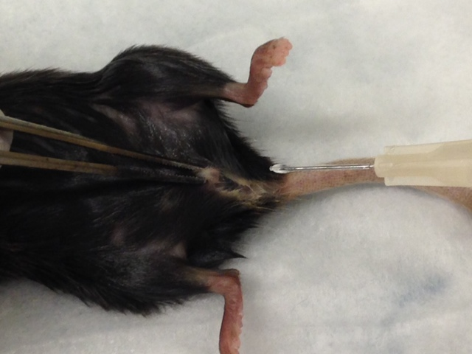
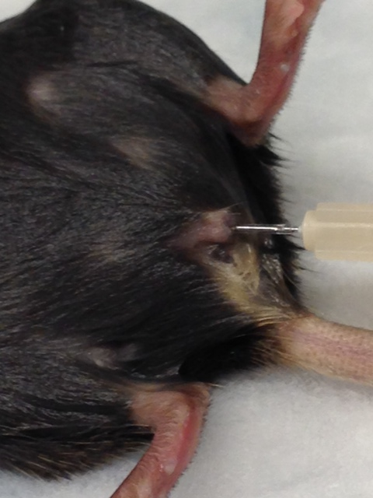
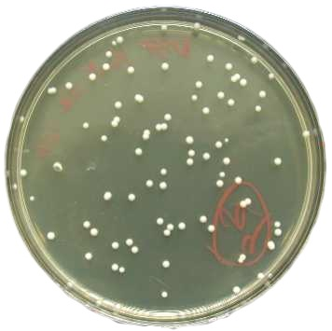
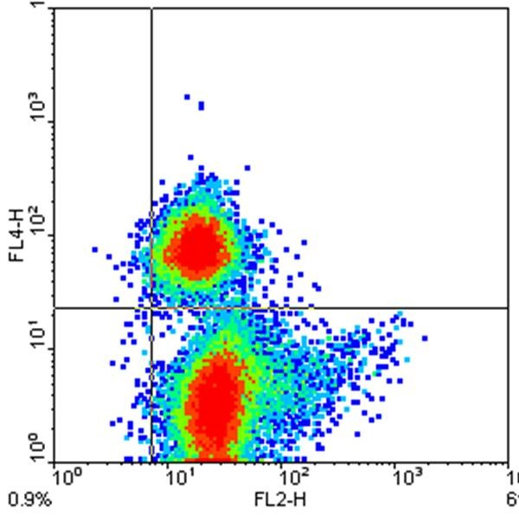
Murine Model of Cystitis and Pyelonephritis
Transurethral E. coli
Inoculation
Outcomes
Bacterial Burden
Inflammatory
Response
Kidney and bladder bacterial cultures
Pathology and Flow cytometry

Slide 15
Results
Bacterial counts were consistently present in infected mice, and absent from control mice (PBS)
Both the wild-type UPEC strain and the cnf-1 null strain caused robust and reproducible bladder and kidney infections

Slide 16
Examination of cnf-1 in Murine UTI
Bacterial burdens of mice infected with wild-type or cnf-1-null E. coli were not significantly different
Notes:
Etiology of Neonates <90 days old admitted to children’s hospital with fever.

Slide 17
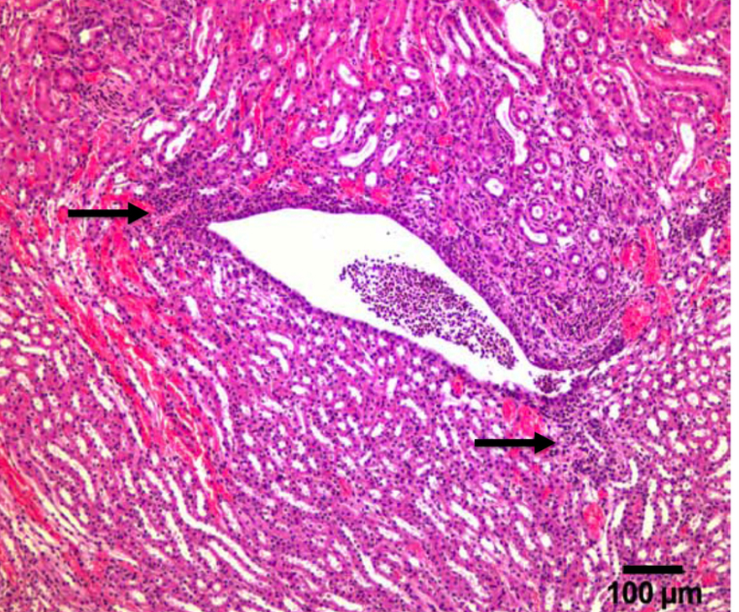
Examination of Inflammation in Murine UTI
Bladder
Kidney
Preliminary data show no alteration in inflammation with cnf-1-null bacteria

Slide 18
Conclusions
A role for CNF-1 in the pathogenesis of UTI is often inferred from the prevalence of CNF-1 expression in clinical isolates of UPEC
Our preliminary data casts doubt on the clinical virulence of CNF-1
Additional studies are in place to study potential genetic linkage of cnf-1 with other factors that might increase UPEC clinical virulence

Slide 19
Acknowledgments
Department of Urology
Pediatric Infectious Disease
Jason E. Michaud, MD, PhD
William Harty, BS
Kwang Sik Kim, MD
Donna Pierce
Thank You!

Slide 20
References
Byington C, Rittichier K, et. al. Pediatrics 2003;111;964
Freedman A. Journal of Urology. Vol. 173, 949–954, March 2005
Jakobsson B, Berg J, et. al. Archives of Disease in Childhood 1994; 70: 111-115
Krieger JN, Nyberg L Jr, Nickel JA. NIH consensus definition and classification of UTI. JAMA 282:235-237, 1999.
National Collaborating Centre for Women’s and Children’s Health Clinical Guideline, Urinary tract infection in children diagnosis, treatment and long-term management, Clinical Guideline, August 2007.
Bergstrdm, T. Sex differences in childhood urinary tract infection. Archives of Disease in Childhood, 47, 227, 1972.
Goossens H, Ferech M, Vander Stichele R, Elseviers M. Outpatient antibiotic use in Europe and association with resistance: a cross-national database study. Lancet 365 (9459): 579–87, 2005.
Mears EM. UTI – a review. Urol Clin North Am 2:3-27, 1975.
Lipsky BA, Byren I, Hoey CT. Treatment of bacterial UTI Clin Infect Dis 50:1641-1652, 2010.
Andreu A, Stapleton AE, Fennell C, Lockman HA, Xercavins M, Fernandez F, Stamm WE. Urovirulence determinants in Escherichia coli strains causing UTI. J Infect Dis 176:464-469, 1997.
Mitsumori K, Terai A, Yamamoto S, Ishitoya S, Yoshida O. Virulence characteristics of Escherichia coli in acute bacterial UTI. J Infect Dis 180:1378-1381, 1999.

Slide 21
Ruiz J, Simon K, Horcajada JP, Velasco M, Barranco M, Roig G, Moreno-Martinez A, Martinez JA, Jimenez de Anta T, Mensa J, Vila J. Differences in virulence factors among clinical isolates of Escherichia coli causing cystitis and pyelonephritis in women and UTI in men. J Clin Microbiol 40:4445-4449, 2002.
Terai A, Yamamoto S, Mitsumori K, Okada Y, Kurazono H, Takeda Y, Yoshida O. Escherichia coli virulence factors and serotypes in acute bacterial UTI. Int J Urol 4:289-294, 1997.
Rippere-Lampe K, Lang M, Ceri H, Olson M, Lockman HA, O’Brien AD. Cytotoxic necrotizing factor 1-positive Escherichia coli causes increased inflammation and tissue damage to the prostate in a rat UTI model. Infect Immun 69:6515-6519, 2001.
Rippere-Lampe K, O’Brien AD, Conran R, Lockman HA. Mutation of the gene encoding cytotoxic necrotizing factor 1 (cnf1) attenuates the virulence of uropathogenic Escherichia coli. Infect Immun 69:3954-3964, 2001.
Boquet P. The cytotoxic necrotizing factor 1 (CNF1) from Escherichia coli. Toxicon 39:1673-1680, 2001.
Falzano L, Quaranta MG, Travaglione S, Filippini P, Fabbri A, Viora M, Donelli G, Fiorentini. Cytotoxic necrotizing factor 1 enhances reactive oxygene species-dependent transcription and secretion of proinflammatory cytokines in human uroepithelial cells. Infect Immun 71:4178-4181, 2003.
E. Moreno et al. / Diagnostic Microbiology and Infectious Disease 53 (2005) 93–99

