Slide 1
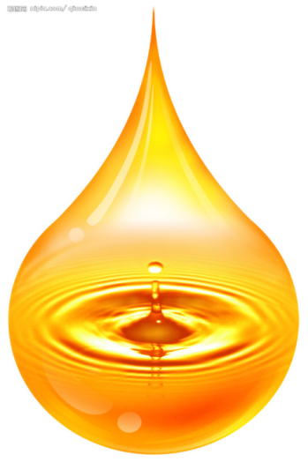

Comparison between different sesame oil production techniques for lignans
Ming-Chang Wu
National Pingtung University of Science and Technology Department of Food Science
20170909

Slide 2
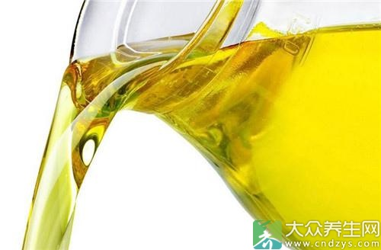

Outline
Introduction
Objective
Experimental design
Conclusions
Results
Materials and methods

Slide 3

Introduction

Slide 4
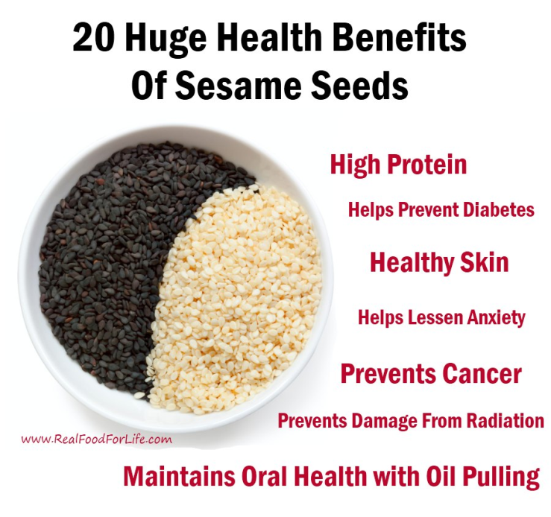
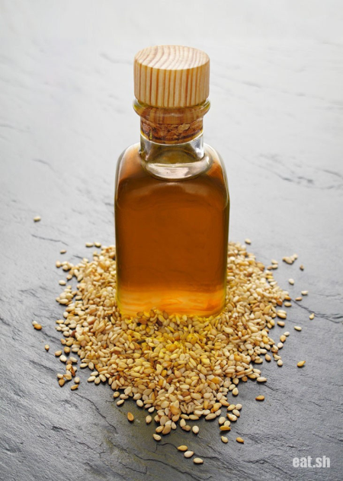
Introduction
Sesame is an important oilseed crop in the world and provides a good source of edible gourmet oil.
Sesame serves as a nutritious food for humans.
(Chen et al., 2005)
(http://realfoodforlife.com/20-health-benefits-of-sesame/)
(http://eat.sh/8769.html)
Notes:
There are many benefit in sesame ,such as high protein and healthy skin
Most Taiwan people intake sesame by oil form.
焙烤是用於生產芝麻油的基本操作，目的在於促進風味以及生成理想的褐色。
研究報導顯示建議最佳的條件為110–150 °C ,焙烤40–60 min

Slide 5
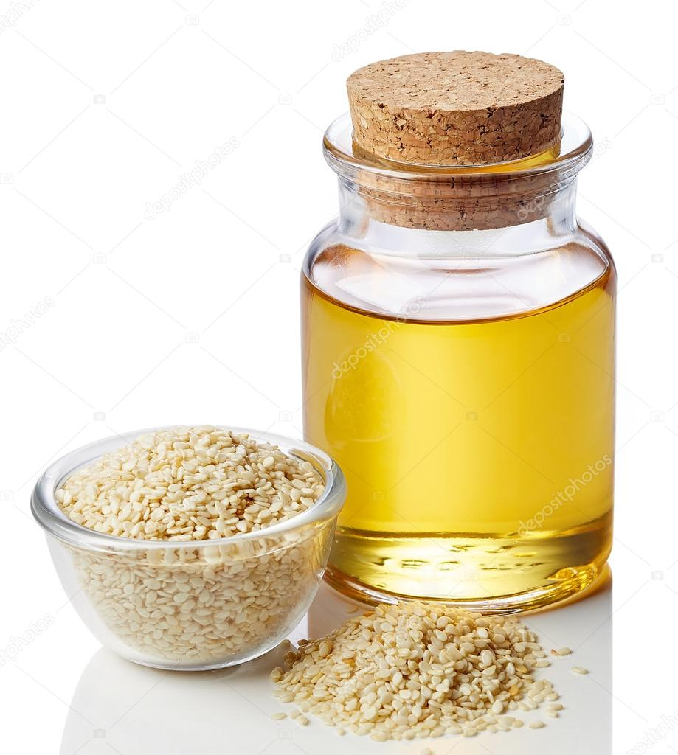
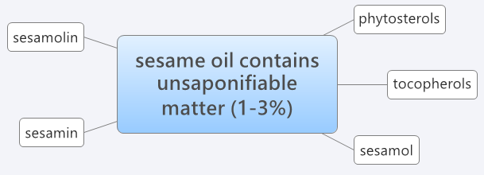
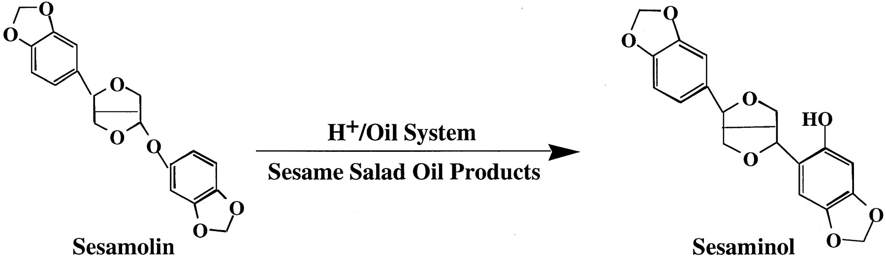
Sesame oil
(Kochhar, 2002)
(Karnika and Naik, 2014)
Notes:
芝麻油含有1~3%的非皂化物 包括芝麻素 芝麻林素 植物固醇 生育酚 芝麻酚等
芝麻林素透過精緻或是加熱的過程會轉變成芝麻素酚 芝麻酚

Slide 6
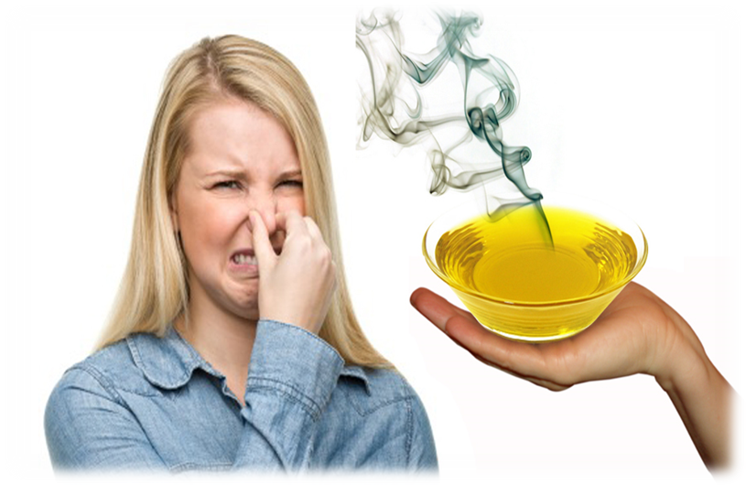
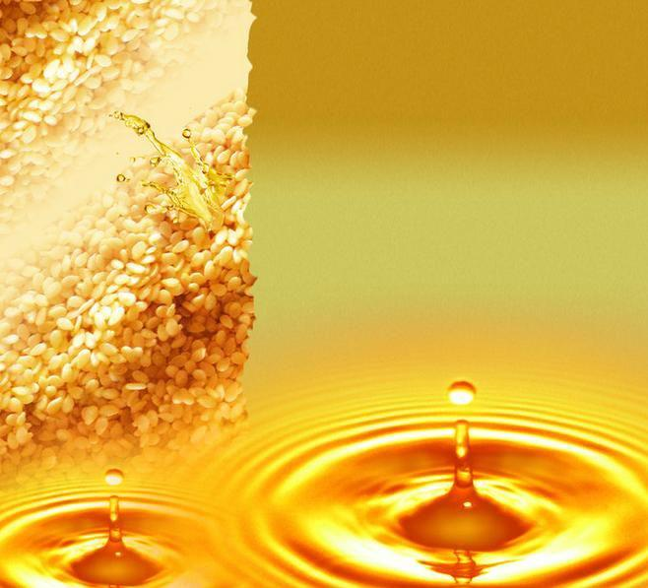
Introduction
Lipid oxidation has been recognized as the major
problem affecting edible oils, as it is the cause of
important deteriorative changes in their chemical,
sensory and nutritional properties.
While peroxides are unstable on heating and transform rapidly to secondary oxidation products . Therefore, estimate absolute oxidative state of oil requires three different oxidation parameters.
The remarkable stability of sesame oil may be due to the presence of unique unsaponifiable constituents namely lignans and tocopherols.
(Velasco et al., 2002)
(Suja et al., 2004)
Sesame oil is known to be significantly resistant to oxidative rancidity.
(Chen et al., 2005)
Notes:
While peroxides are unstable on heating and transform rapidly to secondary oxidation products . Therefore, estimate absolute oxidative state of oil requires three different oxidation parameters.
影響食用油品質的問題來自於”油脂氧化”
芝麻油有較好的抗氧化酸敗的能力

Slide 7
According to the previous research, the most lignans in sesame is sesamin, sesamolin and sesamol.
After heating or acid processing ,the sesamolin will turn into the other kinds of lignans - sesamol. As a result, the sesamol is mainly exist in the hot processing sesame and sesame oil.
(Kamal-Eldin et al., 1995)

Slide 8
Cold-pressing is a special processing procedure
commercially used to produce edible oils.
Therefore, cold-pressed oils rich in α-linolenic acid may be an excellent dietary source of n-3 PUFAs. In addition to their fatty acid contents, shelf stability is a critical factor for the potential food applications of the cold-pressed oils.
Cold-pressed oils may retain a greater level of natural antioxidants than conventionally processed oils and exhibit acceptable oxidative stability and improved safety without added synthetic antioxidants.
(Yu et al., 2002)
(Parker et al., 2003)
Notes:
Parker等於2003年的研究說明，冷壓技術是目前最適合製造高品質、高營養價值食用油脂的技術之一，製造過程不會對原料產生熱破壞。除此之外，冷壓油可能是n-3多元不飽和脂肪酸的極好的膳食來源之一。另外一方面，冷壓油製程無有機溶劑參與，無須擔心有機溶劑殘留。而且比有機溶劑萃取油脂含有更多的天然營養成分（同時也是油脂中的抗氧化劑），並且無須額外添加人工合成的抗氧化劑（如：BHT）即可呈現量好的氧化穩定性。

Slide 9
Compare with the traditional sesame oils, cold-pressed oils have awesome characteristics, like light color, high nutritional value. The use of cold-pressed sesame oil as frying oil, not only increase the nutritional value of fried foods also fried foods will have a special sesame oil flavor.
After 24-hours frying test, the results showed that the content of benzopyrene was no significant difference, which was about 1.16 μg/kg (far lower than the international standard value of 10 μg/kg). And after 18 hours , carbonyl value reached 59.01 meq/kg (more than the international standard value of 50 meq/kg), so the results of cold-pressed sesame oil for fry should be set up at 17 hours.
(Huang et al., 2009)
Notes:
黃等於2009年指出，經由冷壓技術製得冷壓芝麻油與傳統芝麻油相較之下，具有以下特點：色澤淺、風味清香淡雅、高營養價值。楊雅新等於2016年指出，將冷壓芝麻油用作煎炸油使用，不僅增加油炸食品之營養價值而且煎炸過程中會有芝麻油特殊的香味，使煎炸物風味更佳。藉由24小時之煎炸試驗測定冷壓芝麻油的煎炸效果，結果顯示：苯駢芘（benzopyrene）含量無顯著差異，約為1.16 μg/kg（遠低於的國際標準值10 μg/kg）；18小時時羰基價達到 59.01 meq/kg（超過國際標準值50 meq/kg），結果確立冷壓芝麻油適用煎炸壽命為17小時。

Slide 10
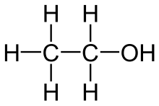
Ethanol is recognized as non-toxic and has less handling risks than other solvent such as hexane and
acetonitrile .
In addition to triglycerides , during the extraction process other compounds such as polyphenols, pigments are extracted jointly.
(Yu et al., 2002)
(wikipedia)
Notes:
利用乙醇提取技術具有生產能力大、便於連續操作、容易實現自動化、溶劑價格相對比較便宜、便於回收利用等優點。乙醇為目前所知最低毒性且最環保的溶劑，因其具有羥基（即氫氧基團）故在萃取油脂可以同時萃取脂溶性以及水溶性抗氧化物質。

Slide 11
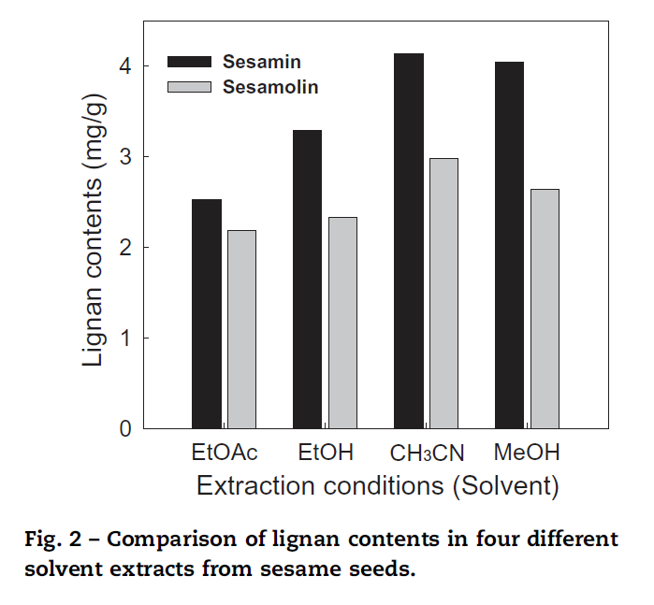
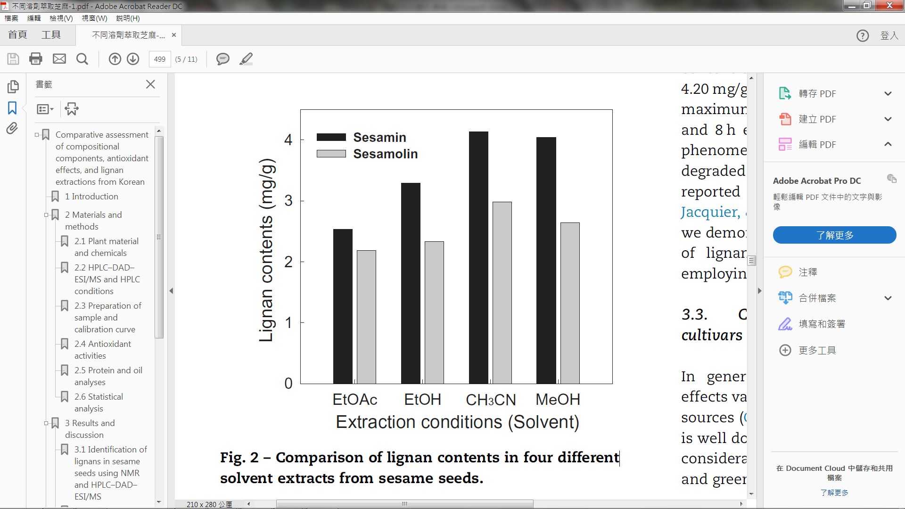
4.13
3.29
2.98
2.33
Fig 1.
(Kim et al.,2014_
Notes:
圖一，為Kim等於2014年之研究報告顯示，利用不同濃度之乙酸乙酯、乙醇、甲醇和乙晴和不同溫度萃取之麻種籽的木酚素，發現以90%乙晴於常溫下萃取6小時可以獲得最好的含量分別為sesamin：4.13 mg/g 以及sesamolin：2.98 mg/g；而乙醇萃取也有3.29 mg/g與2.33 mg/g的表現。

Slide 12
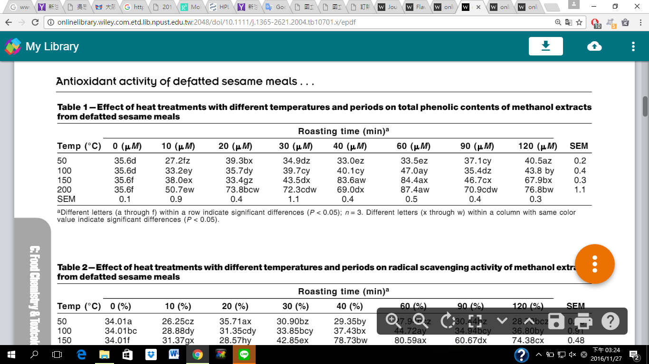
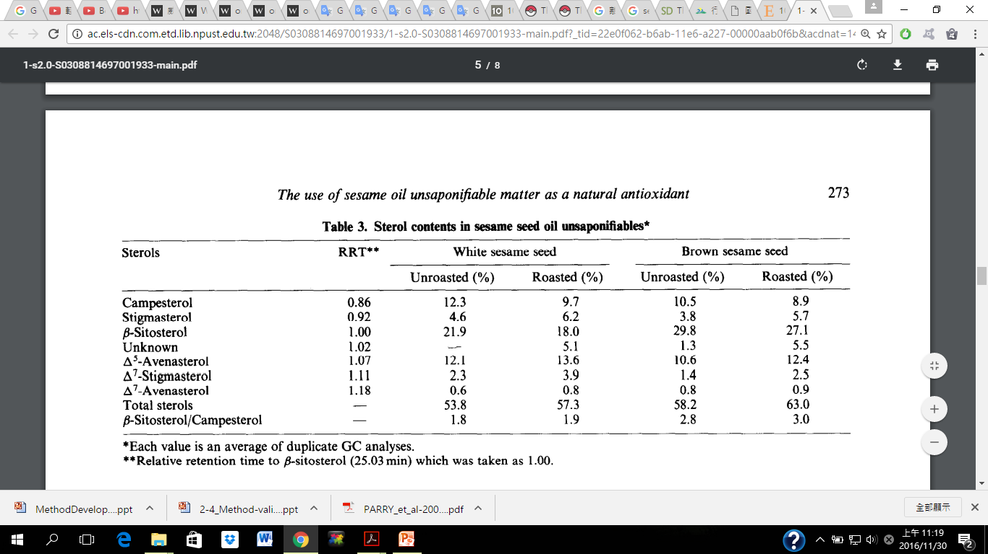
Table 1.
(S.-M. JEONG et al., 2004)
Notes:
Table 1 shows heating treatment……
We can see at 150 and200 度C with 60 mins got the highest concentration of phenolic contents.

Slide 13

Objective
The objective is to evaluate the shelf life of sesame oils from difference extraction methods.
Ethanol extraction method can increase the antioxidants contents which was compared to the tradition heating process in sesame oil.

Slide 14
Experimental design

Slide 15
Traditional processing oils and ethanol extract oils
（120°C, 150°C , 180°C , 210°C ; 30% , 50% , 75% , 95%)
(Part 1)
Quality test
Color
Antioxidant capacity
Acid
Value
Peroxide
Value
Thiobarbituric acid value
Total phenolic and flavonoid contents
DPPH and ABTS radical scavenging activity
Reducing power and Ferrous iron chelating ability
Lignans contents by HPLC
Oven test by incubation at 65°C
(120°C、210°C、30% oils)
(Part 2)
Acid
Value
Peroxide
Value
Total phenolic and flavonoid contents
Lignans contents by HPLC
Color

Slide 16
Materials and methods

Slide 17
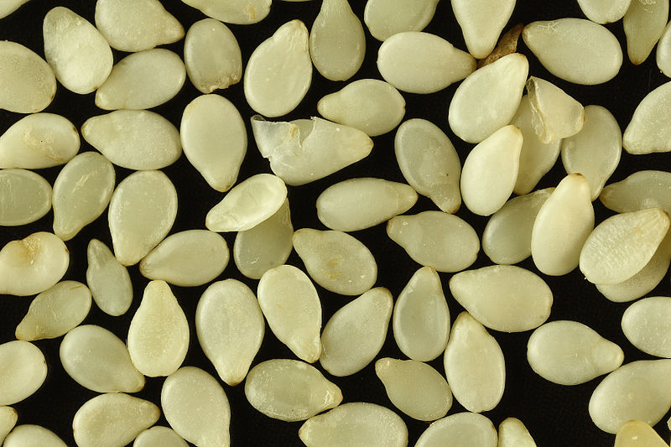
Materials and Methods
Sample preparation
White Sesame ( Sesamum indicum L.) from India

Slide 18
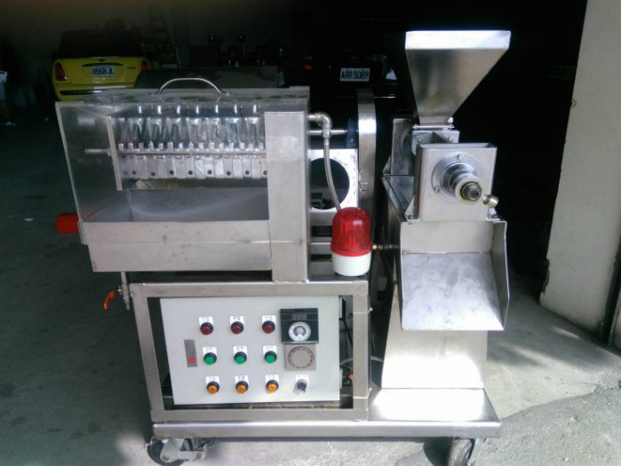
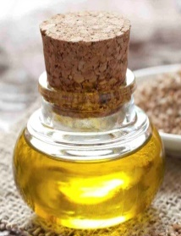

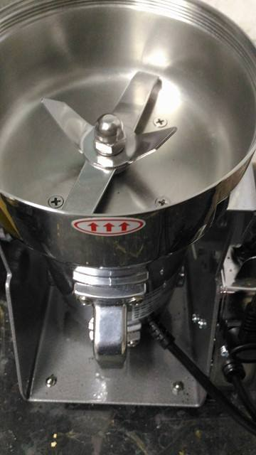
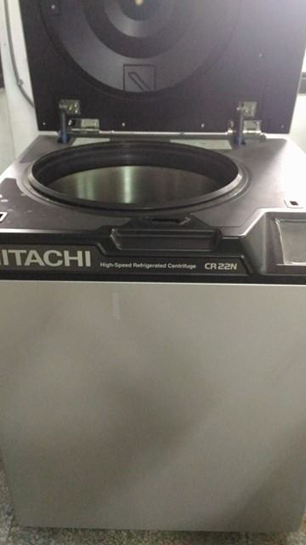
Traditional processing oils
Roast
Squeezing
Ethanol extract oils
Crushed
Soaked with ethanol
Filter with filtering cloth
Centrifuge
Notes:
樣品白芝麻已直立式螺旋榨油機製備，經不同溫度（120℃、150℃、180℃及210℃）炒焙30分鐘後，趁熱壓榨及裝瓶，製備四組熱加工芝麻油。
樣品白芝麻先已粉碎機破碎，經不同乙醇濃度（30%、50%、75%及95%），於室溫下浸泡30分鐘後經孔徑200 mesh之濾布加以壓榨，取得粗萃液，經離心機（8000 rpm, 4℃）離心10分鐘，蒐集油層，最後以減壓濃縮確保乙醇無殘留於最終樣品，如此製備四組乙醇萃取芝麻油。

Slide 19
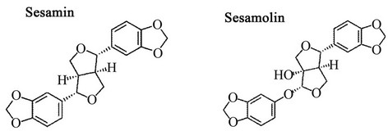
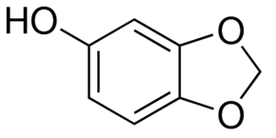
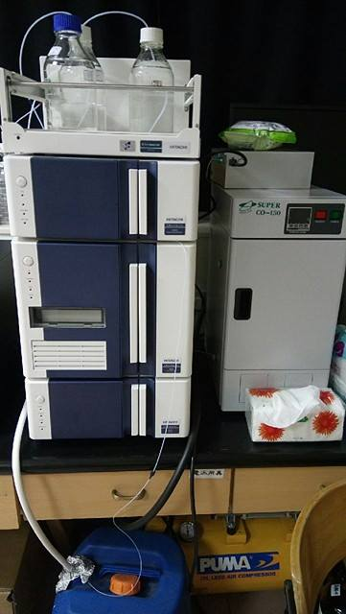
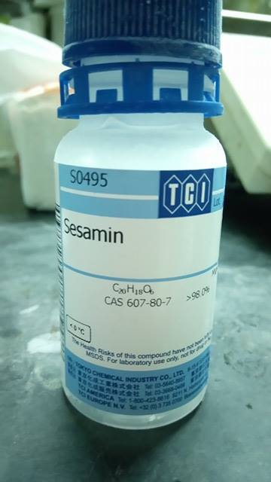
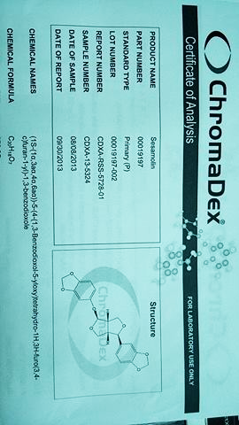
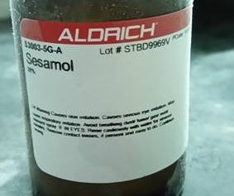
Sesamin
5,5'-(1S,3aR,4S,6aR)-tetrahydro-1H,3H- furo[3,4-c]furan-1,4-diylbis(1,3-benzodioxole)
C₂₀H₁₈O₆
HPLC analysis for
Sesamin, Sesamolin and Sesamol
Sesamolin
5-[4-(1,3-benzodioxolol-5-yloxy)tetrahydro-1h,3h-furo[3,4-c]furan-1-yl]-1,3-benzodioxole
C₂₀H₁₈O₇
Sesamol
3,4-(Methylenedioxy)phenol, 5-Benzodioxolol
C₇H₆O₃
Columns: RP-18 GP, 4.6 x 250mm, 5 µm
Mobile Phase: MeOH(A solution) and H₂O (B solution)
Temperature: 30°C
Flow Rate: 1ml/min
Detection: UV 290 nm
Time | A solution(%) | B solution(%)
0 | 40 | 60
1➞5 | 50 | 50
6➞25 | 70 | 30
HPLC Chromaster 5430 DAD

Slide 20
Results-part 1

Slide 21
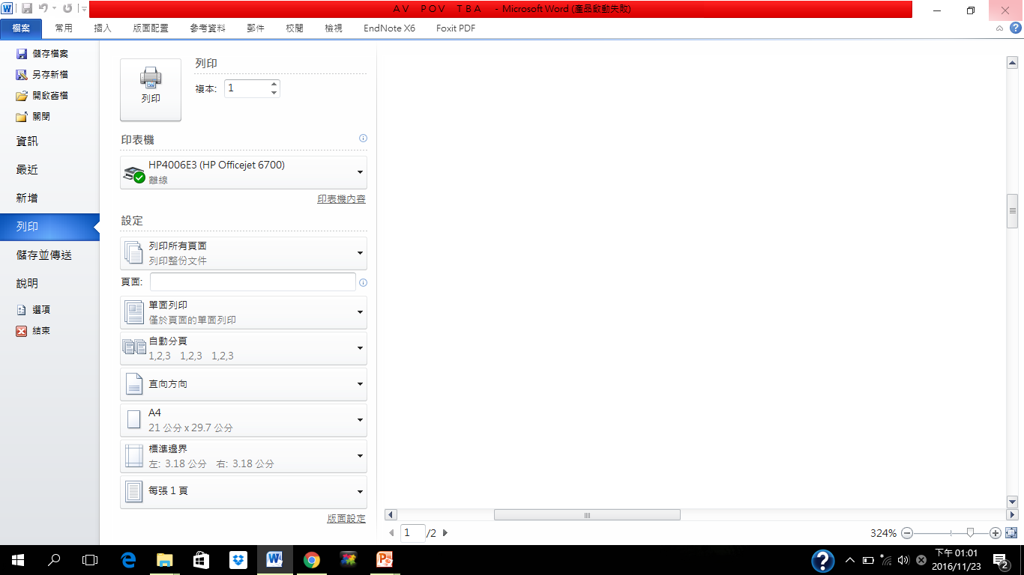
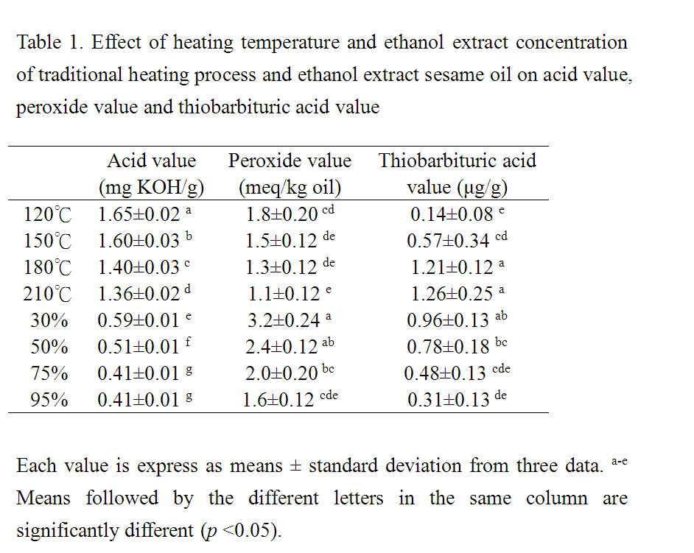
21
Notes:
30%乙醇萃取芝麻油擁有最高過氧化價，推測可能為芝麻本身殘留或經破碎後所生成之過氧化物殘留於油中所致；而210℃熱加工樣品雖擁有最低過氧化價但卻為硫巴比妥酸價最高者，推測210℃加工後，自氧化速度最快，因而後期氧化指標–丙二醛呈現最多。但總體來說，95%乙醇萃芝麻油取擁有最好的初榨品質，推測原因可能為乙醇萃取過程中攜帶游離脂肪酸、氫過氧化物以及丙二醛等物質，隨著後續加工離心後去除所致。
CNS 標準
AV <4
POV<15

Slide 22
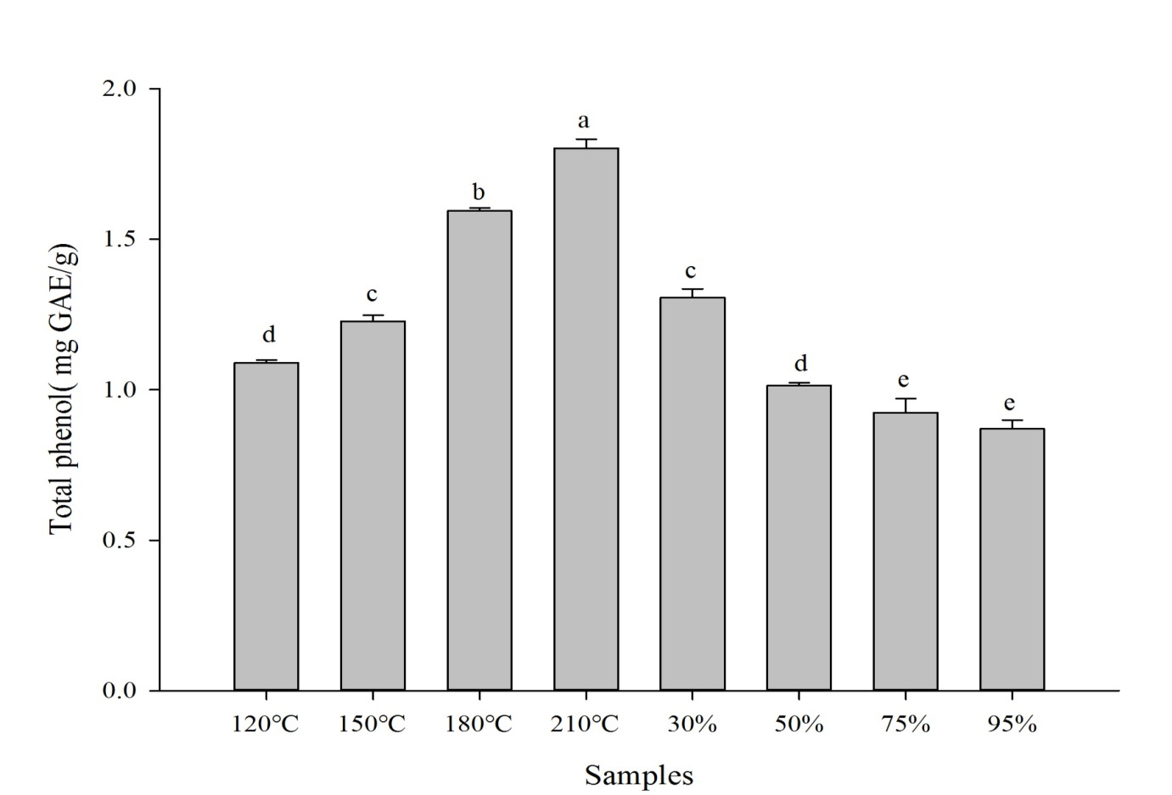
Total Phenolic Contents
1.80
Figure 1. Effect of heating temperature and ethanol extract concentration on total phenolic contents of traditional heating processing sesame oil and ethanol extract sesame oil. Each value is express as means ± standard deviation from three data. a-e Means followed by the different letters in the same column are significantly different (p <0.05).
Notes:
可知210℃熱加工樣品為八組樣品中最高含量者，約有1.8 mg/g

Slide 23
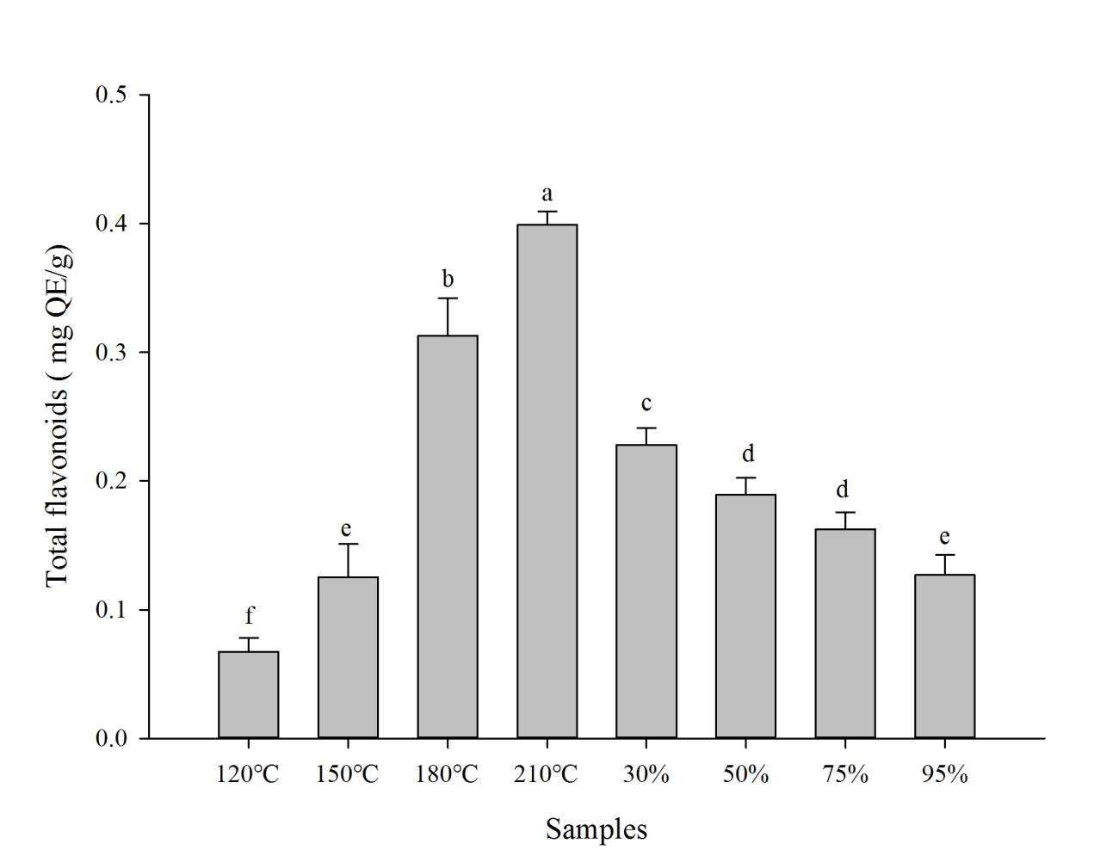
Total Flavonoid Contents
0.38
Figure 2. Effect of heating temperature and ethanol extract concentration on total flavonoid contents of traditional heating processing sesame oil and ethanol extract sesame oil. Each value is express as means ± standard deviation from three data. ^{a-f} Means followed by the different letters in the same column are significantly different (p <0.05).
Notes:
類黃酮含量分析以楜皮素（quercetin）製作標準曲線，由圖 13可知210℃熱加工樣品為八組樣品中最高含量者，約有0.38 mg/g。隨著炒焙溫度提高，總類黃酮含量隨之上升；而使用愈高濃度乙醇濃度萃取芝麻油，易使總類黃酮流失

Slide 24
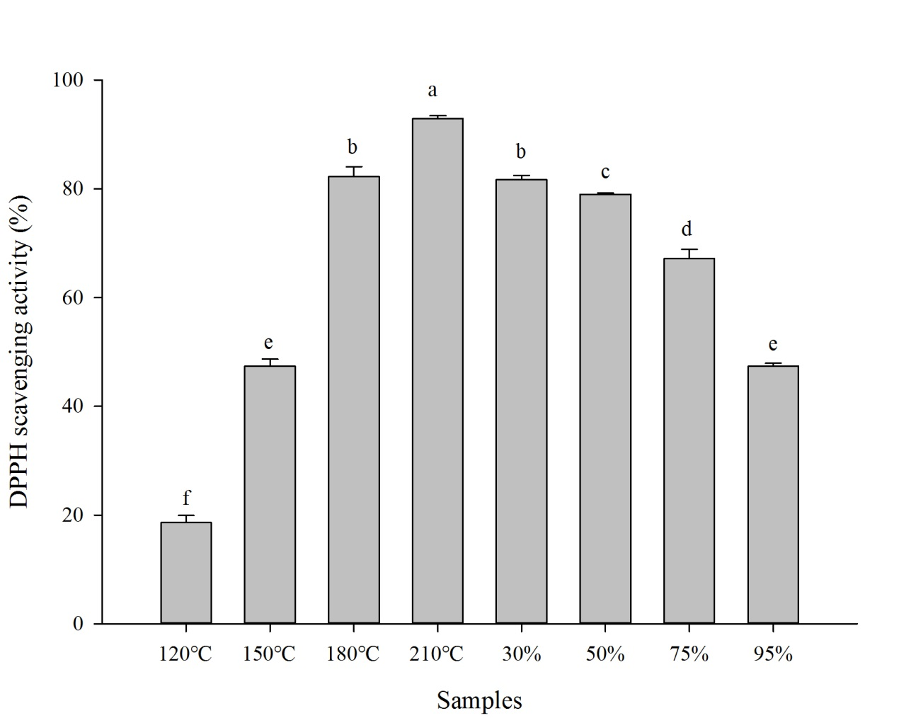
DPPH Scavenging Activity
92%
Figure 3. Effect of heating temperature and ethanol extract concentration on DPPH scavenging activity of traditional heating process sesame oil and ethanol extract sesame oil. Each value was expressed as means ± standard deviation from three data. ^{a-f} Means followed by the different letters in the same column are significantly different (p <0.05).
Notes:
210℃熱加工樣品為八組樣品中最高含量者，約有92%。熱加工樣品隨著炒焙溫度升高，清除率也隨著提高；乙醇萃取的樣品隨著乙醇濃度升高，清除率反而下降。推測高濃度乙醇萃取易攜帶芝麻中的抗氧化物質，經離心後遭到去除反而於在樣品油中保留不多所致

Slide 25
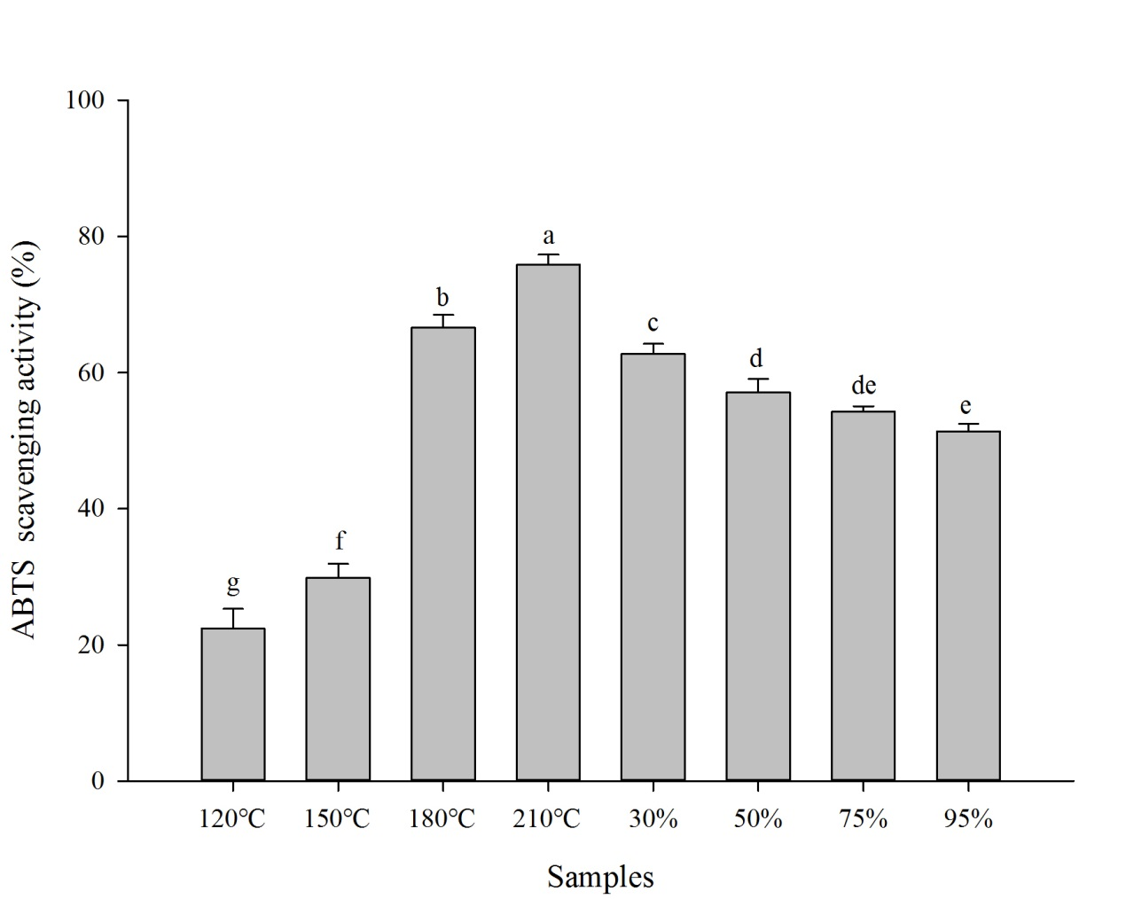
ABTS Scavenging Activity
75%
Figure 4. Effect of heating temperature and ethanol extract concentration on ABTS scavenging activity of traditional heating process sesame oil and ethanol extract sesame oil. Each value was expressed as means ± standard deviation from three data. ^{a-g} Means followed by the different letters in the same column are significantly different (p <0.05).
Notes:
TEAC總抗氧化力測定以trolox製作標準曲線之迴歸方程式。由圖 16可知210℃熱加工樣品為八組樣品中最高含量者，約有75%。熱加工樣品隨著炒焙溫度升高，清除率也隨著提高；乙醇萃取的樣品隨著乙醇濃度升高，清除率反而下降。

Slide 26
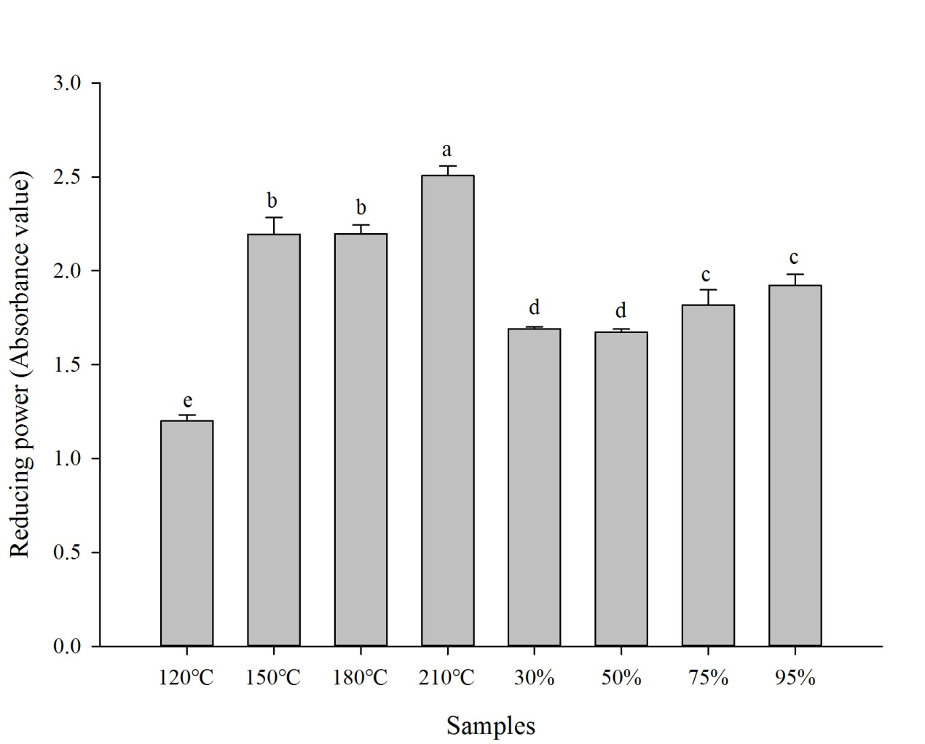
Reducing Power
2.50
Figure 5. Effect of heating temperature and ethanol extract concentration on reducing power of traditional heating processing and ethanol extract sesame oil. Each value was expressed as means ± standard deviation from three data. ^{a-e} Means followed by the different letters in the same column are significantly different (p <0.05).
Notes:
210℃為八組樣品中最高含量者 約有2.50。乙醇萃取樣品隨著乙醇濃度升高，清除率上升，此現象與前述抗氧化能力並不一致，推測可能30%以及50%乙醇萃取樣品中含有比較多的過氧化物質，參與了氧化還原反應，消耗了抗氧化物質的還原。
跟ROOH 相關
氫過氧化物(ROOH)
還原力的其原理即試樣將赤血鹽﹙K₃Fe (CN)₆﹚還原成黃血鹽﹙K₄Fe (CN)₆﹚，黃血鹽再與Fe³⁺作用，生成普魯士藍，在700 nm波長測定吸光值，以檢測普魯士藍之生成量，作為試樣的還原力，吸光值愈高，表示試樣還原力愈強。
利用試驗樣品中的還原物質將赤血鹽K3[Fe(CN)6]還原成黃血鹽
K4[Fe(CN)6]，而 3 分子的K4[Fe(CN)6]和 4 分子FeCl3形成普魯士藍
Fe4[Fe(CN)6]3，此物質為一深藍色複合物，於吸光值 700 nm具有吸光，
當吸光值越高表示樣品中所含之還原物質越多，還原力越強。

Slide 27
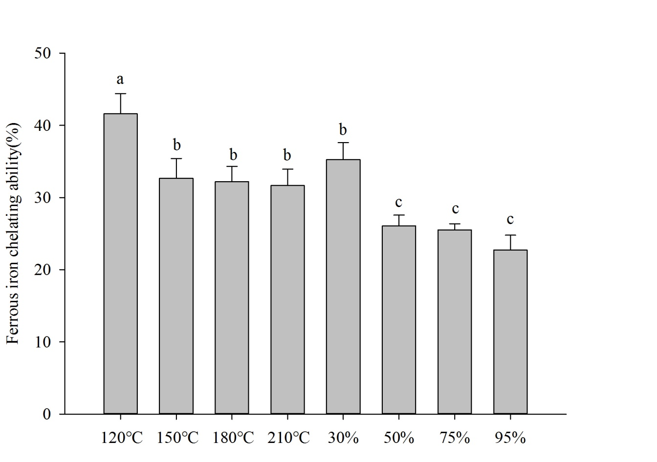
Ferrous iron Chelating Ability (%)
40%
Figure 6. Effect of heating temperature and ethanol extract concentration on Ferrous iron chelating ability of traditional heating processing and ethanol extract sesame oil. Each value was expressed as means ± standard deviation from three data. ^{a-c} Means followed by the different letters in the same column are significantly different (p <0.05).
Notes:
120℃為八組樣品中最高含量者，約為40%，推測清除螯合亞鐵離子的能力與樣品中木酚素含量呈正相關；熱加工樣品隨著炒焙溫度升高，螯合能力下降；乙醇萃取的樣品隨著乙醇濃度升高，螯合能力亦下降；而下降幅度，150℃、180℃、210℃相較於120℃熱加工樣品無顯著差異；50%、75%、95%相較於30%乙醇萃取樣品亦無顯著差異。

Slide 28
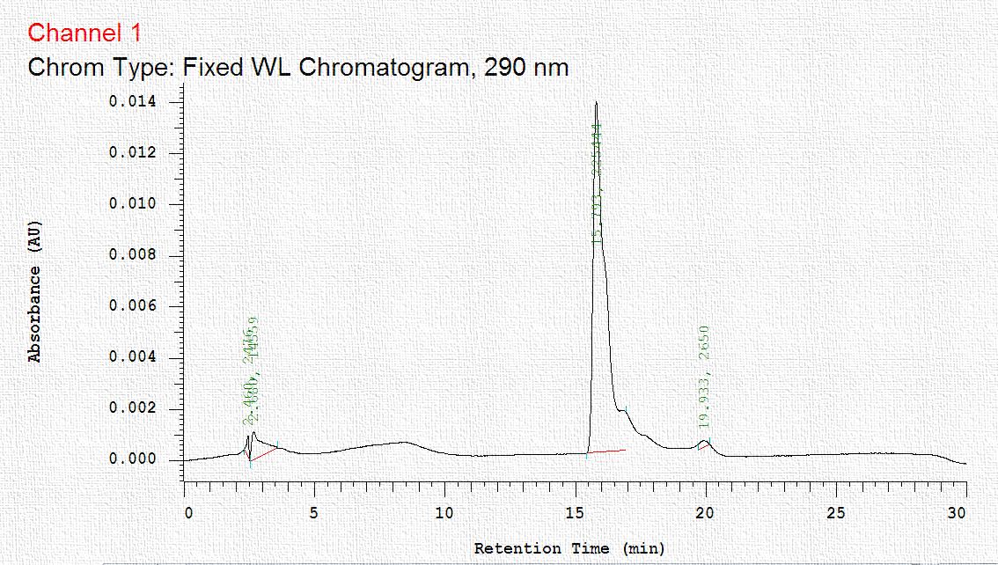
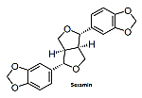
Sesamin standard
Figure 7 . HPLC profile of sesamin standards showing one sharp peak corresponding to sesamin with retention times of 15.7 .

Slide 29
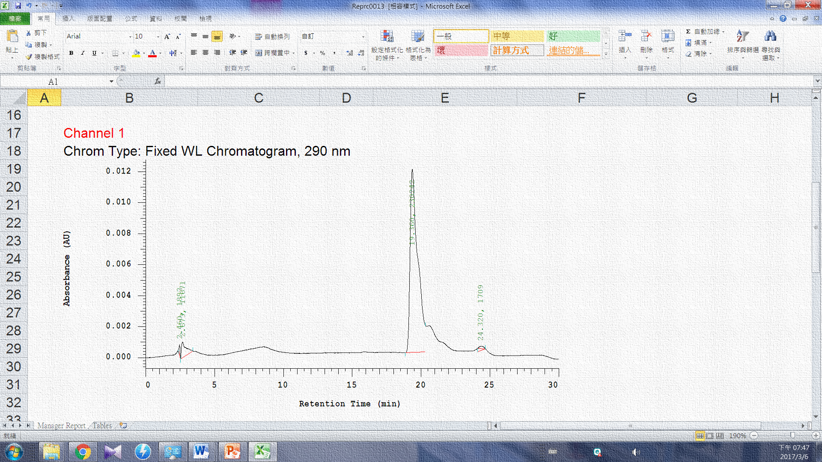
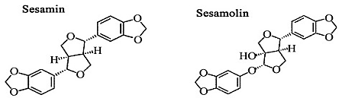
Sesamolin standard
Figure 8 . HPLC profile of sesamin standards showing one sharp peak corresponding to sesamolin with retention times of 19.3 .

Slide 30
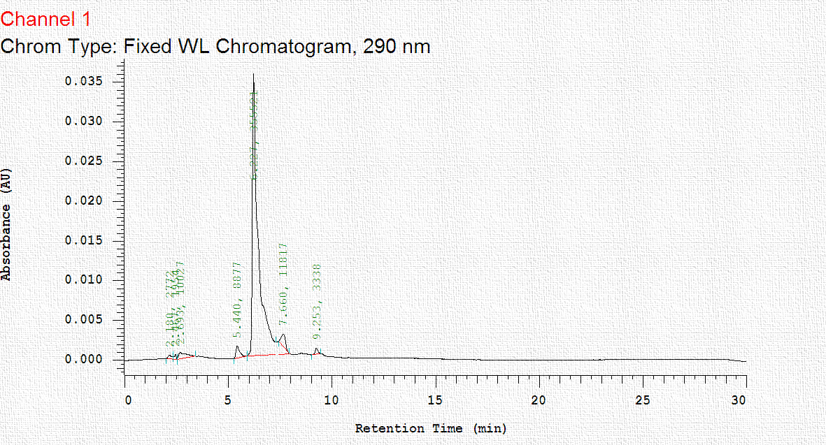

Sesamol standard
Figure 9 . HPLC profile of sesamol standards showing one sharp peak corresponding to sesamol with retention times of 6.2 .

Slide 31
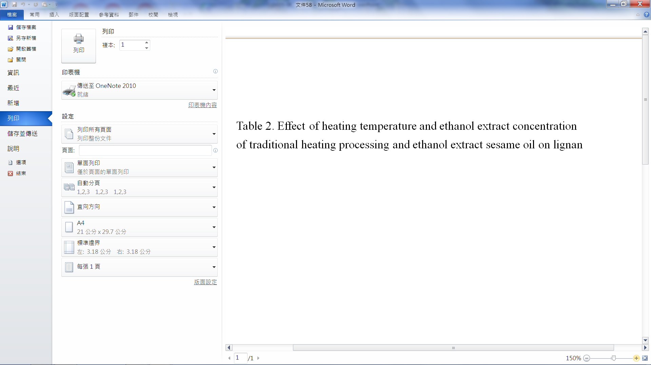
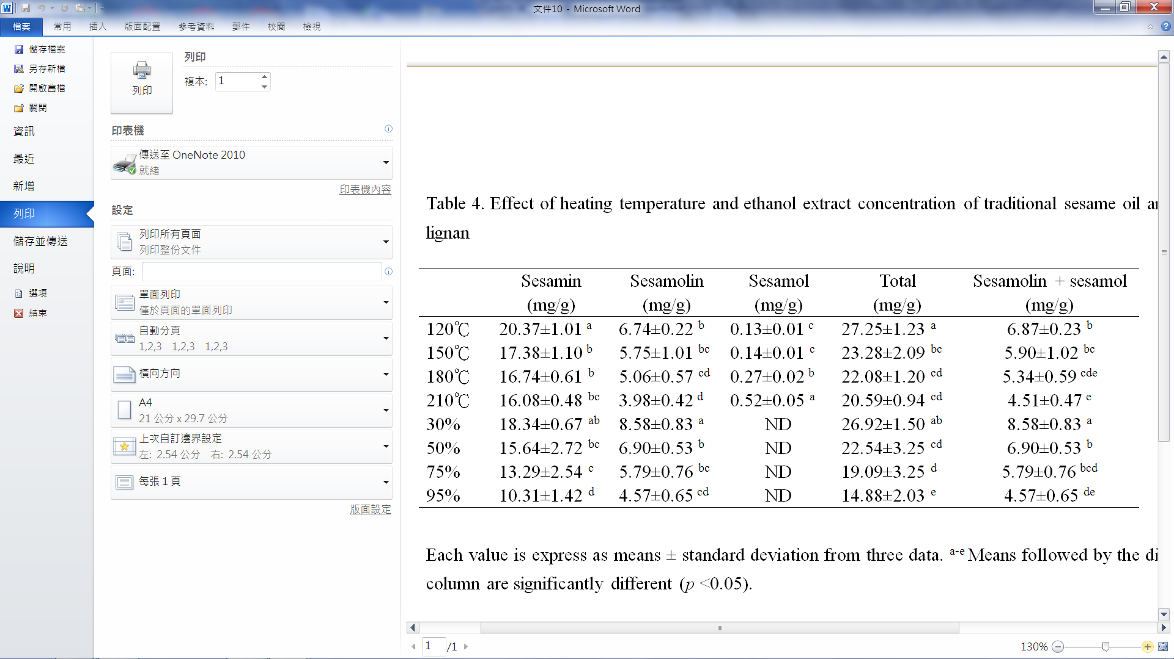
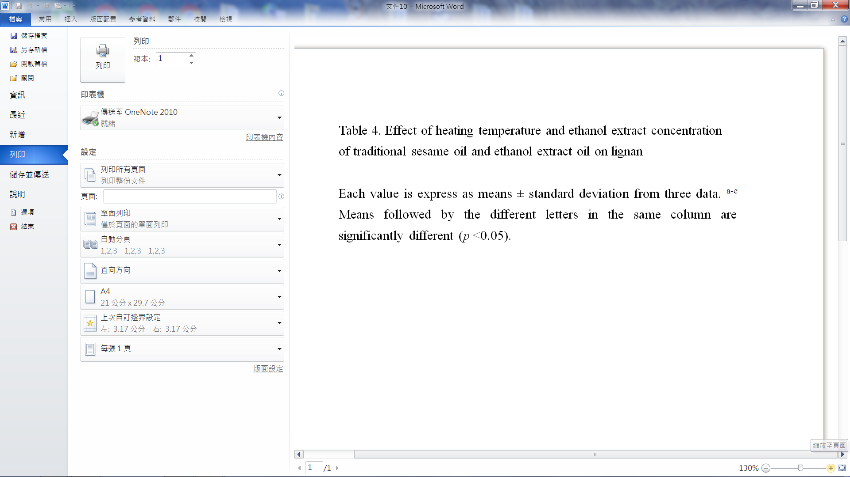
31
Notes:
，120℃熱加工樣品為八組樣品中，sesamin含量最高者；30%乙醇萃取樣品為sesamolin含量最高者；而210℃熱加工樣品則是sesamol含量最高者。隨著炒焙溫度提高，sesamin含量雖略有下降但150℃、180℃及210℃熱加工樣品下降幅度並無顯著差異；相較之下，炒焙溫度提高對sesamolin含量較有顯著性下降。由此可知芝麻炒焙條件與乙醇濃度萃取條件與木酚素含量呈現相關性，隨著炒焙溫度提高，sesamin和sesamolin隨之下降，sesamol則呈現上升現象；而使用愈高濃度乙醇濃度萃取芝麻油，易使木酚素流失。而120℃熱加工樣品及30%為乙醇萃取樣品為木酚素總量最高者。

Slide 32
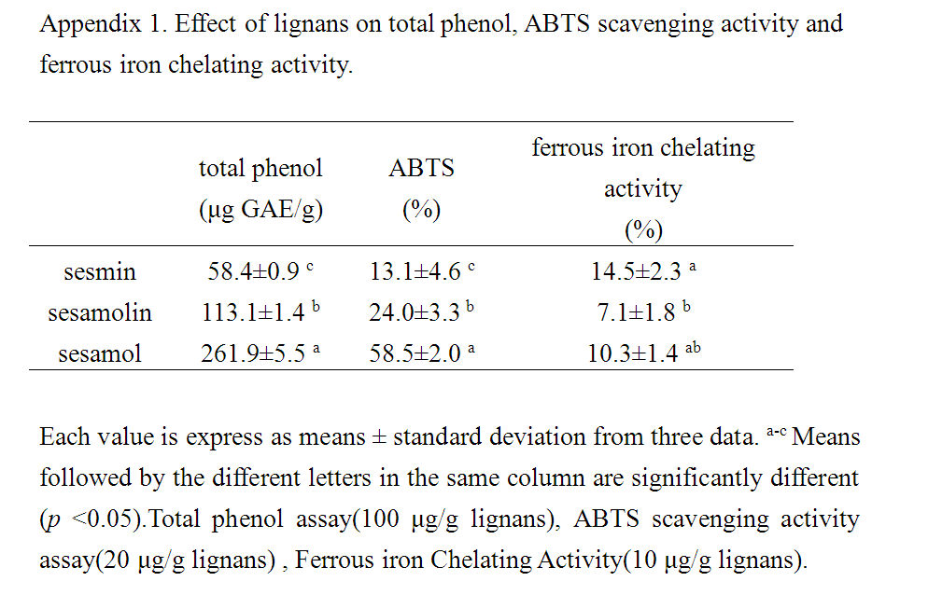
Notes:
附錄一 以純物質 sesamin sesamolin 和sesamol 進行抗氧化實驗，發現sesamol於總酚 總類黃酮效果最佳，此部分佐證
貢獻210度C熱炒被芝麻油在總酚以及ABTS的高表現；另外sesamin於敖和亞鐵效果最佳此部分佐證 貢獻120度C熱炒被及30%乙醇萃取芝芝麻油有高表現的螯合能力

Slide 33
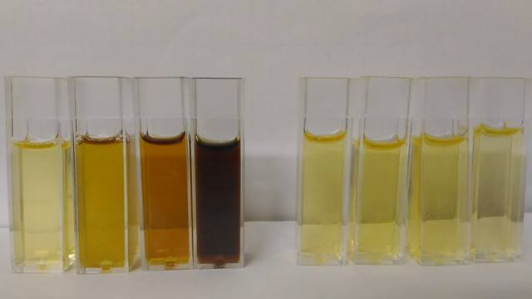
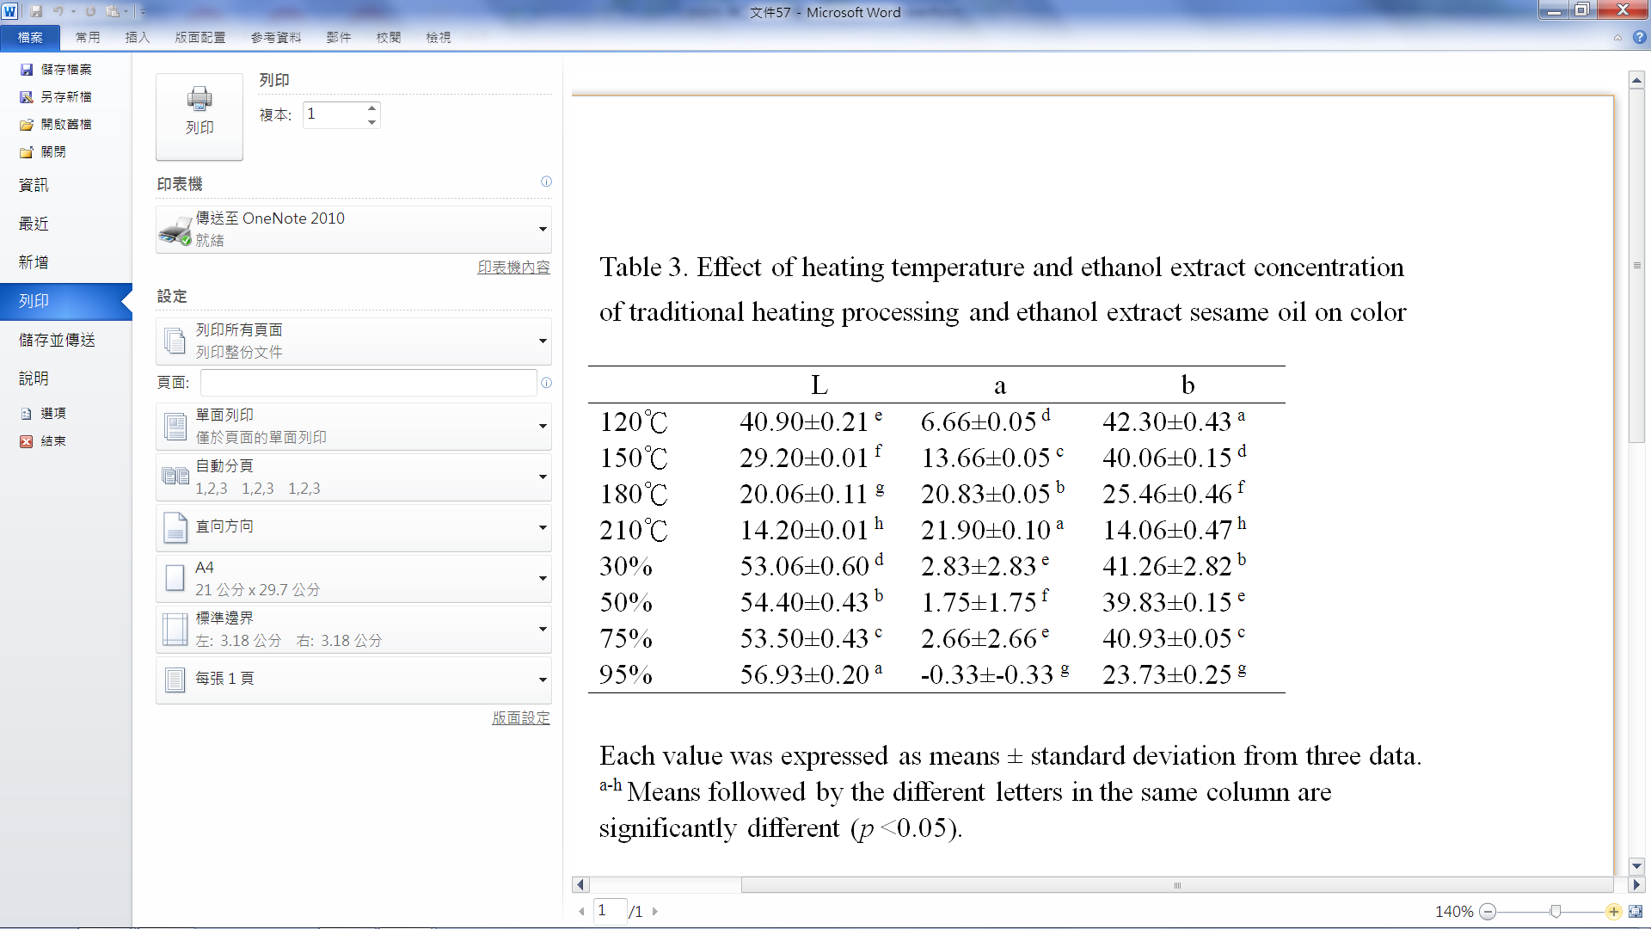
120℃ 150℃ 180℃ 210℃
30% 50% 75% 95%
Notes:
由表 3所示，熱加工樣品隨著炒焙溫度升高，色澤也隨著愈深；乙醇萃取的樣品隨著乙醇濃度升高，色澤反而有愈淺的趨勢。210℃熱加工樣品有最深的色澤（最低L值）；最高紅值（最低a值）；最高黃值（最低b值）。乙醇萃取樣品結果顯示，高濃度95%萃取樣品色澤最淺，推測因為葉綠色可溶於乙醇，經加工離心步驟遭到去除所致

Slide 34
Results-part 2

Slide 35
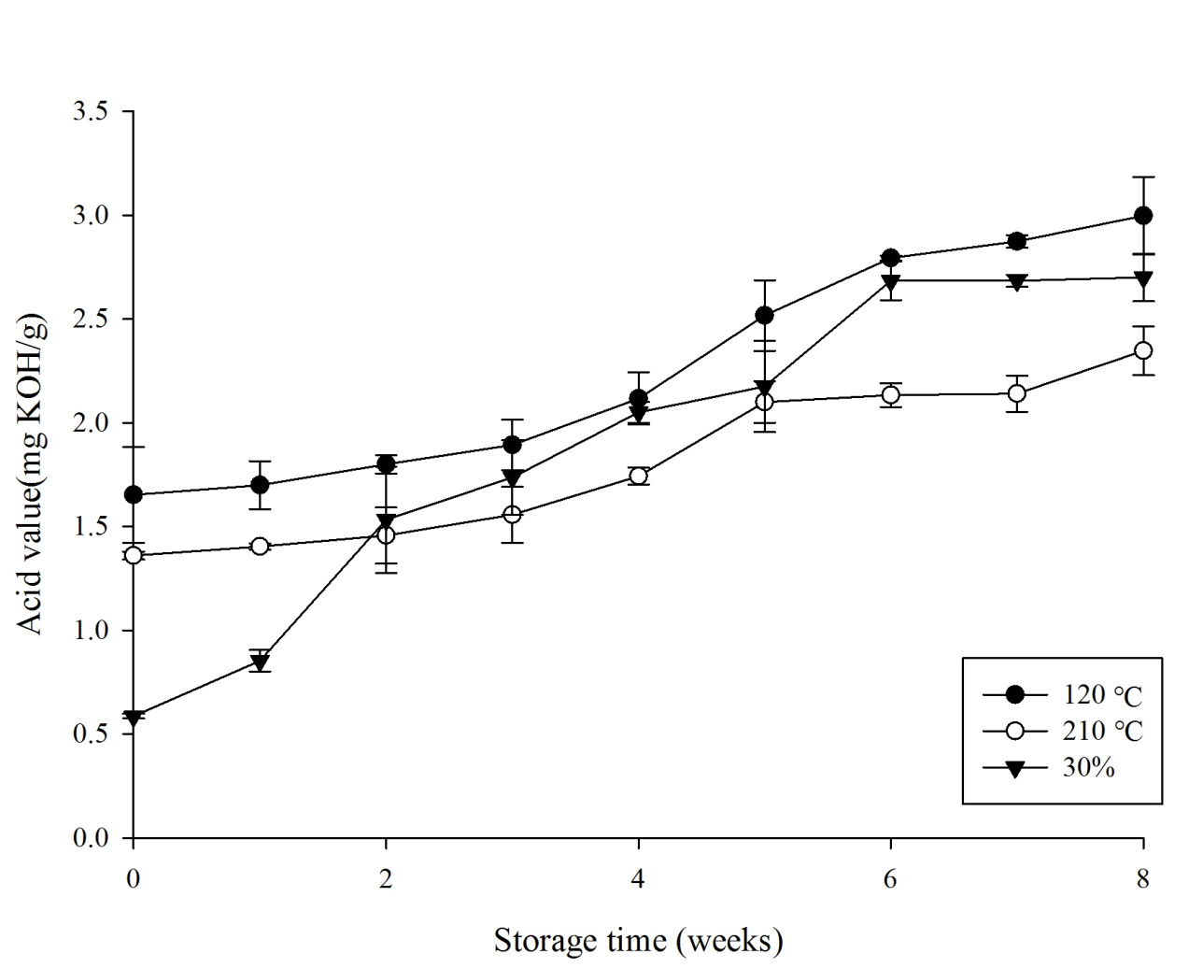
Storage Test-Acid Value
Figure 10. Change on acid value of heating temperature and ethanol extract concentration of traditional heating processing and ethanol extract sesame oil during the incubation at 65℃. Each value was expressed as means ± standard deviation from three data.
Notes:
酸價部分經過8周儲藏，熱炒陪與乙醇萃取芝麻油皆處CNS標準範圍4以下，這與過去文獻符合，因胃酸價與脂解酶水解生成游離脂肪酸有關，過去傳統靠加熱去除此酵素，目前看來30%乙醇也有抑制脂解酶活性之貢獻

Slide 36
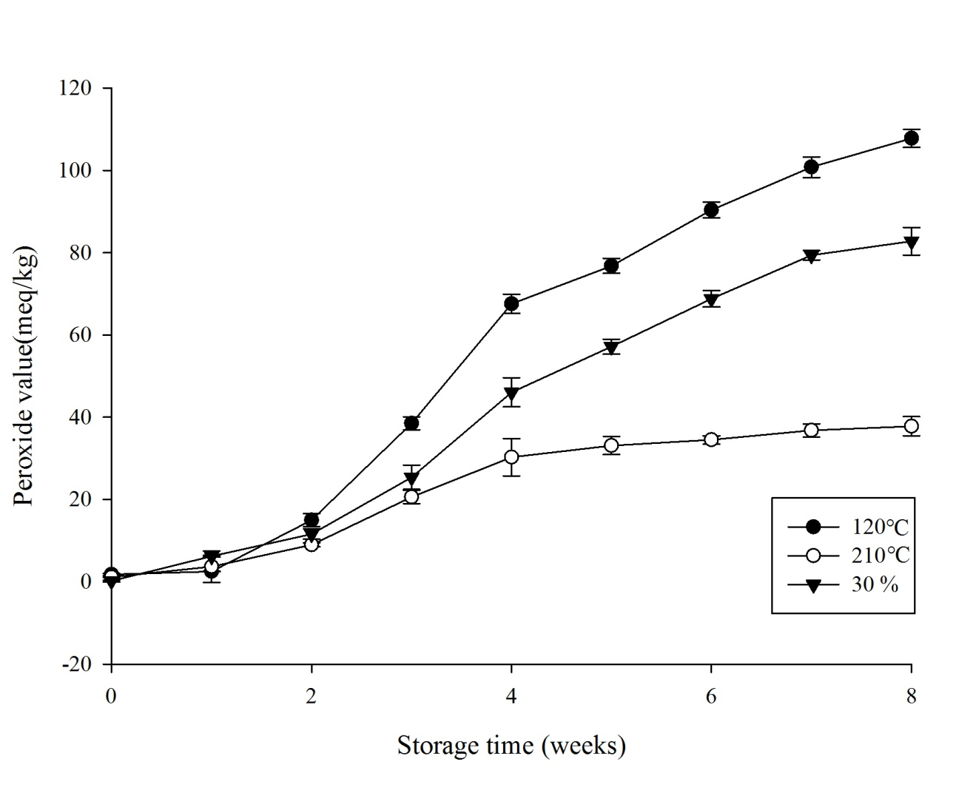
Storage Test-Peroxide Value
Figure 11. Change on peroxide value of heating temperature and ethanol extract concentration of traditional heating processing and ethanol extract sesame oil during the incubation at 65℃. Each value was expressed as means ± standard deviation from three data.
Notes:
過氧化價部分可能與Lipoxygenase(脂肪加氧酶)有關，三者溫度起始值差異不大，120度C 8週後POV值生到100，而210度C 4週後POV值維持在25，推斷低溫致使為此酵素活性未被完全破壞，作用於不飽和脂肪酸產生氫過氧化物導致

Slide 37
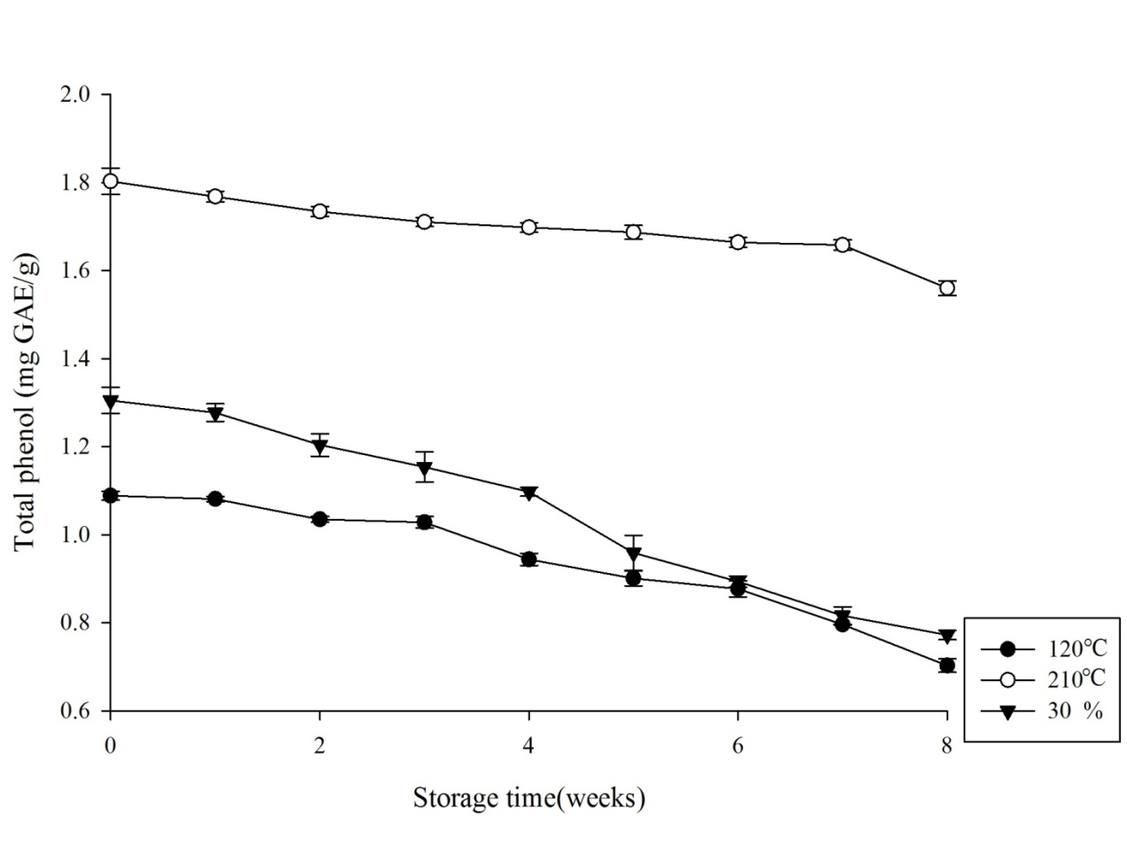
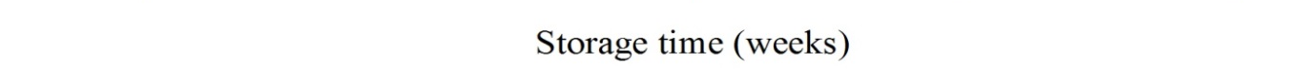
Storage Test-Total Phenol Contents
Figure 12. Change on total phenol contents of heating temperature and ethanol extract concentration of traditional heating processing and ethanol extract sesame oil during the incubation at 65℃. Each value was expressed as means ± standard deviation from three data.
Notes:
總酚以末石子酸為標準品，由結果看來，貢獻210℃的sesamol再儲存期間不易裂解因此能夠在八週後維持高檔；而主要貢獻120℃與30%萃取的sesamin 與sesamolin則裂解導致總酚含量急遽下降

Slide 38
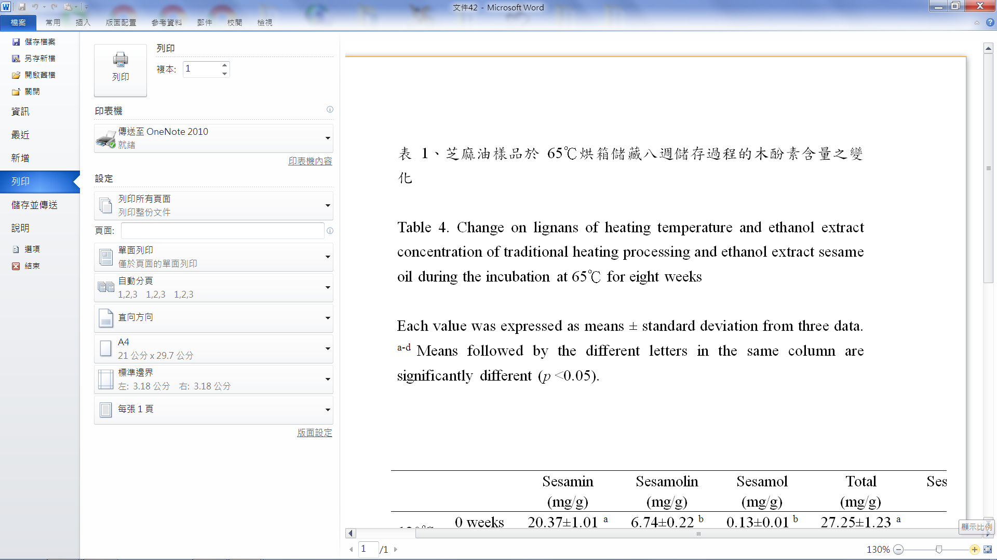
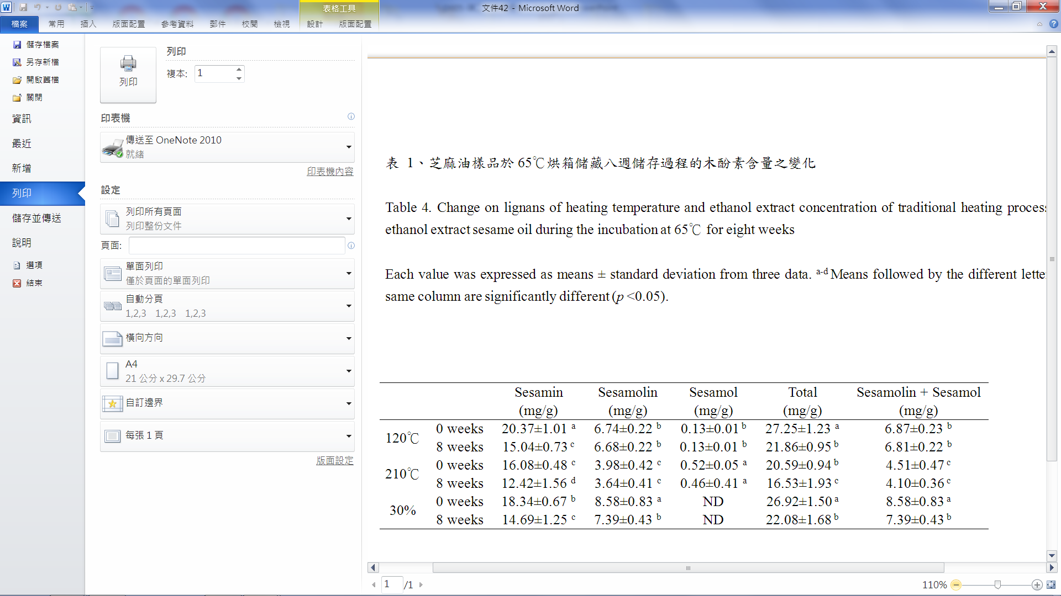
38
Notes:
如表 4所示，經過65°C八週烘箱試驗結果，三組樣品的sesamin含量含量皆有顯著下降；30%乙醇萃取樣品的sesamolin含量有顯著下降；而sesamol則無顯著差異；八週後，木酚素總量以120°C熱加工及30%乙醇萃取樣品保留最多。推測sesamolin裂解並形成sesamol速率較快；而sesamol轉換成sesamol dimer速率較慢。

Slide 39

Storage Test-color analysis-L value
Figure 13. Change on L value of heating temperature and ethanol extract concentration of traditional heating processing and ethanol extract sesame oil during the incubation at 65℃. Each value was expressed as means ± standard deviation from three data.
Notes:
由色澤L值發現，120℃與30%在八周後升高的趨勢，可能為樣品有退色的現象

Slide 40

Storage Test-color analysis-a value
Figure 14. Change on a value of heating temperature and ethanol extract concentration of traditional heating processing and ethanol extract sesame oil during the incubation at 65℃. Each value was expressed as means ± standard deviation from three data.
Notes:
由色澤a值發現，120℃、210℃與30%三者皆有偏紅轉偏綠的趨勢，推斷與油脂氧化呈現正相關，而高溫加高者在儲藏期a 值下降更為明顯

Slide 41

Storage Test-color analysis-b value
Figure 15. Change on b value of heating temperature and ethanol extract concentration of traditional heating processing and ethanol extract sesame oil during the incubation at 65℃. Each value was expressed as means ± standard deviation from three data.
Notes:
由色澤b值發現，三者皆有偏黃轉偏藍的趨勢
低溫120℃與30%樣品在初始以鮮黃色則呈現，而210℃ b值較低，這部分可以與a值做配合，可能為混色的關係，導致210℃因為高a值(偏紅)致使黃色的色澤而呈現較低的現象。

Slide 42



0 weeks
120℃ 210℃ 30%
8 weeks
120℃ 210℃ 30%
42
Notes:
如表 5所示，經過65°C八週烘箱試驗結果，三組樣品皆有明顯色澤變化。推測油脂色澤ΔE*之變化與油脂氧化呈現正相關，210℃熱加工樣品油脂樣品儲藏期間因梅納反應產生的褐變產物等物質致使顏色加深而120℃熱加工樣品以及30%乙醇萃取樣品因為葉綠素含量減少而有退色之現象。
30% 乙醇萃取油退色最多 葉綠素流失最多
而葉綠素可能導致油脂儲存期間總極性物質形成，去除有好處

Slide 43
Conclusions

Slide 44
On quality analysis, 95% ethanol extract oils shows best performance on lowest acid vale, peroxide value and thiobarbituric acid value.
While on antioxidant content analysis, 210 ℃ traditional process oil shows the highest concentration of phenolic contents , flavonoid and scavenging activity.
30% ethanol extract oils shows quite good antioxidant capacity and favorite amber color .It has potential to replace low temperature roasted sesame oil for blended edible oil, salad and sauces of the use in the near future.

Slide 45

Notes:
我做的實驗目的:
在於比較傳統熱加工 以及冷翠處理的芝麻油
透過以上實驗了解 油中的抗氧化能力情形
並請細部了解 親脂性抗氧化劑 (VIT.E) 以及親油性抗氧化劑(酚類化合物) 所發揮的功效為何

Slide 46
Acid value
Determination of free fatty acid. (CNS 3647-N 6082)
Peroxide value
Determination of peroxides which be stated an indicator of the primary level of oil oxidation. (CNS 3650-N 6085)
Hunter L, a, b
• L scale: Dark vs. Light where a low number (0-50) indicates dark and a high number (51-100)indicates light. •a scale: Red vs. Green where a positive number indicates red and a negative number indicates green. •b scale: Yellow vs. Blue where a positive numbe rindicates yellow and a negative number indicates blue.
Thiobarbituric acid value
Determination of Malondialdehyde as an indicator of the final level of oil oxidation. sample extrctions mixed with TBA reagents , and the absorbance of the pink solution was read at 538 nm. (Tarladgis et al.,1960）

Slide 47
Total phenolic contents
The amount of total phenolic compounds was measured using the method. Sample solution was added to 2% Na₂CO₃ and Folin-ciocalteu reagent was added. Absorbance was measured at 760nm. And the results were expressed as gallic acid. (Tahvanainen et al.,2000)
Total flavonoid contents
Sample solution, mixed with then 5% NaNO₂ solution and AlCl₃ solution was added. Then, 1 mol/L NaOH were added, absorbance was measured at 510 nm. The total flavonoid content was expressed as quercetin. (Shen et al.,1999)
Notes:
抗氧化試驗
熱加工與乙醇萃取芝麻油共計八組樣品，取所有樣品1毫升與8毫升甲醇至15毫升離心瓶中，以往復式振盪器震盪15分鐘，再以超音波震盪機震盪15分鐘，取下後再經離心機（8000 rpm, 4℃）離心10分鐘，蒐集甲醇層，視為樣品萃取液備用。
參考Tahvanainen等（2000）所述之Folin-Ciocalteu方法加以修改，以沒食子酸製作標準曲線。取400毫升樣品萃取液，加入10% Na2CO3溶液0.04毫升，室溫下靜置10分鐘（避光），之後加入1毫升磷鉬酸酚（Folin-Ciocalteu）試劑，混勻，室溫下靜置10分鐘（避光）。之後以離心方式（6000 rpm, 4℃）離心3分鐘，將沉澱物與溶液分離，再取上層之澄清液，續利用ELISA reader檢測波長760 nm 之吸光值，吸光值越高表示樣品含有的總酚類化合物越多，並根據此吸光值與沒食子酸濃度之關係求出標準曲線之迴歸方程式。
參考Shen 等（1999）所述之方法加以修改，在中性或弱鹼性及亞硝酸鈉存在條件下，黃酮類化合物與鋁鹽生成螯合物，加入氫氧化鈉溶液後顯紅橙色，在510 nm 波長處有吸收峰，並以槲皮素（quercetin）製作標準曲線。取1毫升樣品萃取液，加入5%亞硝酸鈉（NaNO₂）1.5毫升，於室溫下靜置5分鐘，再添加10% 0.15毫升氯化鋁（AlCl₃），之後加入 1 N 氫氧化鈉2毫升。續利用ELISA reader檢測波長510 nm 之吸光值。而後，根據此吸光值與槲皮素濃度之關係求出標準曲線之迴歸方程式。

Slide 48
DPPH radical scavenging activity
DPPH radical is scavenged by antioxidants through the donation of proton forming the reduced DPPH. The color changes from purple to yellow after reduction, which can be quantified by its decrease of absorbance at wavelength 517 nm. (Shimadaet al.,1992)
ABTS radical scavenging activity
Measure the loss of color when an antioxidant is added to the blue–green ABTS+. The antioxidant reduces ABTS+ to ABTS and decolorize it. Trolox, a water-soluble subtance of vitamin E, can be used as an antioxidant standard. Absorbance was measured at 734 nm. (Luypaert et al.,2004)

Slide 49
Reducing power
Solution were mixed with 0.2 M phosphate buffer and 1% potassium ferricyanide. Then, 10% trichloroacetic acid were added, and the tubes were centrifuged. Thenthe upper layer were mixed with methanol and 0.1% ferric chloride, and the absorbance of the reaction mixtures was measured at 700 nm. (Oyaizu et al.,1986)
Ferrous iron chelating ability
The ferrous ion was monitored by measuring the formation of a red ferrous ion-ferrozine complex . Samples solution were mixed with Ferrous Chloride(2 mM) and ferrozine added to a concentration of 5 mM to start the reaction. The absorbance of the solution was measured at 562 nm. (Decker and Welch,1990)
Notes:
還原力的其原理即試樣將赤血鹽﹙K3Fe (CN)6﹚還原成黃血鹽﹙K4Fe (CN)6﹚，黃血鹽再與Fe3+作用，生成普魯士藍，在700 nm波長測定吸光值，以檢測普魯士藍之生成量，作為試樣的還原力，吸光值愈高，表示試樣還原力愈強。
參考Decker和Welch（1990）所述之方法加以修改，取250微升樣品萃取液，加入400毫升甲醇靜置10秒，對照組以甲醇取代萃取液。之後加入2 mM氯化亞鐵（FeCl2）25微升後靜置反應30秒，再加入5 mM Ferrozine 50微升，混合後靜置10分鐘。隨後以ELISA reader 量測562 nm吸光值。以吸光值呈現螯合亞鐵離子能力，而吸光值越低表示樣品螯合亞鐵離子能力越強。
螯合亞鐵離子能力（%）＝（1－《樣品組吸光值／對照組吸光值》）× 100（%）

Slide 50

Sesamin standard
Naphthalene standard
Sesamolin standard
Sesamol standard
圖十六、sesamin, sesamolin, sesamol, naphthalene 標準品分別有一顯著波峰的高效液相層析圖
Figure 16 . HPLC profile of sesamin, sesamolin, sesamol, naphthalene standards showing one sharp peak with Individual retention times .

Slide 51



Slide 52
 | Press rate %
120℃ | 40
150℃ | 42
180℃ | 44
210℃ | 46
30% | 30
50% | 25
75% | 23
95% | 20
 | Water content (%)
Sesame (raw material) | 6.50±0.15

