Slide 1

Glycosylation regulates CD38 assembly on the cell surface
GLYCOBIOLOGY 2015,
August 12, 2015, Philadelphia
Miki Hara-Yokoyama
Tokyo Medical and Dental University (TMDU), Japan

Slide 2
Outline
Introduction of CD38
Aim of this study
The structural analysis of assembly
1) the extracellular domain of CD38 in solution
2) CD38 on the cell surface
The functional significance of the assembly
The regulation by glycosylation

Slide 3
Introduction of CD38

Slide 4
The leukocyte cell-surface antigen CD38 is
a multifunctional protein.
N-glycosylation site (NXS/T)
Transmembrane domain
N
C
Cytoplasmic domain
(23 amino acid residues）
Extracellular domain
Plasma membrane
Ectoenzyme
Raft-dependent signaling molecule

Slide 5
CD38 is the major NAD⁺ glycohydrolase in mammals.
ADP-ribose
NAD⁺ glycohydrolase
NAD⁺
cADPR hydrolase
ADP-ribosyl cyclase
Cyclic ADP-ribose (cADPR)

Slide 6

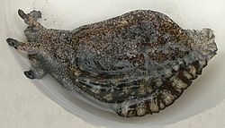
Cyclic ADP-ribose triggers intracellular calcium mobilization
in an IP₃-independent manner.
Trafficking of neutrophils and dendritic cells
Ectoenzyme
Secretion of insulin and oxytocin
Cyclic ADP-ribose (cADPR)
Ca²⁺ mobilizing messenger
cADPR
Aplysia
Human
Ca²⁺
Aplysia ADP-ribosyl cyclase
CD38
IP₃
Similar structure

Slide 7
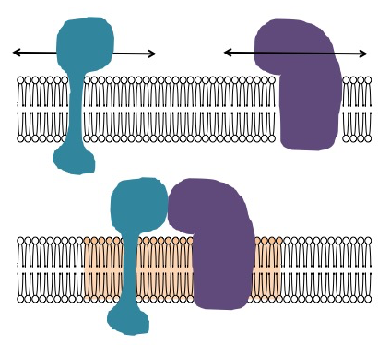
CD38 associates with various supramolecular complexes within lipid rafts.
Cholesterol/sphingolipid-enriched membrane domain (lipid raft)
T cells | CD38/CD3/Lck/LAT
B cells | CD38/BCR/CD19/CD81
NK cells | CD38/CD16
Monocytes | CD38/MHC Class II/CD9
Dendritic cells | CD38/CD83/CD11b/CD81
Notes:
CD19 coreceptor of BCR
CD16 Fc receptor
CD83 antigen presentation
CD11b integrin alpha M

Slide 8
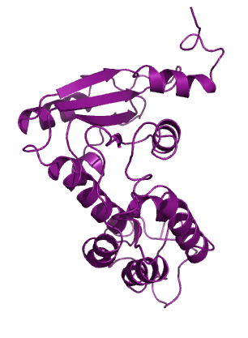
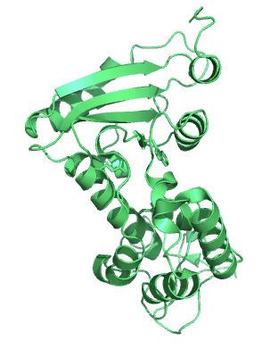
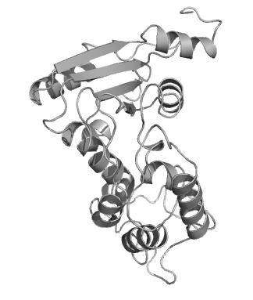
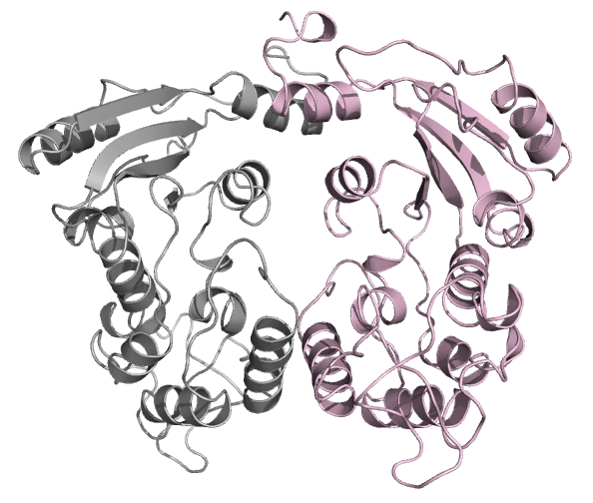
Aim of this study
Aplysia ADP-ribosyl cyclase
(cytosolic protein)
1LBE
BST1/CD157
(GPI-anchored protein)
1ISF
CD38 (transmembrane protein)
1YH3
Structural basis & functional significance
?
Dimer
Tetramer

Slide 9
The structural analysis
(the extracellular domain of CD38 in solution)

Slide 10
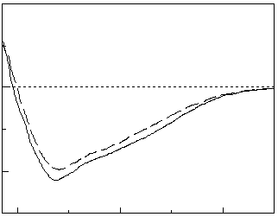
The full-length and the C-terminal-truncated extracellular domains of mouse CD38 exist as homodimers in solution.
Cytoplasmic domain
TM
Extracellular domain
N
C
Full length
C
Δ16 (R48-F288)
C
IgG
(160 kDa)
BSA
(67 kDa)
Cyt C
(12 kDa)
The overall structure was not significantly altered by the truncation.
0.5
Δ16
15
Absorbance at 280 nm (mAU)
Δ16
10
0.4
G68E
FL
FL
5
0.3
10
0
c(s)
G68E
Mol.Ellip.(103・deg・cm2/dmol)
0.2
-5
5
-10
0.1
-15
200
210
220
230
240
250
0
0
1
1.5
2
2.5
3
3.5
4
12
13
14
15
16
17
18
Wave length (nm)
Sedimentation coefficient (S)
Elution volume (ml)
Analytical ultracentrifugation
Size exclusion chromatography
Circular dichroism spectra

Slide 11
Homophilic interfaces were found in the crystal packing of the C-terminal-truncated extracellular domain of CD38 !
Extracellular domain
Cytoplasmic domain
N-glycosylation sites (NXS/T)
TM
N
C
N104D
N124D
N213D
N223D
Full length
C
N104D
N124D
N213D
N223D
Δ16 (R48-F288)
C
Crystalized

Slide 12



Concept of crystal packing
Information of interfaces
Suggested
No information
This study (2EG9)
Previous study (1YH3)

Slide 13
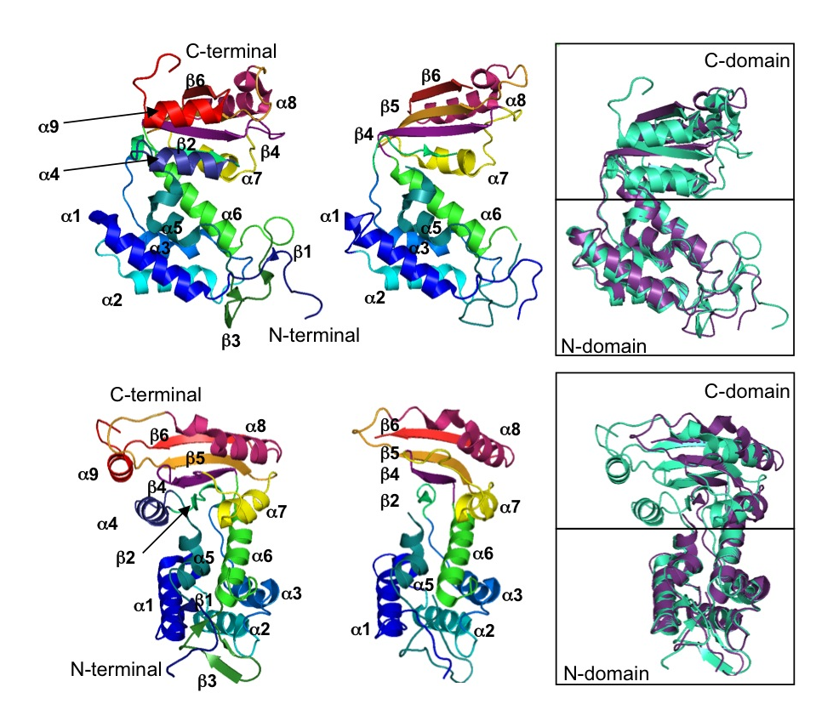
The monomeric structure was not significantly altered by the truncation, except the loss of the α9 helix and the fluctuation of the α4 helix.
1YH3
2EG9
M.Hara-Yokoyama et al, Structure 20: 1585-1595 (2012)

Slide 14
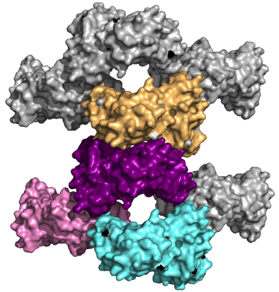
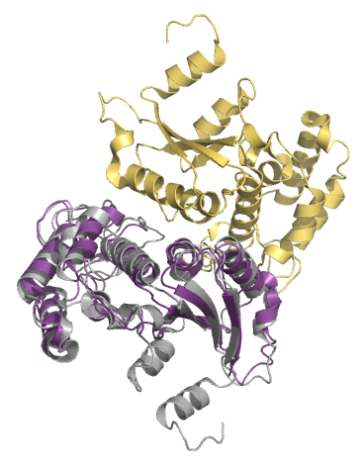
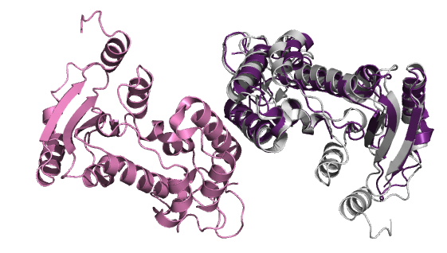
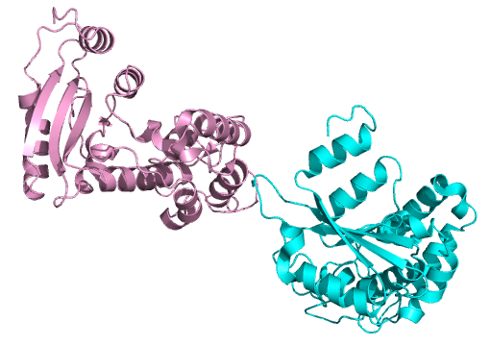
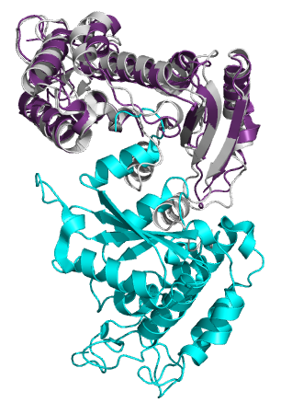
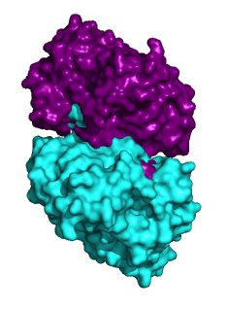
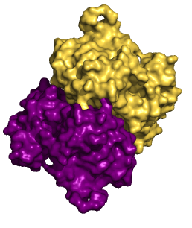
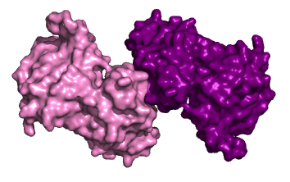
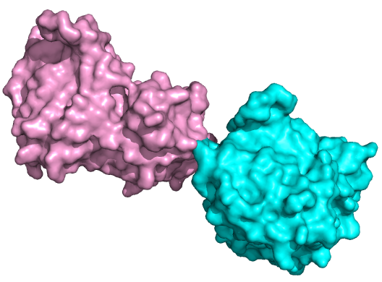
Four types of interfaces (I-IV) were found in the crystal packing of mCD38(R48-F288).
Do the interfaces exist also in solution?
Type IV
2EG9
Type II
Type I
Type II
Type I
α1
α1
Type III
α9
α4
α1
α9
α8
α1
α3
Two molecules of the full-length extracellular domain are oriented according to those in 2EG9.
α4
α9
α4
α2
α7
α4
α2
α9
α8
α9
α4
β6
β5
Type I
Type II
Type III
Type IV

Slide 15
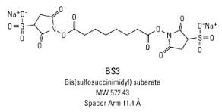
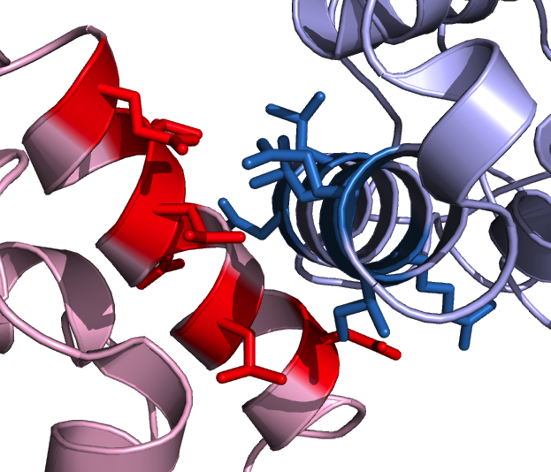
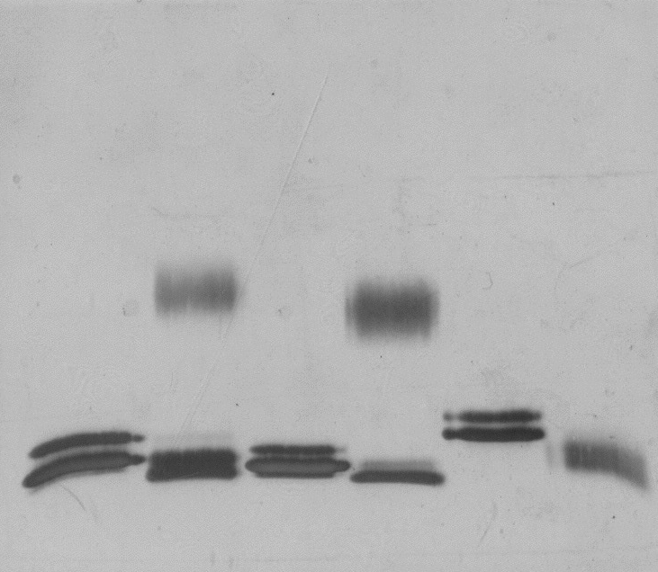
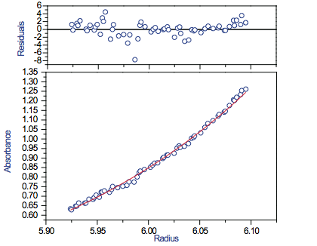
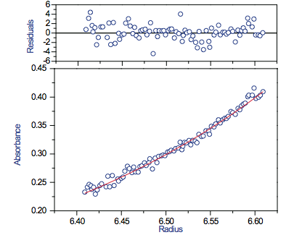
The results of the G68E mutation support the interaction between the α1 helices of the extracellular domain of CD38 in solution.
The G68E mutation should disrupt the type I interface.
BS3
Q75
α1 helix
α1
Q75
L67
I72
64
67
69
72
75
71
D64
L71
KHFSDIFLGRCLIYTQI
L71
R69
KHFSDIFLGRCLIYTQI
I72
R69
L67
D64
FL
Δ16
G68E
-
+
-
+
-
+
BS3
Analytical ultracentrifugation (sedimentation equilibrium)
150
100
FL
G68E
75
50
MW=57054 Da
MW=27268 Da
37
IgG (L)

Slide 16
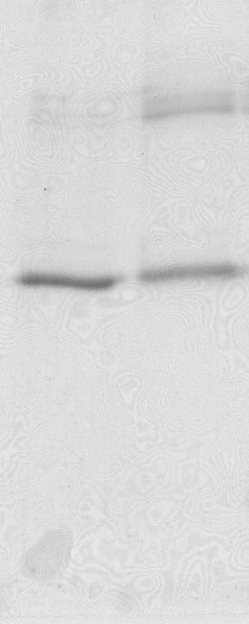


The BS³-dependent crosslinking likely occurs via the type III interaction mode.
FLAG-CD38
α1
α1
crosslink
α1
α9
α1
α4
α9
α4
α4
α2
α9
α9
α4
SDS-PAGE
β5
β6
BS3
-
+
Type I
Type II
Type III
(kDa)
75
Dimer
50
37
Monomer
25
20
15
Trypsin digestion
Monomer
+
+
MS analysis
+
-
Dimer

Slide 17
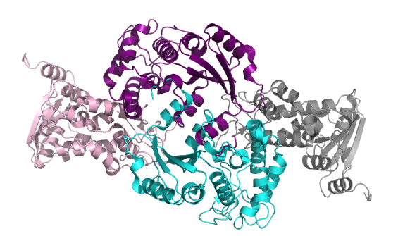
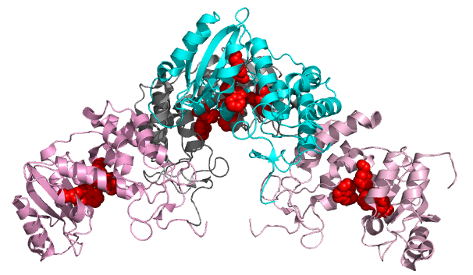
The dimer via the type I interaction mode exist in equilibrium to form a tetramer via the type II/III interaction mode, which is compatible with membrane association.
Type I
Type I
Type III interface
90°
BS³-crosslinking
Type II interface
Membrane

Slide 18
The structural analysis
(CD38 on the cell surface)
Are the interfaces present in CD38 on the cell surface?

Slide 19
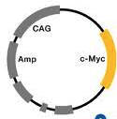
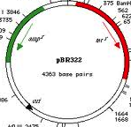

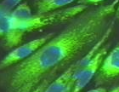
Site-specific crosslinking on the cell surface with an expanded genetic code.
Suppressor tRNA
Aminoacyl-tRNA synthetase
Plasmid
Mutagenesis
UAG
Gene
XYZ
UAG (Amber)
pBpa
Co-transfection
UV
Protein
Cell
Mammalian cell
Crosslinking
Transient expression
Hino et al, Nature Methods 2:201-206 (2005), Nature Protocol 1: 2957-2962 (2006)

Slide 20
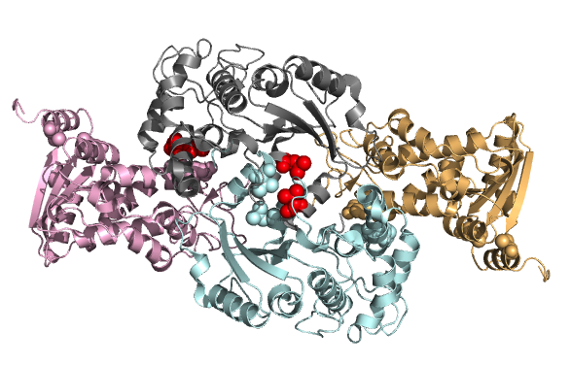
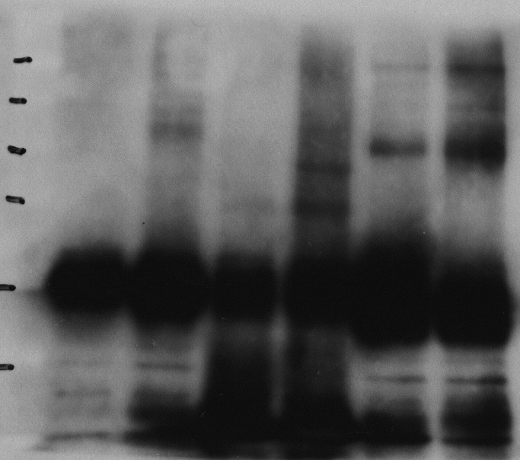
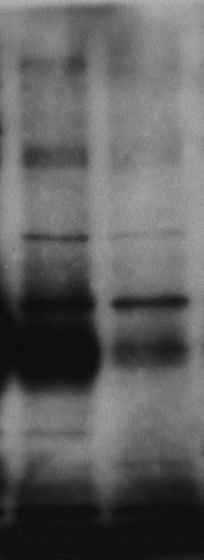
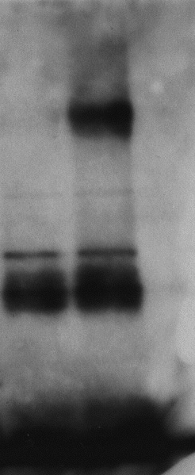
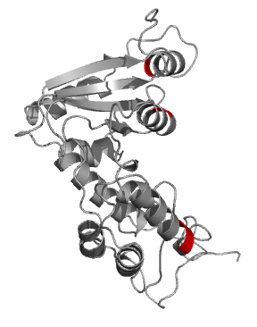
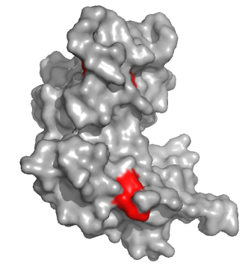
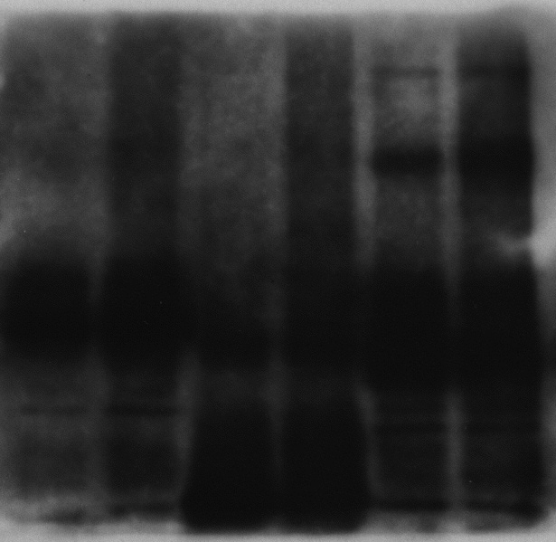
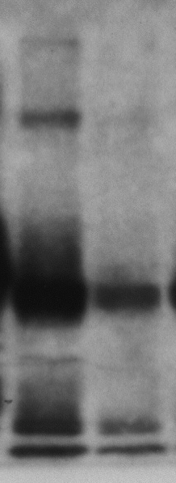
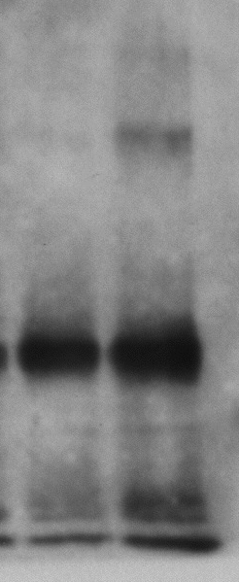
The crosslinking occurs between CD38 molecules and the type I and type II interfaces are involved, suggesting the tetramerization of CD38 on the cell surface.
FLAGx3-CD38/amber
Mycx3-CD38
L135, V292
(Type II Interface)
CHO cells
D64, I65
(Type I Interface)
Crosslink
Wild
L135
V292
D64
I65
UV
-
+
-
+
-
+
-
+
-
+
IP: FLAG
250
150
100
75
IB: FLAG
50
37
90°
Wild
L135
V292
D64
I65
V292
V292
UV
-
+
-
+
-
+
-
+
-
+
α9
α4
250
150
L135
100
IB: Myc
75
b
α1
50
37
D64, I65
Notes:
Asparatic acid D

Slide 21
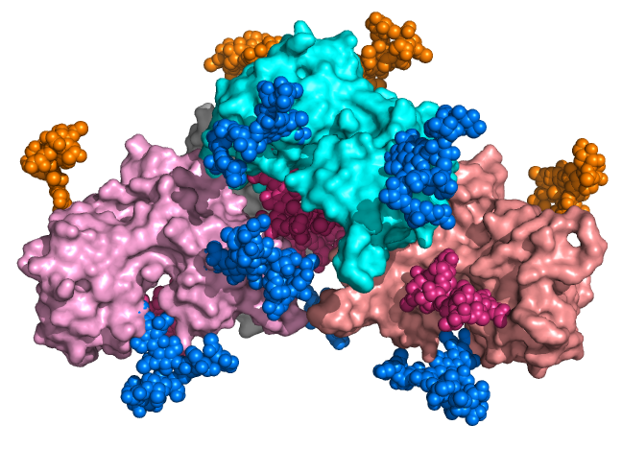
Only the oligosaccharides attached to the N213 residue remained as the high-mannose-type.
A20 cells expressing FLAGx3-CD38
IP: FLAG
(1)
(2)
(3)
(4)
(5)
(20)
(21)
(22)
Trypsin digestion
N104 (Complex/Hybrid)
N213 (High-mannose)
MS analysis
N124
N124
N124 (Complex)
N223 (Complex)
N124
N223
N104
N124
N213
(6)
(7)
(8)
(9)
(10)
(11)
(16)
(17)
(18)
(19)
N104
N223
N223
N213
N213, N213
membrane
Glc
GlcNAc
NeuGc
Man
NeuAc
Gal
Fuc
(12)
(13)
(14)
(15)

Slide 22
The processing of the N-glycan of CD38 is compatible with tetramerization.
α-glucosidase (ER)
α-mannosidase I (ER)
α-mannosidase
(cis-Golgi)
GlcNAcT-I
(medial-Golgi)
Within the tetramer, the processing enzymes are not accessible to the N213 residues.
ER or cis-Golgi
medial-Golgi

Slide 23
The functional significance of tetramerization

Slide 24
Evaluation of the significance of the tetramerization of CD38 on the cell surface.
To impair the type I interface
G68E
To affect the type III interface
C-terminal deletion
C291A, C300A, C291A/C300A
Both the I and type III interfaces are crucial for the tetramerization on the cell surface.

Slide 25
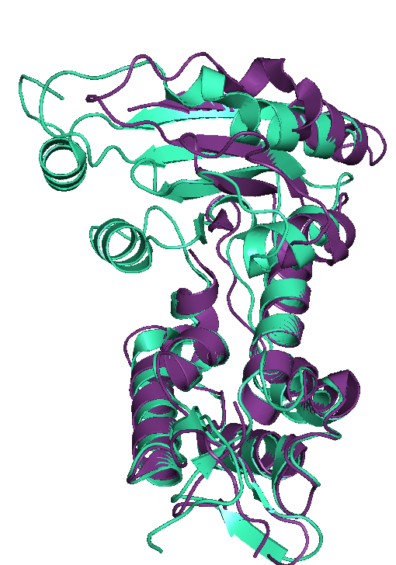
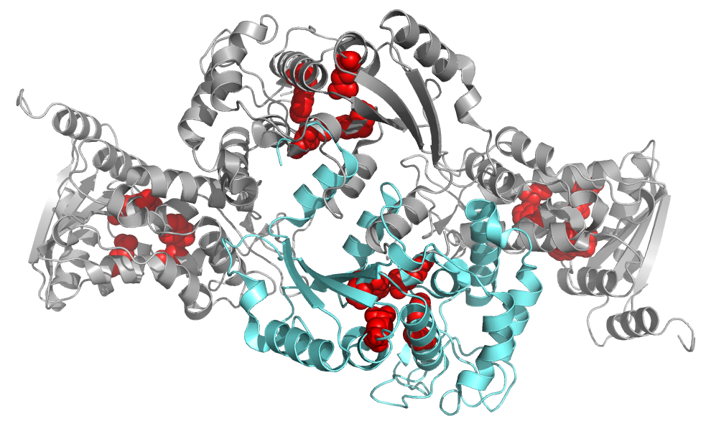
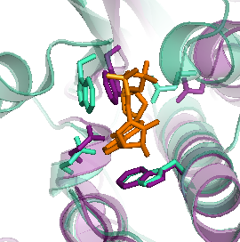
The tetramer structure (both type I and II/III) is required for the catalytic activity of CD38 in A20 cells.
25
**
20
n.s.
Disulfide bridge
15
280
α9
290
300
Human
IQFSCKNIYRPDKFLQCVKNPEDSSCTSEI
10
Mouse
MIFACVDNYRPARFLQCVKNPEHPSCRLNT
5
**
280
290
300
0
FL
Δ4
Δ8
mCD38-T304 (FL)
none
Δ16
Δ20
mCD38-C300 (Δ4)
mCD38-E296 (Δ8)
Fluorescence intensity /min
mCD38-F288 (Δ16)
mCD38-R284 (Δ20)
15
**
**
**
10
**
Catalytic site
**
5
W125
α7
α4
E226
α9
0
FL
none
G68E
C291A
E150L
C300A
C291A/C300A
E146
α9
W189
α4
α6

Slide 26
Preparation of detergent-resistant membranes (DRMs)
A20 cells expressing CD38
Sucrose
5%
12
11
Lysis with Brij-58
10%
10
9
Detergent-resistant membranes (DRMs)
15%
8
Sucrose density gradient ultracentrifugation
20%
7
6
25%
5
4
30%
3
Detergent-resistant membranes (DRMs)
2
40%
1

Slide 27
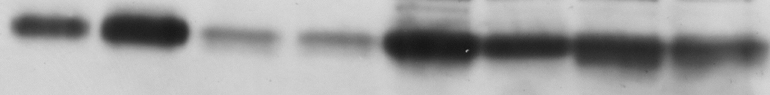
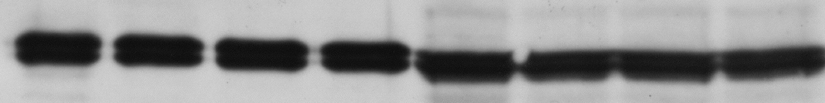
The tetramer structure is required for the association of CD38 with DRMs in A20 cells.
A20 cells expressing full-length CD38
A20 cells expressing truncated CD38
*
200
**
**
CD38
150
Lyn
CD38 in DRMs (%)
100
CS/2
-
+
-
+
-
+
-
+
50
FL
Δ16
FL
Δ16
0
-
+
-
+
DRMs
Bottoms
FL
Δ16

Slide 28
The effect of glycosylation

Slide 29
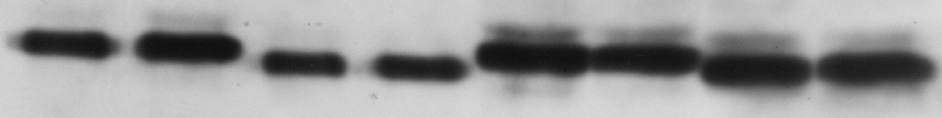
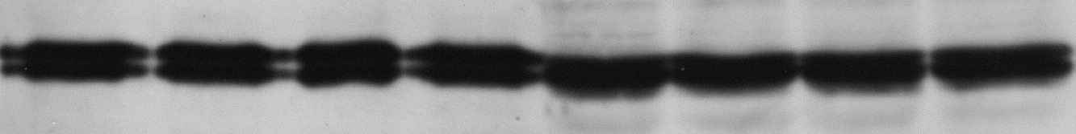
The C-terminal truncation did not alter the amount of nonglycosylated CD38 in DRMs.
N-linked glycosylation sites
Transmembrane
N
C
Cytosolic
Extracellular
A20 cells expressing full-length deglycosylated CD38
A20 cells expressing truncated deglycosylated CD38
200
n.s.
CD38
n.s.
150
n.s.
Lyn
CD38 in DRMs (%)
100
CS/2
-
+
-
+
-
+
-
+
50
FL
Δ16
FL
Δ16
0
-
+
-
+
DRMs
Bottoms
FL
Δ16

Slide 30

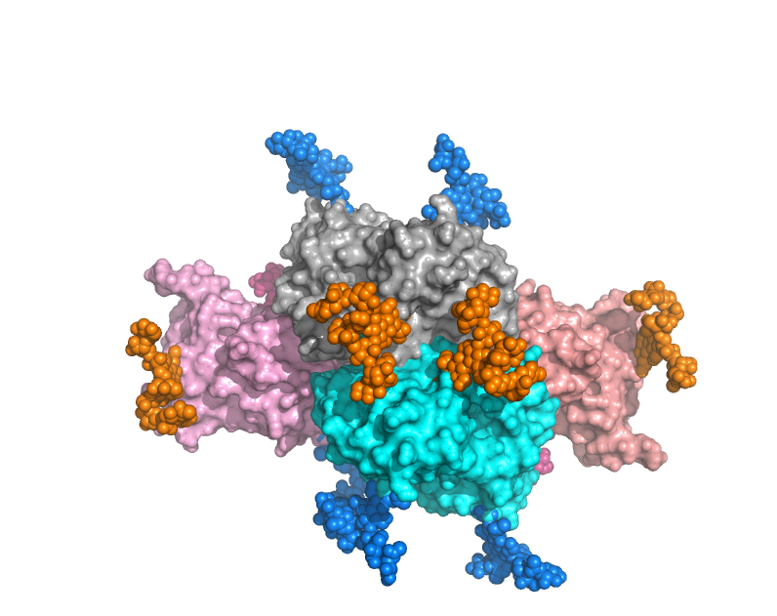
The absence of the N-glycans attached to N104 and N223 enables the formation of the “type IV” interface in the case of cell-surface CD38.
N104
N223
N124
N124
N124
Type IV
N124
N223
N104

Slide 31
The N-glycans probably regulate the assembly of CD38 on the cell surface by inhibiting the “aggregating” type IV interface.
Glycosylation
Nonglycosylation
Full-length
The C-terminal truncation
Amount in DRMs
decreased
unchanged

Slide 32
Summary
Aplysia ADP-ribosyl cyclase
(cytosolic protein)
1LBE
BST1/CD157
(GPI-anchored protein)
1ISF
CD38 (transmembrane protein)
1YH3
Enzyme +
raft-association
Enzyme
Glycosylation
M.Hara-Yokoyama et al, Structure 20: 1585-1595 (2012)

Slide 33
Collaborators
Tokyo Medical and Dental University (TMDU)
National Institute of Health Sciences
Kazue Terasawa
Satoru Harumiya
Katarzyna A. Podyma-Inoue
Takeshi Kasama
Hiroshi Takayanagi
Masaki Yanagishita
Satsuki Itoh
Noritaka Hashimoto
Yoko Hiruta
Nana Kawasaki
Musashino University
Naoko Ustunomiya-Tate
RIKEN (SSBC)
Mutsuko Kukimoto-Niino
Nobumasa Hino
Kensaku Sakamoto
Chiemi Mishima-Tsumagari
Yoko Kaitsu
Tomoko Matsumoto
Motoaki Wakiyama
Mikako Shirouzu
Yoshio Hirabayashi
Shigeyuki Yokoyama
University of Toyama
Kiyoshi Takatsu
RIKEN (BSI)
Yoshio Hirabayashi
University of Tokyo
Toshiaki Katada

Slide 34
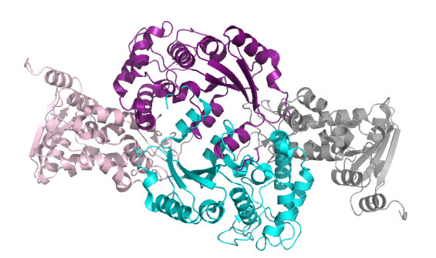
We identified the interfaces contributing the tetramer formation.
Aplysia ADP-ribosyl cyclase
(cytosolic protein)
1LBE
BST1/CD157
(GPI-anchored protein)
1ISF
CD38 (transmembrane protein)
1YH3
?
2EG9
M.Hara-Yokoyama et al, Structure 20: 1585-1595 (2012)

Slide 36
The dimerization of core dimers provides a structural basis for the previously reported tetramerization of CD38 on the cell-surface.
Type I
Type I
Type III interface
Membrane
Type II interface

Slide 37
CD38の細胞膜上での四量体構造は機能と密接に関与する
Aplysia ADP-ribosyl cyclase
(cytosolic protein)
1LBE
BST1/CD157
(GPI-anchored protein)
1ISF
CD38 (transmembrane protein)
1YH3
?
M.Hara-Yokoyama et al, Structure 20: 1585-1595 (2012)

Slide 38
CD38の触媒活性
ADP-ribose
Ca²⁺ mobilizing messenger
NAD glycohydrolase
cADPR hydrolase
ADP-ribosyl cyclase
NAD⁺
Cyclic ADP-ribose (cADPR)
COO⁻
(putative)
Base-exchange
NADP⁺
NAADP
細胞内カルシウム動員活性をもつ

Slide 39
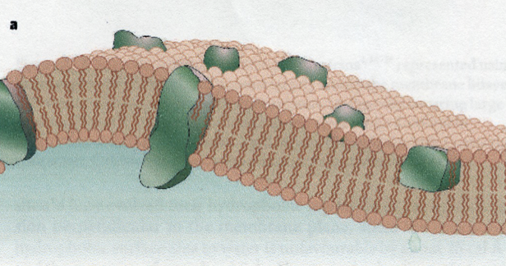
CD38は膜ドメインに存在する
膜ドメインとは
脂質二重層
あああ
あああ
あああ
あああ
あああ
あああ
あああ
あああ
あああ
あああ
あああ
あああ
あああ
あああ
あああ
あああ
あああ
あああ
あああ
あああ
あああ
あああ
あああ
あああ
あああ
あああ
あああ
あああ
あああ
あああ
あああ
あああ
あああ
あああ
あああ
あああ
あああ
あああ
あああ
あああ
あああ
あああ
あああ
あああ
あああ
あああ
あああ
あああ
あああ
あああ
あああ
あああ
あああ
あああ
あああ
あああ
あああ
あああ
あああ
あああ
あああ
あああ
あああ
あああ
あああ
あああ
あああ
あああ
あああ
あああ
あああ
あああ
あああ
あああ
Singer-Nicholson (1972)
あああ
あああ
あああ
あああ
あああ
あああ
あああ
あああ
あああ
あああ
あああ
あああ
あああ
あああ
あああ
あああ
あああ
あああ
あああ
あああ
あああ
あああ
あああ
あああ
あああ
あああ
あああ
あああ
あああ
あああ
あああ
あああ
あああ
あああ
あああ
あああ
あああ
あああ
あああ
あああ
あああ
あああ
あああ
あああ
あああ
あああ
あああ
あああ
生体膜には不均一性がある
あああ
あああ
あああ
あああ
あああ
あああ
あああ
あああ
あああ
あああ
あああ
あああ
あああ
あああ
あああ
あああ
あああ
あああ
あああ
あああ
あああ
あああ
あああ
あああ
あああ
あああ
あああ
あああ
あああ
あああ
あああ
あああ
あああ
あああ
あああ
あああ
あああ
あああ
あああ
あああ
あああ
あああ
あああ
あああ
あああ
あああ
あああ
あああ
流動性の高い領域
コレステロール・スフィンゴ脂質に富む流動性の低い領域
（膜ドメイン）

Slide 40
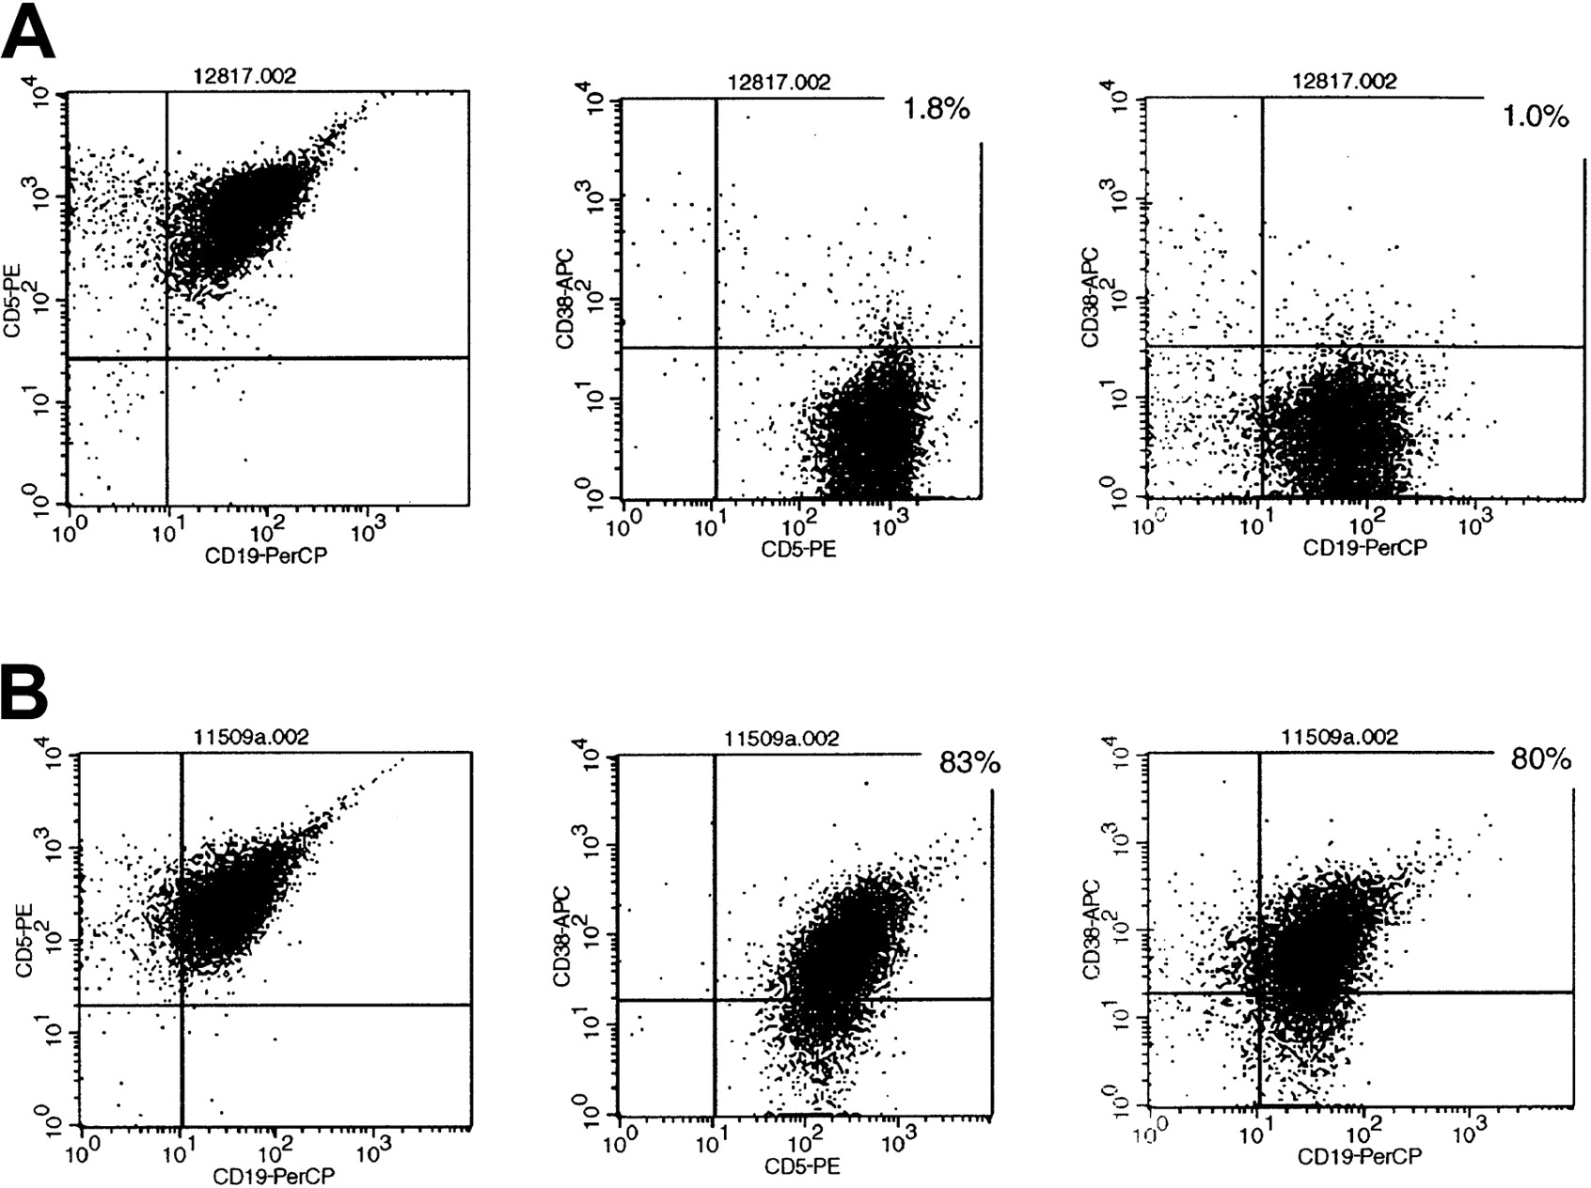
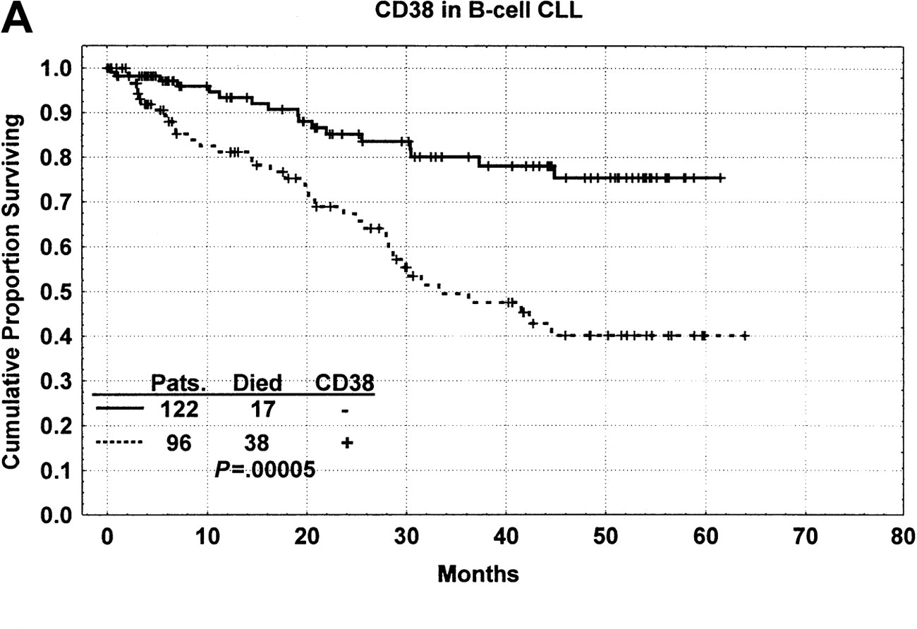
CD38 is recognized as a negative prognostic indicator
in B-CLL patients.
Peripheral blood
Flow cytometry (CD5/CD19/CD38)
B-CLL cells
Kaplan-Meler survival curve
CD38-negative
CD5
C38
C38
CD38-negative
CD19
CD5
CD19
CD38-positive
CD5
C38
C38
CD19
CD5
CD19
BLOOD 98:181-186 (2001)
CD38-positive

Slide 41
The dimer via the type I interaction mode is further considered to exist in equilibrium to form a tetramer via the type II/III interaction mode, which is compatible with membrane association.
Type I
Type I
Type IV
Type III interface
Type II
Type II
Type I
Membrane
Type III
BS³-crosslinking
Type II interface

Slide 42
Daratumumab (anti-CD38 mAb)
Updated results of a key Phase 1/2 trial testing the potential new myeloma therapy daratumumab were released.
“Daratumumab continues to show substantial promise as potential new treatment for multiple myeloma (ASCO2015)”
Publihsed: May 30, 2015
Notes:
CD19 coreceptor of BCR
CD16 Fc receptor
CD83 antigen presentation
CD11b integrin alpha M

