Slide 1
Veltis®: Innovative albumin based technology for half-life extension and optimization of Biotherapeutics
Dr Mikael Bjerg Caspersen
Industrial Biotechnology Conference – August 10th 2015

Slide 2
Innovative technology enabling you to rethink your therapeutic window
Veltis® is an albumin-based drug delivery technology that improves drug efficacy and patient compliance based upon the natural transportation properties of albumin
Control dose frequency and quantity to achieve optimal tolerability and efficacy using engineered human albumin
Approved in GSK’s Eperzan*/ Tanzeum™**
Veltis® delivers outstanding performance from the albumin experts
Science & know-how
Regulatory & technical support
Credible route to commercial manufacture
Long life IPRs
Toxic levels
side effects
Maximum desired dose
Blood concentration
Effective Dose
Minimum effective dose
Ineffective Dose
0
1
2
3
4
5
6
7
8
9
10
11
12
13
14
15
16
Days
Clinically proven
Allows you to optimize your peptide or protein
Dose size
Dose frequency
*EU Approval in March 2014, **FDA Approval in April 2014

Slide 3
ALBUMIN: a natural drug delivery platform
C-terminus
Physical properties
Single polypeptide chain
Very soluble
Flexible
Stable to adverse pH and temperature conditions
Biochemical properties
Very abundant
Highly disulphide bridged
Single free thiol
Long circulatory half-life
Biopharmaceutical properties
Long history of safe use
Low intrinsic activity
Recombinant versions available
Fusions and conjugates approved, safe and well tolerated
Low immunogenicity
Inherent tumour accumulation
Cys34
DI
DIII
N-terminus
DII
Figure 1. Biochemical and biophysical properties of albumin for drug delivery. Albumin’s inherent physical, biochemical and biopharmaceutical properties collectively ensure albumin is an excellent drug delivery platform. The 17 disulphide bonds are indicated in red while the free thiol at Cys34 within DI is shown in turquoise.
D. Sleep. Albumin and its application in drug delivery (2015) Expert Opin Drug Deliv. Vol. 12, Pages 793-812

Slide 4
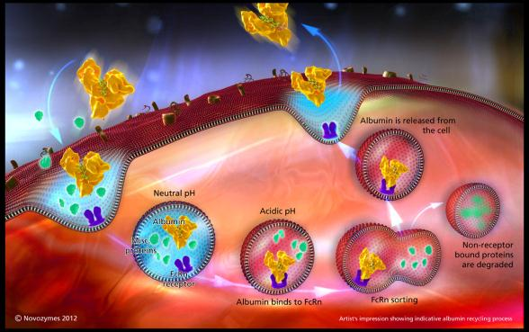
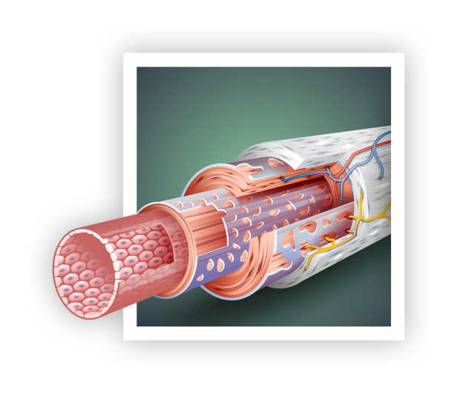
ALBUMIN IS Rescued from degradation by the FcRn RECEPTOR
Human albumin has a naturally long plasma half-life ~19 days due to:
Size - retained by kidney/glomerulus
FcRn (neonatal Fc receptor) recycling: pH-dependent recycling “rescues” albumin from degradation and prolongs half-life

Slide 5
Veltis® technology pipeline
Drug | Pre-clinical | Phase I | Phase II | Phase III | BLA / MAA Submitted | Approved
Eperzan/
Tanzeum™
Diabetes
CSL654
Hemophilia B
TV-1106
Growth hormone deficiency
CSL689
Hemophilia A & B
Tregitopes
Native sequence albumin
Not disclosed
Large Pharma
Engineered albumins

Slide 6
Why Engineer Human Albumin?
Illustrative PK curves
The half-life of albumin fusions and conjugates are typically lower than that of albumin alone
Final drug product can be cleared through either the albumin or the drug component
Improved control over the final half-life of albumin fusion or conjugate to achieve once-weekly, once two-weekly or once-monthly peptide or protein drug dosing
Define therapeutic dosing window by balancing dose size and frequency to achieve optimum efficacy and tolerability
Albumin
Serum Concentration
Albumin
+drug
Free Drug
Time

Slide 7
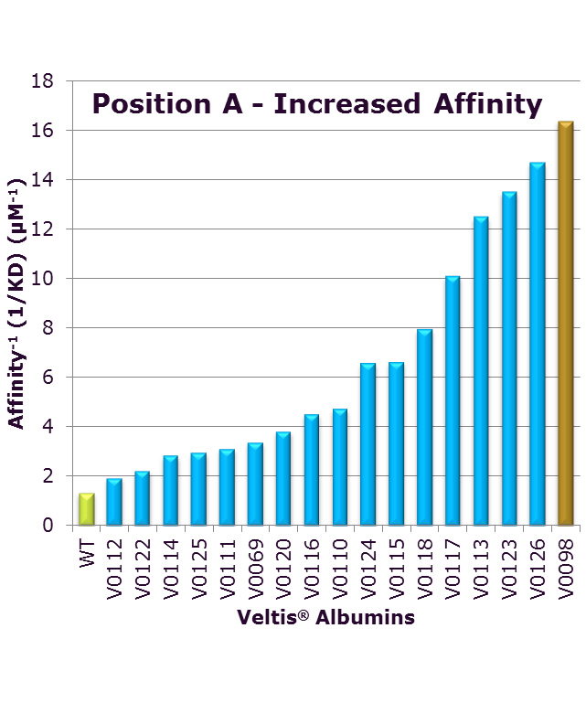
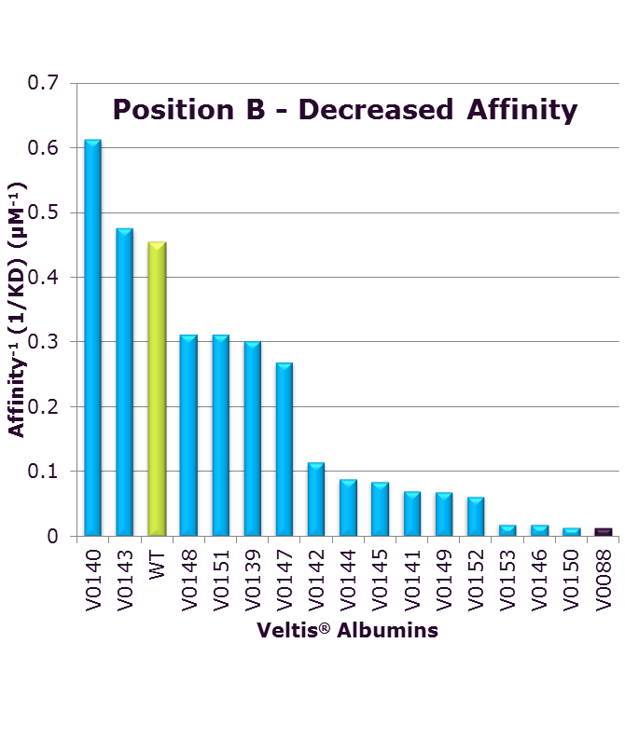
How to achieve control
Receptor affinity can be tuned up or down
Increased affinity
Decreased affinity
NS
NS

Slide 8
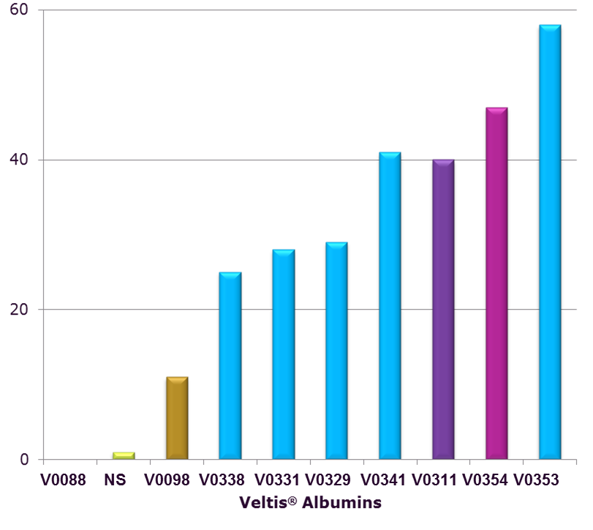
Engineering the albumin-FcRn interaction for Enhanced pharmacokinetics
Relative hFcRn affinity compared to native sequence albumin
Albumins have been engineered for increased and decreased binding affinity to the human FcRn receptor
Variants selected for enhanced binding at endosomal pH and no significant binding at neutral pH
FcRn binding affinity can be both increased and decreased in a pH dependent manner
Variants contain between 1-5 amino acid substitutions

Slide 9
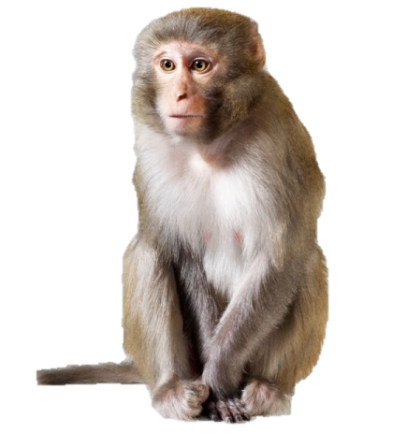
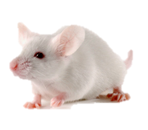
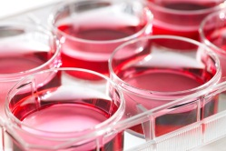
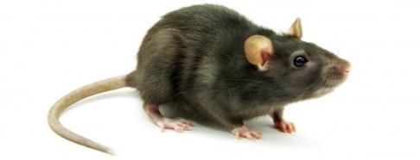
TRANSLATING FcRn BINDING TO IN VIVO Pharmacokinetics
Rodents
Cross species binding difference
Primate
Closest to humans
Double transgenic mice
Human FcRn /Human albumin
How does Veltis® technology behave in common animal species?
Macaque
WT Mice and Tg Mice
Endothelial cell-based rescue assay
In vitro receptor binding (SPR/Biacore)

Slide 10
RODENT PK STUDIES
– NOT AS SIMPLE AS YOU MIGHT THINK
Human albumin has a short half-life in rats
Animal FcRn affinities
Implications for PK and transgenic animals
Albumin | Model | T_{1/2}(h)
Human | Rat | 15
Rat | Rat | 49
KD (µM) | HSA | MSA
Human FcRn | 4.5 | 0.8
Mouse FcRn | 86 | 9.3
Explained by cross-species FcRn binding properties
Human albumin binds very poorly to FcRn from rodents
Human albumin compounds will be out-competed by MSA in WT mice and hFcRn transgenic mice (Roopenian)
Andersen et al. (2010) J. Biol. Chem. 285(7):4826-36

Slide 11
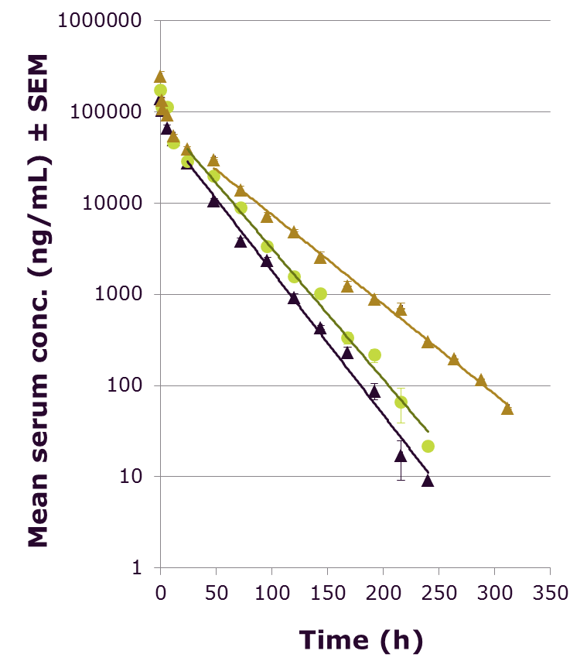
FcRn Binding Translates to PK modification in wild type MICE
V0098 - Improved FcRn binding variant
Half-life extension (31 h)
Increase in AUC
Reduced clearance
Increased FcRn rescue
V0098 - T_{½} 31 h
V0088 -Reduced FcRn binding variant
Shorter half-life (19 h)
Decrease in AUC
Increased clearance
Reduced FcRn rescue
V0088 – T_{½} 19 h
NS - T_{½} 21 h
Animal model: WT NMRI mice; single bolus intravenous administration; 10mg/kg

Slide 12
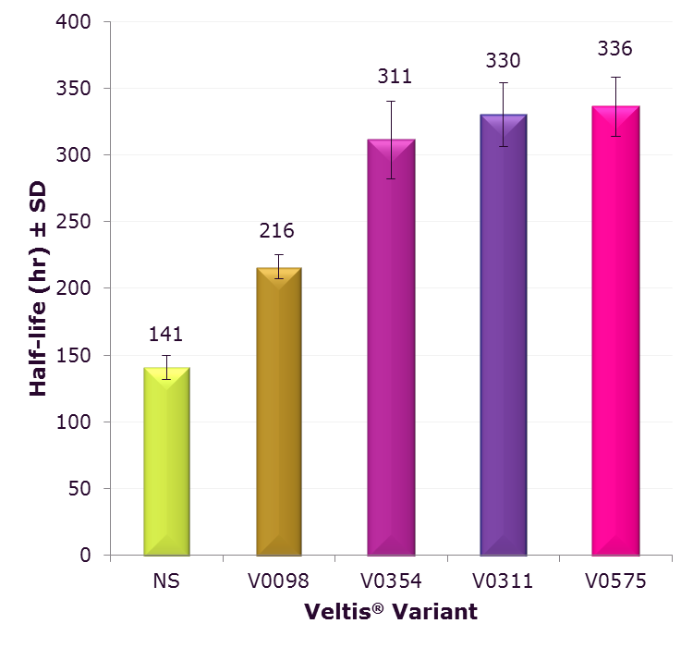
Engineered albumins achieve more than a doubling of half-life in a primate model
The prolongation in half-life is a result of a reduced clearance, increased mean residence time (MRT) and increased AUC
Doubling of half-life in primates opens the door to monthly dosing of therapeutic peptides and proteins in humans
Cynomolgus PK study with a model API demonstrated a half-life of more than 270 hours

Slide 13
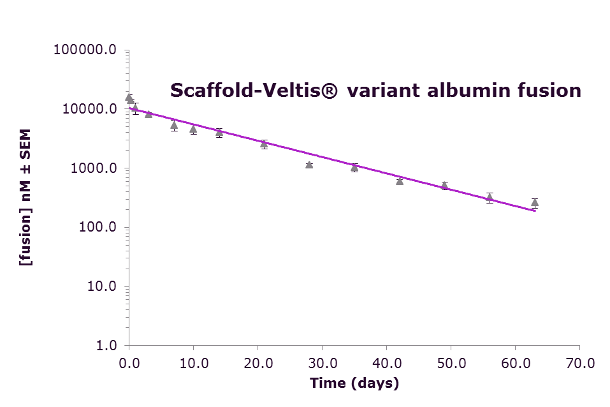
Once-monthly dosing: reasons to believe
Veltis® variant albumin fusion to a scaffold molecule delivered a half-life of over 11 days
PHARMACOKINETIC PROFILE IN CYNOMOLGUS MONKEY (n=3, IV BOLUS 35 mg/kg)
T1/2 (h) = 276.7 ± 19

Slide 14
ATTACHMENT TO VELTIS® CAN BE THROUGH EITHER CONJUGATION OR FUSION
Conjugation to Veltis®
Fusion to Veltis®
Chemically modify peptide or drug to allow covalent attachment to Veltis® albumin molecule:
Lysine
Tyrosine
Free thiol (SH)
Free thiol is the most widely used conjugation route:
Specifically reactive with maleimide groups
1:1 Stoichiometric peptide loading
Veltis® albumin fusion proteins are produced as a single polypeptide
Veltis® Albumin
C-terminal
N-terminal
Combinations
C-terminal + Linker
Peptide/drug
+
Albumin
-Cys-34
N-terminal + Linker

Slide 15
PARTNERING FOR Success IN CHEMICAL CONJUGATION
Next generation maleimide conjugation technology for site-specific protein conjugation
Link target molecule to Veltis® albumin at high reaction yield for serum-stable conjugate
Complete service range
Non-GMP custom synthesis
Conjugation
GMP manufacture
>9000 peptides manufactured
Expertise in challenging peptides

Slide 16
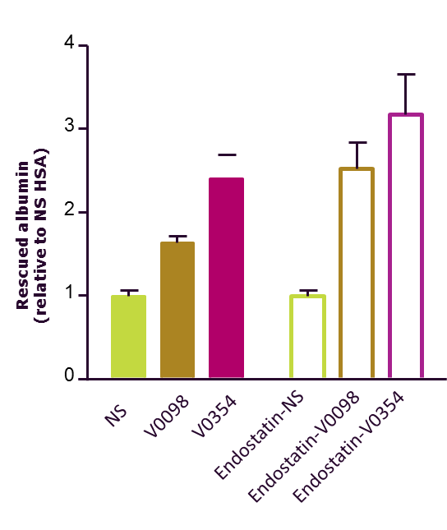
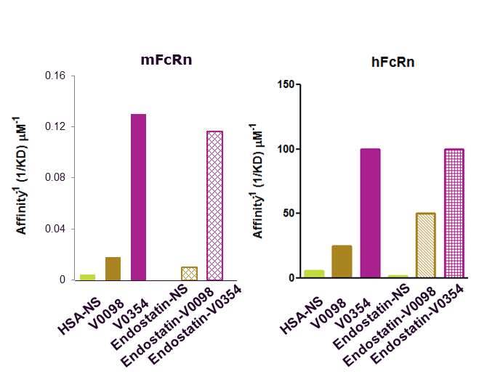
VELTIS® VARIANTS for genetic fusion proof of concept: Endostatin
Receptor affinity maintained when Endostatin is fused to Veltis®
Endothelial cell-based rescue assay

Slide 17
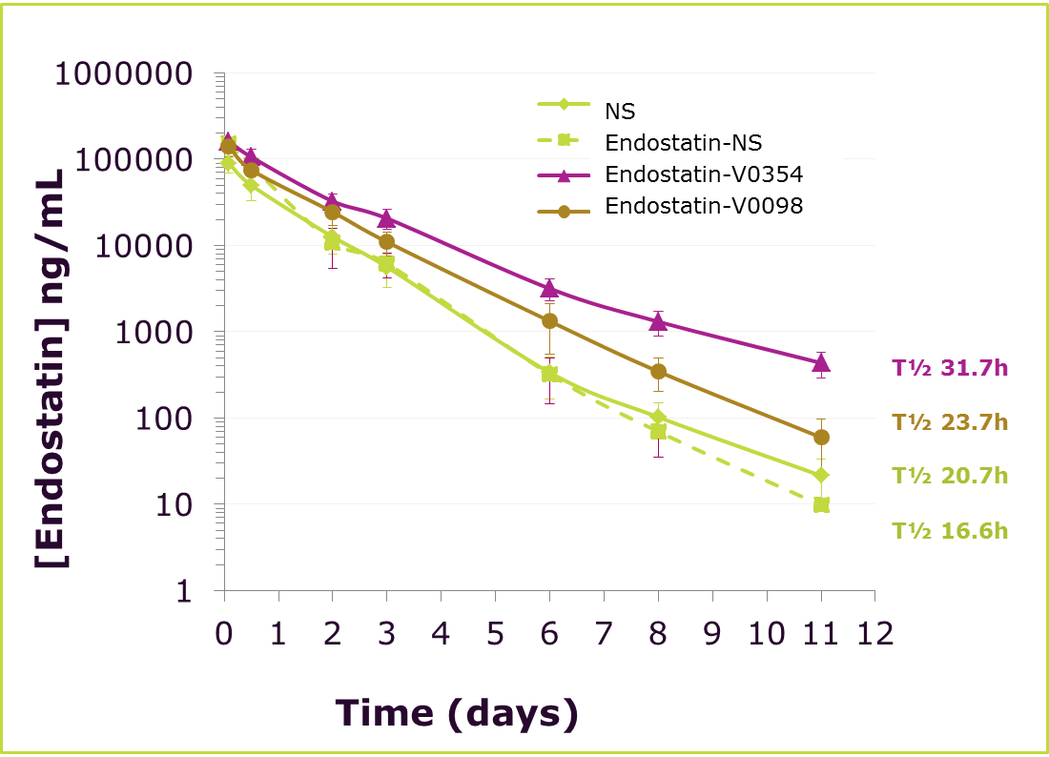
Endostatin fused to Veltis® variants Significantly prolongs half-life
Endostatin genetically fused to Veltis® albuminsV0098 and V0354 shows a 1.4- and 1.9- fold longer half-life, respectively, compared to fusion to NS human albumin
5 subjects/compound, IV Bolus (10 mg/kg) male NMRI mice

Slide 18
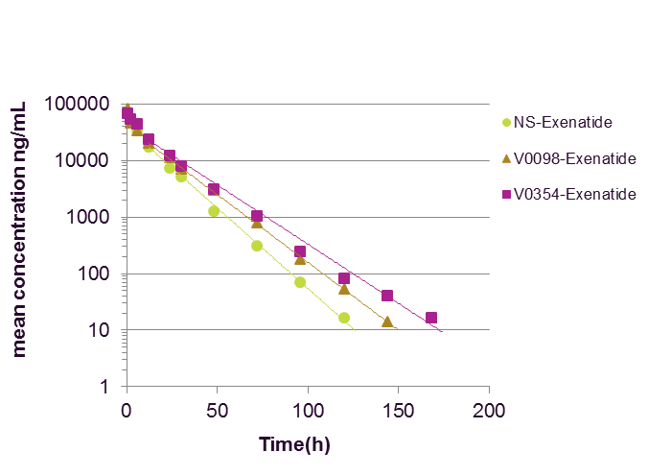
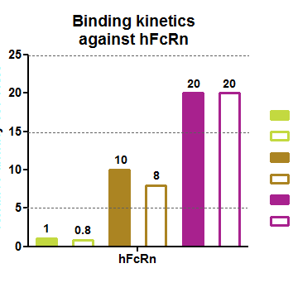
VELTIS® variants for conjugation proof of concept: exenatide
Receptor affinity maintained when Exenatide is conjugated to Veltis®
Pharmacokinetic profiles of albumin exenatide conjugates in WT mice
Relative affinity NS HSA
NS HSA
NS Exenatide
V0098
V0098 Exenatide
V0354
V0354 Exenatide
T_{1/2} =15.3h
T_{1/2} =10.9h
T_{1/2} =12.9h
WT mice IV Bolus (5mg/Kg)

Slide 19
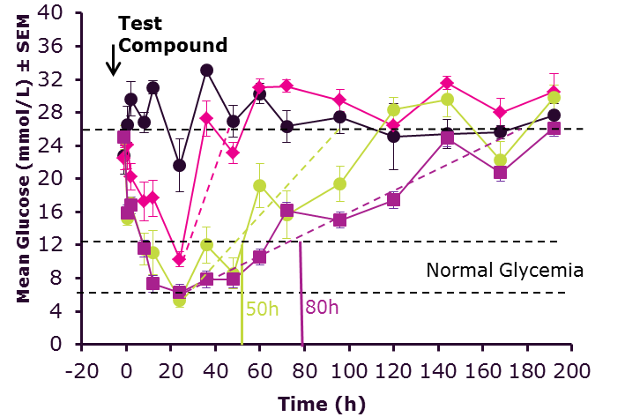
VELTIS® variants for Improved PK/PD
proof of concept: exenatide
Pharmacokinetic profiles of albumin exenatide conjugates in WT mice
Pharmacodynamic profiles in diabetic mice
T_{1/2} =15.3h
T_{1/2} =10.9h
T_{1/2} =12.9h
-
-
WT mice IV Bolus (5mg/Kg)
Diabetic mice SC (500nmol/Kg)
Veltis® exenatide conjugates retain therapeutic effect and prolong efficacy

Slide 20
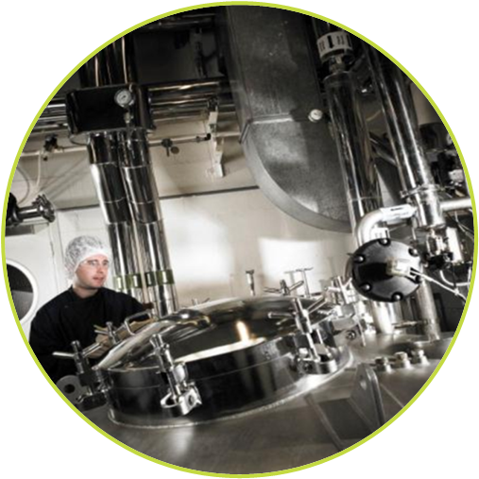
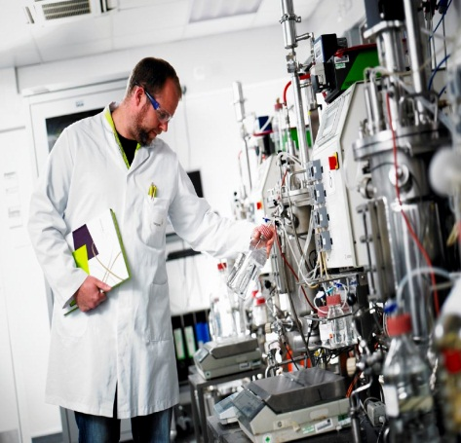
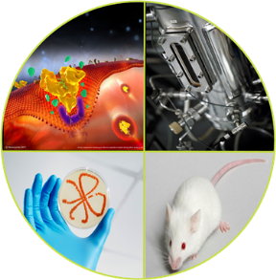
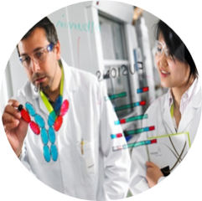
COMPLETE SUPPORT PACKAGE FROM THE ALBUMIN EXPERTS
Clinical Development
Phase I-II supply through Novozymes or partners
Tech transfer to CMO
cGMP supply of Veltis® albumins
Veltis® Tool Box
FcRn and cell assays
Yeast expression
Conjugation technology
2xKOKI mouse
Pre-clinical Development
Fermentation optimization
Process development
Provision of materials for toxicology and in vivo studies from Novozymes or partner
Rapid Proof of Concept
Fusion and conjugate design
Research licences
Veltis® albumin samples

Slide 21
Thank you Booth 105 poster a55 Contact: KBUI@novozymes.com

