Slide 1
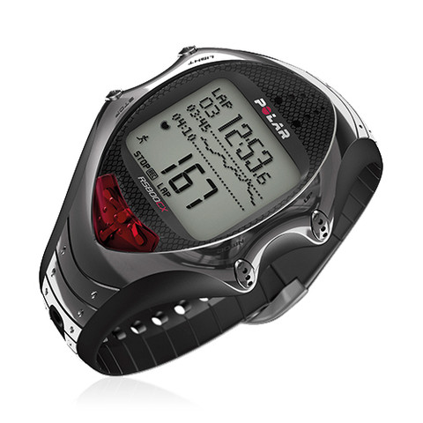
3rd International Conference and Exhibition on
Occupational Health & Safety
June 24-25, 2014 Valencia Conference Centre, Valencia, Spain
ASSESSMENT OF ENERGY EXPENDITURE IN WORKERS IN THE AUTOMOTIVE INDUSTRY
______________________________________________________
Dr. Michaela MACHAJOVÁ, Bc.Monika THÓTOVÁ
Trnava University
Faculty of Health Sciences and Social Work
Department of Public Health
Trnava, Slovakia

Slide 2
Objectives
The main objective
To assess energy expenditure of workers during work shift in automobile industry
The intermediate objectives
To measure heart rate and energy consumption of workers by measurement device Polar RS 400
To compare the results with the legal regulations of Slovak Republic
To find out the difference in levels of energy expenditure between individual work positions
Determine energy expenditure by using index method by Borsky and compare results against measured values
Key words: heart rate, energy expenditure, time frame, work load

Slide 3
Methods
Hall of coating
September – December 2013
5 work positions, 20 workers
Selection of subjects
Inclusion criteria
Exclusion criteria
Data collection
Face to face questionnaire
Observation
Stalking
Instrumental method /Polar RS 400/
Calculation of energetic expenditure
Harris – Benedict equation
Values of index method by Borsky
}
Time frame

Slide 4
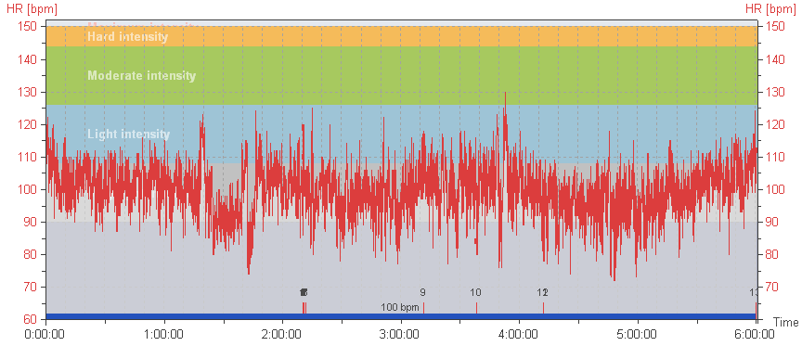
Polar ProTrainer 5
Break HR min HR max
30 min
72 bpm
130 bpm

Slide 5
Results – heart rate
Table 1 Increase in heart rate and comparison with the permissible values ​​and work position of employees in the age group 30-39 y.
ID | Work position /sealing/ | Increase HR /bpm/ | Permissible value /bpm/ |  | Exceeding /bpm/
 |  |  | average | limit | average | limit
1 | Left/right side of the floor | 25 | 29 | 32 | - | -
4 | Left/right side of the floor | 28 | 29 | 32 | - | -
5 | Left/right side of the floor | 38 | 29 | 32 | 9 | 6
7 | Engine compartment | 23 | 29 | 32 | - | -
8 | Engine compartment | 33 | 29 | 32 | 4 | 1
10 | Tail hood | 31 | 29 | 32 | 2 | -
12 | Engine compartment | 39 | 29 | 32 | 10 | 7
13 | Boot | 23 | 29 | 32 | - | -
15 | Doors in hinges | 29 | 29 | 32 | - | -
17 | Doors in hinges | 21 | 29 | 32 | - | -

Slide 6
Results – energy expenditure
Table 2 Comparison of observed and permissible values ​​of energy expenditure of employees in the age group 30-39 y.
ID | Work position /sealing/ | Energy expenditure "netto" /kJ/ | Permissible value /kJ/ | Exceeding /kJ/
1 | Left/right side of the floor | 6058 | 7500 | -
4 | Left/right side of the floor | 7585 | 7500 | 85
5 | Left/right side of the floor | 8059 | 7500 | 559
7 | Engine compartment | 3514 | 7500 | -
8 | Engine compartment | 8433 | 7500 | 933
10 | Tail hood | 6319 | 7500 | -
12 | Engine compartment | 6171 | 7500 | -
13 | Boot | 4105 | 7500 | -
15 | Doors in hinges | 5542 | 7500 | -
17 | Doors in hinges | 7320 | 7500 | -

Slide 7
Results – comparison of work positions
Table 3 Comparison of energy expenditure during the work between work positions
Work position | Energy expenditure of workers /kJ/ | Average /kJ/
Sealing of boot | 8771 | 6701,3
 | 5903
 | 4105
 | 8026
Sealing of left/right side of the floor | 6058 | 6819,5
 | 7585
 | 8059
 | 5576
Sealing of engine compartment | 5711 | 5957,3
 | 3514
 | 8433
 | 6171
Sealing of doors in hinges | 5542 | 5623,0
 | 4489
 | 7320
 | 5141
Sealing of tail hood | 3048 | 4612,8
 | 6319
 | 5334
 | 3750
p |  | NS

Slide 8
Results – time frame
Table 4 Time frame and work energy expenditure - sealing left/right side of the floor
Note: ¹Category by Borsky: A - posture, B - movement (walking), C – amount of muscular effort and degree of load; ²energy expenditure; ³included waiting for car body, failure, extra breaks
Work operation | Category¹ |  |  | Total time for work shift /min/ | EE² "from" /kJ/ | EE "to„ /kJ/
Preparation | A | stand |  | 63 | 81,9 | 182,7
 | C | medium | both upper limbs |  | 504 | 630
 | B | walking 80 m/min |  | 13 | 221 | 221
Coat sealant | A | bend forward |  | 60 | 102 | 174
 |  |  |  |  | 780 | 1080
 | C | medium | both upper limbs and trunk
 | B | walking 80 m/min |  | 13 | 221 | 221
Spread sealant and set out acustic carpet | A | bend forward |  | 189 | 321,3 | 548,1
 | C | medium | both upper limbs and trunk |  | 2457 | 3402
 | B | walking 80 m/min |  | 23 | 391 | 391
Downtime³ | A | stand |  | 89 | 115,7 | 115,7
Break time |  |  |  | 30
Total |  |  |  | 480 | 5194,9 | 6965,5

Slide 9
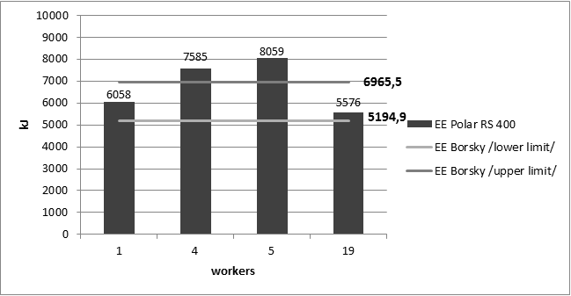
Results – Polar RS 400/Borsky
Graph 1 Comparison of work energy expenditure by Polar RS 400 and index method by Borsky – sealing of left/right side of the floor

Slide 10
Results – Polar RS 400/Borsky
Table 5 Comparison of energy expenditure acquired by Polar RS 400 and index method by Borsky
Work position | Energy expenditure Polar RS 400 /kJ/ | Energy expenditure Borsky /kJ/ | p
Sealing of boot | 8771 | 5068,3 – 6628,7
 | 5903
 | 4105
 | 8026
Average | 6701,3 | 5848,5 | NS
Sealing of left/right side of the floor | 6058 | 5194,9 – 6965,5
 | 7585
 | 8059
 | 5576
Average | 6819,5 | 6080,2 | NS
Sealing of engine compartment | 5711 | 4762,8 – 6550,6
 | 3514
 | 8433
 | 6171
Average | 5957,3 | 5656,7 | NS
Sealing of door in hinges | 5542 | 4573,3 – 6156,1
 | 4489
 | 7320
 | 5141
Average | 5623,0 | 5364,7 | NS
Sealing of tail hood | 3048 | 3007,5 – 4141,5
 | 6319
 | 5334
 | 3750
Average | 4612,8 | 3574,5 | NS

Slide 11
Limitations
Small focus group of workers
Smoking
Body disproportion
High- frequency equipment near the measurement device

Slide 12
Conclusion
Increase of heart rate
8 workers /2 x only average value was exceeded/
3 x sealing of engine compartment
Energetic expenditure
4 workers /3 x heart rate was exceeded/
2 x sealing of left/right side of the floor
Comparison - work position
Difference was not confirmed
Comparison - Polar RS 400/Borsky
Difference was not confirmed

Slide 13
Thank you
for your attention!
mmachajova@gmail.com

