Slide 1
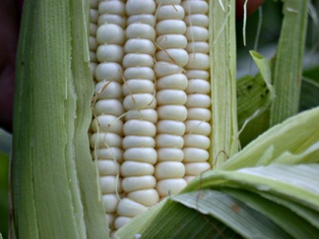
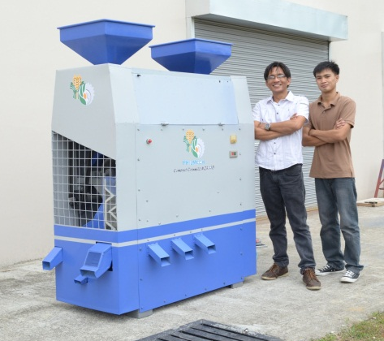
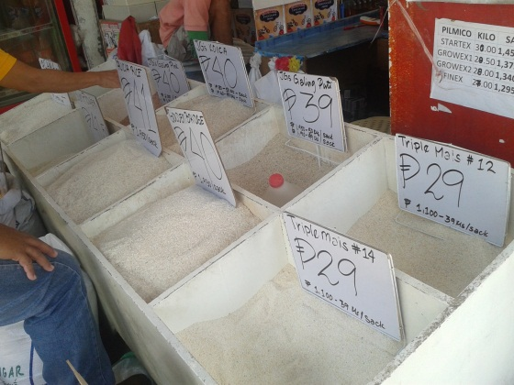




Development of Improved
Compact Cornmill for White Corn
Michael A. Gragasin, Ph.D.
Philippine Center for Postharvest Development and Mechanization (PHilMech)
Department of Agriculture, Philippines

Slide 2
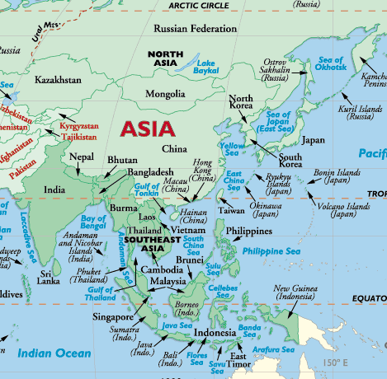

Rice is the food staple for about half of the world’s 7 billion people. Around 90% of the rice produced is consumed in Asia, home to more than two-thirds of the world’s poor and hungry.
Rice is thinly traded in the world market, accounting for only around 6% of the total world production in 2010.

Slide 3
2004-2013
The Philippines is the 8th largest rice producer in the world, accounting for 2.8% of global rice production. However, the Philippines was also the world's largest rice importer in 2010.

Slide 4

The population of the Philippines is estimated at 97 million. Its annual growth rate of around 2% – among the world’s highest.
Philippine population: 97million (2010)

Slide 5
The government aggressively implemented the Food Staple Sufficiency Program in 2010 to increase rice production, maintain per capita consumption of rice and increase consumption of other staple foods such as CORN.

Slide 6

IMPORTANCE OF WHITE CORN
White corn serves as main food staple of about 15% of the total population (mostly in major islands of Visayas and Mindanao) in the form of corn grits.

Slide 7
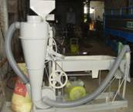
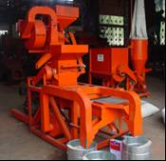
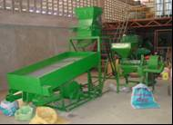
The poor quality of corn grits is one of the major causes of the diminishing consumption of white corn in the country from 20% in 1980s to 15% of the total population nowadays.
The poor quality of corn grits can be attributed to the poor performance of available corn mill in the country.

Slide 8
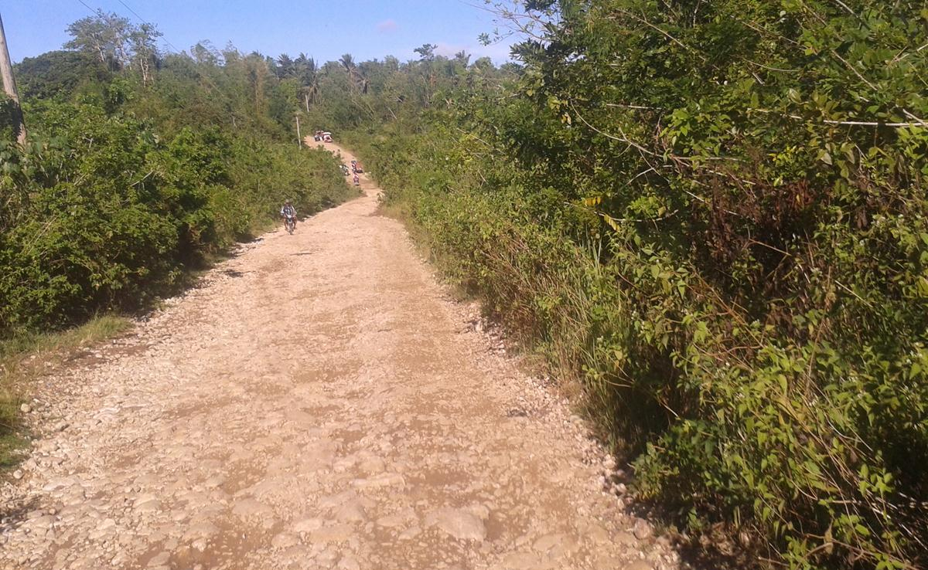
Why there is a need to develop
a village-type corn mill?

Slide 9

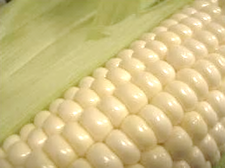
PROJECT OBJECTIVES
General:
To develop an improved village type cornmill for white corn.
Specific:
Establish parameters in coming up with an improved design;
2. Design and fabricate an improved village type corn mill;
Examine the technical performance of the proto-type village cornmill; and,
4. Determine the economic viability of the cornmill.

Slide 10
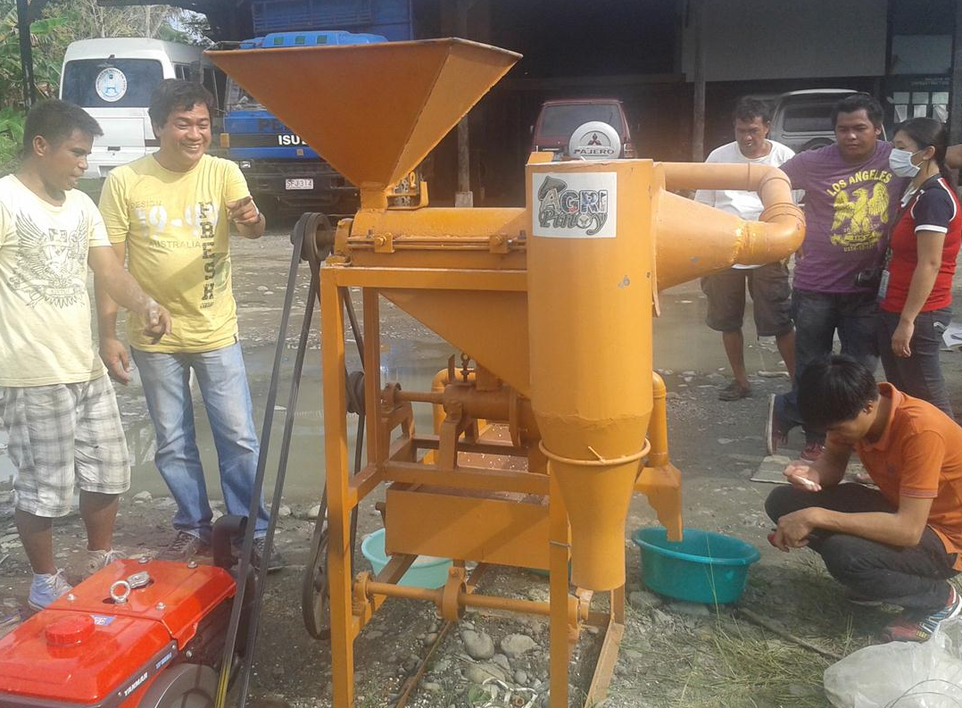
METHODOLOGY
Evaluated the Performance of Existing Cornmills

Slide 11
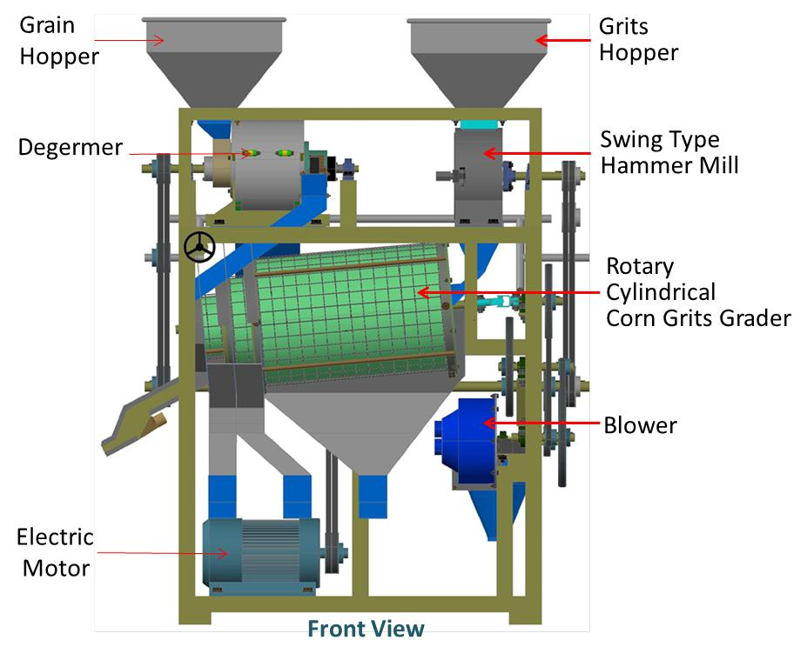
METHODOLOGY
Came up with a New Design of Village-Type Cornmill

Slide 12
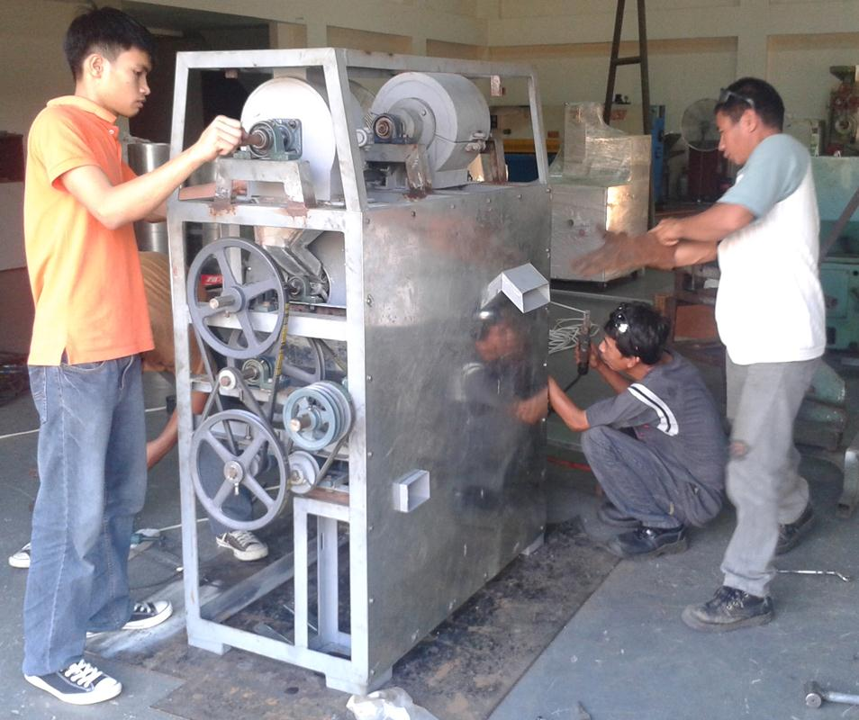
METHODOLOGY
Fabricated the Prototype Unit

Slide 13
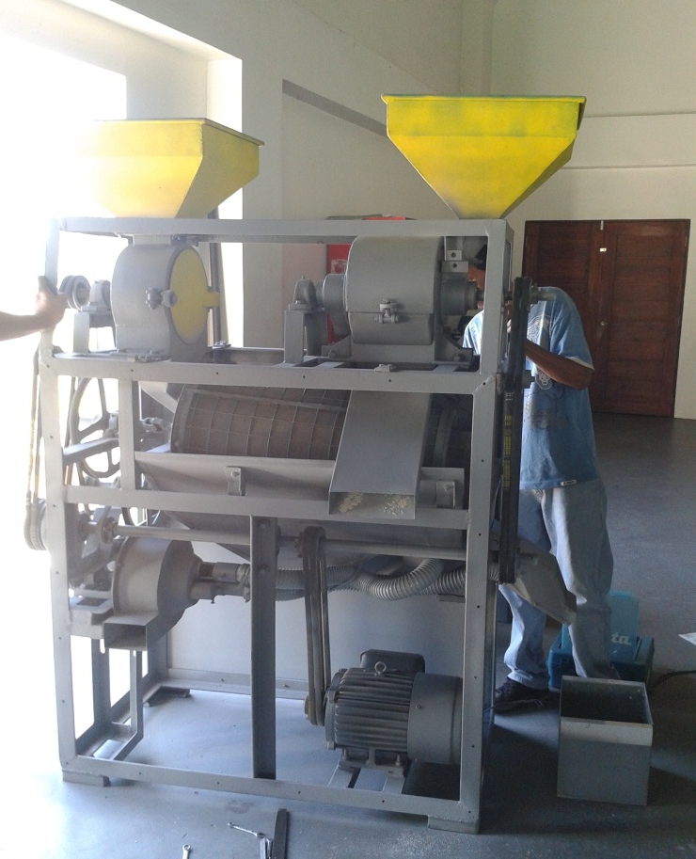
METHODOLOGY
Subjected the Prototype Unit to Laboratory Tests

Slide 14
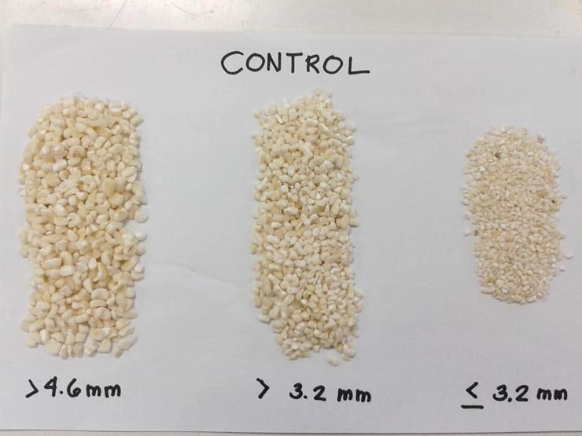
METHODOLOGY
Conducted Physical Analysis on the Output of the Prototype Unt

Slide 15
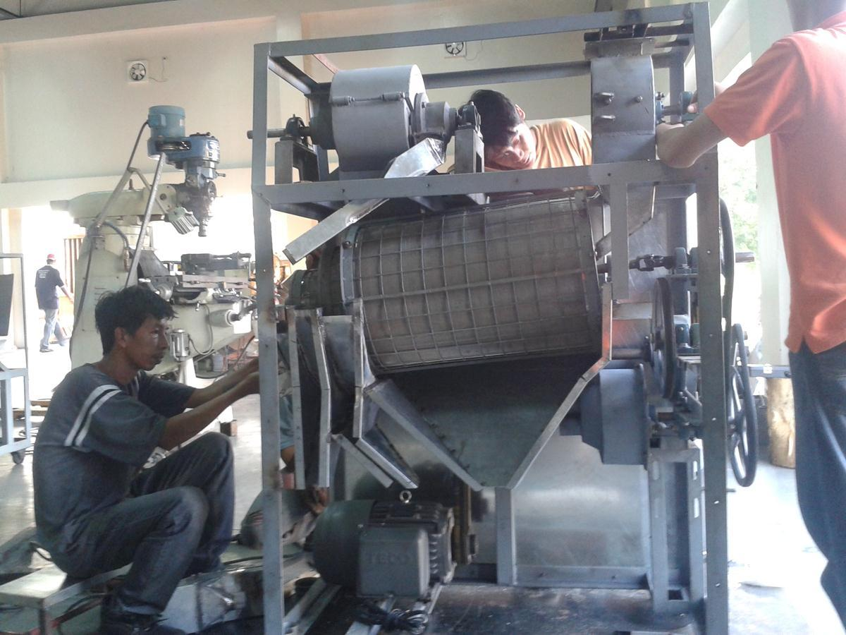
METHODOLOGY
Modified/
Improved the Design to Achieve the Desired Output

Slide 16

METHODOLOGY
Subjected the Prototype Unit to Field Testing

Slide 17
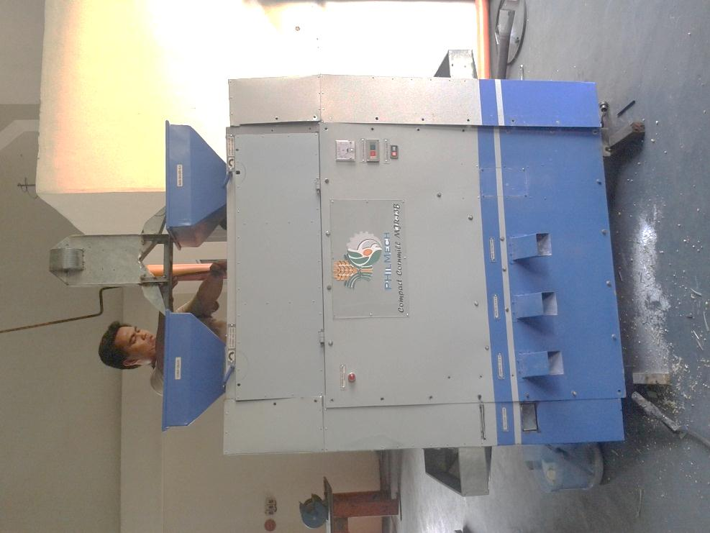
METHODOLOGY
Modified/
Improved the Design to Achieve the Desired Output

Slide 18
RESULTS

Slide 19
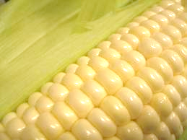
For Objective No. 1
Establishment of parameters to come up with an improved design
What TO BE IMPROVE on the design of existing
corn mills?

Slide 20
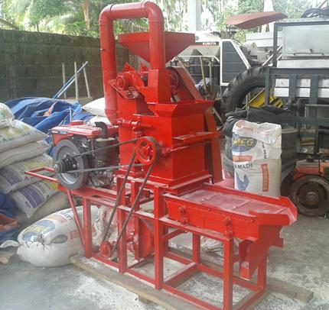
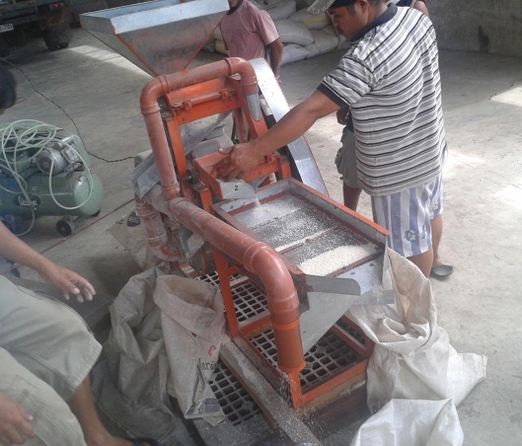
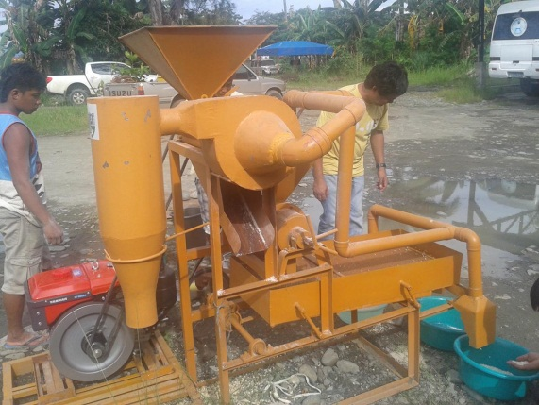
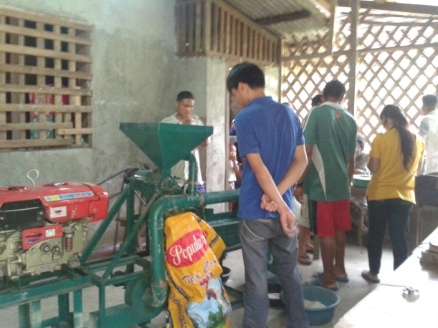
Results of performance evaluation of commercial village cornmill
1st Design Consideration
Type of Cornmill | Input Cap. (kg/h) | Output Cap. (kg/h) | Main Product Rec. (%) | Degermi-nation Eff. (%) | Labor Reqt. | Power/fuel consumption
A | 109.70 | 29.71 | 54.80 | 87.79 | 1-2 | 1 L/h diesel
B | 121.75 | 13.06 | 24.80 | 85.70 | 1-2 | 3.06 kW/hr
C | 65.06 | 14.55 | 64.70 | 50.65 | 1-2 | 1 L/h diesel
D | 69.88 | 14.51 | 67.80 | 56.22 | 1-2 | 1 L/h diesel
Lower than 64%
Low milling
recovery
High postharvest
losses
Lower supply of
corn grits
in the market

Slide 21
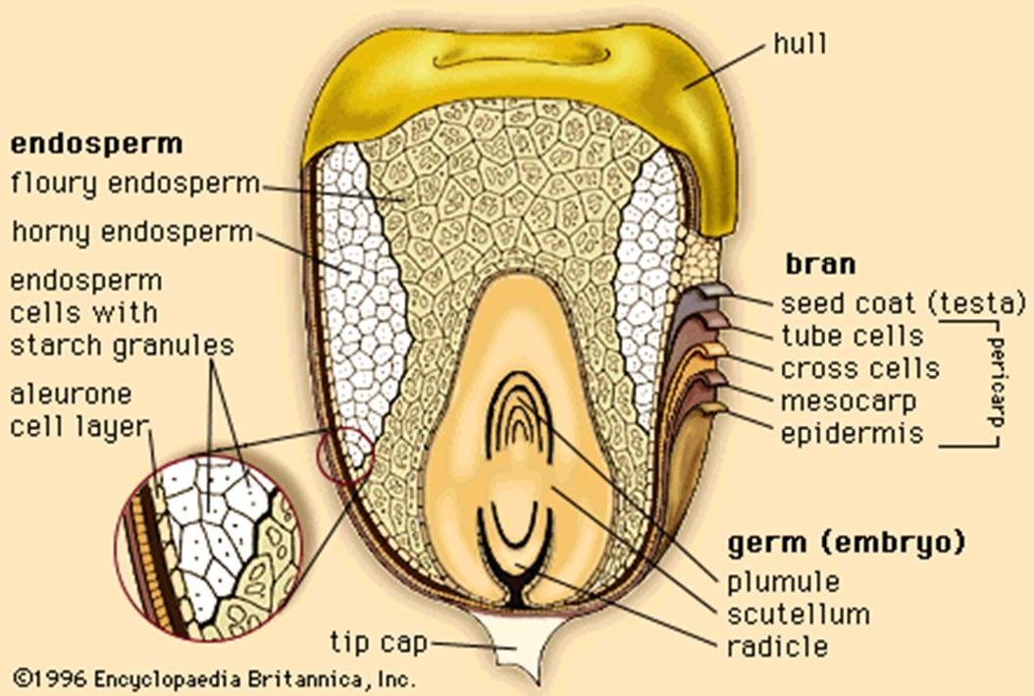
Results of performance evaluation of commercial village cornmill
2nd Design Consideration
Type of Cornmill | Input Cap. (kg/h) | Output Cap. (kg/h) | Main Product Rec. (%) | Degermi-nation Eff. (%) | Labor Reqt. | Power/fuel consumption
A | 109.70 | 29.71 | 54.80 | 87.79 | 1-2 | 1 L/h diesel
B | 121.75 | 13.06 | 24.80 | 85.70 | 1-2 | 3.06 kW/hr
C | 65.06 | 14.55 | 64.70 | 50.65 | 1-2 | 1 L/h diesel
D | 69.88 | 14.51 | 67.80 | 56.22 | 1-2 | 1 L/h diesel
Lower than 80%
High presence of
Impurities
(tip cap, hull & germ)
in the corn grits
Displeasure
on the part of consumers to eat corn
Shift to rice

Slide 22
Results of performance evaluation of commercial village cornmill
3rd Design Consideration
Type of Cornmill | Input Cap. (kg/h) | Output Cap. (kg/h) | Main Product Rec. (%) | Degermi-nation Eff. (%) | Labor Reqt. | Power/fuel consumption
A | 109.70 | 29.71 | 54.80 | 87.79 | 1-2 | 1 L/h diesel
B | 121.75 | 13.06 | 24.80 | 85.70 | 1-2 | 3.06 kW/hr
C | 65.06 | 14.55 | 64.70 | 50.65 | 1-2 | 1 L/h diesel
D | 69.88 | 14.51 | 67.80 | 56.22 | 1-2 | 1 L/h diesel
Low output capacity of existing cornmills

Slide 23
Results of performance evaluation of commercial village cornmill
4th Design Consideration
Type of Cornmill | Input Cap. (kg/h) | Output Cap. (kg/h) | Main Product Rec. (%) | Degermi-nation Eff. (%) | Labor Reqt. | Power/fuel consumption
A | 109.70 | 29.71 | 54.80 | 87.79 | 1-2 | 1 L/h diesel
B | 121.75 | 13.06 | 24.80 | 85.70 | 1-2 | 3.06 kW/hr
C | 65.06 | 14.55 | 64.70 | 50.65 | 1-2 | 1 L/h diesel
D | 69.88 | 14.51 | 67.80 | 56.22 | 1-2 | 1 L/h diesel
High production cost per kg output of corn grits due to low output capacity of village-type corn mill

Slide 24
Results of performance evaluation of commercial village cornmill
Type of Cornmill | Input Cap. (kg/h) | Output Cap. (kg/h) | Main Product Rec. (%) | Degermi-nation Eff. (%) | Labor Reqt. | Power/fuel consumption
A | 109.70 | 29.71 | 54.80 | 87.79 | 1-2 | 1 L/h diesel
B | 121.75 | 13.06 | 24.80 | 85.70 | 1-2 | 3.06 kW/hr
C | 65.06 | 14.55 | 64.70 | 50.65 | 1-2 | 1 L/h diesel
D | 69.88 | 14.51 | 67.80 | 56.22 | 1-2 | 1 L/h diesel
5th Design Considerations
How small is a village-type cornmill to become viable?

Slide 25

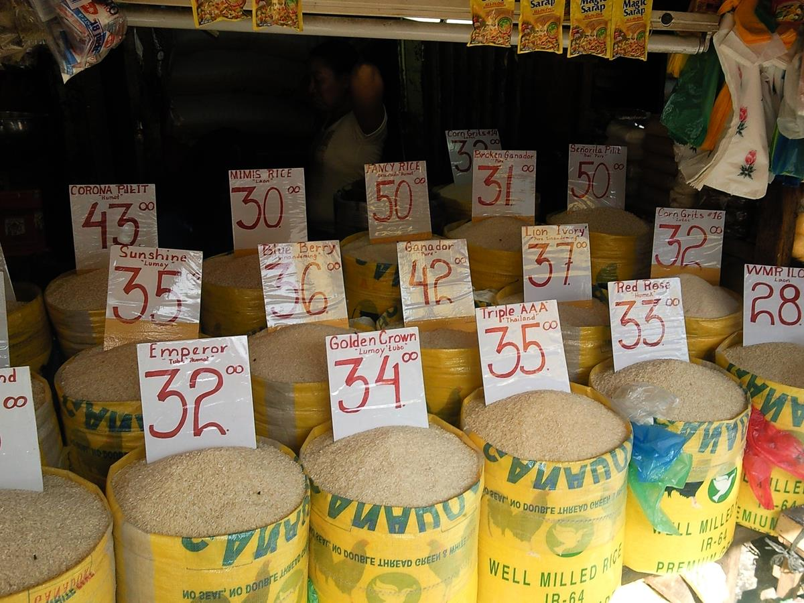
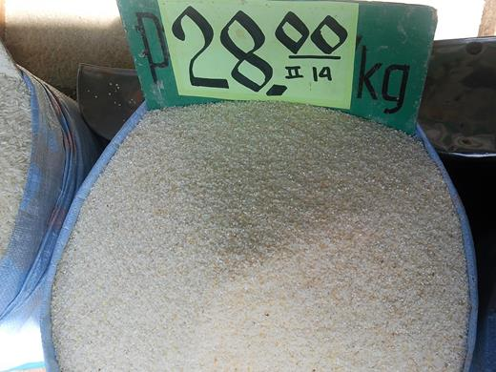
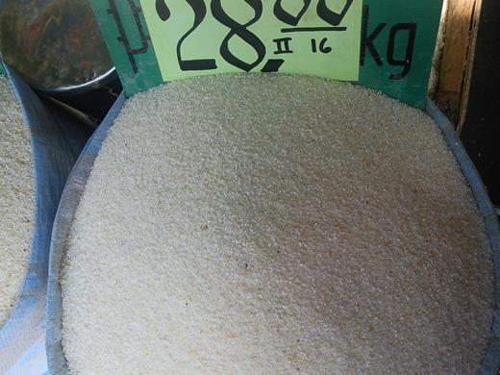
6th Design Consideration
Sagbayan Public Market, Bohol
August 28, 2013
How to satisfy the demand of the market ?
Cebu City Public Market
June 15, 2012
Size No. 14
Size No. 16

Slide 26
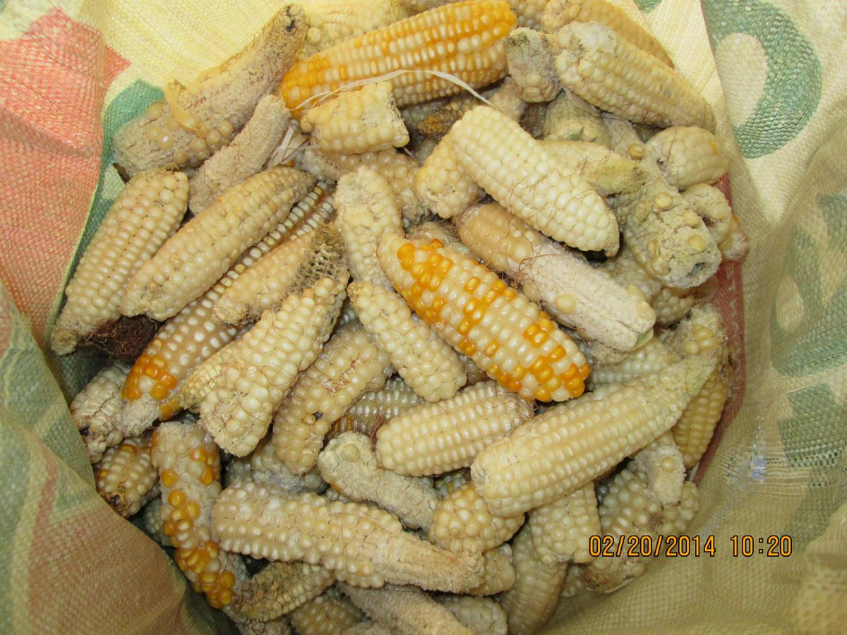
7th Concern
What we will do for those harvest that are highly contaminated with aflatoxin?

Slide 27
For Objective No. 2
Design and fabrication of an improved village type cornmill

Slide 28
Degermer and milling
Components
Grader Assembly

Slide 29
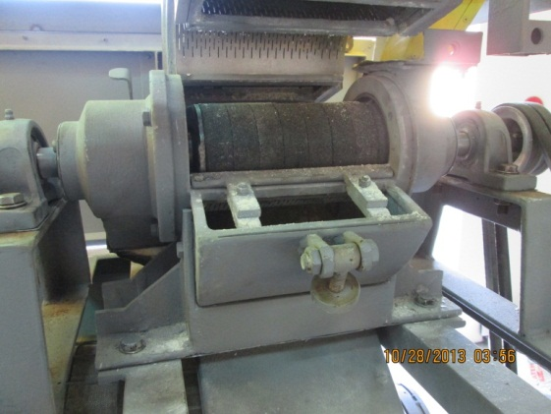
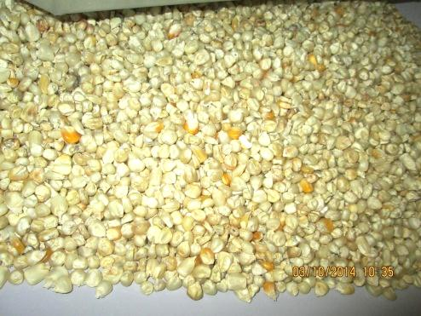
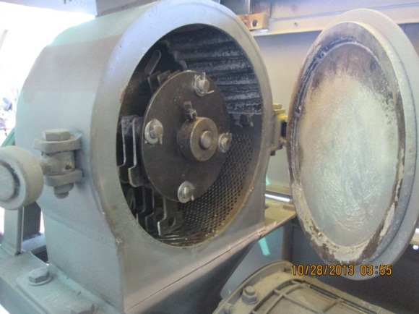
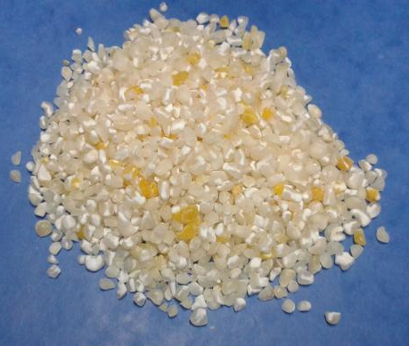
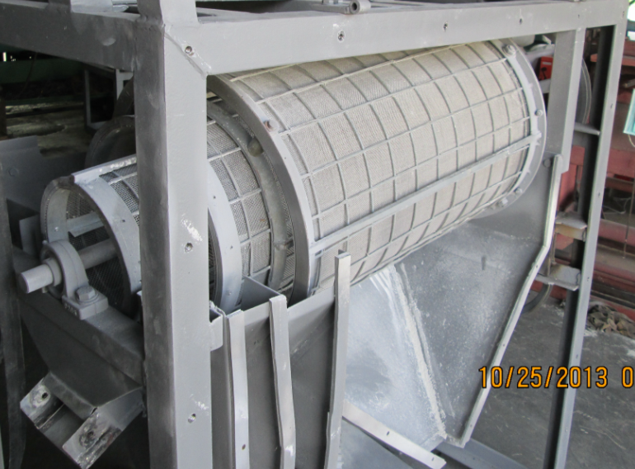
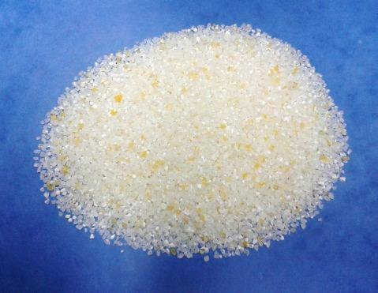
PROCESS FLOW
DEGERMER
HAMMER MILL
GRADER

Slide 30
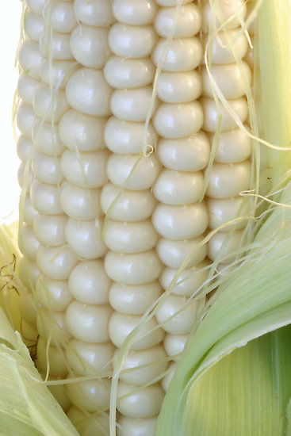
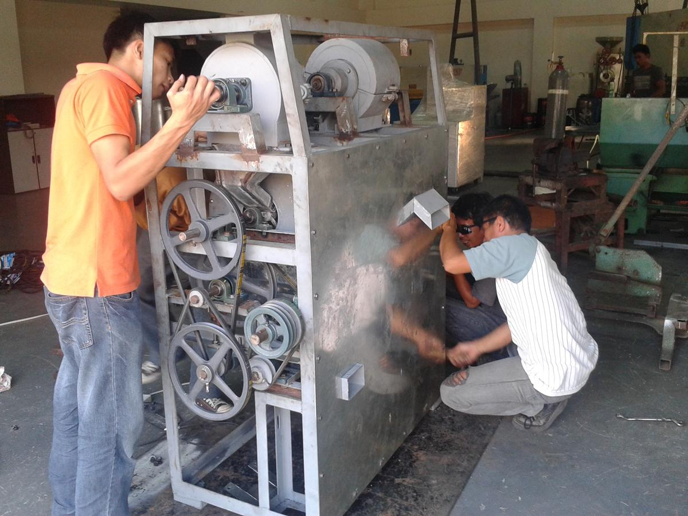
Fabrication of the cornmill machine incorporating the different design of each cornmill component

Slide 31

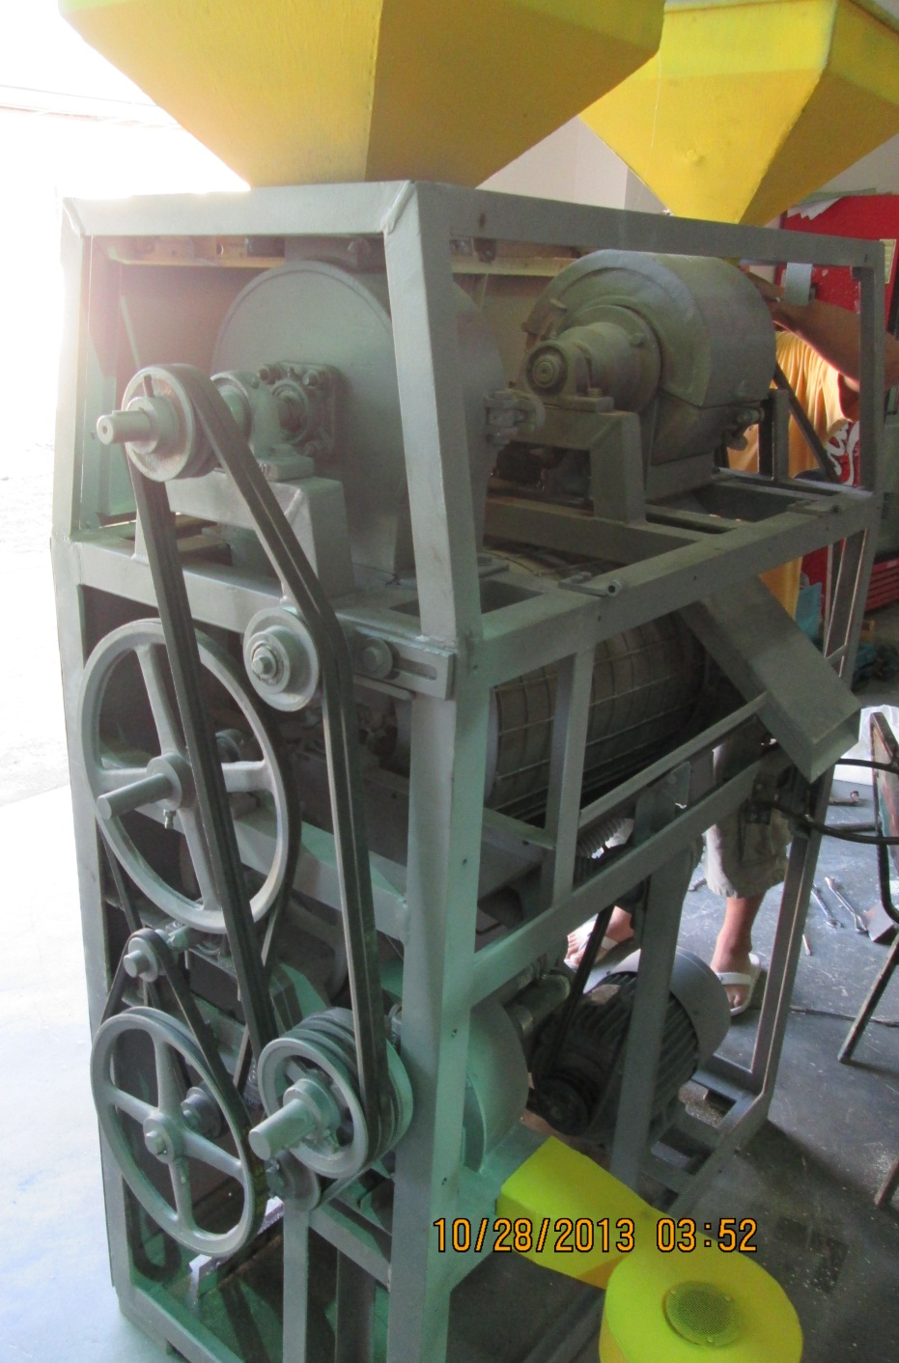
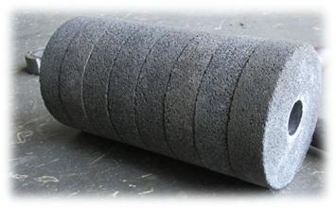
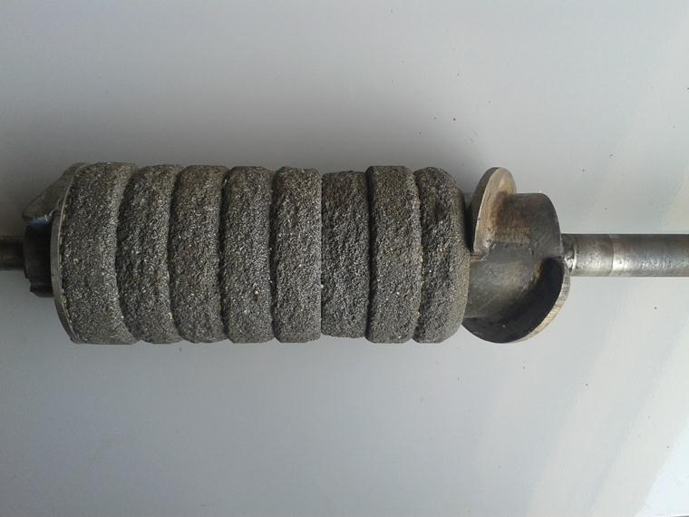
Degermination
Assembly
After Field Testing

Slide 32
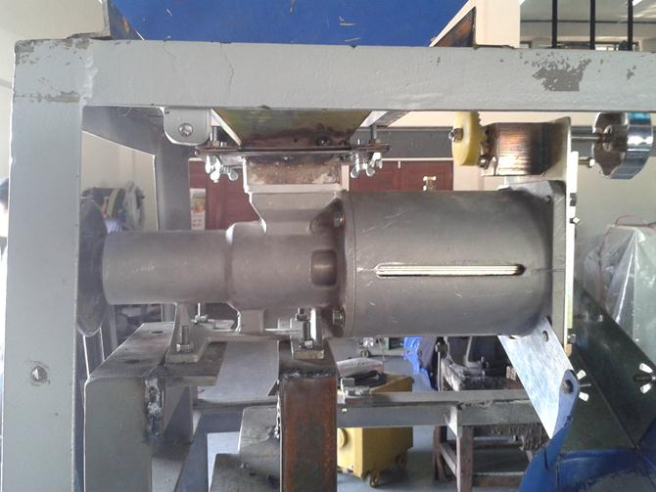
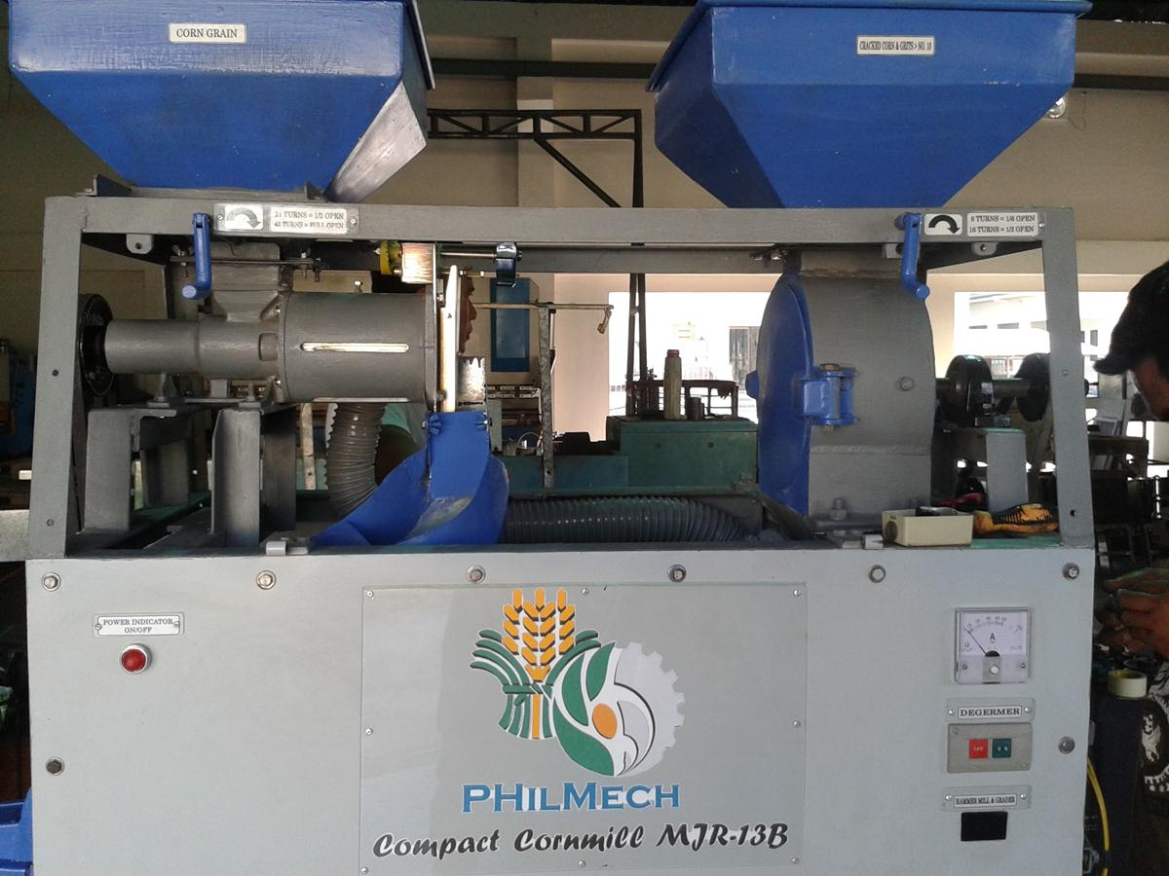
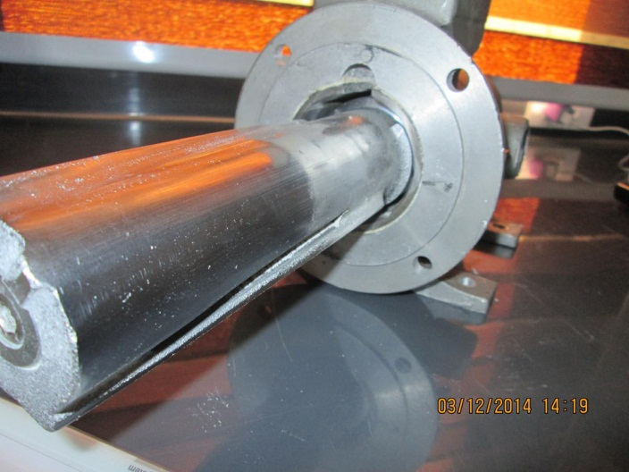
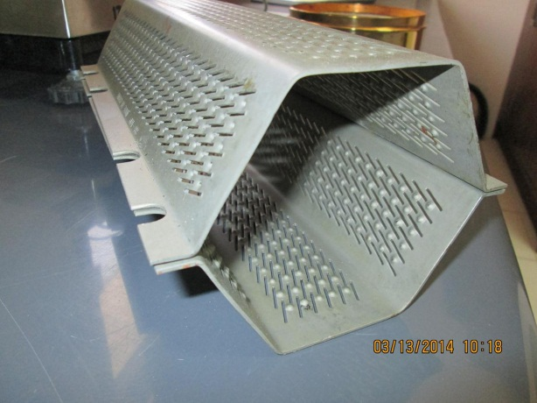
DEGERMER ASSEMBLY

Slide 33
Performance of Emery Stone with Dented Screen Huller

Slide 34

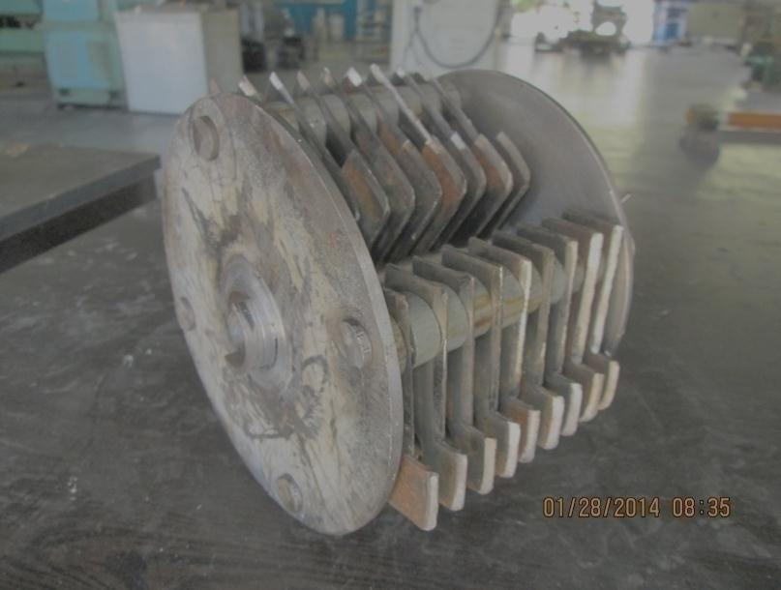
Size Reduction
Assembly
2
Size Reduction
Assembly

Slide 35
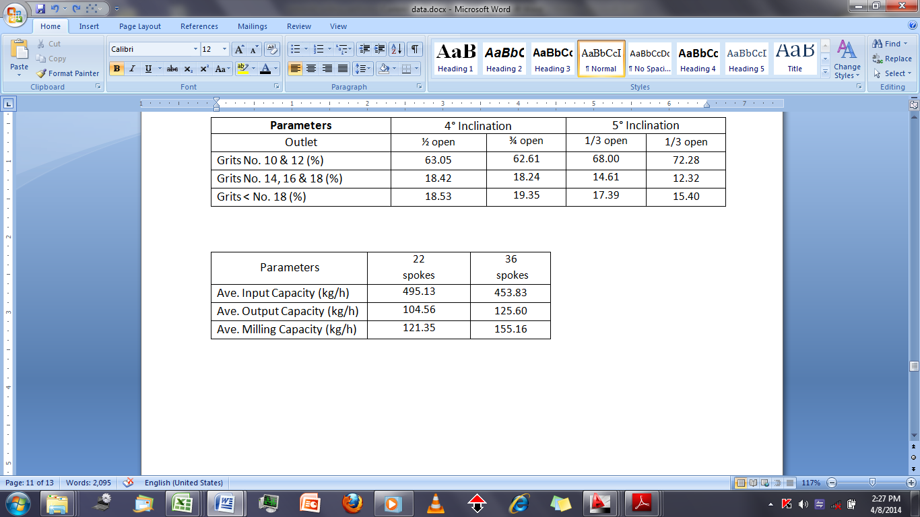
Performance of the hammer mill with different number of spokes

Slide 36
CORN MILL GRADER
Specifications:
Screens
#10 : Slotted Sheet (2mm)
#14 : Slotted Sheet (1.4mm)
#18 : Wire Mesh (0.74mm)
Speed : 50 RPM
Dimensions
(L x W x H) mm : 1,105 x 695 x 879

Slide 37
CORN MILL GRADER
Specifications:
Screens
#10 : Slotted Sheet (2mm)
#14 : Slotted Sheet (1.4mm)
#18 : Wire Mesh (0.74mm)
Speed : 50 RPM
Dimensions
(L x W x H) mm : 1,105 x 695 x 879

Slide 38
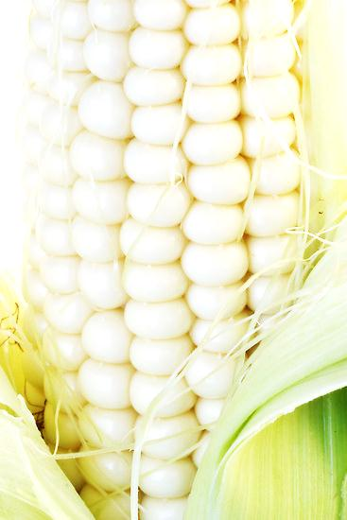
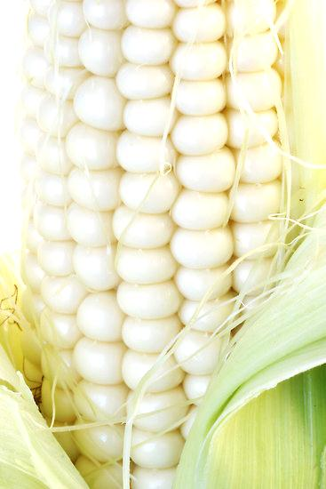
For Objective No. 3
Examine the technical performance of the proto-type village cornmill

Slide 39


Performance Test Result of the
PHilMech Developed Compact Cornmill
• Output Capacity: 160.8 kg/h
• Output Recovery: 64.7%
• Degerming Efficiency: 94.7%
• Prime Mover: 5 hp, Single-phase
• Labor Requirement: 1 person
• Power Consumption: 4.17KW/hr
• Overall Dimensions:
Length: 157 cm
Width: 116 cm
Height: 192 cm
• Overall Weight : 476 kg

Slide 40

Aflatoxin content of corn grits and corn by products after milling, ppb
Corn on cobs
Corn grains
Cracked corn
Corn grits # 12

Slide 41



For Objective No. 4
Determine the economic viability of the cornmill

Slide 42

Economic Analysis

Slide 43
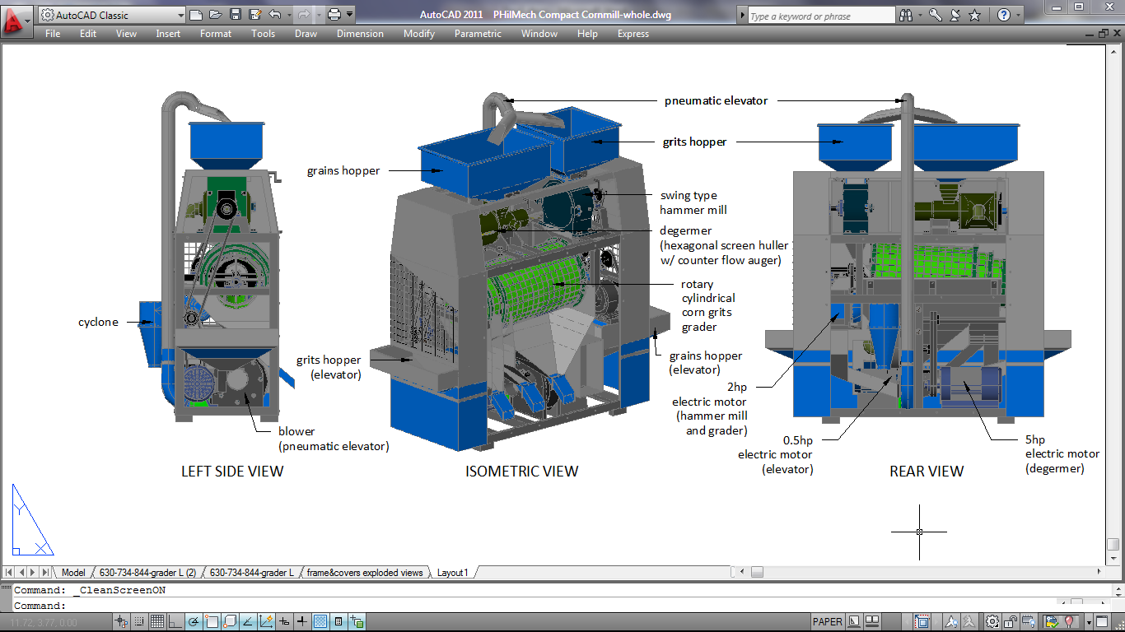
PHilMech Compact Cornmill

Slide 44
SUMMARY & CONCLUSION
Notes:
For the conclusion

Slide 45
SUMMARY AND CONCLUSION
This research has successfully designed and developed an innovative compact cornmill.
The technical performance of the cornmill have fully satisfied the minimum product recovery of 64% and minimum degermer efficiency of 80% as set by PAES.
The developed cornmill is economically viable given a financial internal rate of return of 54.5% and payback period of 2.4 years. The computed cost of milling per kilogram output is only Php1.18/kg (US$26/t).

Slide 46
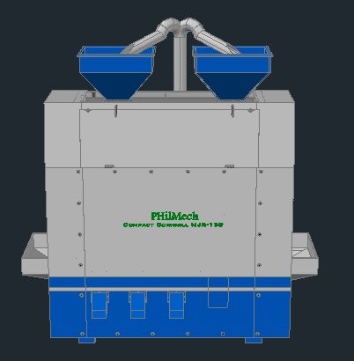
Output
Impact (4A’s)
Potential Impact of the
Developed Technology
Adequacy
of corn grits supply
Higher grits
recovery
Higher degerming
efficiency
Accessibility
of good quality
corn grits
Salvage reject
corn grain due to
aflatoxin
contamination
Availability
of sufficient and safe supply of corn grits
Low operating
cost per kg output
Affordability
of corn grits in
the market
Effect
Food Sufficiency in the country
Reduced pressure to the government in producing the food requirements of the country
Induced consumption of corn as food

Slide 47

Michael Gragasin, Ph.D.
Supervising Science Research Specialist
Philippine Center for Postharvest Development
and Mechanization (PHilMech)
Department of Agriculture, Philippines
Tel No : +63-44-4560-290 loc 400
Fax No : +63-44-4560-110
E-mail: kitgragasin@yahoo.com

Slide 48
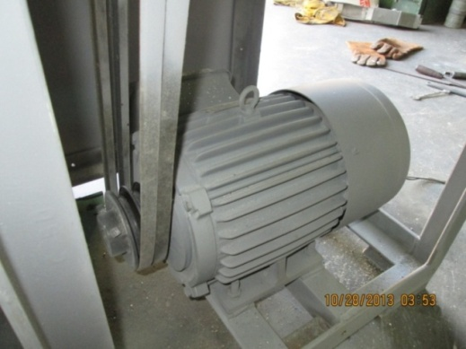
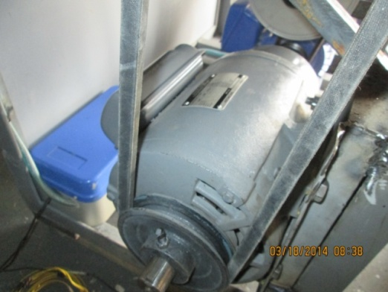
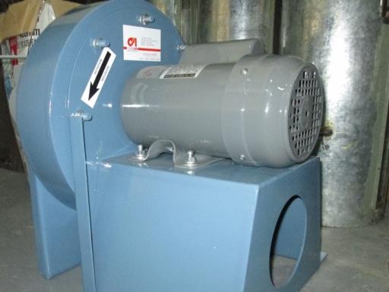
FOR DEGERMER
FOR HAMMER MILL &
GRADER
FOR PNEUMATIC
ELEVATOR
Brand name : TECO Elec. & Mach.
Co., Ltd.
HITACHI
TECO Elec. &
Mach. Co, Ltd.
Single-phase
Condenser Motor
Type : Single-phase
Induction Motor
Single-phase
Induction Motor
Rated power : 5 HP (3.7kW)
@ 1750 RPM
2 HP (1.49 kW)
@ 1730 RPM
0.5 HP (0.37 kW)
@ 3470 RPM
Current : 26 A
10 A
3.2 A
Voltage : 220 V
220 V
220 V
Frequency : 60 Hz
60 Hz
60 Hz
Notes:
The final design of cornmill will utilizes three single-phase electric motors of different horsepower. A 5hp, 2hp and 0.5hp will use to run the degermer assembly, hammer mill and grader assembly, and elevator assembly respectively.

