Slide 1

Isolation and characterization of novel antimicrobial peptides from Japanese medaka plasma
Presenter: Dong Miao
Supervisor: Dr. Lam Yun Wah

Slide 2
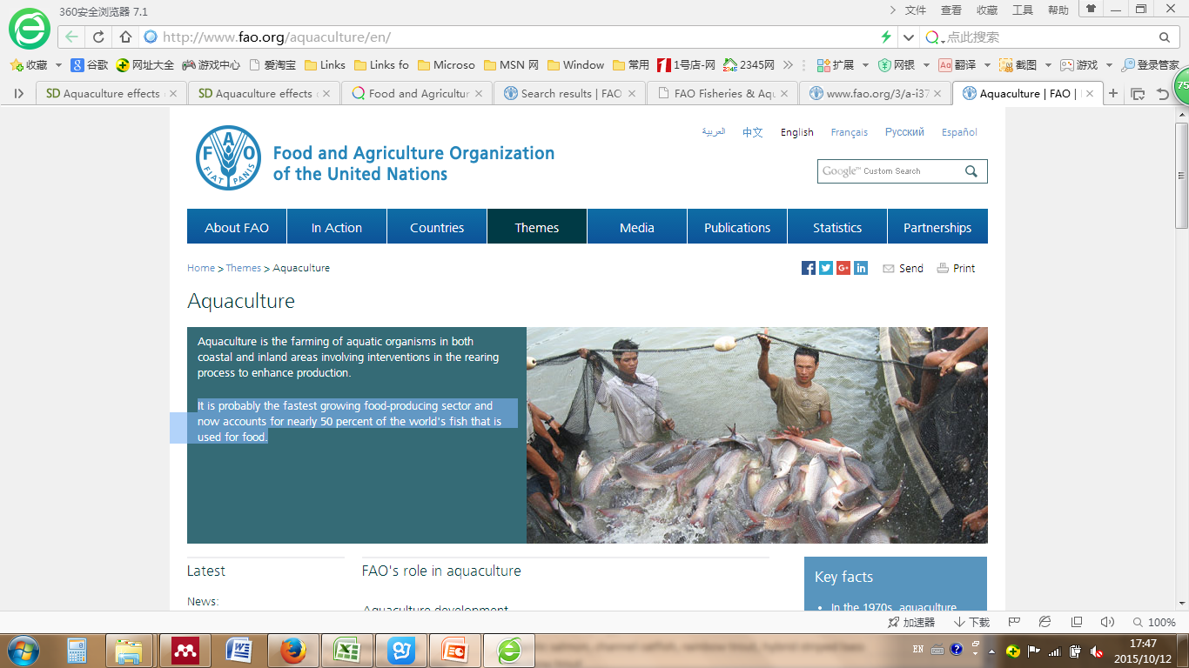
Fishery is the fastest growing food-producing sector
and nearly 50 % of the world's fish is used for food
The Asian aquaculture sector nowadays accounts for nearly 90% of the global aquaculture production
http://www.fao.org/aquaculture/en/

Slide 3
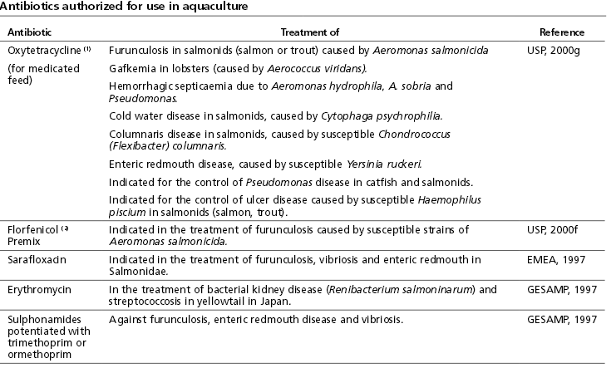
Antibiotics are used to improve the growth and quality of aquatic products
Responsible use of antibiotics in aquaculture. 2005 by FAO

Slide 4

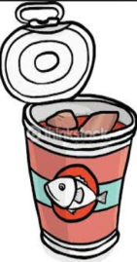

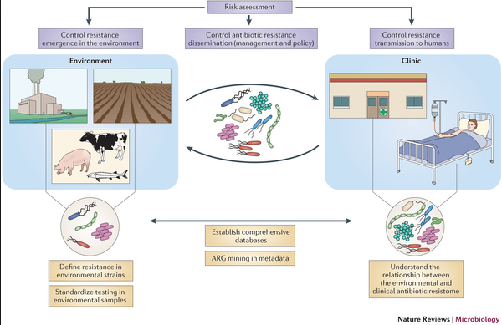





The applications of antibiotics to fish is harmful to environment and human health
Antibiotics
s
Antibiotic accumulated fish
Soil
Antibiotic residues
Resistant bacteria
Antibiotic resistome
Lakes and rivers

Slide 5
Alternative antibacterial agents-antimicrobial peptides （AMPs）
Properties
Net charge | +
Residues length | 4-100 aa
Hydrophobic ratio | 30%-70%
Secondary structures | β -sheet, α -helical, loop, and extended peptides
Amphipathicity | Contain hydrophobic and hydrophilic regions
Isoelectric point (pI) | ~10

Slide 6
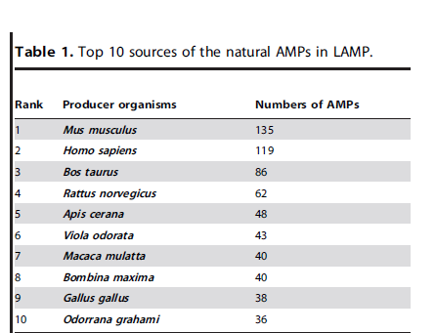
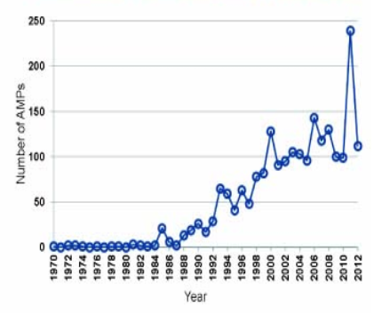
AMPs facts summarized from on line AMP database
Time of AMP discovery (1970-2012)
http://aps.unmc.edu/AP/facts.php
Zhao X, Wu H, Lu H, Li G, Huang Q (2013) LAMP: A Database Linking Antimicrobial Peptides. PLoS ONE 8(6)

Slide 7
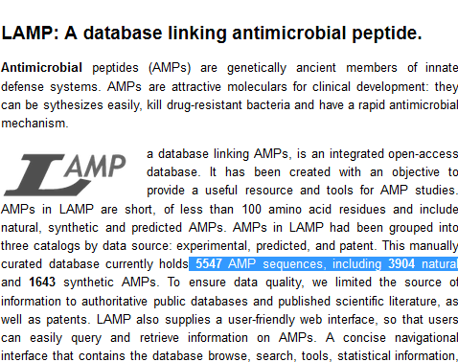
Fish specific AMPs are relatively less
119 homology with other species
133 fish AMPs
14 fish specific
Ali Adem Bahar. et al., Pharmaceuticals 2013, 6, 1543-1575
J. a Masso-Silva and G. Diamond, “Antimicrobial peptides from fish.,” Pharmaceuticals (Basel).2014

Slide 8
Existing problems on the practical use of AMPs
Overlook of fish blood (a great source of AMPs)
Shortage of high throughput technique by which large amounts of AMPs can be collected
A. Falco. et al., Fish & Shellfish Immunology (2008) 24, 102-112

Slide 9
Objectives
Collecting and identifying of peptides isolated from fish plasma by using proteomic approach
Prediction and validation of potential AMPs

Slide 10
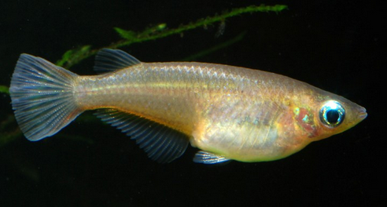
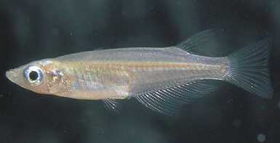
Fish source-Japanese medaka (O. Latipes)
Natural properties: small size, short generation times, high fecundity
Well known fish model in fresh water

Slide 11
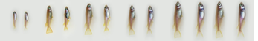
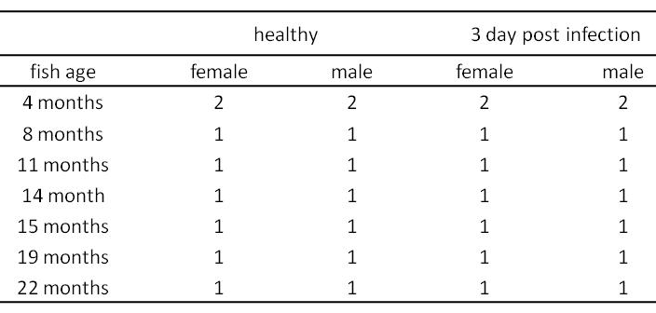
Plasma protein “supermix” isolation
32 in total
Done by Dr. Joseph L. Humble

Slide 12
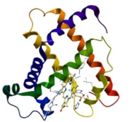

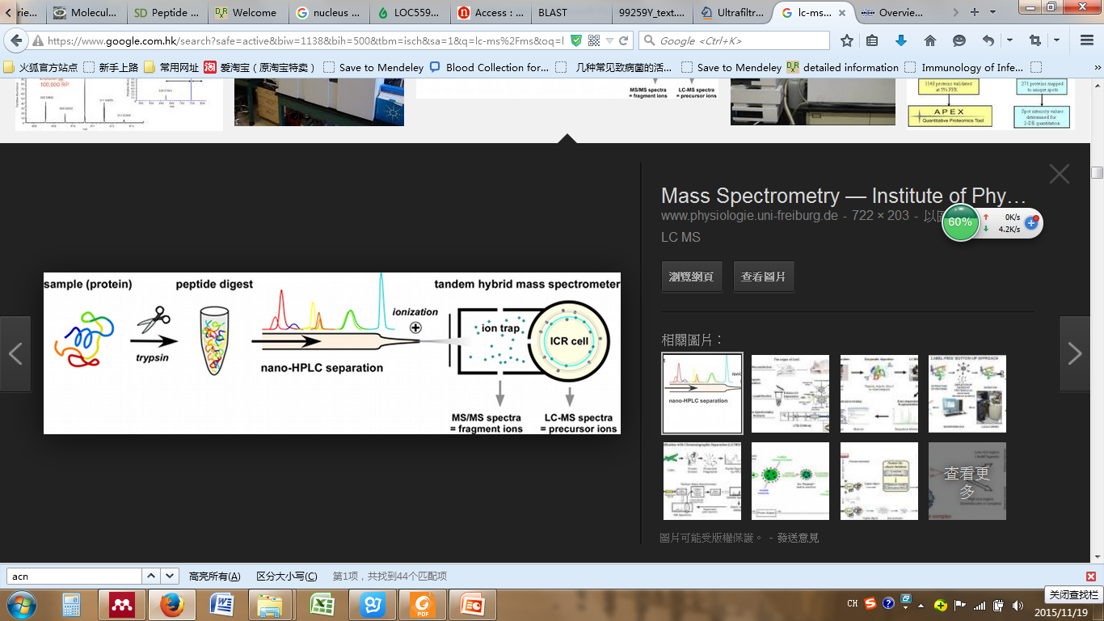
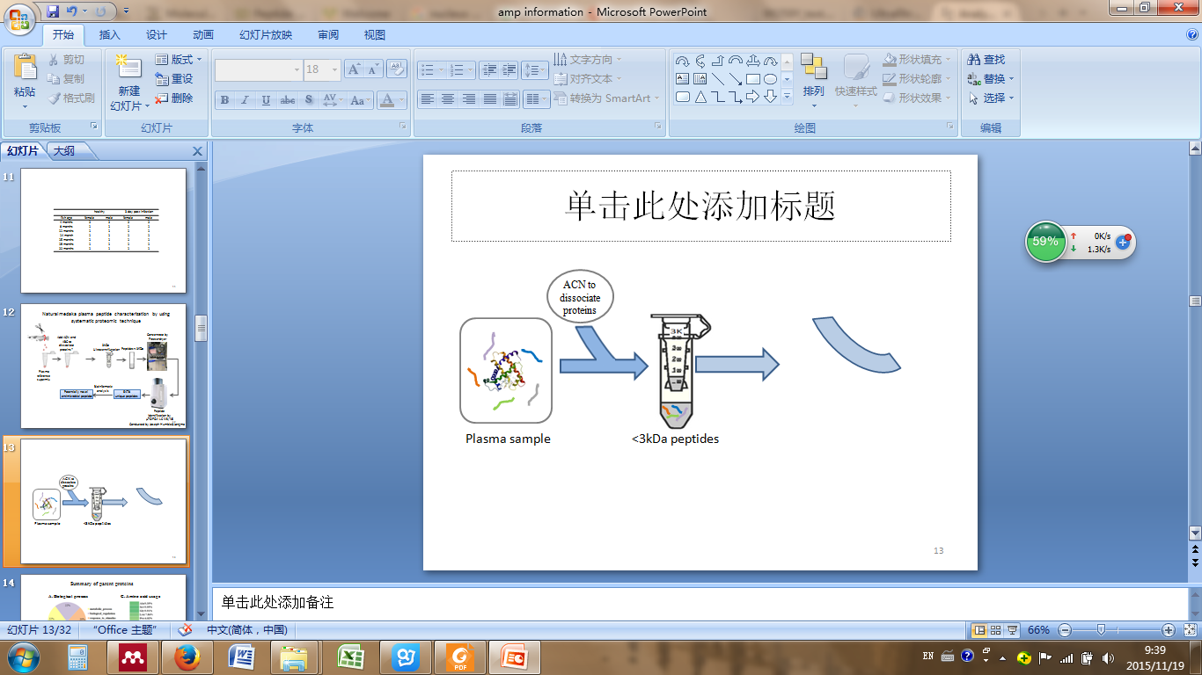
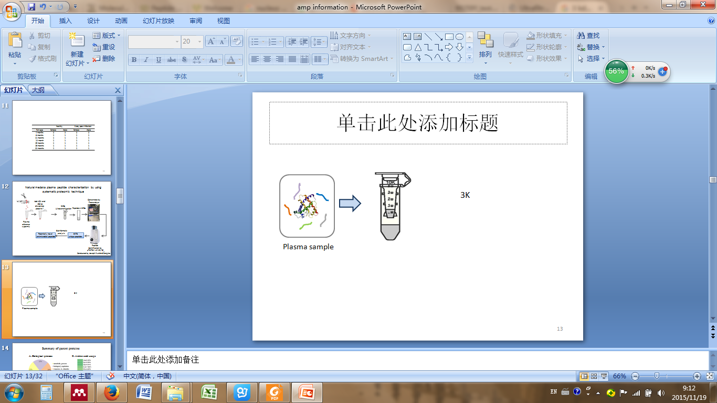

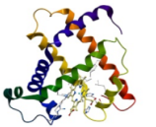

Peptide collection by using ultracentrifugation combining with proteomic approach
Proteins >3kDa
ACN to dissociate proteins
LC
Plasma sample
Peptides <3kDa
MS/MS spectra
6483 in total
Done by Dr. Joseph L. Humble and Yimin Liang

Slide 13
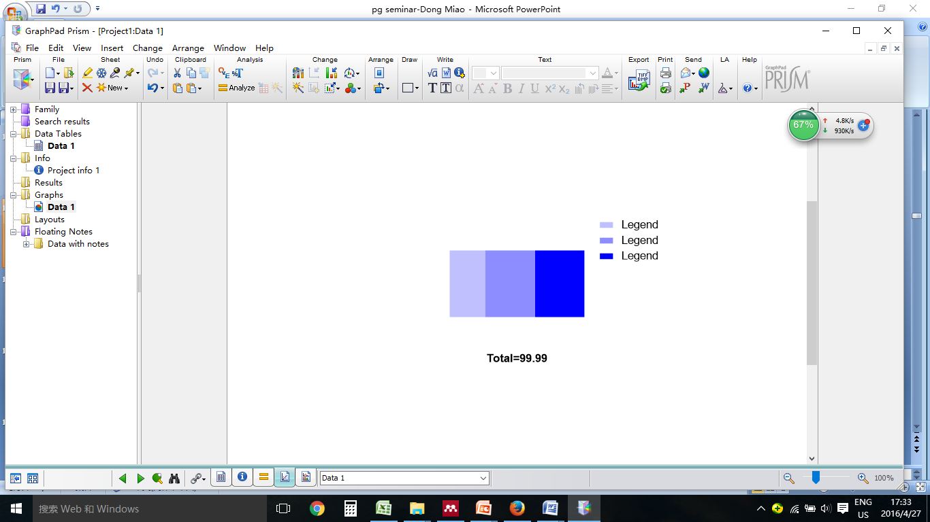
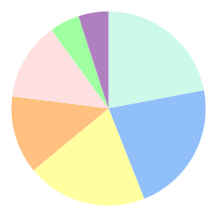
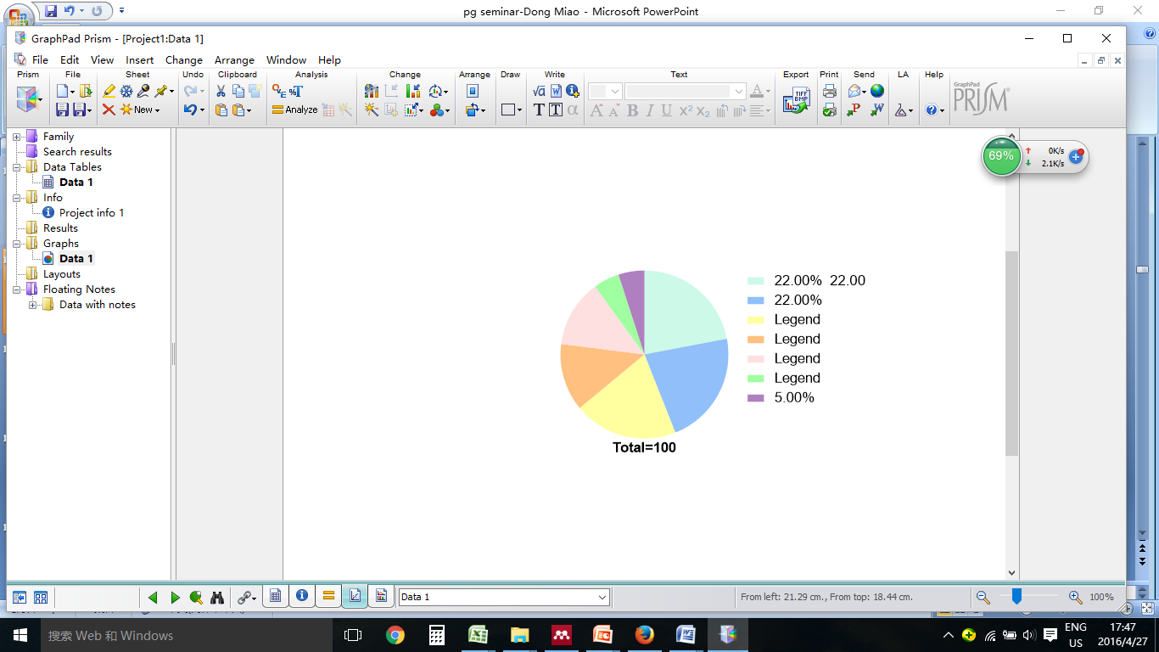
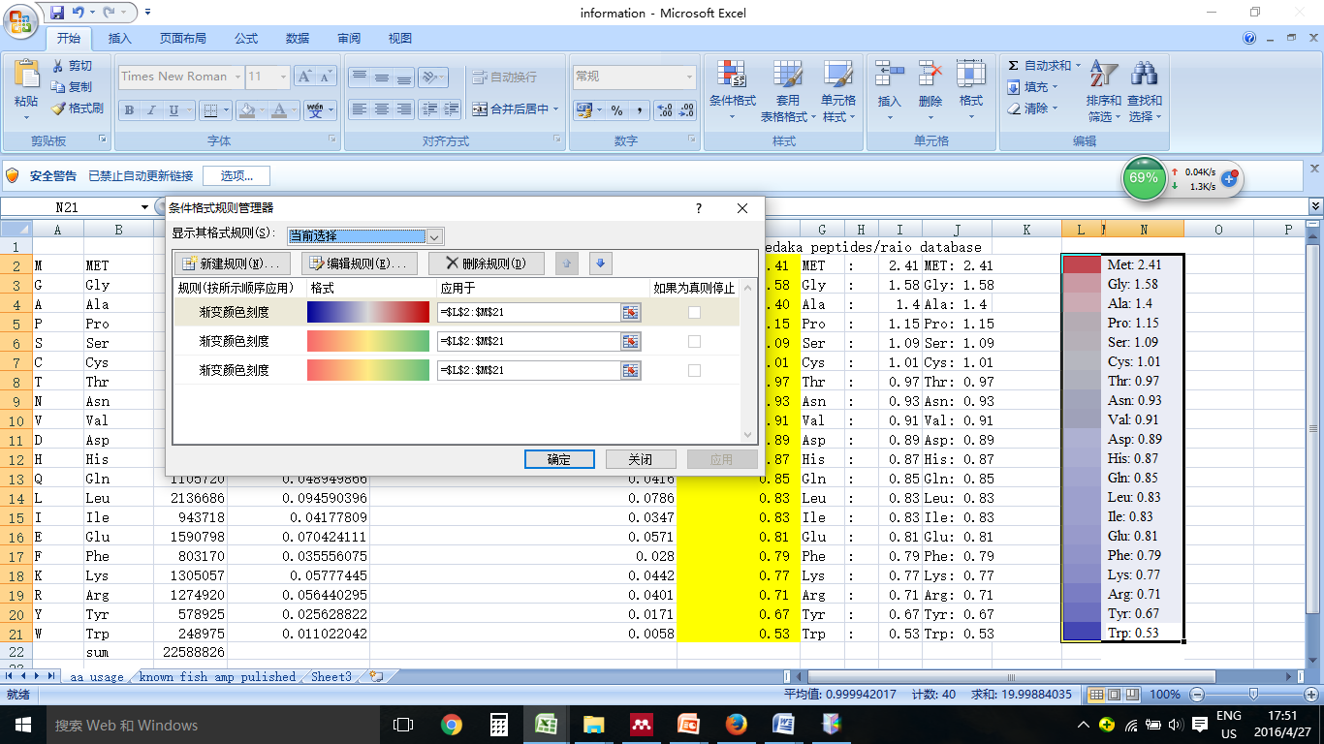
Summary of collected peptides and their parent proteins
A. Cellular component
C. Amino acid usage
Intracellular
26.59%
Extracellular
36.67%
Not sure
36.73%
B. Biological process
5%
22%
5%
13%
22%
13%
20%
0.53
2.41
http://pir.georgetown.edu/cgi-bin/batch.pl

Slide 14
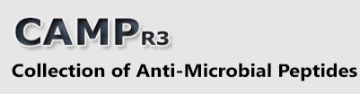
AMPs prediction
6483
Unique peptide
CAMP BLAST
2053 known AMPs
(Identities >60%)
4430 potentially novel AMPs
CAMP Prediction
239 predicted AMPs
AMPs properties
83 predicted AMPs
http://www.camp.bicnirrh.res.in/

Slide 15
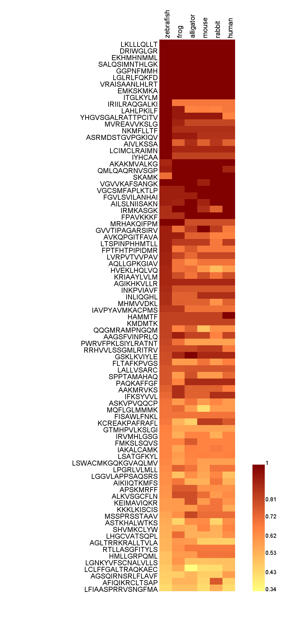

Homology analysis
Zebrafish
Frog
Alligator
Mouse
Rabbit
Human
Nine of 83 are evolutionary conserved
Nine of 83 are fish specific

Slide 16
One (out of 83) predicted AMP- BING
BING: Blocker of Intermembrane stress responses in Gram negative bacteria
Sequence | Accession | Origin | MW | CAMP prediction |  |  |  |  |  | ADP2 prediction
 |  |  |  | SVM |  | RF |  | DA
IRIILRAQGALKI | gi|432960258 | vacuolar protein sorting-associated protein 13D-like | 1464.85 | AMP | 88.90% | AMP | 96.75% | AMP | 93.70% | AMP
 | AMPs Properties | Selected AMP property
Net charge | + | +3
Residues length | 4-100 aa | 13 aa
Hydrophobic ratio | 30%-70% | 61 %
Secondary structures | β -sheet, α -helical, loop, and extended peptides | β -sheet
Amphipathicity | Contain hydrophobic and hydrophilic regions | Yes
Isoelectric point (pI) | ~10 | 12.52

Slide 17
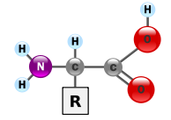
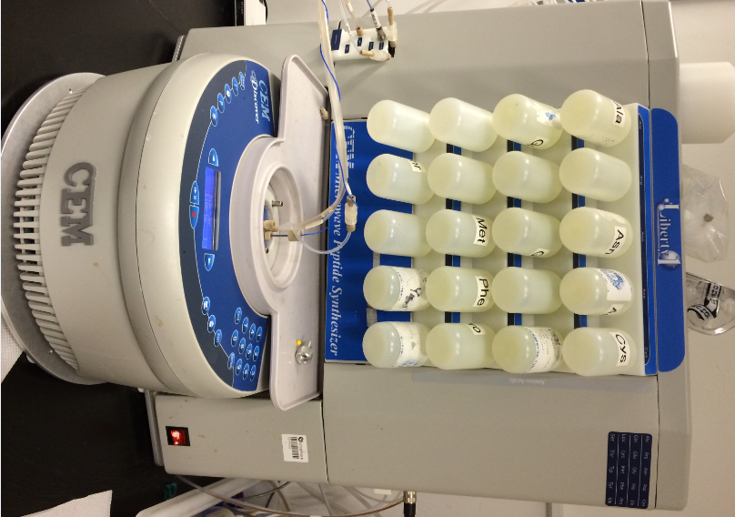
Peptide synthesis
Fmoc-based solid-phase peptide synthesis
R
I
Q
L
A
G
K
IRIILRAQGALKI
Done by Haipeng Lei

Slide 18
MALDI-TOF-MS analysis
(BING)
Done by Haipeng Lei

Slide 19
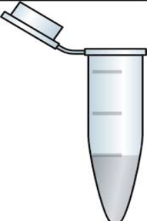
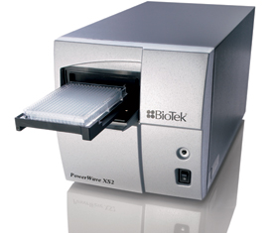
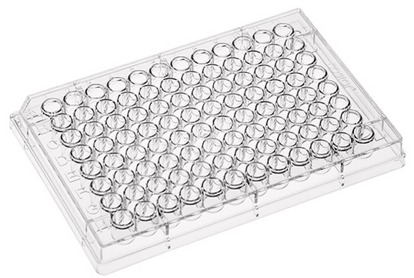
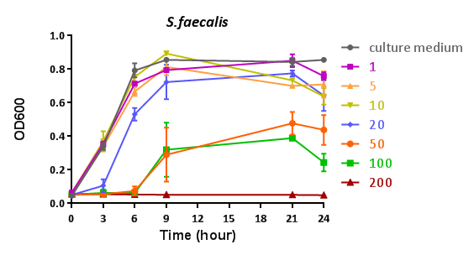
Antibacterial activity detection of Vpsin
Series concentrations of peptide
OD600
Bacteria
(10^6 cfu/ml)

Slide 20
Bacteria involved in the antibaricidal assay
Bacteria | Ref. No. | Source | Gram(+/-)
Streptococcus faecalis | N/A | HKP | +
Streptococcus pyogenes | 14289 | ATCC | +
Staphylococcus aureus | 6538 | ATCC | +
Aeromonas hydrophila | 49140 | ATCC | -
Vibrio alginolyticus | 33840 | ATCC | -
Edwardsiella tarda | PE210 | Japan | -
Escherichia coli | 10536 | ATCC | -
Escherichia coli (pathogenic) | N/A | Hospital | -
Acinetobacter baumannii | 19606 | ATCC | -
fish
Human

Slide 21
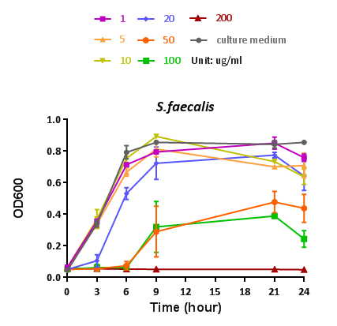
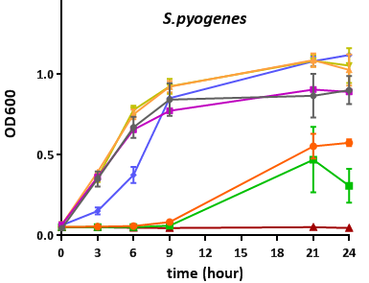
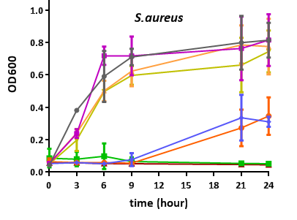
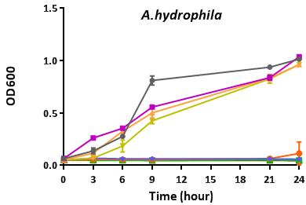
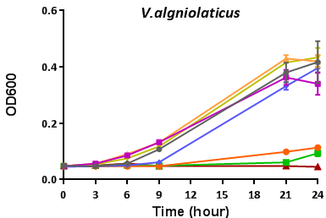
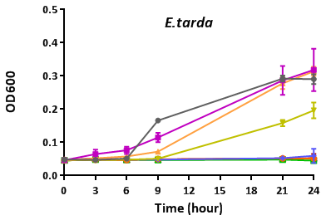
Antibacterial activity on fish pathogenic bacteria
Up: gram positive
Down: gram negative

Slide 22
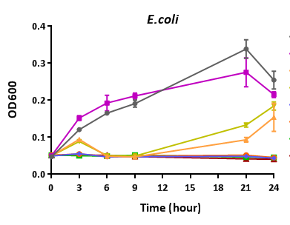
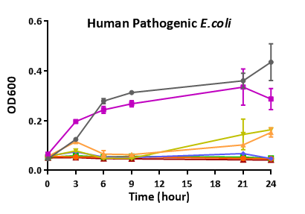
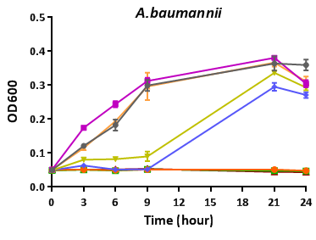
Antibacterial activity on human bacteria
Normal bacteria
Human pathogenic bacteria

Slide 23
BING shows antibacterial ability on different kinds of pathogenic bacteria
Bacteria | Gram(+/-) | Suspected MICs (ug/ml) | Suspected MICs (uM)
S. faecalis | + | 50 | 34.1
S. pyogenes | + | 50 | 34.1
S. aureus | + | 20 | 13.7
A. hydrophila | - | 20 | 13.7
V. alginolyticus | - | 50 | 34.1
E. tarda | - | 10 | 6.8
E. coli | - | 5 | 3.4
E. coli (pathogenic) | - | 5 | 3.4
A. baumannii | - | 10 | 6.8
Minimum inhibitory concentrations (MICs) are defined as the lowest concentration of an antimicrobial that will inhibit the visible growth of a microorganism after overnight incubation

Slide 24
BING shows antibacterial ability on drug resistant bacteria
Bacteria | Gram(+/-) | Suspected MICs (ug/ml)
E. coli BL21 | - | 8
K. pneunmoniae NDM-1 | - | 32
E. coli NDM-1 | - | 16
NDM-1/BL21 | - | 4
SHV-1/BL21 | - | 4
TEM-1/BL21 | - | 8
MCR-1/BL21 | - | 16
S. aureus 29213 | + | 64
Methicillin-resistant S. aureus 41 | + | 32
Multidrug-resistant S. aureus 44 | + | 32
Beta-lactam
Colistin resistance
Done by Ann So Lok Yan

Slide 25
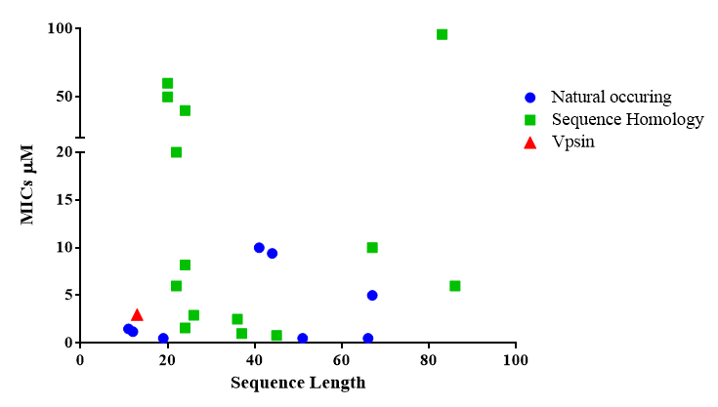
BING is shorter and more effective on E.coli killing comparing with other Fish AMPs
BING
V. Rajanbabu, J.Y. Chen / Peptides 32 (2011) 415–420
Jorge A. Masso-Silva and Gill Diamond/ Pharmaceuticals (2014) 265-310

Slide 26
BING has no observable cell and fish toxicity
MIC for E.coli
µg/ml
14 days post injection of BING into medaka fish
Amount | Survival rate %
1 µg | 100
Done by Wei Shen

Slide 27
Summary
BING has broad-spectra toxicity on fish and human pathogenic bacteria
BING shows stronger antibacterial activity on gram negative than positive bacteria
BING is non-toxic to mammalian cells and fish

Slide 28
Fish efficacy study
(A) One injection
(B) Double injection
PBS alone
PBS+E.tarda
BING+E.tarda
BING+E.tarda
E.tarda alone
Ampicillin+E. tarda
BING: 1ug/ml
E.tarda:10⁴CFU/fish
BING: 2ug/ml
AMP: Ampicillin 2ug/ml
E.tarda:10⁴CFU/fish

Slide 29
Fish survival rate after different injections
A
Co-injection
B
Double injection
BING: 1ug/ml
E.tarda:10⁴CFU/fish
BING: 2ug/ml
AMP: Ampicillin 2ug/ml
E.tarda:10⁴CFU/fish

Slide 30
Summary
BING can inhibit E.tarda infection in fish, suggesting that BING can be an effective chemotherapeutic agent for aquaculture in the future.

Slide 31
BING can disrupt bacteria cell membrane
Cultural medium
BING:50 µg/ml
E.tarda
S. pyogenes
2 µm
2 µm

Slide 32
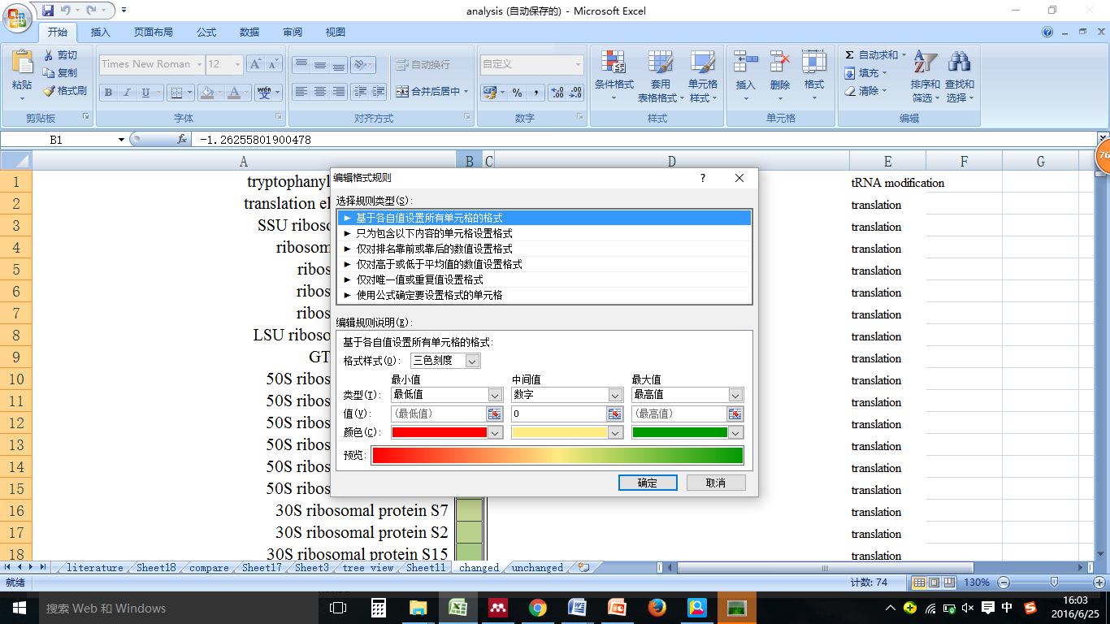
Antibacterial mechanism study-label free proteomic
Tips:
BING can downregulate PPIASE which are responsible for protein folding
PRSA
PPIB
PPIA
FKPA
SURA
DEGQ
Protein folding
-5.4
0
5
Result expressed as log2 fold change.
Only values >1 or <-1 are shown in treeview

Slide 33
Cell envelope stress pathway
Protein
Gene
Positively regulated by σ^{E}
Positively regulated by CPX
Negatively regulated by both σ^{E}
and CPX
-5.4
0
5

Slide 34
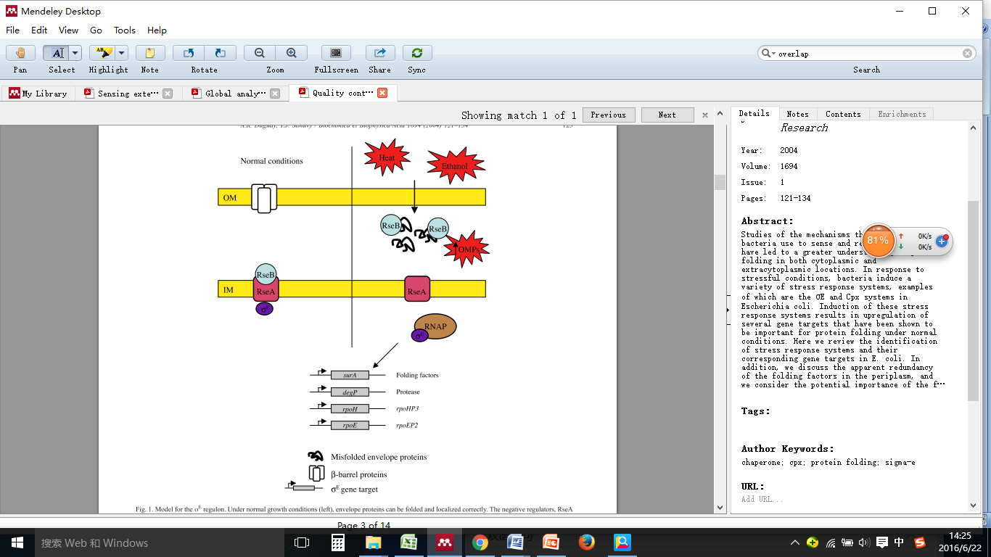
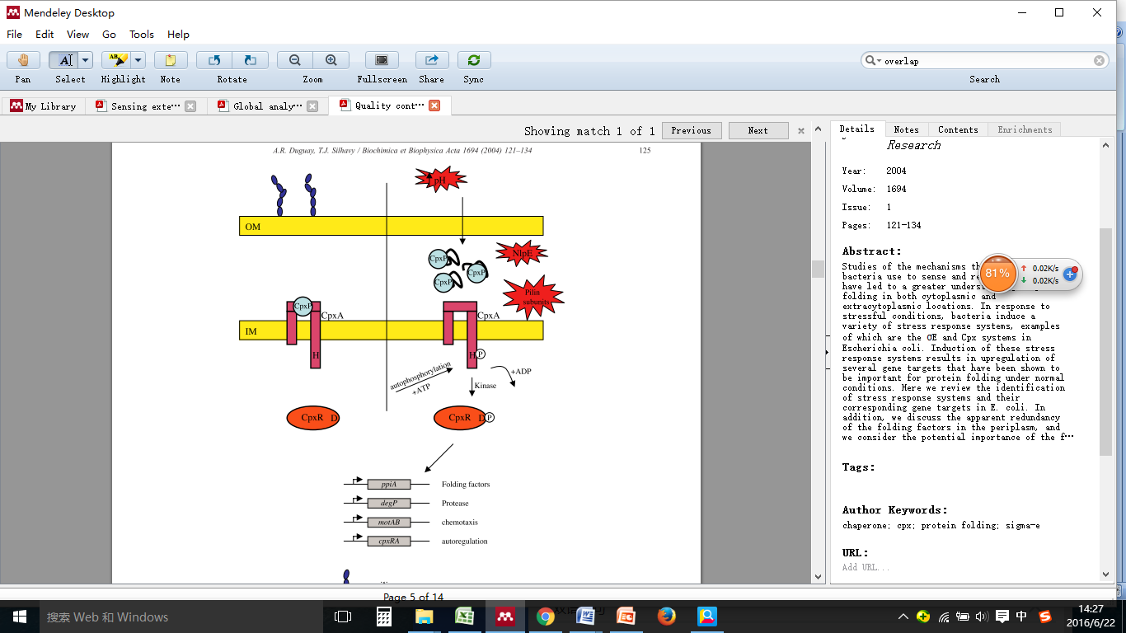
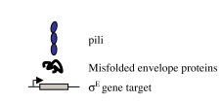
Model for the σ^{E} regulon
Model for the CPX regulon
fkpA
Cpx gene target
A. R. Duguay and T. J. Silhavy, “Quality control in the bacterial periplasm,” Biochim. Biophys. Acta - Mol. Cell Res., vol. 1694, no. 1, pp. 121–134, 2004.

Slide 35
BING induces σ^{E} pathway but suppresses CPX pathway
RT-PCR
Log 2 fold change
Three replicates, result normalized with control group
Same concentration and incubation time as proteomic experiment

Slide 36
Other drugs can not knock down the expression of CPXR
CPXR

Slide 37
Summary
BING induce bacteria cell envelope stress by activating σ^{E} pathway, while specifically suppresses CPXR pathway can be suppressed

Slide 38
Conclusions
Identification
By using proteomic approach we got 6483 unique peptides
Combining with web-based prediction tools we got 83 potentially novel AMP candidates
BING has broad-spectrum antibacterial activity on fish and human pathogens including multi drug resistant bacteria, but non-toxic to mammalian cells and fish
BING can inhibit E.tarda infection in fish, suggesting that BING can be an effective chemotherapeutic agent for aquaculture in the future
This method can also apply on AMPs collection from other species
BING can specifically suppress CPX pathway which is a resistance system to both AMPs and antibiotics.
Application
Mechanism

Slide 39
Long term goal
Antibacterial activity of modified BING (D-isomer, C-amidated and cyclic)
Test the antibacterial activity of rest 82 candidates
Utilize these fish AMPs, either alone or in combination, to combat bacterial infections in aquaculture

Slide 40
Acknowledgement
Funding: HK government scholarship
Lab mates: Yimin Liang, Tweety Tang , Leslie Shen, Karsten Berning,
Collaborators:
Dr. Doris WT AU lab lab, Joseph Humble, Peterson Drew
Dr. Hongyan Sun lab, Haipeng Lei
Prof. Kwok yin Wong lab, Dr. Ann So Lok Yan

Slide 41
Thank you

