Slide 1
Synthesis of a [¹⁸F]-labeled ceritinib analogue for positron emission tomography of anaplastic lymphoma kinase, a receptor tyrosine kinase, in lung cancer
Sandun Perera, David Piwnica-Worms, and Mian M. Alauddin
Department of Cancer Systems Imaging, the University of Texas M D Anderson Cancer Center, Houston, TX, USA

Slide 2
Background
Anaplastic lymphoma kinase (ALK), an oncogenic receptor tyrosine kinase, has emerged as a therapeutic target in solid and hematologic tumors, including several subtypes of lung cancer.
As a result, a variety of ALK inhibitors (Fig. 1), including crizotinib, ceritinib, and alectinib, have been developed and examined in clinical trials.

Slide 3
ALK inhibitors

Slide 4
Background contd.
Although crizotinib is very effective against ALK-positive NSCLC overall, some patients with the disease have ALK point mutations that cause resistance to the drug.
As a result, a second-generation ALK inhibitors ceritinib and alectinib have been developed for treatment of lung cancer.
Most recently, the FDA approved ceritinib for the treatment of patients with certain lung cancers that relapsed after first-line therapy.

Slide 5
Background contd.
Although several ALK inhibitors have gained approval for therapy, non-invasive indicators of target engagement or predictive biomarkers in vivo are lacking.
Thus, there is a need for a suitable biomarker, such as a PET tracer for detection and assessment of therapeutic outcome of cancer patients using these inhibitors.
We designed and synthesized a radiolabeled analogue of the ALK inhibitor ceritinib, [¹⁸F]fluoroethyl-ceritinib, ([¹⁸F]-FEC), for use with positron emission tomography (PET).

Slide 6
Structure of ceritinib
Modelling analyses suggest that the central pyrimidine ring, which can participate in hydrogen bonds to the hinge area via the pyrimidine and amino nitrogen atoms, is critical for its ALK inhibition activity.
Therefore, substitutions on the nitrogen of piperidine are fairly well-tolerated, and several analogues, including an ethyl substituent were synthesized and tested.

Slide 7
Docking of ceritinib in ALK kinase domain
J. Med. Chem. 2013, 5675-5690.

Slide 8
Activity profile of some compounds (IC₅₀ nM)
Substituent Ba/F3-NPM-ALK Ba/F3 WT Karpas299
R=H 26.0±0.3 2477.0±448.0 22.8±0.3
R=Et 32.1±3.8 4120.0±475.0 11.1±0.7
J. Med. Chem. 2013, 5675-5690.

Slide 9
Our objectives
To design and synthesize a radiolabeled analogue of the ALK inhibitor ceritinib.
From the activity profile it appears that ethyl ceritinib has slightly less activity compared to the parent compound in one cell line, but higher in another cell line.
We hypothesized that replacement of a hydrogen by a fluorine atom on the ethyl group should not make any significant difference in efficacy.
Therefore, we haves synthesized [¹⁸F]fluoro-ethyl-ceritinib, ([¹⁸F]-FEC), for use with positron emission tomography (PET).

Slide 10
Methods
Synthesis of non-radioactive fluoroethyl ceritinib
MeCN, Et₃N, 85ºC, 4h; 64% yield
Characterized by ¹H, ¹³C & ¹⁹F NMR; ¹⁹F, δ: -217.9 (s). HRMS: m/z [M+H]+ calculated, 604.1788; found, 604.2540.

Slide 11
Radiosynthetic Methods
We used two methods to synthesize [¹⁸F]-FEC.
Method 1: [¹⁸F]fluoroethyl-tosylate was prepared by radiofluorination of ethylene glycol di-tosylate, purified by HPLC and coupled with ceritinib at 120ºC for 20 min. The product was purified by flash chromatography to yield [¹⁸F]-FEC.
Method 2: A precursor compound, chloroethyl-ceritnib, was synthesized in multiple steps and directly fluorinated with K¹⁸F/kryptofix 2.2.2., and the product was purified either by HPLC or flash chromatography to yield [¹⁸F]-FEC.

Slide 12
Radiosynthesis method 1

Slide 13
Radiosynthesis method 2

Slide 14
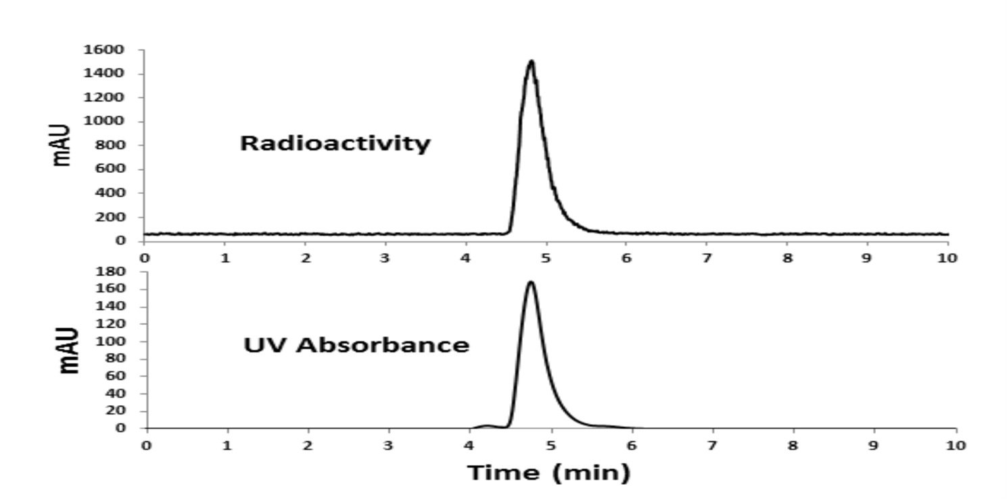
Q C Analysis: HPLC
The product was co-injected with non-radioactive standard compound, Anal Column; 60% MeCN/H₂O/0.5% TFA; flow 1 ml/min.

Slide 15
Results
The first method produced [¹⁸F]-FEC with an average decay-corrected yield of 24% (n=4), specific activity of 1200 mCi/μmol, and >99% purity; synthesis time was 115 min from the end of bombardment (EOB).
The second method produced [¹⁸F]-FEC with an average yield of 7% (n=4), specific activity of 1500 mCi/μmol, and >99% purity; synthesis time was 65 min from the EOB.
Of these two methods, we judged Method 1 to be the better choice for producing a pure compound for biological applications in vitro and in vivo.

Slide 16
Conclusions
Synthesis of a novel ¹⁸F-ceritinib analogue has been achieved in good yields, with high purity and specific activity.
The compound is a potential PET imaging agent for the detection of ALK overexpressing solid tumors, such as lung cancer.
The compound should be tested in vitro in cell culture and in vivo in tumor-bearing mice, which is our future goal.

Slide 17
This work was supported by the National Institutes of Health through the Washington University-MD Anderson Cancer Center Inter-Institutional Molecular Imaging Center grant (NCI P50 CA94056, DPW).
By an MD Anderson Cancer Center Institutional Research Grant (MMA).

Slide 18
Thank you

