Slide 1
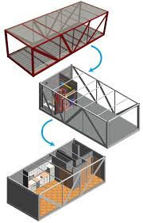
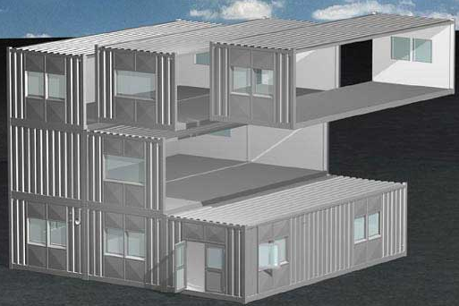
Steel Structure-2015
Dubai, 16 – 18 November 2015
EVALUATION OF
CONNECTION SYSTEMS
IN MODULAR CONSTRUCTIONS
Dr. Merve SAGIROGLU
Prof. Dr. Ali Memari
Notes:
Hi! Ladies and centilmen
Our presentation’s topic is connection systems in modular constructions
Modular buildings are developed as an alternative to conventional on-site construction. Because it has more predictable costs and faster construction. The use of modular buildings is increasing rapidly
This system is becoming more popular. Research activities on this construction system is continuing.
Research about analysis and design methods and connection systems and structural components or materials used in modules are needed

Slide 2
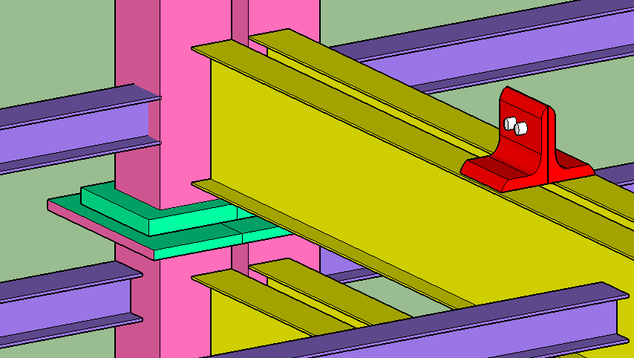
Goals of this study
to introduce commonly used connection systems in several types of modular construction
to explore the limitations for constructing taller modular building
to offer suggestion for improved structural-connection systems
Steel Structure-2015
Dubai, 16 – 18 November 2015
Notes:
TO INTRODUCE COMMONLY USED CONNECTION SYSTEMS IN SEVERAL TYPES OF MODULAR CONSTRUCTION
TO EXPLORE THE LIMITATIONS FOR CONSTRUCTING TALLER MODULAR BUILDING
TO OFFER SUGGESTION FOR IMPROVED STRUCTURAL-CONNECTION SYSTEMS.
But we have been still studying on it. So I actually can not tell any thing about innovative connection systems yet.

Slide 3
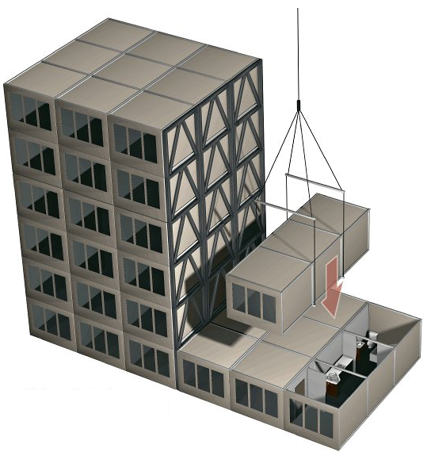
Modular building
Modular buildings are developed as an alternative to conventional on-site construction
The modular units are manufactured in fabrication plants off-site,
The whole units shipped to the site,
The units installed on-site
Steel Structure-2015
Dubai, 16 – 18 November 2015
Notes:
Modular building technology mainly differs from conventional construction in that
THE MODULAR UNITS ARE MANUFACTURED IN FABRICATION PLANTS OFF-SITE, THE WHOLE UNITS SHIPPED TO THE SITE, AND THEN THE UNITS INSTALLED ON-SITE.
Modular construction aims to optimize the use of materials, while forming spaces comparable in size to conventional construction and to offer benefits of installation speed.

Slide 4
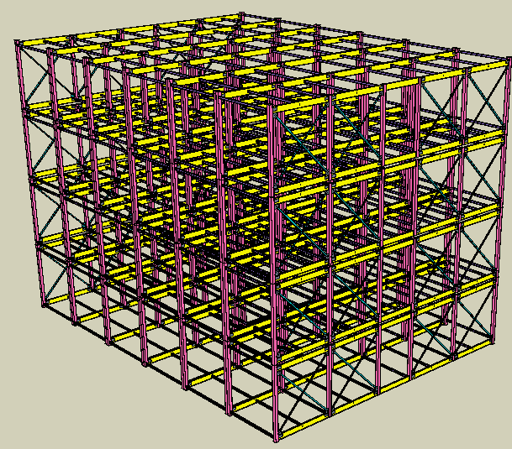
Modular building
The advantages of modular construction:
saving time because of speedy installation
high quality,
less equipment needs
reduced environmental
disturbance because of
off-site manufacturing.
Steel Structure-2015
Dubai, 16 – 18 November 2015
Notes:
In comparison with conventional construction, there are many benefits of modular construction such as

Slide 5
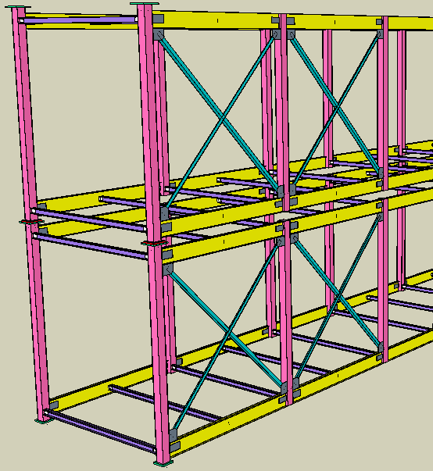
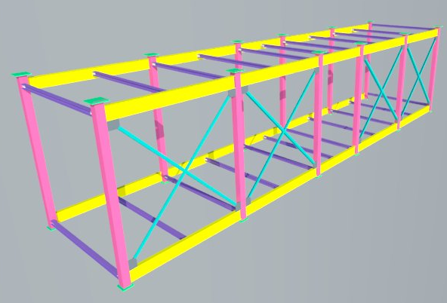
Modular building
Modular construction basically involves stacking the modular units and connecting them to one another.
Modules are used either as a part of the structure or as the main structure of the building.
A corner-supported module unit as an example before stacking process
Steel Structure-2015
Dubai, 16 – 18 November 2015
Notes:
Modules are used either as a part of the structure or as the main structure of the building.

Slide 6
Modules
Modules can be divided into three types according to their load-bearing characteristic:
Load bearing modules -- gravity loads are transferred through the side walls in the modules,
Load bearing corner-supported modules -- gravity loads are transferred via edge beams, and
Non-load bearing modules – modules are supported by any structure.
Steel Structure-2015
Dubai, 16 – 18 November 2015
Notes:
The modules are used as 4-sided, corner-supported module or non-load bearing module

Slide 7
Modular building
The various module types that resist both vertical and horizontal loads are the primary type of structural systems used in the stack erection system
However, the height of the system is normally limited in these systems unless another (supplemental) stabilization system is used as well
Steel Structure-2015
Dubai, 16 – 18 November 2015

Slide 8
High-rise modular building
The most important limitation for constructing taller modular building is to provide the resistance against lateral loads. Because, the lateral load resistance mechanism type depends on the height of the building
Lawson et al. [2] define the following three categories of modular building resisting systems that are functions of the building height:
For 4- to 6-story modular buildings → diaphragm action or bracing within modules
For up to 10-story modular buildings → separate bracing system in lift or stair
For taller than 10-story modular buildings → additional concrete core or steel frame
Steel Structure-2015
Dubai, 16 – 18 November 2015

Slide 9
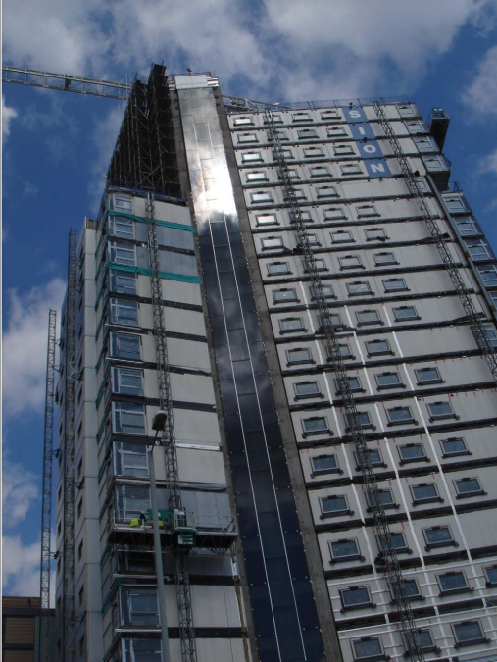
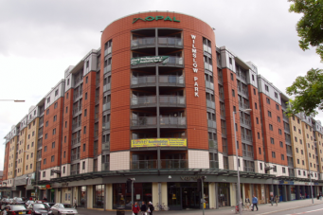
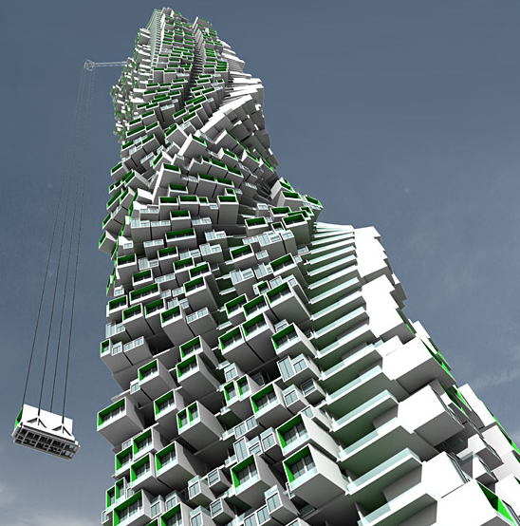
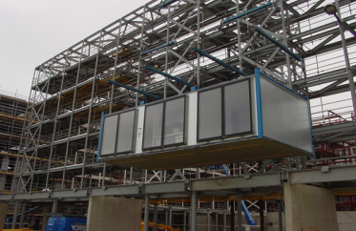
High-rise modular building
The common types of modular constructions that uses another stabilization systems:
Concrete core construction system
Hybrid podium system
Open building systems
Hybrid-skeletal structures
Steel Structure-2015
Dubai, 16 – 18 November 2015
Notes:
the concrete core construction system uses either a center core or a common corridor. While gravity loads are transferred via modules, i.e., module-to-module connection, lateral loads are transferred via the connection between modules and bracing elements, that is, from modules to the core or corridor.
Hybrid approach aims to combine the benefits of various systems. In the hybrid-podium systems, there is a steel or concrete frame called podium for the first one or two stories of building. Then load-bearing modules are stacked on top of the podium. The advantages of these systems are that podium provides larger span and behaves like a foundation, thus modules transfer their gravity loads to the beams of podium. a podium system is generally preferred in a modular building that needs larger spaces such as parking lots and stores, and it is not appropriate for high-rise building.
The open building systems use columns and modules and ensure more flexibility for interior planning. This system is just appropriate for up to eight stories. However, there is interest to design innovative flexible buildings using this modularization technology
In hybrid-skeletal structures, the main structure is constructed as a conventional frame, and load-bearing and non-load-bearing modules are then placed between the beams and columns of the frame. The frame system ensures resisting lateral loads and also utilizes the benefits of modules.

Slide 10
High-rise modular building
Some of the main topics that need to be addressed in design of a high-rise modular building
structural integrity
resistance to lateral forces
the resistance and capacity of compression of structural elements with respect to vertical forces
load-transfer and deformation capacity of connections between structural elements
Steel Structure-2015
Dubai, 16 – 18 November 2015
Notes:
The modules themselves are used as main lateral load resisting systems for low-rise modular buildings
New innovation systems are needed to construct high-rise modular buildings

Slide 11
Connections in modular building
The behavior of connections in analysis and design of buildings should particularly be taken into account in detail because of their effects on the distribution of internal forces and on structural deformations
Their behavior can be defined depending on strength, stiffness and deformation capacity.
“The connections are critical components of structural systems”
Unlike conventional construction, modular buildings have additional interior connections, which further add to the complexity.
“The behavior of multi-story modular construction under lateral loading is still not well-understood because of the complexities of modular connections”
Steel Structure-2015
Dubai, 16 – 18 November 2015
Notes:
[8].. Even conventional steel structures exhibit significant connection failures, which cause structural damage after earthquakes.. Understanding the behavior of connections and reflecting this in proper modeling for analysis and design of structural systems is essential to describe accurate structural behavior. The connections must make an effective attachment between individual elements and transfer the forces and accommodate the deformations between the elements. The force transfer in the connections between modules must take into account the necessary strength, stiffness and ductility required for structural integrity for applicable structural systems. The design applications taking into account second-order effects and tests on the module-module connection are presented by Lawson and Richards [9].

Slide 12
Connections in modular building
The modules are attached to each other or to other structural systems to form a complete modular building
“The connections between modules transfer the applied lateral forces to the group of modules”
“The connections also ensure the stability and robustness of the assembly of modules in modular construction”
Steel Structure-2015
Dubai, 16 – 18 November 2015
Notes:
The modular units are attached both horizontally and vertically to each other or to other structural systems (e.g., structural frames, core walls) to form a complete modular building
The connections between modules transfer the applied lateral forces to the group of modules; the structural design is affected strongly from tying action in module-module connection. So, the connections must be strong enough.

Slide 13
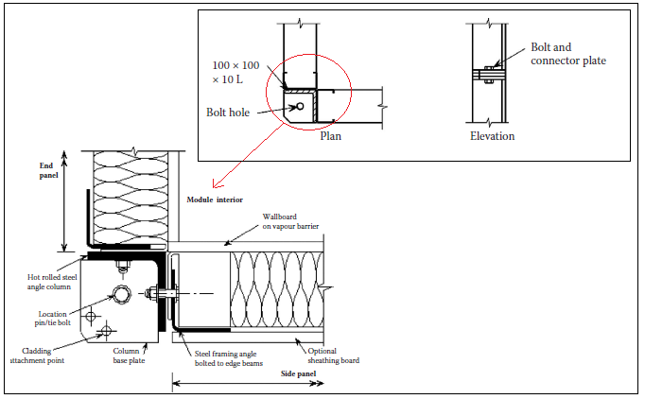
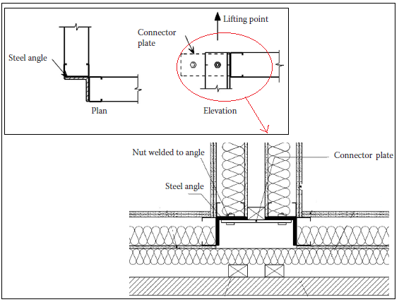
Connections between modules in 4-sided modules
The loads are transferred by:
Vertical loads;
by the modules walls
Lateral loads;
by the bracing or diaphragm action of the board materials
Steel Structure-2015
Dubai, 16 – 18 November 2015
Notes:
Existing types of connections that are used in modular construction are divided into several groups according to the location of connections
In this type of module, the vertical loads are transferred by the module walls; in-plane bracing or diaphragm action of the board materials within the modules provides shear resistance due to lateral loads. Steel angles may be introduced in the recessed corners of the module for stability. The base and top of modules are usually connected by connector plates or side plates in current modular construction. The connections between modules transfer in-plane forces and provide the structural integrity. Robustness can be provided by assembling the modules together at their corners, and this requires the module corners to be connected both horizontally and vertically. While the connection illustrated in Figure 2.1 provides vertical connection by connector plate, the connection illustrated in Figure 2.2 provides horizontal connection by side plate. These plates are connected through bolts at the site. Details can be changed depending on the form or application of the modules. Manufactures can determine the details of the connections in light steel frames according to manufacturing process

Slide 14
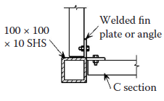
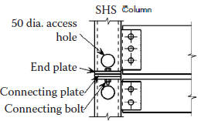
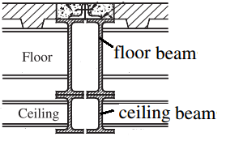
Connections between modules in open-sided modules
The loads are transferred by:
Vertical loads;
by columns and edge beams
“Column-to-column connections ensure bending resistance”
Lateral loads;
by the bracing system or sheatings
“The column-to-beam connection makes some lateral stiffness possible and can provide stability to modules in low-rise building”
Steel Structure-2015
Dubai, 16 – 18 November 2015
Notes:
An open-side module is a variant of the 4-sided module, which has a rigid end frame and usually consists of welded or rigidly connected Square Hollow Sections
The walls of this type of module are not load-bearing systems and the columns must align throughout the building height
Columns and edge beams transfer gravity loads to the foundation, while a bracing system and sheathings resist the lateral loads in this system
SHS columns are connected to the side beams with fin plates, which ensure bending resistance. The fin plate is welded to the post and then bolted to the edge beams as shown in the figure
This type of moment-resisting connection can be designed as the main stabilization system for low-rise buildings.
This connection system also helps the structural stability in accidental excessive and overload situations. Plane forces can be transferred by the connections at the corners of modules in open-sided modules.
For module-to-module connection in open-side modules----A connecting plate is welded to the end of the columns, while the columns of the modules are bolted to each other on-site.
Although SHS columns are typically used in open-sided modules, when loading is heavy, using hot-rolled steel posts or beams, such as I-sections, is more useful. A horizontal connection that is shown in Figure 3 and the connection involves clip angles which are shop-welded to the floor beams and then connected to each other by bolting. The vertical connection is secured by field-welding base plates of an upper module column to cap plates of a lower module column

Slide 15
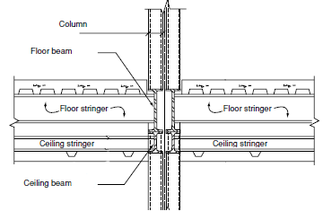
Beam-to-stringer connections in light steel modules
The connection consists of directly welding these members to each other
“This connection is a shear connection, which is assumed not to transfer bending moment“
Steel Structure-2015
Dubai, 16 – 18 November 2015
Notes:
Floor cassette of modules is fully manufactured in the fabrication plant as a grid structure for use in modular framing.
Figure shows the frame members of a multi-story modular building. The connection between the beam and the stringer in the floor cassette of the modules consists of directly welding these members to each other. The stringer web is fully or partially welded to the beam. This connection is a shear connection, which is assumed not to transfer bending moment.
Annan et al. [5] studied the unique connection of a typical modular steel building floor system. In Annan et al.’s study [5], the results of FE method showed that taking into account the behavior of welded connection in modular framing leads to a distribution of forces and moments in contrast to conventional construction.

Slide 16
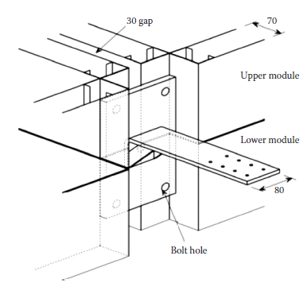
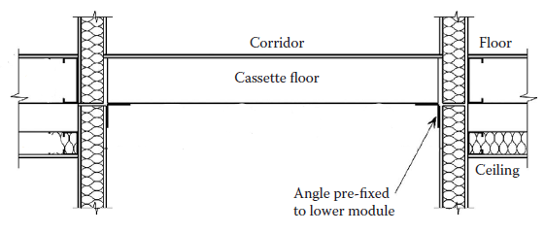
Connections between corridor cassette and modules
The loads are transferred by:
Lateral loads;
by the corridor to the braced system or core
“The beams ensure vertical support to the corridor and provide additional stiffness to improve the rigidity of longitudinal sides of the open-sided modules ”
“The connection does not ensure vertical support to the corridor and just transfers shear forces
Steel Structure-2015
Dubai, 16 – 18 November 2015
Notes:
Load-bearing modules are stacked and connected to each other to form a low-rise modular building. In addition, some perimeter modules are typically bordered by a central corridor or common area to have access for maintenance of connections/modules and easy service connection

Slide 17
Connections between modules and structural components in frame unit system
Properties of the system are not considered dependent on the modules
“The connection between the frame and the modules must be strong enough to transfer gravity loads although modules do not bear any loads except their own gravity loads ”
“A diaphragm system should be taken into account for the integration the modules and frame in the system “
Steel Structure-2015
Dubai, 16 – 18 November 2015
Notes:
A conventional frame is used as the main structure in the frame modular systems

Slide 18
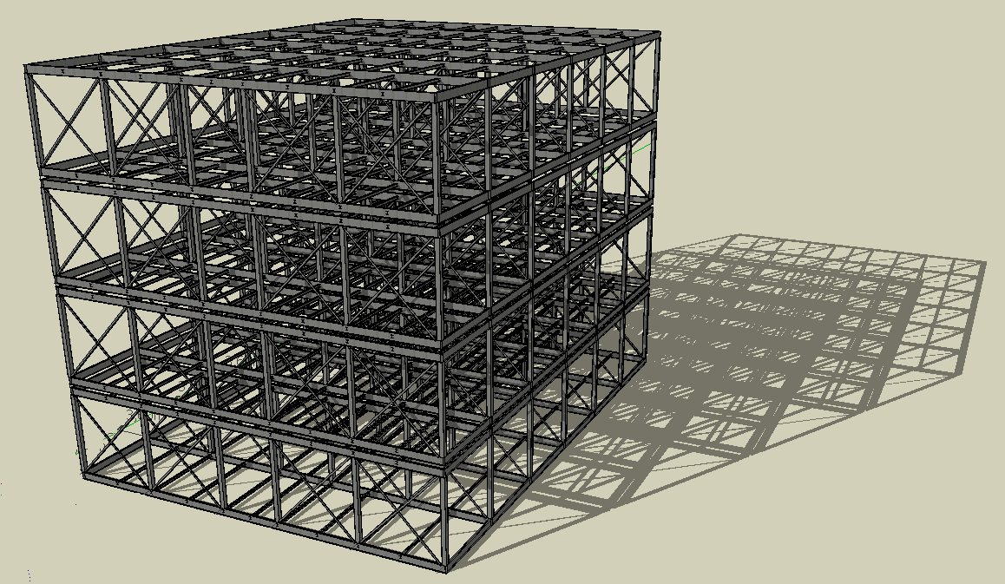
MODELING IN MODULAR BUILDING
Conventional steel technologies are generally used in modular building modeling and analysis due to the lack of special modular building analysis methods.
“The differences between conventional steel frames and modular steel frames can be seen at the modelling stage”
Steel Structure-2015
Dubai, 16 – 18 November 2015
Notes:
For example, modular steel frames include ceiling beams, whereas conventional frames do not and modular construction consists of many inter-connections.

Slide 19
MODELING IN MODULAR BUILDING
Light steel sections are widely used in modular construction because of their efficiency and lighter weight
Light steel framing in modular buildings is limited due to its range of applications; use of hot-rolled steel posts or beams in heavily loaded structures is more suitable and efficient
”Buildings are composed of vertical and horizontal structural members that resist lateral forces caused by wind or earthquake”
Steel Structure-2015
Dubai, 16 – 18 November 2015
Notes:
C-shape light steel elements are used in the module’s floor and ceiling as secondary beams. but larger sections may need to be used for the modules that are subjected to larger and more intensive loading in taller buildings.
Light steel sections are widely used in modular construction because of their efficiency and lighter weight [6]. The later provides allowances for the lifting limitations.

Slide 20
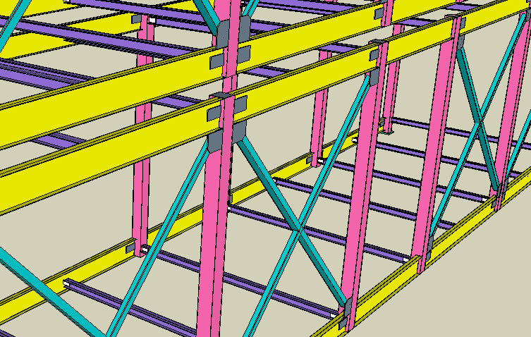
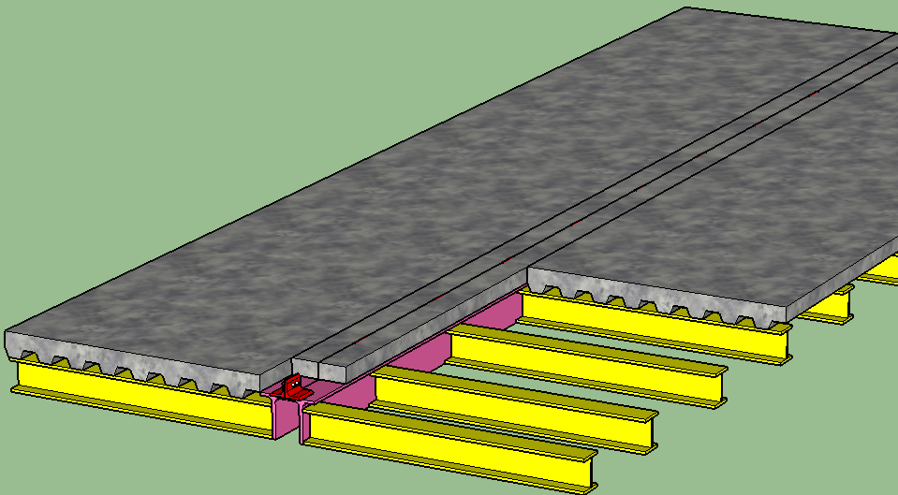
MODELING IN MODULAR BUILDING
The lateral loads are reversible, braces are subjected to both compression and tension; consequently, they are mostly designed according to compression requirements
The braces are designed resisting the horizontal shear in axial compression and tension
The floors having the diaphragm effect may be identified as horizontal resisting system against lateral forces
“The diaphragm behavior is an important aspect for transferring wind or seismic loads”
Steel Structure-2015
Dubai, 16 – 18 November 2015
Notes:
Braces may be identified as vertical trusses resisting lateral loads primarily through the axial stiffness of columns and braces
Buildings are composed of vertical and horizontal structural members that resist lateral forces caused by wind or earthquake. Braces may be identified as vertical trusses resisting lateral loads primarily through the axial stiffness of columns and braces. The braces may be designed resisting the horizontal shear in axial compression and tension. Because the lateral loads are reversible, braces are subjected to both compression and tension; consequently, they are mostly designed according to compression requirements
The floor of the building is constructed as a composite slab composed of a metal deck with concrete topping. Metal deck acts as the tension reinforcement and the shear forces in the floor occur in the concrete topping. Welded studs transfer the shear forces from the concrete slab to the beam top flange. So, the floor composite slabs provide diaphragm action for the horizontal transfer of shear forces to the vertical bracing elements.

Slide 21
MODELING IN MODULAR BUILDING
This study was evaluated conventional modelling of modular steel building (MSB) to demonstrate potential shortcoming of the connections under selected combined lateral and gravity loading conditions.
”A typical story detail of the modular building in this study consists of a set of columns, a floor and a ceiling framing. A gap between floor beam and ceiling beam, and the diagonal braces providing lateral stability exist in these buildings”
“Lateral loads are transferred through the bracing elements via the horizontal connection between the modules and then to the foundation via the vertical connections”
Steel Structure-2015
Dubai, 16 – 18 November 2015
Notes:
Some unique detailing requirements of the MSB system were taken into account in the analysis.

Slide 22
EVALUATION OF THE CONNECTIONS
“The behavior of a connection is important for the distribution of internal forces and modular buildings consist of many inter-connections”
An evaluation of
the vertical (column-to-column) connection,
the horizontal (module-to-module connection for adjacent modules in the same story) connection,
beam-to-column connection,
beam-to-stringer connection is presented.
Steel Structure-2015
Dubai, 16 – 18 November 2015
Notes:
The actual behavior of the connection system is not generally taken into account in the analysis and design of modular structures. However, the behavior of a connection is important for the distribution of internal forces and modular buildings consist of many inter-connections.

Slide 23
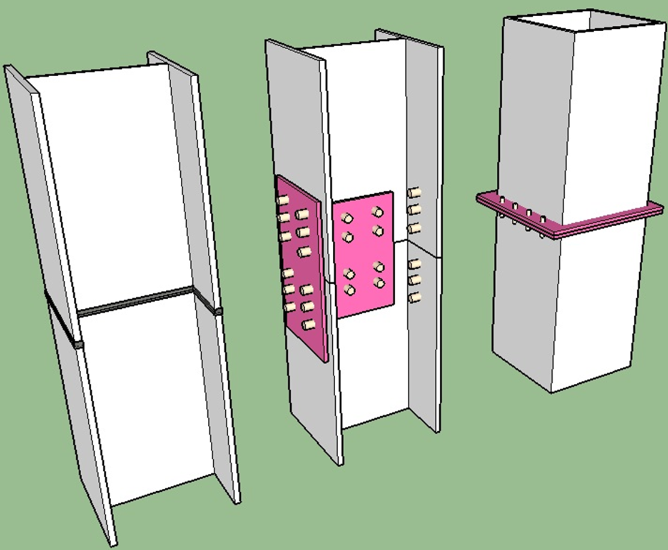
VERTICAL (COLUMN-TO-COLUMN) CONNECTION
Splice connections should be designed to allow for the transfer of stress resultants existing in the joint, with due allowance for second order effects, imperfections and load eccentricities
The connections must provide strength and continuity of stiffness in both axes of the columns
“Splice column connections should be generally used in the locations performing lower buckling strength”
Steel Structure-2015
Dubai, 16 – 18 November 2015
Notes:
The column-to-column connections (vertical connection) are used to join columns along their length and called as “splice column connection” in conventional building. Since lengths of columns are typically up to three stories depending on the production length of sections and the story height of the building. These connections are also necessary for conventional multi-story construction due to the transportation and erection constraints. Splice column connections should be generally used in the locations performing lower buckling strength. The columns in the multi-storey conventional buildings are not connected at the floor levels. So, lateral deformations are prevented in the floor levels.

Slide 24
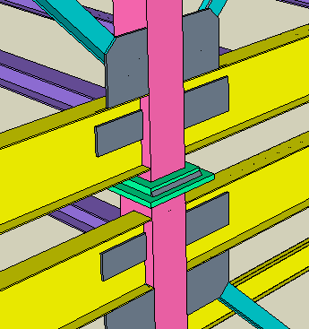
VERTICAL (COLUMN-TO-COLUMN) CONNECTION
The splice column connections consist of welding of base plates of upper module columns to cap plates of lower module columns in modular building
Cap and base plates are welded on site to each other
“Only the outer faces of the columns can have access to welding in these connections”
Steel Structure-2015
Dubai, 16 – 18 November 2015
Notes:
The column-to-column connections (vertical connection) are used to join columns along their length and called as “splice column connection” in conventional building.

Slide 25
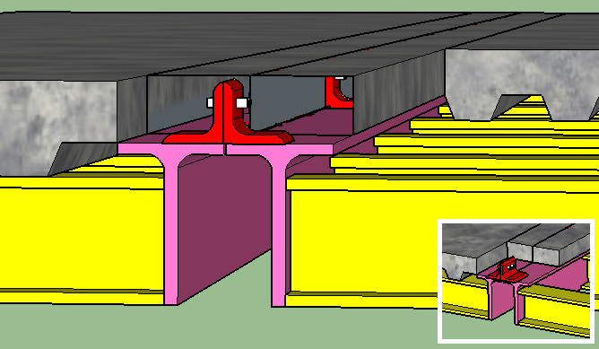
MODULE-TO-MODULE CONNECTION
“The connections are used to join to modules horizontally”
The module-to-module connection (horizontal connection) consisting of field bolting of clip angles that are shop-welded to the flange of floor beams
“The connections between modules transfer in-plane forces and provide the structural integrity and robustness”
Steel Structure-2015
Dubai, 16 – 18 November 2015
Notes:
For example, modular steel frames include ceiling beams, whereas conventional frames do not and modular construction consists of many inter-connections

Slide 26
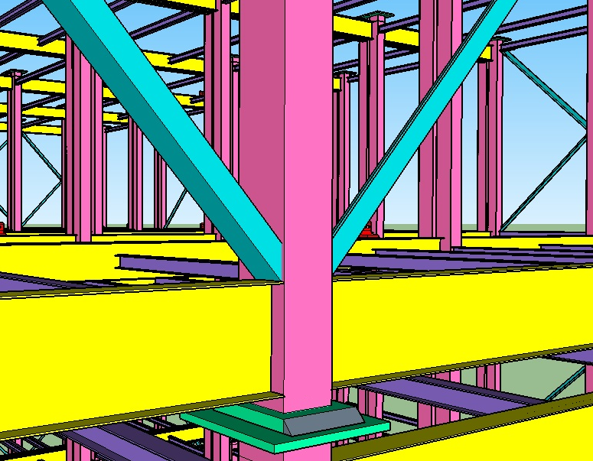
EDGE BEAM-TO-COLUMN CONNECTION
“The connection between the corner column and edge beam makes some lateral stiffness possible and can provide stability to modules in low-rise buildings”
The connection between edge beams and column are generally designed as a moment-resisting connection
“This type of moment-resisting connection can be designed as the main stabilization system for low-rise buildings”
Steel Structure-2015
Dubai, 16 – 18 November 2015
Notes:
Columns and edge beams transfer gravity loads to the foundation, while a bracing system and sheathings resist the lateral loads in this system

Slide 27
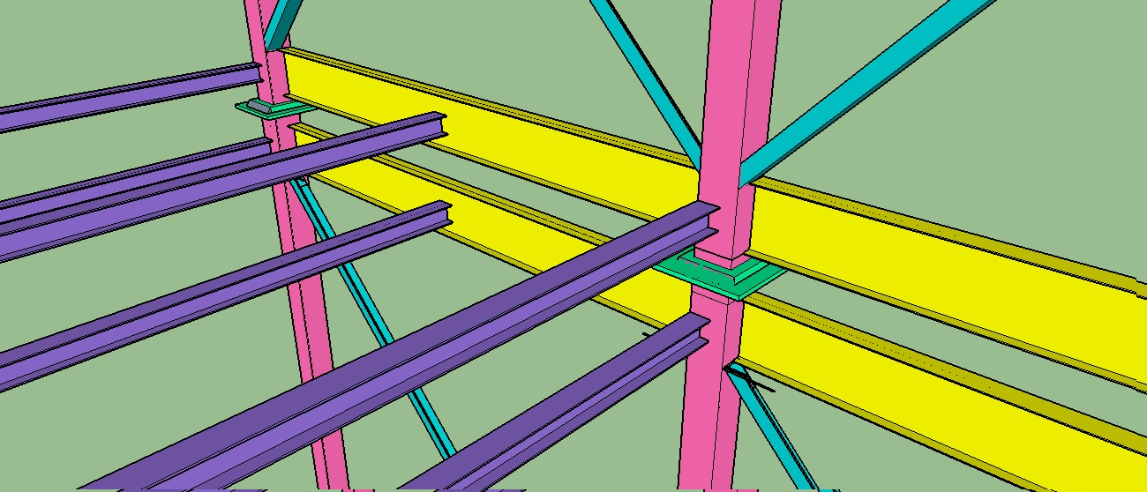
BEAM-TO-STRINGER CONNECTION
“The beam-to-stringer connection consists of directly welding of the stringer to web of the beam”
Steel Structure-2015
Dubai, 16 – 18 November 2015

Slide 28
LIMITATIONS FOR HIGH-RISE MODULAR BUILDING
Resistance to lateral forces, structural integrity, load-transfer and deformation capacity of connections between structural elements were examined as some of the main topics that need to be addressed in design of a high-rise modular building.
These limitations revealed several necessary requirements for connection systems of modular buildings under the lateral loads.
Steel Structure-2015
Dubai, 16 – 18 November 2015

Slide 29
LIMITATIONS OF EXISTING CONNECTIONS
The lack of special modular building analysis methods
Welds have limited deformation capacity and display brittle failure behavior
Welds of column-to-column connections in the worksite
Column and beam or stringer and beam are welded directly to each other
Fully-welded conn can cause damages due to their brittle response
Single side welds in the outer faces of the columns leads to independent upper and lower rotations at the same joint
Steel Structure-2015
Dubai, 16 – 18 November 2015
Notes:
Conventional steel technologies are generally used in modular building modeling and analysis due to the lack of special modular building analysis methods. The differences between conventional steel frames and modular steel frames can be seen at the modelling stage. For example, modular steel frames include ceiling beams, whereas conventional frames do not. And the modular building consists of many inter-connections
Field-welding or shop welding, which is used for the connection in modular buildings should take into account transferring of the forces, in particular since welds have limited deformation capacity and display brittle failure behavior. So, weld fracture must be prevented. However, at least 80% the stringer depth is usually welded to the edge beams. This weld length is often checked by the designers only against the shear forces transferred from the floor stringer to the beam. Designers assume no restraint for rotation at the ends of the stringers. Therefore, this assumption leads to incorrect prediction in the behavior of the floor system [2].
Colon column birleşimlerinde kaynak yapılmasında durumunda bu kaynaklar şantiyede yapılacağından dolayı gaz altı kaynağı değil elektro kaynak kullanılacaktır. Bu kaynak da dayanım açısından yeterlli olmayacaktır.

Slide 30
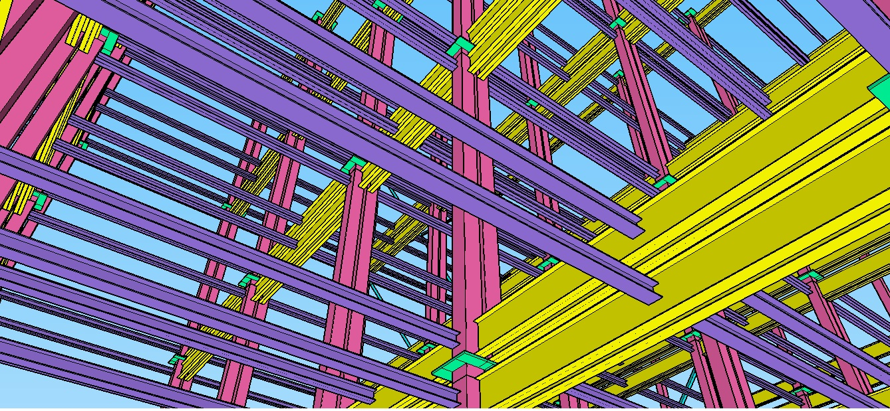
Thanks for your attention
merve.sagiroglu@erzurum.edu.tr
Dr. Merve SAGIROGLU
TURKEY
Steel Structure-2015
Dubai, 16 – 18 November 2015

