Slide 1
Evaluating Water Resources Quality and Water Pollution in Karabuk, Turkey
Associate Prof. Meral TOPCU SULAK
mtopcu@karabuk.edu.tr

Slide 2
Contents
Introduction
Karabuk City
Study Area Description
Materials and Methods
Results
Conclusions

Slide 3
Introduction
Water is an essential component for life on Earth, which contains minerals extremely important in human nutrition.
However, the dramatic increase in population resulted in an enormous consumption of the world’s water reserves.
Water issues are multi-dimensional including economical, social, political and cultural aspects.

Slide 4
Introduction
Rapid urbanization and increasing populations have accelerated the consumption of water resources and caused serious environmental problems in the last few decades.
Numerous studies have shown serve water pollution, as well as adverse effects caused by exploitation, such as land subsidence, water ecosystem degradation, land desertification, drinking water pollution and associated human health risk.

Slide 5
Introduction
The United Nations Millennium Declaration adopted the goal of reducing by half the proportion of people without access to safe drinking water by the 2015.
The supply of safe potable water has a significant impact on the prevention of water transmissible diseases.
The abundance of organic compounds, toxic chemicals, radionuclides, nitrites and nitrates in potable water may cause adverse effects on the human health.
It is essential to constantly monitor water quality used for drinking purposes. Contamination of potable water with chemical polluntants has a considerable impact on the Turkey population health.

Slide 6
Study Area Description
Karabuk, Zonguldak and Bartın are in the western black sea region of the Turkey, about 220 km from Ankara.

Slide 7
Karabuk City…
Karabük is a town and the capital district of Karabük Province in the Black Sea region of Turkey. According to the 2009 census, population of the city is 108 167. The district covers an area of 760 km², and the town lies at an elevation of 354.
Karabük was built in the 1930s as the seat of the iron and steel industry of Turkey. Karabük lies in a location near Filyos River formed by the merge of Araç and Soğanlı rivers.

Slide 8
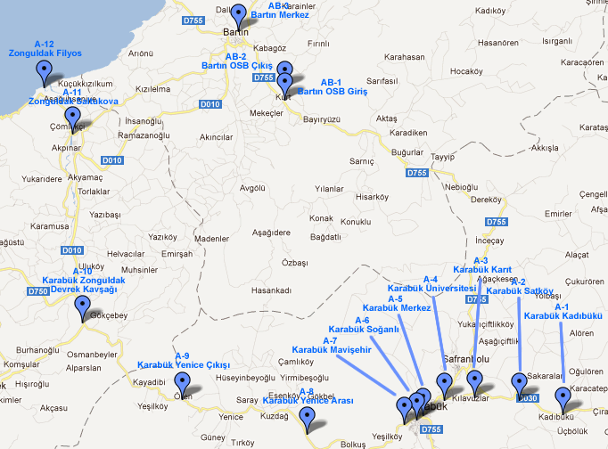
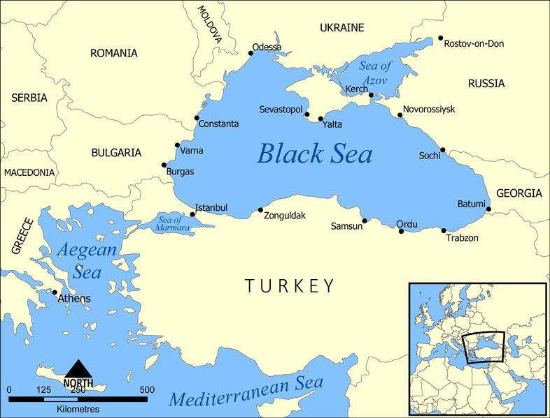
Sampling Area
The drinking water samples were collected from 3 different cities, 12 different locations in western black sea, Turkey.
Fig. 1. Map of a sampling area in the western black sea, Turkey.

Slide 9
Results (Surface Water)
PARAMETER | SAMPLE ID
 | A1 | A2 | A3 | A4 | A5 | A6 | A7 | A8 | A9 | A10 | A11 | A12 | AB-1 | AB-2 | AB-3
Oil- Gres, ppm | 0,600 | 0,400 | 0,600 | 2,400 | 0,800 | 2,000 | 0,600 | 2,800 | 0,800 | 1,800 | 0,800 | 2,000 | 1,800 | 2,400 | 1,000
Colour, Pt-Co | 3,125 | 5,510 | 4,188 | 4,601 | 5,283 | 4,136 | 9,136 | 4,752 | 6,629 | 4,143 | 8,138 | 8,233 | 5,418 | 2,770 | 11,972
pH | 8,17 | 8,16 | 8,3 | 8,33º | 8,1 | 8,03 | 8,55 | 8,39 | 8,46 | 8,37 | 8,44 | 8,47 | 8,48 | 8,45 | 8,54
SS, ppm | 0,850 | 0,900 | 0,700 | 3,200 | 2,450 | 1,750 | 0,400 | 2,850 | 3,450 | 1,250 | 1,050 | 11,750 | 3,750 | 0,700 | 0,200
P, ppm | 0,018 | 0,017 | 0,010 | 0,015 | 0,025 | 0,022 | 0,026 | 0,136 | 0,091 | 0,012 | 0,055 | 0,021 | 0,011 | 0,036 | 0,033
NH₄+, ppm | 0,006 | 0,006 | 0,025 | 0,020 | 0,030 | 2,115 | 1,857 | 2,376 | 0,970 | 0,001 | 0,009 | 0,172 | 0,009 | 0,193 | 0,074
COD, ppm | 5,300 | 1,400 | 5,300 | 1,000 | 0,900 | 0,700 | 0,800 | 14,100 | 6,800 | 1,500 | 1,300 | 7,700 | 5,300 | 5,100 | 6,400
Y.A.M, ppm | 0,002 | 0,003 | 0,003 | 0,003 | 0,005 | 0,004 | 0,005 | 0,008 | 0,003 | 0,002 | 0,004 | 0,008 | 0,002 | 0,004 | 0,002
Cr 6+, ppm | 0,029 | 0,011 | 0,005 | 0,006 | 0,006 | 0,001 | 0,002 | 0,002 | 0,001 | 0,008 | 0,014 | 0,008 | 0,005 | 0,003 | 0,007
Cd, ppb | 1,962 | 1,411 | 0,950 | 0,854 | 0,652 | 0,271 | 0,389 | 0,509 | 0,442 | 0,408 | 0,493 | 0,840 | 0,444 | 0,387 | 0,395
Co, ppb | 1,543 | 0,482 | 1,744 | 0,404 | 1,319 | 0,643 | 0,486 | 1,533 | 0,797 | 0,824 | 0,232 | 1,161 | 1,270 | 0,126 | 0,819
Cr, ppb | 2,291 | 1,594 | 2,878 | 1,529 | 1,968 | 1,755 | 2,401 | 1,599 | 1,967 | 1,275 | 1,117 | 0,942 | 0,666 | 0,387 | 1,086
Cu, ppb | 0,574 | 0,360 | 0,310 | 0,172 | 0,468 | 2,854 | 1,118 | 1,524 | 0,732 | 0,607 | 0,756 | 0,138 | 0,835 | 0,209 | 0,135
Fe, ppb | 8,849 | 9,514 | 1,716 | 5,389 | 6,301 | 63,273 | 28,920 | 23,970 | 28,338 | 2,055 | 82,783 | 23,571 | 457,240 | 5,375 | 43,686
Ni, ppb | 0,343 | 0,229 | 0,834 | 0,007 | 0,748 | 0,653 | 0,243 | 0,302 | 0,707 | 1,652 | 0,473 | 0,314 | 1,197 | 0,672 | 0,108
Pb, ppb | 19,772 | 30,669 | 29,644 | 31,252 | 21,803 | 19,686 | 12,308 | 20,438 | 14,636 | 15,368 | 4,718 | 18,457 | 1,465 | 22,460 | 23,627
Çinko, ppb | 4,258 | 64,864 | 16,373 | 90,656 | 23,449 | 33,457 | 16,245 | 31,086 | 24,483 | 5,400 | 14,545 | 4,710 | 6,645 | 3,591 | 6,862

Slide 10
Results (Potable Water)
 | Western Black Sea (ZONGULDAK) |  |  | Standarts
Parameter | Ereğli | Devrek | Kozlu | Turkish Standardization Institute | WHO | EPA
Turbidity (NTU birimi) | 0,360 | 0,230 | 0,360 | 25 | 5 | 5
Total Coliform | 0,000 | 0,000 | 0,000 | <1 | 0 | <1
F⁻ | 0,312 | 0,247 | 0,268 | 1.5 | 1.5 | 0,7-2,4
NO₃⁻ | 0,216 | 0,560 | 0,148 | 50 | 50
Hg | <0,001 | <0,001 | <0,001 | 0 | 0
Colour(Co-Pt ) | 2,934 | 2,649 | 2,397 | 20 | 15
pH | 7,76 | 7,77/ 19,8º | 7,64/ 21,0º | 6.5-9.5 | 6.5-8.5 | 6.5-9.5
SO₄⁻² | 7,546 | 55,450 | 22,616 | 250 | 250 | 250
Ca | 46,092 | 78,557 | 68,136 | 200
Hardness(CaCO₃) | 142,500 | 157,000 | 102,500 |  | 500
Mg | 96,408 | 78,443 | 34,364 | 50
CI⁻ | 9,997 | 7,498 | 7,498 | 250 | 250 | 250
K | 1,54939 | 1,77307 | 0,88209 | 12
Ag | 0,000493 | 0,001214 | 0,000583 | 0.01 | 0.05
Al | 0,13439 | 0,193627 | 0,030718 | 0.20 | 0.20 | 1
As | 0,005976 | 0,008426 | 0,009784 | 0.01 | 0.01 | 0.01
Ba | 0,173642 | 0,080228 | 0,07823 | 0.03 | 1
Cd | 0,000199 | 0,000487 | 0,000391 | 0.005 | 0.003 | 0.003
Cr(Total) | 0,003338 | 0,002046 | 0,000858 | 0.05 | 0.05 | 0.05
Cu | 0,00084 | 0,003019 | 0,001516 | 3 | 1 | 0
Fe | 0,040762 | 0,040909 | 0,01518 | 0.2 | 0.3 | 0.2
Mn | 0,001099 | 0,00121 | 0,000548 | 0.05 | 0.1 | 0.05
Pb | 0,000284 | 0,003247 | 0,004216 | 0.01 | 0.01 | 0.01
Sb | 0,008171 | 0,002002 | 0,006673 | 0.005 | 0.005 | 0.005
Se | 0,00181 | 0,009308 | 0,007816 | 0.010 | 0.01 | 0.01
Zn | 0,12045 | 0,025204 | 0,020785 | 5 | 5

Slide 11
Results (Potable Water)
 | Western Black Sea (BARTIN) |  |  | Standarts
Parameter | Amasra | Merkez Orduyeri | Ulus | Turkish Standardization Institute | WHO | EPA
Turbidity (NTU birimi) | 0,730 | 0,430 | 0,430 | 25 | 5 | 5
Total Coliform | 0,000 | 0,000 | 0,000 | <1 | 0 | <1
F⁻ | 0,256 | 0,325 | 0,294 | 1.5 | 1.5 | 0,7-2,4
NO₃⁻ | 0,233 | 0,477 | 0,365 | 50 | 50
Hg | <0,001 | <0,001 | <0,001 | 0 | 0
Colour(Co-Pt ) | 3,179 | 2,541 | 3,199 | 20 | 15
pH | 7,97 | 7,53 | 7,91 | 6.5-9.5 | 6.5-8.5 | 6.5-9.5
SO₄⁻² | 10,193 | 12,967 | 1,955 | 250 | 250 | 250
Ca | 70,540 | 86,172 | 74,148 | 200
Hardness(CaCO₃) | 137,500 | 142,500 | 122,500 |  | 500
Mg | 66,960 | 56,328 | 48,352 | 50
CI⁻ | 2,499 | 7,498 | 1,249 | 250 | 250 | 250
K | 0,939582 | 1,61901 | 0,453968 | 12
Ag | 0,000775 | 0,001006 | 0,00019 | 0.01 | 0.05
Al | 0,014505 | 0,174603 | 0,096023 | 0.20 | 0.20 | 1
As | 0,007218 | 0,008103 | 0,007066 | 0.01 | 0.01 | 0.01
Ba | 0,054991 | 0,148291 | 0,123721 | 0.03 | 1
Cd | 0,000144 | 0,000175 | 0,000329 | 0.005 | 0.003 | 0.003
Cr(Total) | 0,000931 | 0,000465 | 0,000229 | 0.05 | 0.05 | 0.05
Cu | 0,000917 | 0,000081 | 0,013254 | 3 | 1 | 0
Fe | 0,027326 | 0,031544 | 0,022861 | 0.2 | 0.3 | 0.2
Mn | 0,002431 | 0,000373 | 0,000016 | 0.05 | 0.1 | 0.05
Pb | 0,003734 | 0,001597 | 0,002415 | 0.01 | 0.01 | 0.01
Sb | 0,002161 | 0,002085 | 0,002087 | 0.005 | 0.005 | 0.005
Se | 0,002937 | 0,002052 | 0,001676 | 0.010 | 0.01 | 0.01
Zn | 0,021346 | 0,018386 | 0,174294 | 5 | 5

Slide 12
Results (Potable Water)
 | Western Black Sea (KARABUK) |  |  |  | Standarts
Parameter | Merkez | Eskipazar | Eflani | Yenice | Turkish Standardization Institute | WHO | EPA
Turbidity (NTU birimi) | 0.150 | 0.360 | 0.57 | 0.310 | 25 | 5 | 5
Total Coliform | 0 | 0 | 0 | 0 | <1 | 0 | <1
F⁻ | 0.226 | 0.348 | 0.267 | 0.284 | 1.5 | 1.5 | 0,7-2,4
NO₃⁻ | 0.895 | 0.509 | 0.119 | 0.310 | 50 | 50
Hg | <0.001 | <0.001 | <0.001 | <0.001 | 0 | 0
Colour(Co-Pt ) | 2.501 | 2.307 | 2.23 | 1.907 | 20 | 15
pH | 7.37 | 7.55 | 8.09 | 8.24 | 6.5-9.5 | 6.5-8.5 | 6.5-9.5
SO₄⁻² | 26.81 | 2.74 | 4.785 | 35,69 | 250 | 250 | 250
Ca | 62.12 | 92.18 | 26.02 | 64.12 | 200
Hardness(CaCO₃) | 190 | 170 | 117.5 | 142.5 |  | 500
Mg | 187.27 | 77.81 | 91.44 | 78.37 | 50
CI⁻ | 4.99 | 2.49 | 2.49 | 2.49 | 250 | 250 | 250
K | 2.07 | 0.72 | 1.72 | 1.19 | 12
Ag | 0.0016 | 0.001 | 0.001 | 0.0001 | 0.01 | 0.05
Al | 0.0015 | 0.0098 | 0.038 | 0.088 | 0.20 | 0.20 | 1
As | 0.0081 | 0.0069 | 0.006 | 0.006 | 0.01 | 0.01 | 0.01
Ba | 0.0496 | 0.054 | 0.124 | 0.119 | 0.03 | 1
Cd | 0.0004 | 0.0003 | 0.0002 | 0.0003 | 0.005 | 0.003 | 0.003
Cr(Total) | 0.0023 | 0.011 | 0.001 | 0.0007 | 0.05 | 0.05 | 0.05
Cu | 0.0024 | 0.001 | 0.0005 | 0.0026 | 3 | 1 | 0
Fe | 0.027 | 0.026 | 0.109 | 0.24 | 0.2 | 0.3 | 0.2
Mn | 0.0019 | 0 | 0.002 | 0.0005 | 0.05 | 0.1 | 0.05
Pb | 0.0035 | 0.0003 | 0.003 | 0.0024 | 0.01 | 0.01 | 0.01
Sb | 0.0002 | 0.0038 | 0.007 | 0.0002 | 0.005 | 0.005 | 0.005
Se | 0.0051 | 0.0031 | 0.017 | 0.0007 | 0.010 | 0.01 | 0.01
Zn | 0.1915 | 0.060 | 0.018 | 0.027 | 5 | 5

Slide 13
Conclusions
Several drinking water samples had values of EC, essential and trace elements are suitable the National Turkish and WHO drinking water standards.
Ba and Mg concentrations exceed the guidelines for safe water for three cities (Karabuk, Zonguldak, Bartın).
Western black sea region has hardness water.
The parameters monitored in drinking water during the study satisfy the standards (set by WHO, EPA, EU, and the relevant Turkish Regulations) except for Ba and Mg.

