Slide 1
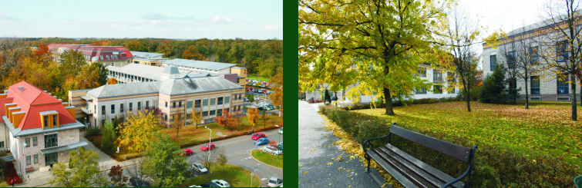
clinical advances of anti-tif1γ autoantibody in a hungarian myositis cohort
Melinda Nagy-Vincze ¹, Zoltán Griger ¹, Levente Bodoki ¹, Zsuzsa Szankai ¹, Zoe E. Betteridge², Katalin Dankó ¹
1 University of Debrecen, Division of Clinical Immunology, Dept. of Internal Medicine, Debrecen, Hungary
2 University of Bath, Institute for Rheumatic Diseases, Bath, UK

Slide 2
idiopathic inflammatory myopathies
Polymyositis (PM)
Dermatomyositis (DM)
Juvene PM/DM
Inclusion body myositis (IBM)
Overlap myositis (OM)
Necrotizing autoimmun myopathy (NAM):
  Cancer associated myositis (CAM)
  Statin induced myopathy
  Infection induced myopathy

Slide 3

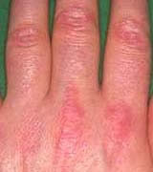
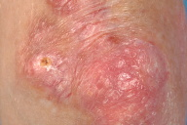
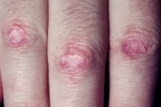


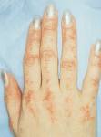
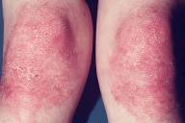
idiopathic inflammatory myopathies –skin symptoms
Gottron’s sign and papule

Slide 4
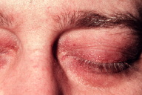
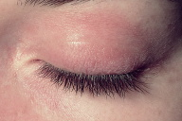

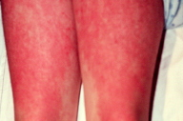
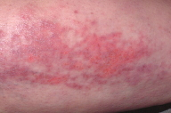
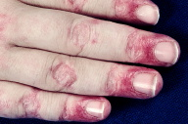
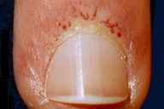
idiopathic inflammatory myopathies –skin symptoms
Heliotrop rash
Linear extensor erythema
Periungual teleangiectasia

Slide 5
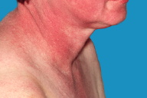


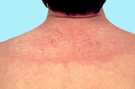
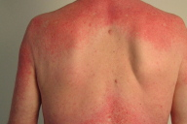
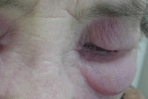
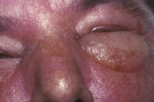
idiopathic inflammatory myopathies –skin symptoms
V-sign
Facial erythema
Shawl sign
Periorbital oedema

Slide 6
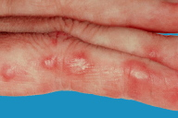
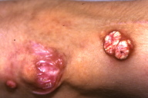
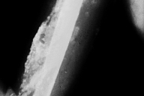
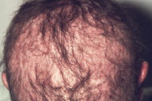
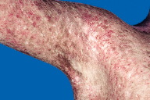
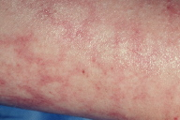
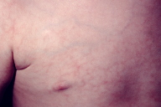
idiopathic inflammatory myopathies –skin symptoms
Calcinosis cutis
Alopecia
Poikiloderma athrophicans vasculare
Livedo reticularis

Slide 7
CAM (Cancer Associated Myositis)
Frequency 7-66%
Relative risk for malignancy
  3x in DM
  1,3x in PM-ben
Tumor types: ovarium, breast, lung, colon, endometrium, nasopharyngeal, lymphoma, prostata)
In time:
  Before myositis symptoms (> 1 years)
  Real paraneoplasia (- 1 – +5 years)
  After myositis diagnosis (> 5 years) – role of immunosuppressive therapy?
R. Aggarwal, C.V. Oddis Paraneoplastic myalgias and myositis Rheum Dis Clin N Am 2011

Slide 8
CAM - Etiology
Paraneoplasia
Cytotoxic/immunesuppressive treatment (Methotrexat, cyclophosphamid)
Common trigger (EBV?)

Slide 9
Crossover immunity in cam
CD8+
T Ly
Cellular Immune response
CD4+
T Ly
B Ly
MSA
?
MSA
MSA
Damage
Cross reactions
MSA
Stuart M. Levine Curr Opin Rheumatol 2006, 18:620-624

Slide 10
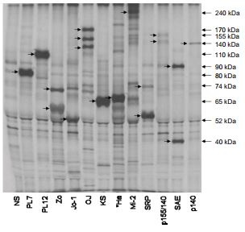
Anti-TIF1γ
antigen: transcription intermedier factor 1 gamma
  155/140kDa protein
13–21% in adult and 23–29% in juvenile DM cases
severe skin symptoms,
high tumor risk in adults

Slide 11
Our study
Autoantibody analysis from IIM patients’ serum (n=202) with ELISA and/or IPP
Frequency of anti-TIF1γ positivity
Frequency of TIF1γ negative CAM
Clinical and lab findings associated with anti-TIF1γ positivity
.

Slide 12
Parameters
Clinical symptoms
  Proximal muscle weakness
  Distal muscle weakness
  Skin rash
  Dysphagia
  Raynaud phenomen
  Arthralgia
  ILD
  Fever
Lab results:
  CK and LDH levels
  CRP
  ESR
  ANF positivity
  Tumor markers

Slide 13
TIF1γ positive patients (n=12)
  CAM n=3
    Real paraneoplasia in DM (n=1)
    After myositis diagnosis in DM (n=1) and in PM (n=1)
Subsets:
  DM n=7
  JDM n=4
  PM n=1
Gender:
  Female 75% (n= 9)
  Male 25 % (n=3)

Slide 14
TIF1γ positive cam patient – real paraneoplasia
34 years old, women
First symptoms in April 2007:
  Skin rash
  Muscle weakness
  Dysphagia
  Arthralgia
In July 2007 – ovarium tumor
Histology: adenocarcinoma with peritoneal metastasis
Operation and chemotherapy
She died in November 2007 due to heart failure

Slide 15
TIF1γ negative cam patients (n=51)
Subsets:
  DM(n=33)
  PM (n=18)
Gender:
  Female 68% (n= 35)
  Male 32 % (n=16)
In time:
  real paraneoplasia (n=37) - 5 months
  before myositis (n=2) - 73,5 months
  After diagnosis (n=12) – 181 months

Slide 16
TIF1γ negative cam (n=51)

Slide 17
Histology

Slide 18
differences in clinical symptoms (%)

Slide 19
lab findings (%)
No differences in tumor markers
No differences in other antibodies (ANF, APA)

Slide 20
Conclusion
TIF1γ positivity is associated with several and severe skin rashes
Tumor specificity did not confirmed
Autoantibody tests help us in the diagnosis
But tumor searching is necessary, specially in DM

Slide 21

Thanks to my collegues
Prof. Dr. Dankó Katalin,
Dr. Griger Zoltán,
Dr. Bodoki Levente,
Szankai Zsuzsa,
Zoe E. Betteridge
This research was organized within the following program: TÁMOP 4.2.4.A/2-11-1-2012-0001 National Excellence Program—local convergence program providing personnel support in the development and operation for students and researchers. The project was funded by the EU and the European Social Fund.
The autoantibody analysis was sponsored by the ESF EuMyoNet Research Networking Programme.

Slide 22

Thanks for the attention!

